Slide 1
CEG 4420/6420: Computer Security Last Lecture
Prabhaker Mateti

Slide 2
Internet Growth

Slide 3
Internet host count
213
1986 5,089
1998 29,670,000
2000 93,047,785
2005 317,646,084
768,913,036
818,374,269
2013 996,230,757
source: www.isc.org
Notes:
2011 numbers may actually be much higher because of NAT etc.

Slide 4
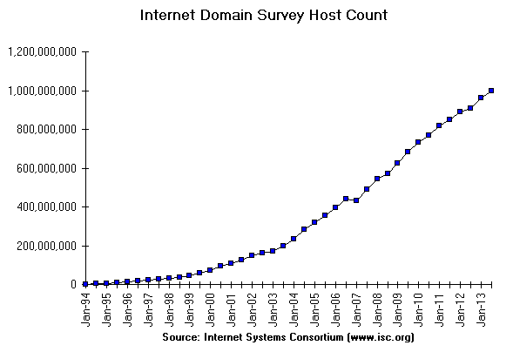

Slide 5
‘Computers’?
Define `Computer’ System!
Main frames
PCs
Smart Phones
Embedded systems
Usage without Internet?

Slide 6
Facts about data theft
More than 12,000 laptops lost per week in US airports alone;
One laptop is stolen every 53 seconds;
Viruses cost US businesses $55 billion annually;
25% of all PC users suffer from data loss each year.
Source: www.technewsworld.com/ 2010

Slide 7
Top N Lists

Slide 8
Top Ten Web Sites in Security
www.cert.org/ US funded. Provides cyber alerts, defense and response to government agencies and industry partners.
www.infosyssec.org/ security portal with many tutorials.
www.phrack.org/ in-depth technical articles on exploits.
defcon.org/ Oldest and one of the largest hacker conventions.
www.securityfocus.com/ Hosts BUGTRAQ. white-hat site.
www.packetstormsecurity.org/ security portal. security tools and exploits.
www.schneier.com/ Security blog focused on crypto.
www.infowar.com/ takes a broader view of security and has articles about how countries can get affected.
www.undergroundnews.com/ “… does not restrict or censor”
www.microsoft.com/technet/security/default.mspx

Slide 9
Links to Others
googleonlinesecurity.blogspot.com/2009/06/top-10-malware-sites.html
www.techsupportalert.com/best_computer_security_sites.htm
20 useful IT security Web sites
informationsecurityhq.com/10-top-websites-for-information-security/
www.secureroot.com/topsites/

Slide 10
Top Internet Security Vulnerabilities
Top Vulnerabilities in Windows Systems
W1. Windows Services
W2. Internet Explorer
W3. Windows Libraries
W4. Microsoft Office and Outlook Express
W5. Windows Configuration Weaknesses
Top Vulnerabilities in Cross-Platform Applications
C1. Backup Software
C2. Anti-virus Software
C3. PHP-based Applications
C4. Database Software
C5. File Sharing Applications
C6. DNS Software
C7. Media Players
C8. Instant Messaging Applications
C9. Mozilla and Firefox Browsers
C10. Other Cross-platform Applications
Top Vulnerabilities in UNIX Systems
U1. UNIX Configuration Weaknesses
U2. Mac OS X
Top Vulnerabilities in Networking Products
N1. Cisco IOS and non-IOS Products
N2. Juniper, CheckPoint and Symantec Products
N3. Cisco Devices Configuration Weaknesses
Source: http://www.sans.org/top20/

Slide 11
Top 125 Security Tools, 2013
Sectools.org
Each respondent could list up to 8.
No votes for the Nmap Security Scanner were counted.
The list is slightly biased toward "attack" tools rather than defensive ones.

Slide 12
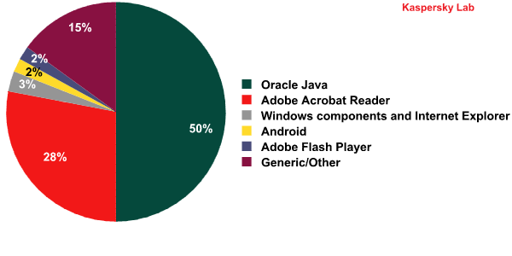
Apps with vulnerabilities in 2012

Slide 13
Open Web Application Security
not-for-profit worldwide charitable organization focused on improving the security of web application software.
free and open software license.
www.owasp.org/

Slide 14
Black/? Hat Sites/Conferences
Suspend all judgments (other than technical quality).
defcon.org/ annual conference in Las Vegas. Excellent presentations by “hackers”.
blackhat.com/ Conferences and training!
shmoocon.org/ “… refusal to take anything about the Internet seriously…”
recon.cx/ reverse engineering. annually in Montreal

Slide 15
Top 25 Software Errors, 2010
Improper Neutralization of Input During Web Page Generation ('Cross-site Scripting')
Improper Neutralization of Special Elements used in an SQL Command ('SQL Injection')
Buffer Copy without Checking Size of Input ('Classic Buffer Overflow')
Cross-Site Request Forgery (CSRF)
Improper Authorization
Reliance on Untrusted Inputs in a Security Decision
Improper Limitation of a Pathname to a Restricted Directory ('Path Traversal')
Unrestricted Upload of File with Dangerous Type
Improper Neutralization of Special Elements used in an OS Command ('OS Command Injection')
Missing Encryption of Sensitive Data
Use of Hard-coded Credentials
Buffer Access with Incorrect Length Value
Improper Control of Filename for Include/Require Statement in PHP Program ('PHP File Inclusion')
Improper Validation of Array Index
Improper Check for Unusual or Exceptional Conditions
Information Exposure Through an Error Message
Integer Overflow or Wraparound
Incorrect Calculation of Buffer Size
Missing Authentication for Critical Function
Download of Code Without Integrity Check
Incorrect Permission Assignment for Critical Resource
Allocation of Resources Without Limits or Throttling
URL Redirection to Untrusted Site ('Open Redirect')
Use of a Broken or Risky Cryptographic Algorithm
Concurrent Execution using Shared Resource with Improper Synchronization ('Race Condition')
http://cwe.mitre.org/top25/archive/2010/2010_cwe_sans_top25.pdf

Slide 16
Recent (Last 5 Years) Attacks

Slide 17
Recent News
Siphoning Data Through a Huge Security Hole in the Internet; wired.com, 2013/12
Microsoft to harden networks, code against government snooping; 2013/12
“To Kill a Centrifuge”, stuxnet pdf on langner.com 2013/11
Mikko Hypponen: How the NSA betrayed the world's trust, TED Talk, 2013/10

Slide 18
USA Today, Dec 04
http://www.usatoday.com/story/news/nation/2013/12/04/internet-hack-web-cybersecurity/3875333/

Slide 19
Attacks on Sony 2011
Sony’s PlayStation Network system was hacked, affecting 100+ million users and forcing the company to shut down the service. April 2011.
Sony in Canada, in Greece, in Japan.
Sued George Hotz, 21. He hacked the fully locked Sony PS3 in 2010 to run homebrew applications and made his method public.
Sony lawsuit demanded that social media sites including YouTube hand over IP addresses of people who visited Hotz’s pages and videos.

Slide 20
Systems of US Congress
The Senate’s Sergeant at Arms reported in 2011 that computer systems of Congress and executive branch agencies are probed or attacked
1.8 billion times per month,
costing about $8 billion annually.

Slide 21
Cell Phone Malware
More mobile phones than people in many countries.

Slide 22
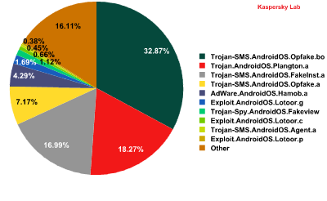

Slide 23
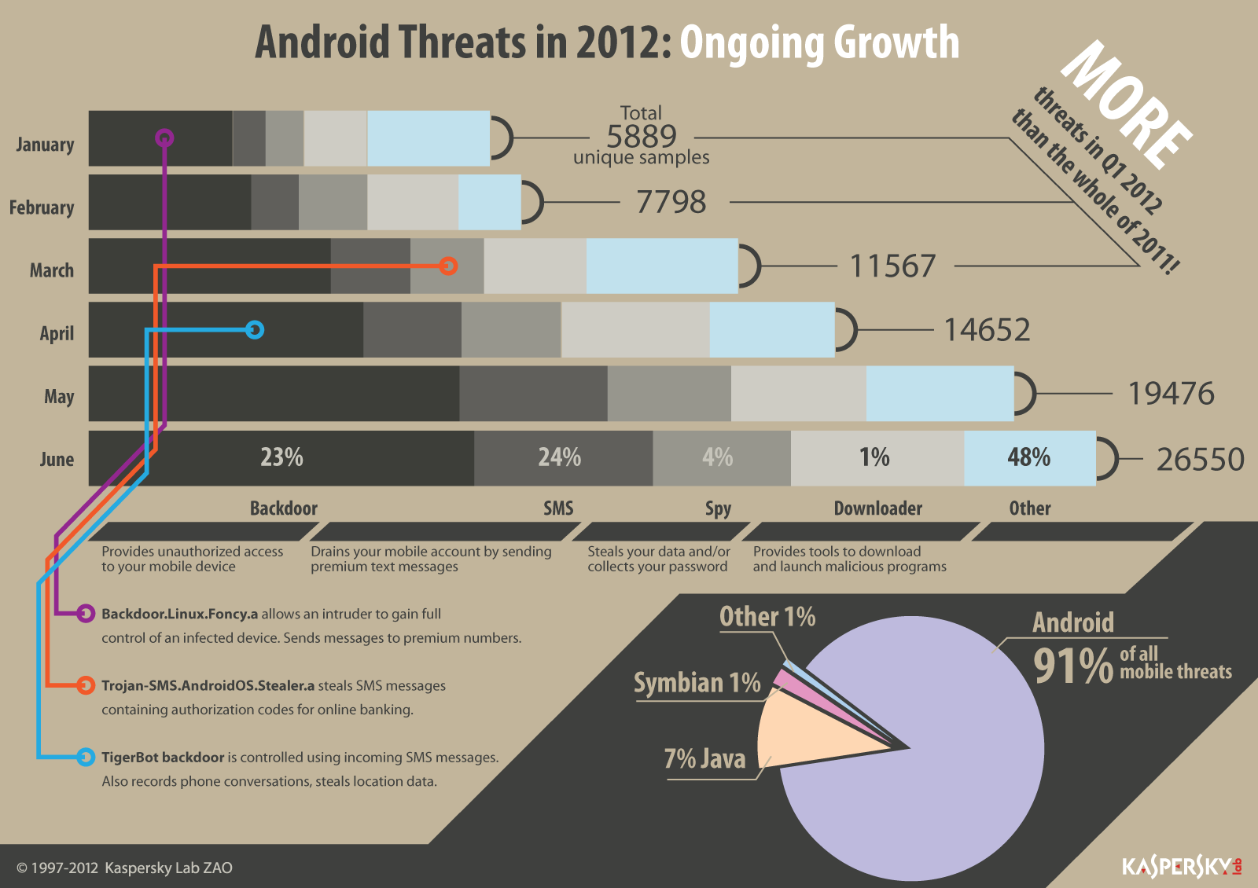

Slide 24
Estonia’s infrastructure
Baltic republic of Estonia
first country in the world to experience cyber war.
Government, financial and media computer networks were paralyzed by a series of attacks
April 2007
Estonia is a heavily wired country: 80 % of Estonians pay their taxes and do their banking on Internet.
Decided to relocate a Soviet war memorial
Russian hackers?
Estonia instituting a real cyber army?

Slide 25
Stuxnet 2011
Worm targeted at a “unique” target in the world
Target = A nuclear facility using specific equipment.
Infects many, but does not hurt any, except one.
Sophisticated internals
Developed by country-level attackers? US + Israel?
More details at http://www.cs.wright.edu/~pmateti/.../Viruses/stuxnet-2011-pm.pptx
2013 www. Langner .com/.../ To- kill- a-centrifuge .pdf

Slide 26
Controversies

Slide 27
Being Able to Read the Source
Enables exploits
Reverse Engineering not required
Internal Structure is understood
Weaknesses can be seen at the design level
Enables fast fixes
Intellectual Property Rights and Privileges
Not (very) relevant in this course
Think: Why do we make laws that let patents expire?

Slide 28
Security Through Obscurity
Use secrecy (of design, implementation, etc.) to ensure security.
May have theoretical or actual security vulnerabilities, but its owners or designers believe that the flaws are not known, and that attackers are unlikely to find them.
We really mean "security implemented solely through obscurity."
Obscurity is not always bad.
Is Obscurity Ever Good?
TBD Read an opinion: www.darkreading.com/blog.asp? blog_sectionid=326&WT.svl=blogger1_1

Slide 29
WikiLeaks
PBS was targeted in retaliation for broadcasting "Frontline: Wiki Secrets“ in May 2011
www.pbs.org/wgbh/pages/frontline/wikileaks/ The inside story of Bradley Manning, Julian Assange and the largest intelligence breach in U.S. history

Slide 30
Course Specific Items

Slide 31
Course Title?
Other titles for the Course
Internet Security
Network Security
Computer Security
System Security
Cyber Security
Integrated View of Security Issues
Selection of Most Relevant Topics
Narrowest Title that Covers the Topics

Slide 32
Ethics: A Personal Opinion
Ethics violations on small scale DOES NOT NECESSARILY IMPLY violations on large scale.
Cf. The movie: Crash (2004) - IMDb

Slide 33
Big Issues

Slide 34
privacyrights.org
“More than 220 million records containing sensitive personal information have been leaked in security breaches in the United States since January 2005.”
This site tracks every breach
Consult if you experience a security breach and aren't sure how to respond

Slide 35
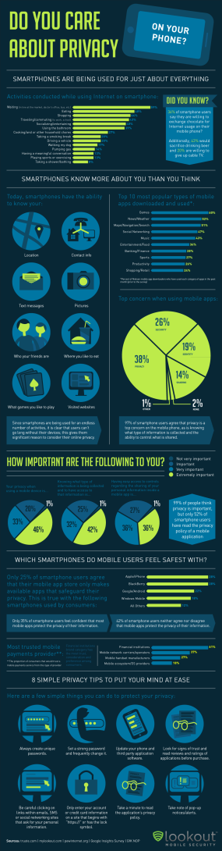

Slide 36
Privacy
Gov't: We want stored emails, phone locations.
The Electronic Communication Privacy Act of 1986
e.g., govt can get past cell phone geolocation data without warrant
www.eff.org/issues/national-security-letters

Slide 37
Will Internet ever be trustworthy?
Non-Answers
Equate the question with:
“Will the world ever be trustworthy?”
Internet is a man-made entity.
Trustworthy = … ?
Ok if cost is high?
Will users get educated?

Slide 38
Trustworthy = No Cheating + …
User authentication
Host authentication
Access authentication
Message/Transaction authentication
No repudiation

Slide 39
Trustworthy = … + Reliable + …
Transactions/Operations/Services/…
Availability
correctly execute
Terminate
Successfully
Failures
Computer Resource consumption
CPU time
Memory
…

Slide 40
Trustworthy = + …?

Slide 41
Will Internet ever be trustworthy?
Predictions

Slide 42
Will Internet ever be trustworthy?
Analysis

Slide 43
US Preparedness

Slide 44
DHS' Classified NCCIC
National Cybersecurity and Communications Integration Center (NCCIC)
DHS-led inter-agency cybersecurity work
responding to cyber threats against government networks
monitoring network sensors across the government and
coordinating response to cyber attacks against power plants or communications networks.
unclassified for one day 10/09/2010

Slide 45
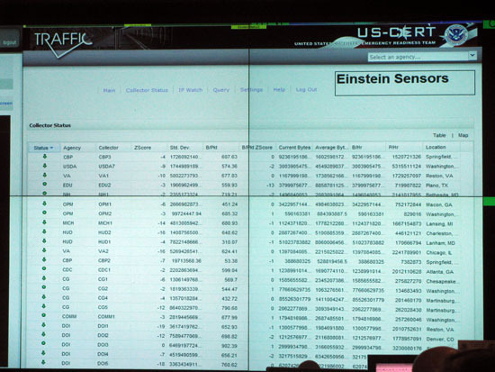
US-CERT Einstein Sensors
This screen shows a selection of real-time information from network flow analyzers placed strategically within government networks nationwide.
Einstein sensors is a series of technologies being deployed across the government for network monitoring, intrusion detection and intrusion prevention.
"We identify not only cyber threats, but also monitor the cyber health of the nation.”

Slide 46
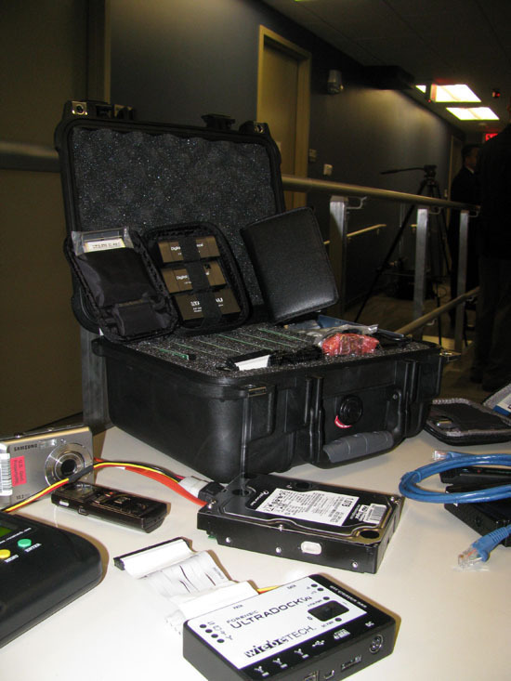
NCCIC Fly-Away Kit
NCCIC doesn't do malware analysis.
However, for demo purposes, DHS brought out some of its digital forensics tools for reporters to see, including these.

Slide 47
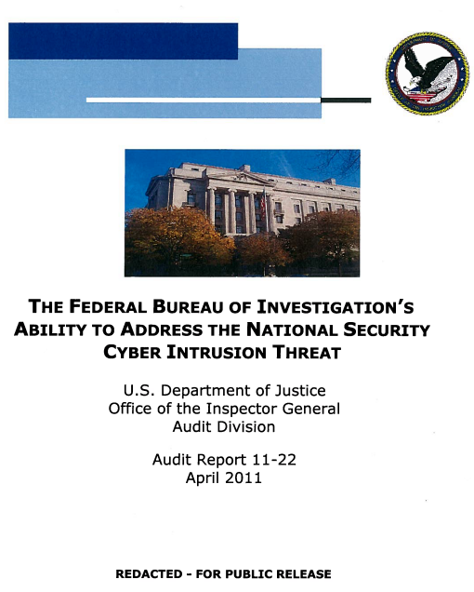
DOJ report critical of FBI
FBI in some cases lacks the skills to properly investigate national security intrusions.
justice.gov/oig/reports/FBI/a1122r.pdf
FBI cyber threat success: the taking down of the CoreFlood botnet.

Slide 48
“Science of Cyber-Security”
Examines the theory and practice of cyber-security, and evaluates whether there are underlying fundamental principles that would make it possible to adopt a more scientific approach.
November 2010, DoD sponsored report
http://www.fas.org/irp/agency/dod/jason/cyber.pdf

Slide 49
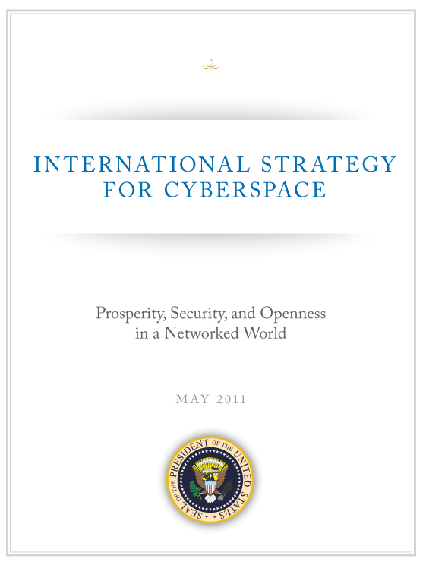

Slide 50
Cybersecurity Plan 2011
International Strategy for Cyberspace
protecting Web infrastructure
freedom of expression and commerce via the Internet
denying those benefits to terrorists and criminals
“Cybersecurity threats and online technologies change quickly -- so quickly that any regulations for cybersecurity could be outdated before they are finalized.”

Slide 51
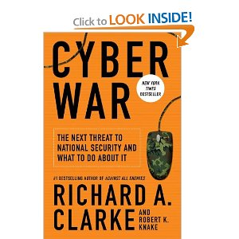
“Cyber War” A Book
Current state of cyber warfare compares to the early days of nuclear weaponry:
Its enormous power is not yet understood and its use is not yet regulated.
America vulnerable to electronic attack.
Clark: former White House terrorism adviser
washingtonpost.com/ review 2010/05/21
4/5 stars (95 Amazon reviews)

Slide 52
UK cyber weapons program
http://qz.com/72598/what-the-heck-is-a-cyber-weapon-anyway/ 2013
Cyber weapons as "an integral part of the country's armory"
Cyberspace represents "conflict without borders"
Cybersecurity a tier one priority
Extra £650m May 2011

Slide 53
Random Quote
“ Restrictions of free thought and free speech is the most dangerous of all subversions. It is the one un-American act that could most easily defeat us.”
- William O. Douglas,
US Supreme Court, 1939-1980

