Slide 1
Cryptography in Internet Security
Prabhaker Mateti

Slide 2
Computationally Infeasible
certain computation that we are talking about takes way too long (hundreds of years) to compute using the fastest of (super) computers.
128-bit numbers 340,282,366,920,938,463,463,374,607,431,768,211,456
using 1,000,000,000 machines that could try 1,000,000,000 keys/sec, it would take all these machines longer than the universe as we know it has existed to find the key.

Slide 3
Average time required for exhaustive key search
Key Size (bits) | Number of Alternate Keys | Time required at 10⁶ decryption/ µs
32 | 2³² = 4.3 x 10⁹ | 2.15 milliseconds
56 | 2⁵⁶ = 7.2 x 10¹⁶ | 10 hours
128 | 2¹²⁸ = 3.4 x 10³⁸ | 5.4 x 10¹⁸ years
168 | 2¹⁶⁸ = 3.7 x 10⁵⁰ | 5.9 x 10³⁰ years

Slide 4
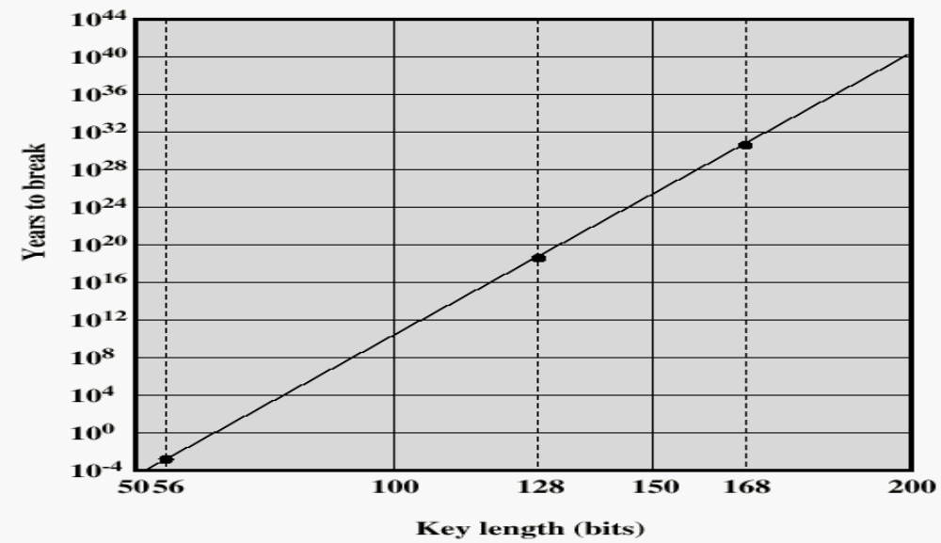
Time to break a code (10⁶ decryptions/µs)

Slide 5
Turing-incomputable
Mathematical idea of impossible computation based on Turing machines.
Not a paradox:
“This sentence is False.”

Slide 6
Prime Factorization
N = 2^{n2} * 3^{n3} * 5^{n5} * 7^{n7} * ...
Any number can be written as a product of factors, each of which is a power of a prime number.
Given an N, how easy is it to find its prime factors (i.e., finding its n2, n3, n5, n7, …)?

Slide 7
The Three Cryptography Dimensions
  The type of operations used for transforming plaintext to ciphertext
  The number of keys used
    symmetric (single key)
    asymmetric (two-keys, or public-key encryption)
  The way in which the plaintext is processed

Slide 8
SymmetricKey Encryption
Five ingredients:
  Encryption algorithm, EA
  Decryption algorithm, DA
  Secret Key, SK
  Ciphertext = EA(SK, plaintext)
  Plaintext = DA(SK, ciphertext)
Security depends on the secrecy of the key, not the secrecy of the algorithm

Slide 9
Data Encryption Standard (DES)
The key is 56-bits in length
Transforms the input into a 64-bit output
The most widely used symmetric-key encryption scheme
The algorithm is called Data Encryption Algorithm (DEA)
DES is a block cipher: The plaintext is processed in 64-bit blocks
Developed in 1975, ANSI X.3.92 in 1981

Slide 10
Triple DEA
C = EK3[DK2[EK1[P]]]
Use three keys and three executions of the DES algorithm (encrypt-decrypt-encrypt)
  C = ciphertext
  P = Plaintext
  EK[X] = encryption of X using key K
  DK[Y] = decryption of Y using key K
Effective key length of 3*56 bits

Slide 11
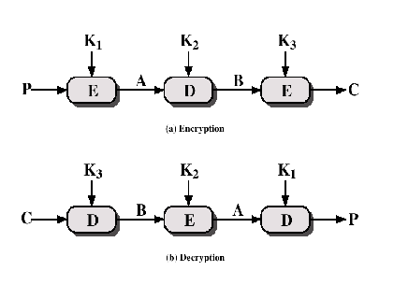
Triple DEA

Slide 12
IDEA
International Data Encryption Algorithm
128-bit key
Used in PGP

Slide 13
Blowfish
symmetric block cipher
drop-in replacement for DES or IDEA
variable-length key, 32 to 448 bits
Easy to implement
High execution speed
Run in less than 5K of memory

Slide 14
RC5
Suitable for hardware and software
Fast, simple
Adaptable to CPU of different word lengths
Variable number of rounds
Variable-length key
Low memory requirement
High security
Data-dependent rotations

Slide 15
Public-Key Cryptography
Public key, KU
Private (secret) key, KR
KU and KR are mathematically coupled
x = encrypt(KU, y)
y = decrypt(KR, x)

Slide 16

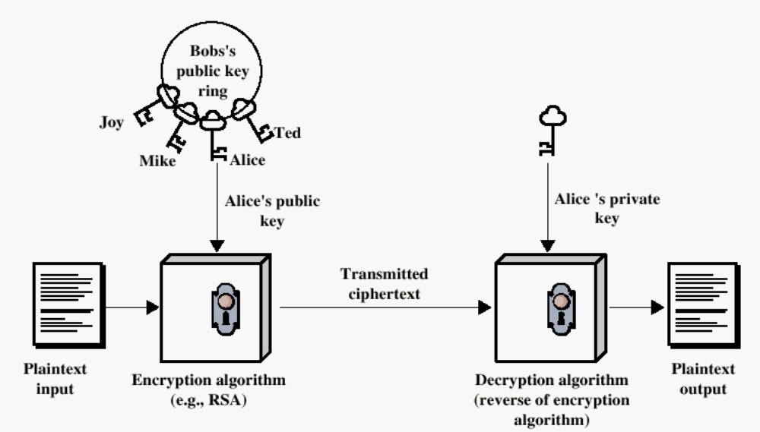
Bob sends msg to Alice

Slide 17
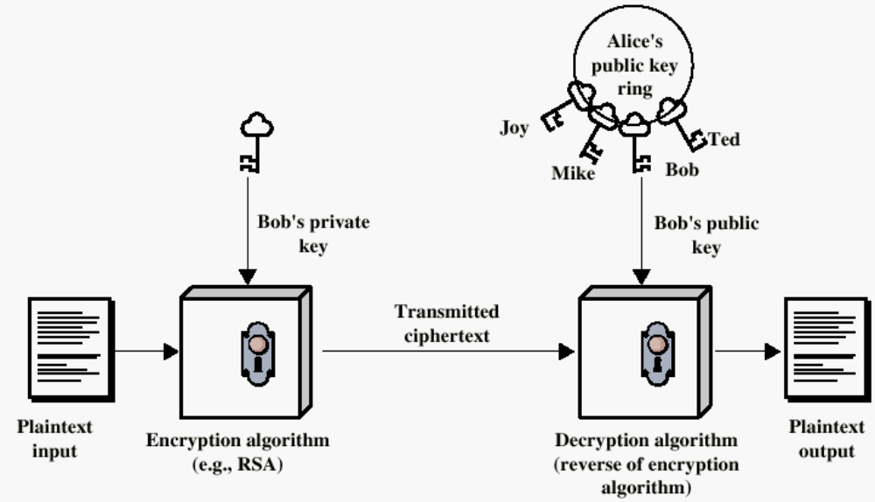
Bob Authenticates to Alice

Slide 18
Applications for Public-Key Cryptosystems
Encryption/decryption: The sender encrypts a message with the recipient’s public key.
Digital signature: The sender ”signs” a message with its private key.
Key exchange: Two sides cooperate two exchange a session key.

Slide 19
Requirements for Public-Key Cryptography
Computationally easy for a party B to generate a pair (public key KUb, private key KR_{b})
Easy for sender to generate ciphertext = encrypt(KUb, MSG)
Easy for the receiver to decrypt:
MSG = decrypt(KRb, ciphertext)

Slide 20
Requirements for Public-Key Cryptography
Computationally infeasible to determine private key (KR_{b}) knowing public key (KU_{b})
Computationally infeasible to recover message M, knowing KU_{b} and ciphertext C
Either of the two keys can be used for encryption, with the other used for decryption:

Slide 21
Public-Key Cryptographic Algorithms
RSA 1977
  Ron Rives, Adi Shamir and Len Adleman
  RSA is a block cipher
  The most widely implemented
Diffie-Hellman 1976
  Exchange a secret key securely
  Compute discrete logarithms
Public-key crypto is about 1000 times slower than symmetric key crypto.

Slide 22
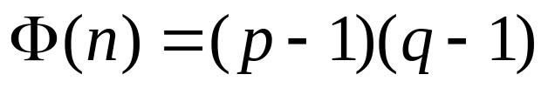
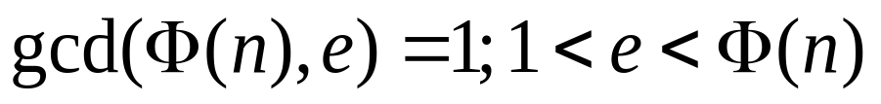
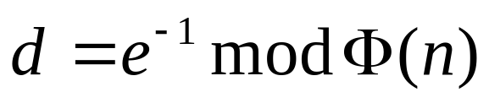
The RSA Key Generation
Select p,q p and q both prime
Calculate n = p x q
Calculate
Select integer e
Calculate d
Public Key KU = {e,n}
Private key KR = {d,n}

Slide 23
RSA Key Generation
Find two primes, p and q.
Compute the product, n = p*q (called, the public modulus).
Choose e (the public exponent), such that (i) e < n, and (ii) e is relatively prime to (p-1)*(q-1).
Compute d (the private exponent) such that (e*d) mod (p-1)*(q-1) = 1.
Public key = (n, e)
Private key = (n, d)

Slide 24
RSA Algorithm
The un-breakability of the algorithm is based on the fact that there is
no efficient way to factor very large numbers into their primes.
If n is small, easy to compute e, d.
Choose p and q to be as large as possible (more than a hundred digits long)
Never reveal p and q.

Slide 25
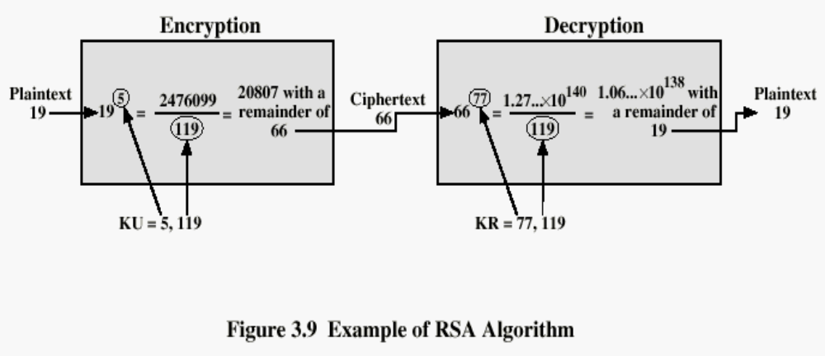
Example of RSA Algorithm

Slide 26
The RSA Encryption
Consider the entire plaintext message as a sequence of bits.
Let b = length of p*q in bits.
Split the message into blocks of length b or b-1. A block viewed as a b-bit number should be less than n; if it is not, choose it to be b-1 bits long.
Each block is separately encrypted, and the encryption of the entire message is the catenation of the encryption of the blocks.
Let m stand for a block viewed as a number. Multiply m with itself e times, and take the modulo n result as c, which is the encryption of m. That is,
c = m^e mod n.
Decryption is the "inverse" operation:
m = c^d mod n.

Slide 27
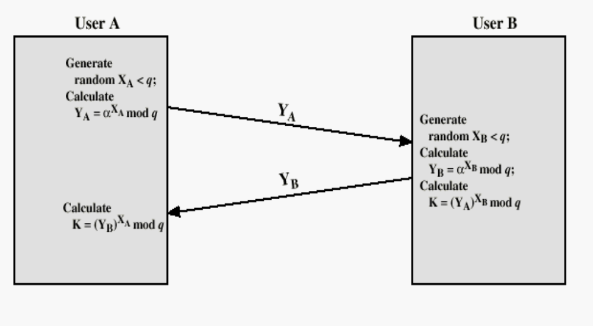
Diffie-Hellman Key Exchange

Slide 28
Other Public-Key Cryptographic Algorithms
Digital Signature Standard (DSS)
  Makes use of the SHA-1
  Not for encryption or key echange
Elliptic-Curve Cryptography (ECC)
  Good for smaller bit size
  Low confidence level, compared with RSA
  Very complex

Slide 29
Key Distribution
Session key: Data encrypted with a one-time session key.At the conclusion of the session the key is destroyed.
Permanent key: Used between entities for the purpose of distributing session keys.

Slide 30
Key Distribution
A key could be selected by A and physically delivered to B.
A third party could select the key and physically deliver it to A and B.
If A and B have previously used a key, one party could transmit the new key to the other, encrypted using the old key.

Slide 31
Key Distribution
If A and B each have an encrypted connection to a third party C, C could deliver a key on the encrypted links to A and B.

Slide 32
Secure Communication Using Public Keys
public keys are rarely used to encrypt actual messages because public-key cryptography is slow.
public-key cryptography is used to distribute symmetric keys
Bob sends Alice his public key.
Alice generates a random symmetric key (usually called a session key), encrypts it with Bob's public key, and sends it to Bob.
Bob decrypts the session key with his private key.
Alice and Bob exchange messages using session key as the symmetric key.

Slide 33
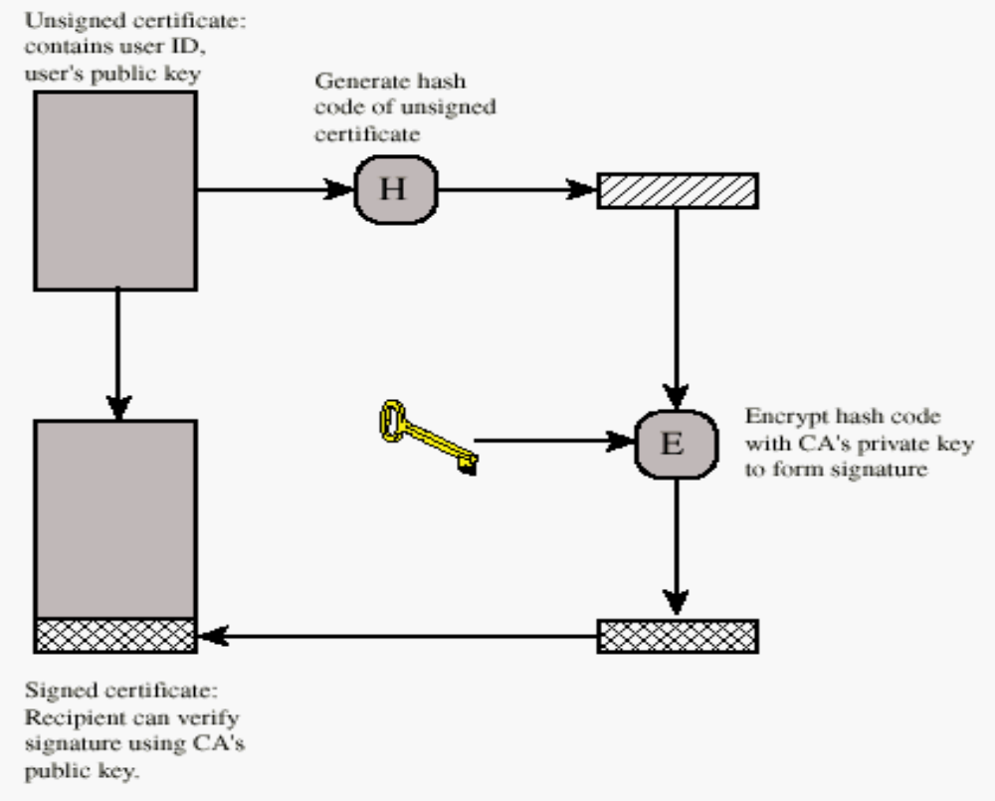
Key Management
Public-Key Certificate Use

Slide 34
One way hash functions
X is a block of data of any size
H produces a fixed length output
The output length k considerably shorter than input.
Obviously, there exist x, y, x != y, such that H(x) = H(y).

Slide 35
A Good Hash function H(x)
H(x) is easy to compute for any given x.
It is computationally infeasible to find a pair (x, y) such that H(x) = H(y)
For a given h, it is computationally infeasible to find x such that H(x) = h

Slide 36
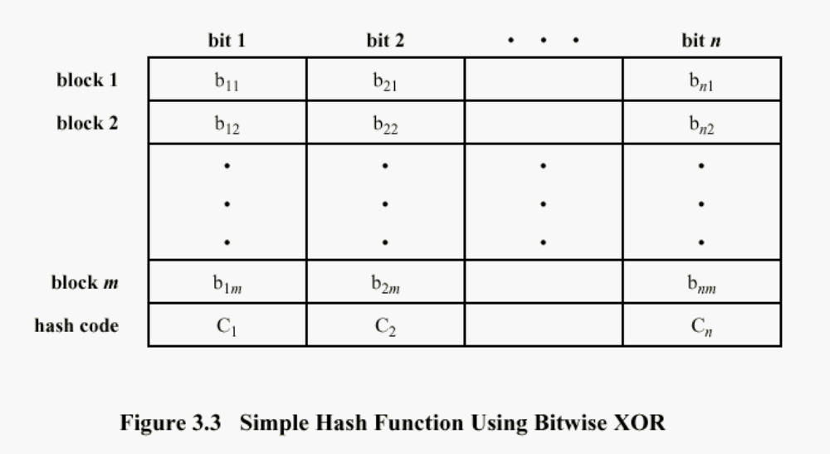
Simple Hash Function
One-bit circular shift on the hash value after each block is processed would improve

Slide 37
A Few Secure HASH functions
 | SHA-1 | MD5 | RIPEMD-160
Digest length | 160 bits | 128 bits | 160 bits
Basic unit of processing | 512 bits | 512 bits | 512 bits
Number of steps | 80 (4 rounds of 20) | 64 (4 rounds of 16) | 160 (5 paired rounds of 16)
Maximum message size | 2⁶⁴-1 bits | Infinite | infinite

Slide 38
Digital Signatures
A digital signature is a way to authenticate to a recipient that a received object is indeed that of the sender.
Alice computes a one-way hash DH of a document D.
Alice encrypts DH with her private key. The encrypted hash DS becomes the document's signature.
Alice sends D along with the DS to Bob.
Bob receives D’, DS’. Hopefully, D’ = D, DS’ = DS.
Bob computes one-way hash BH of the D’
Bob decrypts the signature DS’ with Alice's public key; call the decrypted value DG.
If DG = BH, Bob knows that:
  the document really came from Alice and
  the document was not tampered with during transmission.

Slide 39
Man-in-the-Middle Attack
Assume: No trusted repositories of public keys
Bob sends Alice his public key. Mallory intercepts the key and sends her own public key to Alice.
Alice generates a random session key, encrypts it with "Bob’s" public key (which is really Mallory's), and sends it to Bob.
Mallory intercepts the message. He decrypts the session key with his private key, encrypts it with Bob's public key, and sends it to Bob.
Bob receives the message thinking it came from Alice. He decrypts it with his private key and obtains the session key.
Alice and Bob start exchanging messages using the session key. Mallory, who also has that key, can now decipher the entire conversation.

Slide 40
MiTM Attack Prevention
MiTM attack works because Alice and Bob have no way to verify they are talking to each other.
An independent third party that everyone trusts is needed to foil the attack.
This third party could bundle the name "Bob" with Bob's public key and sign the package with its own private key.
When Alice receives the signed public key from Bob, she can verify with the third party. This way she knows that the public key really belongs to Bob, and not Mallory.

Slide 41
Unix crypt()
Unix crypt() function (not the crypt(1) program) is based on the Data Encryption Standard (DES).
Takes the first 8 characters of the password
Assembles a 56-bit key == low 7-bits * 8
Using this key, 000…0, a block of 64-zero-bits, is encrypted
This is repeated 25 times.
Append two zero bits; we now have 66-bits.
Split into 11 six-bit numbers.
Each six-bit number i is stored as a char q[i] from the sequence q == [., /, 0-9, A-Z, a-z] of 64 characters.
This computation is perturbed with a randomly generated value called the salt, a two-character string chosen from the q.
The salt value is prepended resulting in a sequence of 13 characters.

