Slide 1



Statically Detecting Likely Buffer Overflow Vulnerabilities
David Larochelle
David Evans
Supported by USENIX Student Grant and NASA LRC
University of Virginia
Department of Computer Science

Slide 2
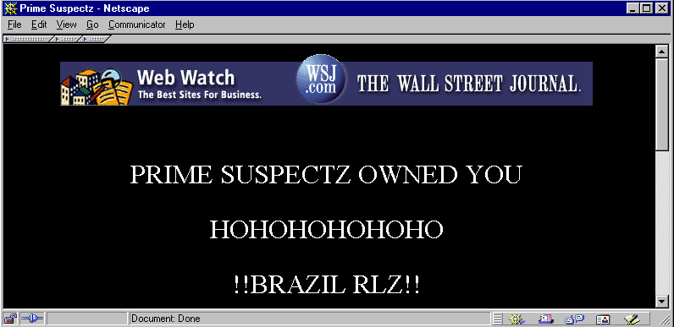
1988: Morris worm exploits buffer overflows in fingerd to infect 6,000 servers
2001: Code Red exploits buffer overflows in IIS to infect 250,000 servers
  Single largest cause of vulnerabilities in CERT advisories
  Buffer overflow threatens Internet- WSJ(1/30/01)

Slide 3
Why aren’t we better off than we were 13 years ago?
Ignorance
C is difficult to use securely
  Unsafe functions
  Confusing APIs
Even security aware programmers make mistakes.
Security Knowledge has not been codified into the development process

Slide 4
Automated Tools
Run-time solutions
  StackGuard[USENIX 7], gcc bounds-checking, libsafe[USENIX 2000]
  Performance penalty
  Turns buffer overflow into a DoS attack
Compile-time solutions - static analysis
  No run-time performance penalty
  Checks properties of all possible executions

Slide 5
Design Goals
Tool that can be used by typical programmers as part of the development process
  Fast, Easy to Use
Tool that can be used to check legacy code
  Handles typical C programs
Encourage a proactive security methodology
  Document key assumptions

Slide 6
Our approach
Document assumptions about buffer sizes
  Semantic comments
  Provide annotated standard library
  Allow user's to annotate their code
Find inconsistencies between code and assumptions
Make compromises to get useful checking
  Use simplifying assumptions to improve efficiency
  Use heuristics to analyze common loop idioms
  Accept some false positives and false negatives (unsound and incomplete analysis)

Slide 7
Implementation
Extended LCLint
  Open source checking tool [FSE ‘94] [PLDI ‘96]
  Uses annotations
  Detects null dereferences, memory leaks, etc.
Integrated to take advantage of existing checking and annotations (e.g., modifies)
Added new annotations and checking for buffer sizes

Slide 8
Annotations
requires, ensures
maxSet
  highest index that can be safely written to
maxRead
  highest index that can be safely read
char buffer[100];
  ensures maxSet(buffer) == 99

Slide 9
SecurityFocus.com Example
char *strncat (char *s1, char *s2, size_t n)
/*@requires maxSet(s1)
>=maxRead(s1) + n@*/
void func(char *str){ char buffer[256]; strncat(buffer, str, sizeof(buffer) - 1); return;
}
uninitialized array
Source: Secure Programming working document,
SecurityFocus.com

Slide 10
Warning Reported
char * strncat (char *s1, char *s2, size_t n)
/*@requires maxSet(s1) >= maxRead(s1) + n @*/
char buffer[256];
strncat(buffer, str, sizeof(buffer) - 1);
strncat.c:4:21: Possible out-of-bounds store:
strncat(buffer, str, sizeof((buffer)) - 1);
Unable to resolve constraint:
requires maxRead (buffer @ strncat.c:4:29) <= 0
needed to satisfy precondition:
requires maxSet (buffer @ strncat.c:4:29)
>= maxRead (buffer @ strncat.c:4:29) + 255
derived from strncat precondition:
requires maxSet (<parameter 1>)
>= maxRead (<parameter1>) + <parameter 3>

Slide 11
Overview of checking
Intraprocedural
  But use annotations on called procedures and global variables to check calls, entry, exit points
Expressions generate constraints
  C semantics, annotations
Axiomatic semantics propagates constraints
Simplifying rules (e.g. maxRead(str+i) ==> maxRead(str) - i)
Produce warnings for unresolved constraints

Slide 12
Loop Heuristics
Recognize common loop idioms
Use heuristics to guess number of iterations
Analyze first and last iterations
Example:
  for (init; *buf; buf++)
  Assume maxRead(buf) iterations
  Model first and last iterations

Slide 13
Case studies
wu-ftpd 2.5 and BIND 8.2.2p7
  Detected known buffer overflows
  Unknown buffer overflows exploitable with write access to config files
Performance
  wu-ftpd: 7 seconds/ 20,000 lines of code
  BIND: 33 seconds / 40,000 lines
  Athlon 1200 MHz

Slide 14
Results
Instances in wu-ftpd (grep)
LCLint warnings with no annotations added
LCLint warning with annotations
strcat
27
19
12
strcpy
97
40
21
strncpy
55
4
4
Other Warnings
-
132 writes
220 reads
95 writes
166 reads

Slide 15
wu-ftpd vulnerablity
int acl_getlimit(char *class, char *msgpathbuf)
{
struct aclmember *entry = NULL;
while (getaclentry("limit", &entry)) {
…
strcpy(msgpathbuf, entry->arg[3]);
int access_ok( int msgcode) {
char class[1024], msgfile[200];
int limit;
…
limit = acl_getlimit(class, msgfile);
/*@requires maxSet(msgpathbuf) >= 199 @*/
/*@requires maxSet(msgpathbuf) >= 1023 @*/
strncpy(msgpathbuf, entry->arg[3], 1023);
msgpathbuf[1023] = ‘\0’;
strncpy(msgpathbuf, entry->arg[3], 199);
msgpathbuf[199] = ‘\0’;
LCLint reports a possible buffer overflow for
strcpy(msgpathbuf, entry->arg[3]);
LCLint reports an error at a call site of acl_getlimit

Slide 16
Related Work
Lexical analysis
  grep, its4, RATS, FlawFinder
Wagner, Foster, Brewer [NDSSS ‘00]
  Integer range constraints
  Flow insensitive analysis
Dor, Rodeh and Sagiv [SAS ‘01]
  Source-to-source transformation with asserts and additional variables.

Slide 17
Impediments to wide spread adoption
People are lazy
Programmers are especially lazy
Adding annotations is too much work (except for security weenies)
Working on techniques for automating the annotation process

Slide 18
Conclusion
2014:???
  Will buffer overflows still be common?
  Codify security knowledge in tools real programmers can use
Beta version now available: http://lclint.cs.virginia.edu
David Larochelle David Evans
larochelle@cs.virginia.edu evans@cs.virginia.edu

