Slide 1


kenu@okjsp.pe.kr
http://okjsp.tistory.com/

Slide 2


http://findbugs.sourceforge.net

Slide 3

Find Java Program Bugs
Search by bug patterns
Search for compiled byte code
  Refer source code for Human Readable
Provide fix guide for each bug

Slide 4

Command line
Desktop Application
  Java Web Start; jnlp
Plugin
  IDE:
    Eclipse, NetBeans …
  Build Tool:
    Ant, Maven
  CI Tool :
    Hudson

Slide 5

Download, Unzip, set Path
options
  findbugs
  -textui
  -javahome /path/to/jdk1.5.0
  -xml
  -output findbugs.xml
  /path/to/classes

Slide 6

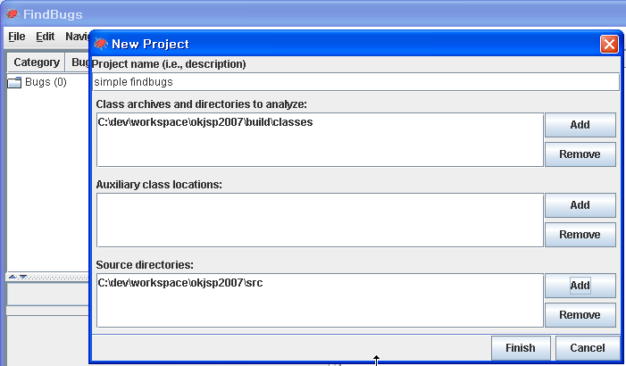

Slide 7

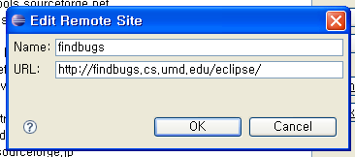
Update URL
  http://findbugs.cs.umd.edu/eclipse/

Slide 8

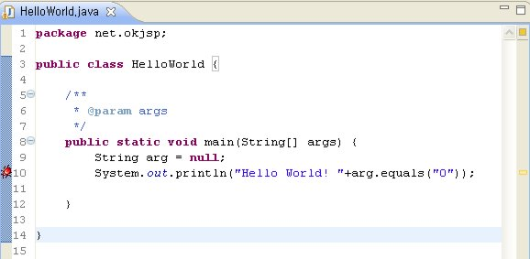

Slide 9

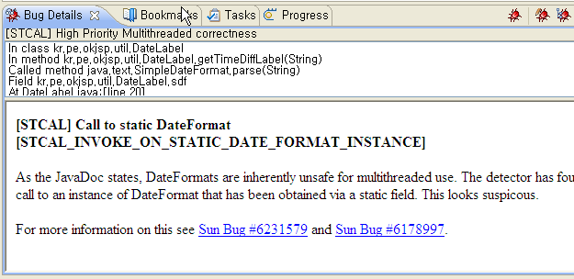

Slide 10

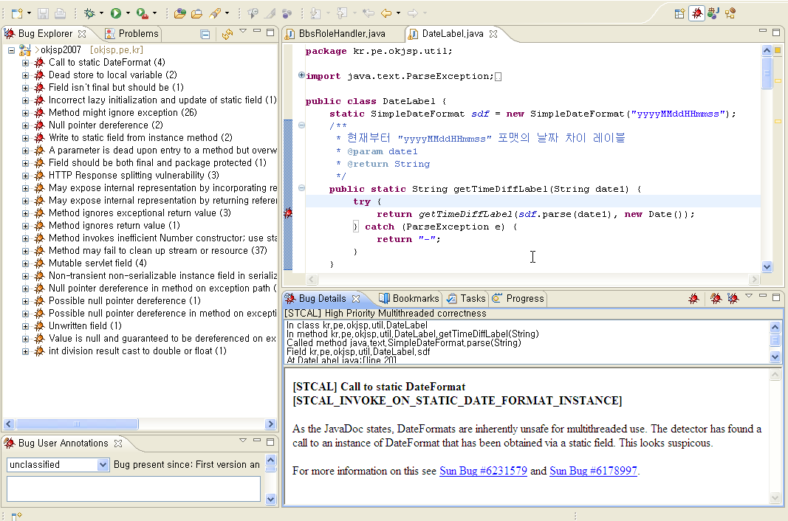

Slide 11

$FINDBUGS_HOME/lib/findbugs-ant.jar
copy to $ANT_HOME/lib/
<taskdef name="findbugs" classname="edu.umd.cs.findbugs.anttask.FindBugsTask" />
<target name="findbugs" depends="compile">
<findbugs home="${findbugs.home}"
output="xml" outputFile="findbugs.xml"
jvmargs="-Xms512M -Xmx1024M " timeout="1800000">
<sourcePath path="WebContent/WEB-INF/src" />
<class location="WebContent/WEB-INF/classes" />
</findbugs>
</target>

Slide 12

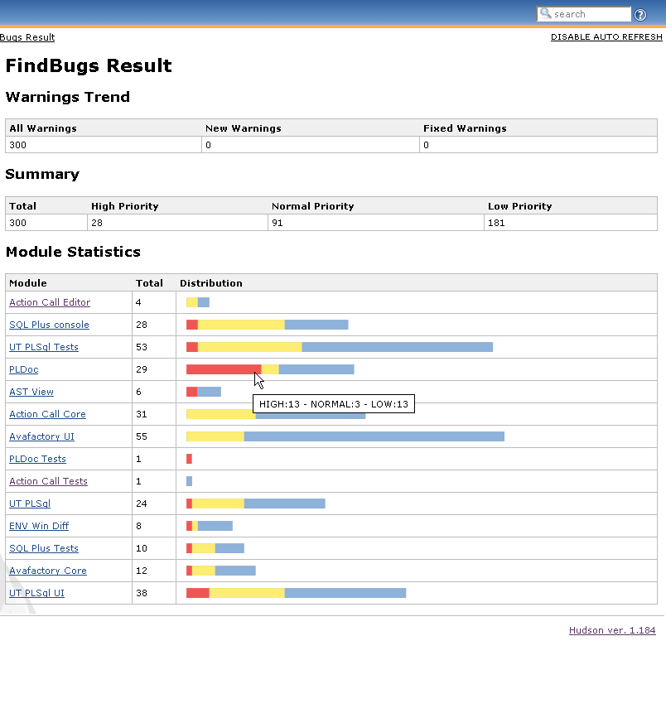
https://hudson.dev.java.net/

Slide 13

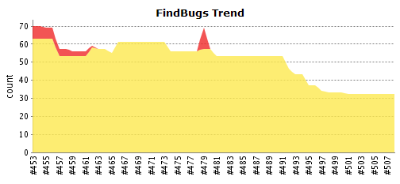
Each one’s IDE; before commit;
Using App’s Health Care
  CI graph
Code Review

Slide 14

http://findbugs.sourceforge.net
https://hudson.dev.java.net
http://okjsp.tistory.com/tag/findbugs

