Slide 1
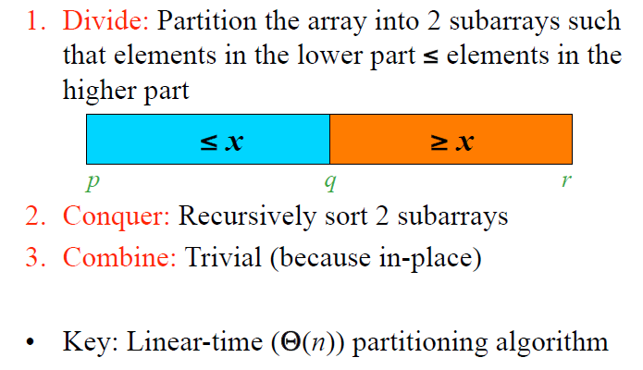
Quicksort
Analysis of Algorithms

Slide 2
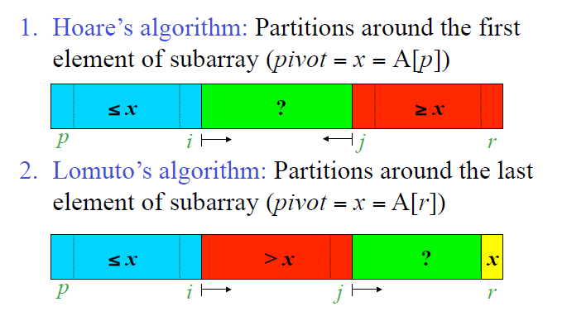
Quicksort – Two Partioning Algorithms
Analysis of Algorithms

Slide 3
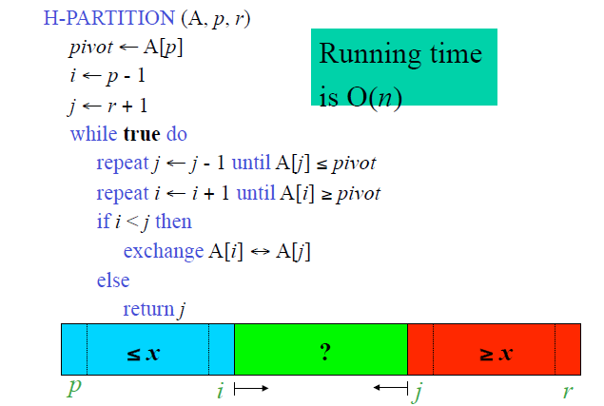
Hoares’ Partitioning Algorithm
Analysis of Algorithms

Slide 4
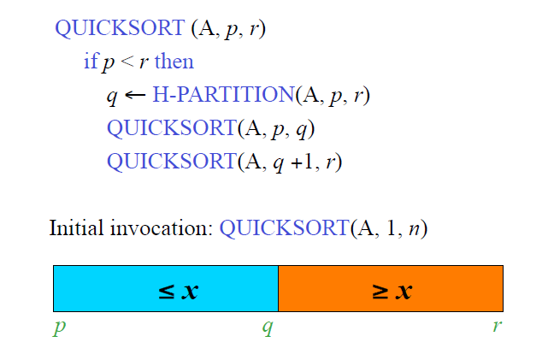
Quicksort
Analysis of Algorithms

Slide 5
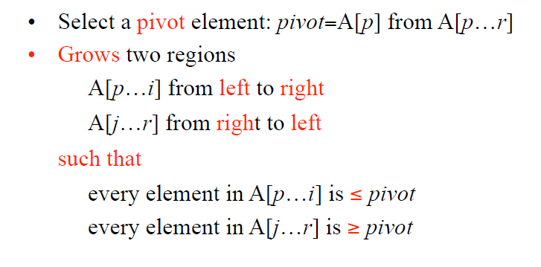
Hoare’s Partitioning Algorithm
Analysis of Algorithms

Slide 6
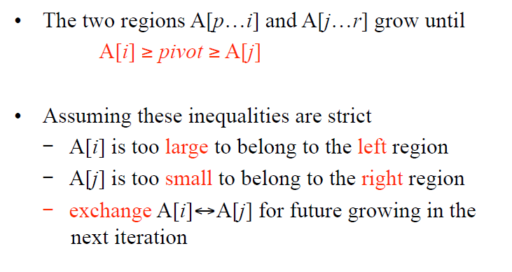
Hoare’s Partitioning Algorithm
Analysis of Algorithms

Slide 7
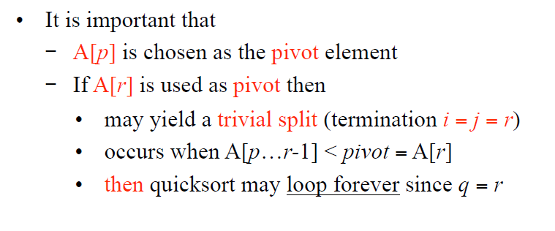
Hoare’s Partitioning Algorithm
Analysis of Algorithms

Slide 8
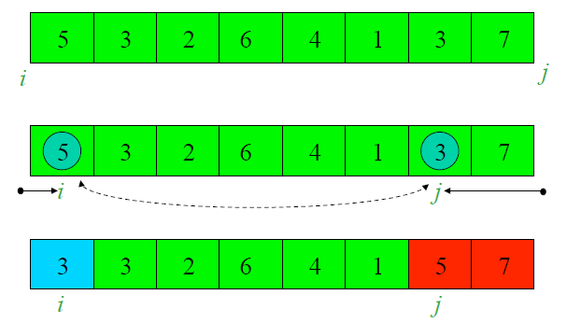
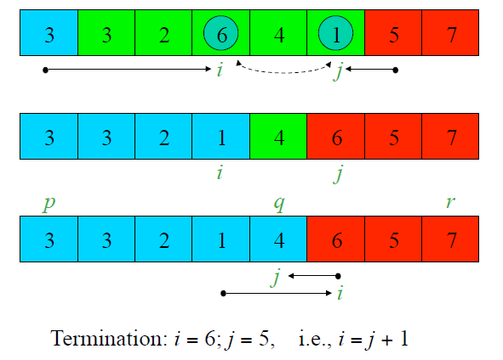
Hoare’s Partitioning Algorithm - Ex1 (pivot=5)
Analysis of Algorithms

Slide 9
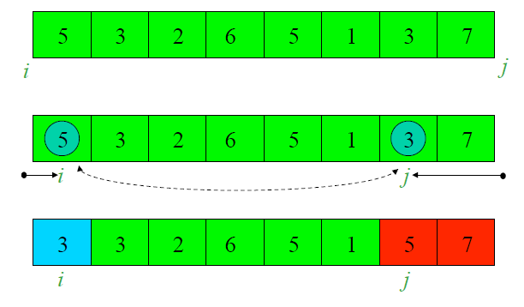
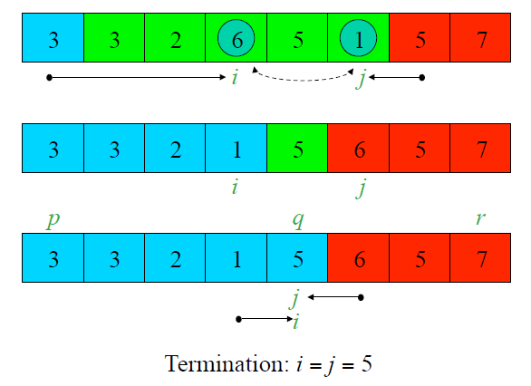
Hoare’s Partitioning Algorithm – Ex2 (pivot=5)
Analysis of Algorithms

Slide 10
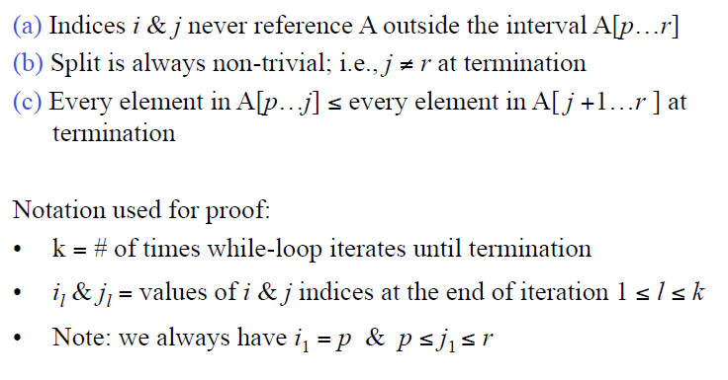
Correctness of Hoare’s Partitioning Algorithm
Analysis of Algorithms

Slide 11
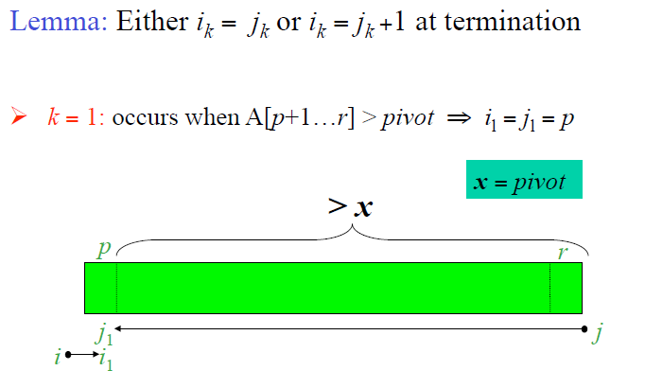
Correctness of Hoare’s Partitioning Algorithm
Analysis of Algorithms

Slide 12
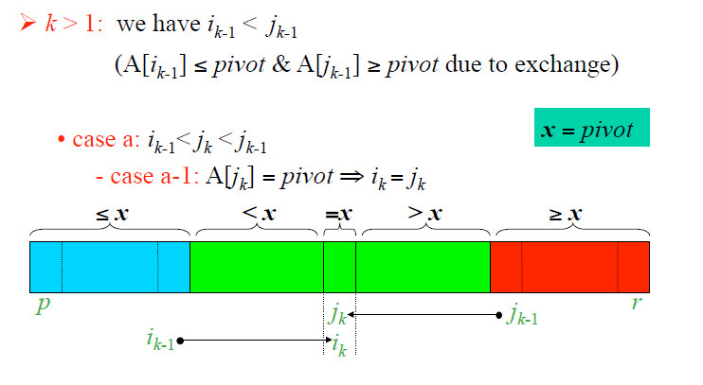
Correctness of Hoare’s Partitioning Algorithm
Analysis of Algorithms

Slide 13
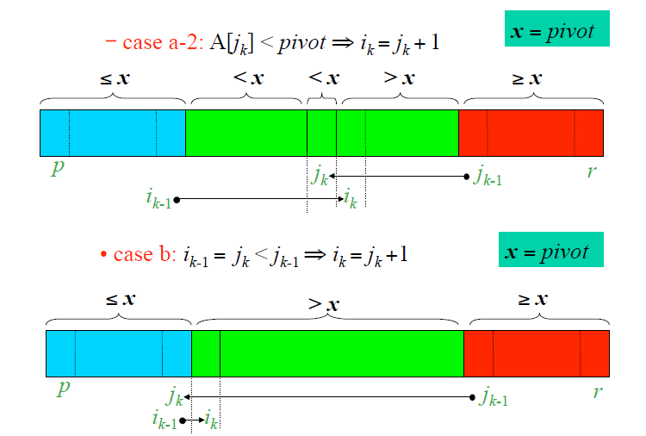
Correctness of Hoare’s Partitioning Algorithm
Analysis of Algorithms

Slide 14
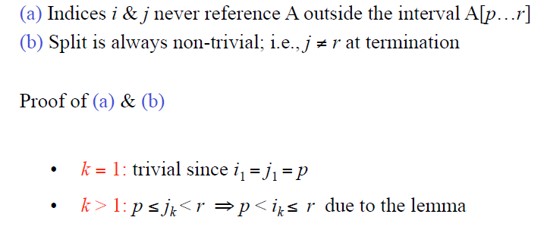
Correctness of Hoare’s Partitioning Algorithm
Analysis of Algorithms

Slide 15
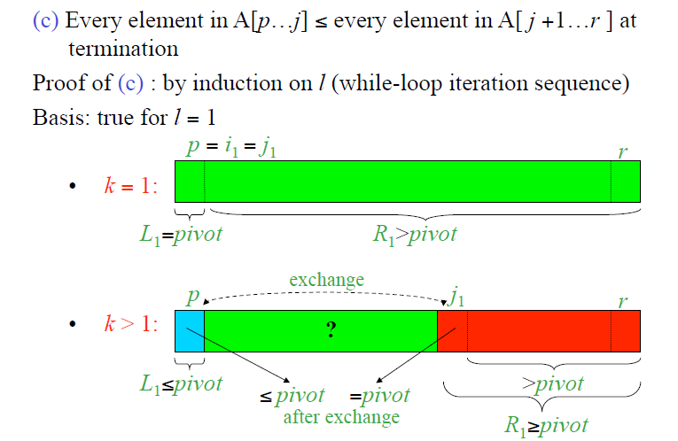
Correctness of Hoare’s Partitioning Algorithm
Analysis of Algorithms

Slide 16
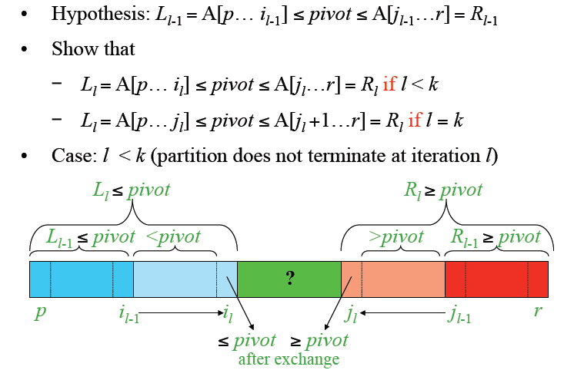
Correctness of Hoare’s Partitioning Algorithm
Analysis of Algorithms

Slide 17
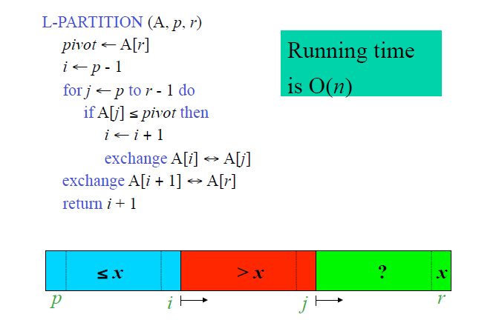
Lomuto’s Partitioning Algorithm
Analysis of Algorithms

Slide 18
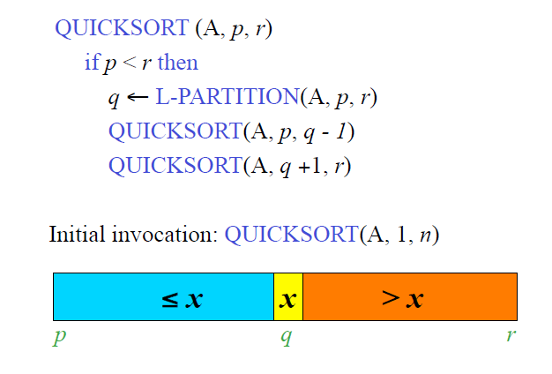
Quiksort – Lumuto’s Algorithm
Analysis of Algorithms

Slide 19
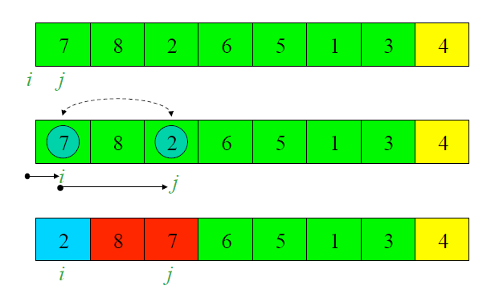
Lomuto’s Algorithm: Example (pivot = 4)
Analysis of Algorithms

Slide 20
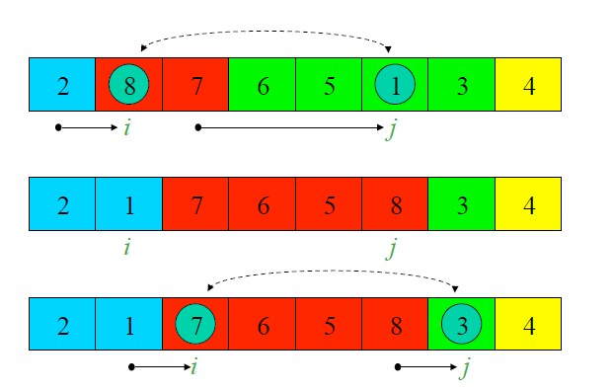
Lomuto’s Algorithm: Example (pivot = 4)
Analysis of Algorithms

Slide 21
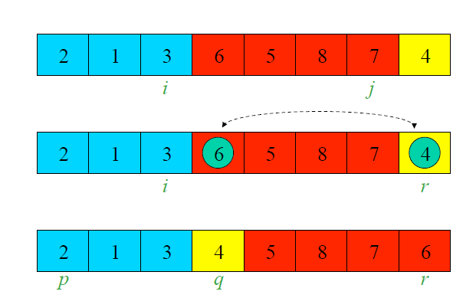
Lomuto’s Algorithm: Example (pivot = 4)
Analysis of Algorithms

Slide 22
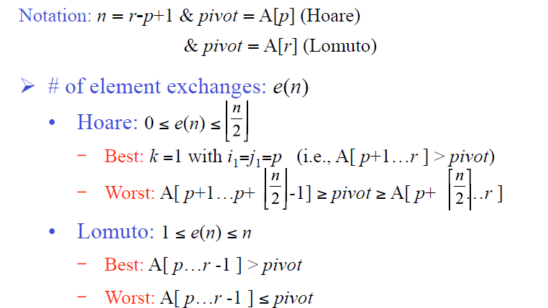
Comparison of Hoare’s & Lomuto’s Algorithms
Analysis of Algorithms

Slide 23
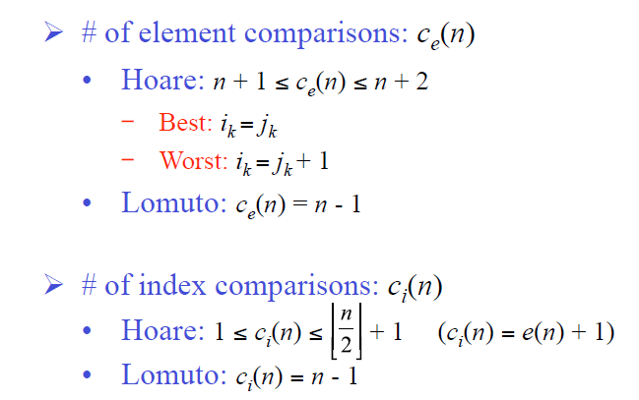
Comparison of Hoare’s & Lomuto’s Algorithms
Analysis of Algorithms

Slide 24
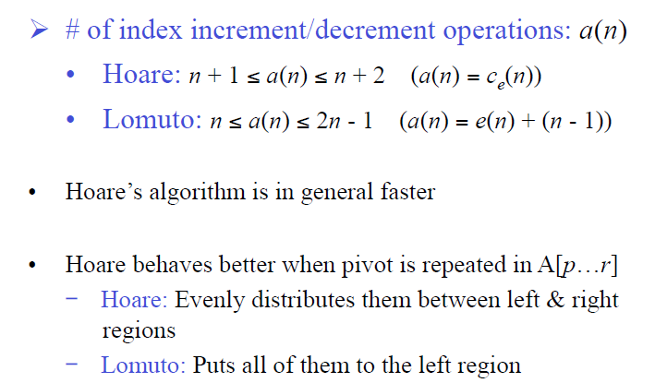
Comparison of Hoare’s & Lomuto’s Algorithms
Analysis of Algorithms

Slide 25
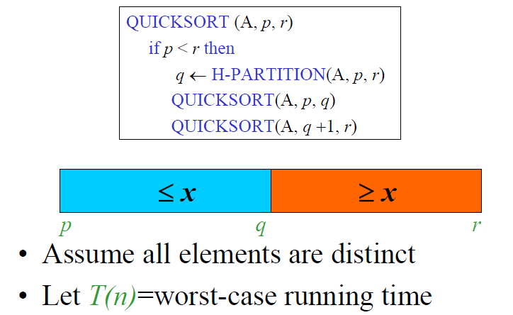
Analysis of Quicksort
Analysis of Algorithms

Slide 26
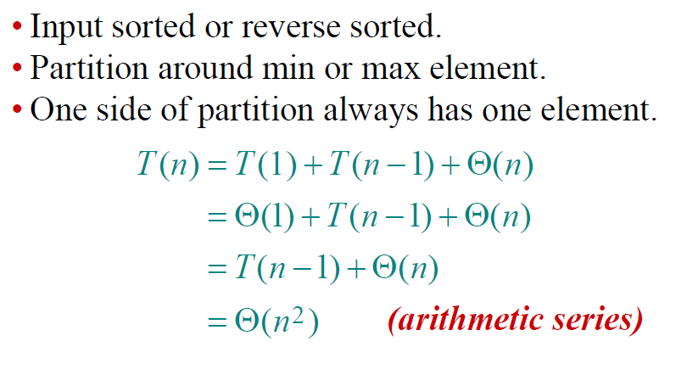
Worst-case of quicksort
Analysis of Algorithms

Slide 27
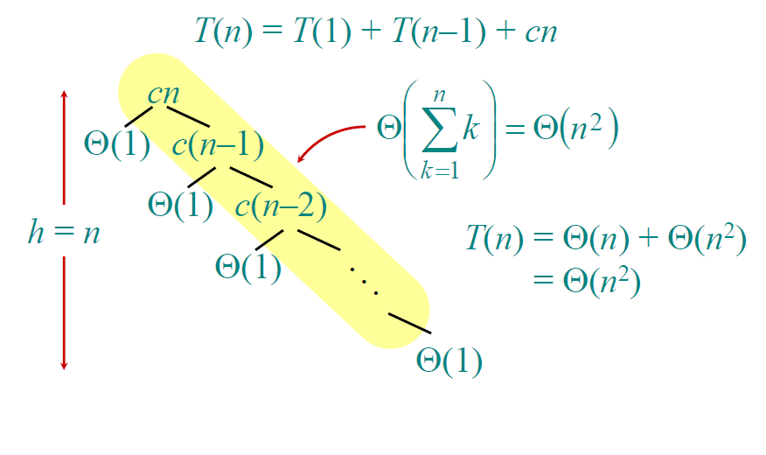
Worst-case recursion tree
Analysis of Algorithms

Slide 28
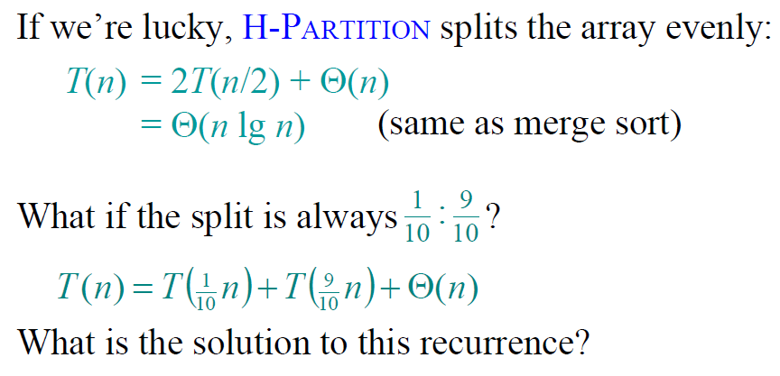
Best-case analysis
Analysis of Algorithms

Slide 29
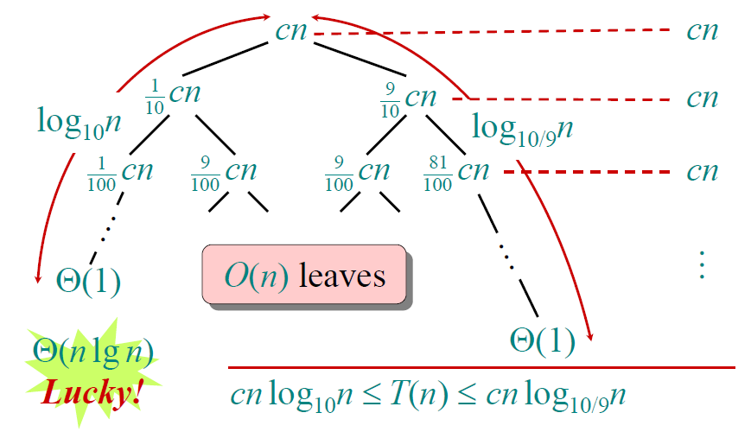
Analysis of “almost-best” case
Analysis of Algorithms

Slide 30
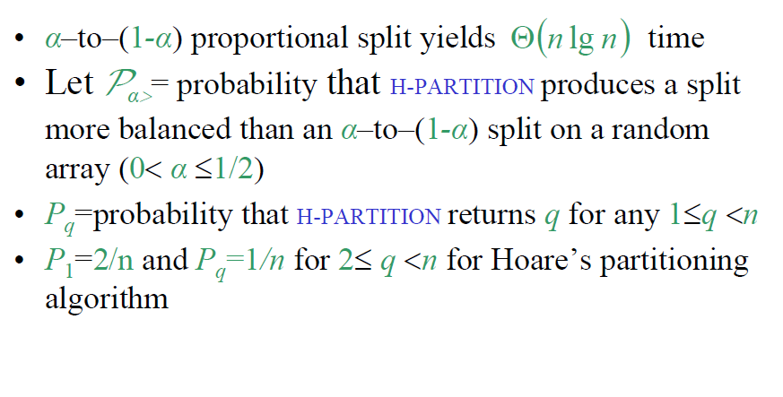
Balanced Partitionings:
Splits of constant proportionality
Analysis of Algorithms

Slide 31
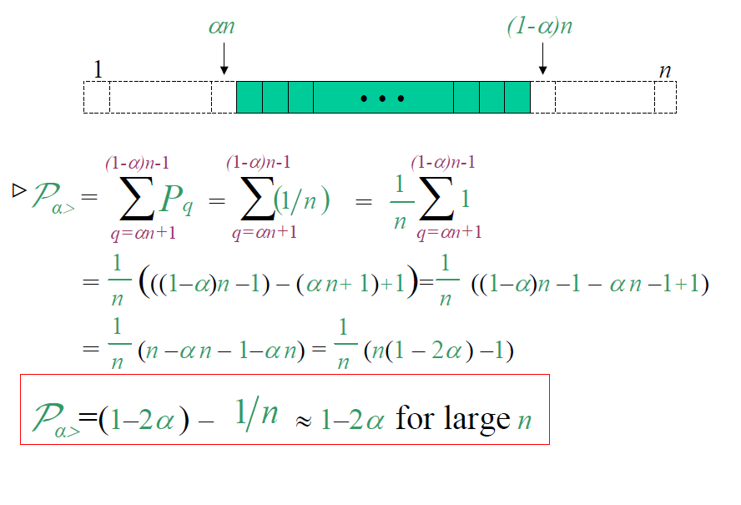
Analysis of Algorithms

Slide 32
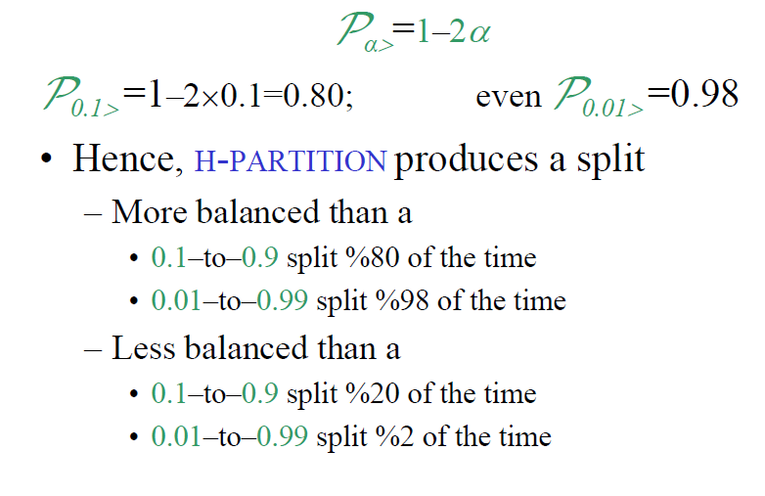
Balanced Partitionings
Analysis of Algorithms

Slide 33
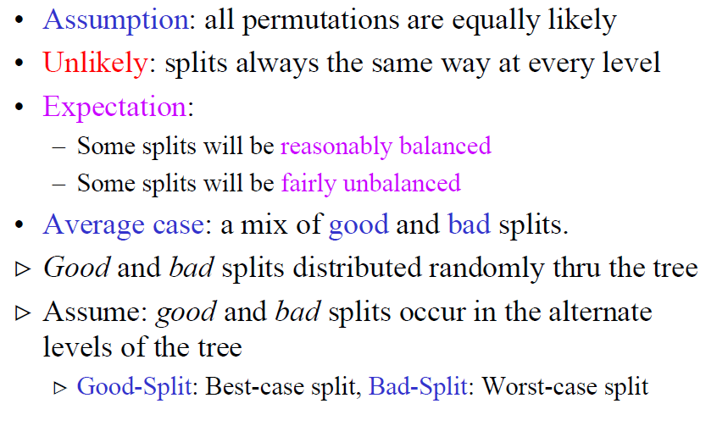
Intuition for the average case
Analysis of Algorithms

Slide 34
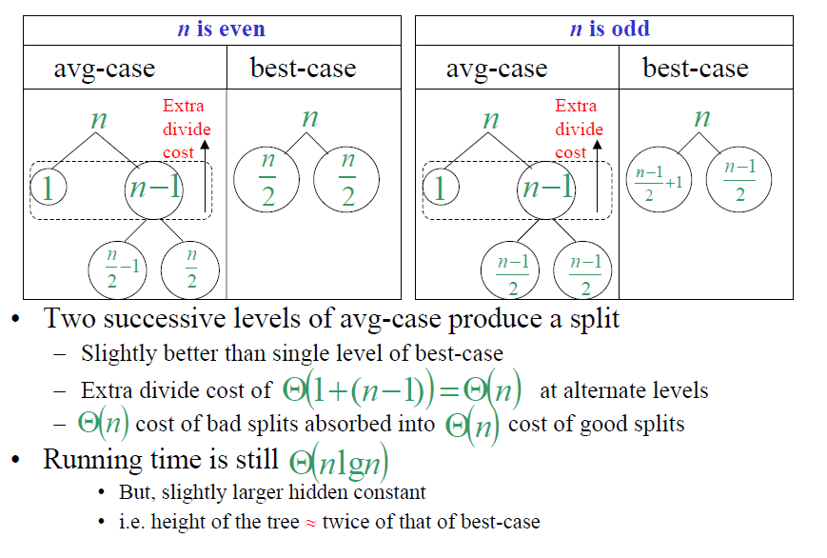
Intuition for the average case
Analysis of Algorithms

Slide 35
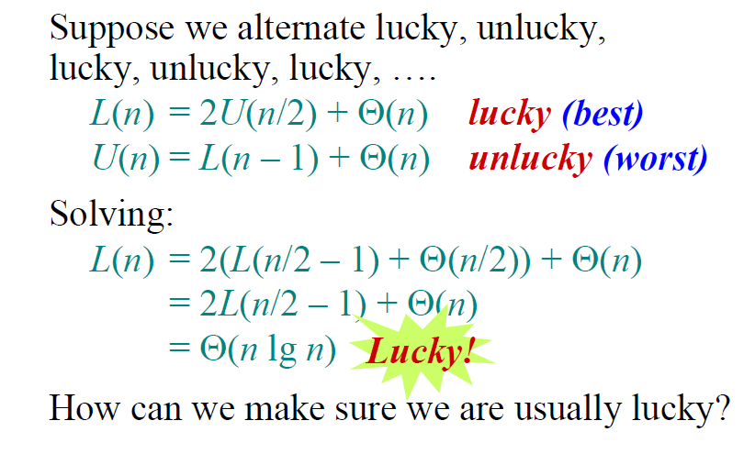
Intuition for the average case
Analysis of Algorithms

Slide 36
Randomized Quicksort
• Average-case assumption:
  – all permutations are equally likely
  – cannot always expect to hold
• Alternative to assuming a distribution: Impose a distribution
  –Partition around a random pivot
• Typically useful when
  – there are many ways that an algorithm can proceed
  – but, it is difficult to determine a way that is guaranteed to be good.
  – Many good alternatives; simply choose one randomly
• Running time is independent of input ordering
• No specific input causes worst-case behavior
• Worst case determined only by output of random number generator
Analysis of Algorithms

Slide 37
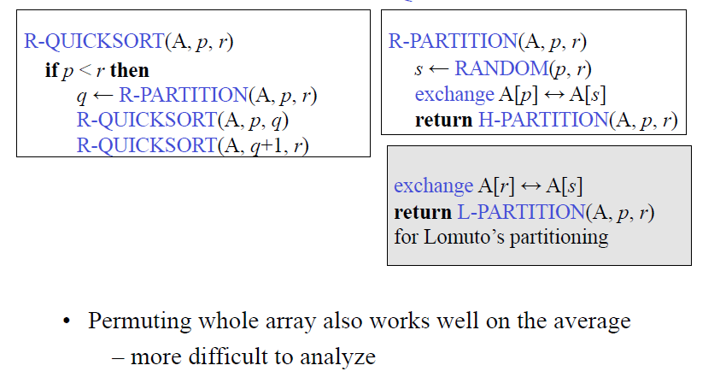
Randomized Quicksort
Analysis of Algorithms

Slide 38
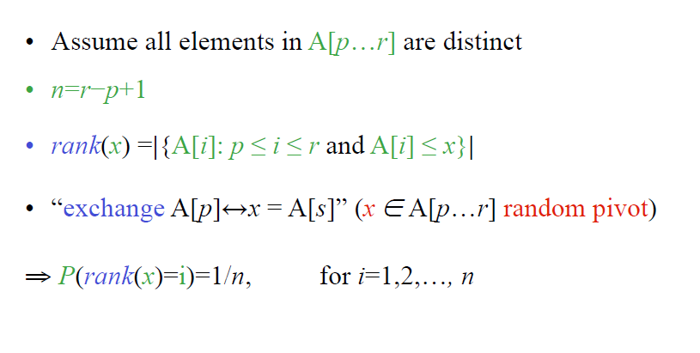
Formal Average - Case Analysis
Analysis of Algorithms

Slide 39
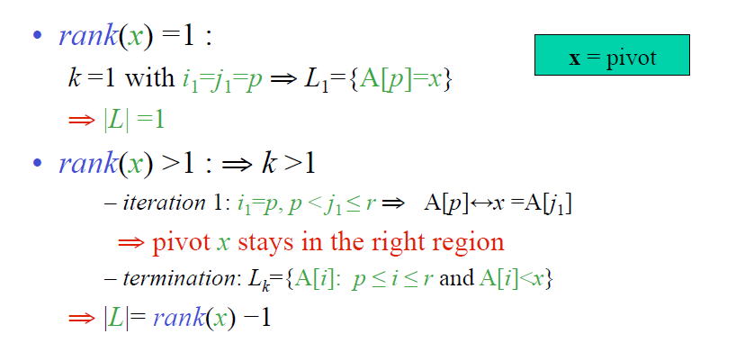
Likelihood of Various Outcomes of
Hoare’s Partitioning Algorithm
Analysis of Algorithms

Slide 40
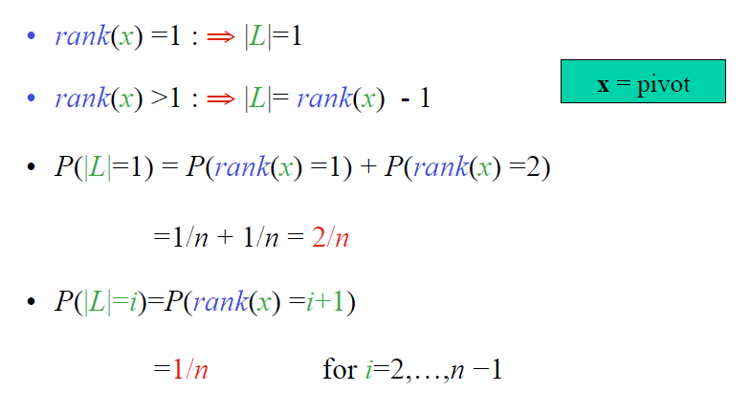
Various Outcomes
Analysis of Algorithms

Slide 41
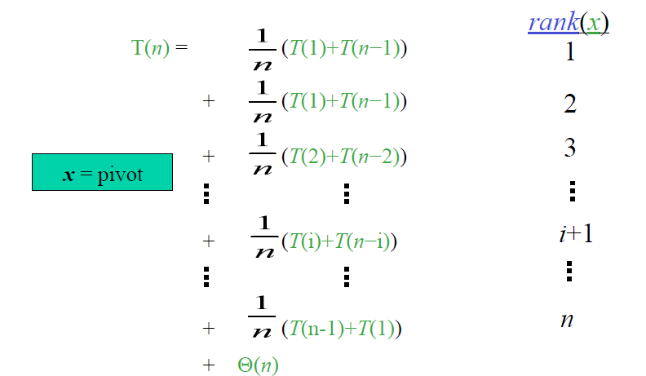
Average - Case Analysis: Recurrence
Analysis of Algorithms

Slide 42
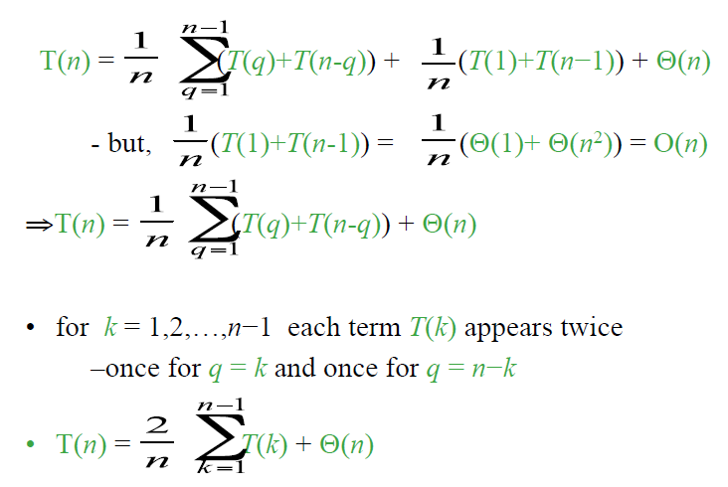
Average - Case Analysis: Recurrence
Analysis of Algorithms

Slide 43
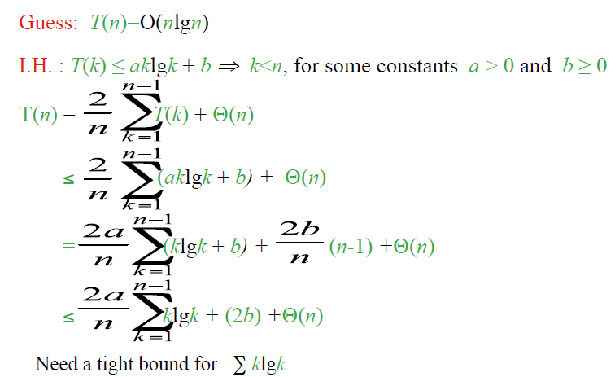
Solving Recurrence: Substitution
Analysis of Algorithms

Slide 44
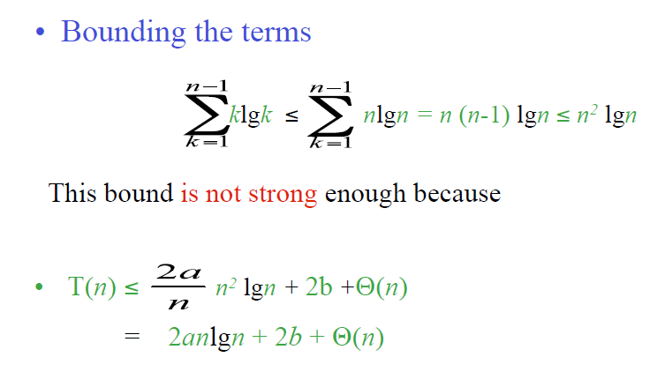
Tight bound for Σ klgk
Analysis of Algorithms

Slide 45
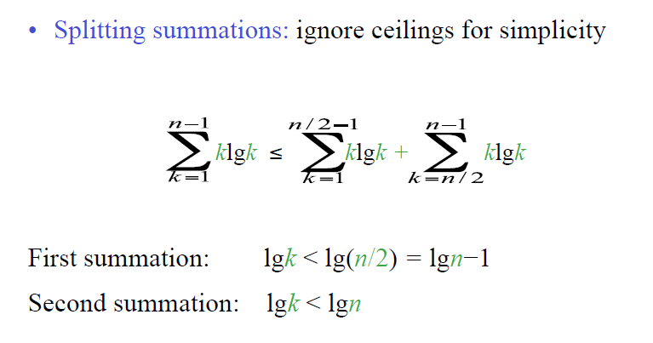
Tight bound for Σ klgk
Analysis of Algorithms

Slide 46
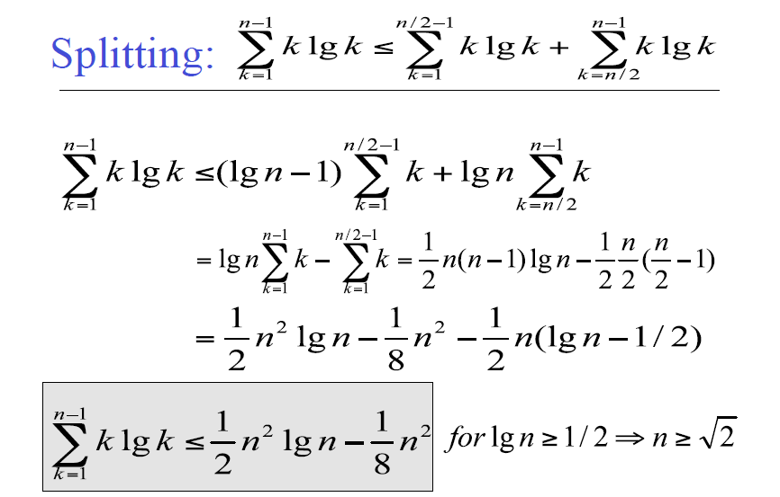
Analysis of Algorithms

Slide 47
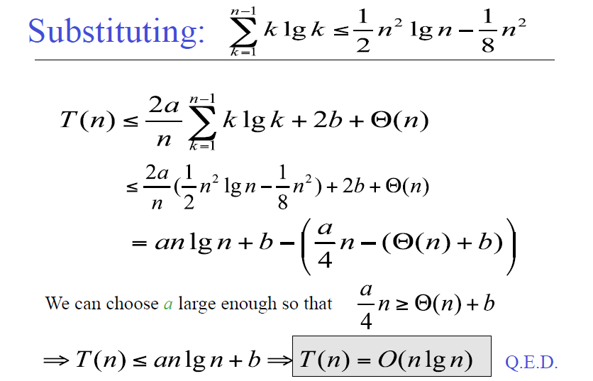
Analysis of Algorithms

