Slide 1
Model Checking Formal Methods Workshop August 18, 2017 Cybersecurity @ Amrita

Slide 2
The Origins of Model Checking (late 1970’s)
Difficulty of carrying out proofs for real programs, with
arrays, pointers, classes, threads, … even with the
aid of automated proof assistants:
- loop invariants, termination proofs, lemmas, etc.
For many systems, a finite-state model can be developed.
Can replace proof-based approach by algorithmic
approach of checking whether the finite-state model (M)
satisfies specification (S) written in temporal logic.
M ⊨ S

Slide 3
Finite State Models
Initial focus of model checking was on systems
amenable to finite-state models:
Hardware Systems
Controllers in Embedded Systems
Programs, conceptually, are not finite state:
- an integer variable can take an unbounded
number of values
- but we can abstract them in many cases, although
state space can be very large

Slide 4
The Need for Models
Every model is an abstraction of reality – omit needless details, keep what is of interest to modeler.
Example: A resistor in an electrical circuit is made of carbon, ceramic, resin, …
Model of Resistor for Electrical Engineer:
R – resistance value
V – voltage across resistor
I – current through resistor
V = I * R
This abstraction is useful because it helps analyze and predict behavior of complex circuits.

Slide 5
Model vs Reality
Finite State Models useful since they helps analyze
global properties without being bogged down in minutiae.
- network communication protocols were early examples of
success in building finite-state models;
- ideally, use model-checking “in the large” and traditional
program verification “in the small”.
But checking the model ≠ checking the actual system.
model may not agree with actual system;
methods that help bridge the gap between model and reality also needed.

Slide 6
Model Checking
Model Checking involves two main steps:
Build a finite-state model of the program or system of interest.
Check whether the model satisfies the
specification.

Slide 7
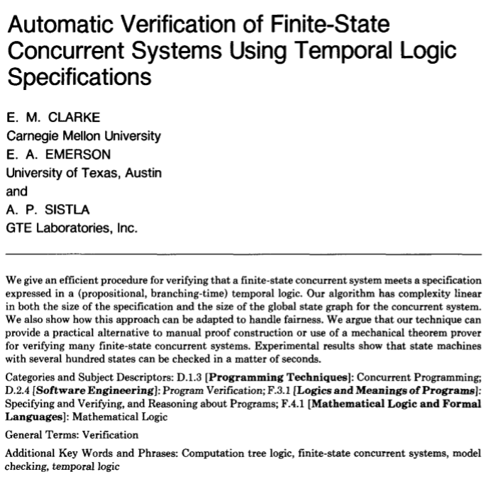
A Classic Paper
Received
the ACM Turing Award
for their work
on Model
Checking

Slide 8
Ex: Two Concurrent Threads
import java.util.concurrent.Semaphore;
class Main {
public static void main(String[] args) {
Semaphore lock = new Semaphore(1);
MyThread p1 = new MyThread(lock);
MyThread p2 = new MyThread(lock);
p1.start();
p2.start();
}
}
Two Concurrent
Threads Synchronizing
with a Semaphore

Slide 9
class MyThread
public class MyThread extends Thread {
Semaphore lock;
MyThread(Semaphore lock) {
this.lock = lock
}
public void run() {
try { while(true) {
not_relevant_code;
lock.acquire();
critical_section
lock.release();
}
} catch(Exception e){}
}
}
N
T
C

Slide 10
Concurrent Program Abstraction
Thread 1
Thread 2
while (true) {
N1;
T1;
[[ C1; ]]
}
while (true) {
N2;
T2;
[[ C2; ]]
}
Critical Region

Slide 11
Finite State Model
N1, N2
T1, N2
N1, T2
C1, N2
T1, T2
N1, C2
C1, T2
T1, C2

Slide 12
Kripke Structure (Model)
The finite state model is also called a Kripke Structure (in modal logic):
<S, R, P>, where
S = finite set of states
R = transition relation (total)
P = labeling function, S → 2^{AP}
AP = atomic propositions

Slide 13
Concurrent Program
The Transition Relation is total because there is
a transition coming out of every state.
The set of Atomic Propositions, AP, is:
{N1, T1, C1, N2, T2, C2}
e.g., C1 means “Thread 1 is in the Critical Region”
The Labeling function S → 2^{AP} is defined by showing
which atomic propositions are true for each state.

Slide 14
Aside: State Explosion Problem
Given n concurrent threads each with m states, the
number of possible states is:
m^{n}
Integer variable with n bits:
2^{n} states
Approaches to deal with this problem:
Symbolic Model Checking (OBDD, 10¹²⁰ states)
Partial Order Reduction (used by SPIN)
Bounded Model Checking (most popular)
Abstraction Refinement
…
Continues to be an active area of research!

Slide 15
The SPIN Tool
Since the number of states can get very large, it is not
feasible to list all the states in providing a finite state
model of some system.
Tools, such as SPIN, adopt a high-level language for
defining the model.
- This language is called PROMELA, for
PROcess MEta LAnguage.
- SPIN stands for Simple Promela INterpreter.
To be discussed by Mr. Jinesh later today …

Slide 16
Simple PROMELA Model
byte x = 0;
proctype A()
{ atomic {
x = x + 1
}
}
proctype B()
{ atomic {
x = x + 2
}
}
init
{ run A(); run B()
}
P: x = 0
Q: x = 1
R: x = 2
S: x = 3
P
Q
R
S

Slide 17
Model Checking
Model Checking involves two main steps:
Build a finite-state model of the program or system of interest.
Check whether the model satisfies the
specification.
Specifications stated in Propositional Temporal Logic.

Slide 18
Branching vs Linear Time Temporal Logic
We can view the state transitions either as
a computation tree or as a set of sequences.
a
a
{abababababab …,
abbabbabababba…,
abbbabbbbbabbbab…,
…
abbbbbbbbbbbbb….
}
b
b
a
b
b
a
b

Slide 19
Computation Tree vs Sets of Sequences
Programmers and system engineers may be more comfortable thinking in terms of Sets of Sequences: timing diagrams, message sequence charts, etc. Also, popular tool SPIN (to be studied) is founded on this model.
But the model-checking with Computation Trees is more efficient than with sets of sequences (to be studied), and this also influenced early adoption of this approach.

Slide 20
Linear-time Logic (LTL)
Propositional Logic over the atomic propositions
AP augmented with four temporal operators:
X p ➔ “p is true in the next state”
F p ➔ “p is true in some future state”
G p ➔ “p is true globally in all states”
p U q ➔ “p is true until q becomes true”

Slide 21
Linear-time Logic (LTL)

Slide 22
Computation Tree Logic (CTL)
Here we attach path quantifiers (A, E) to the temporal operators F, G, and X. A stands for “all” and E stands for “exists”.
CTL temporal operators:
AX, EX, AF, EF, AG, EG
Note: there is also the U operator (“until”)

Slide 23
s |= EX p
s
p
. . . . . . . . . . . . . . . .

Slide 24
s |= AX p
s
p
p
p
. . . . . . . . . . . . . . . .

Slide 25
s |= EF p
s
p
. . . . . . . . . . . . . . . .

Slide 26
s |= AF p
s
p
p
p
p
p
p
p
. . . . . . . . . . . . . . . .

Slide 27
s |= EG p
s
p
p
p
p
p
. . . . . . . . . . . . . . . .
p

Slide 28
s |= AG p
p
s
p
p
p
p
p
p
p
p
p
p
p
p
p
p
p
p
p
p
p
p
p
p
p
. . . . . . . . . . . . . . . .

Slide 29
CTL Semantics

Slide 30
CTL Semantics (cont’d)

Slide 31
Relating A and E Formulae
AF p = ¬ EG ¬p
AG p = ¬ EF ¬p
These equivalences can be easily understood in terms of
the computation tree.
During model-checking, we will see that AF and AG formulae
will be implemented in term of EG and EF (respectively),
thanks to the equivalences.

Slide 32
Checking EF and EG Formulae
For s |= EF p, perform a depth-first search
from the state s until you find a state
where property p is true.
For s |= EG p, find a path from s leading
to a state s’ that is part of a cycle and
p is true globally on this path including
the cycle.
Break complex formula into parts. More later
on a systematic approach …

Slide 33
s |= AF C1 ?
N1, N2
False
s
T1, N2
N1, T2
C1, N2
T1, T2
N1, C2
C1, T2
T1, C2

Slide 34
s |= AG [T1 → AF C1]?
N1, N2
False
s
T1, N2
N1, T2
C1, N2
T1, T2
N1, C2
C1, T2
T1, C2

Slide 35
A More Refined Model
N1, N2
s
T1, N2
N1, T2
T1, T2
T1, T2
C1, N2
N1, C2
C1, T2
T1, C2

Slide 36
Which model should we use?
The model with one state for T1,T2 does not give any
consideration to which request came first. Thus, even
if process P1 tried for the resource before process P2,
P2 could continually overtake T1 and hence AG[T1→AF C1]
is false in this model.
On the other hand, the model with two states for T1,T2
distinguishes whether the request for T1 came before
T2 or not. Hence, here AG[T1→AF C1] is true in this model.

Slide 37
s |= AG[T1 → AF C1]
N1, N2
s
T1, N2
N1, T2
T1, T2
T1, T2
C1, N2
N1, C2
C1, T2
T1, C2

Slide 38
s |= AG ~(C1 /\ C2)
N1, N2
s
T1, N2
N1, T2
T1, T2
T1, T2
C1, N2
N1, C2
C1, T2
T1, C2

Slide 39
JIVE Model Checking
JIVE supports Kripke structures given as a Papyrus
UML state diagrams.
Simple CTL formulae are supported where one of
the temporal operators (EX, EF, EG, AX, AF, AG) appears at the outermost level.
JIVE also extracts a run-time state diagram from a Java program execution trace and checks consistency of design-time and run-time diagrams (to be discussed later).

Slide 40
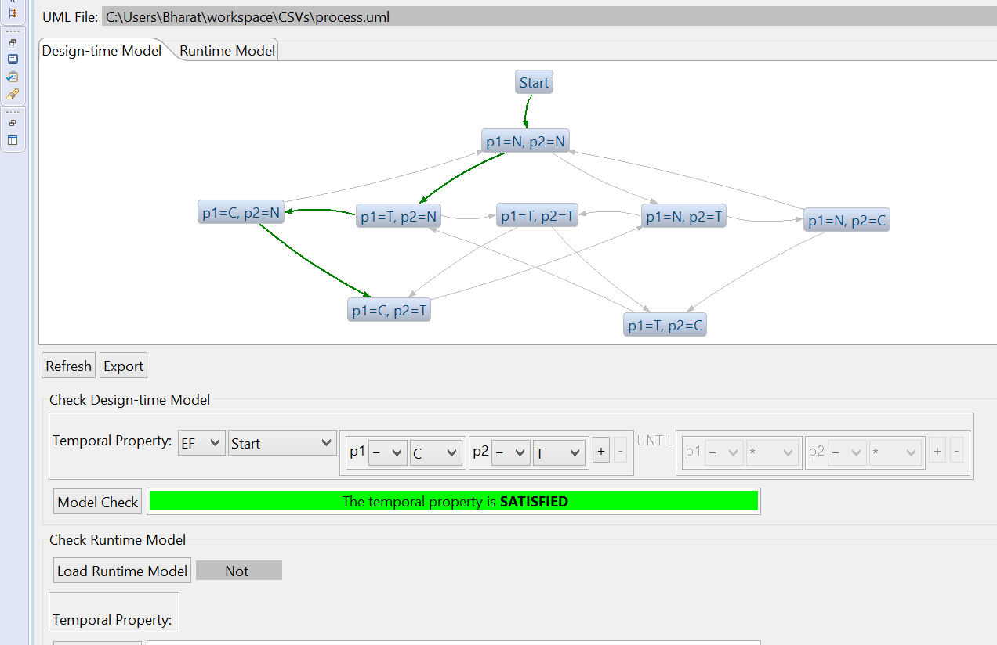
JIVE: EF [C1 /\ T2]

Slide 41
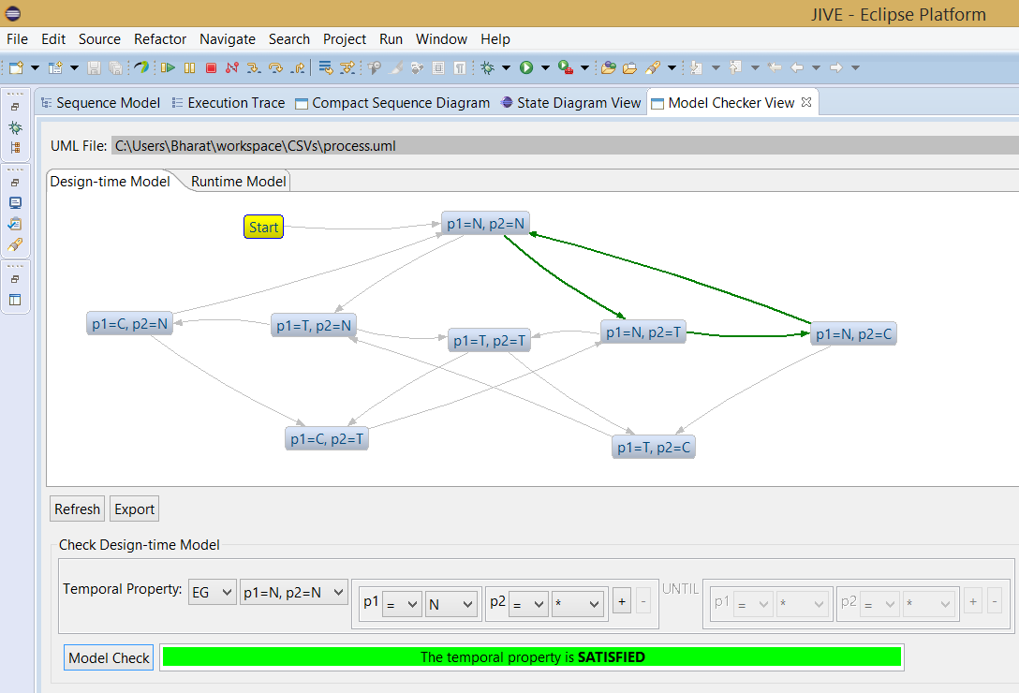
JIVE: EG [N1]

Slide 42
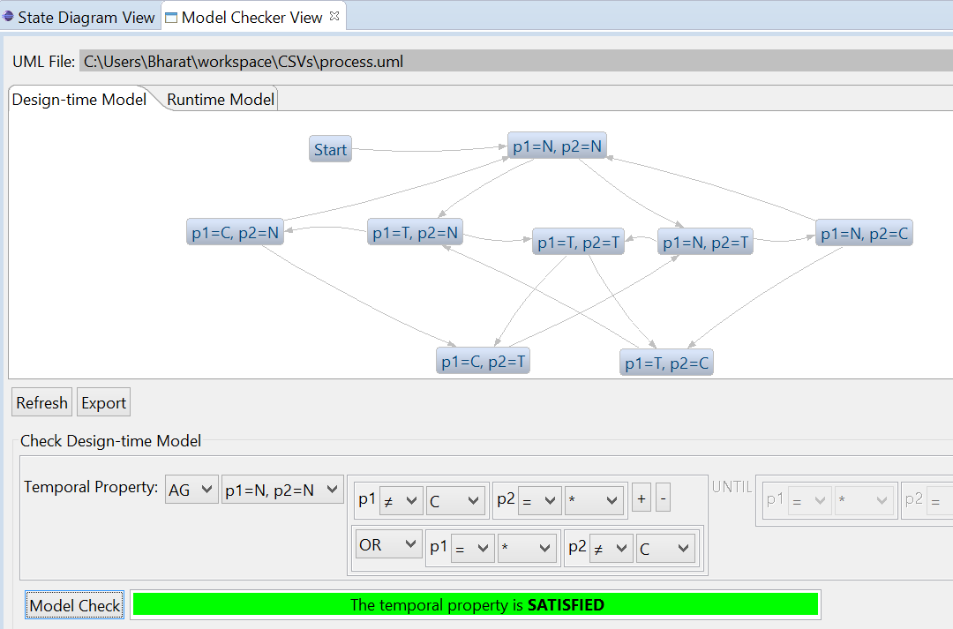
JIVE: AG [~(C1 /\ C2)]

Slide 43
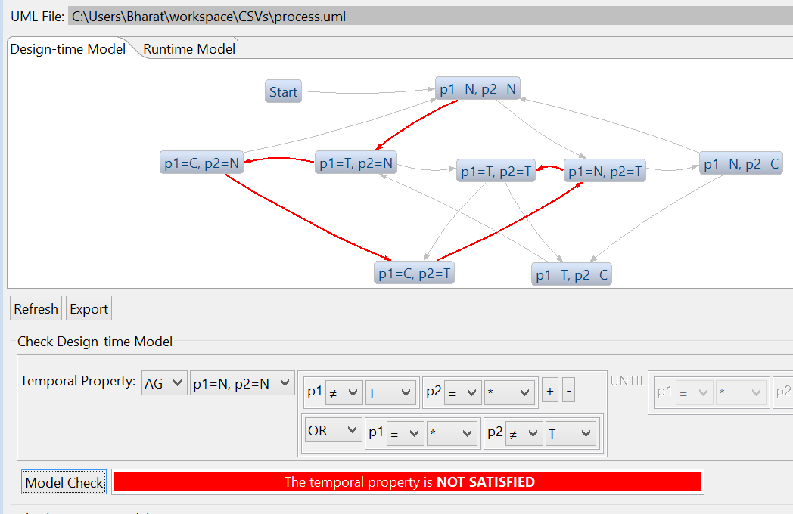
JIVE Property Violation: AG [~(T1 /\ T2)]

Slide 44
Another Example of Model Checking: States of a Microwave Oven

Slide 45
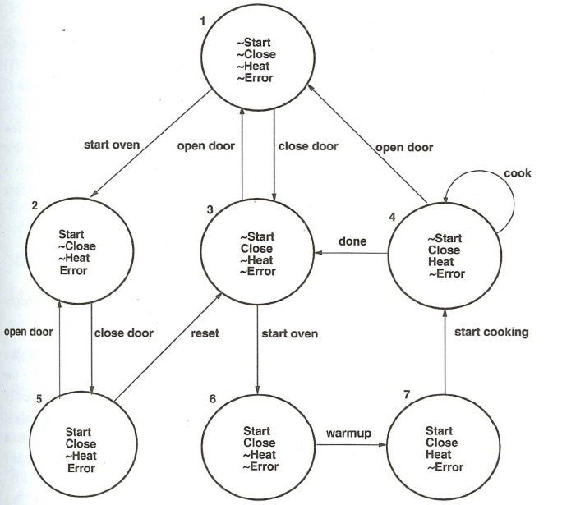
s |= EG [¬Error /\ Heat] ?
States of a Microwave Oven
s
AG [Start →
AF Heat] ?
AG [Start /\
¬Error
→
AF Heat] ?

Slide 46
Model Checking of CTL
1. Check propositional formulae without any temporal operators: EX, EF, EG, AX, AF, AG
2. Replace A formulae by E formulae, and develop
technique for EF and EG formulae:
AF f = ¬ EG ¬f
AG f = ¬ EF ¬f
3. Divide and conquer:
- compute sets for subformulae
- combine sets together

Slide 47
Checking Propositional Formulae
a. To check whether s |= a, where a ∈ AP, the set of atomic propositions:
- just check that a ∈ P(s), where P is the labeling function.
b. To check whether s |= f, where formula f is made up of only atomic propositions and /\, \/, ¬, →:
- just evaluate f using the truth values of the atomic
propositions at state s.

Slide 48
s |= Close /\ (¬Start \/ Heat)
s

Slide 49
Checking EF f
S₁ = {s | s |= f}.
2. S₂ = {t | s ∈ S₁ /\ R(t, s)} U S₁, where R is the
transition relation.
3. S₃ = {t | s ∈ S₂ /\ R(t, s)} U S₂
…
n. S_{n} = S_{n-1}
EF f = S_{n}

Slide 50
Explanation of EF f
S_{n-1}
S_{n-2}
…
Edge in
Transition Graph
State in
Transition Graph
S₃
S₂
S₁
f
f
f
f
f
f

Slide 51
Checking EG f
SCC = { s | s |= f /\ s is in some strongly connected
component in the transition graph}
S1 = { t | R(t, s) /\ t |= f /\ s ∈ SCC /\ t ∈ SCC }
U SCC
2. S2 = { t | R(t, s) /\ t |= f /\ s ∈ S1} U S1
…
n. S_{n} = S_{n-1}
EG f = S_{n}

Slide 52
Explanation of EG f
S_{n-1}
f
f
f
f
f
f
f
S_{n-2}
…
State in
Transition Graph
Edge in
Transition Graph
S₁
f
f
f
f
f
f
f
f
f
SCC
f
f
f
f
f
f
f

Slide 53
Check: AG[Error → EG[Close]]
Convert AG to EF:
¬ EF ¬[Error → EG[Close]]
≡ ¬ EF ¬[¬Error \/ EG[Close]]
≡ ¬ EF [Error /\ ¬ EG[Close]]
2. Compute ¬ EG[Close]
…

Slide 54
Check: ¬ EF [Error /\ ¬ EG[Close]]
2. ¬ EG[Close]
a. EG [Close]
= {5, 3, 6, 7, 4}
b. ¬ EG [Close]
= {1, 2}

Slide 55
Check: ¬ EF [Error /\ ¬ EG[Close]]
2. ¬ EG[Close]
= {1, 2}
3. Error
= {2, 5}
4. Error /\ ¬ EG[Close]
= {2, 5} ∩ {1,2}
= {2}

Slide 56
Check: ¬ EF [Error /\ ¬ EG[Close]]
4. Error /\ ¬ EG[Close]
= {2}
5. EF {2}
= {1,2,3,4,5,6,7}
6. ¬ EF {2}
= {}
AG[Error → EG[Close]] ≡ False

Slide 57
Complexity of CTL Model Checking
Theorem (Clarke, Emerson, Sistla 1986):
Given a Kripke Structure M = <S, R, P>, a state s ∈ S, and a CTL formula f,
M, s |= f
can be checked in time O(|f| x (|S| + |R|)).
Note: SCC can be constructed in time O(|S| + |R|), using
Tarjan’s algorithm.

Slide 58
Linear-time Logic (LTL)
Propositional Logic over the atomic propositions
AP augmented with four temporal operators:
X p ➔ “p is true in the next state”
F p ➔ “p is true in some future state”
G p ➔ “p is true globally in all states”
p U q ➔ “p is true until q becomes true”

Slide 59
Linear-time Logic (LTL)
An LTL formula is true for a state transition graph only if it is true for every execution trace of the state transition graph.

Slide 60
Meaning of LTL Formula
suffix

Slide 61
p,… |= G [T1 → F C1]
N1, N2
p
T1, N2
N1, T2
T1, T2
T1, T2
C1, N2
N1, C2
C1, T2
T1, C2

Slide 62
Comparison of LTL and CTL
For many practical problems, LTL and CTL are
both suitable for expressing the desired properties.
In CTL, a formula f is true or false at some state,
i.e., s |= f
In LTL, a formula f is true or false for some path,
i.e., p |= f
But are these two approaches equivalent?

Slide 63
LTL: ‘Sometime’ is ‘Not Never’
In LTL, ‘sometime p’ can be defined as F p.
- this means that, for every infinite path, p is true
somewhere along the path.
In LTL, F p ≡ ¬G¬p
therefore, ‘sometime’ is equivalent to ‘not never’

Slide 64
CTL: ‘Sometime’ is not ‘Not Never’
In CTL, ‘not never p’ is defined as ¬AG ¬p.
Note: ¬EG ¬p would not be correct for ‘not never’.
But, ¬AG ¬p ≡ EF p
p is true somewhere along some path
But LTL ‘sometime’ requires p to be true somewhere along every path, i.e., AF p
Hence CTL ‘sometime’ is not equivalent to ‘not never’.

Slide 65
LTL formulae must be true for all paths. Hence the CTL operators EX, EF, and EG cannot always be translated into LTL. - there are exceptions when negation is used; - for example, ¬EF ¬p ≡ AG p, and we can express AG p in LTL as G p.
Comparing LTL and CTL

Slide 66
Comparing LTL and CTL
s0
s1
s2
p
p
FG p is true in state s0 but AFAG p is not true:
Every infinite sequence will end with an infinite
sequence of p’s, hence FG p is true (LTL)
But the computation tree will include s1 and
p is false at s1 (CTL) – see next slide.

Slide 67
s |= AFAG p
s
p
p
p
p
p
p
p
p
p
p
. . . . . . . . . . . . . . . .

Slide 68
Explanation for s |= AFAG p
Recall that s0 |= AF f if for every infinite path s0, s1, s2, …, there is some k ≥ 0 such sk |= f.
In the present example, the formula f = AG p.
The figure on the previous slide shows one path starting from s, namely, the leftmost spine, along which there is no state sk such that sk |= AG p.
Hence, s |= AFAG p.

Slide 69
Final Remarks
Model Checking is a mature technology with
proven success in a number of domains.
Still, many research problems remain, both
in terms theory, applications, implementation.
Variations:
Probabilistic Model Checking (as in PRISM)
Real-time Model Checking (as in UPPAAL)
Run-time Model Checking (as in JIVE)

