Slide 1

Chapter 8
Testing the
Programs
Shari L. Pfleeger
Joann M. Atlee
4th Edition
4th Edition

Slide 2
Contents
8.1 Software Faults and Failures
8.2 Testing Issues
8.3 Unit Testing
8.4 Integration Testing
8.5 Testing Object Oriented Systems
8.6 Test Planning
8.7 Automated Testing Tools
8.8 When to Stop Testing
8.9 Information System Example
8.10 Real Time Example
8.11 What this Chapter Means for You

Slide 3
Chapter 8 Objectives
Types of faults and how to clasify them
The purpose of testing
Unit testing
Integration testing strategies
Test planning
When to stop testing

Slide 4
8.1 Software Faults and Failures
Why Does Software Fail?
Wrong requirement: not what the customer wants
Missing requirement
Requirement impossible to implement
Faulty design
Faulty code
Improperly implemented design

Slide 5
8.1 Software Faults and Failures Objective of Testing
Objective of testing: discover faults
A test is successful only when a fault is discovered
  Fault identification is the process of determining what fault caused the failure
  Fault correction is the process of making changes to the system so that the faults are removed

Slide 6
8.1 Software Faults and Failures
Types of Faults
Algorithmic fault
Computation and precision fault
  a formula’s implementation is wrong
Documentation fault
  Documentation doesn’t match what program does
Capacity or boundary faults
  System’s performance not acceptable when certain limits are reached
Timing or coordination faults
Performance faults
  System does not perform at the speed prescribed
Standard and procedure faults

Slide 7
8.1 Software Faults and Failures
Typical Algorithmic Faults
An algorithmic fault occurs when a component’s algorithm or logic does not produce proper output
  Branching too soon
  Branching too late
  Testing for the wrong condition
  Forgetting to initialize variable or set loop invariants
  Forgetting to test for a particular condition
  Comparing variables of inappropriate data types
Syntax faults

Slide 8
8.1 Software Faults and Failures
Orthogonal Defect Classification
Fault Type | Meaning
Function | Fault that affects capability, end-user interface, product interface with hardware architecture, or global data structure
Interface | Fault in interacting with other component or drivers via calls, macros, control, blocks or parameter lists
Checking | Fault in program logic that fails to validate data and values properly before they are used
Assignment | Fault in data structure or code block initialization
Timing/serialization | Fault in timing of shared and real-time resources
Build/package/merge | Fault that occurs because of problems in repositories management changes, or version control
Documentation | Fault that affects publications and maintenance notes
Algorithm | Fault involving efficiency or correctness of algorithm or data structure but not design

Slide 9
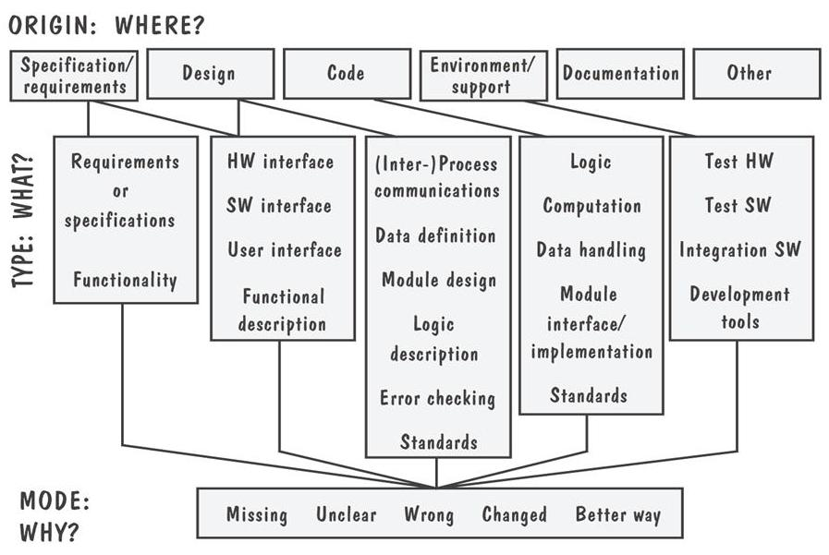
8.1 Software Faults and Failures
Sidebar 8.1 Hewlett-Packard’s Fault Classification

Slide 10
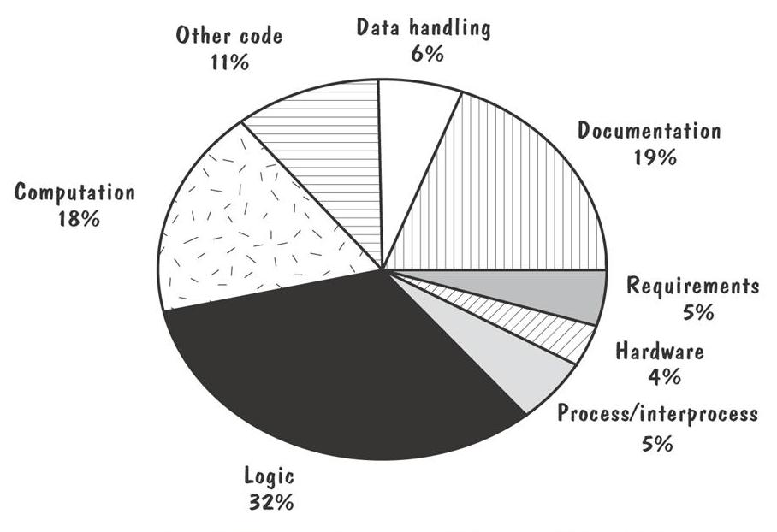
8.1 Software Faults and Failures
Sidebar 8.1 Faults for one Hewlett-Packard Division

Slide 11
8.2 Testing Issues
Testing Organization
Module testing, component testing, or unit testing
Integration testing
Function testing
Performance testing
Acceptance testing
Installation testing

Slide 12
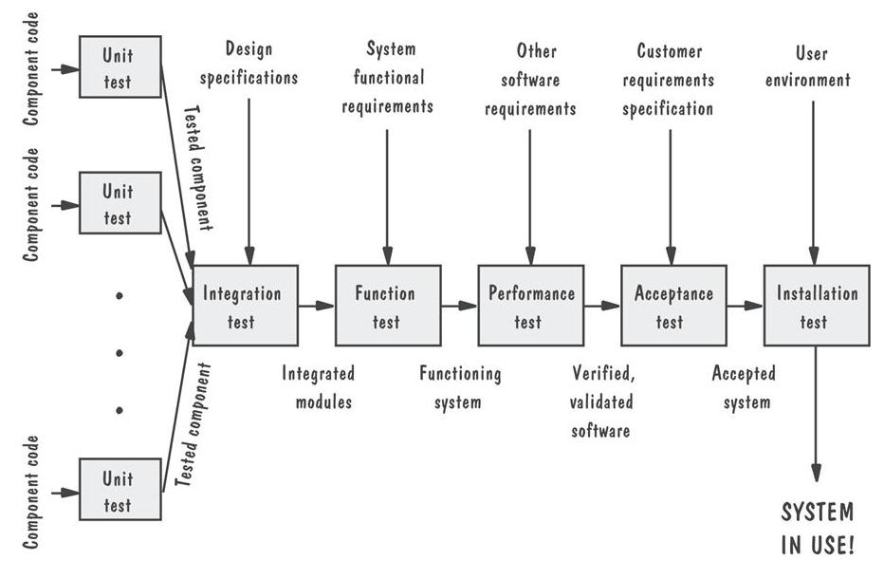
8.2 Testing Issues
Testing Organization Illustrated

Slide 13
8.2 Testing Issues
Attitude Toward Testing
Egoless programming: programs are viewed as components of a larger system, not as the property of those who wrote them

Slide 14
8.2 Testing Issues
Who Performs the Test?
Independent test team
  avoid conflict
  improve objectivity
  allow testing and coding concurrently

Slide 15
8.2 Testing Issues
Views of the Test Objects
Closed box or black box: functionality of the test objects
Clear box or white box: structure of the test objects

Slide 16
8.2 Testing Issues
White Box
Advantage
  free of internal structure’s constraints
Disadvantage
  not possible to run a complete test

Slide 17
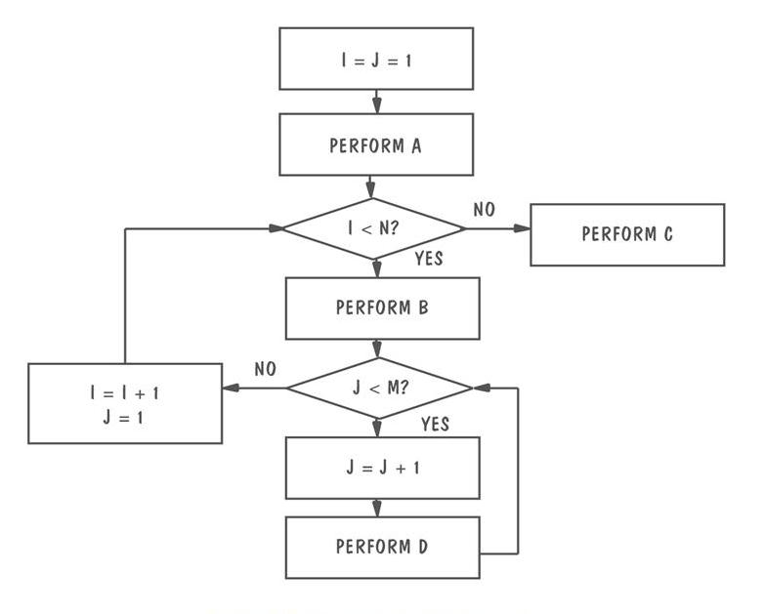
8.2 Testing Issues
Clear Box
Example of logic structure

Slide 18
8.2 Testing Issues
Sidebar 8.2 Box Structures
Black box: external behavior description
State box: black box with state information
White box: state box with a procedure

Slide 19
8.2 Testing Issues
Factors Affecting the Choice of Test Philosophy
The number of possible logical paths
The nature of the input data
The amount of computation involved
The complexity of algorithms

Slide 20
8.3 Unit Testing
Code Review
Code walkthrough
Code inspection

Slide 21
8.3 Unit Testing
Typical Inspection Preparation and Meeting Times
Development Artifact | Preparation Time | Meeting Time
Requirement Document | 25 pages per hour | 12 pages per hour
Functional specification | 45 pages per hour | 15 pager per hour
Logic specification | 50 pages per hour | 20 pages per hour
Source code | 150 lines of code per hour | 75 lines of code per hour
User documents | 35 pages per hour | 20 pages per hour

Slide 22
8.3 Unit Testing
Fault Discovery Rate
Discovery Activity | Fault Found per Thousand Lines of Code
Requirements review | 2.5
Design Review | 5.0
Code inspection | 10.0
Integration test | 3.0
Acceptance test | 2.0

Slide 23
8.3 Unit Testing
Sidebar 8.3 The Best Team Size for Inspections
The preparation rate, not the team size, determines inspection effectiveness
The team’s effectiveness and efficiency depend on their familiarity with their product

Slide 24
8.3 Unit Testing
Proving Code Correct
Formal proof techniques
Symbolic execution
Automated theorem-proving

Slide 25
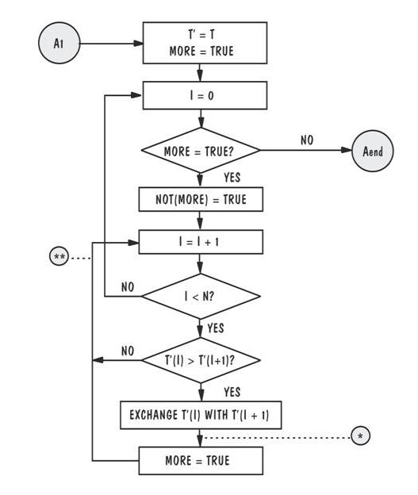
8.3 Unit Testing
Proving Code Correct: An Illustration

Slide 26
8.3 Unit Testing
Testing versus Proving
Proving: hypothetical environment
Testing: actual operating environment

Slide 27
8.3 Unit Testing
Steps in Choosing Test Cases
Determining test objectives
Selecting test cases
Defining a test

Slide 28
8.3 Unit Testing
Test Thoroughness
Statement testing
Branch testing
Path testing
Definition-use testing
All-uses testing
All-predicate-uses/some-computational-uses testing
All-computational-uses/some-predicate-uses testing

Slide 29
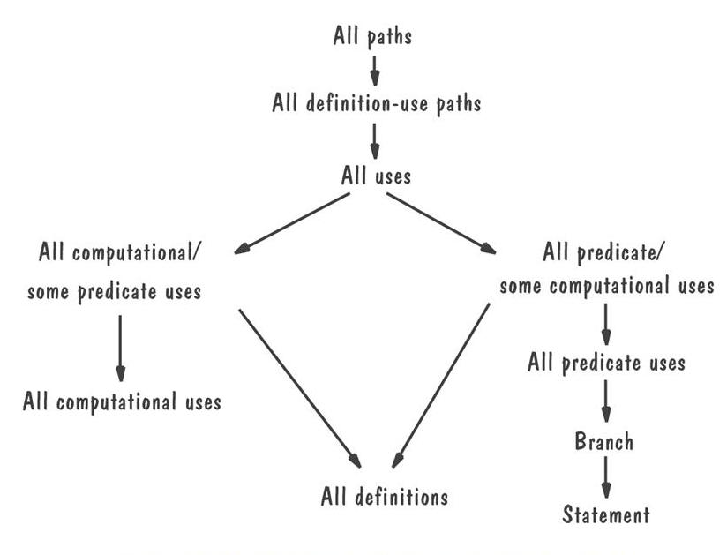
8.3 Unit Testing
Relative Strengths of Test Strategies

Slide 30
8.3 Unit Testing
Comparing Techniques
Fault discovery Percentages by Fault Origin
Discovery Techniques | Requirements | Design | Coding | Documentation
Prototyping | 40 | 35 | 35 | 15
Requirements review | 40 | 15 | 0 | 5
Design Review | 15 | 55 | 0 | 15
Code inspection | 20 | 40 | 65 | 25
Unit testing | 1 | 5 | 20 | 0

Slide 31
8.3 Unit Testing
Comparing Techniques (continued)
Effectiveness of fault-discovery techniques
 | Requirements Faults | Design Faults | Code Faults | Documentation Faults
Reviews | Fair | Excellent | Excellent | Good
Prototypes | Good | Fair | Fair | Not applicable
Testing | Poor | Poor | Good | Fair
Correctness Proofs | Poor | Poor | Fair | Fair

Slide 32
8.3 Unit Testing
Sidebar 8.4 Fault Discovery Efficiency at Contel IPC
17.3% during inspections of the system design
19.1% during component design inspection
15.1% during code inspection
29.4% during integration testing
16.6% during system and regression testing
0.1% after the system was placed in the field

Slide 33
8.4 Integration Testing
Bottom-up
Top-down
Big-bang
Sandwich testing
Modified top-down
Modified sandwich

Slide 34
8.4 Integration Testing
Terminology
Component Driver: a routine that calls a particular component and passes a test case to it
Stub: a special-purpose program to simulate the activity of the missing component

Slide 35
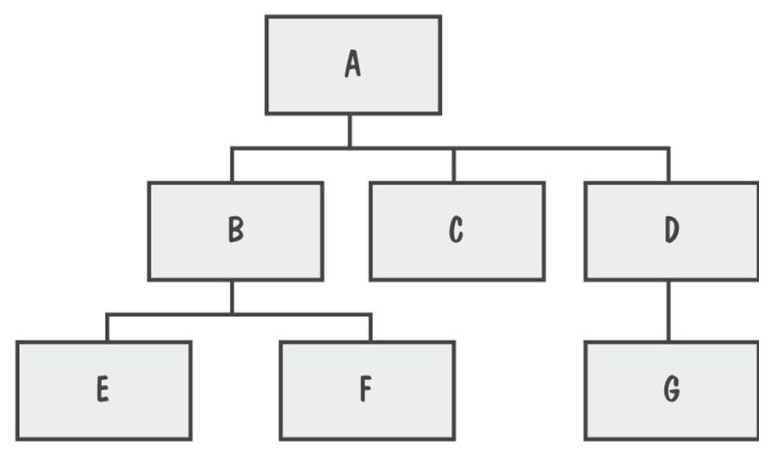
8.4 Integration Testing
View of a System
System viewed as a hierarchy of components

Slide 36
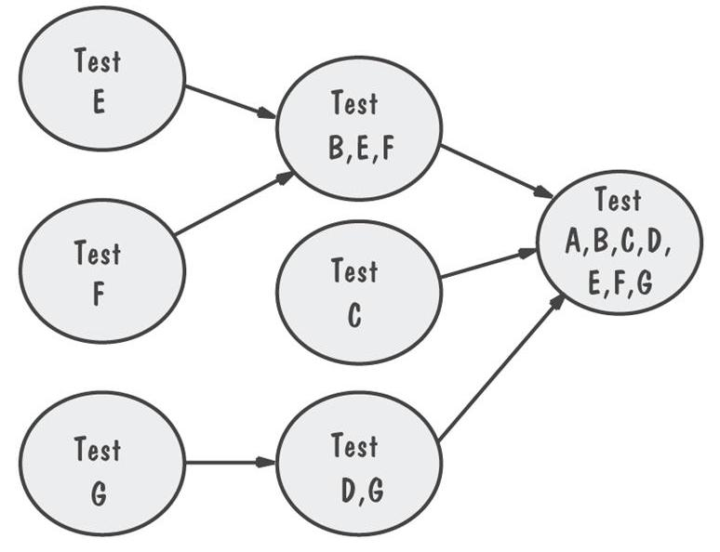
8.4 Integration Testing
Bottom-Up Integration Example
The sequence of tests and their dependencies

Slide 37
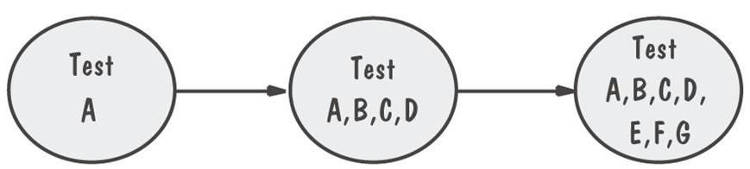
8.4 Integration Testing
Top-Down Integration Example
Only A is tested by itself

Slide 38
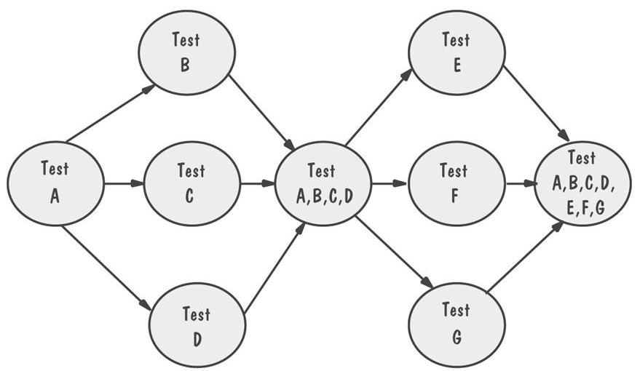
8.4 Integration Testing
Modified Top-Down Integration Example
Each level’s components individually tested before the merger takes place

Slide 39
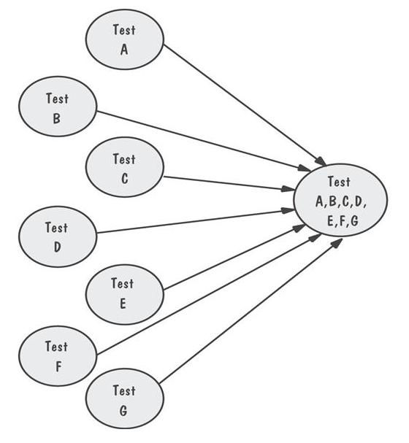
8.4 Integration Testing
Bing-Bang Integration Example
Requires both stubs and drivers to test the independent components

Slide 40
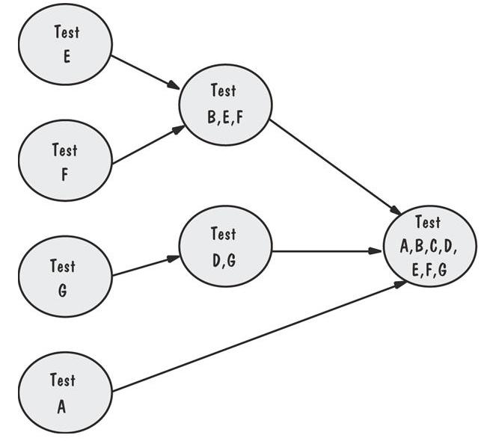
8.4 Integration Testing
Sandwich Integration Example
Viewed system as three layers

Slide 41
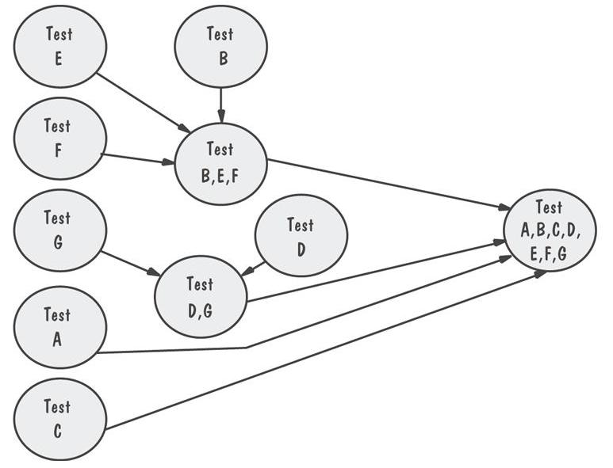
8.4 Integration Testing
Modified Sandwich Integration Example
Allows upper-level components to be tested before merging them with others

Slide 42
8.4 Integration Testing
Comparison of Integration Strategies
 | Bottom-up | Top-down | Modified top-down | Bing-bang | Sandwich | Modified sandwich
Integration | Early | Early | Early | Late | Early | Early
Time to basic working program | Late | Early | Early | Late | Early | Early
Component drivers needed | Yes | No | Yes | Yes | Yes | Yes
Stubs needed | No | Yes | Yes | Yes | Yes | Yes
Work parallelism at beginning | Medium | Low | Medium | High | Medium | High
Ability to test particular paths | Easy | Hard | Easy | Easy | Medium | Easy
Ability to plan and control sequence | Easy | Hard | Hard | Easy | Hard | hard

Slide 43
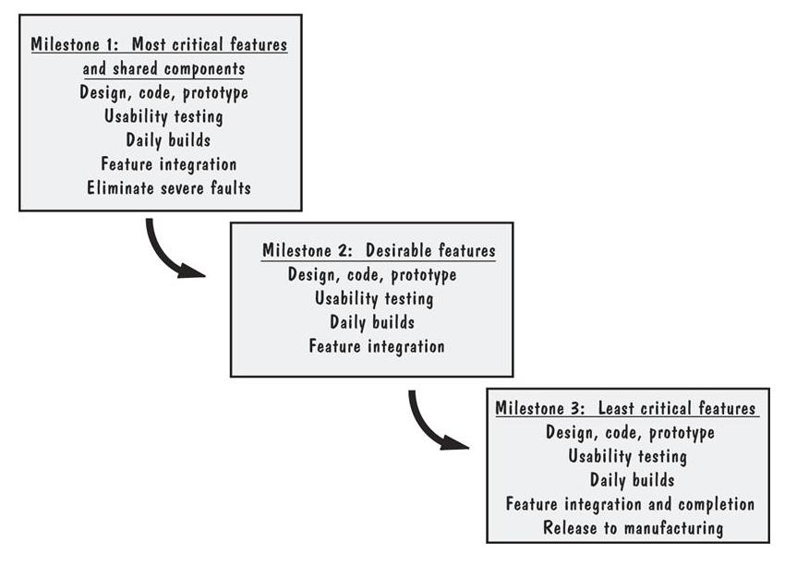
8.4 Integration Testing
Sidebar 8.5 Builds at Microsoft
The feature teams synchronize their work by building the product and finding and fixing faults on a daily basis

Slide 44
8.5 Testing Object-Oriented Systems
Questions at the Beginning of Testing OO System
Is there a path that generates a unique result?
Is there a way to select a unique result?
Are there useful cases that are not handled?

Slide 45
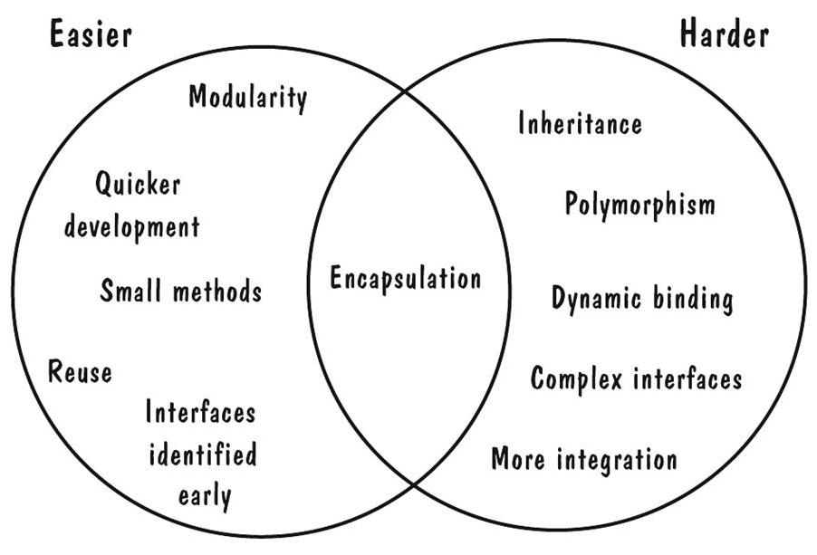
8.5 Testing Object-Oriented Systems
Easier and Harder Parts of Testing OO Systems
OO unit testing is less difficult, but integration testing is more extensive

Slide 46
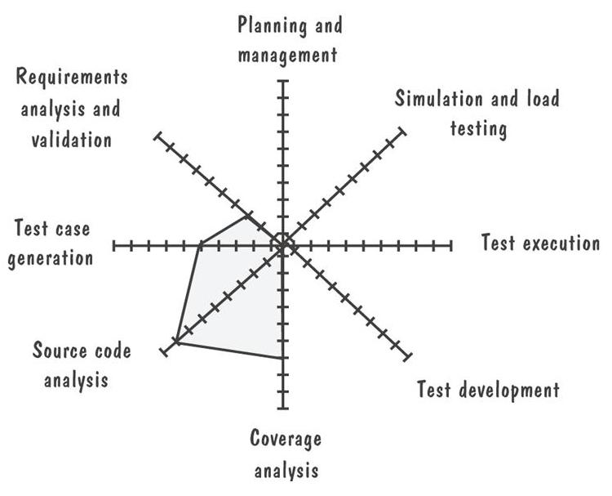
8.5 Testing Object-Oriented Systems
Differences Between OO and Traditional Testing
The farther the gray line is out, the more the difference

Slide 47
8.6 Test Planning
Establish test objectives
Design test cases
Write test cases
Test test cases
Execute tests
Evaluate test results

Slide 48
8.6 Test Planning
Purpose of the Plan
Test plan explains
  who does the testing
  why the tests are performed
  how tests are conducted
  when the tests are scheduled

Slide 49
8.6 Test Planning
Contents of the Plan
What the test objectives are
How the test will be run
What criteria will be used to determine when the testing is complete

Slide 50
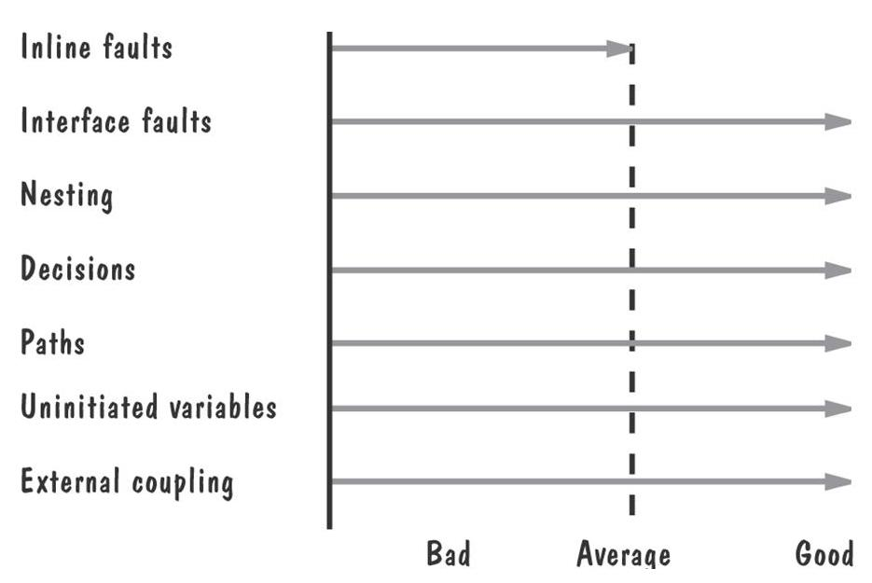
8.7 Automated Testing Tools
Code analysis
  Static analysis
    code analyzer
    structure checker
    data analyzer
    sequence checker
Output from static analysis

Slide 51
8.7 Automated Testing Tools (continued)
Dynamic analysis
  program monitors: watch and report program’s behavior
Test execution
  Capture and replay
  Stubs and drivers
  Automated testing environments
Test case generators

Slide 52
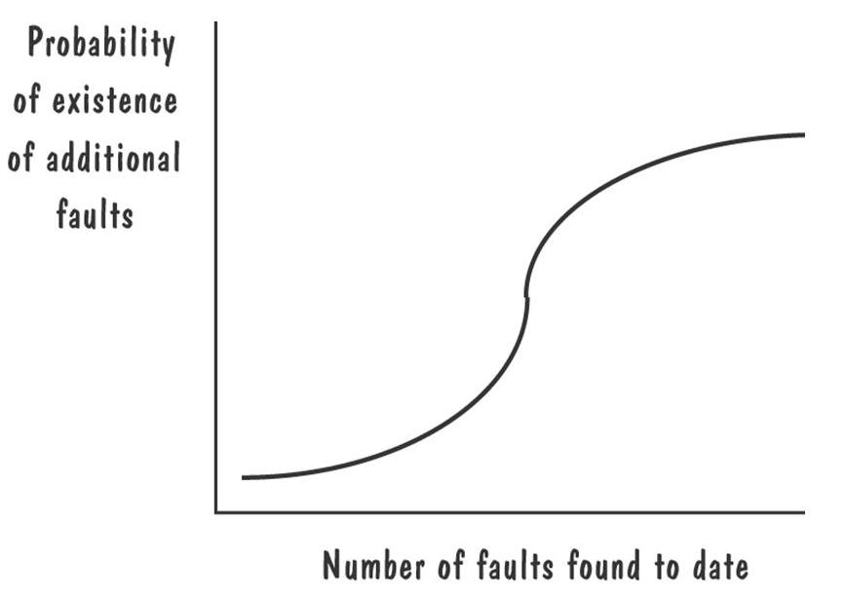
8.8 When to Stop Testing
More faulty?
Probability of finding faults during the development

Slide 53
8.8 When to Stop Testing
Stopping Approaches
Coverage criteria
Fault seeding
    detected seeded Faults ₌ detected nonseeded faults
    total seeded faults total nonseeded faults
Confidence in the software, C
    = 1, if n >N
    = S/(S – N + 1) if n ≤ N

Slide 54
8.8 When to Stop Testing
Identifying Fault-Prone Code
Track the number of faults found in each component during the development
Collect measurement (e.g., size, number of decisions) about each component
Classification trees: a statistical technique that sorts through large arrays of measurement information and creates a decision tree to show best predictors
  A tree helps in deciding the which components are likely to have a large number of errors

Slide 55
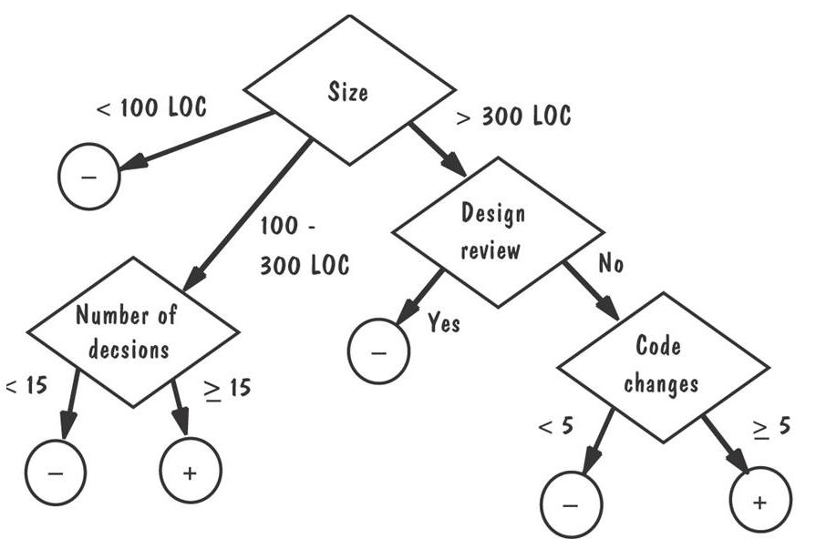
8.8 When to Stop Testing
An Example of a Classification Tree

Slide 56
8.9 Information Systems Example
Piccadilly System
Using data-flow testing strategy rather than structural
  Definition-use testing

Slide 57
8.10 Real-Time Example
The Ariane-5 System
The Ariane-5’s flight control system was tested in four ways
  equipment testing
  on-board computer software testing
  staged integration
  system validation tests
The Ariane-5 developers relied on insufficient reviews and test coverage

Slide 58
8.11 What this Chapter Means for You
It is important to understand the difference between faults and failures
The goal of testing is to find faults, not to prove correctness

