Slide 1
How to Build and
Use a Beowulf Cluster
Prabhaker Mateti
Wright State University

Slide 2
Beowulf Cluster
Parallel computer built from commodity hardware, and open source software
Beowulf Cluster characteristics
  Internal high speed network
  Commodity of the shelf hardware
  Open source software and OS
  Support parallel programming such as MPI, PVM

Slide 3
Beowulf Project
Originating from Center of Excellence and Information Systems Sciences(CESDIS) at NASA Goddard Space Center by Dr. Thomas Sterling, Donald Becker
“Beowulf is a project to produce the software for off-the-shelf clustered workstations based on commodity PC-class hardware, a high-bandwidth internal network, and the Linux operating system.”

Slide 4
Why Is Beowulf Good?
Low initial implementation cost
  Inexpensive PCs
  Standard components and Networks
  Free Software: Linux, GNU, MPI, PVM
Scalability: can grow and shrink
Familiar technology, easy for user to adopt the approach, use and maintain system.

Slide 5

Beowulf is getting bigger
Size of typical Beowulf systems increasing rapidly

Slide 6
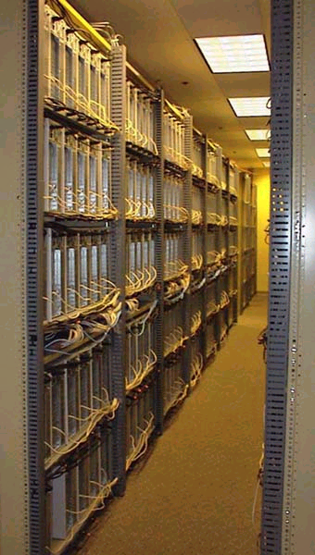
Biggest Beowulf?
1000 nodes Beowulf Cluster System
Used for genetic algorithm research by John Coza, Stanford University
http://www.genetic-programming.com/

Slide 7
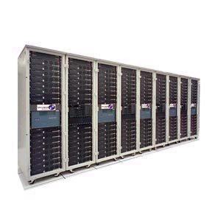
Chiba City, Argonne National Laboratory
“Chiba City is a scalability testbed for the High Performance Computing communities to explore the issues of
  scalability of large scientific application to thousands of nodes
  systems software and systems management tools for large-scale systems
  scalability of commodity technology”
  http://www.mcs.anl/chiba

Slide 8
PC Components
Motherboard and case
CPU and Memory
Hard Disk
CD ROM, Floppy Disk
Keyboard, monitor
Interconnection network

Slide 9
Mother Board
Largest cache as possible ( 512 K at least)
FSB >= 100 MHz
Memory expansion
  Normal board can go up to 512 Mbytes
  Some server boards can expand up to 1-2 Gbytes
  Number and type of slots

Slide 10
Mother Board
Built-in options?
  SCSI, IDE, FLOPPY, SOUND USB
  More reliable, less costly, but inflexible
Front-side bus speed, as fast as possible
Built-in hardware monitor
Wake-on LAN for on demand startup/shutdown
Compatibility with Linux.

Slide 11
CPU
Intel, CYRIX, 6x86, AMD – all OK
Celeron processor seems to be a good alternative in many cases
Athlon is a new emerging high performance processors

Slide 12
Memory
100MHz SDRAM is almost obsolete
133 MHz common
Rambus

Slide 13
Hard Disk
IDE
  inexpensive and fast
  controller built-in on board, typically
  large capacity 75GB available
  ATA-66 to ATA 100
SCSI
  generally faster than IDE
  more expensive

Slide 14
RAID Systems and Linux
RAID is a technology that use multiple disks simultaneously to increase reliability and performance
Many drivers available

Slide 15
Keyboard, Monitor
Compute nodes, don’t need keyboard, monitor, or mouse
Front-end needs monitor for X windows, software development, etc.
Need BIOS setup to disable keyboard on some system
Keyboard Monitor Mouse switch

Slide 16
Interconnection Network
ATM
  Fast (155Mbps - 622 Mbps)
  Too expensive for this purpose
Myrinet
  Great, offer 1.2 Gigabit bandwidth
  Still expensive
Gigabit Ethernet
Fast Ethernet: Inexpensive

Slide 17
Fast Ethernet
The most popular network for cluster
Getting cheaper and cheaper fast
Offer good bandwidth
Limit: TCP/IP Stack can pump only about 30-60 Mbps only
Future technology : VIA (Virtual Interface Architecture) by Intel, Berkeley have just released VIA implementation on Myrinet

Slide 18
Network Interface Card
100 Mbps is typical
100 Base-T, use CAT-5 cable.
Linux Drivers
  Some cards are not supported
  Some supported, but do not function properly.

Slide 19
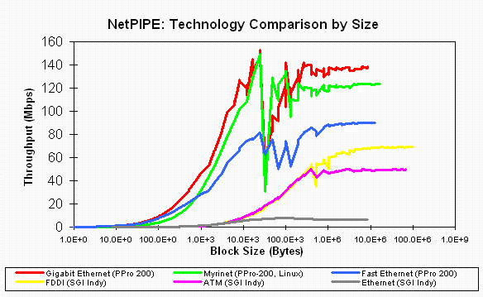
Performance Comparison
(from SCL Lab, Iowa State University)

Slide 20

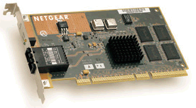

Gigabit Ethernet
Very standard and easily integrate to existing system
Good support for Linux
Cost drop rapidly, expected to be much cheaper soon
http://www.syskonnect.com/
http://netgear.baynetworks.com/

Slide 21
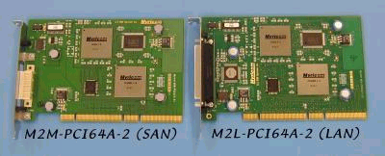
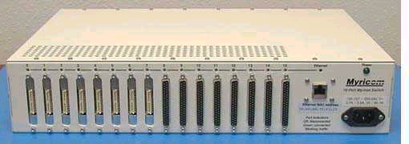
Myrinet
Full-duplex 1.28+1.28 Gigabit/second links, switch ports, and interface ports.
Flow control, error control, and "heartbeat" continuity monitoring on every link.
Low-latency, cut-through, crossbar switches, with monitoring for high-availability applications.
Any network topology is allowed. Myrinet networks can scale to tens of thousands of hosts, with network-bisection data rates in Terabits per second. Myrinet can also provide alternative communication paths between hosts.
Host interfaces that execute a control program to interact directly with host processes ("OS bypass") for low-latency communication, and directly with the network to send, receive, and buffer packets.

Slide 22
Quick Guide for Installation
Planning the partitions
  Root filesystem ( / )
  Swap file systems (twice the size of memory)
  Shared directory on file server
    /usr/local for global software installation
    /home for user home directory on all nodes
Planning IP, Netmask, Domain name, NIS domain

Slide 23
Basic Linux Installation
Make boot disk from CD or network distribution
Partition harddisk according to the plan
Select packages to install
  Complete installation for Front-end, fileserver
  Minimal installation on compute nodes
Installation
Setup network, X windows system, accounts

Slide 24
Cautions
Linux is not fully plug-and-play. Turn it off using bios setup
Set interrupt and DMA on each card to different interrupts to avoid conflict
For nodes with two or more NIC, kernel must be recompiled to turn on IP masquerading and IP forwarding

Slide 25
Setup a Single System View
Single file structure can be achieved using NFS
  Easy and reliable
  Scalability to really large clusters?
  Autofs system can be used to mount filesystem when used
In OSIS, /cluster is shared from a single NFS server

Slide 26
Centralized accounts
Centralized accounts using NIS (Network Information System)
  Set NIS domain using domainname command
  Start “ypserv” on NIS server (usually fileserver of front-end)
  run make in /var/yp
  add “++” at the end of /etc/password file and start “ypbind” on each nodes.
/etc/host.equiv lists all nodes

Slide 27
MPI Installation
MPICH: http://www.mcs.anl.gov/mpi/mpich/
LAM: http://lam.cs.nd.edu
MPICH and LAM can co-exist

Slide 28
MPI Installation (MPICH)
MPICH is a popular implementation by Argonne National Laboratory and Missisippy State University
Installation ( in /cluster/mpich)
  Unpack distribution
  run configure
  make
  make prefix=/cluster/mpich install
  set up path and environment

Slide 29
PVM Installation
Unpack the distribution
Set environment
  PVM_ROOT to pvm directory
  PVM_ARCH to LINUX
  Set path to $PVM_ROOT/bin;$PVM_ROOT/lib
Goto pvm directory, run make file

Slide 30
Power requirements

Slide 31
Performance of Beowulf System

Slide 32

Little Blue Penguin : ACL / Lanl
“The Little Blue Penguin (LBP) system is a parallel computer (a cluster) consisting of 64 dual Intel Pentium II/333Mhz nodes (128 CPUSs) interconnected with specialized low latency gigabit networking system called Myrinet and a 1/2 terabyte of RAID disk storage.”

Slide 33
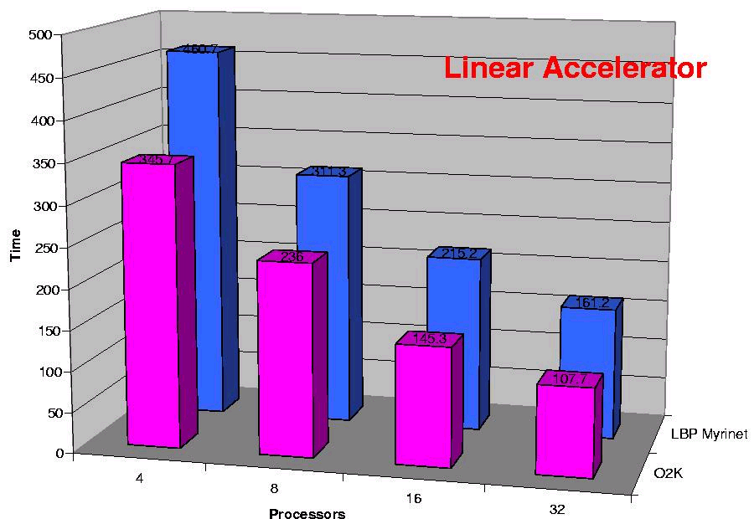
Performance compared to SGI Origin 2000

Slide 34
Beowulf Systems for …
HPC platform for scientific applications
  This is the original purpose of Beowulf project
Storage and processing of large data
  Satellites image processing
  Information Retrieval, Data Mining
Scalable Internet/Intranet Server
Computing system in an academic environment

Slide 35
More Information on Clusters
www.beowulf.org
www.beowulf-underground.org "Unsanctioned and unfettered information on building and using Beowulf systems." Current events related to Beowulf.
www.extremelinux.org “Dedicated to take Linux beyond Beowulf into commodity cluster computing.”
http://www.ieeetfcc.org/ IEEE Task Force on Cluster Computing

