Slide 1
PVM
Prabhaker Mateti
Wright State University

Slide 2
PVM Resources
Web site www.epm.ornl.gov/pvm/pvm_home.html
Book
PVM: Parallel Virtual Machine
A Users' Guide and Tutorial for Networked Parallel Computing
Al Geist, Adam Beguelin, Jack Dongarra, Weicheng Jiang, Robert Manchek, Vaidy Sunderam
www.netlib.org/pvm3/book/pvm-book.html

Slide 3
PVM = Parallel Virtual Machine
Software package
  Standard daemon: pvmd
  Application program interface
Network of heterogeneous machines
  Workstations
  Supercomputers
  Unix, NT, VMS, OS/2

Slide 4
The pvmd3 process
Manages each host of vm
  Message router
  Create, destroy, … local processes
  Fault detection
  Authentication
  Collects output
Inter-host point of contact
  One pvmd3 on each host
Can be started during boot

Slide 5
The program named pvm
Interactive control console
  Configuration of PVM
  Status checking
Can start pvmd

Slide 6
The library libpvm
Linked with application programs
Functions
  Compose a message
  Send
  Receive
System calls to pvmd
libpvm3.a, libfpvm3.a, libgpvm3.a

Slide 7
libpvm3.a
Initiate and terminate processes
Pack, send, and receive messages
Synchronize via barriers
Query and change configuration of the pvm
Talk to local pvmd3
Data format conversion (XDR)

Slide 8
libfpvm3.a
additionally required for Fortran codes

Slide 9
libgpvm3.a
Dynamic groups of processes

Slide 10
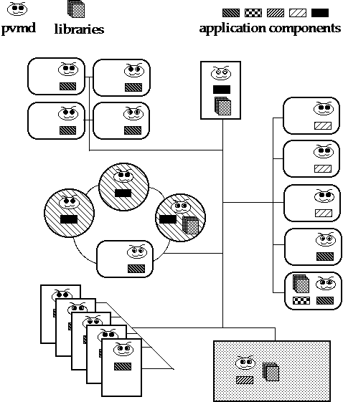

Slide 11
PVM: Hello World!
#include <stdio.h>
#include "pvm3.h"
main()
{
me = pvm_mytid());
cc = pvm_spawn("hello_other”, 0, 0, "", 1, &tid);
…
pvm_exit();
exit(0);
}
#include "pvm3.h"
main()
{
ptid = pvm_parent();
strcpy(buf, "hello, world from ");
gethostname(buf + strlen(buf), 64);
pvm_initsend(PvmDataDefault);
pvm_pkstr(buf);
pvm_send(ptid, 1);
pvm_exit();
exit(0);
}

Slide 12
PVM: Hello World!
#include <stdio.h>
#include "pvm3.h"
main()
{
cc = pvm_spawn("hello_other", 0, 0, "", 1, &tid);
if (cc == 1) {
cc = pvm_recv(-1, -1);
pvm_bufinfo(cc, 0, 0, &tid);
pvm_upkstr(buf);
printf("from t%x: %s\n", tid, buf);
} else …
}
#include "pvm3.h"
main()
{
int ptid;
char buf[100];
ptid = pvm_parent();
strcpy(buf, "hello, world from ");
gethostname(buf + strlen(buf), 64);
pvm_initsend(PvmDataDefault);
pvm_pkstr(buf);
pvm_send(ptid, 1);
pvm_exit();
exit(0);
}

Slide 13
PVM: Hello World!
#include <stdio.h>
#include "pvm3.h"
main()
{
int cc, tid;
char buf[100];
printf("i'm t%x\n", pvm_mytid());
cc = pvm_spawn("hello_other", 0, 0, "", 1, &tid);
if (cc == 1) {
cc = pvm_recv(-1, -1);
pvm_bufinfo(cc, 0, 0, &tid);
pvm_upkstr(buf);
printf("from t%x: %s\n", tid, buf);
} else
printf("can't start hello_other\n");
pvm_exit();
exit(0);
}
#include "pvm3.h"
main()
{
int ptid;
char buf[100];
ptid = pvm_parent();
strcpy(buf, "hello, world from ");
gethostname(buf + strlen(buf), 64);
pvm_initsend(PvmDataDefault);
pvm_pkstr(buf);
pvm_send(ptid, 1);
pvm_exit();
exit(0);
}

Slide 14
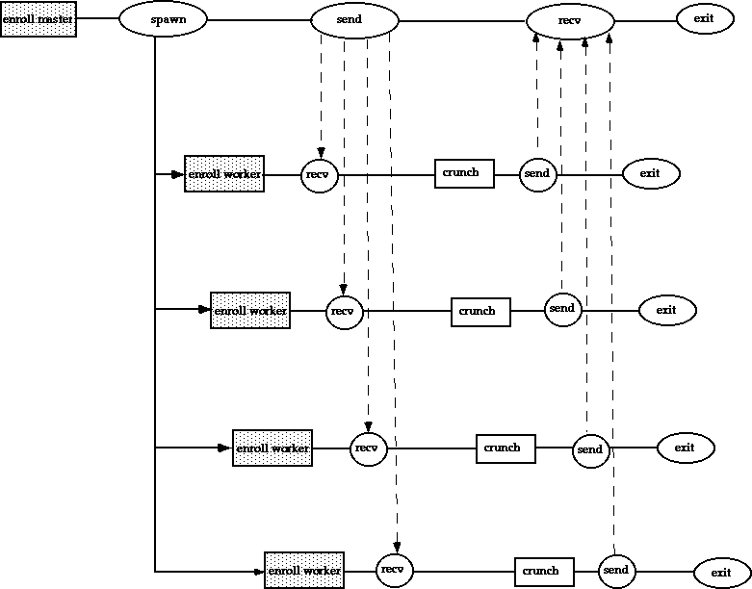

Slide 15
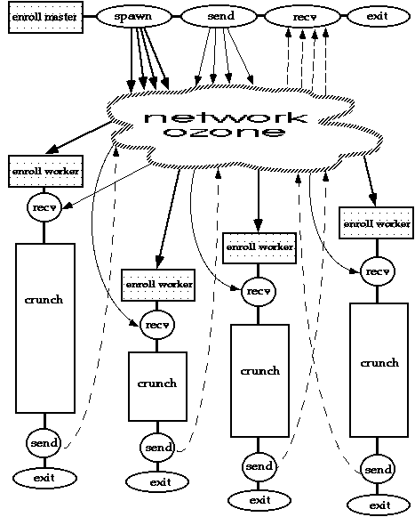

Slide 16
pvm_mytid
Enrolls the calling process into PVM and generates a unique task identifier if this process is not already enrolled in PVM. If the calling process is already enrolled in PVM, this routine simply returns the process's tid.
tid = pvm_mytid ();

Slide 17
pvm_spawn
Starts new PVM processes. The programmer can specify the machine architecture and machine name where processes are to be spawned.
numt = pvm_spawn ("worker",0,PvmTaskDefault,"",1,&tids[i]);
numt = pvm_spawn ("worker",0,PvmTaskArch,"RS6K",1,&tid[i]);

Slide 18
pvm_exit
Tells the local pvmd that this process is leaving PVM. This routine should be called by all PVM processes before they exit.

Slide 19
pvm_addhosts
Add hosts to the virtual machine. The names should have the same syntax as lines of a pvmd hostfile.
pvm_addhosts (hostarray,4,infoarray);

Slide 20
pvm_delhost
Deletes hosts from the virtual machine.
pvm_delhosts (hostarray,4);

Slide 21
pvm_pkdatatype
Pack the specified data type into the active send buffer. Should match a corresponding unpack routine in the receive process. Structure data types must be packed by their individual data elements.

Slide 22
pvm_upkdatatype
Unpack the specified data type into the active receive buffer. Should match a corresponding pack routine in the sending process. Structure data types must be unpacked by their individual data elements.

Slide 23
pvm_send
Immediately sends the data in the message buffer to the specified destination task. This is a blocking, send operation. Returns 0 if successful, < 0 otherwise.
pvm_send (tids[1],MSGTAG);

Slide 24
pvm_psend
Both packs and sends message with a single call. Syntax requires specification of a valid data type.

Slide 25
pvm_mcast
Multicasts a message stored in the active send buffer to tasks specified in the tids[]. The message is not sent to the caller even if listed in the array of tids.
pvm_mcast (tids,ntask,msgtag);

Slide 26
pvm_recv
Blocks the receiving process until a message with the specified tag has arrived from the specified tid. The message is then placed in a new active receive buffer, which also clears the current receive buffer.
pvm_recv (tid,msgtag);

Slide 27
pvm_nrecv
Same as pvm_recv, except a non-blocking receive operation is performed. If the specified message has arrived, this routine returns the buffer id of the new receive buffer. If the message has not arrived, it returns 0. If an error occurs, then an integer < 0 is returned.
pvm_nrecv (tid,msgtag);

Slide 28
PVM Collective Communication

Slide 29
pvm_barrier
Blocks the calling process until all processes in a group have called pvm_barrier().
pvm_barrier ("worker",5 );

Slide 30
pvm_bcast
Asynchronously broadcasts the data in the active send buffer to a group of processes. The broadcast message is not sent back to the sender.
pvm_bcast ("worker",msgtag);

Slide 31
pvm_gather
A specified member receives messages from each member of the group and gathers these messages into a single array. All group members must call pvm_gather().
pvm_gather (&getmatrix,&myrow,10,PVM_INT,msgtag,"workers",root);

Slide 32
pvm_scatter
Performs a scatter of data from the specified root to each of the members of the group, including itself. All group members must call pvm_scatter(). Each receives a portion of the data array from the root in their local result array.
pvm_scatter (&getmyrow,&matrix,10,PVM_INT,
msgtag,"workers",root);

Slide 33
pvm_reduce
Performs a reduce operation over members of the group. All group members call it with their local data, and the result of the reduction operation appears on the root. Users can define their own reduction functions or the predefined PVM reductions
pvm_reduce (PvmMax,&myvals,10,PVM_INT,msgtag,"workers",root);

Slide 34
Prepare to Execute Your PVM session
PVM expects executables to be located in ~/pvm3/bin/$PVM_ARCH
% ln -s $PVM_ROOT/lib ~/pvm3/lib
% cc -o myprog myprog.c -I$PVM_ROOT/include
-L$PVM_ROOT/lib/$PVM_ARCH -lpvm3

Slide 35
Create your PVM hostfile
PVM hostfile defines your parallel virtual machine. It contains the names of all desired machines, one per line.

Slide 36
Create Your $HOME/.rhosts file
Example .rhosts file
  mamma.cs.wright.edu user02
  fr2s02.mhpcc.edu user02
  beech.tc.cornell.edu jdoe
  machine.mit.edu user02

Slide 37
Start pvmd3
% pvmd3 hostfile &
This starts up daemons on all other machines (remote) specified in your hostfile.
PVM console can be started after pvmd3 by typing "pvm".

Slide 38
Execute your application
% myprog

Slide 39
Quitting PVM
Application components must include call of pvm_exit().
Halting the master pvmd3 will automatically kill all other pvmd3s and all processes enrolled in this PVM.
In pvm console: "halt"
Running in the background: enter console mode by typing "pvm" and halt.

