Slide 1
Cluster Computing
Prabhaker Mateti
Wright State University

Slide 2
Abstract
Cluster computing distributes the computational load to collections of similar machines. This talk describes what cluster computing is, the typical Linux packages used, and examples of large clusters in use today. This talk also reviews cluster computing modifications of the Linux kernel.

Slide 3
What Kind of Computing, did you say?
Sequential
Concurrent
Parallel
Distributed
Networked
Migratory
Cluster
Grid
Pervasive
Cloud
Quantum
Optical
Molecular

Slide 4
Fundamentals Overview

Slide 5
Fundamentals Overview
Granularity of Parallelism
Synchronization
Message Passing
Shared Memory

Slide 6
Granularity of Parallelism
Fine-Grained Parallelism
Medium-Grained Parallelism
Coarse-Grained Parallelism
NOWs (Networks of Workstations)

Slide 7
Fine-Grained Machines
Tens of thousands of Processor Elements
Processor Elements
Slow (bit serial)
Small Fast Private RAM
Shared Memory
Interconnection Networks
Message Passing
Single Instruction Multiple Data (SIMD)

Slide 8
Medium-Grained Machines
Typical Configurations
Thousands of processors
Processors have power between coarse- and fine-grained
Either shared or distributed memory
Traditionally: Research Machines
Single Code Multiple Data (SCMD)

Slide 9
Coarse-Grained Machines
Typical Configurations
Hundreds/Thousands of Processors
Processors
Powerful (fast CPUs)
Large (cache, vectors, multiple fast buses)
Memory: Shared or Distributed-Shared
Multiple Instruction Multiple Data (MIMD)

Slide 10
Networks of Workstations
Exploit inexpensive Workstations/PCs
Commodity network
The NOW becomes a “distributed memory multiprocessor”
Workstations send+receive messages
C and Fortran programs with PVM, MPI, etc. libraries
Programs developed on NOWs are portable to supercomputers for production runs

Slide 11
Levels of Parallelism
Code-Granularity
Code Item
Large grain
(task level)
Program
Medium grain
(control level)
Function (thread)
Fine grain
(data level)
Loop (Compiler)
Very fine grain
(multiple issue)
With hardware
PVM/MPI
Task i-l
Task i
Task i+1
func1 ( )
{
....
....
}
func2 ( )
{
....
....
}
func3 ( )
{
....
....
}
Threads
Compilers
a ( 0 ) =..
b ( 0 ) =..
a ( 1 )=..
b ( 1 )=..
a ( 2 )=..
b ( 2 )=..
CPU
+
x
Load

Slide 12
Definition of “Parallel”
S1 begins at time b1, ends at e1
S2 begins at time b2, ends at e2
S1 || S2
Begins at min(b1, b2)
Ends at max(e1, e2)
Commutative (Equiv to S2 || S1)

Slide 13
Data Dependency
x := a + b; y := c + d;
x := a + b || y := c + d;
y := c + d; x := a + b;
X depends on a and b, y depends on c and d
Assumed a, b, c, d were independent

Slide 14
Types of Parallelism
Result: Data structure can be split into parts of same structure.
Specialist: Each node specializes. Pipelines.
Agenda: Have list of things to do. Each node can generalize.

Slide 15
Result Parallelism
Also called
Embarrassingly Parallel
Perfect Parallel
Computations that can be subdivided into sets of independent tasks that require little or no communication
Monte Carlo simulations
F(x, y, z)

Slide 16
Specialist Parallelism
Different operations performed simultaneously on different processors
E.g., Simulating a chemical plant; one processor simulates the preprocessing of chemicals, one simulates reactions in first batch, another simulates refining the products, etc.

Slide 17
Agenda Parallelism: MW Model
Manager
Initiates computation
Tracks progress
Handles worker’s requests
Interfaces with user
Workers
Spawned and terminated by manager
Make requests to manager
Send results to manager

Slide 18
Embarrassingly Parallel
Result Parallelism is obvious
Ex1: Compute the square root of each of the million numbers given.
Ex2: Search for a given set of words among a billion web pages.

Slide 19
Reduction
Combine several sub-results into one
Reduce r1 r2 … rn with op
Becomes r1 op r2 op … op rn
Hadoop is based on this idea

Slide 20
Shared Memory
Process A writes to a memory location
Process B reads from that memory location
Synchronization is crucial
Excellent speed
Semantics … ?

Slide 21
Shared Memory
Needs hardware support:
multi-ported memory
Atomic operations:
Test-and-Set
Semaphores

Slide 22
Shared Memory Semantics: Assumptions
Global time is available. Discrete increments.
Shared variable, s = vi at ti, i=0,…
Process A: s := v1 at time t1
Assume no other assignment occurred after t1.
Process B reads s at time t and gets value v.

Slide 23
Shared Memory: Semantics
Value of Shared Variable
v = v1, if t > t1
v = v0, if t < t1
v = ??, if t = t1
t = t1 +- discrete quantum
Next Update of Shared Variable
Occurs at t2
t2 = t1 + ?

Slide 24
Distributed Shared Memory
“Simultaneous” read/write access by spatially distributed processors
Abstraction layer of an implementation built from message passing primitives
Semantics not so clean

Slide 25
Semaphores
Semaphore s;
V(s) ::= ⟨ s := s + 1 ⟩
P(s) ::= ⟨ when s > 0 do s := s – 1 ⟩
Deeply studied theory.

Slide 26
Condition Variables
Condition C;
C.wait()
C.signal()

Slide 27
Distributed Shared Memory
A common address space that all the computers in the cluster share.
Difficult to describe semantics.

Slide 28
Distributed Shared Memory: Issues
Distributed
Spatially
LAN
WAN
No global time available

Slide 29
Distributed Computing
No shared memory
Communication among processes
Send a message
Receive a message
Asynchronous
Synchronous
Synergy among processes

Slide 30
Messages
Messages are sequences of bytes moving between processes
The sender and receiver must agree on the type structure of values in the message
“Marshalling”: data layout so that there is no ambiguity such as “four chars” v. “one integer”.

Slide 31
Message Passing
Process A sends a data buffer as a message to process B.
Process B waits for a message from A, and when it arrives copies it into its own local memory.
No memory shared between A and B.

Slide 32
Message Passing
Obviously,
Messages cannot be received before they are sent.
A receiver waits until there is a message.
Asynchronous
Sender never blocks, even if infinitely many messages are waiting to be received
Semi-asynchronous is a practical version of above with large but finite amount of buffering

Slide 33
Message Passing: Point to Point
Q: send(m, P)
Send message M to process P
P: recv(x, Q)
Receive message from process Q, and place it in variable x
The message data
Type of x must match that of m
As if x := m

Slide 34
Broadcast
One sender Q, multiple receivers P
Not all receivers may receive at the same time
Q: broadcast (m)
Send message M to processes
P: recv(x, Q)
Receive message from process Q, and place it in variable x

Slide 35
Synchronous Message Passing
Sender blocks until receiver is ready to receive.
Cannot send messages to self.
No buffering.

Slide 36
Asynchronous Message Passing
Sender never blocks.
Receiver receives when ready.
Can send messages to self.
Infinite buffering.

Slide 37
Message Passing
Speed not so good
Sender copies message into system buffers.
Message travels the network.
Receiver copies message from system buffers into local memory.
Special virtual memory techniques help.
Programming Quality
less error-prone cf. shared memory

Slide 38
Computer Architectures

Slide 39
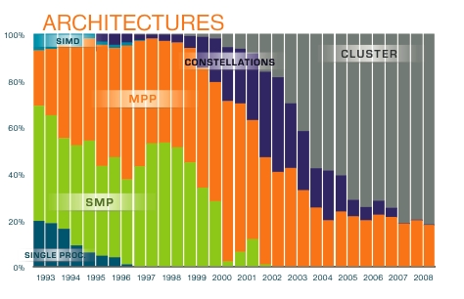
Architectures of Top 500 Sys

Slide 40
“Parallel” Computers
Traditional supercomputers
SIMD, MIMD, pipelines
Tightly coupled shared memory
Bus level connections
Expensive to buy and to maintain
Cooperating networks of computers

Slide 41
Traditional Supercomputers
Very high starting cost
Expensive hardware
Expensive software
High maintenance
Expensive to upgrade

Slide 42
Computational Grids
“Grids are persistent environments that enable software applications to integrate instruments, displays, computational and information resources that are managed by diverse organizations in widespread locations.”

Slide 43
Computational Grids
Individual nodes can be supercomputers, or NOW
High availability
Accommodate peak usage
LAN : Internet :: NOW : Grid

Slide 44
Buildings-Full of Workstations
Distributed OS have not taken a foot hold.
Powerful personal computers are ubiquitous.
Mostly idle: more than 90% of the up-time?
100 Mb/s LANs are common.
Windows and Linux are the top two OS in terms of installed base.

Slide 45
Networks of Workstations (NOW)
Workstation
Network
Operating System
Cooperation
Distributed+Parallel Programs

Slide 46
“Workstation OS”
Authenticated users
Protection of resources
Multiple processes
Preemptive scheduling
Virtual Memory
Hierarchical file systems
Network centric

Slide 47
Clusters of Workstations
Inexpensive alternative to traditional supercomputers
High availability
Lower down time
Easier access
Development platform with production runs on traditional supercomputers
Dedicated Nodes
Come-and-Go Nodes

Slide 48
Clusters with Part Time Nodes
Cycle Stealing: Running of jobs on a workstation that don't belong to the owner.
Definition of Idleness: E.g., No keyboard and no mouse activity
Tools/Libraries
Condor
PVM
MPI

Slide 49
Cooperation
Workstations are “personal”
Others use slows you down
…
Willing to share
Willing to trust

Slide 50
Cluster Characteristics
Commodity off the shelf hardware
Networked
Common Home Directories
Open source software and OS
Support message passing programming
Batch scheduling of jobs
Process migration

Slide 51
Beowulf Cluster
Dedicated nodes
Single System View
Commodity of the shelf hardware
Internal high speed network
Open source software and OS
Support parallel programming such as MPI, PVM
Full trust in each other
Login from one node into another without authentication
Shared file system subtree

Slide 52
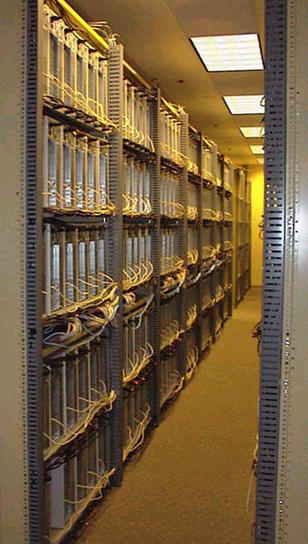
Example Clusters
July 1999
1000 nodes
Used for genetic algorithm research by John Koza, Stanford University
www.genetic-programming.com/

Slide 53
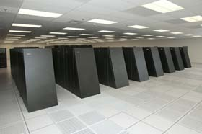
A Large Cluster System
IBM BlueGene, 2007
DOE/NNSA/LLNL
Memory: 73728 GB
OS: CNK/SLES 9
Interconnect: Proprietary
PowerPC 440
106,496 nodes
478.2 Tera FLOPS on LINPACK

Slide 54
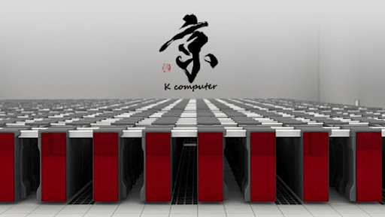
Fujitsu K Cluster, #1 Nov 2011
SPARC64 2.0GHz, Tofu interconnect
OS: Linux
229376 GB RAM
548352 Cores

Slide 55
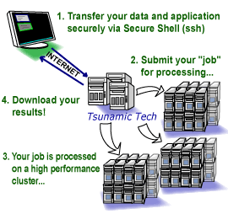
Cluster Computers for Rent
Transfer executable files, source code or data to your secure personal account on TTI servers (1). Do this securely using winscp for Windows or "secure copy" scp for Linux.
To execute your program, simply submit a job (2) to the scheduler using the "menusub" command or do it manually using "qsub" (we use the popular PBS batch system). There are working examples on how to submit your executable. Your executable is securely placed on one of our in-house clusters for execution (3).
Your results and data are written to your personal account in real time. Download your results (4).

Slide 56
Why are Linux Clusters Good?
Low initial implementation cost
Inexpensive PCs
Standard components and Networks
Free Software: Linux, GNU, MPI, PVM
Scalability: can grow and shrink
Familiar technology, easy for user to adopt the approach, use and maintain system.

Slide 57
2007 OS Share of Top 500
OS Count Share Rmax (GF) Rpeak (GF) Processor
Linux 426 85.20% 4897046 7956758 970790
Windows 6 1.20% 47495 86797 12112
Unix 30 6.00% 408378 519178 73532
BSD 2 0.40% 44783 50176 5696
Mixed 34 6.80% 1540037 1900361 580693
MacOS 2 0.40% 28430 44816 5272
Totals 500 100% 6966169 10558086 1648095
http://www.top500.org/stats/list/30/osfam Nov 2007

Slide 58
2011 Cluster OS Share
Linux 457 91.4
Unix 30 6
Mixed 11 2.2
BSD Based 1
Windows 1
Source: top500.org

Slide 59
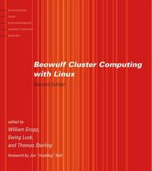
Many Books on Linux Clusters
Search:
google.com
amazon.com
Example book:
William Gropp, Ewing Lusk, Thomas Sterling, MIT Press, 2003, ISBN: 0-262-69292-9

Slide 60
Why Is Beowulf Good?
Low initial implementation cost
Inexpensive PCs
Standard components and Networks
Free Software: Linux, GNU, MPI, PVM
Scalability: can grow and shrink
Familiar technology, easy for user to adopt the approach, use and maintain system.

Slide 61
Single System Image
Common filesystem view from any node
Common accounts on all nodes
Single software installation point
Easy to install and maintain system
Easy to use for end-users

Slide 62
Closed Cluster Configuration
High Speed Network
High Speed Network
File
Server
node
compute
node
compute
node
compute
node
compute
node
compute
node
compute
node
compute
node
compute
node
Service Network
gateway
node
gateway
node
Front-end
External Network
External Network

Slide 63
Open Cluster Configuration
High Speed Network
File
Server
node
compute
node
compute
node
compute
node
compute
node
compute
node
compute
node
compute
node
compute
node
External Network
Front-end

Slide 64
DIY Interconnection Network
Most popular: Fast Ethernet
Network topologies
Mesh
Torus
Switch v. Hub

Slide 65
Software Components
Operating System
Linux, FreeBSD, …
“Parallel” Programs
PVM, MPI, …
Utilities
Open source

Slide 66
Cluster Computing
Ordinary programs run as-is on clusters is not cluster computing
Cluster computing takes advantage of :
Result parallelism
Agenda parallelism
Reduction operations
Process-grain parallelism

Slide 67
Google Linux Clusters
GFS: The Google File System
thousands of terabytes of storage across thousands of disks on over a thousand machines
150 million queries per day
Average response time of 0.25 sec
Near-100% uptime

Slide 68
Cluster Computing Applications
Mathematical
fftw (fast Fourier transform)
pblas (parallel basic linear algebra software)
atlas (a collections of mathematical library)
sprng (scalable parallel random number generator)
MPITB -- MPI toolbox for MATLAB
Quantum Chemistry software
Gaussian, qchem
Molecular Dynamic solver
NAMD, gromacs, gamess
Weather modeling
MM5 (http://www.mmm.ucar.edu/mm5/mm5-home.html)

Slide 69
Development of Cluster Programs
New algorithms + code
Old programs re-done:
Reverse engineer design, and re-code
Use new languages that have distributed and parallel primitives
With new libraries
Parallelize legacy code
Mechanical conversion by software tools

Slide 70
Distributed Programs
Spatially distributed programs
A part here, a part there, …
Parallel
Synergy
Temporally distributed programs
Compute half today, half tomorrow
Combine the results at the end
Migratory programs
Have computation, will travel

Slide 71
Technological Bases of Distributed+Parallel Programs
Spatially distributed programs
Message passing
Temporally distributed programs
Shared memory
Migratory programs
Serialization of data and programs

Slide 72
Technological Bases for Migratory programs
Same CPU architecture
X86, PowerPC, MIPS, SPARC, …, JVM
Same OS + environment
Be able to “checkpoint”
suspend, and
then resume computation
without loss of progress

Slide 73
Parallel Programming Languages
Shared-memory languages
Distributed-memory languages
Object-oriented languages
Functional programming languages
Concurrent logic languages
Data flow languages

Slide 74
Linda: Tuple Spaces, shared mem
<v1, v2, …, vk>
Atomic Primitives
In (t)
Read (t)
Out (t)
Eval (t)
Host language: e.g., C/Linda, JavaSpaces

Slide 75
Data Parallel Languages
Data is distributed over the processors as a arrays
Entire arrays are manipulated:
A(1:100) = B(1:100) + C(1:100)
Compiler generates parallel code
Fortran 90
High Performance Fortran (HPF)

Slide 76
Parallel Functional Languages
Erlang http://www.erlang.org/
SISAL http://www.llnl.gov/sisal/
PCN Argonne
Haskell-Eden http://www.mathematik.uni-marburg.de/~eden
Objective Caml with BSP
SAC Functional Array Language

Slide 77
Message Passing Libraries
Programmer is responsible for initial data distribution, synchronization, and sending and receiving information
Parallel Virtual Machine (PVM)
Message Passing Interface (MPI)
Bulk Synchronous Parallel model (BSP)

Slide 78
BSP: Bulk Synchronous Parallel model
Divides computation into supersteps
In each superstep a processor can work on local data and send messages.
At the end of the superstep, a barrier synchronization takes place and all processors receive the messages which were sent in the previous superstep

Slide 79
BSP: Bulk Synchronous Parallel model
http://www.bsp-worldwide.org/
Book: Rob H. Bisseling, “Parallel Scientific Computation: A Structured Approach using BSP and MPI,” Oxford University Press, 2004, 324 pages, ISBN 0-19-852939-2.

Slide 80
BSP Library
Small number of subroutines to implement
process creation,
remote data access, and
bulk synchronization.
Linked to C, Fortran, … programs

Slide 81
Portable Batch System (PBS)
Prepare a .cmd file
naming the program and its arguments
properties of the job
the needed resources
Submit .cmd to the PBS Job Server: qsub command
Routing and Scheduling: The Job Server
examines .cmd details to route the job to an execution queue.
allocates one or more cluster nodes to the job
communicates with the Execution Servers (mom's) on the cluster to determine the current state of the nodes.
When all of the needed are allocated, passes the .cmd on to the Execution Server on the first node allocated (the "mother superior").
Execution Server
will login on the first node as the submitting user and run the .cmd file in the user's home directory.
Run an installation defined prologue script.
Gathers the job's output to the standard output and standard error
It will execute installation defined epilogue script.
Delivers stdout and stdout to the user.

Slide 82
TORQUE, an open source PBS
Tera-scale Open-source Resource and QUEue manager (TORQUE) enhances OpenPBS
Fault Tolerance
Additional failure conditions checked/handled
Node health check script support
Scheduling Interface
Scalability
Significantly improved server to MOM communication model
Ability to handle larger clusters (over 15 TF/2,500 processors)
Ability to handle larger jobs (over 2000 processors)
Ability to support larger server messages
Logging
http://www.supercluster.org/projects/torque/

Slide 83
PVM, and MPI
Message passing primitives
Can be embedded in many existing programming languages
Architecturally portable
Open-sourced implementations

Slide 84
Parallel Virtual Machine (PVM)
PVM enables a heterogeneous collection of networked computers to be used as a single large parallel computer.
Older than MPI
Large scientific/engineering user community
http://www.csm.ornl.gov/pvm/

Slide 85
Message Passing Interface (MPI)
http://www-unix.mcs.anl.gov/mpi/
MPI-2.0 http://www.mpi-forum.org/docs/
MPICH: www.mcs.anl.gov/mpi/mpich/ by Argonne National Laboratory and Missisippy State University
LAM: http://www.lam-mpi.org/
http://www.open-mpi.org/

Slide 86
OpenMP for shared memory
Distributed shared memory API
User-gives hints as directives to the compiler
http://www.openmp.org

Slide 87
SPMD
Single program, multiple data
Contrast with SIMD
Same program runs on multiple nodes
May or may not be lock-step
Nodes may be of different speeds
Barrier synchronization

Slide 88
Condor
Cooperating workstations: come and go.
Migratory programs
Checkpointing
Remote IO
Resource matching
http://www.cs.wisc.edu/condor/

Slide 89
Migration of Jobs
Policies
Immediate-Eviction
Pause-and-Migrate
Technical Issues
Check-pointing: Preserving the state of the process so it can be resumed.
Migrating from one architecture to another

Slide 90
Kernels Etc Mods for Clusters
Dynamic load balancing
Transparent process-migration
Kernel Mods
http://openmosix.sourceforge.net/
http://kerrighed.org/
http://openssi.org/
http://ci-linux.sourceforge.net/
CLuster Membership Subsystem ("CLMS") and
Internode Communication Subsystem
http://www.gluster.org/
GlusterFS: Clustered File Storage of peta bytes.
GlusterHPC: High Performance Compute Clusters
http://boinc.berkeley.edu/
Open-source software for volunteer computing and grid computing

Slide 91
OpenMosix Distro
Quantian Linux
Boot from DVD-ROM
Compressed file system on DVD
Several GB of cluster software
http://dirk.eddelbuettel.com/quantian.html
Live CD/DVD or Single Floppy Bootables
http://bofh.be/clusterknoppix/
http://sentinix.org/
http://itsecurity.mq.edu.au/chaos/
http://openmosixloaf.sourceforge.net/
http://plumpos.sourceforge.net/
http://www.dynebolic.org/
http://bccd.cs.uni.edu/
http://eucaristos.sourceforge.net/
http://gomf.sourceforge.net/
Can be installed on HDD

Slide 92
What is openMOSIX?
An open source enhancement to the Linux kernel
Cluster with come-and-go nodes
System image model: Virtual machine with lots of memory and CPU
Granularity: Process
Improves the overall (cluster-wide) performance.
Multi-user, time-sharing environment for the execution of both sequential and parallel applications
Applications unmodified (no need to link with special library)

Slide 93
What is openMOSIX?
Execution environment:
farm of diskless x86 based nodes
UP (uniprocessor), or
SMP (symmetric multi processor)
connected by standard LAN (e.g., Fast Ethernet)
Adaptive resource management to dynamic load characteristics
CPU, RAM, I/O, etc.
Linear scalability

Slide 94
Users’ View of the Cluster
Users can start from any node in the cluster, or sysadmin sets-up a few nodes as login nodes
Round-robin DNS: “hpc.clusters” with many IPs assigned to same name
Each process has a Home-Node
Migrated processes always appear to run at the home node, e.g., “ps” show all your processes, even if they run elsewhere

Slide 95
MOSIX architecture
network transparency
preemptive process migration
dynamic load balancing
memory sharing
efficient kernel communication
probabilistic information dissemination algorithms
decentralized control and autonomy

Slide 96
A two tier technology
Information gathering and dissemination
Support scalable configurations by probabilistic dissemination algorithms
Same overhead for 16 nodes or 2056 nodes
Pre-emptive process migration that can migrate any process, anywhere, anytime - transparently
Supervised by adaptive algorithms that respond to global resource availability
Transparent to applications, no change to user interface

Slide 97
Tier 1: Information gathering and dissemination
In each unit of time (e.g., 1 second) each node gathers information about:
CPU(s) speed, load and utilization
Free memory
Free proc-table/file-table slots
Info sent to a randomly selected node
Scalable - more nodes better scattering

Slide 98
Tier 2: Process migration
Load balancing: reduce variance between pairs of nodes to improve the overall performance
Memory ushering: migrate processes from a node that nearly exhausted its free memory, to prevent paging
Parallel File I/O: bring the process to the file-server, direct file I/O from migrated processes
Notes:
Process is much smaller than the file usually. If it is the process go the file, if not it goes vice-versa.

Slide 99
Network transparency
The user and applications are provided a virtual machine that looks like a single machine.
Example: Disk access from diskless nodes on fileserver is completely transparent to programs

Slide 100
Preemptive process migration
Any user’s process, trasparently and at any time, can/may migrate to any other node.
The migrating process is divided into:
system context (deputy) that may not be migrated from home workstation (UHN);
user context (remote) that can be migrated on a diskless node;

Slide 101
Splitting the Linux process
Userland
Userland
Remote
Local
openMOSIX Link
master node
Deputy
diskless node
Kernel
Kernel
System context (environment) - site dependent- “home” confined
Connected by an exclusive link for both synchronous (system calls) and asynchronous (signals, MOSIX events)
Process context (code, stack, data) - site independent - may migrate

Slide 102
Dynamic load balancing
Initiates process migrations in order to balance the load of farm
responds to variations in the load of the nodes, runtime characteristics of the processes, number of nodes and their speeds
makes continuous attempts to reduce the load differences among nodes
the policy is symmetrical and decentralized
all of the nodes execute the same algorithm
the reduction of the load differences is performed indipendently by any pair of nodes

Slide 103
Memory sharing
places the maximal number of processes in the farm main memory, even if it implies an uneven load distribution among the nodes
delays as much as possible swapping out of pages
makes the decision of which process to migrate and where to migrate it is based on the knoweldge of the amount of free memory in other nodes

Slide 104
Efficient kernel communication
Reduces overhead of the internal kernel communications (e.g. between the process and its home site, when it is executing in a remote site)
Fast and reliable protocol with low startup latency and high throughput

Slide 105
Probabilistic information dissemination algorithms
Each node has sufficient knowledge about available resources in other nodes, without polling
measure the amount of available resources on each node
receive resources indices that each node sends at regular intervals to a randomly chosen subset of nodes
the use of randomly chosen subset of nodes facilitates dynamic configuration and overcomes node failures

Slide 106
Decentralized control and autonomy
Each node makes its own control decisions independently.
No master-slave relationships
Each node is capable of operating as an independent system
Nodes may join or leave the farm with minimal disruption

Slide 107
File System Access
MOSIX is particularly efficient for distributing and executing CPU-bound processes
However, the processes are inefficient with significant file operations
I/O accesses through the home node incur high overhead
“Direct FSA” is for better handling of I/O:
Reduce the overhead of executing I/O oriented system-calls of a migrated process
a migrated process performs I/O operations locally, in the current node, not via the home node
processes migrate more freely

Slide 108
DFSA Requirements
DFSA can work with any file system that satisfies some properties.
Unique mount point: The FS are identically mounted on all.
File consistency: when an operation is completed in one node, any subsequent operation on any other node will see the results of that operation
Required because an openMOSIX process may perform consecutive syscalls from different nodes
Time-stamp consistency: if file A is modified after B, A must have a timestamp > B's timestamp

Slide 109
DFSA Conforming FS
Global File System (GFS)
openMOSIX File System (MFS)
Lustre global file system
General Parallel File System (GPFS)
Parallel Virtual File System (PVFS)
Available operations: all common file-system and I/O system-calls

Slide 110
Global File System (GFS)
Provides local caching and cache consistency over the cluster using a unique locking mechanism
Provides direct access from any node to any storage entity
GFS + process migration combine the advantages of load-balancing with direct disk access from any node - for parallel file operations
Non-GNU License (SPL)

Slide 111
The MOSIX File System (MFS)
Provides a unified view of all files and all mounted FSs on all the nodes of a MOSIX cluster as if they were within a single file system.
Makes all directories and regular files throughout an openMOSIX cluster available from all the nodes
Provides cache consistency
Allows parallel file access by proper distribution of files (a process migrates to the node with the needed files)

Slide 112
MFS Namespace
/
etc
usr
var
bin
mfs
/
node1
etc
usr
var
bin
mfs
node2

Slide 113
Lustre: A scalable File System
http://www.lustre.org/
Scalable data serving through parallel data striping
Scalable meta data
Separation of file meta data and storage allocation meta data to further increase scalability
Object technology - allowing stackable, value-add functionality
Distributed operation

Slide 114
Parallel Virtual File System (PVFS)
http://www.parl.clemson.edu/pvfs/
User-controlled striping of files across nodes
Commodity network and storage hardware
MPI-IO support through ROMIO
Traditional Linux file system access through the pvfs-kernel package
The native PVFS library interface

Slide 115
General Parallel File Sys (GPFS)
www.ibm.com/servers/eserver/clusters/software/gpfs.html
“GPFS for Linux provides world class performance, scalability, and availability for file systems. It offers compliance to most UNIX file standards for end user applications and administrative extensions for ongoing management and tuning. It scales with the size of the Linux cluster and provides NFS Export capabilities outside the cluster.”

Slide 116
Mosix Ancillary Tools
Kernel debugger
Kernel profiler
Parallel make (all exec() become mexec())
openMosix pvm
openMosix mm5
openMosix HMMER
openMosix Mathematica

Slide 117
Cluster Administration
LTSP (www.ltsp.org)
ClumpOs (www.clumpos.org)
Mps
Mtop
Mosctl

Slide 118
Mosix commands & files
setpe – starts and stops Mosix on the current node
tune – calibrates the node speed parameters
mtune – calibrates the node MFS parameters
migrate – forces a process to migrate
mosctl – comprehensive Mosix administration tool
mosrun, nomig, runhome, runon, cpujob, iojob, nodecay, fastdecay, slowdecay – various way to start a program in a specific way
mon & mosixview – CLI and graphic interface to monitor the cluster status
/etc/mosix.map – contains the IP numbers of the cluster nodes
/etc/mosgates – contains the number of gateway nodes present in the cluster
/etc/overheads – contains the output of the ‘tune’ command to be loaded at startup
/etc/mfscosts – contains the output of the ‘mtune’ command to be loaded at startup
/proc/mosix/admin/* - various files, sometimes binary, to check and control Mosix

Slide 119
Monitoring
Cluster monitor - ‘mosmon’(or ‘qtop’)
Displays load, speed, utilization and memory information across the cluster.
Uses the /proc/hpc/info interface for the retrieving information
Applet/CGI based monitoring tools - display cluster properties
Access via the Internet
Multiple resources
openMosixview with X GUI

Slide 120
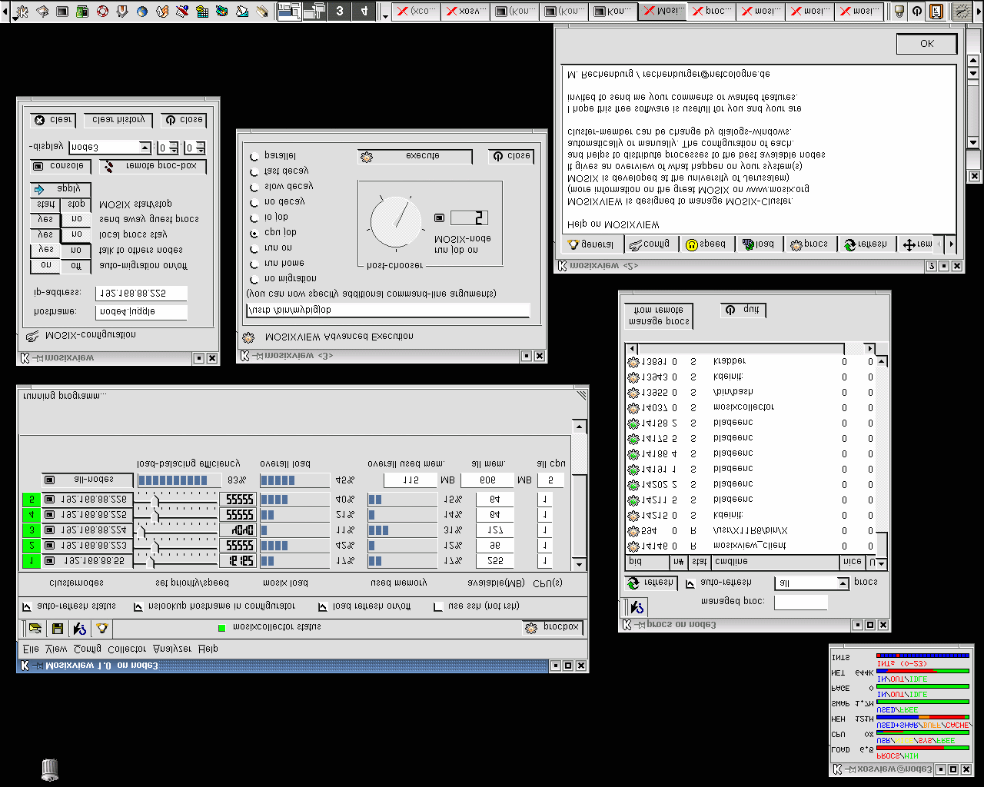
openMosixview
by Mathias Rechemburg
www.mosixview.com

Slide 121
Qlusters OS
http://www.qlusters.com/
Based in part on openMosix technology
Migrating sockets
Network RAM already implemented
Cluster Installer, Configurator, Monitor, Queue Manager, Launcher, Scheduler
Partnership with IBM, Compaq, Red Hat and Intel

Slide 122
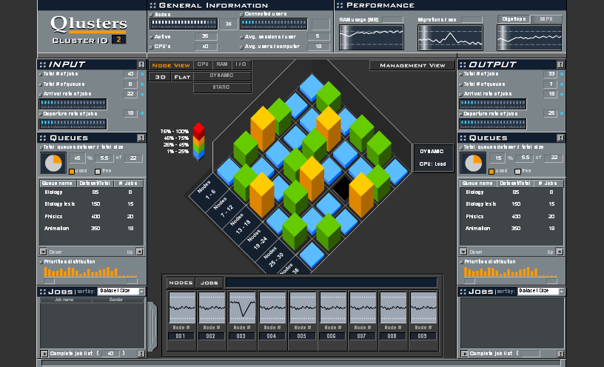
QlusterOS Monitor

