Slide 1
Java RMI
Prabhaker Mateti

Slide 2
Goals
Prerequisites
Assume you know Java and C++ well
But not threaded programming with Java and RMI
WhiteBoard Project Again
Use "just enough" Java for our project
Understand Java RMI
Relate RMI to C-RPC

Slide 3
Java compared to C++
Similar syntax for expressions, control structures, etc.
No pointer arithmetic.
No malloc/free or delete; Instead, automatic garbage collection.
Logically all methods are virtual; overloading and implementation of interfaces is ubiquitous.
Exceptions, rarely used in C++, are used universally in Java.
Single inheritance only
extends and implements

Slide 4
Public Classes and package
Public Classes
Any public class can declare
public static void main(String [] args) {…}
File name must match class name.
package WhiteBoard;
cwd == parent of WhiteBoard/
java WhiteBoard.WbServerImpl 1 localhost &

Slide 5
CLASSPATH
a list of directories and jar files containing .class files.
export CLASSPATH=.:..:WhiteBoard:~/JavaClasses
echo $CLASSPATH
empty → "."
not empty → "." not included by default

Slide 6
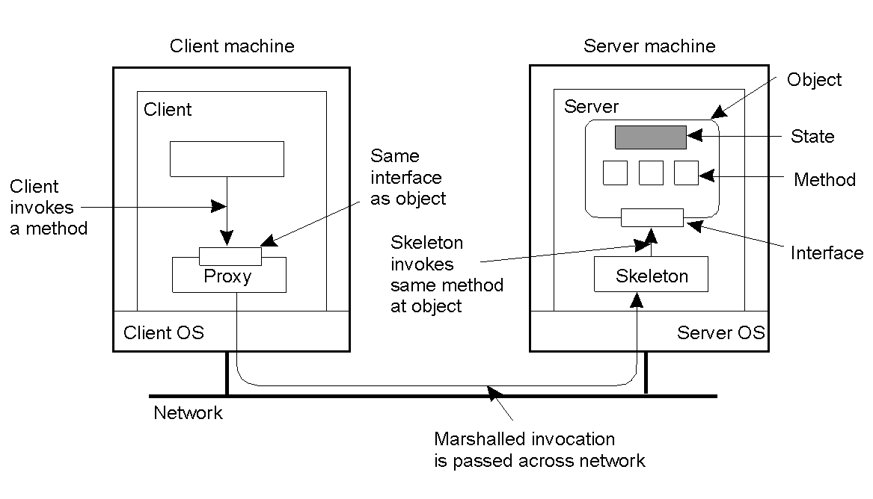
From RPC to RMI
2-16
But what are the essential differences?

Slide 7
RMI Example interface
public interface Hello extends
java.rmi.Remote {
String sayHello() throws java.rmi.RemoteException;
}

Slide 8
RMI Example Server
import java.rmi.Naming; import java.rmi.RemoteException; import java.rmi.server.UnicastRemoteObject; public class HelloServer extends UnicastRemoteObject implements Hello { public HelloServer() throws RemoteException { super(); } public String sayHello() { return "Hello World!"; } public static void main(String args[]) { try { HelloServer obj = new HelloServer(); Naming.rebind("//127.0.0.1/HelloServer", obj); System.out.println( "HelloServer bound in registry"); } catch (Exception e) { e.printStackTrace(); } } }

Slide 9
RMI Example Client
import java.rmi.Naming;
import java.rmi.RemoteException;
public class HelloClient {
public static void main(String args[]) {
try {
Hello obj = (Hello) Naming.lookup("//localhost/HelloServer");
System.out.println( obj.sayHello() + args[0] );
} catch (Exception e) { e.printStackTrace(); }
}}

Slide 10
RMI Example Compile and Run
javac HelloServer.java HelloClient.java
Hello.java also gets compiled
rmic HelloServer
rmiregistry &
java HelloServer &
for i in 1 2 3; do java HelloClient $i done

Slide 11
RMI
Overview
RPC for Java
Objects as arguments and values
Object Serialization (marshalling)
Mobile behavior: Returned objects can execute on caller
Language specific
JVM to JVM only
no XDR issues
Integrated security
Built-in concurrency (threads, synchronization, …)

Slide 12
RMI
RMI applications: Server Application + Client Application
Server: Creates remote objects, makes them accessible, and waits for the clients to invoke methods
Client: Gets remote references, and invokes methods on them.
RMI provide mechanism for Client and Server to communicate and pass information back and forth.
Distributed Object Application
Locate remote objects
Communicate with remote object
Load class bytecodes for objects that are passed around

Slide 13
Java RMI Components
Base RMI classes
Java compiler – javac
Recognizes RMI as integral part of language
Interface compiler – rmic
Generates stubs from class files
RMI Registry
cf. rpc.portmap (rpcbind)
rmiregistry &
Default RMI port 1099
RMI Run-time activation system – rmid
Supports activatable objects that run only on demand

Slide 14
RMI Interfaces and Classes
Object
Remote
RemoteObject
IOException
RemoteServer
RemoteException
Client stub
...
UnicastRemoteObject
...
extension
implementation

Slide 15
Remote Interfaces and Objects
A Remote Interface
package WhiteBoard;
public interface WbServer extends java.rmi.Remote {
void addClient(WbClient wc, String brnm) throws java.rmi.RemoteException;
void delClient(WbClient wc, String brnm) throws java.rmi.RemoteException;
void addLine(LineCoords ln, String brnm) throws java.rmi.RemoteException;
void sendAllLines(WbClient wc, String brnm) throws java.rmi.RemoteException;
}
Remote Objects
have methods that can be called across VMs.
It passes a Stub instead of the real Object
Note: Stub is the "Remote Proxy" Design Pattern of RMI
Stub acts as the local representative of the remote reference
A stub implements the same Remote interfaces as the real Object
rmic (cf. rpcgen) generates stubs
rmic -keep WhiteBoard.LinesFrameImpl \ WhiteBoard.WbClientImpl WhiteBoard.WbServerImpl

Slide 16
java.rmi.server.UnicastRemoteObject
Continuously running server
Supplies Object methods: equals, hashCode, toString
constructors and static methods
UnicastRemoteObject.exportObject
Instead of UnicastRemoteObject can use java.rmi.activation.Activatable
Activatable.exportObject

Slide 17
Passing Objects in RMI
Arguments or Return Values can be almost any type
Primitive Data Types
Passed by Copy
Local Objects (if they are Serializable)
Passed by Copy using serialization
Changes done will not affect the original Object
Remote Objects
Passed by reference. A remote object reference is a stub, which is a client side proxy that implements the complete set of remote interfaces that the remote object implements.
Only Remote Interface methods are available to the Client.
Changes done will affect the Original Object

Slide 18
RMI Object Serialization
Key difference from DCE: Can send object to be invoked at remote site
Allows objects as arguments/results
Mechanism: Object Serialization
Object passed must inherit from serializable
Provides methods to translate object to/from byte stream
Security issues:
Ensure object not tampered with during transmission
Solution: Class-specific serialization Throw it on the programmer

Slide 19
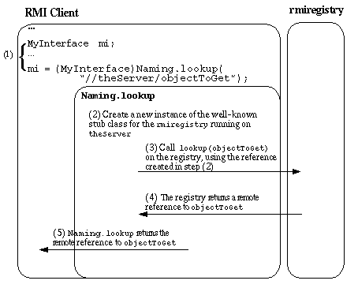
Java RMI Registry Operation

Slide 20
java.rmi.Naming
Naming.rebind(url, remoteobjref)
Naming.rebind(myURL, this);
URL may include a port number. (Default is 1099)
"//hoare.osis.cs.wright.edu:8089/objectname"
Naming.lookup(myURL);
Naming.unbind(myURL);
For security reasons,
bind, unbind, rebind can be called only to the registry running in the same host.
lookup can be called from any host.

Slide 21
Creating a Security Manager
Security Manager determines if the downloaded code has access to the local file system, or can perform any other privileged operations
If there is no Security Manager, RMI will not download classes for objects received as parameters, return values, or exceptions, from places other than the local class path.
RMISecurityManager enforces a similar security policy as the applets.
if (System.getSecurityManager()==null) { System.setSecurityManager ( new RMISecurityManager() ) ; }

Slide 22
cat > ~/java.policy << END
grant { permission java.security.AllPermission;};
grant {
permission java.io.filePermission "/tmp/*", "read", "write";
permission java.net.SocketPermission somehost.somedomain.com:999", "connect";
permission java.net.SocketPermission "*:1024-5535","connect,request";
permission java.net.SocketPermission "*:80","connect";
};
Notes:
END not shown
All double quotes are are normal.

Slide 23
CEG730 WhiteBoard
Doxygen Link http://www.cs.wright.edu/~pmateti/Courses/730/Projects/730-WB-Java-RMI-2012/html/index.html

Slide 24
References
Java Tutorial Bundle Download http://www.oracle.com/technetwork/java/javase/downloads/
Java Concuurency, http://docs.oracle.com/javase/tutorial/essential/concurrency/
Java RMI, http://docs.oracle.com/javase/tutorial/rmi/index.html

