Slide 1
Multiple-Input-Multiple- Output (MIMO) Systems
Basic principles, Algorithms and Networking Applications
HARISH GANAPATHY

Slide 2
Topics
Motivations for the development of MIMO systems
MIMO System Model and Capacity Studies
Design Criterion for MIMO Systems (Diversity Vs Spatial Multiplexing)
Some actual architectures based on these criterion
MIMO-OFDM
Networking Applications: MAC protocol for MIMO PHY layer
Conclusions

Slide 3
Aspirations
High data rate wireless communications links with transmission rates nearing 1 Gigabit/second (will quantify a “bit” shortly)
Provide high speed links that still offer good Quality of Service (QoS) (will be quantified mathematically)

Slide 4
Aspirations (Mathematical) of a
System Designer
Achieve
“Channel Capacity (C)”
High data rate
Quality
Minimize Probability of Error (P_{e})
Minimize complexity/cost of
implementation of proposed
System
Minimize transmission power
required (translates into SNR)
Minimize Bandwidth (frequency
spectrum) Used
Real-life Issues

Slide 5
Antenna Configurations
Single-Input-Single-Output (SISO) antenna system
User data stream
channel
User data stream
Theoretically, the 1Gbps barrier can be achieved using this configuration if you are allowed to use much power and as much BW as you so please!
Extensive research has been done on SISO under power and BW constraints. A combination a smart modulation, coding and multiplexing techniques have yielded good results but far from the 1Gbps barrier

Slide 6
MIMO Antenna Configuration
Use multiple transmit and multiple receive antennas for a single user
1
1
2
2
User data stream
.
.
.
channel
User data stream
.
.
.
.
.
.
.
M_{T}
M_{R}
Now this system promises enormous data rates!

Slide 7
Data Units
Will use the following terms loosely and
interchangeably,
Bits (lowest level): +1 and -1
Symbols (intermediate): A group of bits
Packets (highest level): Lots and lots of
symbols

Slide 8
Shannon’s Capacity (C)
Given a unit of BW (Hz), the max error-free transmission rate is
C = log₂(1+SNR) bits/s/Hz
Define
R: data rate (bits/symbol)
R_{S}: symbol rate (symbols/second)
w: allotted BW (Hz)
Spectral Efficiency is defined as the number of bits transmitted per second per Hz
R x R_{S} bits/s/Hz
W
As a result of filtering/signal reconstruction requirements, R_{S} ≤ W. Hence Spectral Efficiency = R if R_{S} = W
If I transmit data at a rate of R ≤ C, I can achieve an arbitrarily low P_{e}

Slide 9
Spectral Efficiency
Spectral efficiencies of some widely used modulation schemes
Scheme | b/s/Hz
BPSK | 1
QPSK | 2
16-QAM | 4
64-QAM | 6
The Whole point: Given an acceptable P_{e} , realistic power and BW limits, MIMO Systems using smart modulation schemes provide much higher spectral efficiencies than traditional SISO

Slide 10
MIMO System Model
h₁₁
s₁
y₁
h₁₂
s₂
.
.
y₂
User data stream
User data stream
.
.
.
.
.
.
Channel
Matrix H
s_{M}
y_{M}
s
y
Transmitted vector
Received vector
y = Hs + n
M_{T}
h₁₁ h₂₁ …….. h_{M1}
h_{ij} is a Complex Gaussian random variable that models fading gain between the ith transmit and jth receive antenna
h₁₂ h₂₂ …….. h_{M2}
Where H =
M_{R}
. . …….. .
h_{1M} h_{2M} …….. h_{MM}

Slide 11
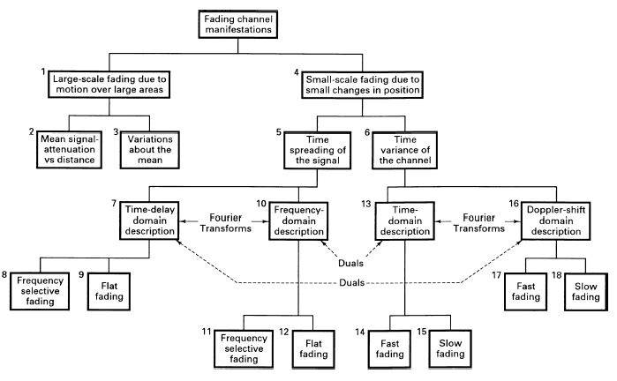
Types of Channels

Slide 12
Fading Channels
Fading refers to changes in signal amplitude and phase caused by the channel as it makes its way to the receiver
Define T_{spread} to be the time at which the last reflection arrives and T_{sym} to be the symbol time period
Time-spread of signal
Frequency-selective
Frequency-flat
T_{spread}
T_{spread}
time
time
T_{sym}
T_{sym}
freq
freq
1/T_{sym}
1/T_{sym}
Occurs for wideband signals (small T_{sym})
TOUGH TO DEAL IT!
Occurs for narrowband signals (large T_{sym})
EASIER! Fading gain is complex Gaussian
Multipaths NOT resolvable

Slide 13
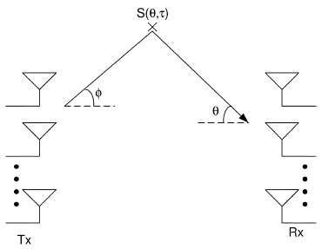



Channel Matrix H
In addition, assume slow fading
MIMO Channel Response
Channel Time-variance
Time-spread
Taking into account slow fading, the MIMO channel impulse response is constructed as,
a and b are transmit and receive array factor vectors respectively. S is the complex gain that is dependant on direction and delay. g(t) is the transmit and receive pulse shaping impulse response
Because of flat fading, it becomes,
  With suitable choices of array geometry and antenna element patterns,
  H( ) = H which is an M_{R} x M_{T} matrix with complex Gaussian i. i. d random variables
  Accurate for NLOS rich-scattering environments, with sufficient antenna spacing at transmitter and receiver with all elements identically polarized

Slide 14
Capacity of MIMO Channels
y = Hs + n
Let the transmitted vector s be a random vector to be very general and n is normalized noise. Let the total transmitted power available per symbol period be P. Then,
C = log ₂ (I_{M} + HQH^{H}) b/s/Hz
where Q = E{ss^{H}} and trace(Q) < P according to our power constraint
Consider specific case when we have users transmitting at equal power over the channel and the users are uncorrelated (no feedback available). Then,
C_{EP} = log ₂ [I_{M} + (P/M_{T})HH^{H}] b/s/Hz
Telatar showed that this is the optimal choice for blind transmission
Foschini and Telatar both demonstrated that as M_{T} and M_{R} grow,
C_{EP} = min (M_{T},M_{R}) log ₂ (P/M_{T}) + constant b/s/Hz
Note: When feedback is available, the Waterfilling solution is yields maximum capacity but converges to equal power capacity at high SNRs

Slide 15
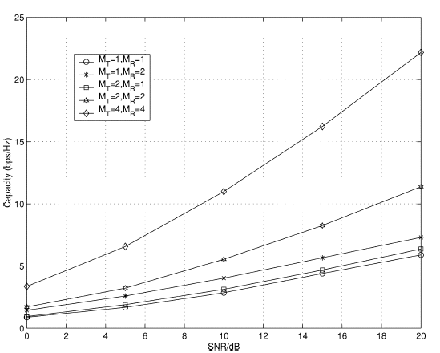
Capacity (contd)
The capacity expression presented was over one realization of the channel. Capacity is a random variable and has to be averaged over infinite realizations to obtain the true ergodic capacity. Outage capacity is another metric that is used to capture this
  So MIMO promises enormous rates theoretically! Can we exploit this
  practically?

Slide 16
MIMO Design Criterion
MIMO Systems can provide two types of gain
Spatial Multiplexing Gain
Diversity Gain
Maximize transmission rate (optimistic approach)
Use rich scattering/fading to your advantage
Minimize P_{e} (conservative approach)
Go for Reliability / QoS etc
Combat fading
If only I could have both! As expected, there is a tradeoff
System designs are based on trying to achieve either goal or a little of both

Slide 17
Diversity
Each pair of transmit-receive antennas provides a signal path from transmitter to receiver. By sending the SAME information through different paths, multiple independently-faded replicas of the data symbol can be obtained at the receiver end. Hence, more reliable reception is achieved
A diversity gain d implies that in the high SNR region, my P_{e} decays at a rate of 1/SNR^{d} as opposed to 1/SNR for a SISO system
The maximal diversity gain d_{max} is the total number of independent signal paths that exist between the transmitter and receiver
For an (M_{R},M_{T}) system, the total number of signal paths is M_{R}M_{T}
1 ≤ d ≤ d_{max}= M_{R}M_{T}
The higher my diversity gain, the lower my P_{e}

Slide 18

Spatial Multiplexing
y = Hs + n → y’ = Ds’ + n’ (through SVD on H)
where D is a diagonal matrix that contains the eigenvalues of HH^{H}
Viewing the MIMO received vector in a different but equivalent way,
C_{EP} = log ₂ [I_{M} + (P/M_{T})DD^{H}] = log ₂ [1 + (P/M_{T})ג_{i}] b/s/Hz
Equivalent form tells us that an (M_{T},M_{R}) MIMO channel opens up
m = min (M_{T},M_{R}) independent SISO channels between the transmitter and the receiver
So, intuitively, I can send a maximum of m different information symbols over the channel at any given time

Slide 19
Practical System
1
r_{s} : number of different symbols N transmitted in T symbol periods
r_{s} = N/T
R bits/symbol
2
Channel coding
Symbol mapping
Space-Time Coding
.
.
M_{T}
Redundancy in time
Coding rate = r_{c}
Space- time redundancy over T symbol periods
Spatial multiplexing gain = r_{s}
Non-redundant portion of symbols
Spectral efficiency = (R*r_{c} info bits/symbol)(r_{s})(R_{s} symbols/sec)
w
= Rr_{c}r_{s} bits/s/Hz assuming R_{s} = w
r_{s} is the parameter that we are concerned about: 0 ≤ r_{s} ≤ M_{T}
** If r_{s} = M_{T}, we are in spatial multiplexing mode (max transmission rate)
**If r_{s} ≤ 1, we are in diversity mode

Slide 20
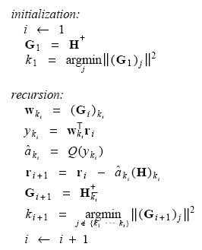
V-BLAST – Spatial Multiplexing
(Vertical Bell Labs Layered Space-Time Architecture)
This is the only architecture that goes all out for maximum rate. Hope the channel helps me out by ‘splitting’ my info streams!
s₁
y₁
User data stream
s₂
y₂
V-BLAST Processing
User data stream
.
.
H
.
.
.
.
.
.
s_{M}
y_{M}
M_{T} ≤ M_{R}
s
y
Split data into M_{T} streams → maps to symbols → send
Assume receiver knows H
Uses old technique of ordered successive cancellation to recover signals
Sensitive to estimation errors in H
r_{s} = M_{T} because in one symbol period, you are sending M_{T} different symbols

Slide 21
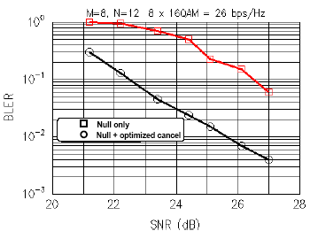
V-BLAST
(Experimental Results)
The prototype in an indoor environment was operated at a carrier frequency of 1.9 GHz, and a symbol rate of 24.3 ksymbols/sec, in a bandwidth of 30 kHz with M_{T} = 8 and M_{R} = 12
Results shown on Block-Error-Rate Vs average SNR (at one received antenna element); Block = 100 symbols ; 20 symbols for training
Each of the eight substreams utilized uncoded
16-QAM, i.e. 4 b/symb/trans
Spec eff = (8 xmtr) ( 4 b/sym/xmtr )(24.3 ksym/s)
30 kHz
= 25. 9 bps/Hz
In 30 kHz of bandwidth, I can push across 621Kbps of data!! Wireless spectral efficiencies of this magnitude are unprecedented, and are furthermore unattainable using traditional techniques

Slide 22
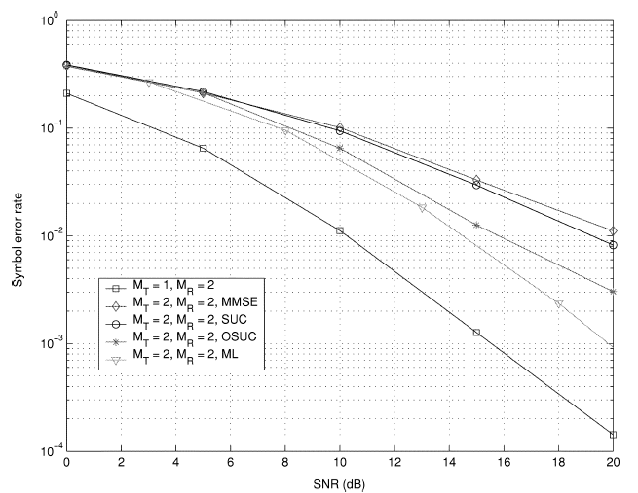
Alternate Receivers
Can replace OSUC by other front-ends; MMSE, SUC, ML for instance
OSUC
ML

Slide 23

D-BLAST – a little of both
(Diagonal Bell Labs Layered Space-Time Architecture)
In D-BLAST, the input data stream is divided into sub streams which
are coded, each of which is transmitted on different antennas time
slots in a diagonal fashion
For example, in a (2,2) system
receiver first estimates x₂⁽¹⁾ and then
estimates x₁⁽¹⁾ by treating x₂⁽¹⁾ as
interference and nulling it out
The estimates of x₂⁽¹⁾ and x₁⁽¹⁾ are fed to a
joint decoder to decode the first substream
M_{T} ≤ M_{R}
After decoding the first substream, the receiver cancels
the contribution of this substream from the received signals
and starts to decode the next substream, etc.
Here, an overhead is required to start the detection process;
corresponding to the 0 symbol in the above example
Receiver complexity high

Slide 24

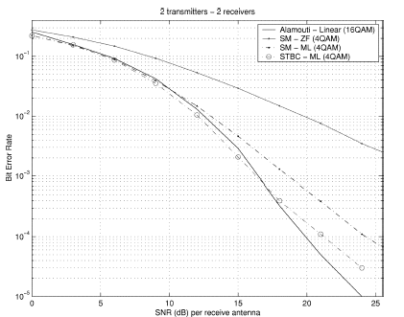
Alamouti’s Scheme - Diversity
Transmission/reception scheme easy to implement
Space diversity because of antenna transmission. Time diversity because of transmission over 2 symbol periods
Consider (2, M_{R}) system
Receiver uses combining and ML detection
r_{s} = 1
If you are working with a (2,2) system, stick with Alamouti!
Widely used scheme: CDMA 2000, WCDMA and IEEE 802.16-2004 OFDM-256
V-BLAST SUC
Alamouti

Slide 25
Comparisons
Scheme | Spectral Efficiency | P_{e} | Implementation Complexity
V-BLAST | HIGH | HIGH | LOW
D-BLAST | MODERATE | MODERATE | HIGH
ALAMOUTI | LOW | LOW | LOW

Slide 26
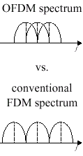
Orthogonal Frequency Division Multiplexing (OFDM)
As the data rate increases in a multipath environment, the interference goes from flat fading to frequency selective (last reflected component arrives after symbol period). This results in heavy degradation
Most popular solution to compensate for ISI: equalizers
As we move to higher data rates (i.e.> 1 Mbps), equalizer complexity grows to level of complexity where the channel changes before you can compensate for it!
Alternate solution: Multi-carrier Modulation (MCM) where channel is broken up into subbands such that the fading over each subchannel becomes flat thus eliminating the problem of ISI
Multi-carrier Modulation
FDMA
OFDM

Slide 27

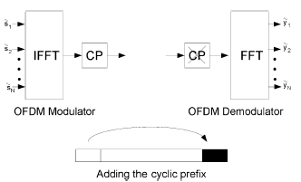
OFDM Spectral Efficiency
The spectral efficiency of an OFDM-(PSK/ASK) system is same as compared to using the (PSK/ASK) system alone
Spec eff = log ₂ M bits/s/Hz
However, you have successfully converted an ugly channel into a channel that you can use
R_{s}/ 3 symbols/s
R_{s} symbols/s
easy to implement
Used in IEEE 802.11A, .11G, HiperLAN, IEEE 802.16

Slide 28
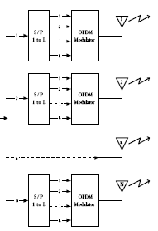
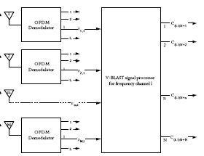
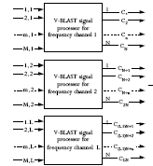
MIMO-OFDM
OFDM extends directly to MIMO channels with the IFFT/FFT and CP operations being performed at each of the transmit and receive antennas. MIMO-OFDM decouples the frequency-selective MIMO channel into a set of parallel MIMO channels with the input–output relation for the ith (i = 0, 2,…,L-1) tone,
y_{i} = H_{i}s_{i} + n_{i} i = 0, 2,…, L-1

Slide 29
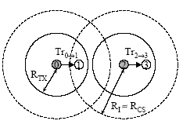
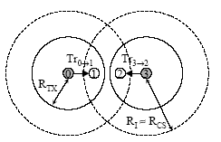
IEEE 802.11 MAC (DCF Mode)
As a result of the CSMA/CA with RTS/CTS MAC protocol, two issues arise
-the unfairness problem
-extreme throughput degradation (ETD)
Throughtput T_{2→3} > Throughtput T_{0→1}
Unfairness
Both throughtput T_{2→3} and throughtput T_{0→1} are equally affected
ETD

Slide 30
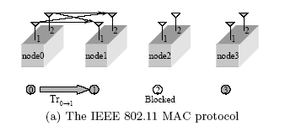
MIMO-Based Solutions
Use multiple transmit and receive antennas
Again, MIMO provides
-increase in rate
-decrease in P_{e} (as a result of diversity, interference cancellation abilities etc)
Simply use 802.11 with M_{T}= M_{R}=2.
VBLAST-ZF is an option
Two data streams transmitted from node 0 to 1 instead of 1. Increases transmission rate. Increases overall capacity of network
Does not address unfairness and ETD

Slide 31
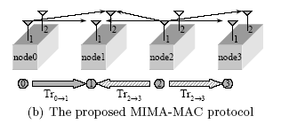
MIMO-Based Solutions
MIMA-MAC Protocol
Mitigating Interference using Multiple Antennas (MIMA) MAC protocol
[Tang, Park, Nettles, Texas at Austin, submitted to Proc. ACM Mobicom, Philadelphia, PA, USA on Sep. 26 – Oct. 1, 2004]
Each transmitter views it as a (1,2) MIMO system.
Unfairness (SDT): node 1 concentrates on node 0 and supresses node 2. Increase in throughput Tr_{o→1}
ETD (ODT): node 1 concentrates on node 0 and supresses node 3 stream. node 2 concentrates on node 3 and supresses node 0 stream. Increase in throughput Tr_{o→1} and Tr_{3→2}

Slide 32
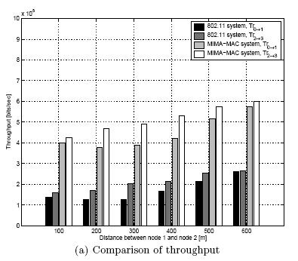
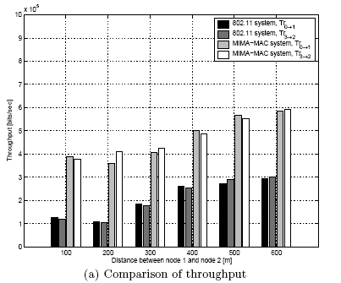
Simulation Results
SDT
Unfairness
ODT
Throughput degradation

Slide 33
Summary/Conclusions
MIMO Systems are getting us closer to the 1Gbps landmark (aspiration 1)
At the same time, they provide reliable communications (aspiration 2)
Different architectures available for use
Developing efficient network protocols for a MIMO PHY layer is an area of open research

Slide 34
References
“Layered Space-Time Architecture for Wireless Communication in a Fading
Environment When using Multi-Element Antennas”, G.J.Foschini, Bell Labs Tech Journal, 1996
“An Overview of MIMO Communications – A Key to Gigabit Wireless”, A.J Paulraj,
Gore, Nabar and Bolcskei, IEEE Trans Comm, 2003
“Improving Fairness and Throughput of Ad Hoc Networks Using Multiple Antennas”, Park, Choi and Nettles, submitted Mobicom 2004
“From Theory to Practice: An Overview of MIMO Space-Time Coded Wireless Systems”, Gesbert et al.,IEEE Sel Comm, 2003
“On Limits of Wireless Communications in a Fading Environment”, Foschini and Gans, Wireless Personal Comm, 1998
“A Simple Transmit Diversity Technique for Wireless Communications”, Alamouti, IEEE Sel Comm, 1998
“Diversity and Multiplexing: A Fundamental Tradeoff in Multiple-Antenna Channels”, Zheng and Tse, IEEE Trans Info Theory, 2003
“V-BLAST: An Architecture for Realizing Very High Data Rates
Over the Rich-Scattering Wireless Channel”, Wolniansky, Foschini, Golden and Valenzuela, Electronic Letters, 1999
“MIMO-OFDM Systems for High Data Rate Wireless Networks”, Whu

