Slide 1
Inmate Narratives: Analysis of the last words spoken by prison inmates
Paridhi Mathur
University of Maryland, College Park

Slide 2
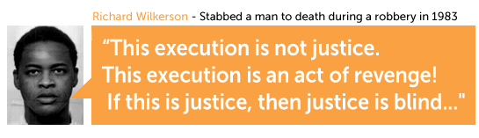
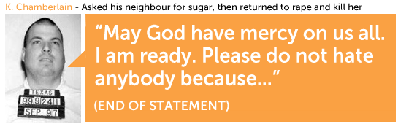
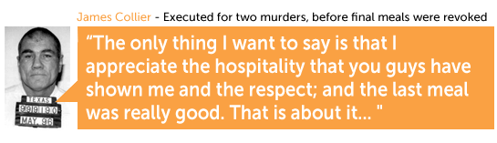
"...I'm ready to roll. Time to get this party started."
James Jackson

Slide 3
Can we model the state of mind of a convicted felon who is sentenced to death, at the time of execution, given a set of features derived from prisoner demographics, last statements and crime conducted?

Slide 4
Motivation
Move Psychology closer to Predictive Science.
Mental-State research as a precursor to emotion/sentiment analysis and prediction.
Data availability for mental state analysis.
Notes:
Potential applications :
Mental-healthcare (Forecasting)
Pre-emptive care for individuals experiencing extreme mental conditions(Army personnel at war, Cyber-bullying victims)

Slide 5
Related Work
Kelley, B. D. & Foley, S. R. (2013). Love, spirituality and regret: Thematic analysis of last statements from Death Row, Texas (2006-2011). Journal of the American Academy of Psychiatry and the Law, 41(4), 540-550.
Inferential Statistical analysis of the last statements of prisoners based on derived themes.
Tangney, J. P., Stuewig, J., & Hafez, L. (2011). Shame, Guilt and Remorse: Implications for Offender Populations.
The differences between the feelings of shame and guilt through psychological theories and research.
Concluded that shame is more influenced by public factors whereas guilt is an internal feeling.

Slide 6
Related Work
Nikfarjam, A., Emadzadeh, E., & Gonzalez, G. (2012). A Hybrid System for Emotion Extraction from Suicide Notes.
Rule-based and machine learning technique
Rules based on semantic and syntactic features
Osherenko, A. (2008, April). Towards semantic affect sensing in sentences.
Text split into sentences, which are further split into phrases
Emotion classification based on semantic features

Slide 7
Dataset
Collection Process:
Approximately 72% data was in the form of images.
Two techniques used:
Web-scraping
Manual Transcribing
Total records in dataset: 532
Records of 12 inmates were unavailable
Manual feature extraction
Source: ‘Texas Department of Criminal Justice’ website.
Total number of death penalties: 544

Slide 8
Data Features
Features
Has_codefendants
No_months_deathrow
No_victims
Is_child_victim
Is_victim_related
Is_sexual_assault
Religious_reference
Literary_reference
Forgiveness_request
Used_love
Race
Age at the time of crime
Age when executed
Regret
Hostility
Apology
Mental states
Unbearable Psychological Pain
Indirect Expressions
Rejection Aggression
Identification Egression
Cognitive Constriction
Inability to adjust

Slide 9
“”
“You're not about to witness an execution, you are about to witness a murder. I am strapped down for something Marcus Rhodes did. I never killed anybody, ever. I love you, Mom. I love you, Tali. This is wrong. This whole thing is wrong. I can't believe you are going to let Marcus Rhodes walk around free. Justice has let me down. Somebody completely screwed this up. I love you too, Mom. Well Warden, if you are going to murder someone, go ahead and do it. Pull the trigger. It's coming. I can feel it coming. Goodbye.”
Steven Woods
Notes:
Unbearable
Cognitive
Rejection Aggression

Slide 10
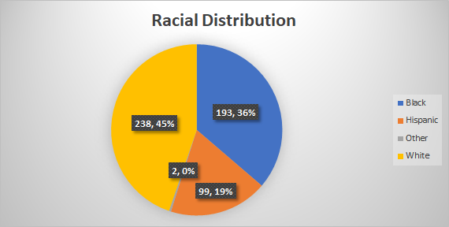
Understanding the Data
Age: 388 inmates were in the age group of 20-35 with 37 inmates were received at the age of 23, while 13 at the age of 35.
Race: 238 (44.74%) inmates were white, followed by 193 (36.28%) blacks.
Education: 107(20.11%) inmates had completed education till 12th while 88(16.54%) had completed till 10th. 35 (6.58%) had no formal education.
78 cases (14%) involved a child.
110 cases (20%) involved sexual assault.
In 103 cases (19%), the victim was known.

Slide 11
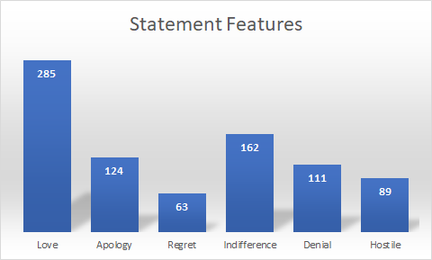
Understanding the data
Statement features
201(37%) inmates made reference to God in the form of Jesus and Allah.
Love was the most recurring feature. 285 i.e. 53% inmates used the word love in their last statements.
Love and an apologetic behavior occurred together 94 (17%) last statements.
103 inmates i.e. 19% did not give a last statement.

Slide 12
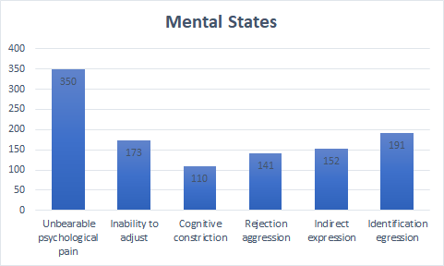
Understanding the Data
Mental States:
Most common mental state was ‘Unbearable Psychological Pain’, shown by 350 (65.79%) inmates.
Least common mental state was ‘Cognitive Constriction’, shown by 110 (20.68%) inmates.
367(68%) showed an overlap between 2-3 mental states while 120(22%) inmates showed only one mental state.
Unbearable psychological pain and Identification egression occurred together in 126 (23%) inmates.

Slide 13
Approach
Number of mental states | Count
One | 120
Two | 298
Three | 69
Four | 34
Five | 8
Six | 3
 | 532
77% of the inmates were found to be having multiple mental states at the time of execution
Instead of building one multi-class classifier, one classifier for each of the mental state
Following classification techniques applied:
Logistic Regression
Support Vector Machine
Random Forest
Naive Bayes

Slide 14
Evaluation
Ground Truth
At the individual level, homicidal behavior is strongly associated with suicidal ideation and suicide attempts
86 percent of psychiatric patients who report homicidal ideation also report suicidal ideation
Feature | UPP | CC | In Exp | ITA | RA | IE
Ground Truth % (n=179) | 46 | 34 | 31 | 27 | 40 | 53
Labelling % (n=431) | 58 | 26 | 35 | 17 | 33 | 44

Slide 15
Evaluation
Krippendorff's Alpha Reliability
Computed to measure inter-rater reliability
Reliability values reflect the effectiveness and clarity of the template used for labelling
Labelling was done in phases and iterations to ensure sufficient inter-rater reliability metric
Obtained Alpha Reliability values >0.67 for most dependent labels indicating sufficient clarity in the reference template used
Reliability Reference Table:
Reliability | Excellent | Sufficient | Poor
Alpha Values | >0.8 | 0.67-0.8 | <0.67

Slide 16
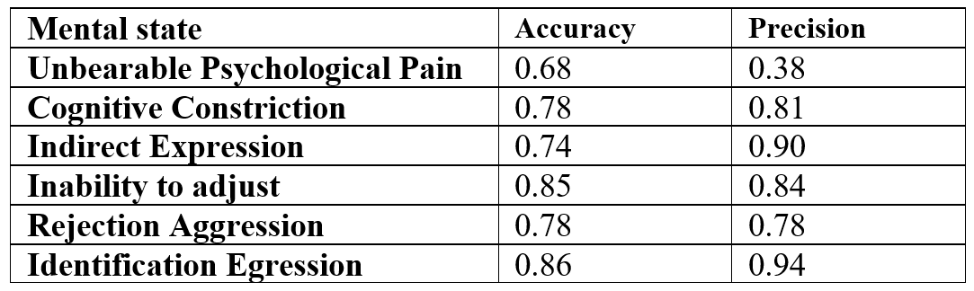
Evaluation
Two measures used to evaluate the models :
Accuracy
Precision
Different models work for different mental states
Notes:
Naive bayes
SVM
Naive bayes
Random Forest
SVM
Naive bayes

Slide 17
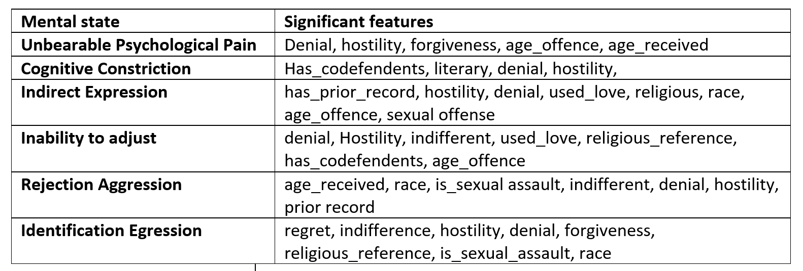
Insights

Slide 18
Thank You

Slide 19
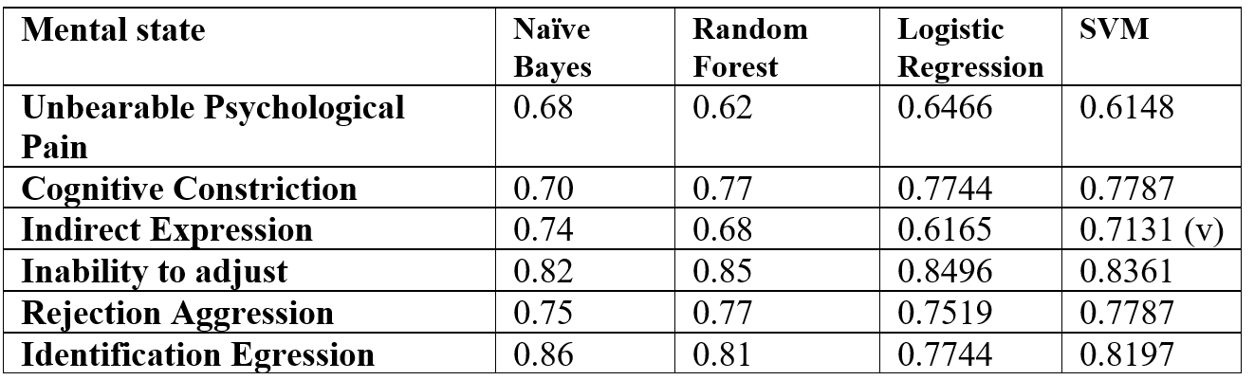
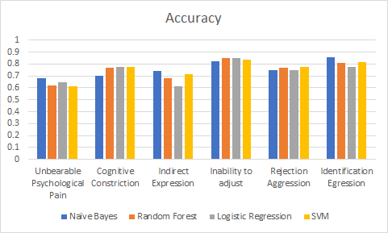
Evaluation
Accuracy

Slide 20
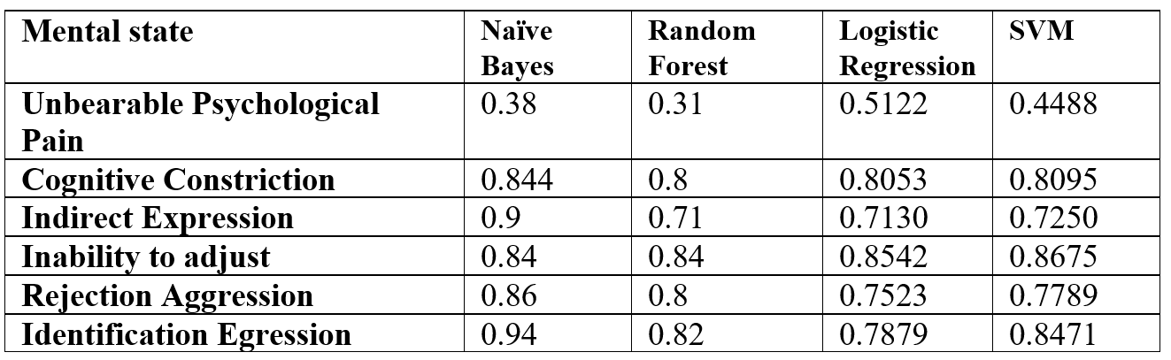
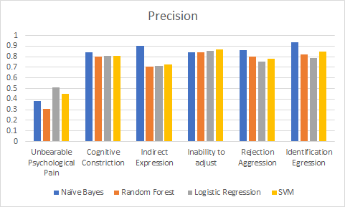
Evaluation
Precision

Slide 21
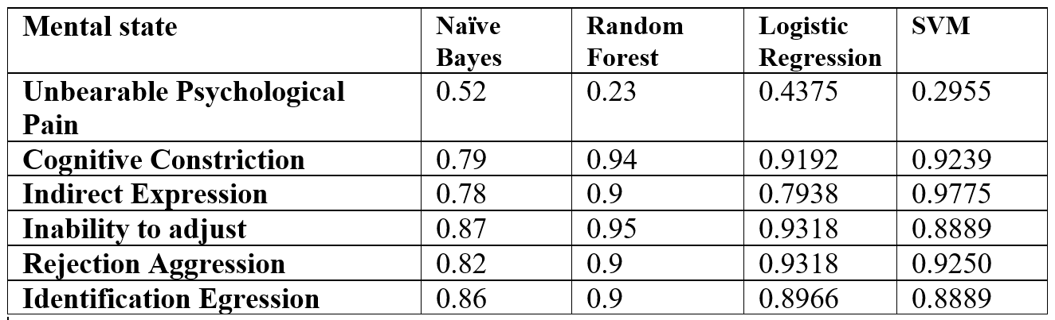
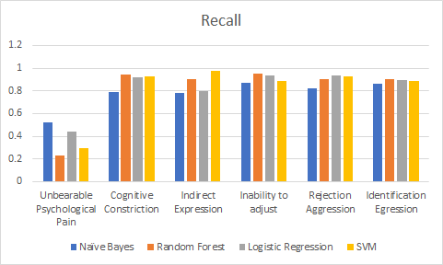
Evaluation
Recall

