Slide 1
UBS Data Science Task
Ismet Ferdi SEN

Slide 2
Data Pre-processing
Check whether there is missing value?
If yes eliminate them whether deleting if the number not to much
or impute them if keeping them more logical.
Check whether the classes are evenly sampled?
If not try to duplicate the less one to reach a more balanced sampling.
Split Data into Training and Validation parts, use stratify parameter to preserve proportion of classes balanced in the train and validation set.
Perform Feature Normalization (Data standardization) using only TRAINING DATA for both Training set and Validation Set, to sure our model generalize well on new, unseen data.

Slide 3
Classifier preparation
Define a function to train many classifier at once and to print their performance.
Search on scikit-learn for different classifier.
Chosen ones:
Linear SVM, SVM Classifier, Decision Tree, Random Forest, Neural Net, AdaBoost, Naive Bayes

Slide 4
Results for Task-1 (with 130 features)
Classifier | Training-Set Accuracy | Validation-Set Accuracy
Linear SVM | 84.64% | 85.80%
SVM Classifier | 95.85% | 92.55%
Decision Tree | 92.77% | 91.30%
Random Forest | 85.49% | 81.95%
Neural Net | 94.17% | 92.75%
AdaBoost | 92.10% | 92.00%
Naive Bayes | 82.93% | 83.45%

Slide 5
Challenges
Neural Network tend to be overfitted with default parameters.
Activated the early stopping parameter for Neural Network Classifier to prematurely stop the training at an optimal epoch. It solved the overfitting-problem.
Neural Network Classifiers | Training-Set Accuracy | Validation-Set Accuracy
Without early stopping | 98.66% | 91.55%
With early stopping | 94.17% | 92.75%

Slide 6
Feature Selection
Measure associations between a feature and the target using Mutual Information. Mutual Information (MI) detect any kind of relationship, while correlation only detects linear relationships.
Selected 9 features with the highest MI-scores had show better performance.
In order to speed up the model, I reduced the number of hidden layers of the neural network as the number of feature sets decreased.
Other than that, I created new features with PCA from the strongest features and checked their success. I got reasonable results with only 4 principal component.

Slide 7
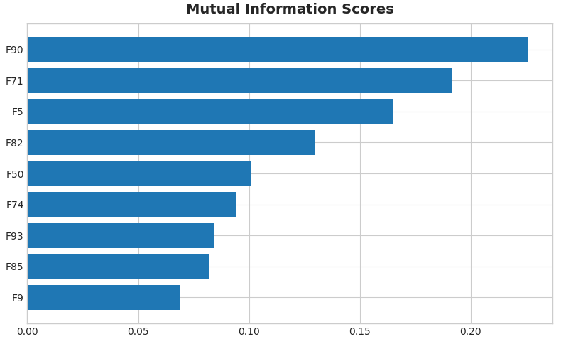
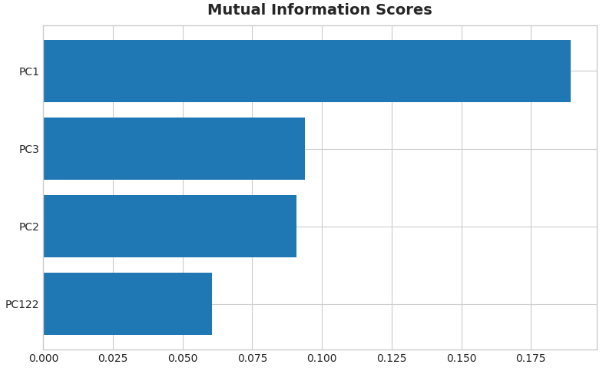
Feature-Mutual Information and PCA-Mutual Information
Feature Set
Principal Components

Slide 8
Results for Task-2
Classifier | Validation-Set Accuracy Without feature selection (130 features) | Validation-Set Accuracy Feature selection with Mutual Information (10 features) | Validation-Set Accuracy Feature selection with PCA (4 PCs)
Linear SVM | 85.80% | 86.40% | 83.10%
SVM Classifier | 92.55% | 94.80% | 92.60%
Decision Tree | 91.30% | 92.05% | 88.65%
Random Forest | 81.95% | 91.35% | 90.10%
Neural Net | 92.75% | 92.45% | 91.65%
AdaBoost | 92.00% | 92.60% | 88.75%
Naive Bayes | 83.45% | 83.55% | 88.10%

Slide 9
Thank you for giving me chance to show my skills.
Ismet Ferdi SEN

