Slide 1

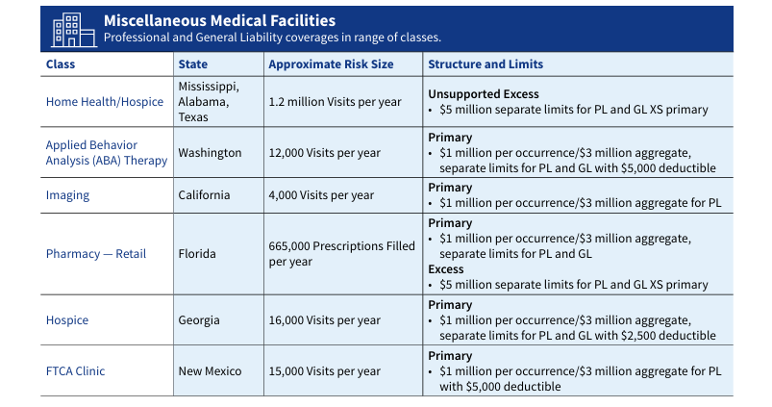
Lexington Healthcare An AIG company
For more than 50 years, brokers have turned to Lexington Insurance Company for reliable and market-leading insurance products and services. Our solutions meet the specialized needs a wide range of healthcare organizations, including large hospitals, remote ambulatory facilities, and long-term care providers.
Why Choose Lexington Healthcare? Lexington Healthcare combines its collective experience with broad coverages and flexibility in rate and policy terms to create tailored insurance programs. And, with continual investment in risk management services, policyholders are supported with best-in class tools and resources to help prevent or mitigate losses. When a loss does occur, however, Lexington Healthcare’s claims investigation and resolution services are provided by experienced claims teams dedicated solely to healthcare-related claims. Healthcare Industry Leader for 50+ Years 25+ In-House Healthcare Claims Professionals Dedicated Healthcare Clinical Risk Managers Solutions for Hospitals and Healthcare Systems
Today, hospitals across the country face challenges, including economic pressures, financial stability, physician recruitment, and patient safety. However, while delivery of care challenges may be the same, no two organizations are exactly alike.
With organizational structures varying from system to system, the flexibility and scope of coverage from a professional liability carrier become critical in order to ensure proper protection is in place. Lexington Insurance has been providing continuous, flexible coverage options to the healthcare industry for over 50 years. It combines collective experience with broad coverages and flexibility in rate and form to create tailored insurance programs. And, with Lexington and AIG’s continuous investment in risk management clients are supported with best-in-class tools and resources to prevent and mitigate losses. However, if and when a loss does occur, Lexington clients can rest assured knowing that claims investigation and resolution services are flexible as well, and are provided by experienced teams dedicated solely to healthcare-related claims.
Coverage Solutions
From underwriting expertise and flexible coverage solutions to unparalleled patient safety and claims management services, Lexington’s hospital clients are supported with continuous, tailored protection to manage their exposures at the time when it matters most.
Sample of March 2025 Coverage Written

