Slide 1


Web PII Projeto Interdisciplinar
João Pinho nº40200357
Pedro Baldaia nº40200388

Slide 2
TÓPICOS A ABORDAR
REST API
PLANEAMENTO DE PROJETO
STAKEHOLDER REGISTER
MODELO DE GESTÃO
FERRAMENTAS DE GESTÃO
INTERAÇÃO DE IA
PERFORMANCE

Slide 3
INTRODUÇÃO
Testar os conhecimentos sobre filmes e séries
Obter badges
Catálogo de filmes e séries

Slide 4
STAKEHOLDER REGISTER
NAME | TITLE | ROLE | POWER | INTEREST | NEEDS AND WANTS | CONCERN
Team | Developer team | Developer and tester | 100/100 | 100/100 | Programming code review, website fluidity without errors | Time to do it
Admin | UserAdmin | Administrator | 70/100 | 100/100 | Full privileges to add, edit, remove and update quiz, movies and series catalog | Website management
User guest | UserViewer | Viewer | 33/100 | 85/100 | Wants a website where can find review on quizzes, movies and films | Fould of reviews
User player | UserPlayer | Player | 70/100 | 100/100 | Wants a website where can play on quizzes and show their knowledge about it | Foul of games
User creator | UserCreator | Creator | 50/100 | 100/100 | Wants a website where can add, edit, update and delete quizzes | Foul of quizzes

Slide 5

FERRAMENTAS DE GESTÃO
TRELLO
MICROSOFT TEAMS
MICROSOFT PROJECT

Slide 6
PLANEAMENTO DO PROJETO

Slide 7
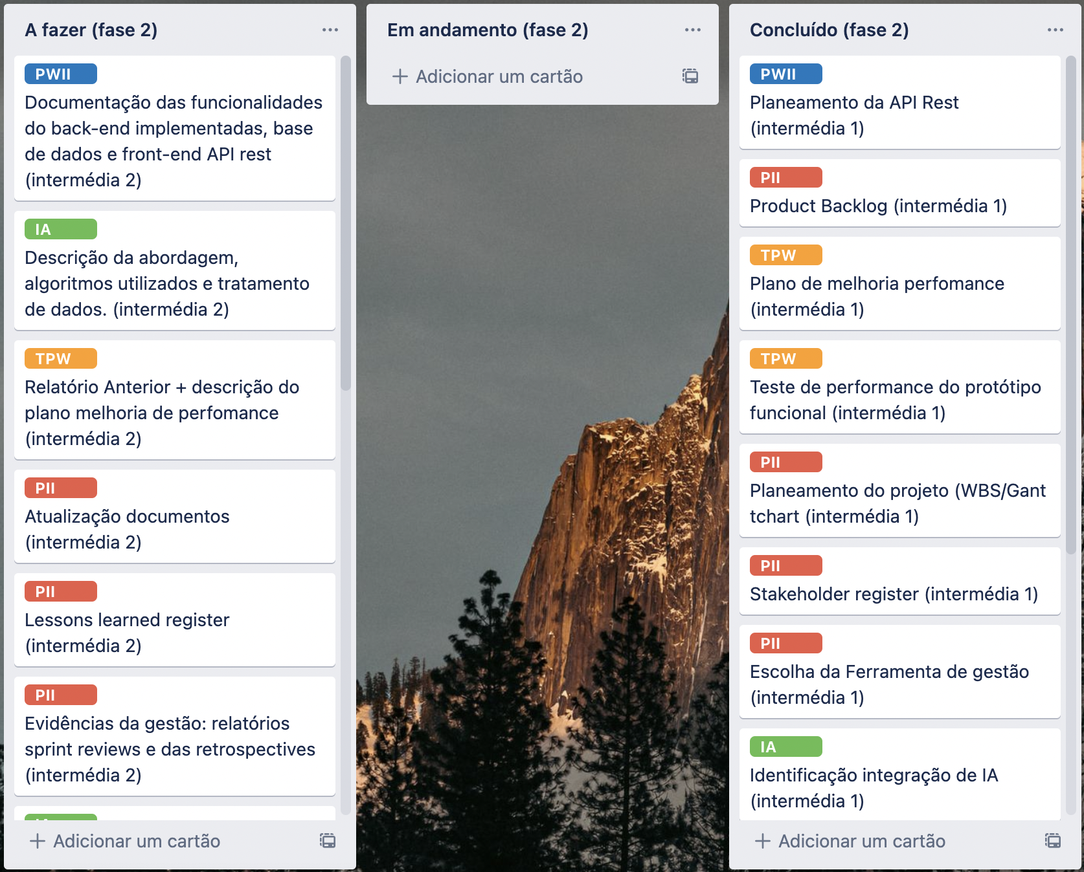
MODELO DE GESTÃO

Slide 8
INTERAÇÃO DE IA
FILTRAR COMENTÁRIOS
CLASSIFICAÇÕES
POPULARES
INTEGRAÇÃO
DE IA

Slide 9
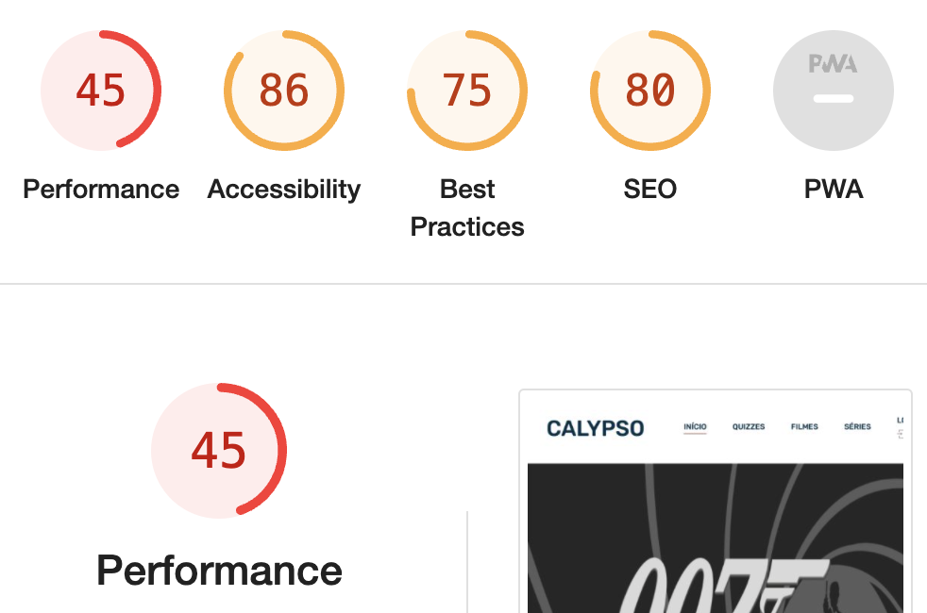
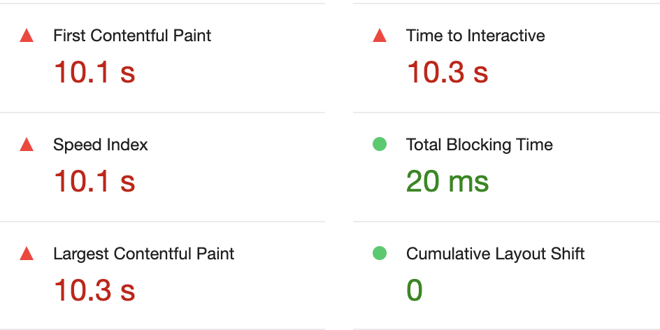
PERFORMANCE

Slide 10
PERFORMANCE – Plano de melhoria
Otimizar o tamanho das imagens;
Reduzir os possíveis plugins presentes;
Minimizar ficheiros de layout, css;
Minimizar ficheiros de javascript;
Simplificar o código removendo espaços.
PERFORMNCE

Slide 11
REST API
GET for catalogs
Method | URL
GET | /movies?page=pageNB&tipo={tipo_id}&ano={year}
Status | Response
200 OK | Response will be an object containing the selected amount of movies (array) as well as the updated recipe database.
404 Not Found | {"error":" Page not found"}
500 Internal server error | {"error":"Something went wrong. Please try again later"}
Type | Parameters | Format | Required
BODY | pageNB | Int | yes
BODY | tipo_id | String | no
Body | Year | Int | no

