Slide 1
Preliminary Secondary Ejecta Model Results
Anthony M. DeStefano
NASA/MSFC/EV44
6/16/2020

Slide 2
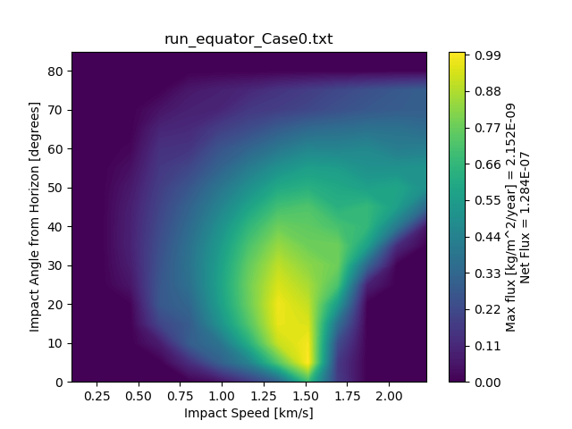
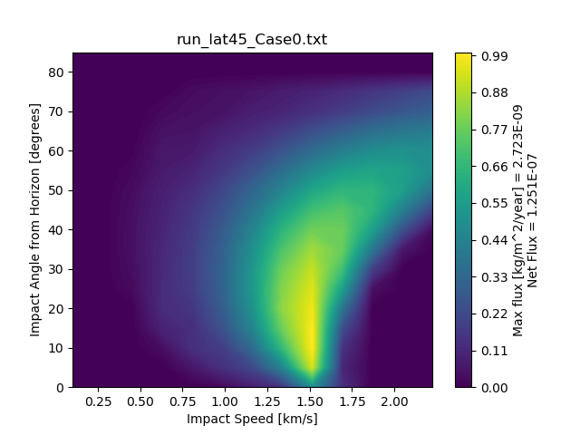
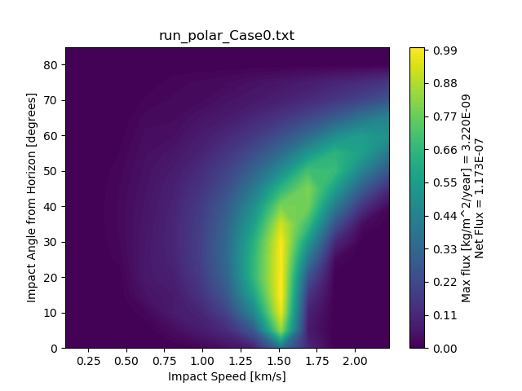
Case 0: Isotropic ejecta (all angles reach ROI [unphysical])
Trying to show latitudinal dependence of primary fluxes on the secondary fluxes (not taking into account the speed distribution)
  A broader distribution of speeds can be “seen” at the equator compared with higher latitude regions

Slide 3
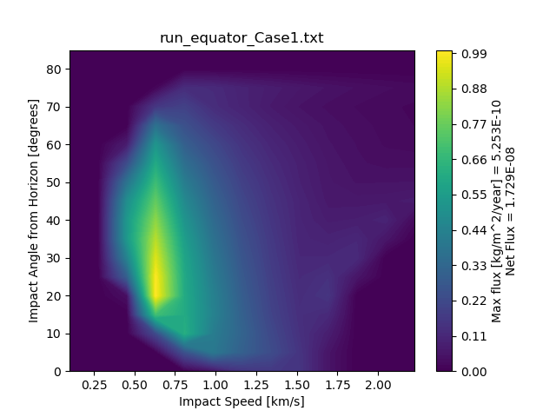
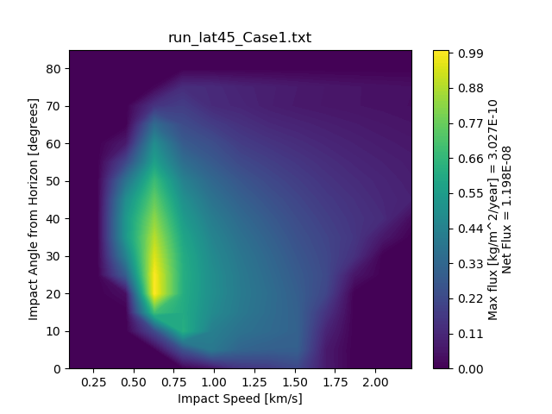
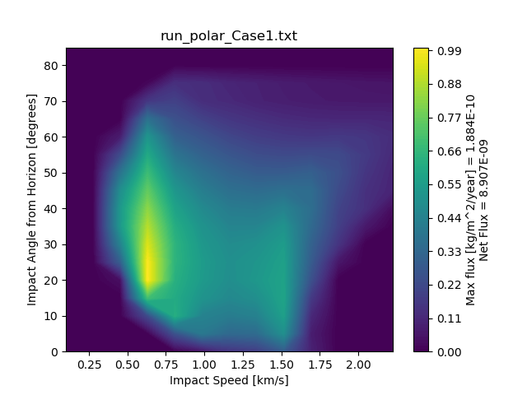
Case 1: Isotropic ejecta (only FOV reaches ROI)
About a factor of 2 less flux at poles than equator
Equatorial region has a single large speed “sweet spot”
Polar region has two, one similar to the equatorial region and another at twice the speed

