Slide 1

Informal Technical Discussion of LMEEM Anthony M. DeStefano
NASA/MSFC/EV44 Natural Environments Branch 10/20/2022

Slide 2
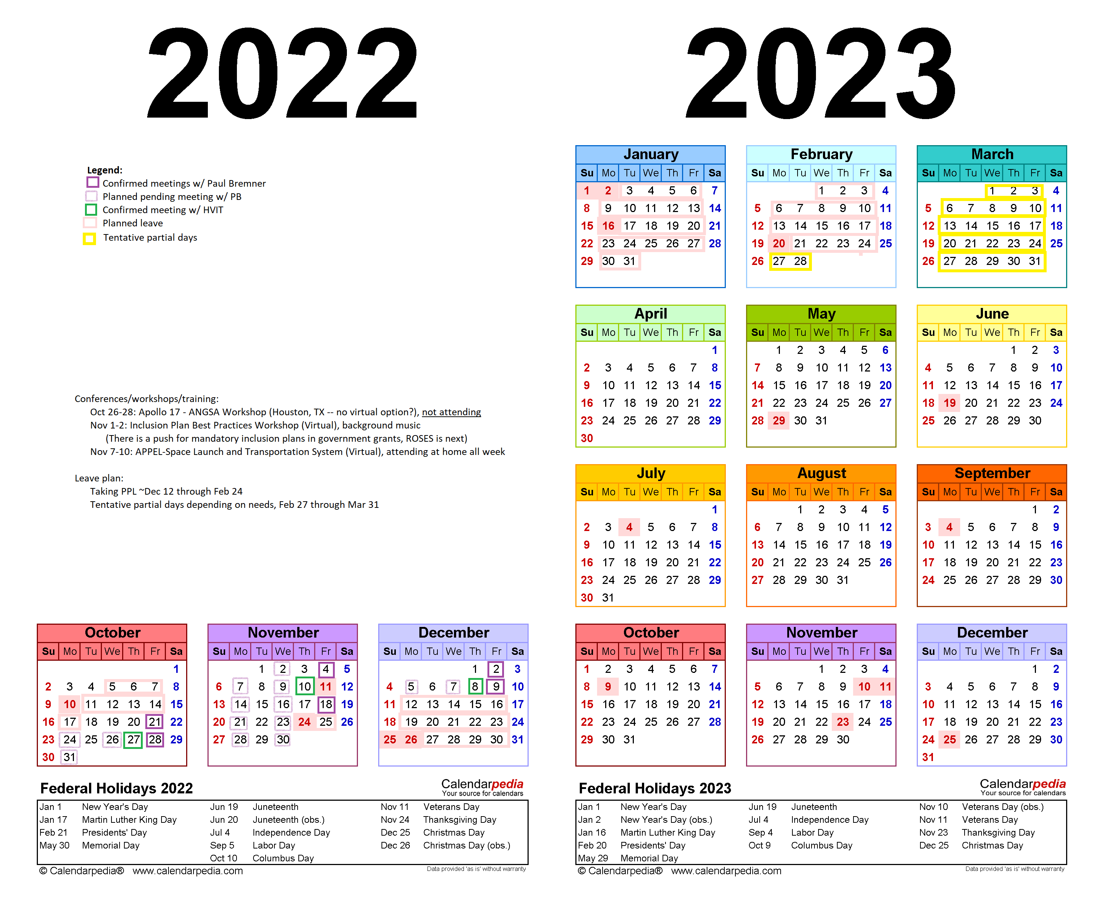
Got the OK from ST13 BC to ask Paul Bremner for 20% of his time (at least through mid Dec)
Confirmed meetings w/ Paul on Fridays
Adding quick (AGILE) Monday and Wednesday meetings
Confirmed meetings w/ HVIT biweekly on Thursdays until mid Dec
Asked EV (and ED?) through EV40 if we have a software engineering person available for 0.5 FTE for 6 months
No hits as of now
Continuing to incorporate software engineering techniques (design patterns, test driven development)

Slide 3
Backup

Slide 4



