Slide 1

Tag-up with HVIT on Bumper & LMEEM
NASA MSFC Natural Environments EV44
Anthony M. DeStefano, Ph.D.
September 29, 2022

Slide 2
Overview
Previously agreed upon input format for Bumper from LMEEM
DSNE tables of meteoroid ejecta horizon angle & speed + mass distribution and constant density for different selenographic latitudes
Post NESC review, e.g.:
Mass distribution will be computed using Monte Carlo models and not assuming virgin regolith mass distribution
Possibility for more speed bins
Include speeds faster than escape speed (for near-field effects)
Take into account height of surface asset
Answer questions given by Kevin Deighton (HVIT) per 9/7/22 email
Discussion

Slide 3
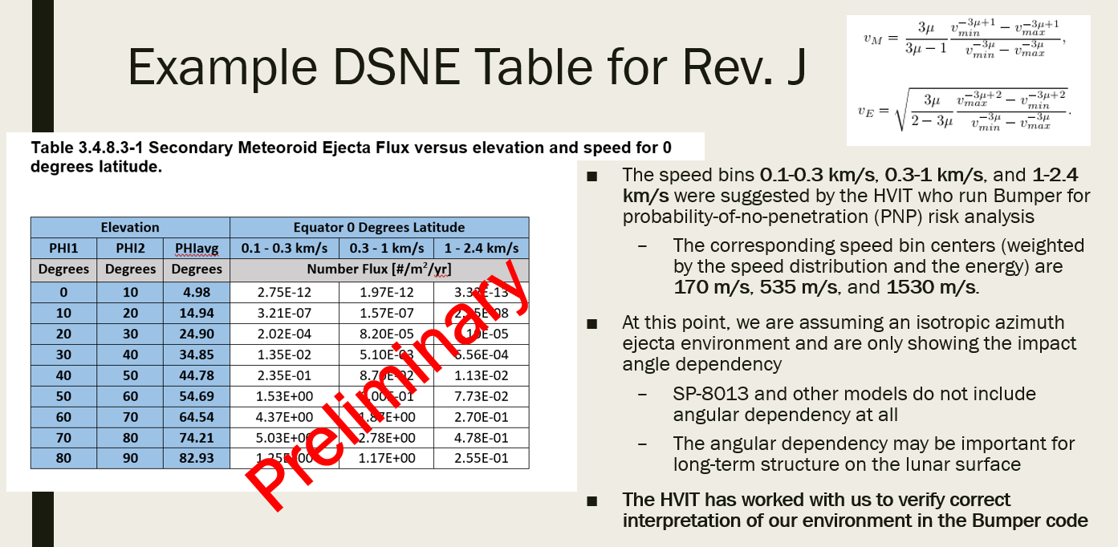

Slide 4
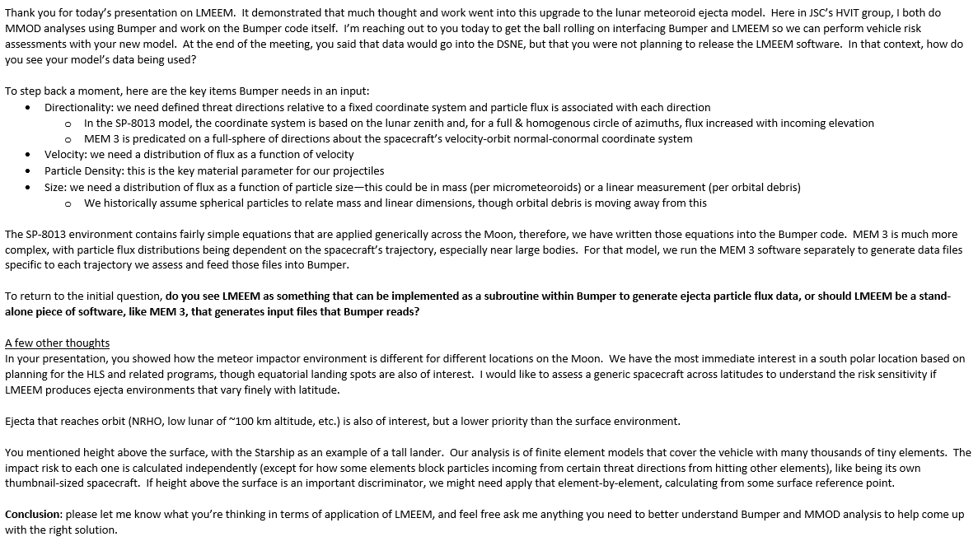
HVIT Questions
(1)
(2)
(3)
(4)
(5)

Slide 5
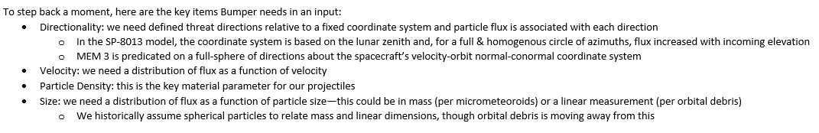
(1) Bumper Input
Directionality: Currently we are planning to include only the elevation angle in DSNE
For more detailed analyses, we have the ability to include azimuthal dependence in the form of the igloo format produced by MEM, if needed
Velocity: Agreed upon 3 velocity bins for DSNE
Possibly can include more in DSNE
Can include additional bins for more detailed analyses
Particle Density: Assuming particle density of regolith (constant) and spherical particles
Size: Had previously used Carrier 2003 distribution (regolith size) – there is strong evidence to believe that for larger impactors, the possibility for large ejected fragments are missed using this distribution…
Now using a more sophisticated algorithm to take into account impact parameter dependencies (based on O’Keefe & Ahrens 1985)

Slide 6
(2) LMEEM Availability
The output of LMEEM as an environment definition will be made available in DSNE for public consumption
The LMEEM code will not be released and will be handled by EV44 Natural Environments
If specific cases are requested or further fidelity is needed that isn’t available in DSNE, we can work with the customer to produce a specific environment
E.g., operational lunar surface EVAs, asset-specific geometries, cis-lunar space trajectories
The output of LMEEM will be input files that Bumper can read

Slide 7
(3) Selenographic dependence of meteoroids and corresponding ejecta
We are interested as well:
Both speed and elevation of sporadic meteoroids change as a function of latitude
Preliminary findings show the western limb (leading side) has > 10% more sporadic meteoroid flux than the eastern limb, using a 19-year average
The DNSE environment will include the worst-case longitude location (most likely the western limb) for various latitudinal locations (equator, +/- 45 degrees, and poles)

Slide 8
(4) Meteoroid ejecta in cis-lunar space
LMEEM is capable of computing the meteoroid ejecta environment above the surface of the Moon
Plans for computing the meteoroid ejecta environment along a trajectory, but not a priority at this time

Slide 9
(5) Asset-dependent and element-dependent environment
There is height-dependence of the meteoroid ejecta environment, however, if this dependence is enough to cause a non-trivial effect to the asset is dependent on the specific asset in interest
In theory, element-wise environment definitions could be generated, however, further work would be needed to include this functionality
Currently assume a cylindrically shaped asset
Basically, I would have to make a mask for each element. Since I don’t solve the adjoint problem (i.e., I solve the forward Monte Carlo), this would be computationally expensive to get enough statistics for each element.

Slide 10
Further Discussion…

Slide 11



