Slide 1

Chapter 6: Waves in Weakly Coupled Dusty Plasmas
Patrick Brown
Physics of Dusty Plasmas
Baylor University

Slide 2
Review of Fluid Theory for Plasmas
Before we begin with waves it is necessary to look over the fluid theory of plasma physics
Discussion Question: Why model a plasma as a fluid?

Slide 3
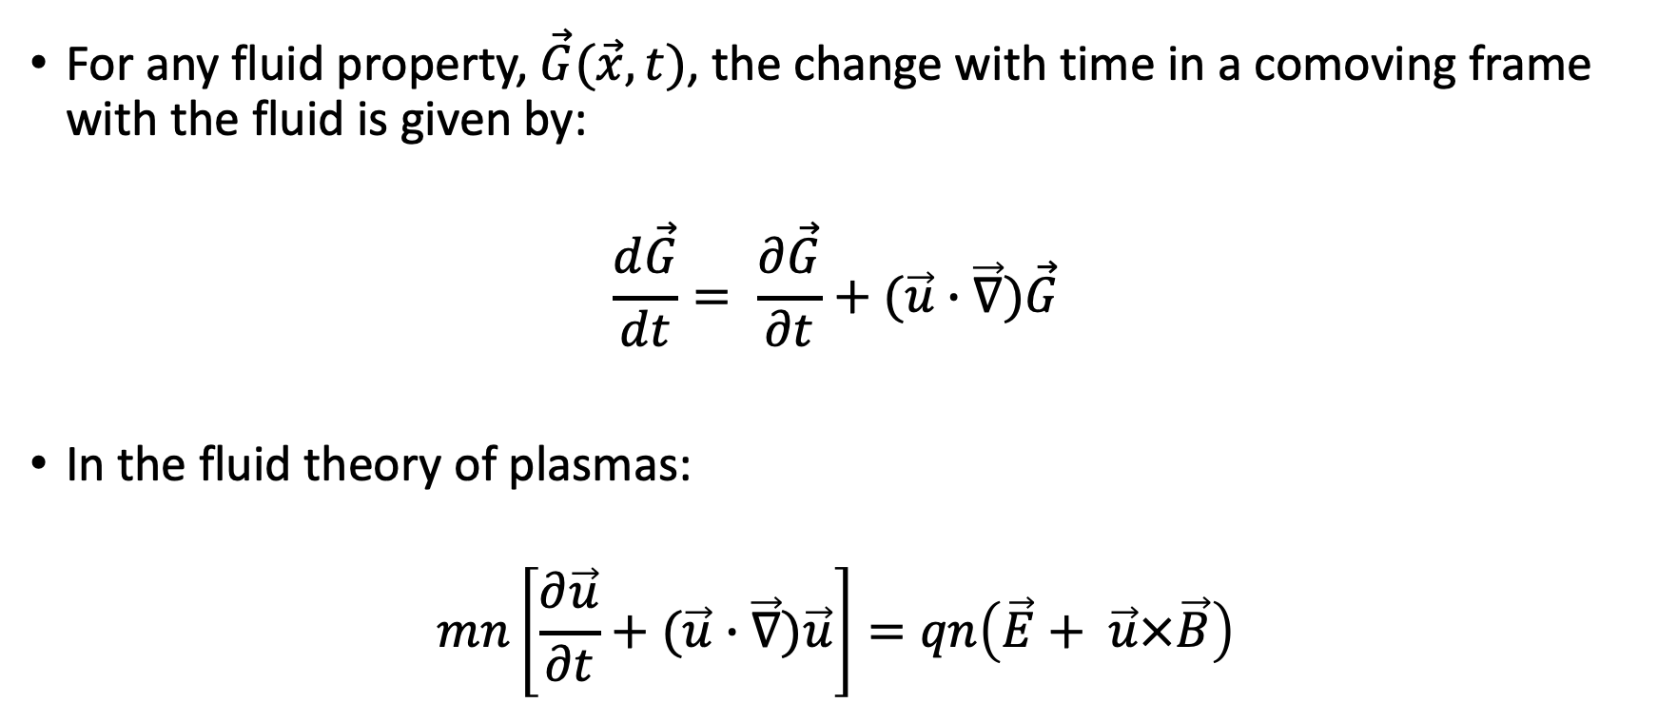
Convective Derivative
For any fluid property, $\vec{G}(\vec{x},t)$, the change with time in a comoving frame with the fluid is given by:
$$\frac{d\vec{G}}{dt}= \frac{∂\vec{G}}{∂t}+(\vec{u}∙\vec{∇})\vec{G}$$
In the fluid theory of plasmas:
$$mn\left[\frac{∂\vec{u}}{∂t}+(\vec{u}∙\vec{∇})\vec{u}\right]=qn\left(\vec{E}+ \vec{u}×\vec{B}\right)$$

Slide 4
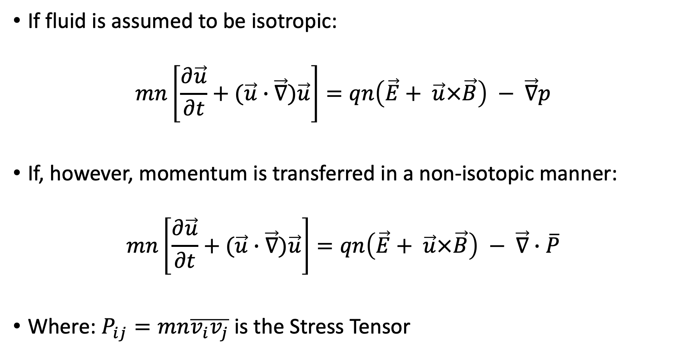
Stress Tensor
If fluid is assumed to be isotropic:
$$mn\left[\frac{∂\vec{u}}{∂t}+(\vec{u}∙\vec{∇})\vec{u}\right]=qn\left(\vec{E}+ \vec{u}×\vec{B}\right) − \vec{∇}p$$
If, however, momentum is transferred in a non-isotopic manner:
$$mn\left[\frac{∂\vec{u}}{∂t}+(\vec{u}∙\vec{∇})\vec{u}\right]=qn\left(\vec{E}+ \vec{u}×\vec{B}\right) − \vec{∇}∙\overline{P}$$
Where: $P_{ij}=mn\overline{v_{i}v_{j}}$ is the Stress Tensor

Slide 5
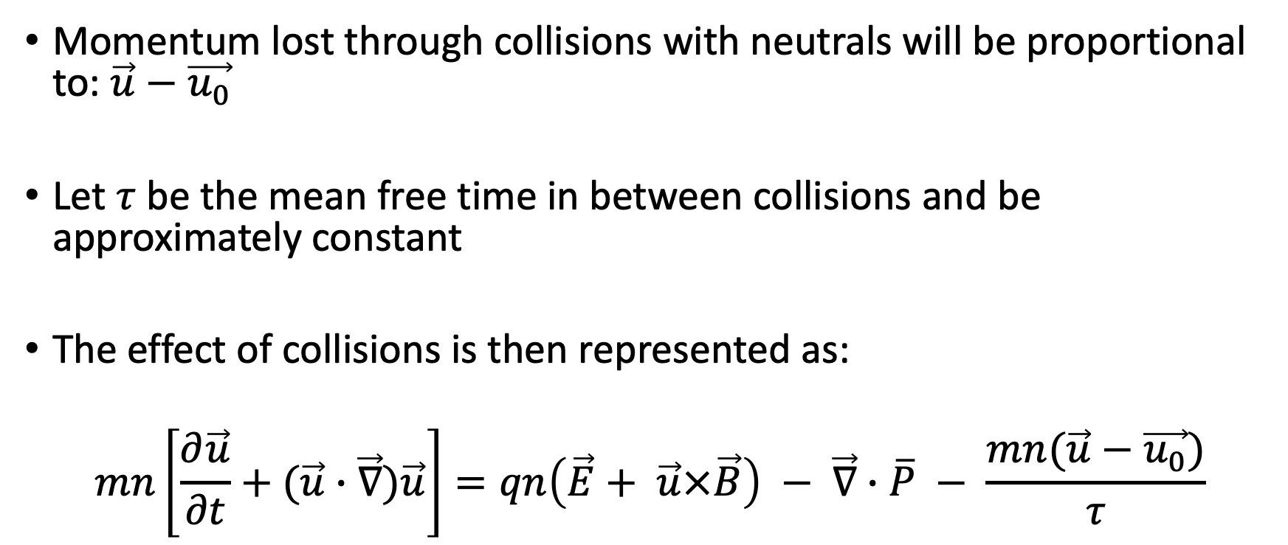
Collisions
Momentum lost through collisions with neutrals will be proportional to: $\vec{u}−\vec{u_{0}}$
Let $τ$ be the mean free time in between collisions and be approximately constant
The effect of collisions is then represented as:
$$mn\left[\frac{∂\vec{u}}{∂t}+(\vec{u}∙\vec{∇})\vec{u}\right]=qn\left(\vec{E}+ \vec{u}×\vec{B}\right) − \vec{∇}∙\overline{P} − \frac{mn(\vec{u}−\vec{u_{0}})}{τ}$$

Slide 6
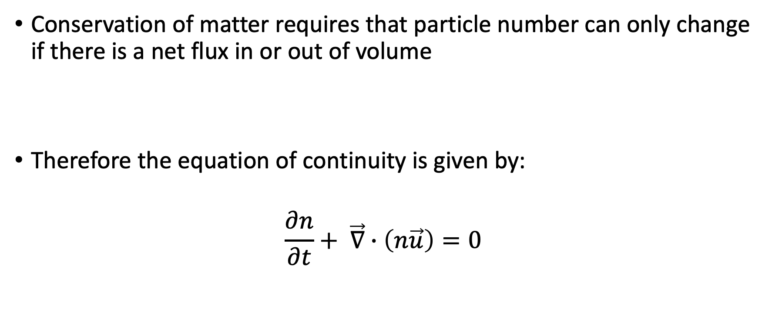
Equation of Continuity
Conservation of matter requires that particle number can only change if there is a net flux in or out of volume
Therefore the equation of continuity is given by:
$$\frac{∂n}{∂t}+ \vec{∇}∙\left(n\vec{u}\right)=0$$

Slide 7

Equation of State
Relate $p \& n$ through thermodynamic relation $(C= C_{p}/C_{V})$:
$$p=Cρ^{γ}$$
Therefore:
$$\frac{\vec{∇}p}{p}= γ\frac{\vec{∇}n}{n}$$
For isothermal compression:
$$\vec{∇}p=k_{B}T\vec{∇}n$$

Slide 8
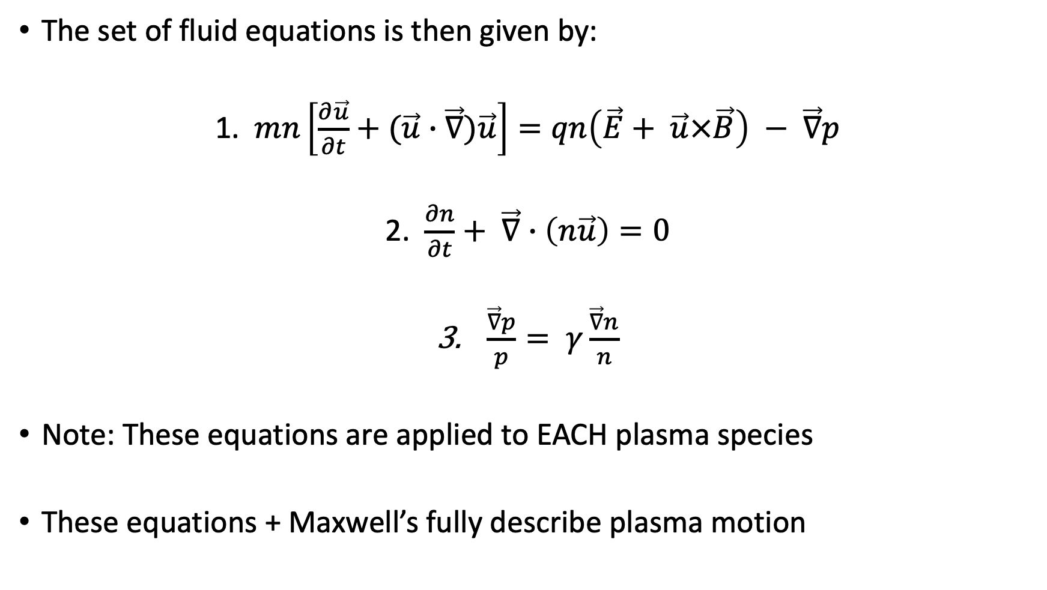
Fluid Equations of Plasmas
The set of fluid equations is then given by:
1. $mn\left[\frac{∂\vec{u}}{∂t}+(\vec{u}∙\vec{∇})\vec{u}\right]=qn\left(\vec{E}+ \vec{u}×\vec{B}\right) − \vec{∇}p$
2. $\frac{∂n}{∂t}+ \vec{∇}∙\left(n\vec{u}\right)=0$
$\frac{\vec{∇}p}{p}= γ\frac{\vec{∇}n}{n}$
Note: These equations are applied to EACH plasma species
These equations + Maxwell’s fully describe plasma motion

Slide 9
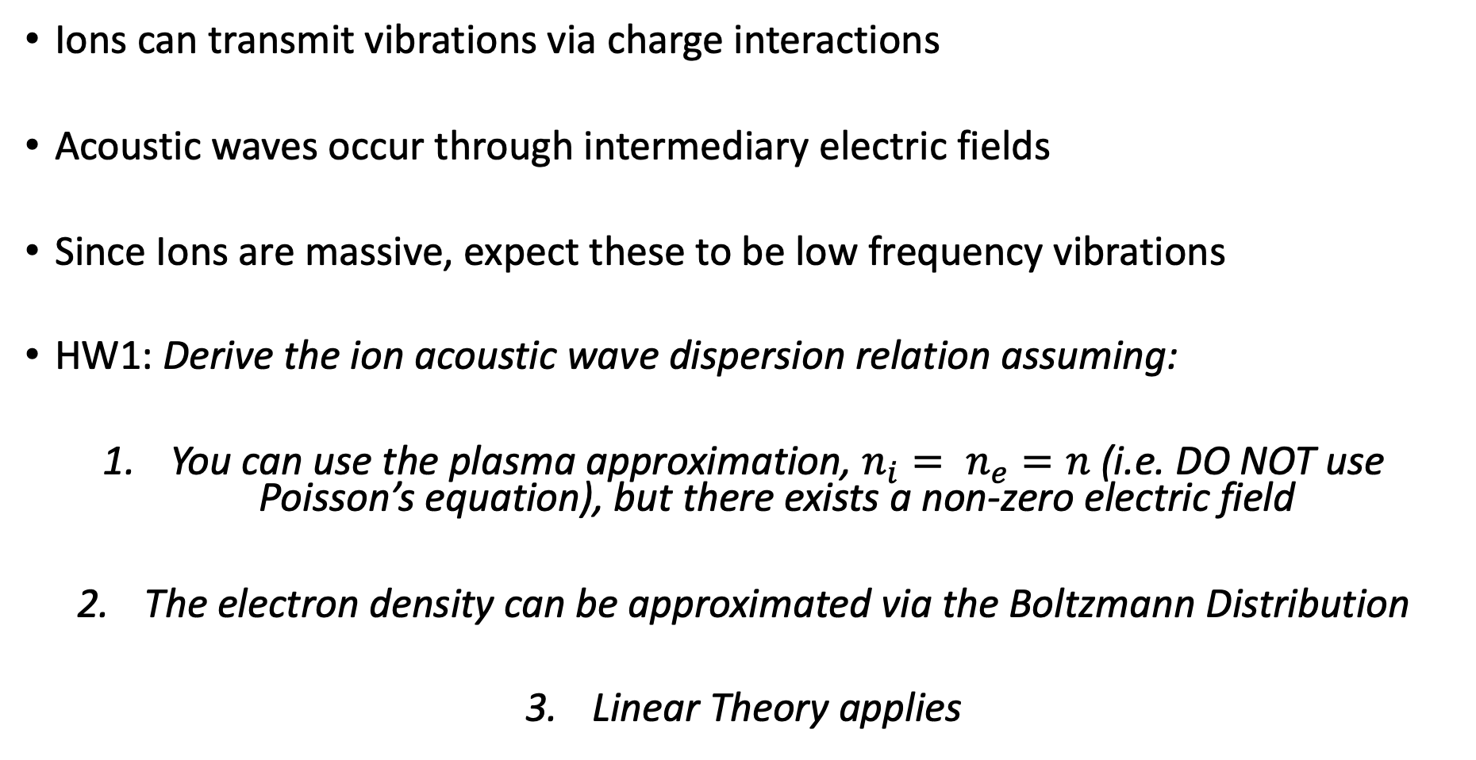
Review: Ion Acoustic Waves (HW1)
Ions can transmit vibrations via charge interactions
Acoustic waves occur through intermediary electric fields
Since Ions are massive, expect these to be low frequency vibrations
HW1: Derive the ion acoustic wave dispersion relation assuming:
You can use the plasma approximation, $n_{i}= n_{e}=n$ (i.e. DO NOT use Poisson’s equation), but there exists a non-zero electric field
The electron density can be approximated via the Boltzmann Distribution
Linear Theory applies

Slide 10
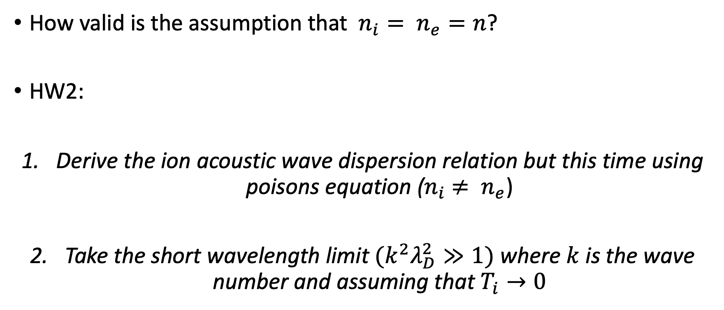
Review: Validity of Plasma Approximation (HW2)
How valid is the assumption that $n_{i}= n_{e}=n$?
HW2:
Derive the ion acoustic wave dispersion relation but this time using poisons equation ($n_{i}$ $≠ n_{e}$)
Take the short wavelength limit $(k^{2}λ_{D}^{2}≫1)$ where $k$ is the wave number and assuming that $T_{i}→0$

Slide 11
Waves in Weakly Coupled Plasmas
Do not rely on ordered pairs of dust particles
Two types of Weakly Coupled waves:
Dust Acoustic Wave (DAW)
Dust Ion-Acoustic Wave (DIAW)
DAW: Dust particles are moving species
DIAW: Dust considered immobile, but influence propagation

Slide 12
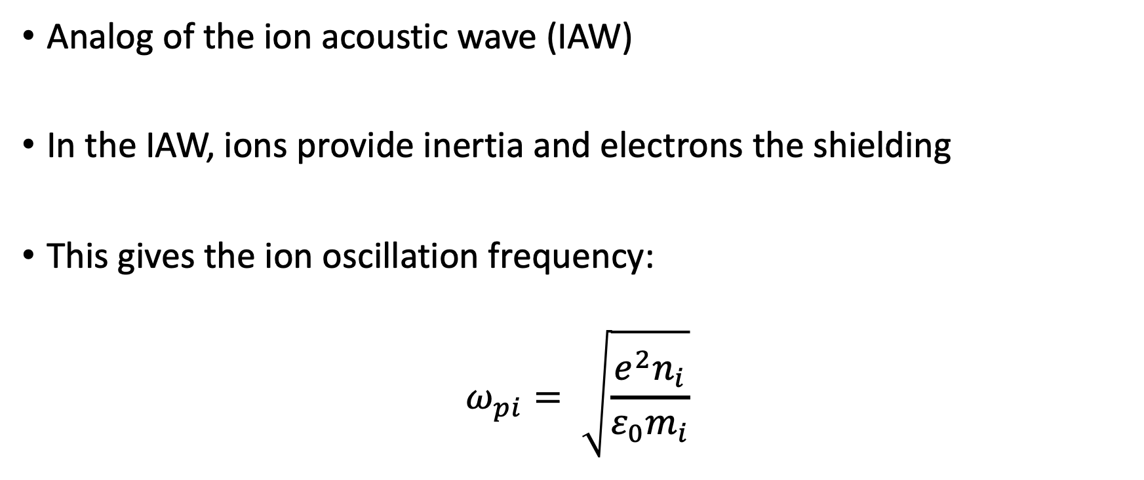
Dust Acoustic Wave (DAW)
Analog of the ion acoustic wave (IAW)
In the IAW, ions provide inertia and electrons the shielding
This gives the ion oscillation frequency:
$$ω_{pi}= \sqrt{\frac{e^{2}n_{i}}{ε_{0}m_{i}}}$$

Slide 13
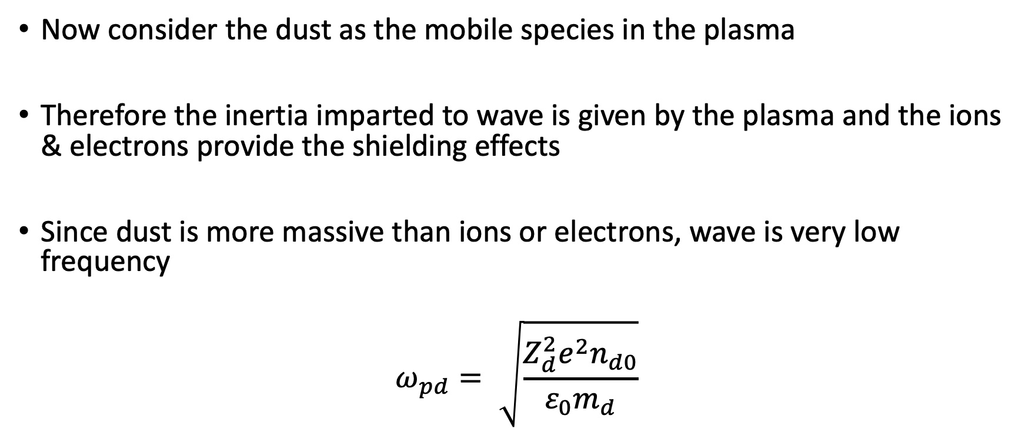
DAW
Now consider the dust as the mobile species in the plasma
Therefore the inertia imparted to wave is given by the plasma and the ions & electrons provide the shielding effects
Since dust is more massive than ions or electrons, wave is very low frequency
$$ω_{pd}= \sqrt{\frac{Z_{d}^{2}e^{2}n_{d0}}{ε_{0}m_{d}}}$$

Slide 14
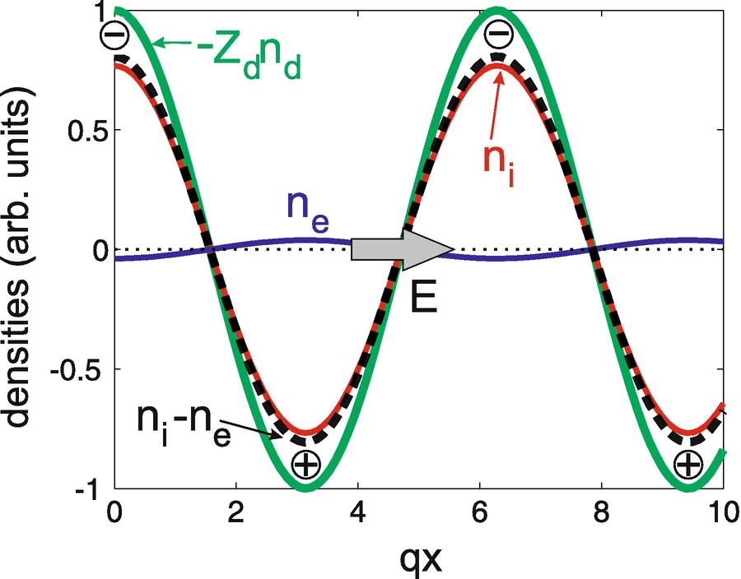
DAW Mechanism
Consider wave like perturbation in dust density
Incomplete shielding forms negative and positive space charge regions around dust
This forms electric field which drives DAWs
Image Source [1].

Slide 15
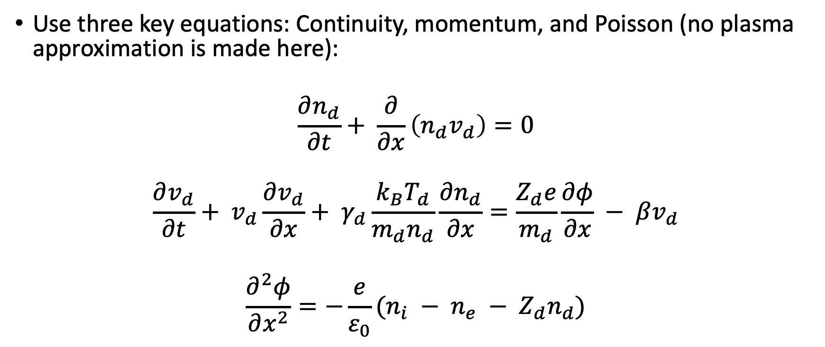
DAW: Dispersion Relation
Use three key equations: Continuity, momentum, and Poisson (no plasma approximation is made here):
$$\frac{∂n_{d}}{∂t}+ \frac{∂}{∂x}\left(n_{d}v_{d}\right)=0$$
$$\frac{∂v_{d}}{∂t}+ v_{d}\frac{∂v_{d}}{∂x}+ γ_{d}\frac{k_{B}T_{d}}{m_{d}n_{d}}\frac{∂n_{d}}{∂x}=\frac{Z_{d}e}{m_{d}}\frac{∂φ}{∂x} − βv_{d}$$
$$\frac{∂^{2}φ}{∂x^{2}}=−\frac{e}{ε_{0}}(n_{i} − n_{e} − Z_{d}n_{d})$$

Slide 16
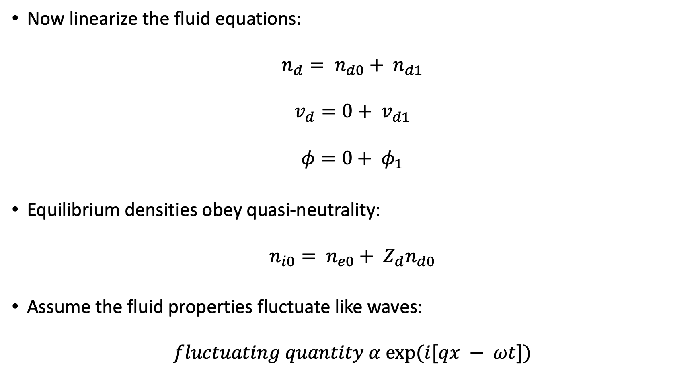
DAW: Dispersion Relation (Linearization)
Now linearize the fluid equations:
$$n_{d}= n_{d0}+ n_{d1}$$
$$v_{d}=0+ v_{d1}$$
$$φ=0+ φ_{1}$$
Equilibrium densities obey quasi-neutrality:
$$n_{i0}= n_{e0}+ Z_{d}n_{d0}$$
Assume the fluid properties fluctuate like waves:
$$fluctuating quantity α exp⁡(i[qx − ωt])$$

Slide 17
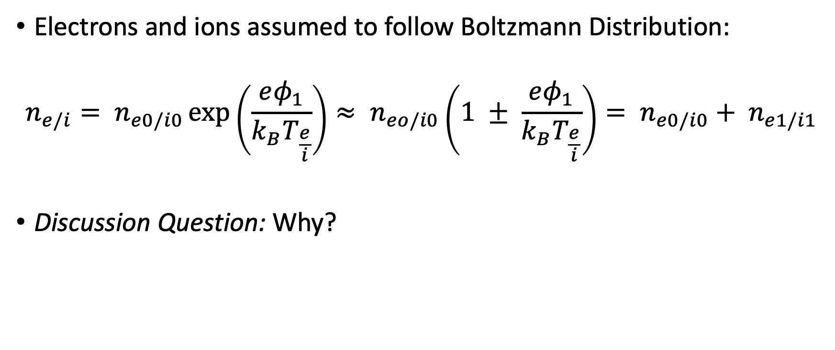
DAW: Dispersion Relation
Electrons and ions assumed to follow Boltzmann Distribution:
$$n_{e/i}= n_{e0/i0}\exp\left(\frac{eφ_{1}}{k_{B}T_{\frac{e}{i}}}\right)≈ n_{eo/i0}\left(1 ± \frac{eφ_{1}}{k_{B}T_{\frac{e}{i}}}\right)= n_{e0/i0}+ n_{e1/i1}$$
Discussion Question: Why?

Slide 18
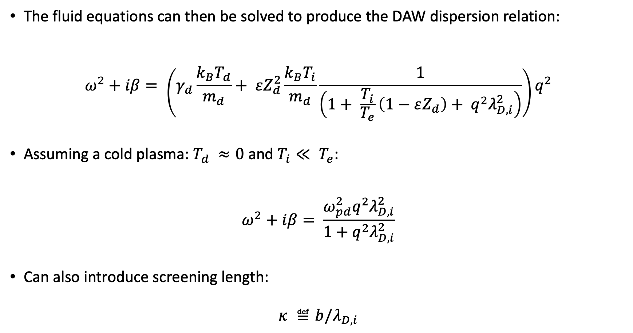
DAW: Dispersion Relation
The fluid equations can then be solved to produce the DAW dispersion relation:
$$ω^{2}+iβ= \left(γ_{d}\frac{k_{B}T_{d}}{m_{d}}+ εZ_{d}^{2}\frac{k_{B}T_{i}}{m_{d}}\frac{1}{\left(1+ \frac{T_{i}}{T_{e}}\left(1−εZ_{d}\right)+ q^{2}λ_{D,i}^{2}\right)}\right)q^{2}$$
Assuming a cold plasma: $T_{d} ≈0$ and $T_{i}≪ T_{e}$:
$$ω^{2}+iβ= \frac{ω_{pd}^{2}q^{2}λ_{D,i}^{2}}{1+q^{2}λ_{D,i}^{2}}$$
Can also introduce screening length:
$$κ ≝b/λ_{D,i}$$

Slide 19
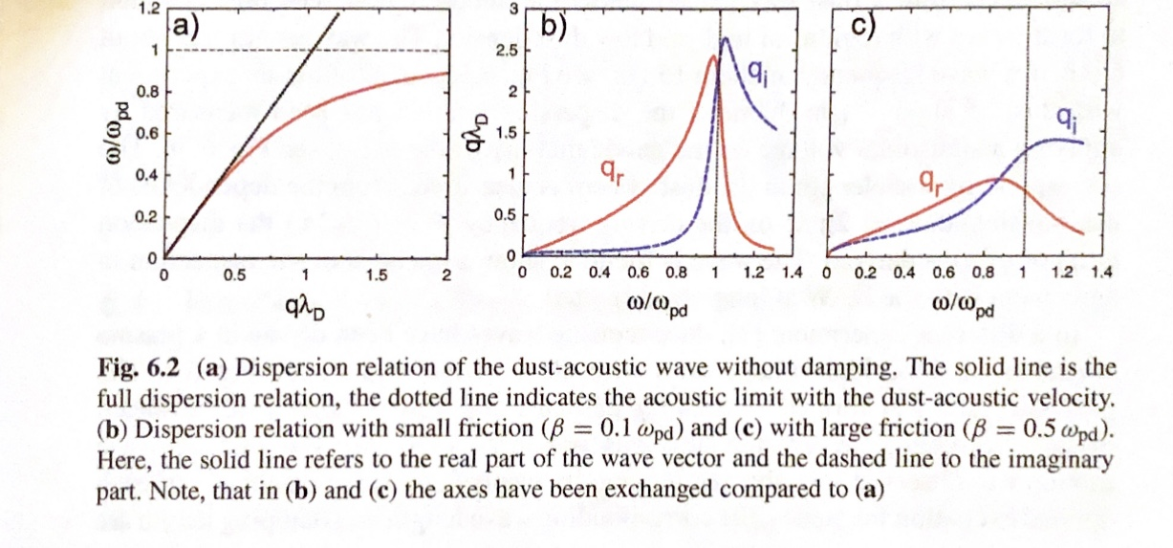
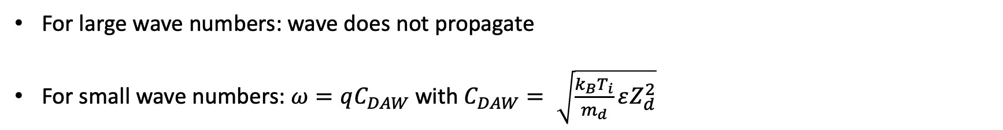
DAW: Dispersion Relation
Image Source [1].
For large wave numbers: wave does not propagate
For small wave numbers: $ω=qC_{DAW}$ with $C_{DAW}= \sqrt{\frac{k_{B}T_{i}}{m_{d}}εZ_{d}^{2}}$

Slide 20
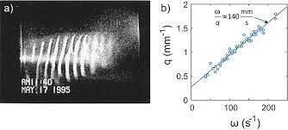
Experiments with DAW
Image Source [1].

Slide 21
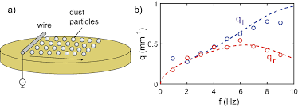
Experiments with DAW
Image Source [1].

Slide 22
Ion Flow Driven DAWs
DAWs do not need to be externally excited
Self-excited DAWs are found in number experiments
Dust usually confined by ambipolar or sheath electric field
Electric field also drives an ion flow
Ion current excites slow DAWs (think two stream instability)

Slide 23
Review: Two Stream Instability (HW3)
When two fluids move past each other with varying velocities, this causes instabilities
If the two fluids are streaming electrons and ions, electric fields and charge currents can induce non-Maxwellian distributions and therefore instabilities are formed
HW3: Derive the dispersion relation for the simple two stream instability between streaming electrons and ions (Hint: You will need to consider the fluid equation for BOTH electrons and ions)

Slide 24
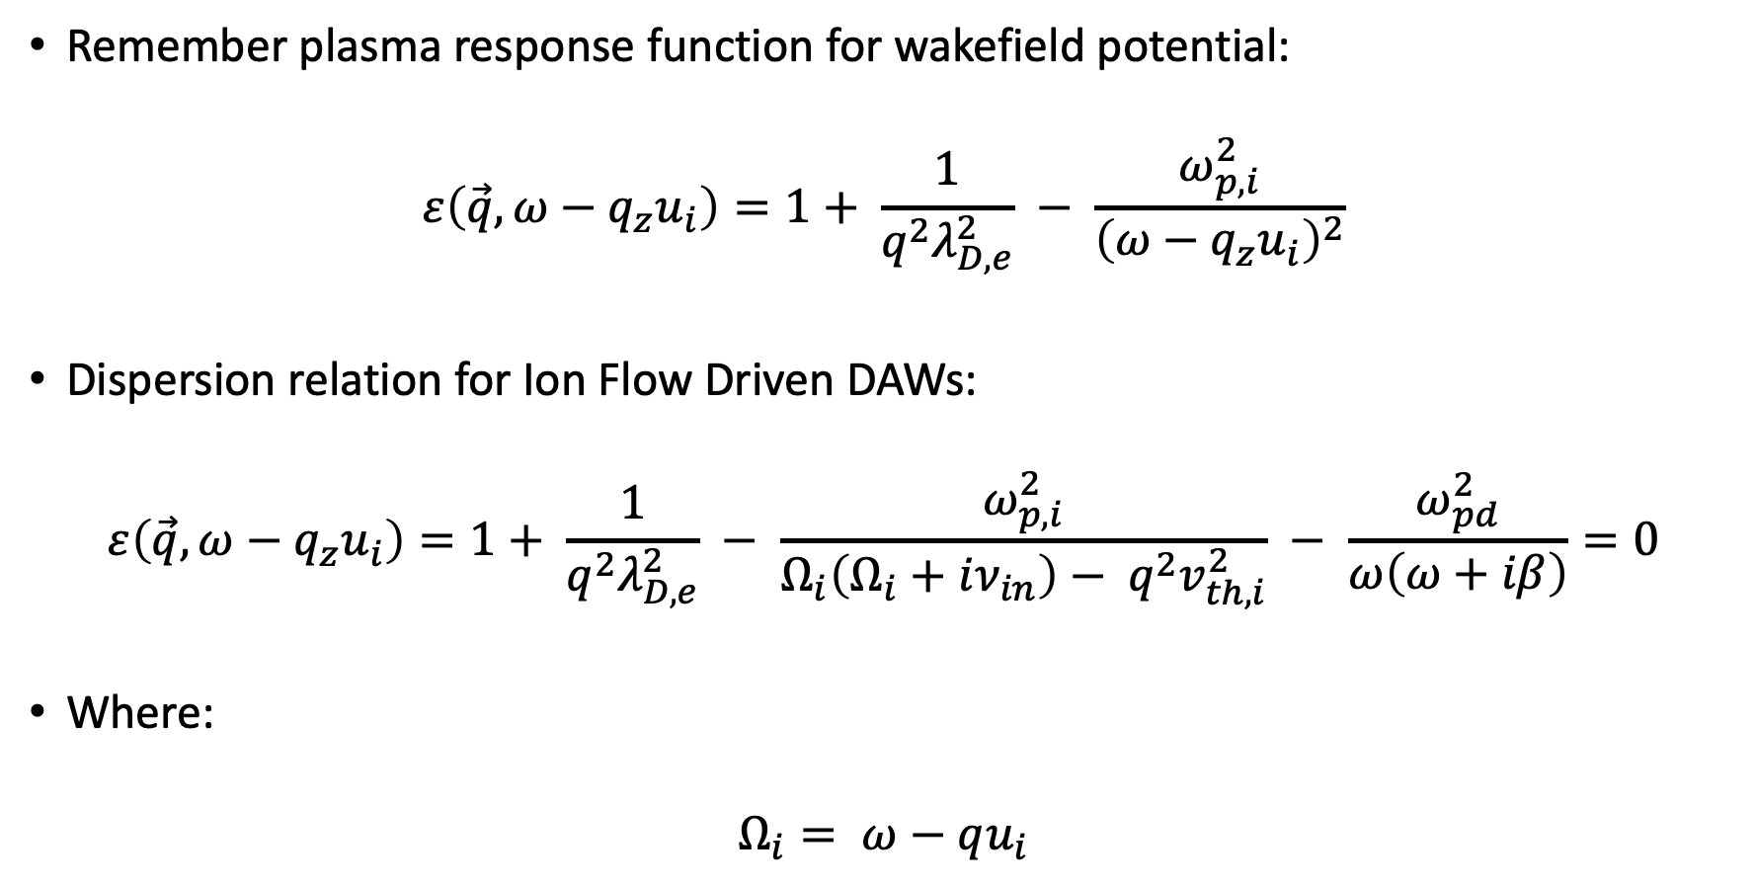
Ion Flow Driven DAWs
Remember plasma response function for wakefield potential:
$$ε\left(\vec{q},ω−q_{z}u_{i}\right)=1+ \frac{1}{q^{2}λ_{D,e}^{2}} − \frac{ω_{p,i}^{2}}{{\left(ω−q_{z}u_{i}\right)}^{2}}$$
Dispersion relation for Ion Flow Driven DAWs:
$$ε\left(\vec{q},ω−q_{z}u_{i}\right)=1+ \frac{1}{q^{2}λ_{D,e}^{2}} − \frac{ω_{p,i}^{2}}{Ω_{i}\left(Ω_{i}+iν_{in}\right)− q^{2}v_{th,i}^{2}} − \frac{ω_{pd}^{2}}{ω\left(ω+iβ\right)}=0$$
Where:
$$Ω_{i}= ω−qu_{i}$$

Slide 25
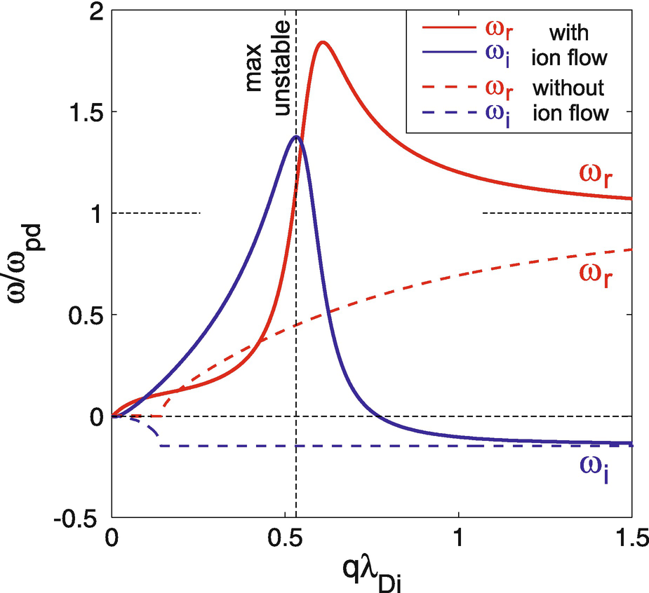

Ion Flow Driven DAWs
In general there exist 4 complex roots of the form: $ω= ω_{r}+iω_{i}$
We are interested in ONLY low frequency roots: $ω_{pd}≈ ω≪ ω_{pi},ω_{pe}$
Image Source [1].

Slide 26
DIAWs
Usual ion acoustic wave with addition of dust particle influence
The mobile species in DIAWs are the IONs
The dust is considered immobile
Therefore wave frequencies on order of the ion plasma frequency
Dust influences wave by reducing the number of free electrons present

Slide 27
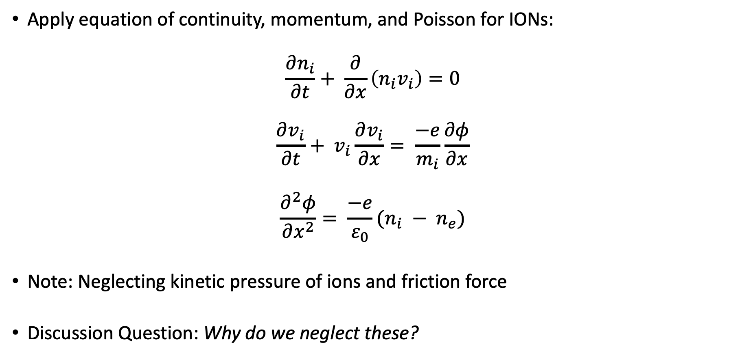
DIAWs
Apply equation of continuity, momentum, and Poisson for IONs:
$$\frac{∂n_{i}}{∂t}+ \frac{∂}{∂x}\left(n_{i}v_{i}\right)=0$$
$$\frac{∂v_{i}}{∂t}+ v_{i}\frac{∂v_{i}}{∂x}= \frac{−e}{m_{i}}\frac{∂φ}{∂x}$$
$$\frac{∂^{2}φ}{∂x^{2}}= \frac{−e}{ε_{0}}(n_{i} − n_{e})$$
Note: Neglecting kinetic pressure of ions and friction force
Discussion Question: Why do we neglect these?

Slide 28
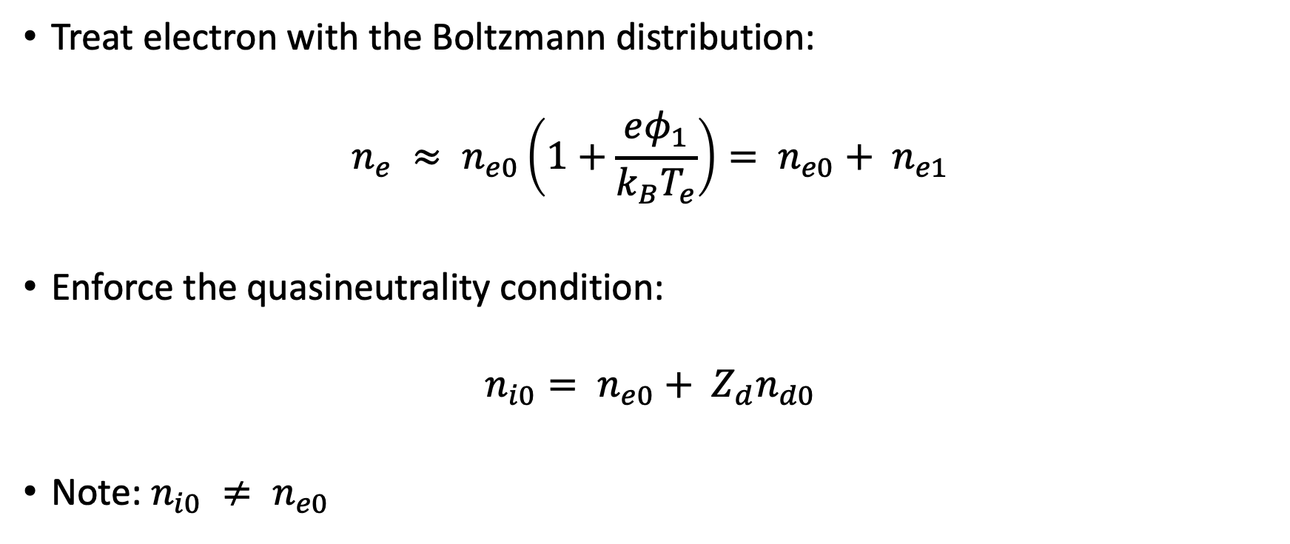
DIAWs
Treat electron with the Boltzmann distribution:
$$n_{e} ≈ n_{e0}\left(1+\frac{eφ_{1}}{k_{B}T_{e}}\right)= n_{e0}+ n_{e1}$$
Enforce the quasineutrality condition:
$$n_{i0}= n_{e0}+ Z_{d}n_{d0}$$
Note: $n_{i0} ≠ n_{e0}$

Slide 29
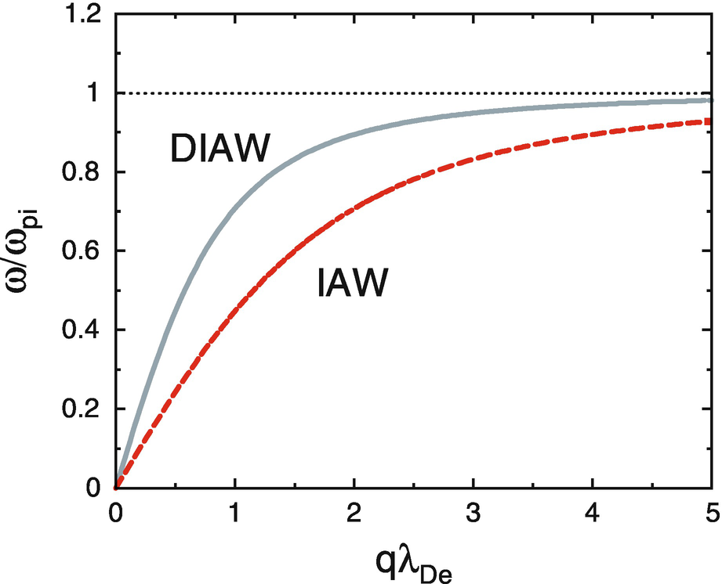
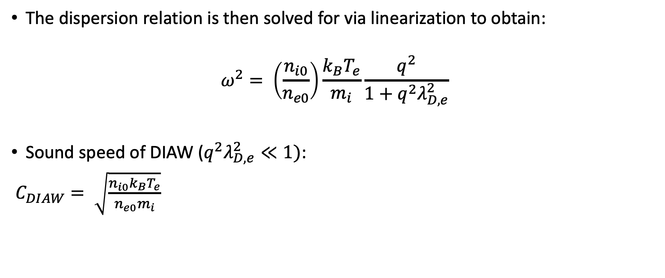
DIAWs
The dispersion relation is then solved for via linearization to obtain:
$$ω^{2}= \left(\frac{n_{i0}}{n_{e0}}\right)\frac{k_{B}T_{e}}{m_{i}}\frac{q^{2}}{1+q^{2}λ_{D,e}^{2}}$$
Sound speed of DIAW ($q^{2}λ_{D,e}^{2}≪1)$:
$C_{DIAW}= \sqrt{\frac{n_{i0}k_{B}T_{e}}{n_{e0}m_{i}}}$
Image Source [1].

Slide 30
Sources
Melzer A., Physics of Dusty Plasmas An Introduction. (Springer, Cham) p. 101-113.
Chen F., Introduction to Plasma Physics and Controlled Fusion, Third Edition. (Springer, Cham).

