Slide 1

Maintaining a Wormhole with a Scalar Field
Author: Dan N. Vollick, Physical Review D
Presented by: Patrick Brown
Baylor University Graduate Physics Colloqiuum

Slide 2
Outline
Review basic definition of wormhole
Equations of Motion
Energy Momentum Tensor
Wormhole Solutions
(Note: This presentation is equation heavy and therefore many steps in the calculations are left out)

Slide 3
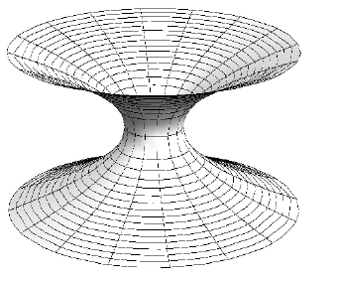
Definition of a Wormhole
Basic Definition: A region of curved spacetime that connects two separate regions of spacetime (manifolds)
Requires Exotic Matter!
Question: How can we maintain a wormhole?
Let us try using a scalar field
Note: This definition says nothing about “traversability”
Hannam, Mark & Husa, Sascha & Ohme, Frank & Bruegmann, Bernd & O'Murchadha, Niall. (2008). Wormholes and trumpets: Schwarzschild spacetime for the moving-puncture generation. Physical Review D. 78. 10.1103/PhysRevD.78.064020.

Slide 4
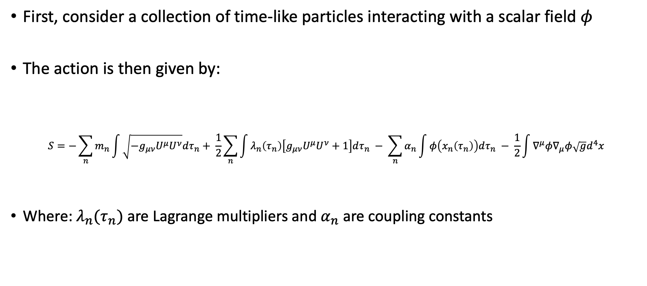
Equations of Motion
First, consider a collection of time-like particles interacting with a scalar field $φ$
The action is then given by:
$$S=−\sum_{n}{m_{n}\int{\sqrt{{−g}_{μν}U^{μ}U^{ν}}dτ_{n}}+ \frac{1}{2}\sum_{n}{\int{λ_{n}\left(τ_{n}\right)\left[g_{μν}U^{μ}U^{ν}+1\right]dτ_{n}}} − \sum_{n}{α_{n}\int{φ\left(x_{n}\left(τ_{n}\right)\right)dτ_{n}}} − \frac{1}{2}\int{∇^{μ}φ∇_{μ}φ\sqrt{g}d^{4}x}}$$
Where: $λ_{n}(τ_{n})$ are Lagrange multipliers and $α_{n}$ are coupling constants

Slide 5
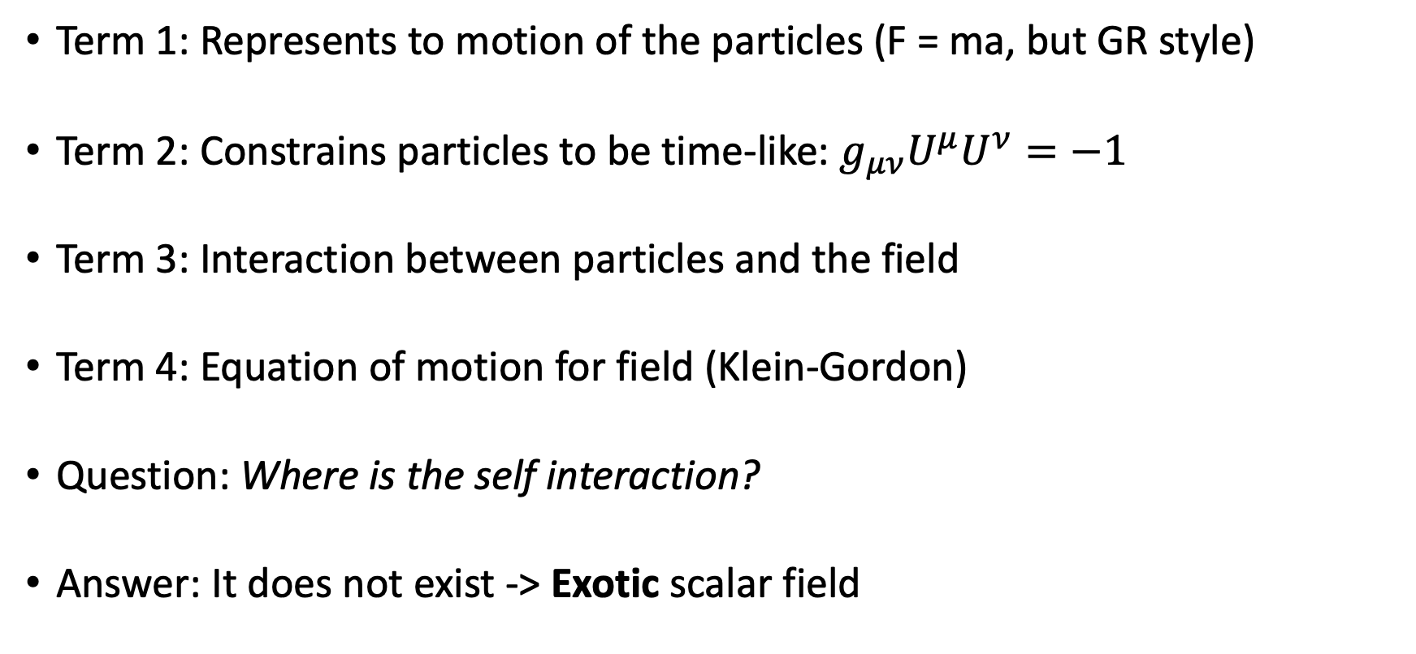
What does this mean?
Term 1: Represents to motion of the particles (F = ma, but GR style)
Term 2: Constrains particles to be time-like: $g_{μν}U^{μ}U^{ν}=−1$
Term 3: Interaction between particles and the field
Term 4: Equation of motion for field (Klein-Gordon)
Question: Where is the self interaction?
Answer: It does not exist -> Exotic scalar field

Slide 6
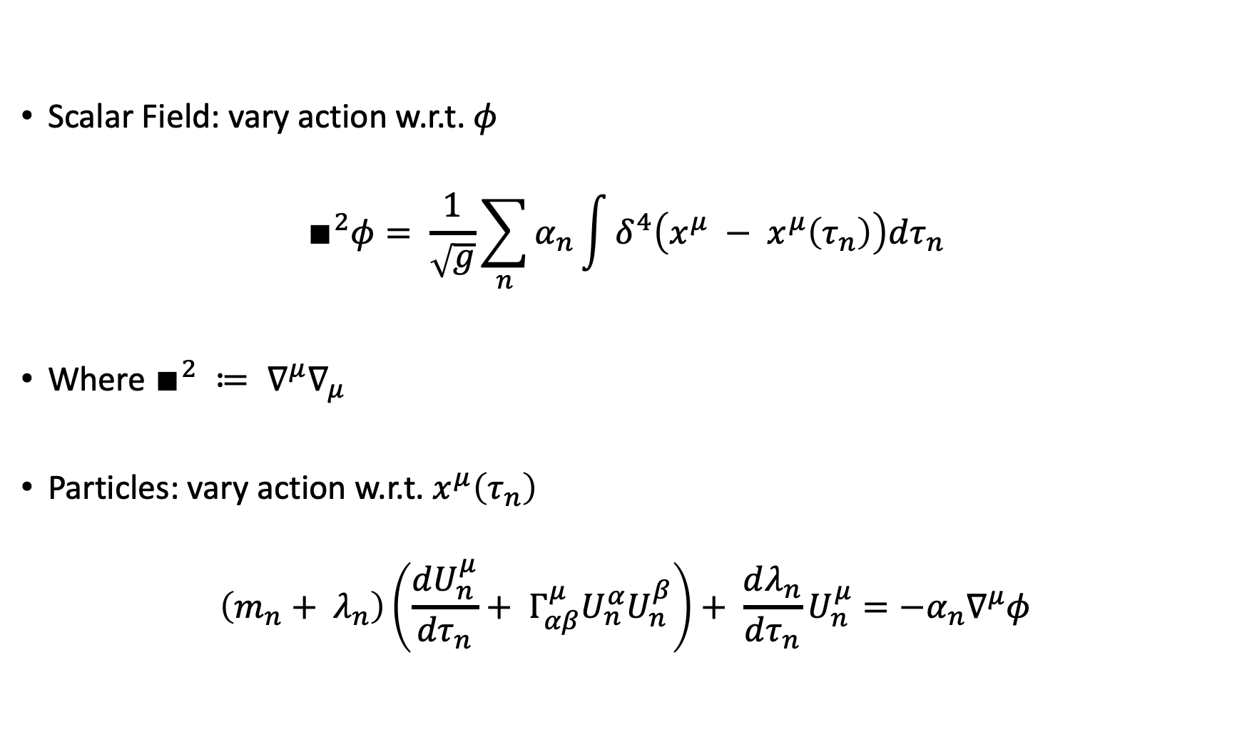
Equations of Motion
Scalar Field: vary action w.r.t. $φ$
$$∎^{2}φ= \frac{1}{\sqrt{g}}\sum_{n}{α_{n}\int{δ^{4}\left(x^{μ} − x^{μ}\left(τ_{n}\right)\right)dτ_{n}}}$$
Where $∎^{2} ≔ ∇^{μ}∇_{μ}$
Particles: vary action w.r.t. $x^{μ}\left(τ_{n}\right)$
$$\left(m_{n}+ λ_{n}\right)\left(\frac{dU_{n}^{μ}}{{dτ}_{n}}+ Γ_{αβ}^{μ}U_{n}^{α}U_{n}^{β}\right)+ \frac{dλ_{n}}{dτ_{n}}U_{n}^{μ}=−α_{n}∇^{μ}φ$$

Slide 7
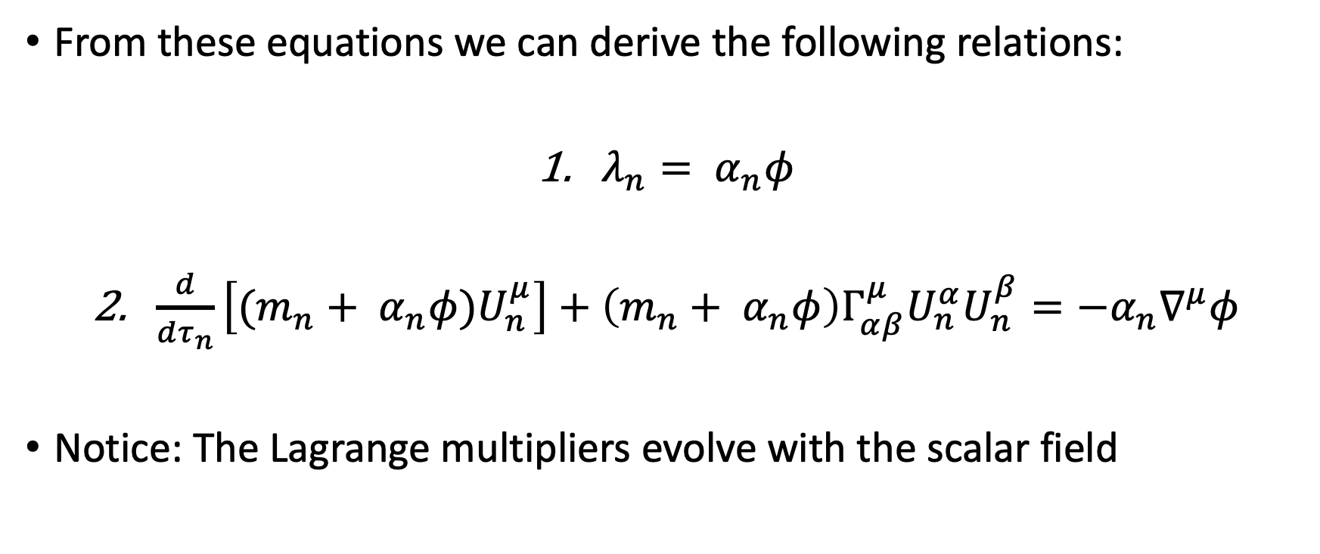
Equations of Motion
From these equations we can derive the following relations:
$λ_{n}= α_{n}φ$
$\frac{d}{dτ_{n}}\left[(m_{n}+ α_{n}φ)U_{n}^{μ}\right]+\left(m_{n}+ α_{n}φ\right)Γ_{αβ}^{μ}U_{n}^{α}U_{n}^{β}=−α_{n}∇^{μ}φ$
Notice: The Lagrange multipliers evolve with the scalar field

Slide 8
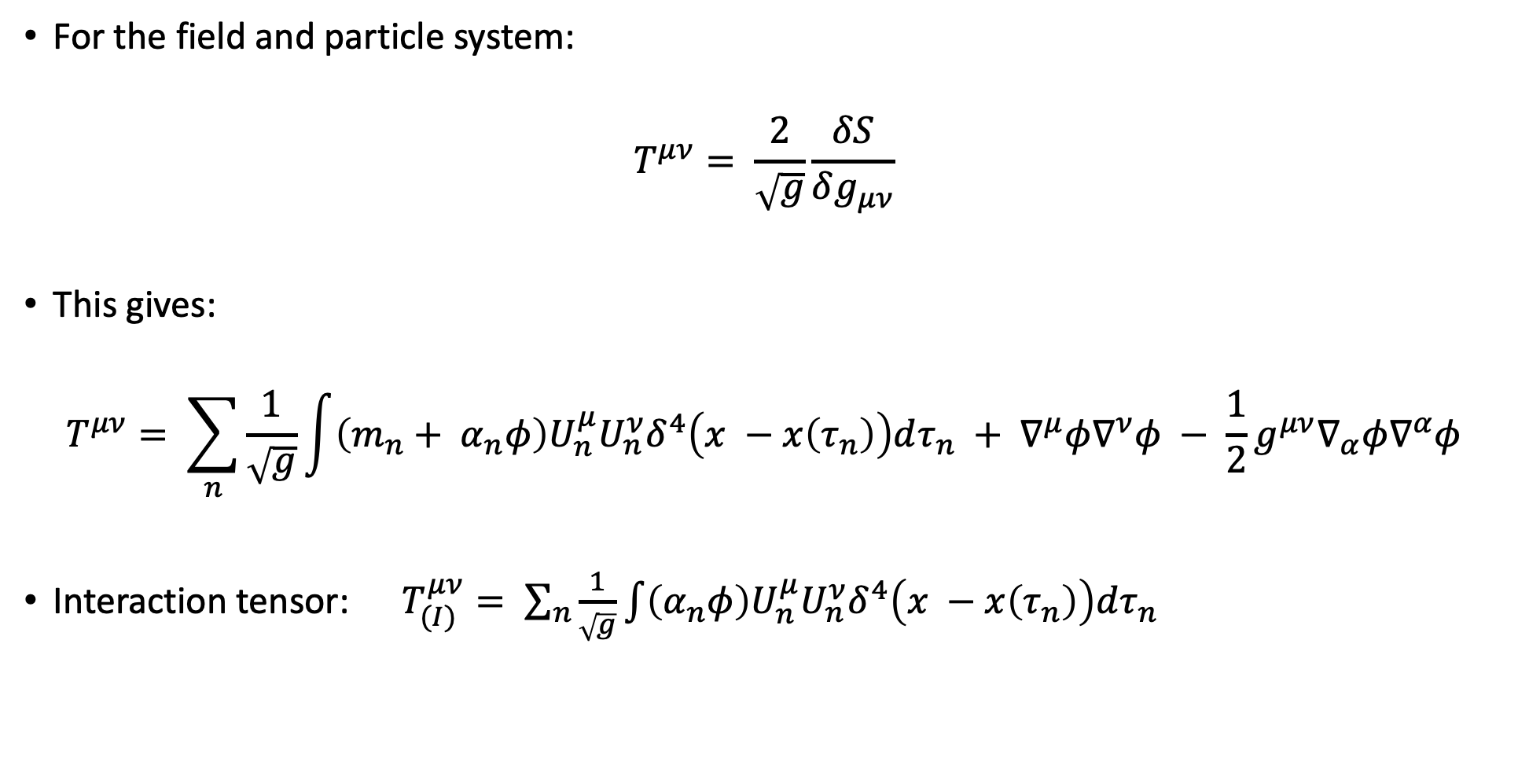
Energy Momentum Tensor
For the field and particle system:
$$T^{μν}= \frac{2}{\sqrt{g}}\frac{δS}{δg_{μν}}$$
This gives:
$$T^{μν}= \sum_{n}{\frac{1}{\sqrt{g}}\int{\left(m_{n}+ α_{n}φ\right)U_{n}^{μ}U_{n}^{ν}δ^{4}\left(x −x\left(τ_{n}\right)\right)dτ_{n} }}+ ∇^{μ}φ∇^{ν}φ − \frac{1}{2}g^{μν}∇_{α}φ∇^{α}φ$$
Interaction tensor: $T_{(I)}^{μν}= \sum_{n}{\frac{1}{\sqrt{g}}\int{\left(α_{n}φ\right)U_{n}^{μ}U_{n}^{ν}δ^{4}\left(x −x\left(τ_{n}\right)\right)dτ_{n} }}$

Slide 9
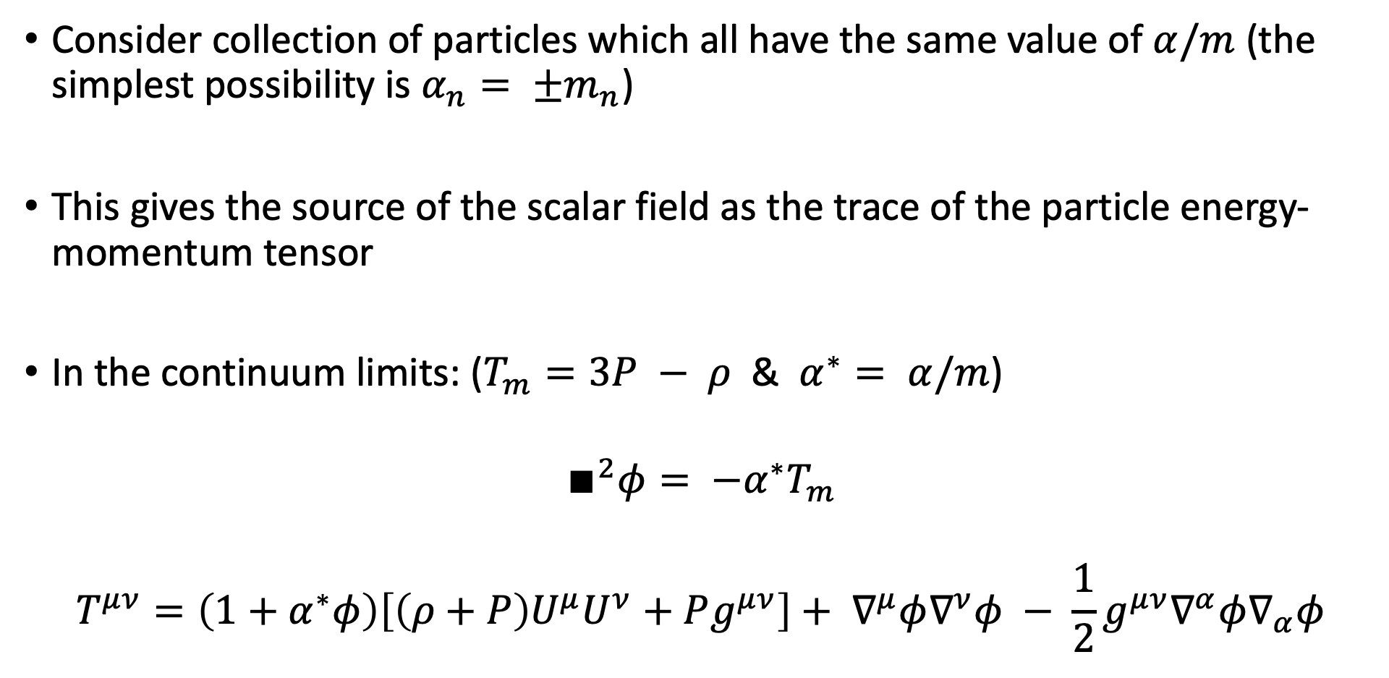
Energy Momentum Tensor
Consider collection of particles which all have the same value of $α/m$ (the simplest possibility is $α_{n}= ±m_{n}$)
This gives the source of the scalar field as the trace of the particle energy-momentum tensor
In the continuum limits: ($T_{m}=3P − ρ$ & $α^{∗}= α/m$)
$$∎^{2}φ= {−α}^{∗}T_{m}$$
$$T^{μν}=\left(1+α^{∗}φ\right)\left[\left(ρ+P\right)U^{μ}U^{ν}+Pg^{μν}\right]+ ∇^{μ}φ∇^{ν}φ − \frac{1}{2}g^{μν}∇^{α}φ∇_{α}φ$$

Slide 10
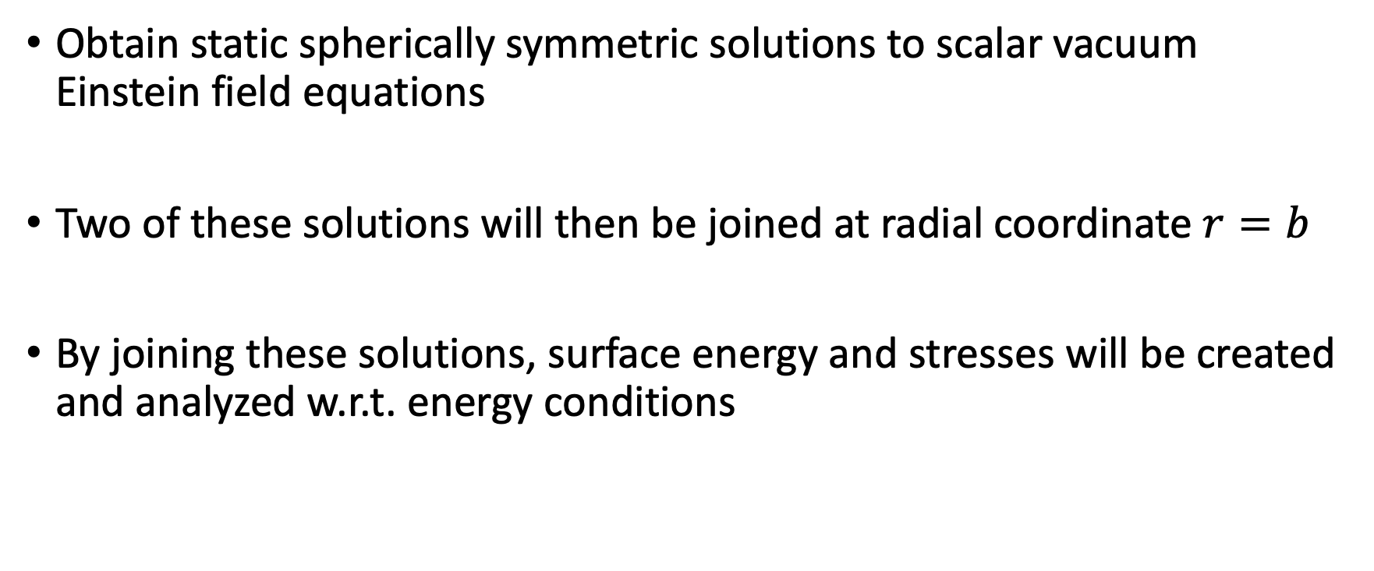
Wormhole Solutions: Game Plan
Obtain static spherically symmetric solutions to scalar vacuum Einstein field equations
Two of these solutions will then be joined at radial coordinate $r=b$
By joining these solutions, surface energy and stresses will be created and analyzed w.r.t. energy conditions

Slide 11
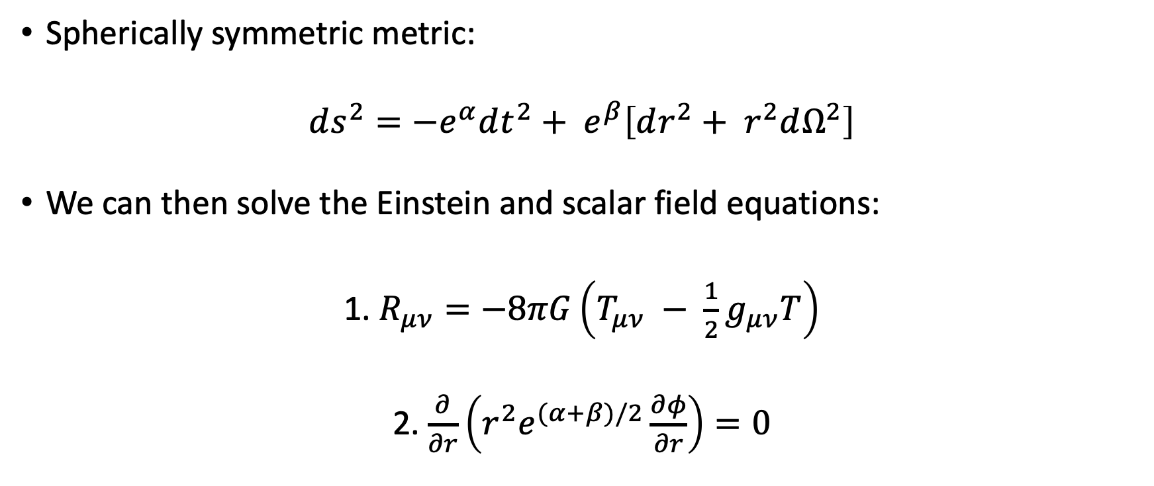
Wormhole Solutions
Spherically symmetric metric:
$$ds^{2}=−e^{α}dt^{2}+ e^{β}\left[dr^{2}+ r^{2}dΩ^{2}\right]$$
We can then solve the Einstein and scalar field equations:
1. $R_{μν}=−8πG\left(T_{μν} − \frac{1}{2}g_{μν}T\right)$
2. $\frac{∂}{∂r}\left(r^{2}e^{(α+β)/2}\frac{∂φ}{∂r}\right)=0$

Slide 12
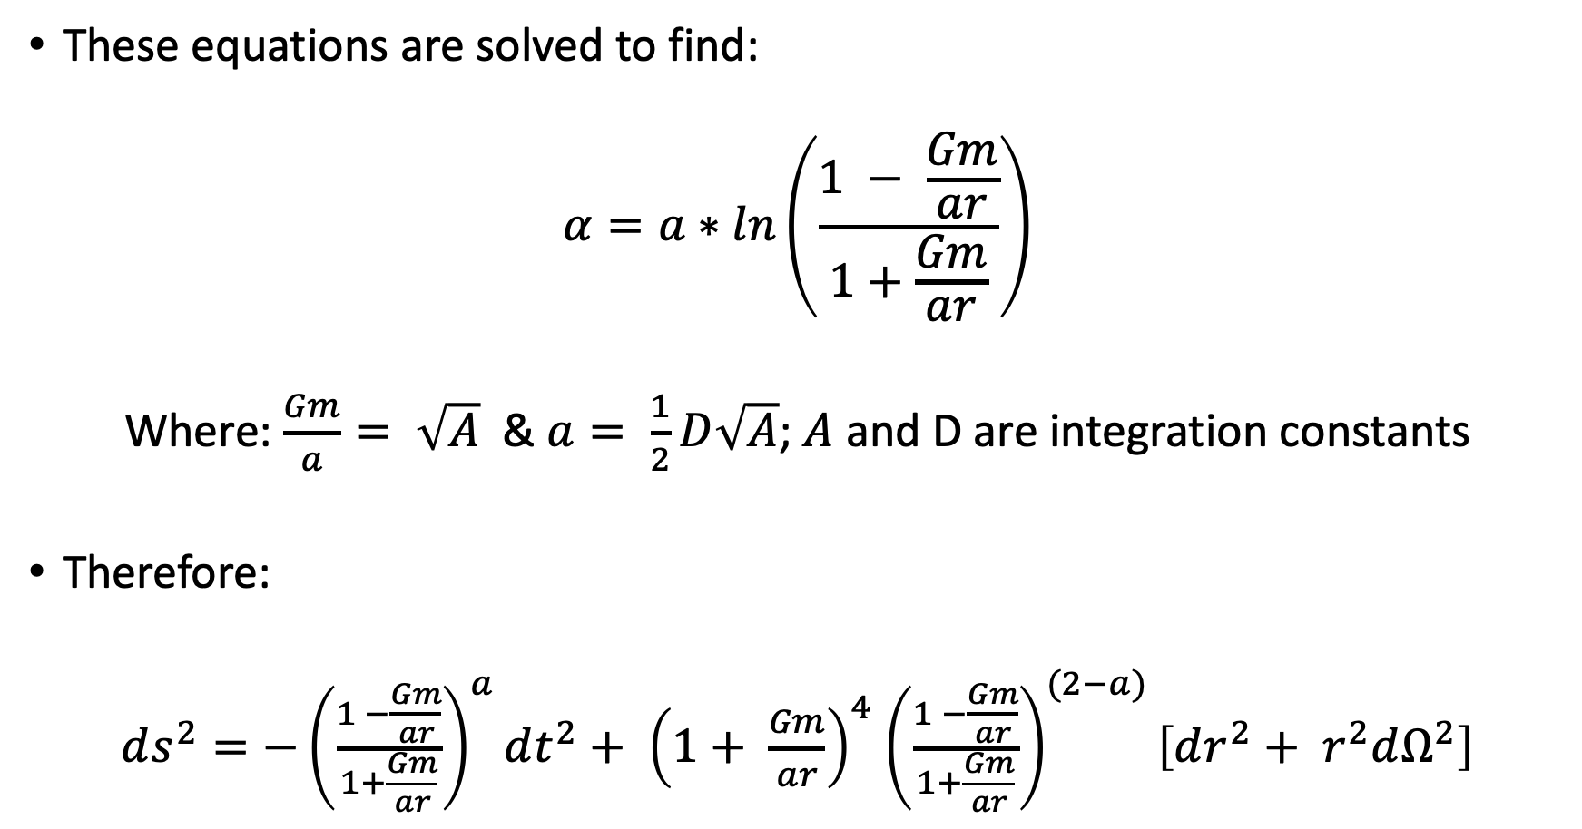
Wormhole Solutions
These equations are solved to find:
$$α=a∗ln\left(\frac{1 − \frac{Gm}{ar}}{1+\frac{Gm}{ar}}\right)$$
Where: $\frac{Gm}{a}= \sqrt{A}$ & $a= \frac{1}{2}D\sqrt{A}$; $A$ and D are integration constants
Therefore:
$ds^{2}=−{\left(\frac{1 −\frac{Gm}{ar}}{1+\frac{Gm}{ar}}\right)}^{a}dt^{2}+ {\left(1+ \frac{Gm}{ar}\right)}^{4}$ ${\left(\frac{1 −\frac{Gm}{ar}}{1+\frac{Gm}{ar}}\right)}^{(2−a)}\left[dr^{2}+ r^{2}dΩ^{2}\right]$

Slide 13
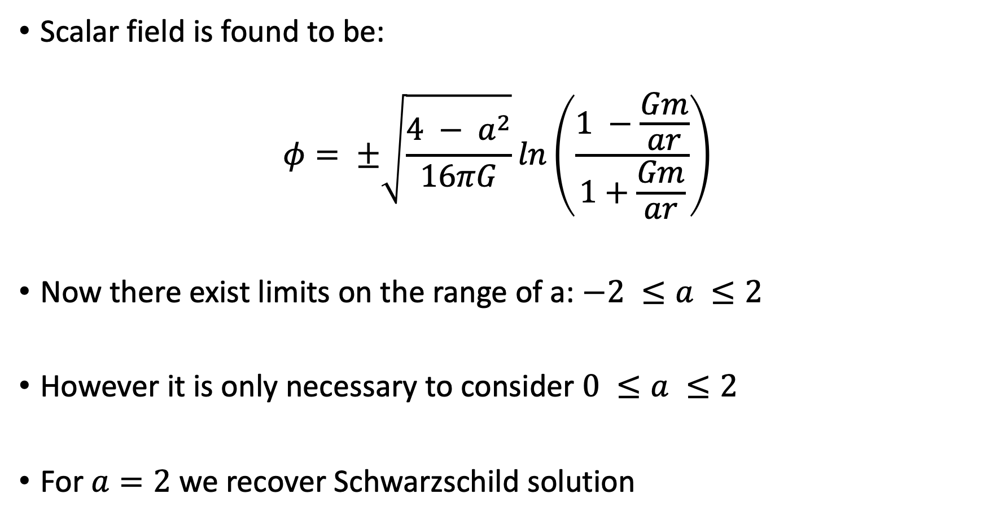
Wormhole Solutions
Scalar field is found to be:
$$φ= ±\sqrt{\frac{4 − a^{2}}{16πG}}ln\left(\frac{1 −\frac{Gm}{ar}}{1+\frac{Gm}{ar}}\right)$$
Now there exist limits on the range of a: $−2 ≤a ≤2$
However it is only necessary to consider $0 ≤a ≤2$
For $a=2$ we recover Schwarzschild solution

Slide 14
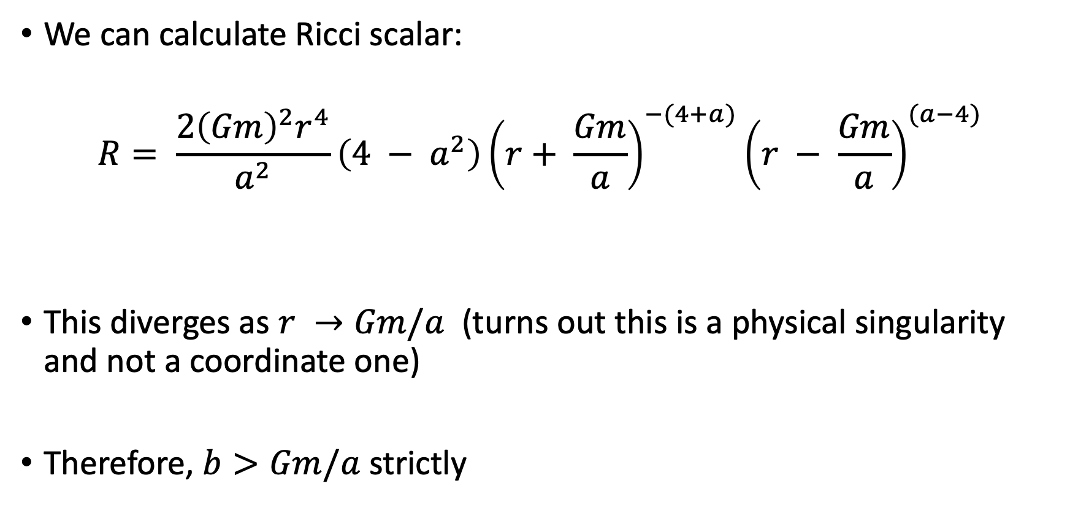
Wormhole Solutions
We can calculate Ricci scalar:
$$R= \frac{2{\left(Gm\right)}^{2}r^{4}}{a^{2}}\left(4 − a^{2}\right){\left(r+ \frac{Gm}{a}\right)}^{−(4+a)}{\left(r − \frac{Gm}{a}\right)}^{(a−4)}$$
This diverges as $r →Gm/a$ (turns out this is a physical singularity and not a coordinate one)
Therefore, $b>Gm/a$ strictly

Slide 15
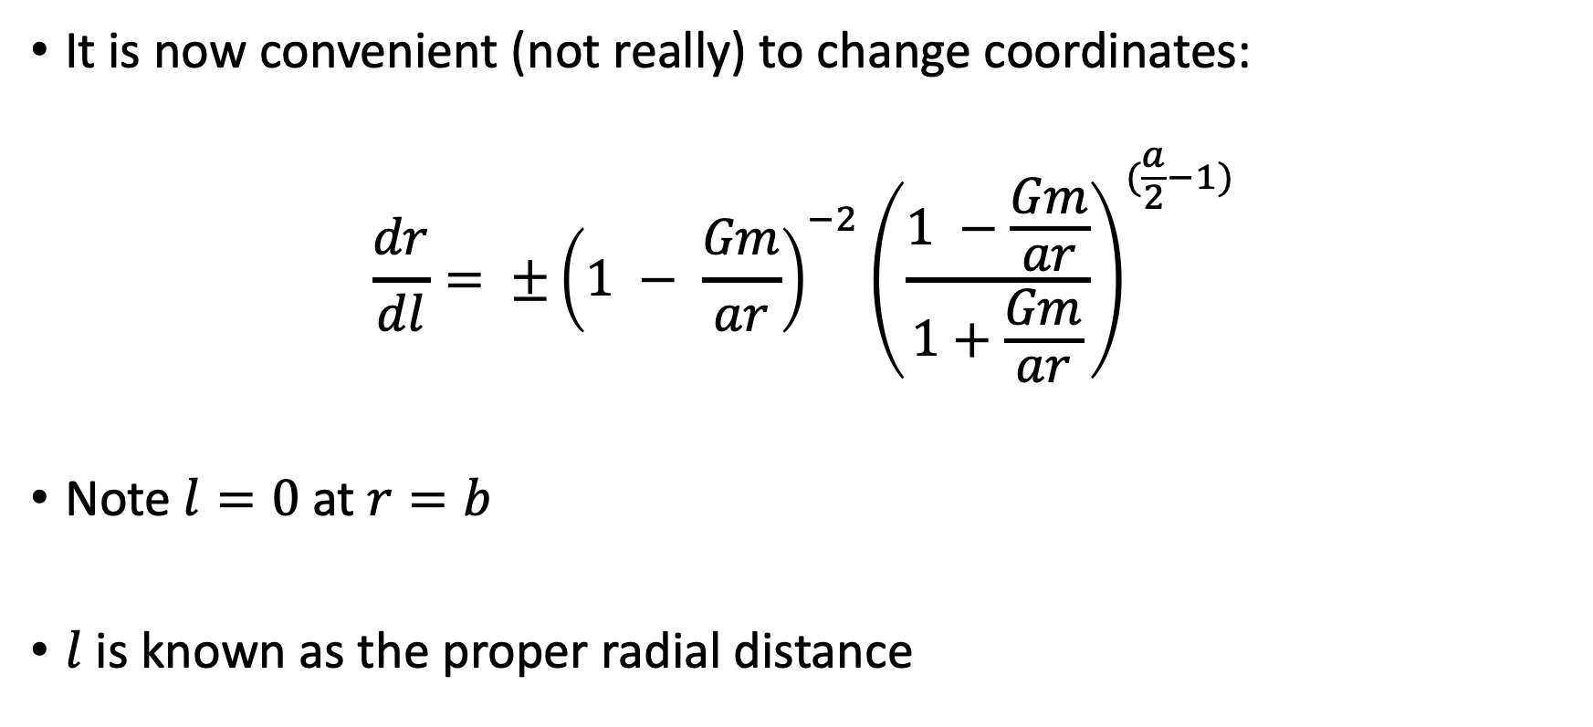
Wormhole Solutions
It is now convenient (not really) to change coordinates:
$$\frac{dr}{dl}= ±{\left(1 − \frac{Gm}{ar}\right)}^{−2}{\left(\frac{1 −\frac{Gm}{ar}}{1+\frac{Gm}{ar}}\right)}^{(\frac{a}{2}−1)}$$
Note $l=0$at $r=b$
$l$ is known as the proper radial distance

Slide 16
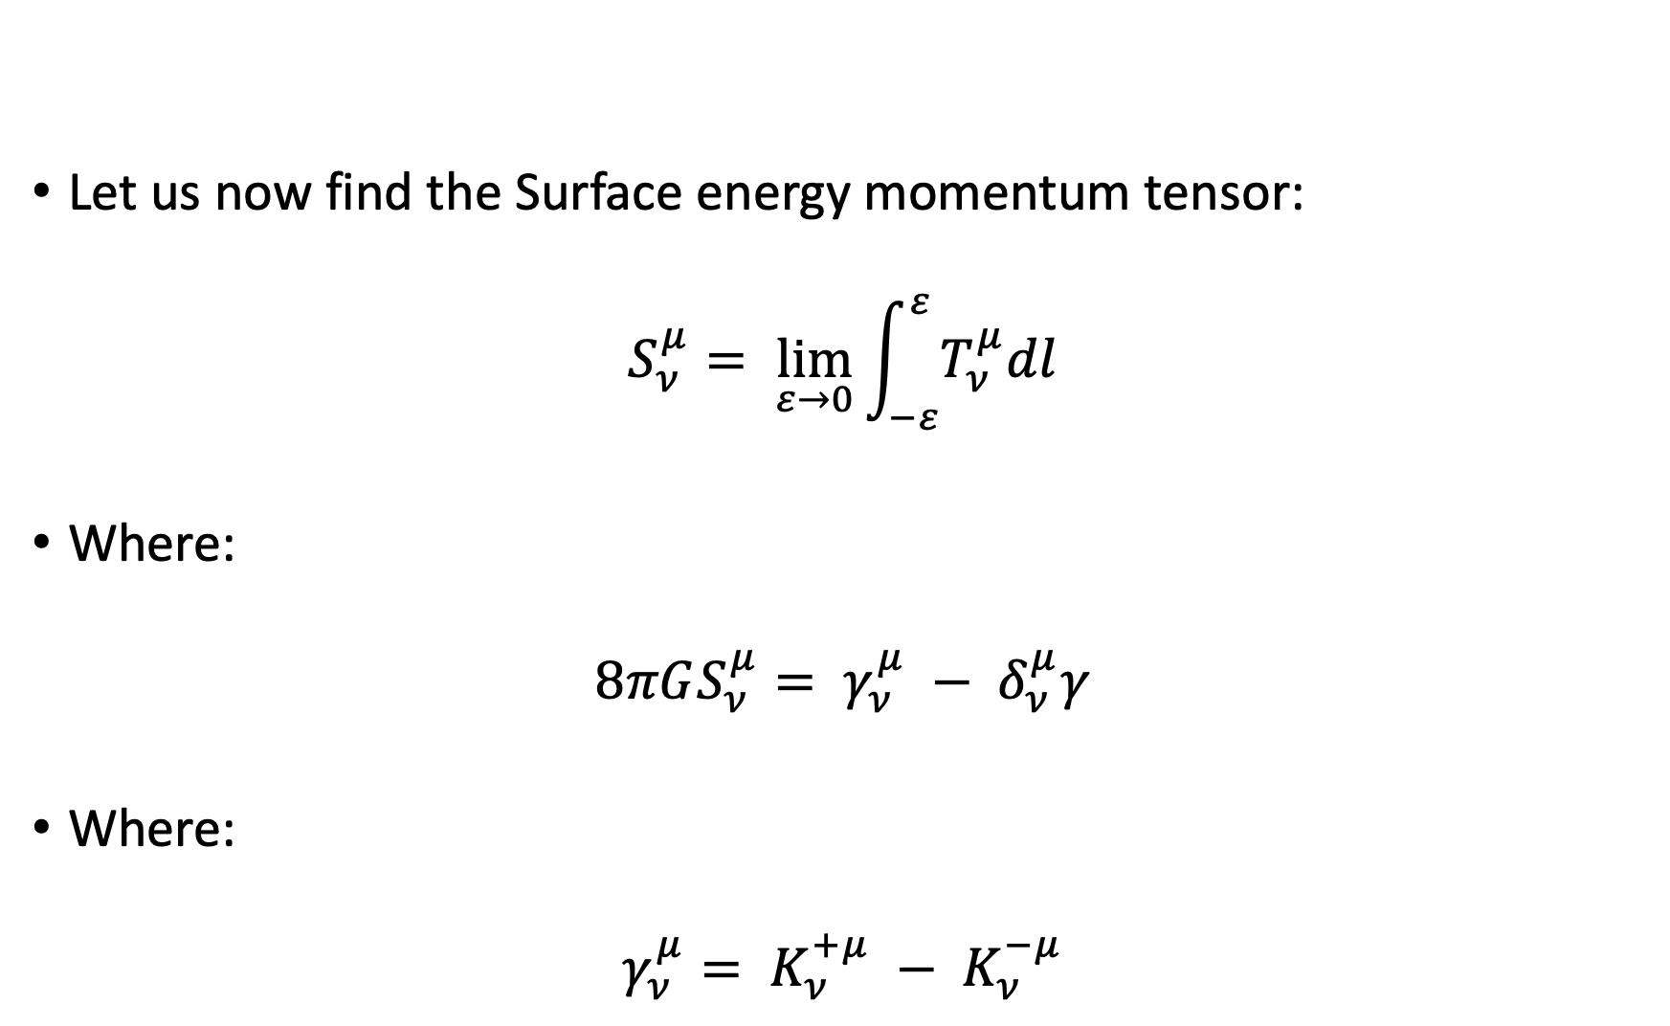
Wormhole Solutions
Let us now find the Surface energy momentum tensor:
$$S_{ν}^{μ}= \lim_{ε→0}{\int_{−ε}^{ε}{T_{ν}^{μ}dl}}$$
Where:
$$8πGS_{ν}^{μ}= γ_{ν}^{μ} − δ_{ν}^{μ}γ$$
Where:
$$γ_{ν}^{μ}= K_{ν}^{+μ} − K_{ν}^{−μ}$$

Slide 17
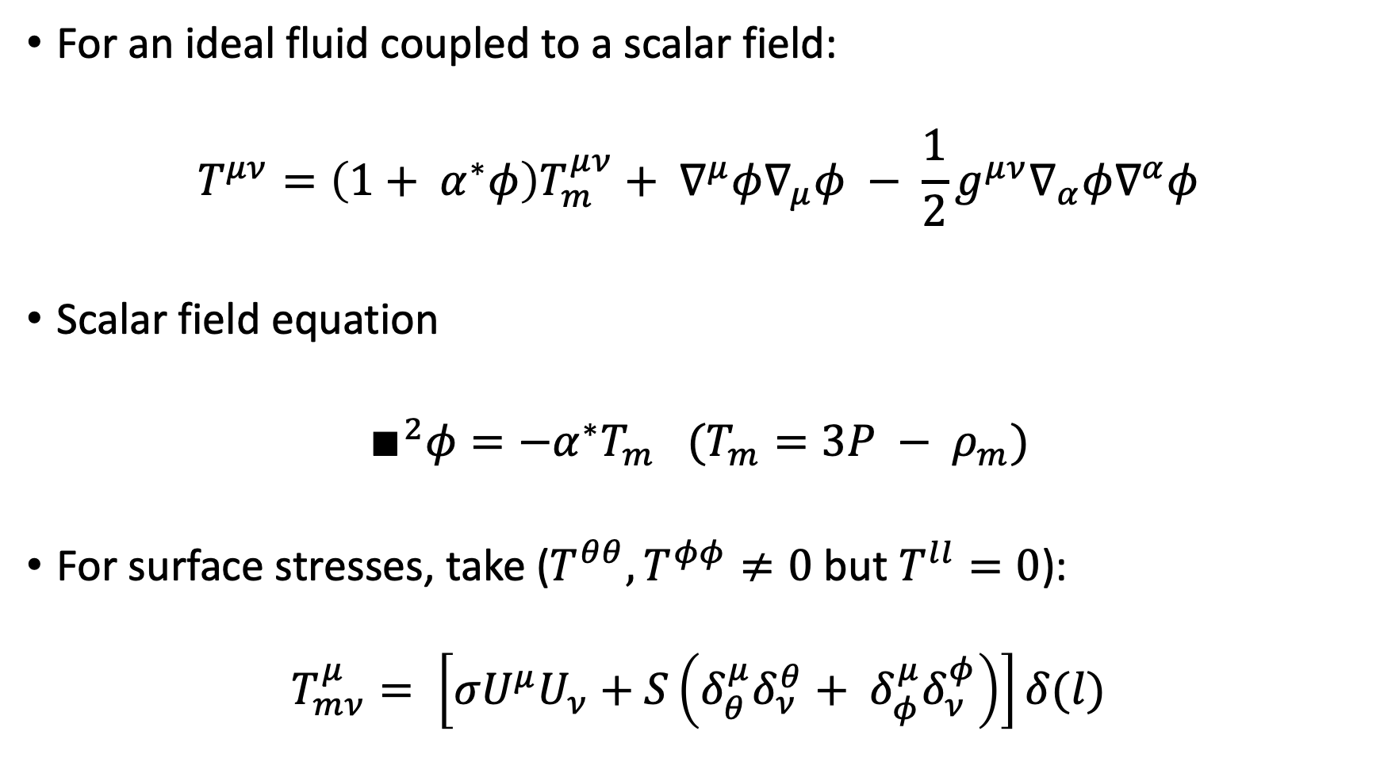
Wormhole Solutions
For an ideal fluid coupled to a scalar field:
$$T^{μν}=\left(1+ α^{∗}φ\right)T_{m}^{μν}+ ∇^{μ}φ∇_{μ}φ − \frac{1}{2}g^{μν}∇_{α}φ∇^{α}φ$$
Scalar field equation
$∎^{2}φ=−α^{∗}T_{m}$ $(T_{m}=3P − ρ_{m})$
For surface stresses, take ($T^{θθ}, T^{φφ}≠0$ but $T^{ll}=0$):
$$T_{mν}^{μ}= \left[σU^{μ}U_{ν}+S\left(δ_{θ}^{μ}δ_{ν}^{θ}+ δ_{φ}^{μ}δ_{ν}^{φ}\right)\right]δ(l)$$

Slide 18
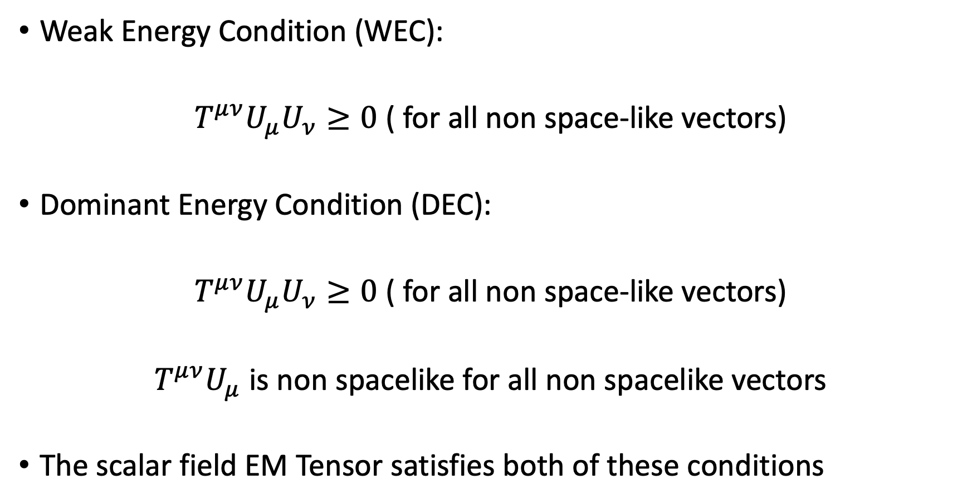
Wormhole Solutions: Energy Conditions
Weak Energy Condition (WEC):
$T^{μν}U_{μ}U_{ν}≥0$ ( for all non space-like vectors)
Dominant Energy Condition (DEC):
$T^{μν}U_{μ}U_{ν}≥0$ ( for all non space-like vectors)
$T^{μν}U_{μ}$ is non spacelike for all non spacelike vectors
The scalar field EM Tensor satisfies both of these conditions

Slide 19
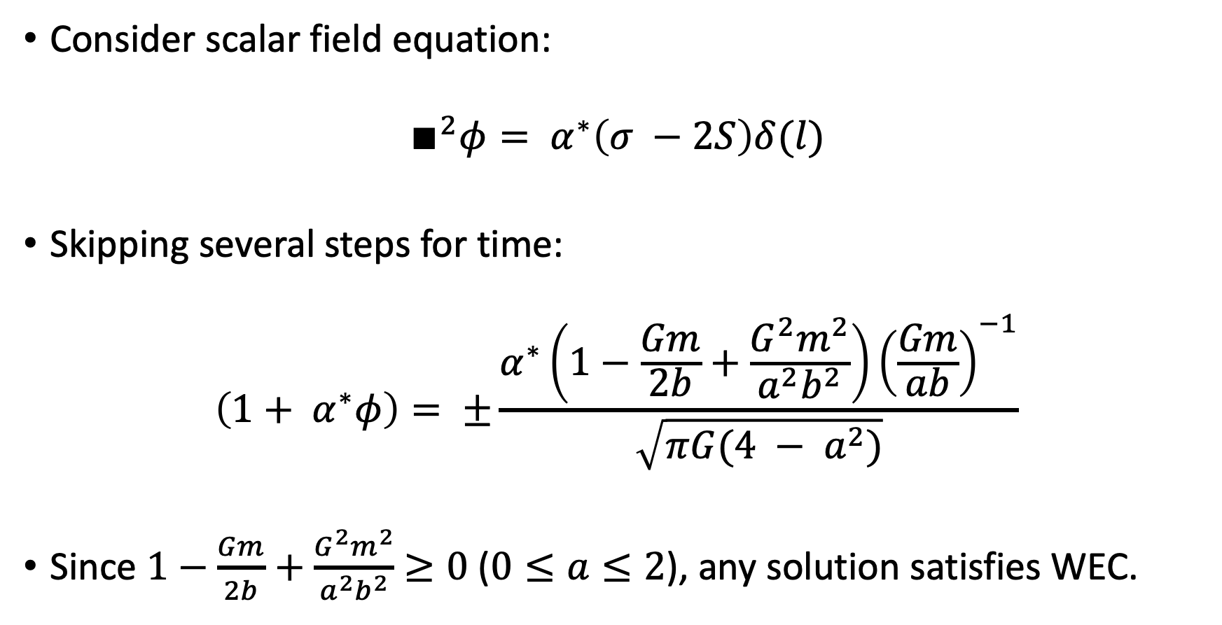
Wormhole Solutions
Consider scalar field equation:
$$∎^{2}φ= α^{∗}\left(σ −2S\right)δ(l)$$
Skipping several steps for time:
$$\left(1+ α^{∗}φ\right)= ±\frac{α^{∗}\left(1−\frac{Gm}{2b}+\frac{G^{2}m^{2}}{a^{2}b^{2}}\right){\left(\frac{Gm}{ab}\right)}^{−1}}{\sqrt{πG(4 − a^{2})}}$$
Since $1−\frac{Gm}{2b}+\frac{G^{2}m^{2}}{a^{2}b^{2}}$ $≥0$ ($0≤a≤2$), any solution satisfies WEC.

Slide 20
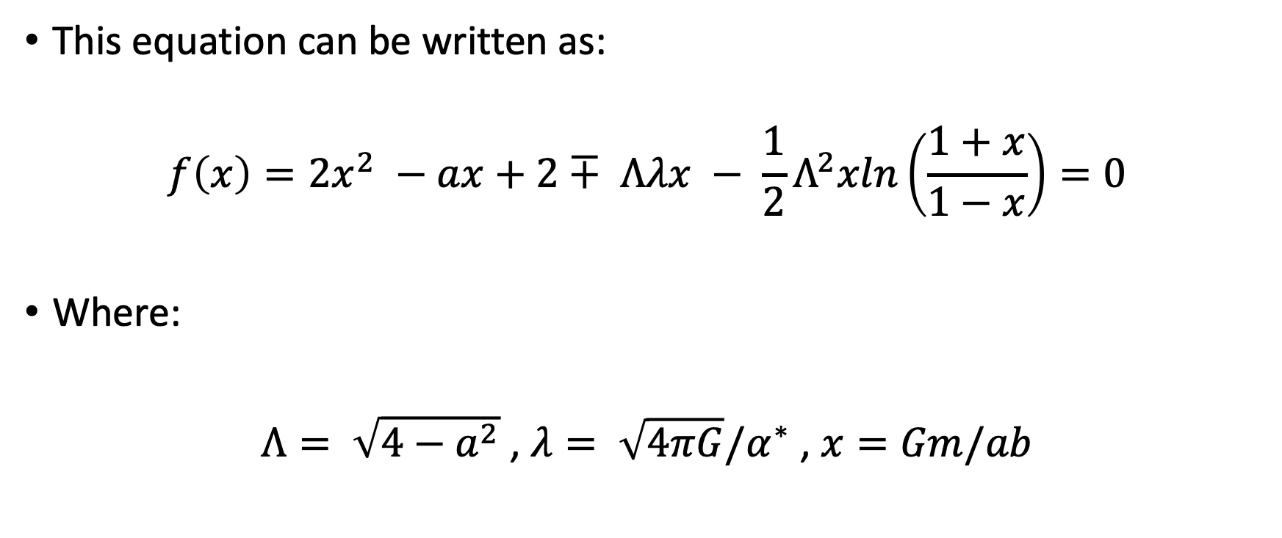
Wormhole Solutions
This equation can be written as:
$$f\left(x\right)=2x^{2} −ax+2∓ Λλx − \frac{1}{2}Λ^{2}xln\left(\frac{1+x}{1−x}\right)=0$$
Where:
$Λ= \sqrt{4−a^{2}}$ , $λ= \sqrt{4πG}/α^{∗}$ , $x=Gm/ab$

Slide 21
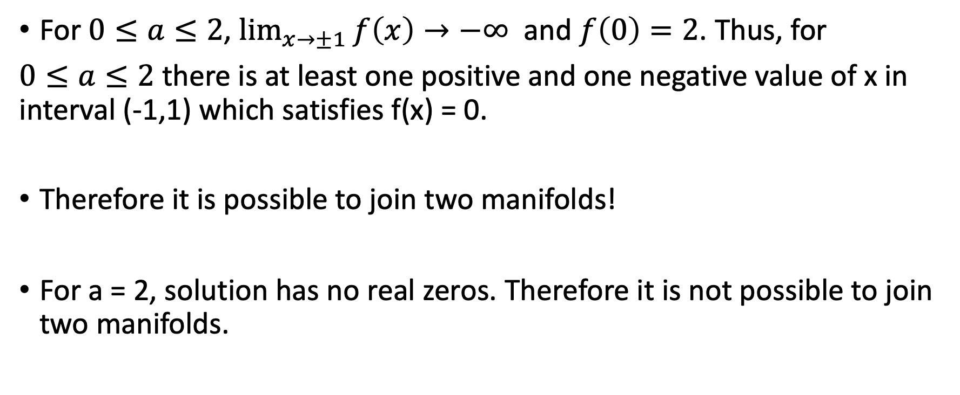
Wormhole Solutions
For $0≤a≤2$, $\lim_{x→±1}{f\left(x\right)→−∞}$ and $f\left(0\right)=2$. Thus, for
$0≤a≤2$ there is at least one positive and one negative value of x in interval (-1,1) which satisfies f(x) = 0.
Therefore it is possible to join two manifolds!
For a = 2, solution has no real zeros. Therefore it is not possible to join two manifolds.

Slide 22
Conclusion
The interaction energy-momentum tensor can violate the weak energy condition-allowing wormhole to be maintained
Surface energy-momentum tensor that violates the weak energy condition exists on the surface where the two manifolds are joined
Thus, it is possible to maintain a wormhole classically by coupling a scalar field to matter that satisfies the weak and dominant energy conditions

Slide 23
Sources
Vollick Dan N. Maintaining a Wormhole with a Scalar Field. Physical Review D, January 16 1997.

