Slide 1

The Polarizable Vacuum Model and Levi-Civita Effect
Patrick Brown
EUCOS Group
Baylor University

Slide 2
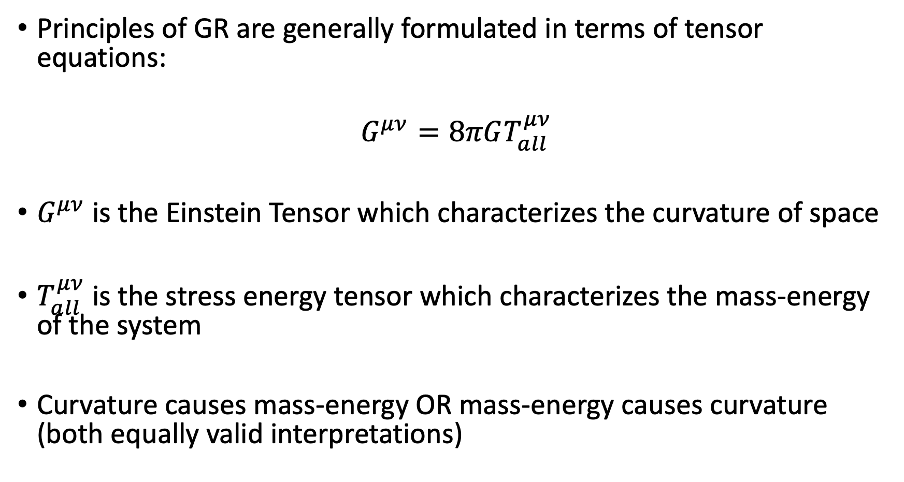
Overview
Principles of GR are generally formulated in terms of tensor equations:
$$G^{μν}=8πGT_{all}^{μν}$$
$G^{μν}$ is the Einstein Tensor which characterizes the curvature of space
$T_{all}^{μν}$ is the stress energy tensor which characterizes the mass-energy of the system
Curvature causes mass-energy OR mass-energy causes curvature (both equally valid interpretations)

Slide 3
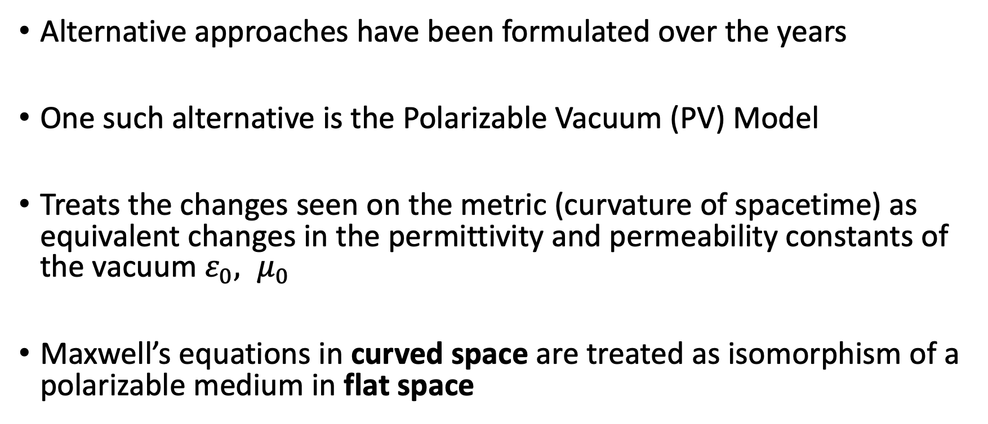
Overview
Alternative approaches have been formulated over the years
One such alternative is the Polarizable Vacuum (PV) Model
Treats the changes seen on the metric (curvature of spacetime) as equivalent changes in the permittivity and permeability constants of the vacuum $ε_{0}, μ_{0}$
Maxwell’s equations in curved space are treated as isomorphism of a polarizable medium in flat space

Slide 4
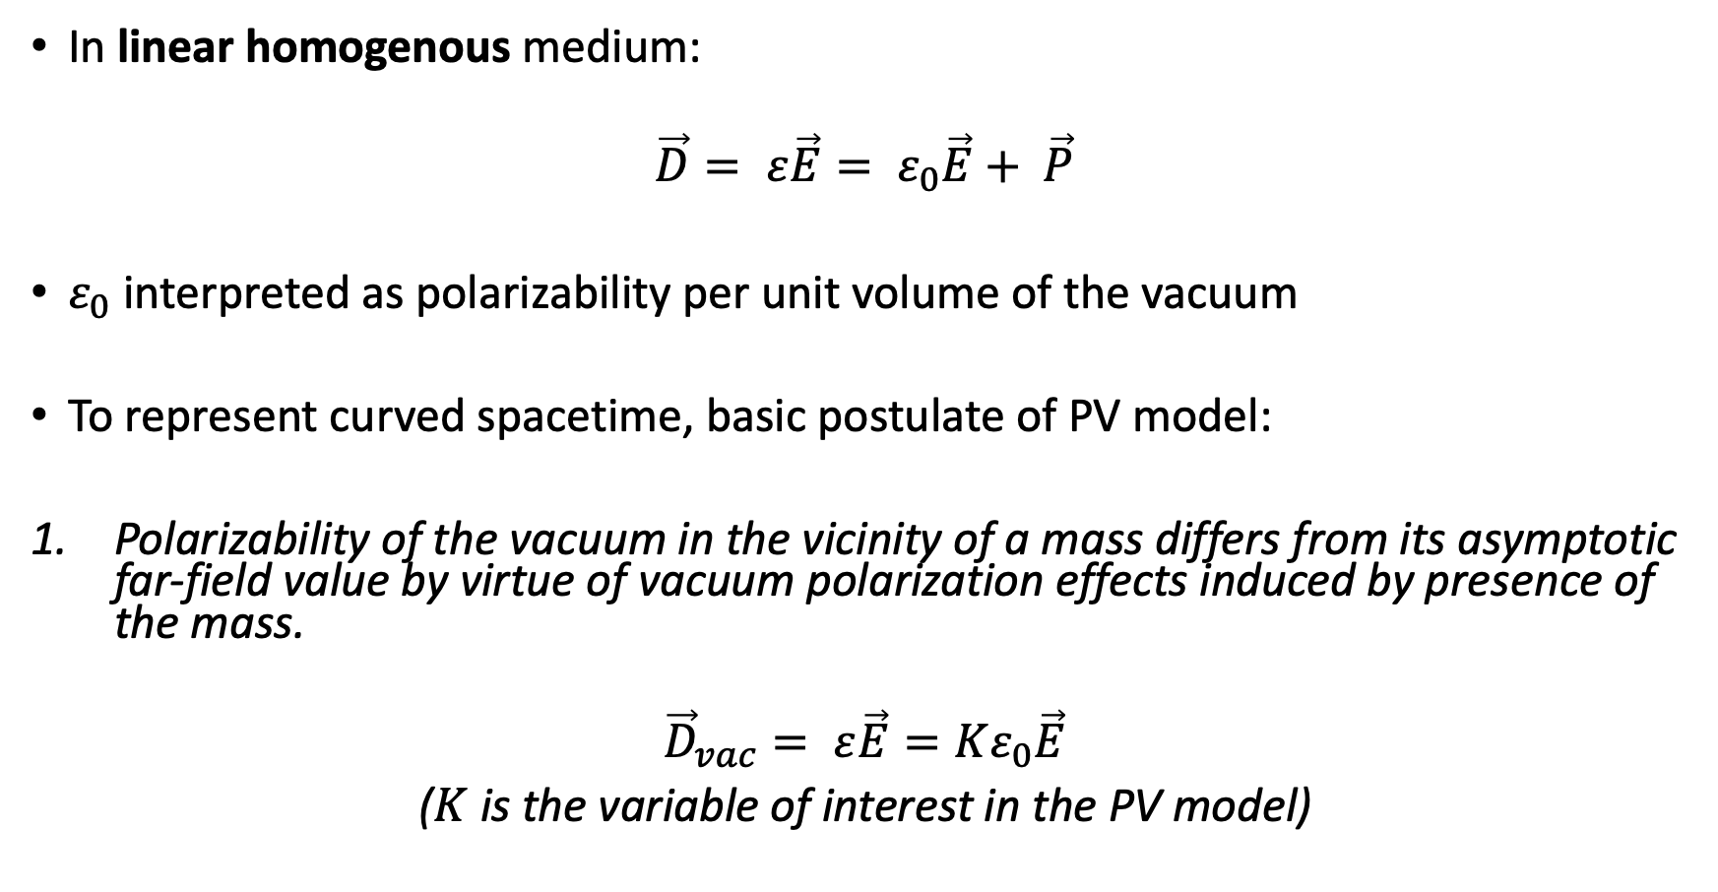
The Polarizable Vacuum
In linear homogenous medium:
$$\vec{D}= ε\vec{E}= ε_{0}\vec{E}+ \vec{P}$$
$ε_{0}$ interpreted as polarizability per unit volume of the vacuum
To represent curved spacetime, basic postulate of PV model:
Polarizability of the vacuum in the vicinity of a mass differs from its asymptotic far-field value by virtue of vacuum polarization effects induced by presence of the mass.
$${\vec{D}}_{vac}= ε\vec{E}=Kε_{0}\vec{E}$$
($K$ is the variable of interest in the PV model)

Slide 5

Velocity of Light in PV Model
Begin with well known constant from observations, fine structure:
$α= \frac{e^{2}}{4πε_{0}ℏc}$ where $c= \frac{1}{\sqrt{ε_{0}μ_{0}}}$
$e$ and $ℏ$ are constants; $ε\left(K\right)=Kε_{0}$ and $μ= μ(K)$:
$$c= \frac{1}{\sqrt{ε(K)μ(K)}}$$
Therefore:
$$α= \frac{e^{2}}{4πε_{0}ℏc}\sqrt{\frac{μ(K)/μ_{0}}{K}}$$

Slide 6
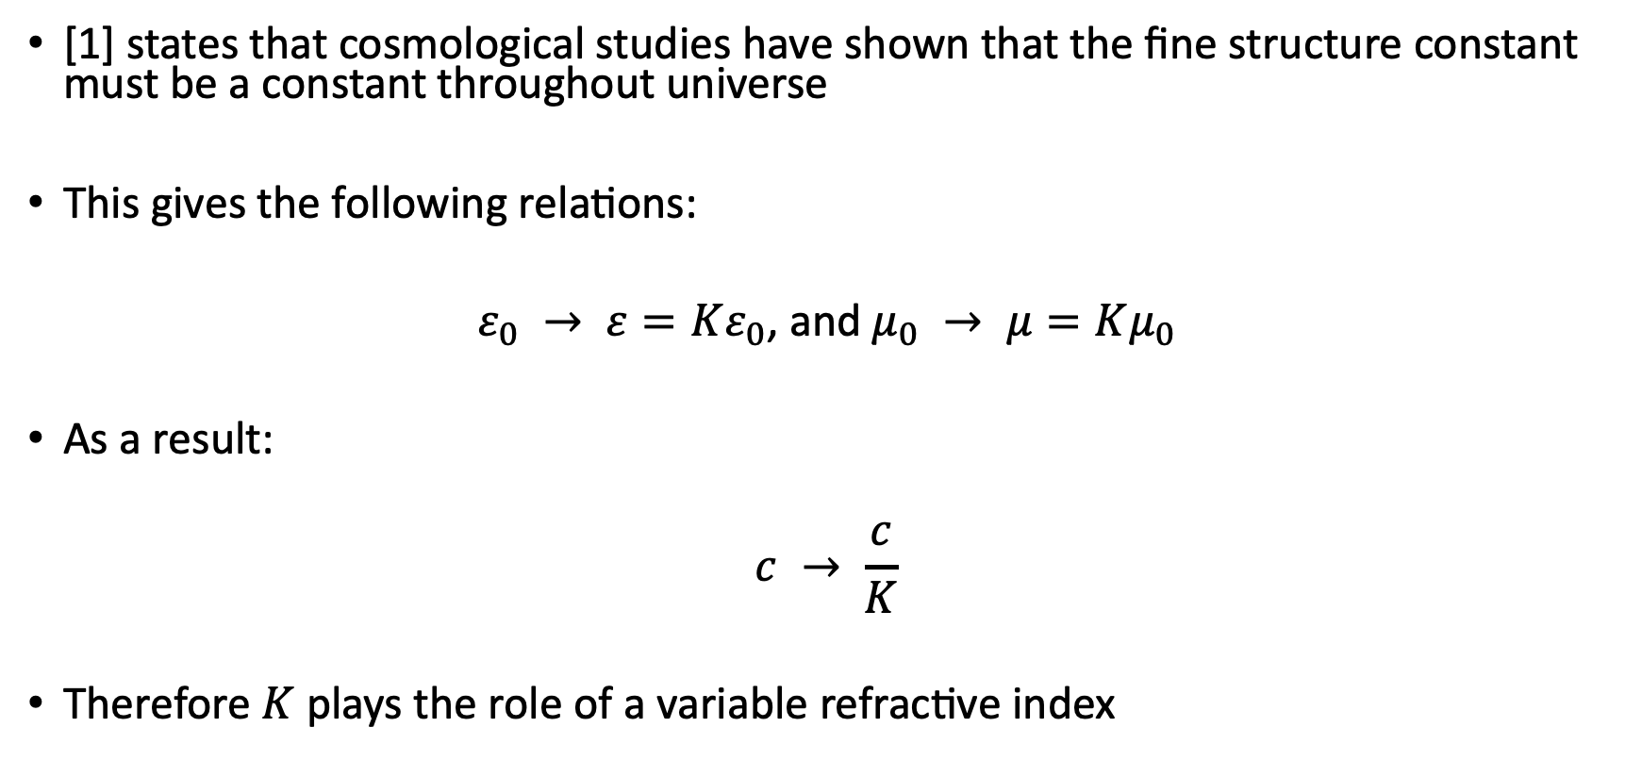
Velocity of Light in PV Model
[1] states that cosmological studies have shown that the fine structure constant must be a constant throughout universe
This gives the following relations:
$ε_{0} → ε=Kε_{0}$, and $μ_{0} → μ=Kμ_{0}$
As a result:
$$c → \frac{c}{K}$$
Therefore $K$ plays the role of a variable refractive index

Slide 7
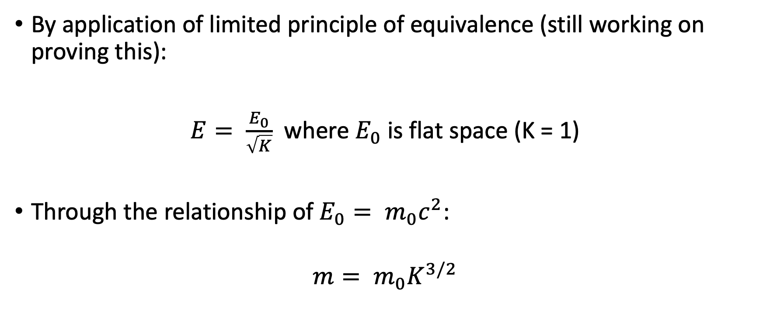
Energy in PV Model
By application of limited principle of equivalence (still working on proving this):
$E= \frac{E_{0}}{\sqrt{K}}$ where $E_{0}$ is flat space (K = 1)
Through the relationship of $E_{0}= m_{0}c^{2}$:
$$m= m_{0}K^{3/2}$$

Slide 8
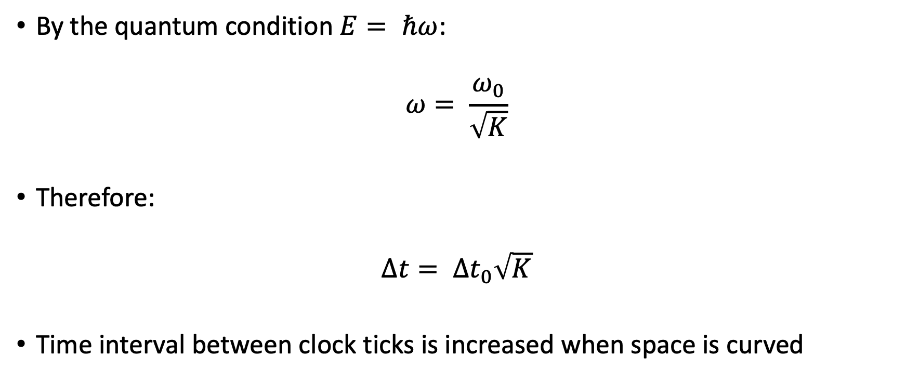
Rod and Clock Changes in PV Model
By the quantum condition $E= ℏω$:
$$ω= \frac{ω_{0}}{\sqrt{K}}$$
Therefore:
$$∆t= ∆t_{0}\sqrt{K}$$
Time interval between clock ticks is increased when space is curved

Slide 9
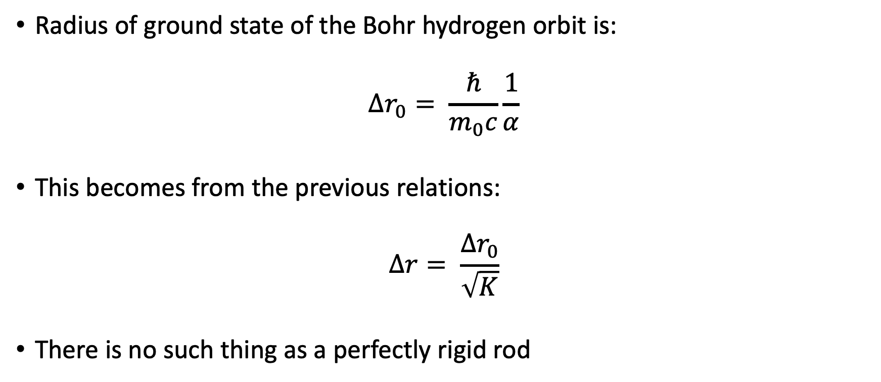
Rod and Clock Changes in PV Model
Radius of ground state of the Bohr hydrogen orbit is:
$$∆r_{0}= \frac{ℏ}{m_{0}c}\frac{1}{α}$$
This becomes from the previous relations:
$$∆r= \frac{∆r_{0}}{\sqrt{K}}$$
There is no such thing as a perfectly rigid rod

Slide 10
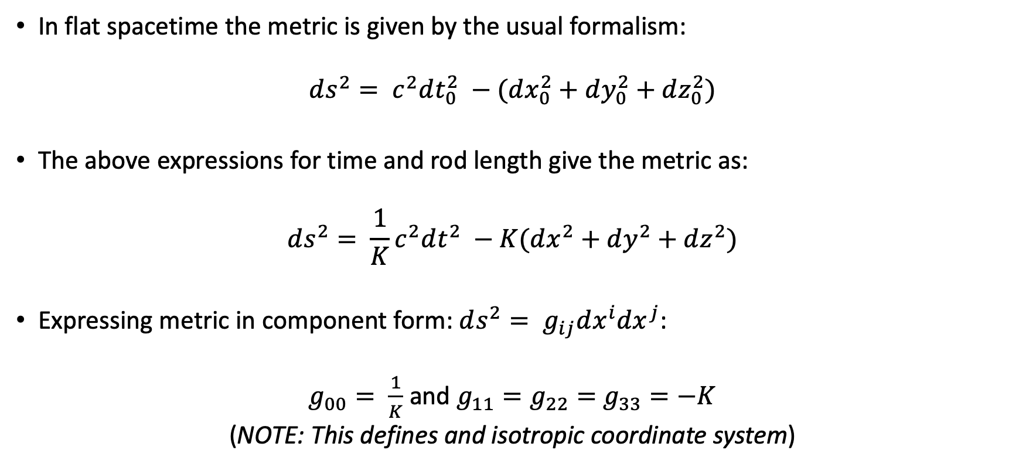
Metric Tensor in PV Model
In flat spacetime the metric is given by the usual formalism:
$$ds^{2}= c^{2}dt_{0}^{2} −(dx_{0}^{2}+dy_{0}^{2}+dz_{0}^{2})$$
The above expressions for time and rod length give the metric as:
$$ds^{2}= {\frac{1}{K}c}^{2}dt^{2} −K(dx^{2}+dy^{2}+dz^{2})$$
Expressing metric in component form: $ds^{2}= g_{ij}dx^{i}{dx}^{j}$:
$g_{00}= \frac{1}{K}$ and $g_{11}=g_{22}=$ $g_{33}=−K$
(NOTE: This defines and isotropic coordinate system)

Slide 11
Coupled Matter-Field Equations
Need proper form of K induced by presence of mass-energy (matter-field interactions)
Approach to this consists of following standard Lagrangian techniques
In this case, however, K is treated as variable function of time and space

Slide 12
Lagrangian Approach
The main components of the matter-field interaction are:
Interaction of a free particle with EM fields
The Lagrangian density for the EM fields themselves
The Lagrangian density for the K
Note: Since we are dealing with special-relativistic quantities, the Lagrangian densities need to be on Lorentz-invariant form

Slide 13
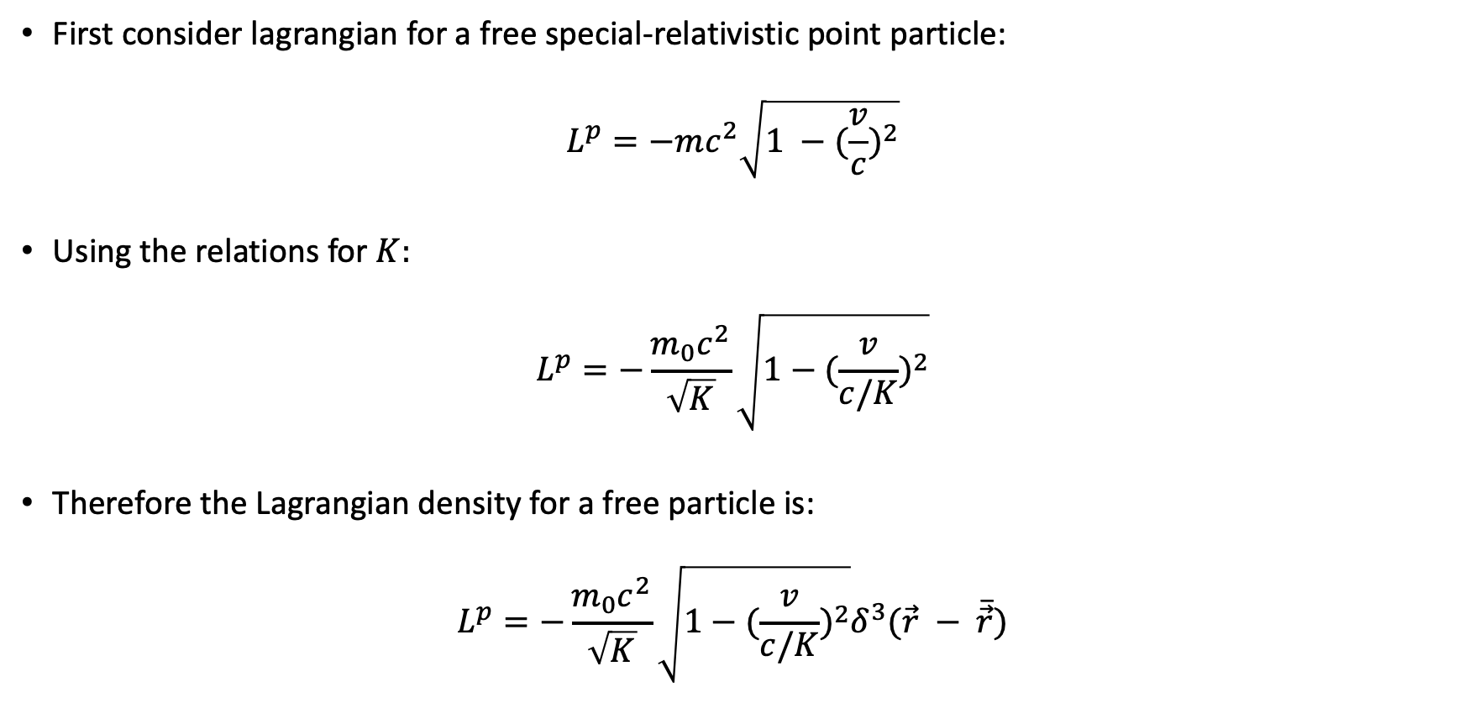
Lagrangian Approach
First consider lagrangian for a free special-relativistic point particle:
$$L^{p}=−mc^{2}\sqrt{1 −(\frac{v}{c})^{2}}$$
Using the relations for $K:$
$$L^{p}=−\frac{m_{0}c^{2}}{\sqrt{K}}\sqrt{1−(\frac{v}{c/K})^{2}}$$
Therefore the Lagrangian density for a free particle is:
$$L^{p}=−\frac{m_{0}c^{2}}{\sqrt{K}}\sqrt{1−(\frac{v}{c/K})^{2}}δ^{3}(\vec{r} − \overline{\vec{r}})$$

Slide 14
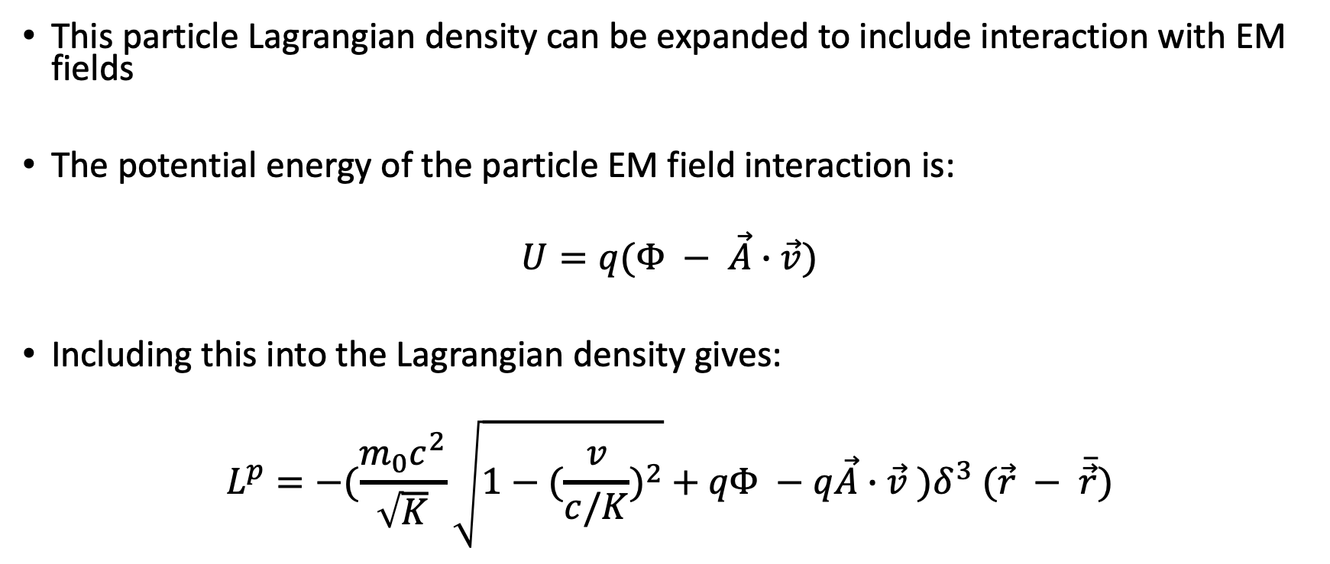
Lagrangian Approach
This particle Lagrangian density can be expanded to include interaction with EM fields
The potential energy of the particle EM field interaction is:
$$U=q(Φ − \vec{A}∙\vec{v})$$
Including this into the Lagrangian density gives:
$$L^{p}=−(\frac{m_{0}c^{2}}{\sqrt{K}}\sqrt{1−(\frac{v}{c/K})^{2}}{+ qΦ −q\vec{A}∙\vec{v} )δ}^{3}(\vec{r} − \overline{\vec{r}})$$

Slide 15
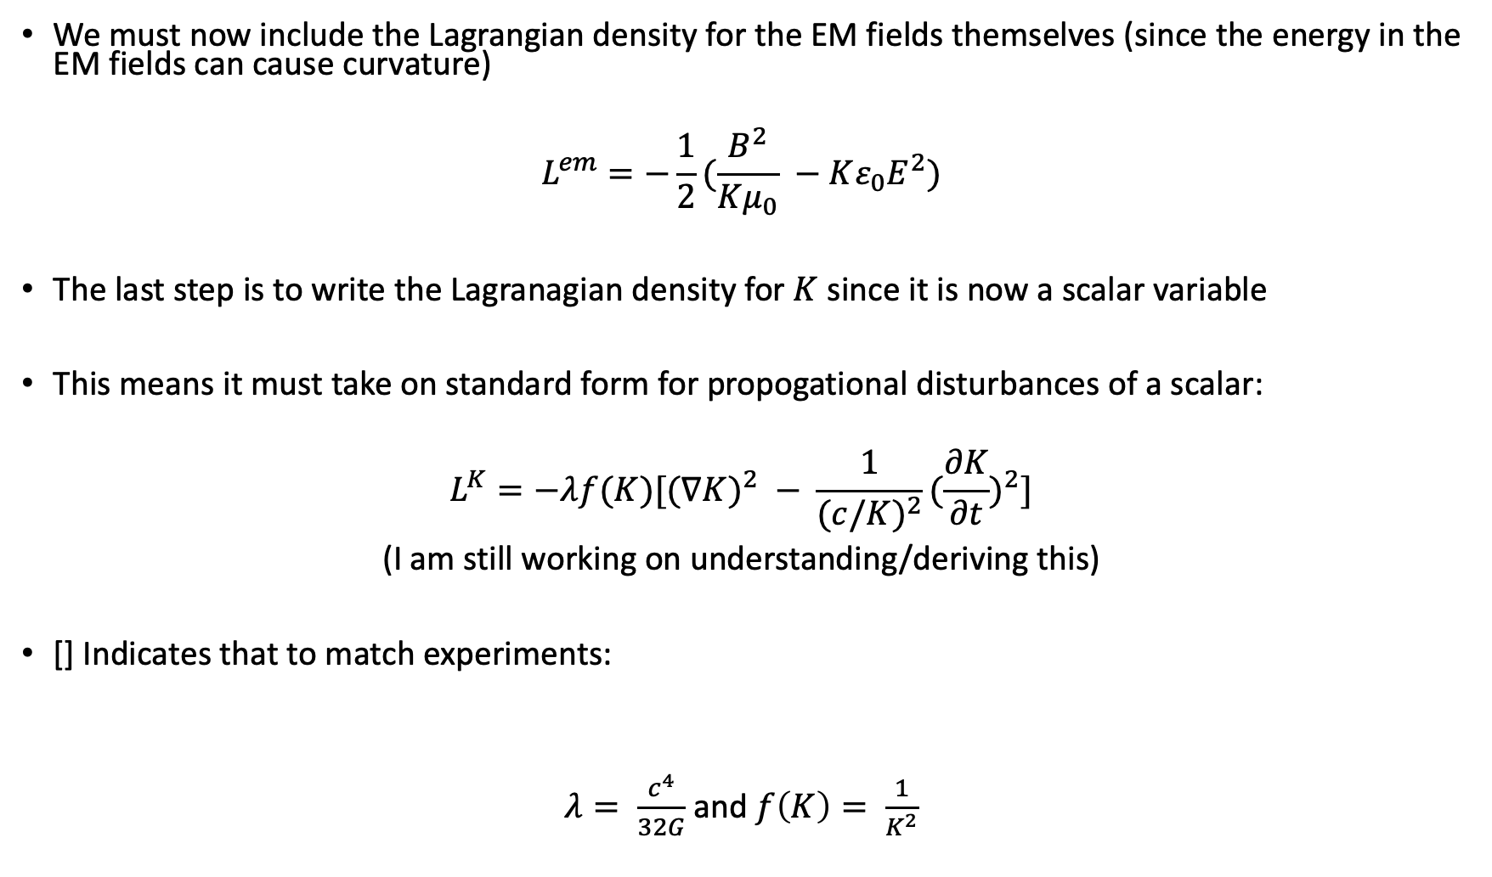
Lagrangian Approach
We must now include the Lagrangian density for the EM fields themselves (since the energy in the EM fields can cause curvature)
$$L^{em}=−\frac{1}{2}(\frac{B^{2}}{Kμ_{0}} −Kε_{0}E^{2})$$
The last step is to write the Lagranagian density for $K$ since it is now a scalar variable
This means it must take on standard form for propogational disturbances of a scalar:
$$L^{K}=−λf(K)[(∇K)^{2} − \frac{1}{(c/K)^{2}}(\frac{∂K}{∂t})^{2}]$$
(I am still working on understanding/deriving this)
[] Indicates that to match experiments:
$λ= \frac{c^{4}}{32G}$ and $f\left(K\right)= \frac{1}{K^{2}}$

Slide 16
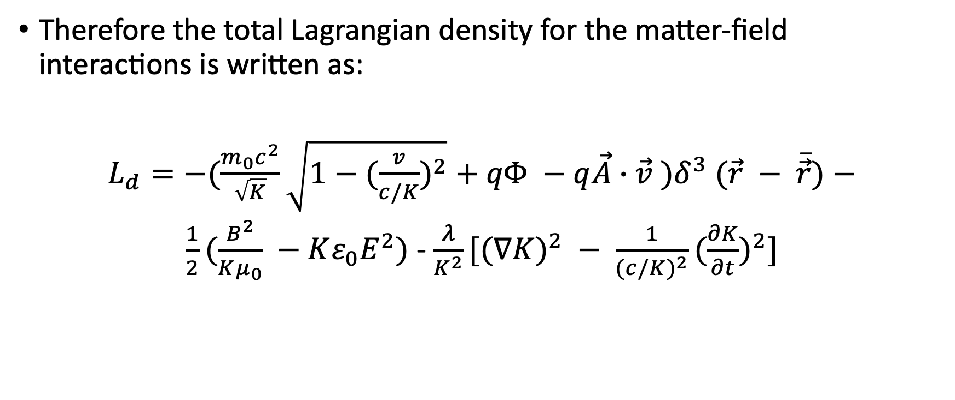
Lagrangian Approach
Therefore the total Lagrangian density for the matter-field interactions is written as:
$L_{d}=−(\frac{m_{0}c^{2}}{\sqrt{K}}\sqrt{1−(\frac{v}{c/K})^{2}}{+ qΦ −q\vec{A}∙\vec{v} )δ}^{3}(\vec{r} − \overline{\vec{r}})$ $−$
$\frac{1}{2}(\frac{B^{2}}{Kμ_{0}} −Kε_{0}E^{2})$ - $\frac{λ}{K^{2}}[(∇K)^{2} − \frac{1}{(c/K)^{2}}(\frac{∂K}{∂t})^{2}]$

Slide 17
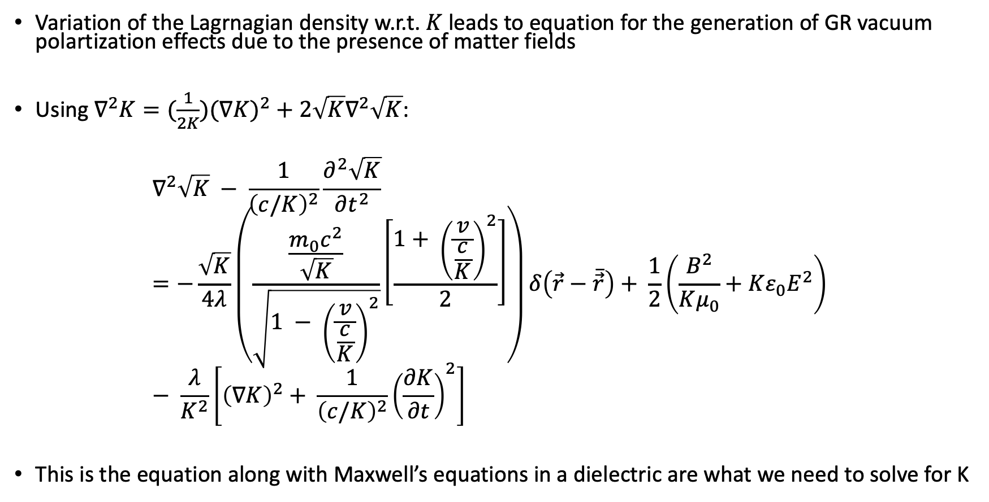
General Matter Field Equations
Variation of the Lagrnagian density w.r.t. $K$ leads to equation for the generation of GR vacuum polartization effects due to the presence of matter fields
Using $∇^{2}K=(\frac{1}{2K})(∇K)^{2}+2\sqrt{K}∇^{2}\sqrt{K}$:
$$∇^{2}\sqrt{K} − \frac{1}{{\left(c/K\right)}^{2}}\frac{∂^{2}\sqrt{K}}{∂t^{2}}=−\frac{\sqrt{K}}{4λ}\left(\frac{\frac{m_{0}c^{2}}{\sqrt{K}}}{\sqrt{1 − {\left(\frac{v}{\frac{c}{K}}\right)}^{2}}}\left[\frac{1+ {\left(\frac{v}{\frac{c}{K}}\right)}^{2}}{2}\right]\right)δ\left(\vec{r}−\overline{\vec{r}}\right)+ \frac{1}{2}\left(\frac{B^{2}}{Kμ_{0}}+Kε_{0}E^{2}\right) − \frac{λ}{K^{2}}\left[{\left(∇K\right)}^{2}+ \frac{1}{{\left(c/K\right)}^{2}}{\left(\frac{∂K}{∂t}\right)}^{2}\right]$$
This is the equation along with Maxwell’s equations in a dielectric are what we need to solve for K

Slide 18
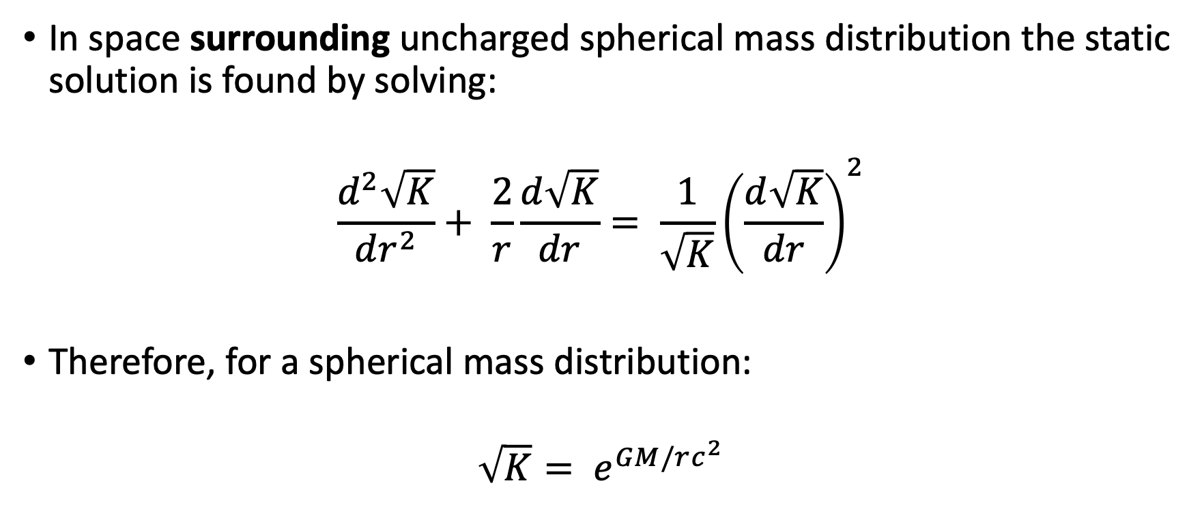
Static Fields (Gravitational)
In space surrounding uncharged spherical mass distribution the static solution is found by solving:
$$\frac{d^{2}\sqrt{K}}{dr^{2}}+ \frac{2}{r}\frac{d\sqrt{K}}{dr}= \frac{1}{\sqrt{K}}{\left(\frac{d\sqrt{K}}{dr}\right)}^{2}$$
Therefore, for a spherical mass distribution:
$$\sqrt{K}= e^{GM/rc^{2}}$$

Slide 19
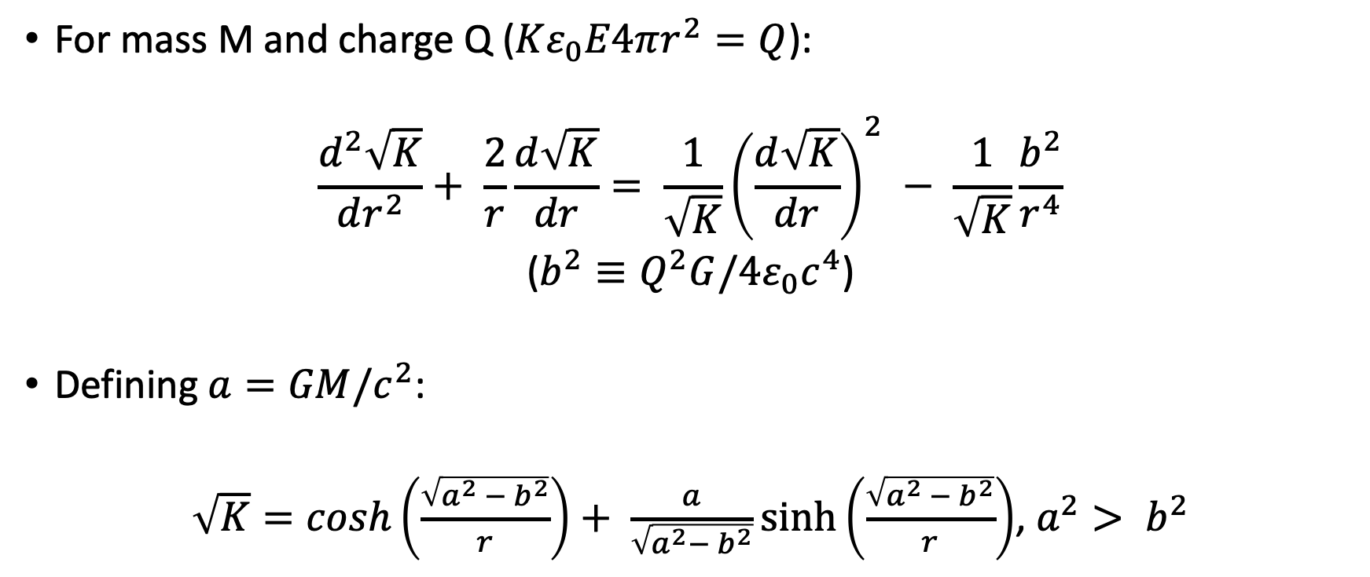
Static Fields (Gravitational Plus Electrical)
For mass M and charge Q ($Kε_{0}E4πr^{2}=Q$):
$$\frac{d^{2}\sqrt{K}}{dr^{2}}+ \frac{2}{r}\frac{d\sqrt{K}}{dr}= \frac{1}{\sqrt{K}}{\left(\frac{d\sqrt{K}}{dr}\right)}^{2} − \frac{1}{\sqrt{K}}\frac{b^{2}}{r^{4}}$$
($b^{2}≡Q^{2}G/4ε_{0}c^{4}$)
Defining $a=GM/c^{2}$:
$\sqrt{K}=cosh\left(\frac{\sqrt{a^{2} − b^{2}}}{r}\right)+ \frac{a}{\sqrt{a^{2}− b^{2}}}sinh⁡\left(\frac{\sqrt{a^{2} − b^{2}}}{r}\right)$, $a^{2}> b^{2}$

Slide 20
The Levi-Civita Effect
Now that we have seen that the PV model can be used to solve for the matter-field interactions of the EM fields and mass; we now ask the question:
Can homogenous electric and magnetic fields cause spacetime curvature (artificial gravitational field)?

Slide 21

Magnetic Solution
Consider static homogenous magnetic field: $\vec{B}=B\hat{z}$:
$\frac{d^{2}\sqrt{K}}{dz^{2}}= \frac{1}{\sqrt{K}}{\left(\frac{d\sqrt{K}}{dz}\right)}^{2}$ - $\frac{1}{\sqrt{K}}\frac{4πGB^{2}}{μ_{0}c^{4}}$
The solution for this equation takes the form:
$$\sqrt{K}= αcos\left(βz\right)$$
Where:
$$α^{2}β^{2}= \frac{4πGB^{2}}{μ_{0}c^{4}}$$

Slide 22
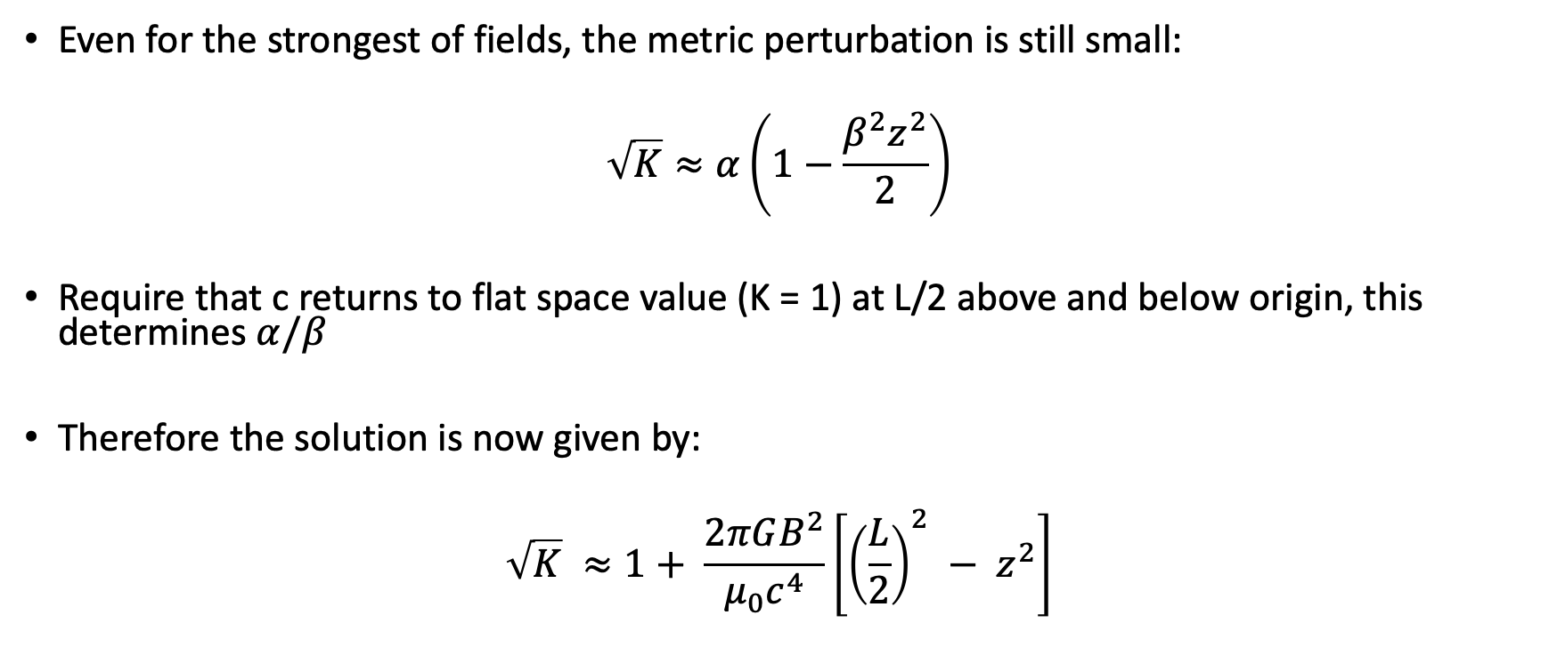
Magnetic Solution
Even for the strongest of fields, the metric perturbation is still small:
$$\sqrt{K}≈α\left(1−\frac{β^{2}z^{2}}{2}\right)$$
Require that c returns to flat space value (K = 1) at L/2 above and below origin, this determines $α/β$
Therefore the solution is now given by:
$$\sqrt{K} ≈1+ \frac{2πGB^{2}}{μ_{0}c^{4}}\left[{\left(\frac{L}{2}\right)}^{2} − z^{2}\right]$$

Slide 23
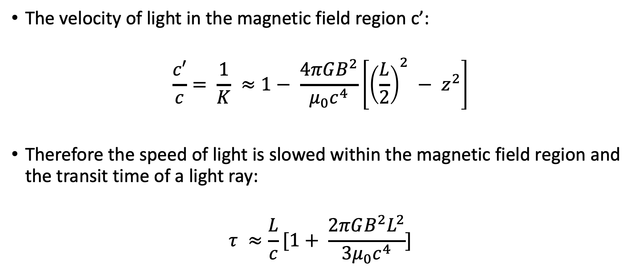
Magnetic Solution
The velocity of light in the magnetic field region c’:
$$\frac{c′}{c}= \frac{1}{K} ≈1− \frac{4πGB^{2}}{μ_{0}c^{4}}\left[{\left(\frac{L}{2}\right)}^{2} − z^{2}\right]$$
Therefore the speed of light is slowed within the magnetic field region and the transit time of a light ray:
$$τ ≈\frac{L}{c}[1+ \frac{2πGB^{2}L^{2}}{{3μ}_{0}c^{4}}]$$

Slide 24
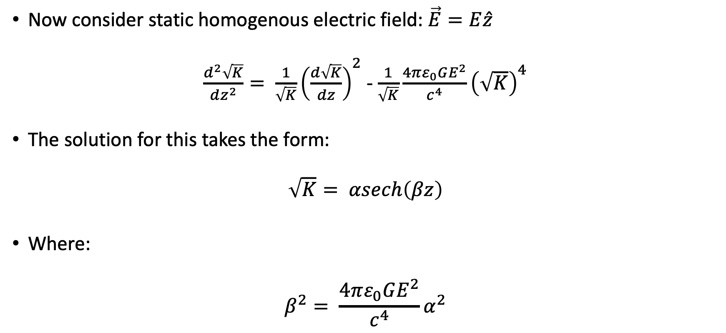
Electric Field Solution
Now consider static homogenous electric field: $\vec{E}=E\hat{z}$
$\frac{d^{2}\sqrt{K}}{dz^{2}}= \frac{1}{\sqrt{K}}{\left(\frac{d\sqrt{K}}{dz}\right)}^{2}$ - $\frac{1}{\sqrt{K}}\frac{4πε_{0}GE^{2}}{c^{4}}{\left(\sqrt{K}\right)}^{4}$
The solution for this takes the form:
$$\sqrt{K}= αsech\left(βz\right)$$
Where:
$$β^{2}= \frac{4πε_{0}GE^{2}}{c^{4}}α^{2}$$

Slide 25
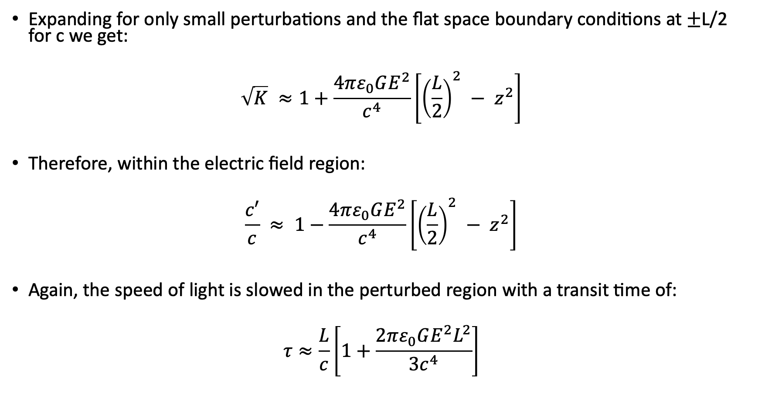
Electric Field Solution
Expanding for only small perturbations and the flat space boundary conditions at $±$L/2 for c we get:
$$\sqrt{K} ≈1+\frac{4πε_{0}GE^{2}}{c^{4}}\left[{\left(\frac{L}{2}\right)}^{2} − z^{2}\right]$$
Therefore, within the electric field region:
$$\frac{c′}{c} ≈ 1−\frac{4πε_{0}GE^{2}}{c^{4}}\left[{\left(\frac{L}{2}\right)}^{2} − z^{2}\right]$$
Again, the speed of light is slowed in the perturbed region with a transit time of:
$$τ≈\frac{L}{c}\left[1+\frac{2πε_{0}GE^{2}L^{2}}{{3c}^{4}}\right]$$

Slide 26
Summary
The PV model provides a unique alternative to traditional GR techniques
In the PV model the vacuum is itself treated a polarizable (dielectric) medium with variable dielectric constant
This dielectric constant is related to the curvature of spacetime as being subject to change within the gravitational field of a massive (energetic) object
This creates an isomorphism between Maxwell’s equations in curved space and a dielectric medium in flat spacetime

Slide 27
Summary
The bending of light rays in the PV model is seen from the spatial variation of the dielectric constant
The Levi-Civita effect is modeled in a straightforward way using the PV model
The effect of homogenous static electric and magnetic fields on spacetime curvature is seen by the spatial variation in the dielectric constant and change in speed of light
This clearly shows that homogenous static EM fields can induce spacetime curvature

Slide 28
Sources
H.E. Puthoff, Gravitation and Cosmology from the Hubble Radius to the Plank Scale (Fundamental Theories of Physics), 431-446 (Kluwer Academic Publishers, 2003).
H.E. Puthoff, et. al., Levi-Civita Effect in the Polarizable Vacuum (PV) Representation of General Relativity.

