Slide 1
Using an Astrophysical Model to Characterize Nuclear Dust
2LT Anita Dunsmore
6 February 2018
Thesis Defense

Slide 2
Dust Cloud Characterization
Sponsor: Defense Threat Reduction Agency (DTRA)
Advisor: Dr. John McClory
Committee:
LtCol Brian J. Fry
LtCol James R. Fee

Slide 3
Outline
Introduction
Theory
Methodology
Building the Input Files
Results
Initial
Altered Values
Observed Data
Analysis
Lessons Learned

Slide 4
Motivation
Don’t currently have a full picture of the dust cloud after an explosion
Needed for planning and consequence management
Aircraft
Communications
Nearby cities
Must understand all effects of a weapon to plan for the use effectively

Slide 5
Research Goals
Can models from astrophysics be used for nuclear dust clouds?
Choose an astrophysical model to try
Determine if there are any intrinsic barriers to using it for a nuclear dust cloud
Compare the results to observations to determine accuracy

Slide 6
Historical Background
Mostly concentrated on fallout
DEFLIC, HPAC, etc.
Care about how fallout particles are dispersed long-term
Less about short-term modeling
Very little about early cloud modeling – chemically and physically complex
Only simplistic models used (e.g. the distribution of large particles is based on a “power law” – power unknown)
Mostly older models – less computational power

Slide 7
Theory
Proposed solution: use a model from astrophysics of a supernova
Very studied area
Core-collapse supernova: fusion until Fe core, collapse past a certain limit causes the explosion
Similarities
General physical situation: compression, explosion
Effects: shock waves, radiation fields, dust clouds
Differences
Scope of explosion (density, time, distance, etc.)
Will the differences be minimal enough for the solution to still work?

Slide 8
Overview of Options
Chemical analysis
Equations describing processes that would change the chemical composition
Stoichiometric equations, radioactive decay, etc.
Chose a finite number of elements/compounds to follow
Equations depended on the specific properties of the element/compound
Usability for nuclear dust clouds
Equations would have to change based on materials in nuclear explosion
Would not really be using the astrophysical model

Slide 9
MOCASSIN: Introduction
Monte Carlo SimulationS of Ionized Nebulae
Used MC approach to model radiative transfer through dust and gas clouds
3 dimensional (asymmetry – ground burst)
Stochastic
Solves thermal balance and ionization equilibrium equations in grid – iterates until values converge
Difference between iterations small

Slide 10
MOCASSIN: Setup
Input files
Describe entire physical situation
Source – temperature, power, radius, output spectrum
Dust and gas – densities, distribution, composition
Give parameters of the trial
Convergence criteria
Number of photons
Number of iterations
Wavelength range of output

Slide 11
MOCASSIN: Algorithm
Tracks photons through gas/dust cloud
Groups them in “energy packets” of specific frequencies
Computationally efficient
Originally determined by the flux of the source, emitted isotropically in random directions
Packets tracked through cells
Either pass through, scatter, or absorb
Scatter: frequency unchanged, direction changed
Absorbed: both changed
Overall energy stays the same
Tracked until the edge of the grid – recorded
Check convergence criteria after finished – iterate if needed
Gas only or both: rate of change of neutral hydrogen
Dust only: rate of change of dust temperatures

Slide 12
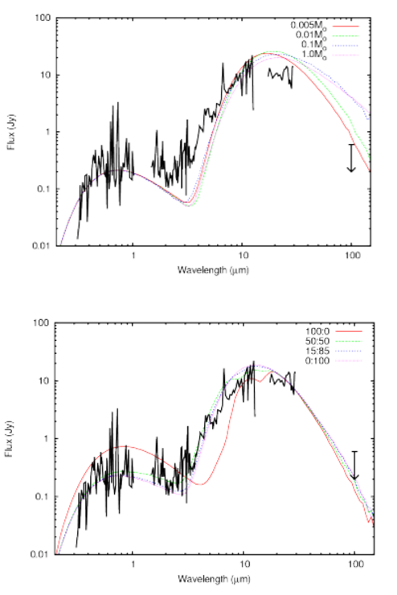
MOCASSIN: End Result
Sum of photons from code – spectral output (SED)
Wavelength dependent
Asymmetric – can depend on the direction of output
Wavelength range
Infrared for dust “shining”
Optical photons absorbed and re-emitted at longer wavelengths
Compare output to observed
Change input values for closest match possible

Slide 13
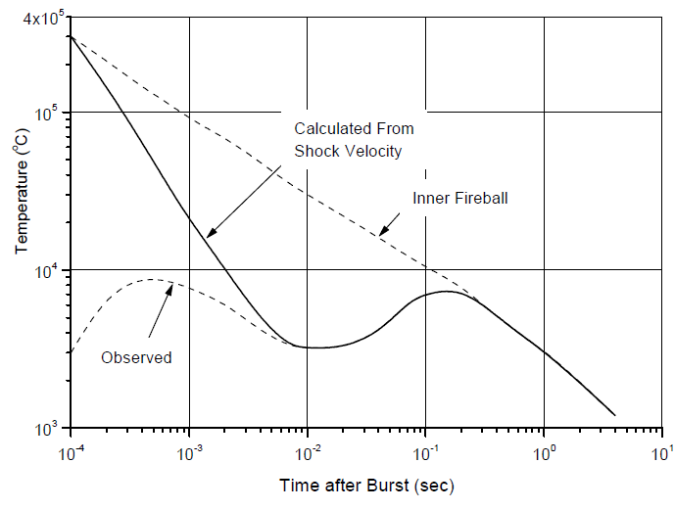
Problem Space
Dust starts to form at 2000-3000 K – choose 2500
Gas in MOCASSIN is ionized - want as early as possible
Need inner fireball source to still be present
Phase of fireball at 2500 K: hydrodynamic growth
After breakaway – inner fireball and transparent shock wave
Mixing has not yet occurred – only materials from air, weapon
Type of bomb
Doesn’t matter – model with input files

Slide 14
Methodology
Build approximate input files representing several nuclear explosions
Run files to see if any issues occur
Approximate – need answers before beginning, so all will be guesses (just need OOM)
Input files to create:
Main – describes source, run parameters
Density – describes distribution of dust/gas
Dust/gas abundance – relative amounts of compounds/elements
Dust – optical constants of dust compounds
Gas – abundances of ionized elements

Slide 15
Explosion Parameters
Need to pick explosions – yield, HOB, bomb design
Operation Dominic Harlem
1.1-1.2 MT, 4160 m (note: will use 1 MT for input values)
Only data found
Fat Man
20 kT, 550 m
Published bomb design

Slide 16
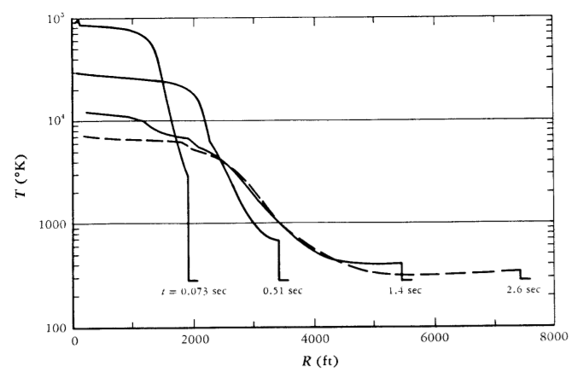
General Input Values
All based on fireball temperature of 2500 K
Assume constant in fireball
Assume scalability
Time
Fireball radius (use breakaway)

Slide 17
Dust and Gas by Zone
Not yet distinguishing between – need to know sources
3 zones:
Inside fireball: weapon debris, ionized air
Ionized air out to hydrodynamic separation
Between fireball and shock: air based on Sedov-Taylor
Outside shock: ambient air

Slide 18
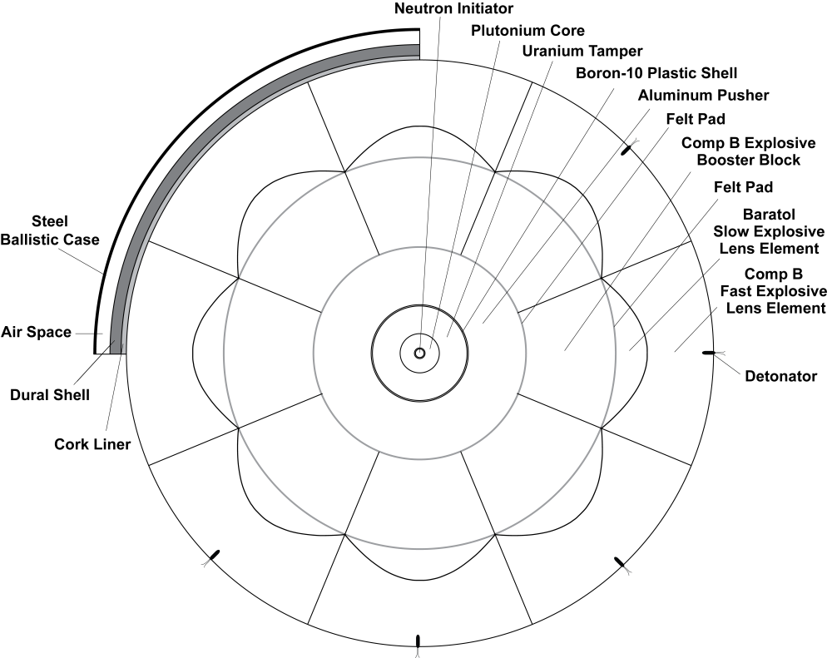
Weapon Debris
20 kT – Fat Man
Used known design, assumed evenly distributed throughout fireball
1 MT – Dominic Harlem
W-47Y2 Polaris warhead with a Mk-36 casing
Mostly steel
Bomb: largely depleted U
Scaled Fat Man for explosives, etc. to get correct mass

Slide 19
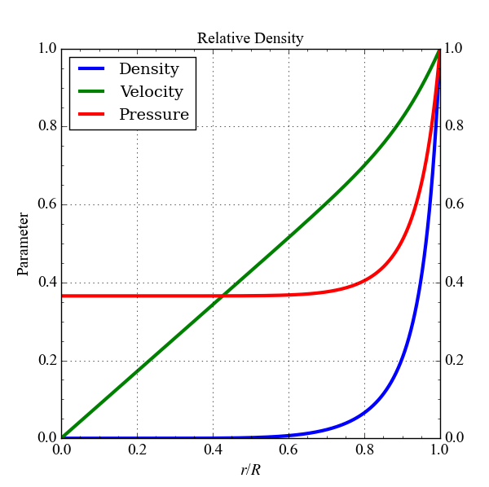
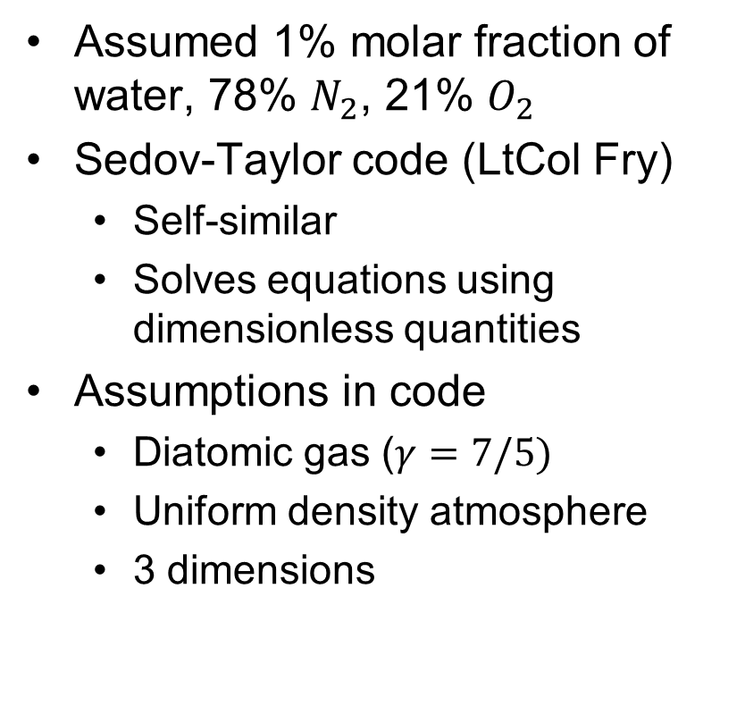
Air
Assumed 1% molar fraction of water, 78% $N_{2}$, 21% $O_{2}$
Sedov-Taylor code (LtCol Fry)
Self-similar
Solves equations using dimensionless quantities
Assumptions in code
Diatomic gas ($γ=7/5)$
Uniform density atmosphere
3 dimensions

Slide 20
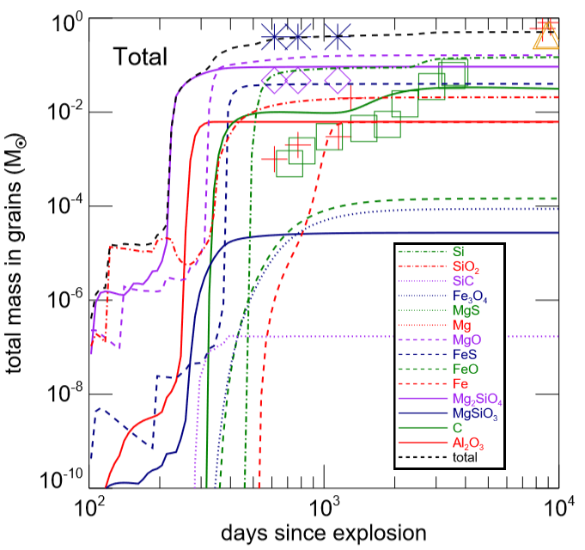
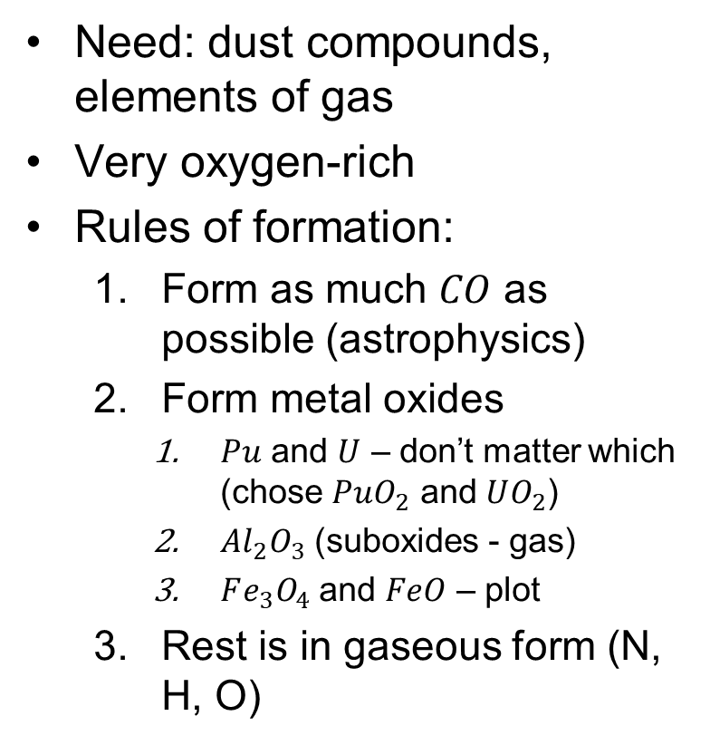
Dust vs. Gas
Need: dust compounds, elements of gas
Very oxygen-rich
Rules of formation:
Form as much $CO$ as possible (astrophysics)
Form metal oxides
$Pu$ and $U$ – don’t matter which (chose $PuO_{2}$ and $UO_{2}$)
$Al_{2}O_{3}$ (suboxides - gas)
$Fe_{3}O_{4}$ and $FeO$ – plot
Rest is in gaseous form (N, H, O)

Slide 21
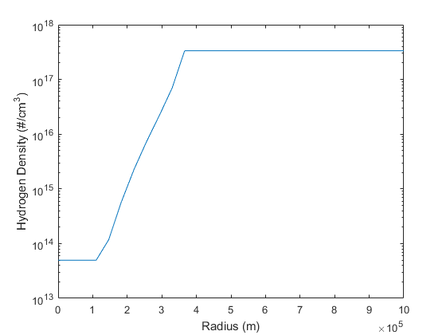
Final Hydrogen Density
All H in gaseous form
Density used for gas abundances (density file)
3 zones for calculation
Even split for mesh
Would not have “hard” edges – product of using zones

Slide 22
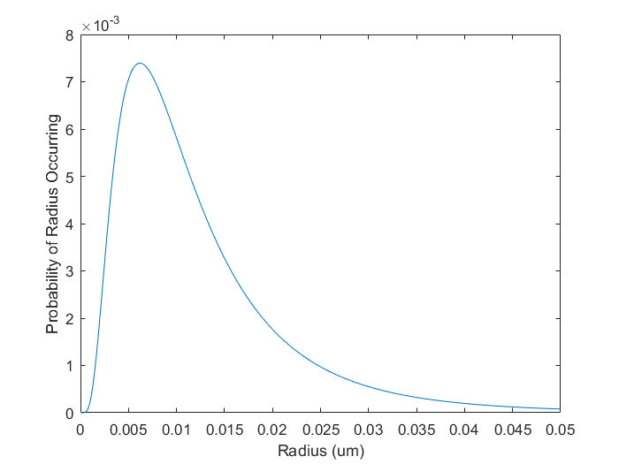
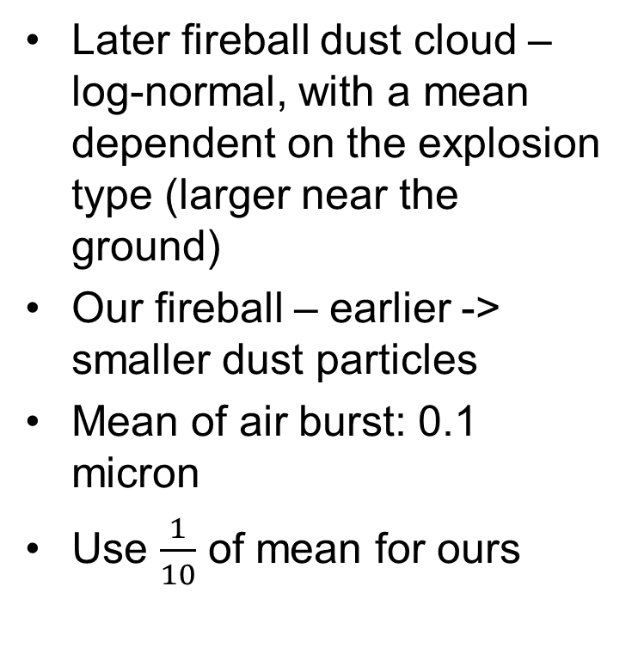
Radius Distribution
Later fireball dust cloud – log-normal, with a mean dependent on the explosion type (larger near the ground)
Our fireball – earlier -> smaller dust particles
Mean of air burst: 0.1 micron
Use $\frac{1}{10}$ of mean for ours

Slide 23
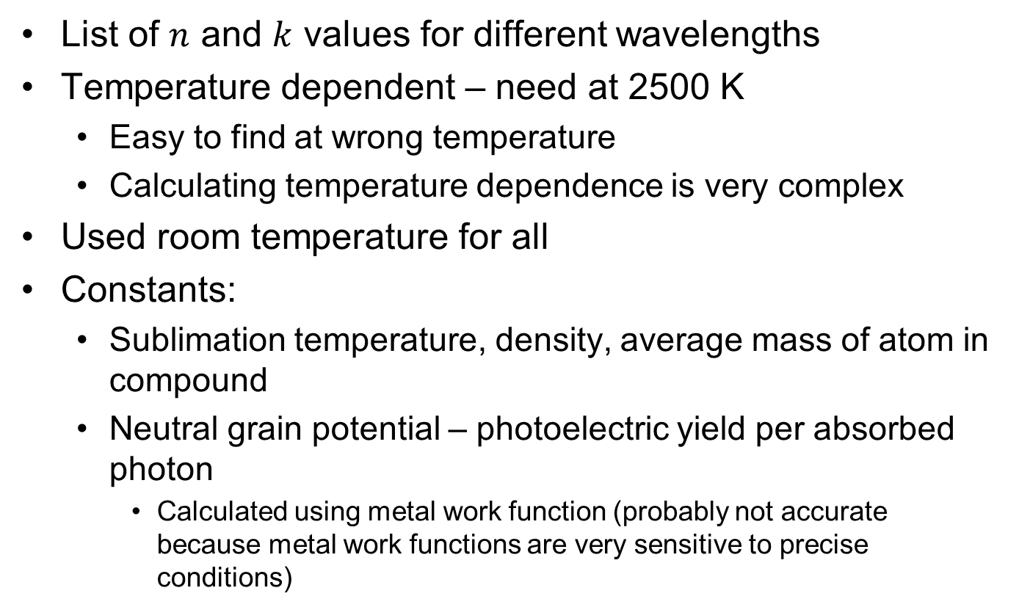
Dust Optical Files
List of $n$ and $k$ values for different wavelengths
Temperature dependent – need at 2500 K
Easy to find at wrong temperature
Calculating temperature dependence is very complex
Used room temperature for all
Constants:
Sublimation temperature, density, average mass of atom in compound
Neutral grain potential – photoelectric yield per absorbed photon
Calculated using metal work function (probably not accurate because metal work functions are very sensitive to precise conditions)

Slide 24
Results
While running: output files update at each iteration
Percent converged and “no hit cells”
No hit cell – cells where no photon interactions occurred
Current SED output
Stop when:
Reach 100% convergence
Reach number of iterations in input file
Manually stopped

Slide 25
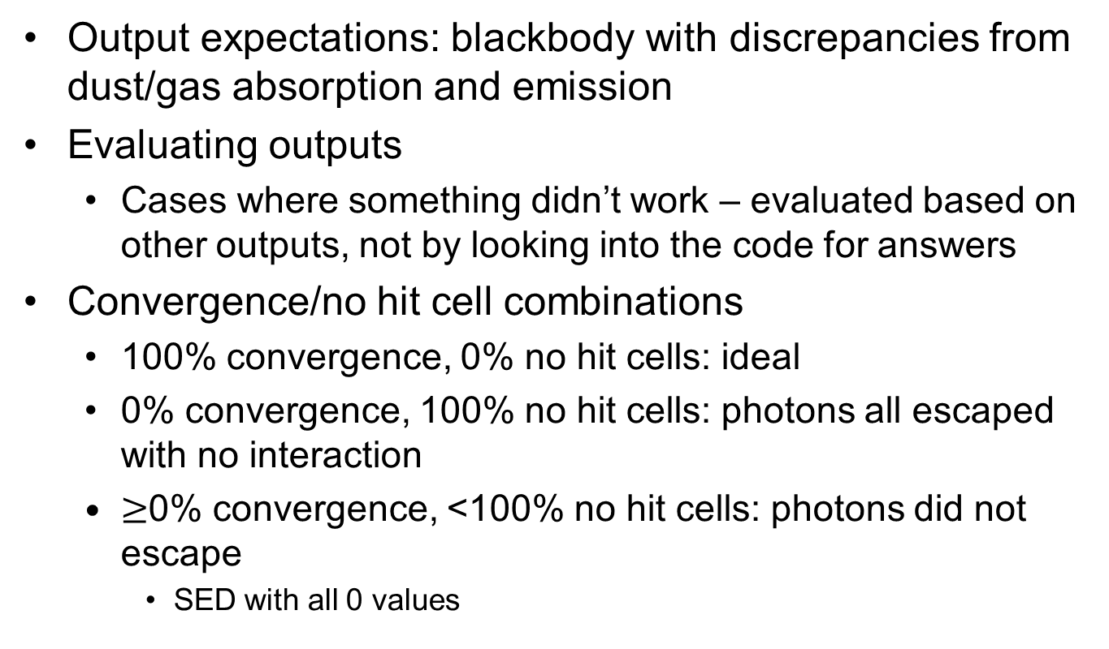
Results
Output expectations: blackbody with discrepancies from dust/gas absorption and emission
Evaluating outputs
Cases where something didn’t work – evaluated based on other outputs, not by looking into the code for answers
Convergence/no hit cell combinations
100% convergence, 0% no hit cells: ideal
0% convergence, 100% no hit cells: photons all escaped with no interaction
$≥$0% convergence, <100% no hit cells: photons did not escape
SED with all 0 values

Slide 26
Initial Tests
Regular input files: no final output
1 MT: 3% convergence, 95% no hit cells, 8 iterations, 1418 hours
20 kT: 0% convergence, 84% no hit cells, 1 iteration, 611 hours
SED outputs all 0 (no photons escaped)
Stopped due to convergence levels not changing
Want to discover why tests didn’t work – run tests with altered values to see what works and what doesn’t
Changing densities, radii, temperature
Run with dust, gas, and both

Slide 27
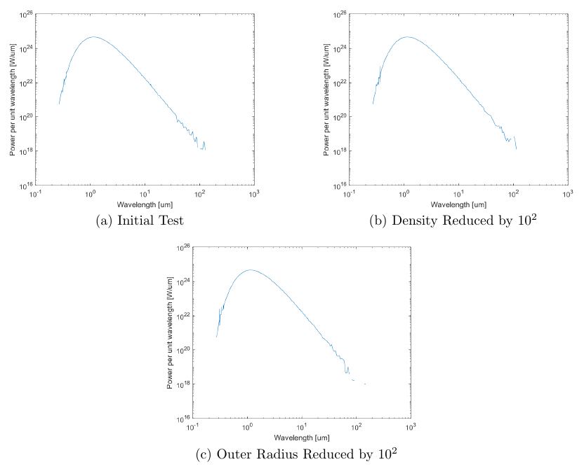
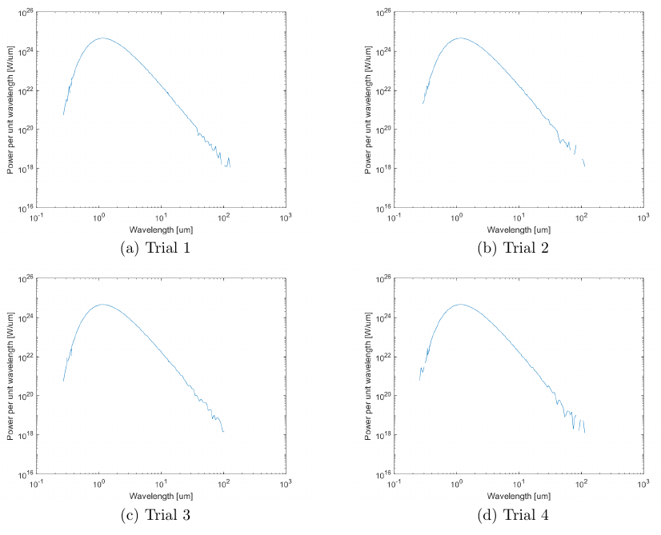
Gas Only
2 possibilities
Finish set number of iterations within 1 minute, 0 % convergence, 100% no hit cells
Stop after 1 iteration with 0% convergence, 100% no hit
Changes due to input variable alterations indistinguishable from changes due to stochastic nature
No hit cells + SED output = no photon interactions

Slide 28
Increased Temperature
Recall: MOCASSIN assumes gas to be ionized
Computes amount in each ionization level
Percent in neutral state for runs with gas
usually 100%, always over 94% (for gas-only and initial tests)
Need to increase ionization levels – gas is not being properly modeled if it is not ionized
Increase temperature for initial tests to 15,000 K
Results mostly unchanged (SED 0, around 0-4% convergence)
Ionization level changes:
C: 100% -> 99.45%
N: 100% -> 99.0%
O: 100% -> 99.6%
Not realistic to increase more - earlier time

Slide 29
Reduced Outer Radius
Air attenuates IR wavelengths a lot
Try at different radii (where the observer would be)
Right outside shock wave
Right outside fireball
Inside fireball
All SEDs were 0
Over 90% no hit cells, 0% convergence
density of fireball is too large
Cannot work with densities in this range

Slide 30
Dust Only
Gas-only unsuccessful – try to run with only dust to see if gas is the main problem
Regular parameters
Very similar to initial results
SED of 0
Both kept iterating, but convergence not increasing
Note: stopping after 1 iteration only occurred when gas was present
20 kT: 5% convergence, 94% no hit
1 MT: 3% convergence, 96% no hit
No hit cells + SED of 0 = density too high
Problems with both gas and dust

Slide 31
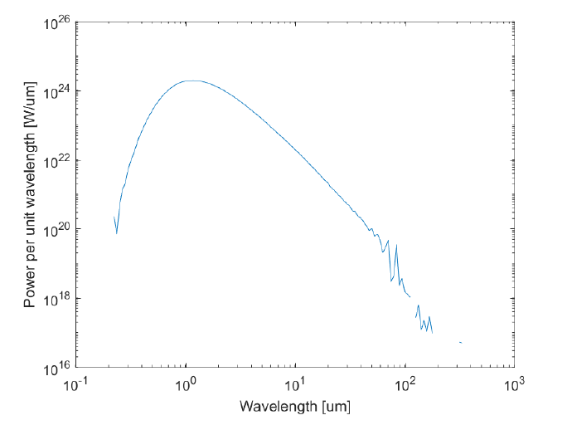
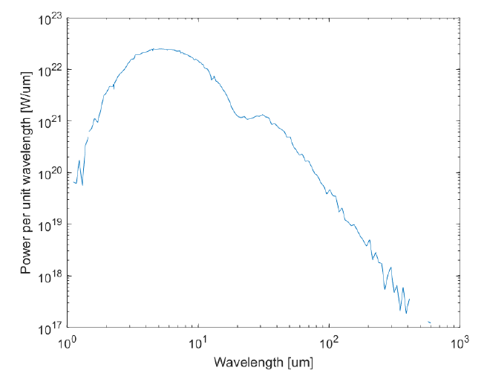
Reduced Density
Reduce by 2 OOM until results obtained
1 MT: Density reduced by 2 OOM (in all 3 zones)
Successful trials (100% convergence, non-zero spectra)

Slide 32
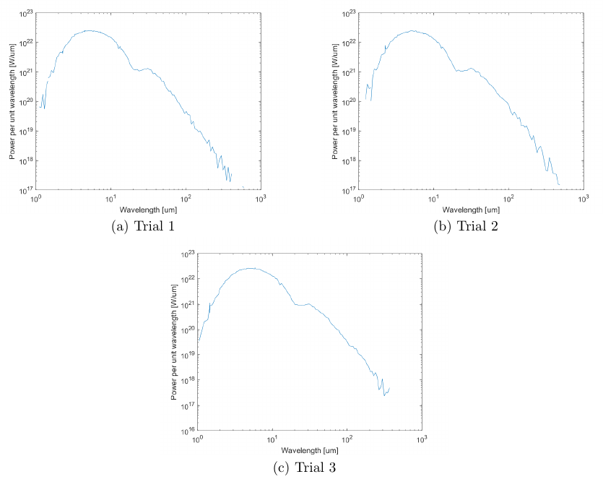
Repeated Trials
Ensure trials yield same results

Slide 33
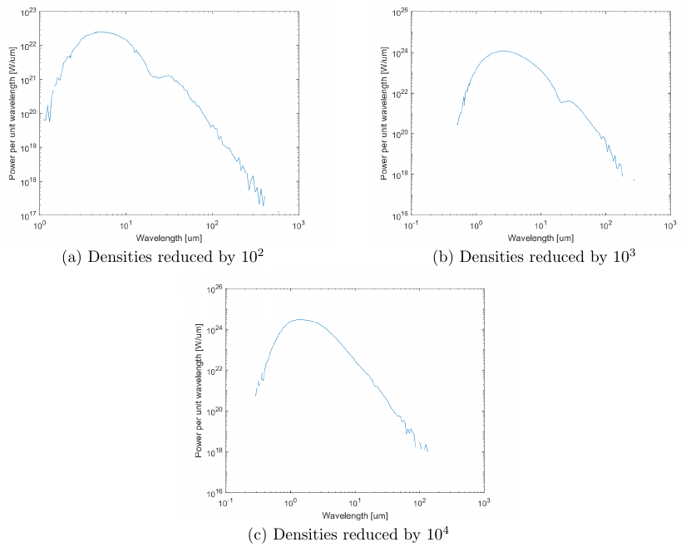
Density Comparisons
For dust and gas – can reduced density give features?
Flattening and wavelength changes

Slide 34
Alternate Air Modeling
Problems with trials so far:
Not enough ionization -> need higher temp -> earlier time
Density values too large -> need later time
Ideal: model the situation at a later time with lower densities
Need to model the gas without requiring ionization
Model gas as a dust with optical constants
Did not work
Allocation error?
Error in our input files?
Radial distribution file

Slide 35
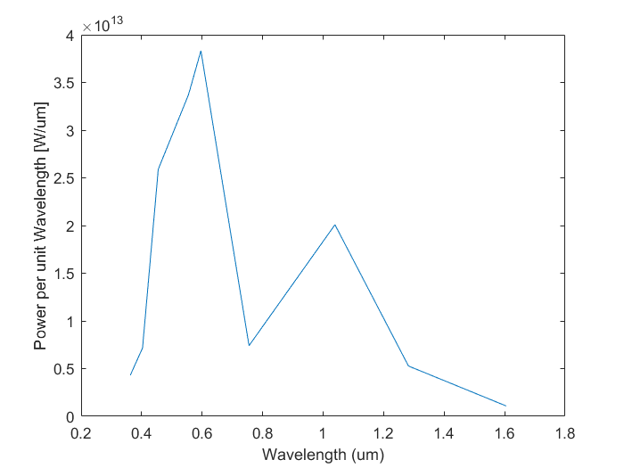
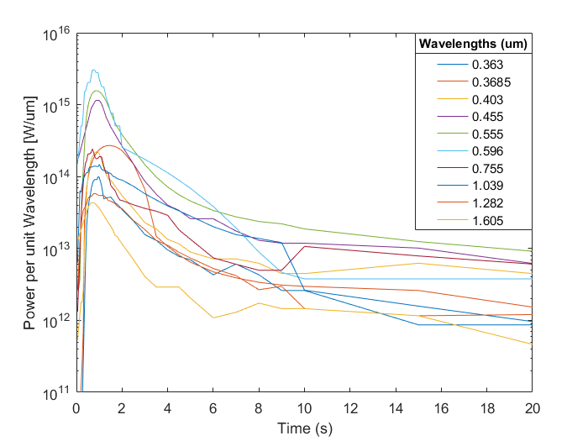
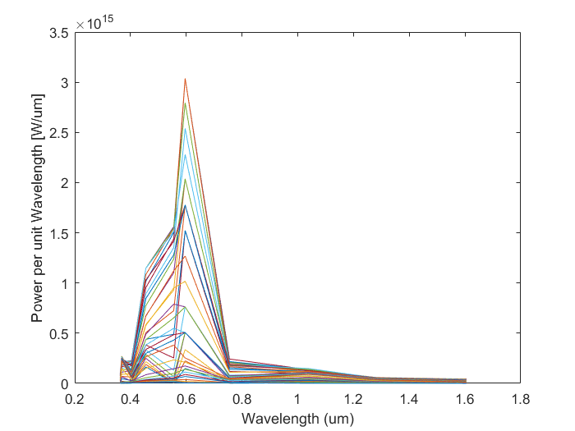
Observed Data

Slide 36
Conclusions
Early problems: Optical files
Need exact numbers
Temperature dependence
Work functions
Everything else is approximate and going to be changed
Problems during tests
Ionization of gas
Temperature increase did not help
Density values
Lower density has different features
Modeling air as gas
Unsuccessful for various reasons
Conclusion: MOCASSIN is not a viable option for modeling a nuclear dust cloud.

Slide 37
Lessons Learned
Chose MOCASSIN because it would not need to be remade for a nuclear fireball
Ended up being too inflexible
Need a model that can be adapted, but not entirely redone
Changed for higher densities
Different form of elements – ionization
Distances, times, etc.

Slide 38
Questions

Slide 39
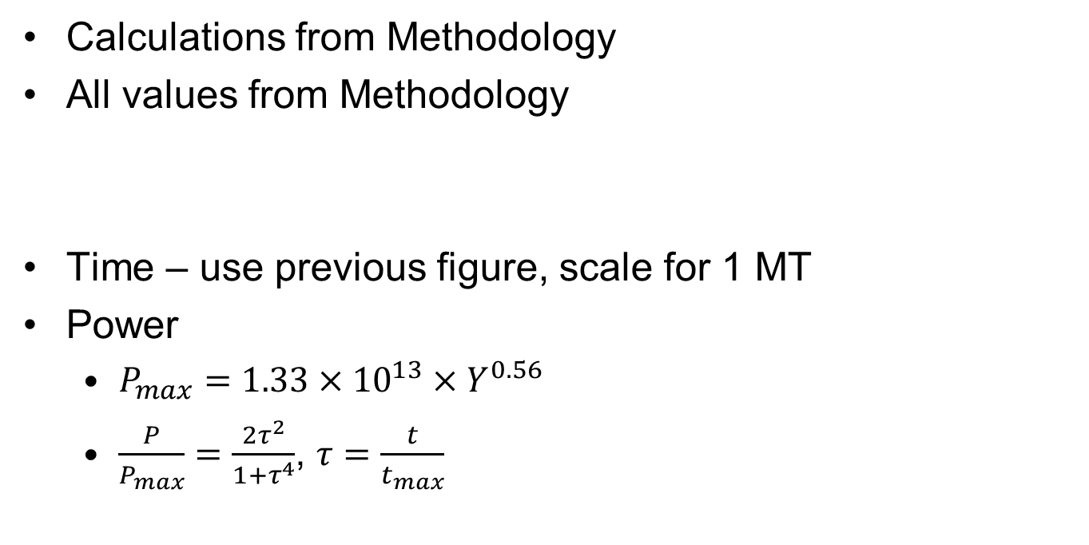
Backup Slides
Calculations from Methodology
All values from Methodology
Time – use previous figure, scale for 1 MT
Power
$P_{max}=1.33×{10}^{13}×Y^{0.56}$
$\frac{P}{P_{max}}=\frac{2τ^{2}}{1+τ^{4}}$, $τ=\frac{t}{t_{max}}$

Slide 40
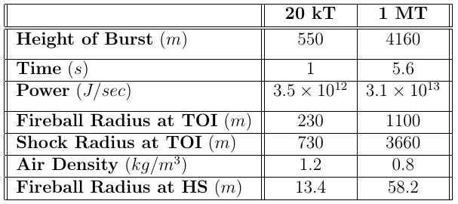
Nuclear Input Values

Slide 41
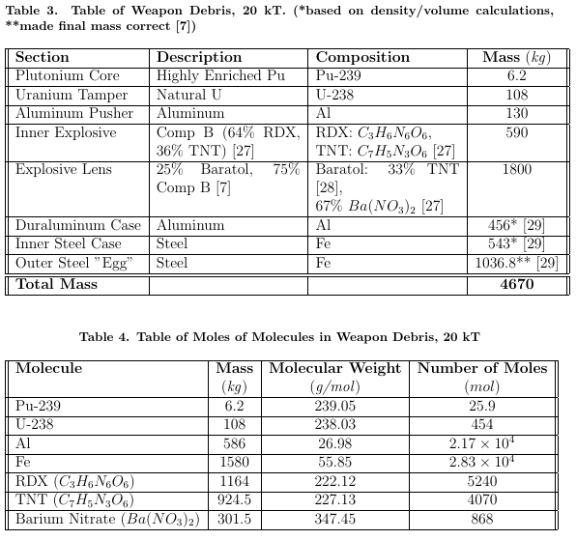
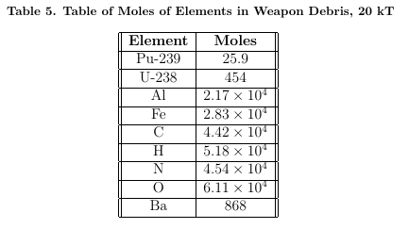
Fat Man Weapon Debris

Slide 42
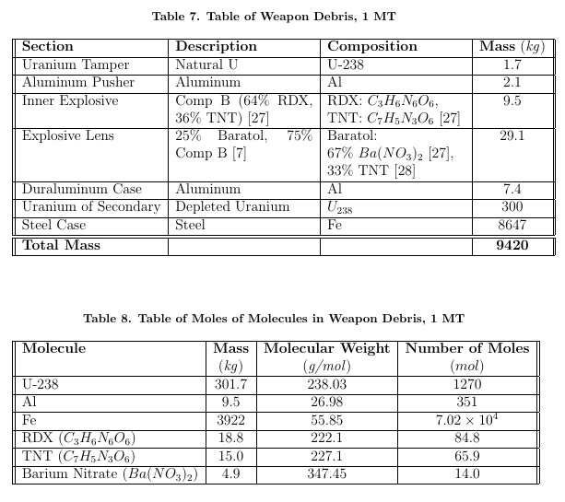
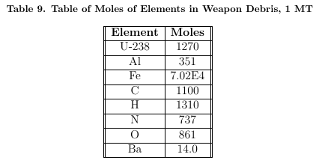
1 MT Weapon Debris

Slide 43
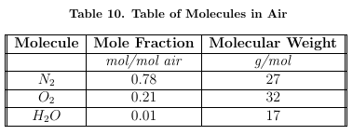
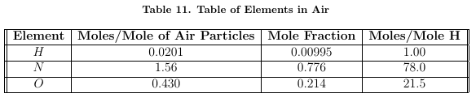
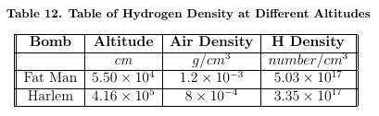
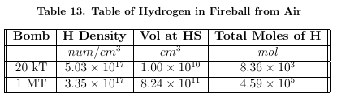
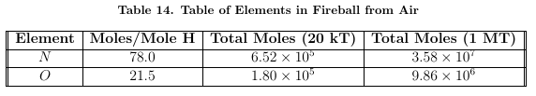
Air Composition

Slide 44
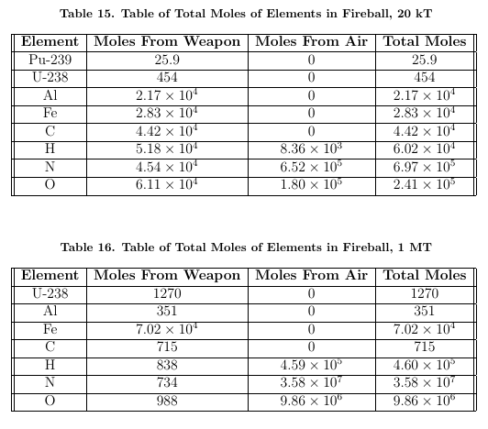
Elements in Fireball

Slide 45
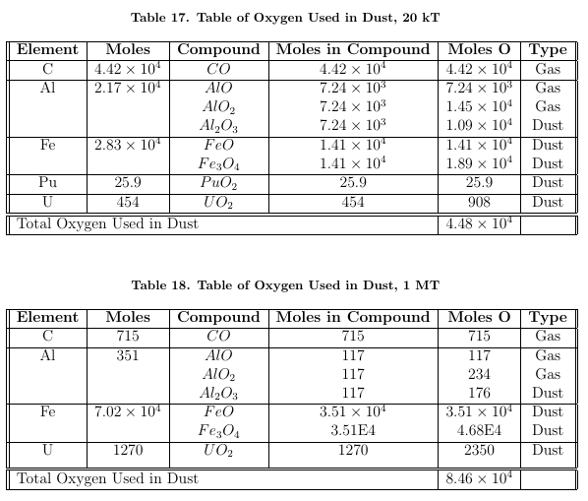
Oxygen Used

Slide 46
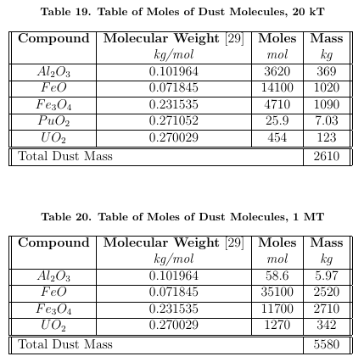
Dust Molecules

Slide 47
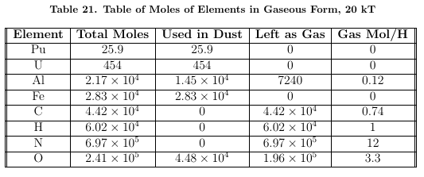
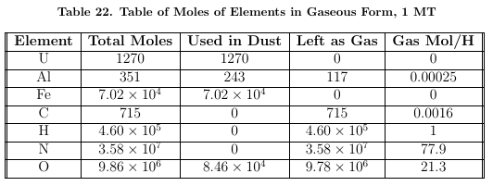
Gaseous Elements

Slide 48
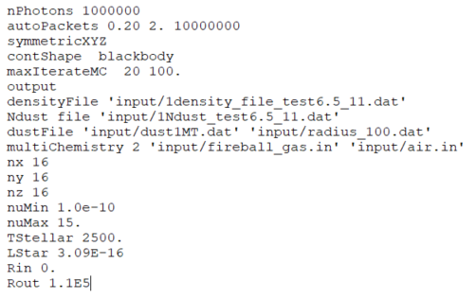
Main Input File

Slide 49
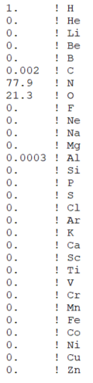

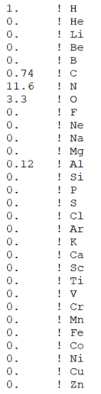
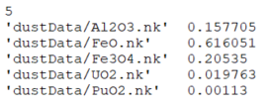
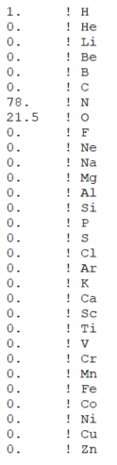
Abundance Files
1 MT Abundance
20 kT Abundance
Air

Slide 50
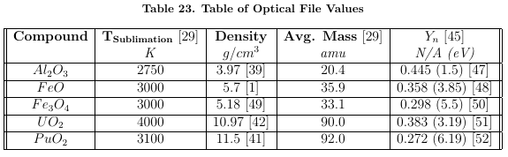
Optical File Constants

Slide 51
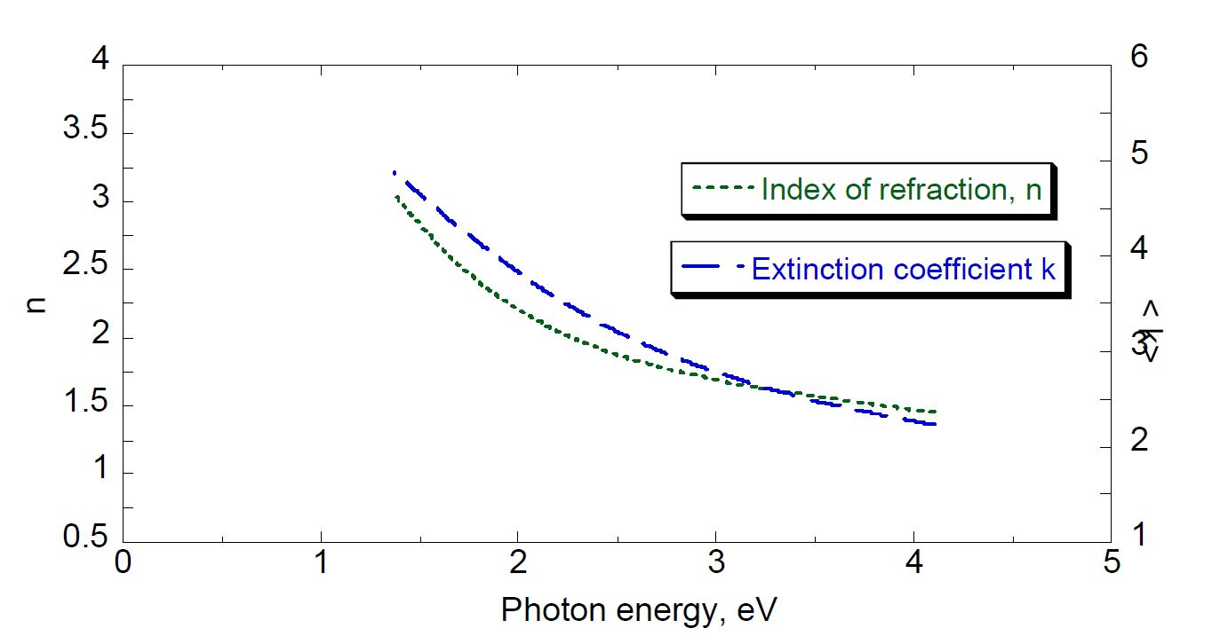
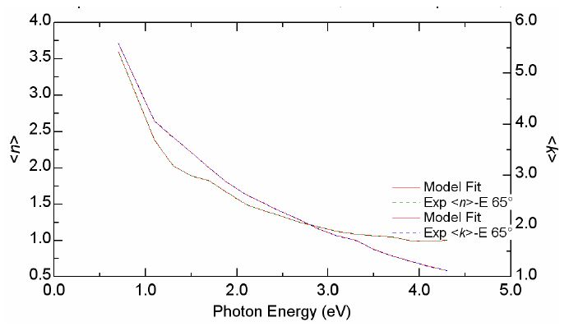


Optical Constants
$UO_{2}$ Optical Constants
$PuO_{2}$ Optical Constants

Slide 52
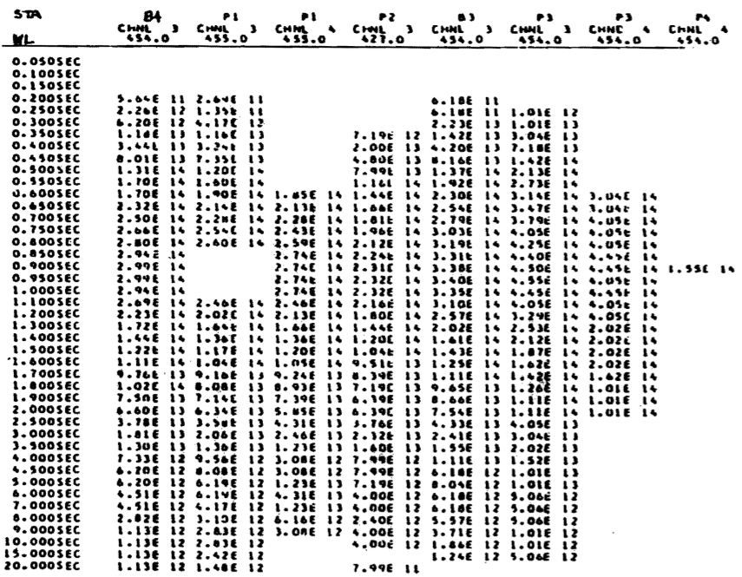
Dominic Harlem Data
Example Data Page

Slide 53
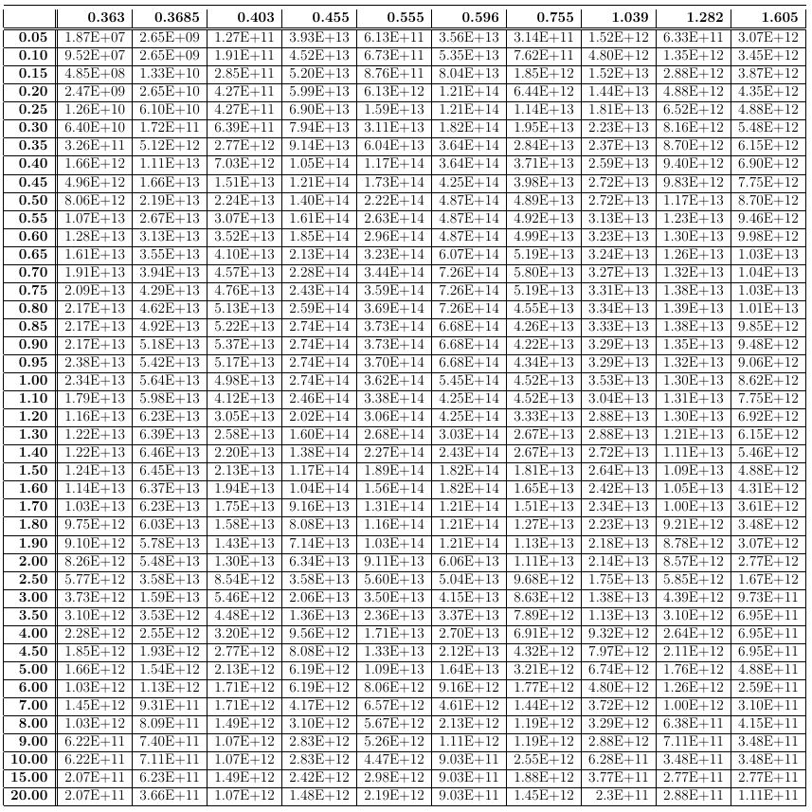
Filled Data Set
Filled Data in cal/um/sec

Slide 54
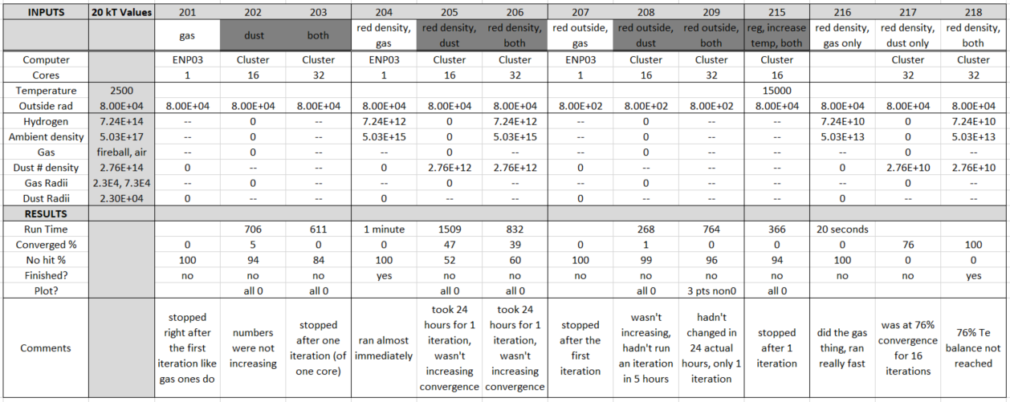
20 kT Tests

Slide 55
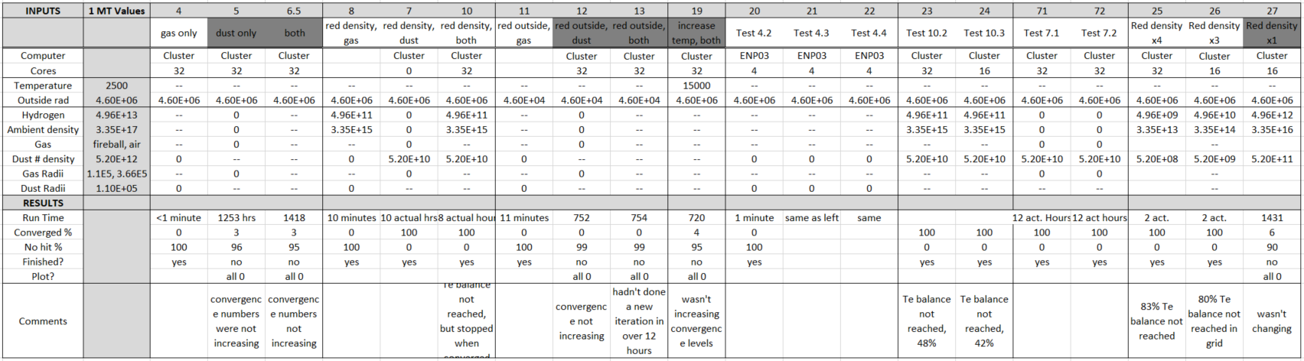
1 MT Tests

