Slide 1
A GPU FFT-Wrapper to Co-optimize
Floating-Point Precision and Library Selection
via Predictive Error Modeling
Julius Lehner, Eishi Arima, Martin Schulz
Technical University of Munich
PMBS Workshop @ SC’25

Slide 2
Executive Summary
Background:
Approximate Computing essential for demanding scientific workloads
FFT as a key function used in many areas of scientific computing
Problem:
Optimal FFT kernel (library + precision) depends on input data and user’s optimization and accuracy requirements
Contributions:
Analyzed impact of library choices, FP precision types, and input data on performance and accuracy using multiple GPU-accelerated FFT libraries
Designed and implemented a wrapper for multiple GPU-accelerated FFT libraries, providing a set of API functions
Explored several lightweight ML techniques to predict the kernel error, using input features characterized at runtime
Quantified benefits, accuracy, and overhead, resulting in >40% mean speedup with >98% selection accuracy

Slide 3
Motivation: Approximate Computing
In many applications high-precision (e.g. FP64) is not required
Low-precision (e.g. FP16) can lead to higher performance and energy efficiency while maintaining an acceptable accuracy
Trend towards low-precision can be seen in definition of new standards
Introduction of FP16 into the IEEE 754 Standard in 2008
Introduction of FP8 by ARM, Intel and NVIDIA in a 2022 White Paper
Question: How can we leverage this trend for scientific computing?
8x
Source: NVIDIA A100 Tensor Core GPU Architecture White Paper

Slide 4
Motivation: Targeting FFTs on GPUs
Fast Fourier Transform (FFT) essential in many scientific simulations
Popular optimization target
GPUs as an increasingly common platform for FFTs, especially in HPC
High throughput and performance compared to CPUs
Industry and academia have released multiple GPU-accelerated FFT libraries (e.g. cuFFT, cuFFTDx or VkFFT)
Libraries also support multiple precision types (FP64, FP32 and FP16)
User must choose from a complex set of options

Slide 5

?
cuFFT + FP32
cuFFTDx + FP64
GPU-Accelerated FFT Kernel
VkFFT + FP16
cuFFTDx + FP32
Scientific Simulation (e.g. Turbulent Flow, Quantum Mechanics, etc.)
.
.
.
Problem: How to choose appropriate combination of Library + Precision?

Slide 6
Observations: Methodology
Premise:
Each FFT library makes different design trade-offs
Performance and accuracy can vary, even for the same input
Investigation:
Explored how different inputs and error requirements affect the optimal Kernel (library + precision) choice
Benchmarked all three libraries in all available precision types across a diverse dataset with varying sizes, magnitudes, and distributions
Error Metric:
We define Error as the Mean Absolute Error compared to a high-precision FFTW (FP64) reference

Slide 7
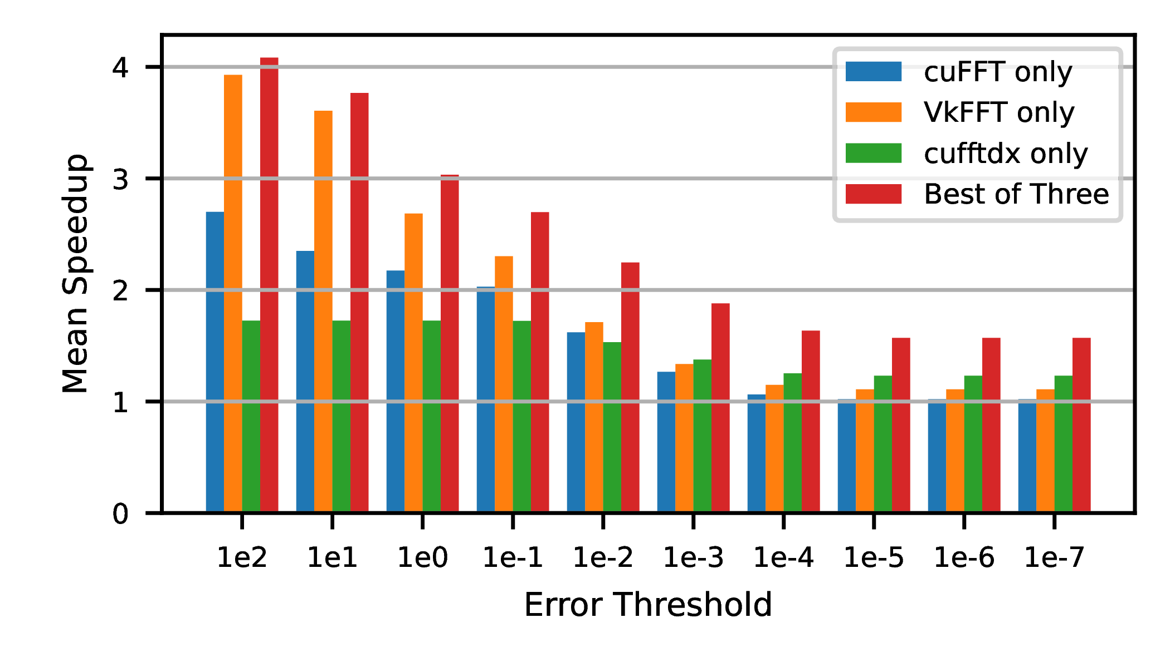
Observations: Static Choice is Suboptimal
1.5x speedup of cuFFT-only compared to 2.2x speedup of Best of Three
Observation 1: Single-Library fails to capture possible performance gains

Slide 8
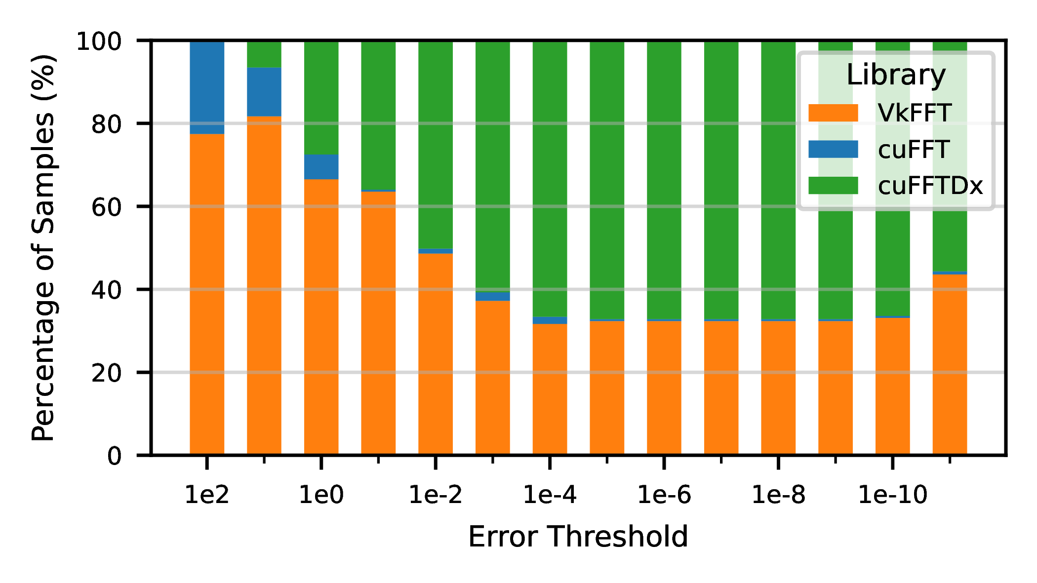
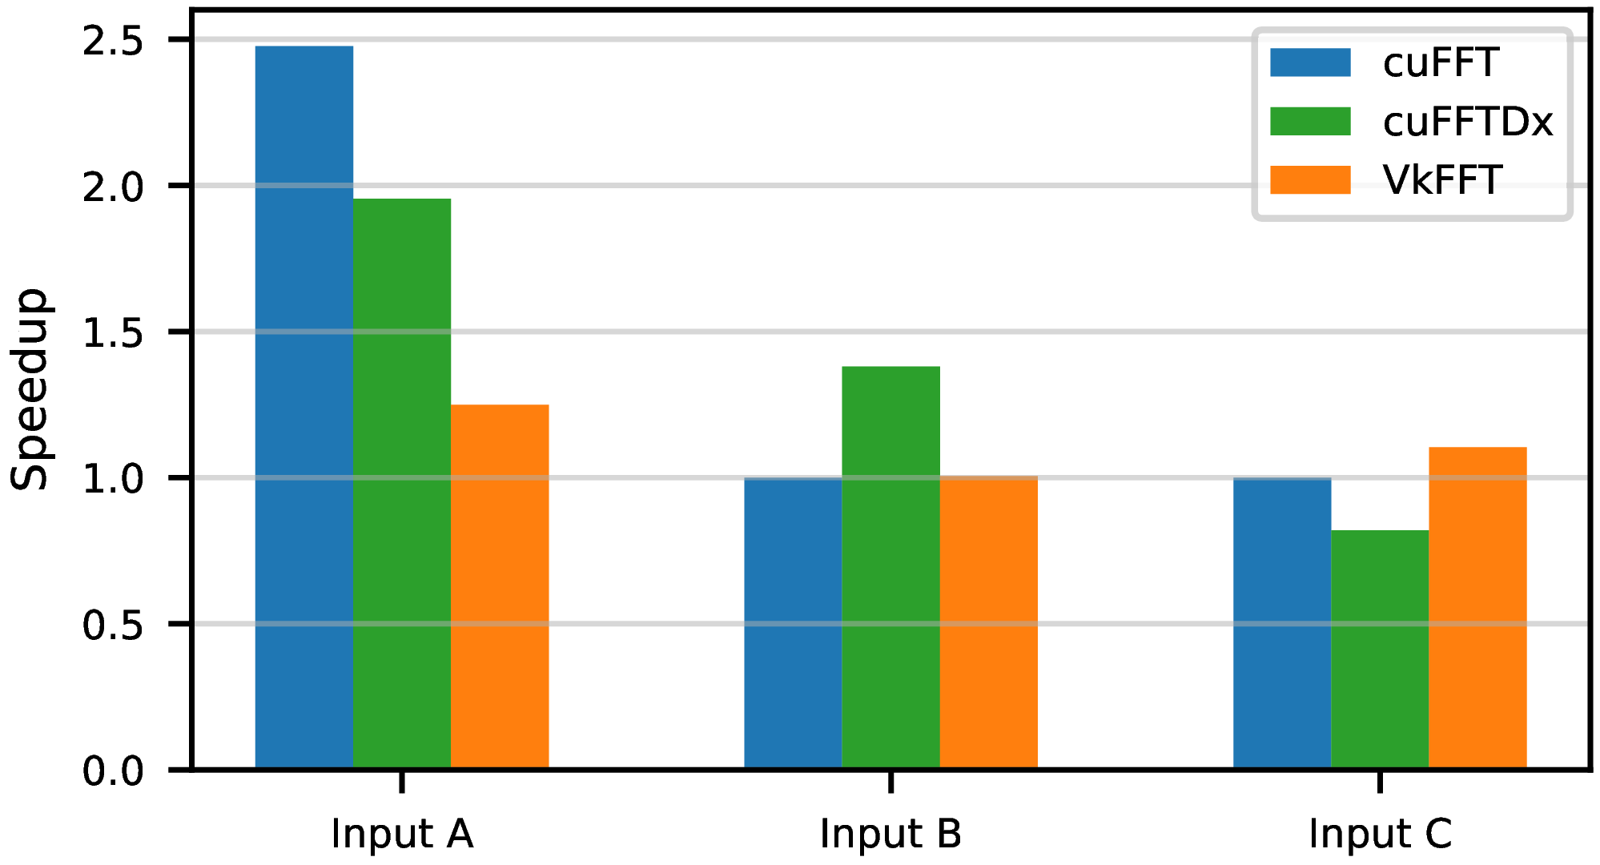
Observations: Choice Depends on Context
Library performance varies across error constraints
Input affects choice even within same threshold
Observation 2: Each library has its own sweet spot depending on input and threshold

Slide 9
Key Takeaways
Our solution must be:
Dynamic
The “best“ choice of library + precision is not static
Input-aware
It must adapt to content and size of the data array
Constraint-driven, it must take into account the user‘s
Error Threshold
Optimization goal (e.g. Minimizing Time or Energy)

Slide 10
Approach: Problem Formalization
Inputs
Selection Function
Output
Input Array
min: Obj(Array, Kernel, Optimization Goal)
s.t.: Error(Array, Kernel) ≤ Error Threshold
Error Threshold
Kernel
(∈ Kernel Pool)
Optimization Goal

Slide 11
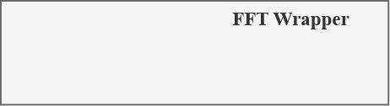
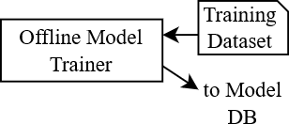
Approach: Solution Overview
Offline Trainer (Run Once)
Use extensive Training Dataset to create ML Models for each Kernel
ML Models predict Error based on input array

Slide 12
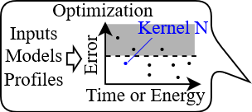

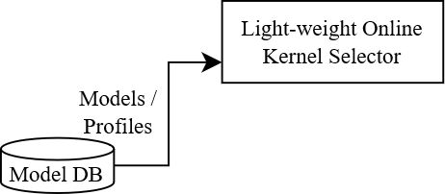
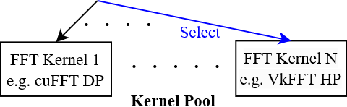
Approach: Solution Overview
Online Kernel Selector
Uses previously created Model Database
Takes in Array and User Criteria
Uses Performance Data to select ideal Kernel

Slide 13
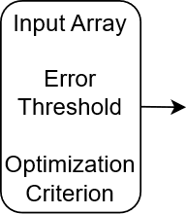
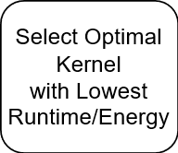


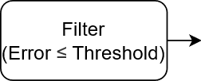
Approach: Selection Workflow
Feature Extraction: Lightweight sampling of the input array
Error Prediction: ML models predict absolute error for all kernels
Filter: Discard kernels which don‘t satisfy the user‘s threshold
Select: Pick the optimal kernel based on offline profiles

Slide 14
Approach: Feature Extraction
Based on domain knowledge and regression analysis, we chose features that are statistically significant predictors of error (p < 0.001):
Array Size (N_{x} and N_{y})
Variance (Real and Imaginary)
Mean Magnitude
Problem: Calculating the features requires a full-array read (O(N_{x} * N_{y}))
Infeasible and too slow for our application
Feature Extraction should be lightweight, ideally O(1)

Slide 15
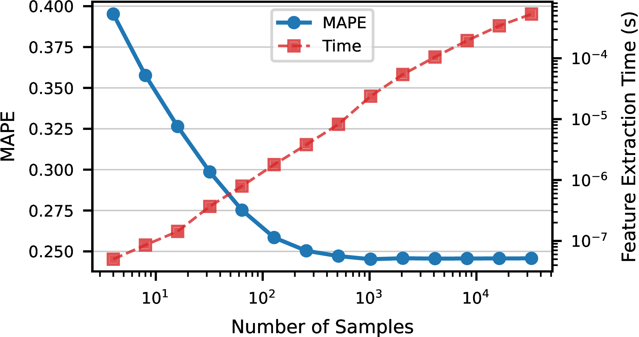
Approach: Feature Extraction
Solution: Uniform Sampling
Fixed number of input elements are selected at evenly spaced intervals
Features are calculated from those sampled elements
Reduces associated overhead to O(1)
Model accuracy (MAPE) saturates after a few hundred samples

Slide 16
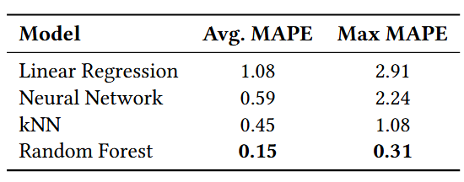
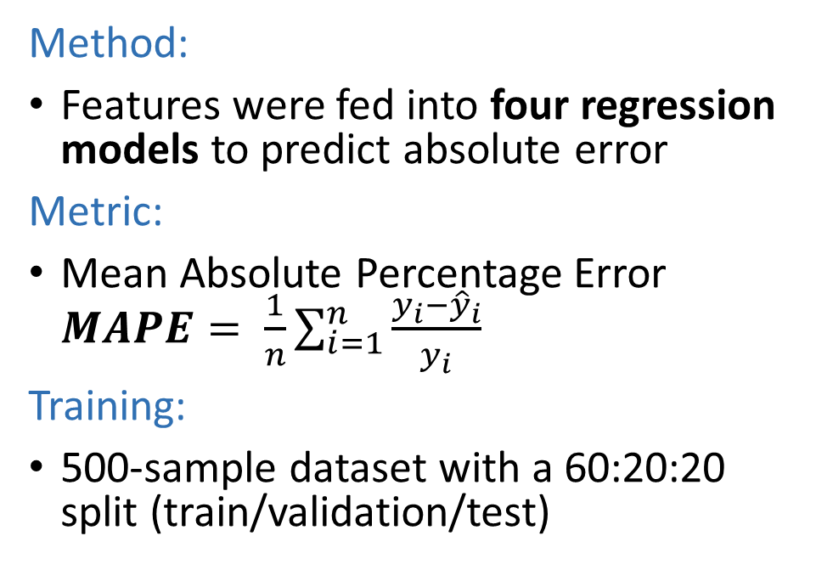
Approach: Error Prediction Model
Method:
Features were fed into four regression models to predict absolute error
Metric:
Mean Absolute Percentage Error $MAPE= \frac{1}{n}\sum_{i=1}^{n}{\frac{y_{i}−{\hat{y}}_{i}}{y_{i}}}$
Training:
500-sample dataset with a 60:20:20 split (train/validation/test)
Random Forest predicted the error most accurately

Slide 17
Results: Evaluation Setup
Environment
CPU: AMD Threadripper 2990WX
GPU: NVIDIA A100 PCIe 40GB
OS: Ubuntu 22.04.4 LTS
Libraries: cuFFT, cuFFTDx, VkFFT
Dataset
Training: 500 inputs (60:20:20)
Evaluation: 100 inputs
FFT sizes:
1D: 2²² to 2²⁶,
2D: 2¹¹ x 2¹¹ to 2¹³ x 2¹³
Content:
Varied magnitudes
Varied distributions

Slide 18
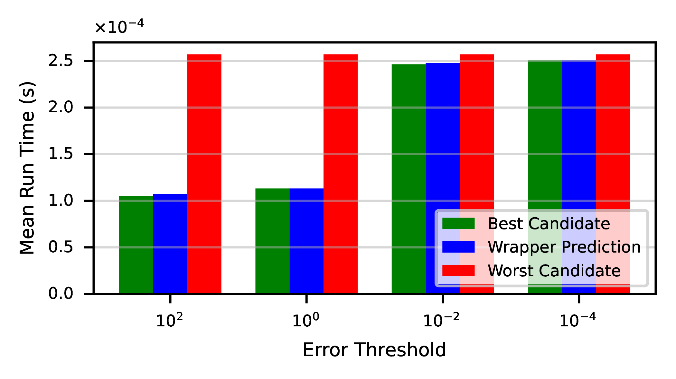
Results: Performance Benefits
Wrapper Prediction closely tracks optimal selection
Result 1: Wrapper‘s performance is near-optimal

Slide 19
Results: High Selection Accuracy
Selection Accuracy: >98%
1D Selector: 98.3%
Vs. 1D Baseline (cuFFT DP): 47.8%
2D Selector: 98.4%
Vs. 2D Baseline (cuFFTDx DP): 32.9%
Average Speedup: >40%
1D Selector: 44.1%
2D Selector: 41.1%
Compared to static FP64 Baseline
Result 2: High Accuracy of Selector unlocks significant speedups

Slide 20
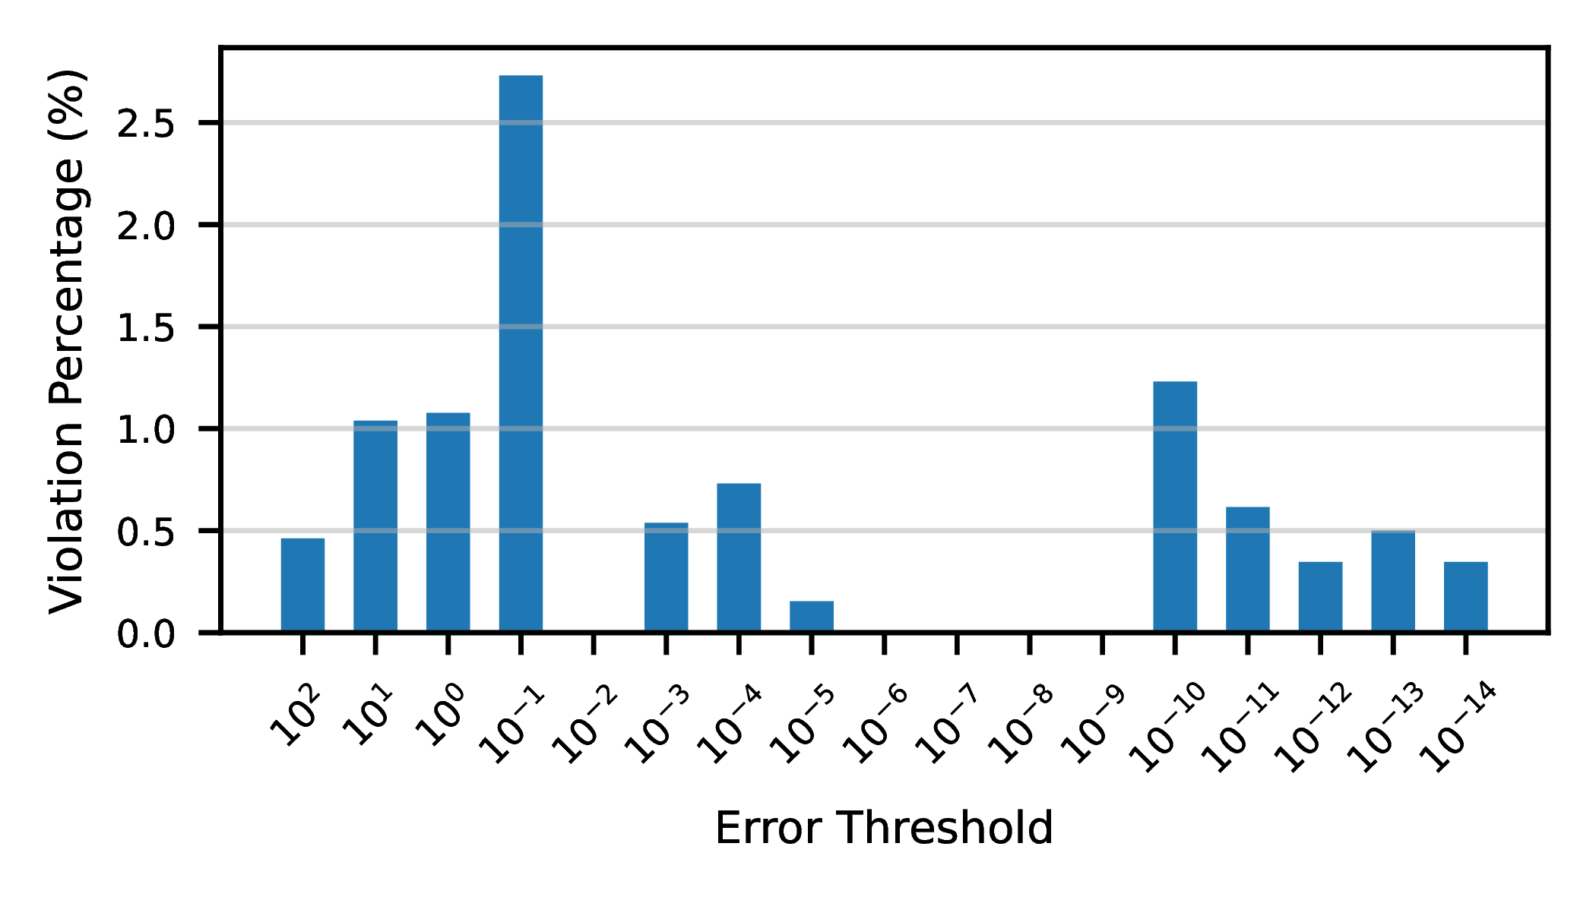
Results: Reliability
Violation = Predicted error ≤ threshold, but true error > threshold
Violation Rate <3% for all thresholds
Result 3: Wrapper‘s error predictions are reliable, rarely violating the threshold

Slide 21
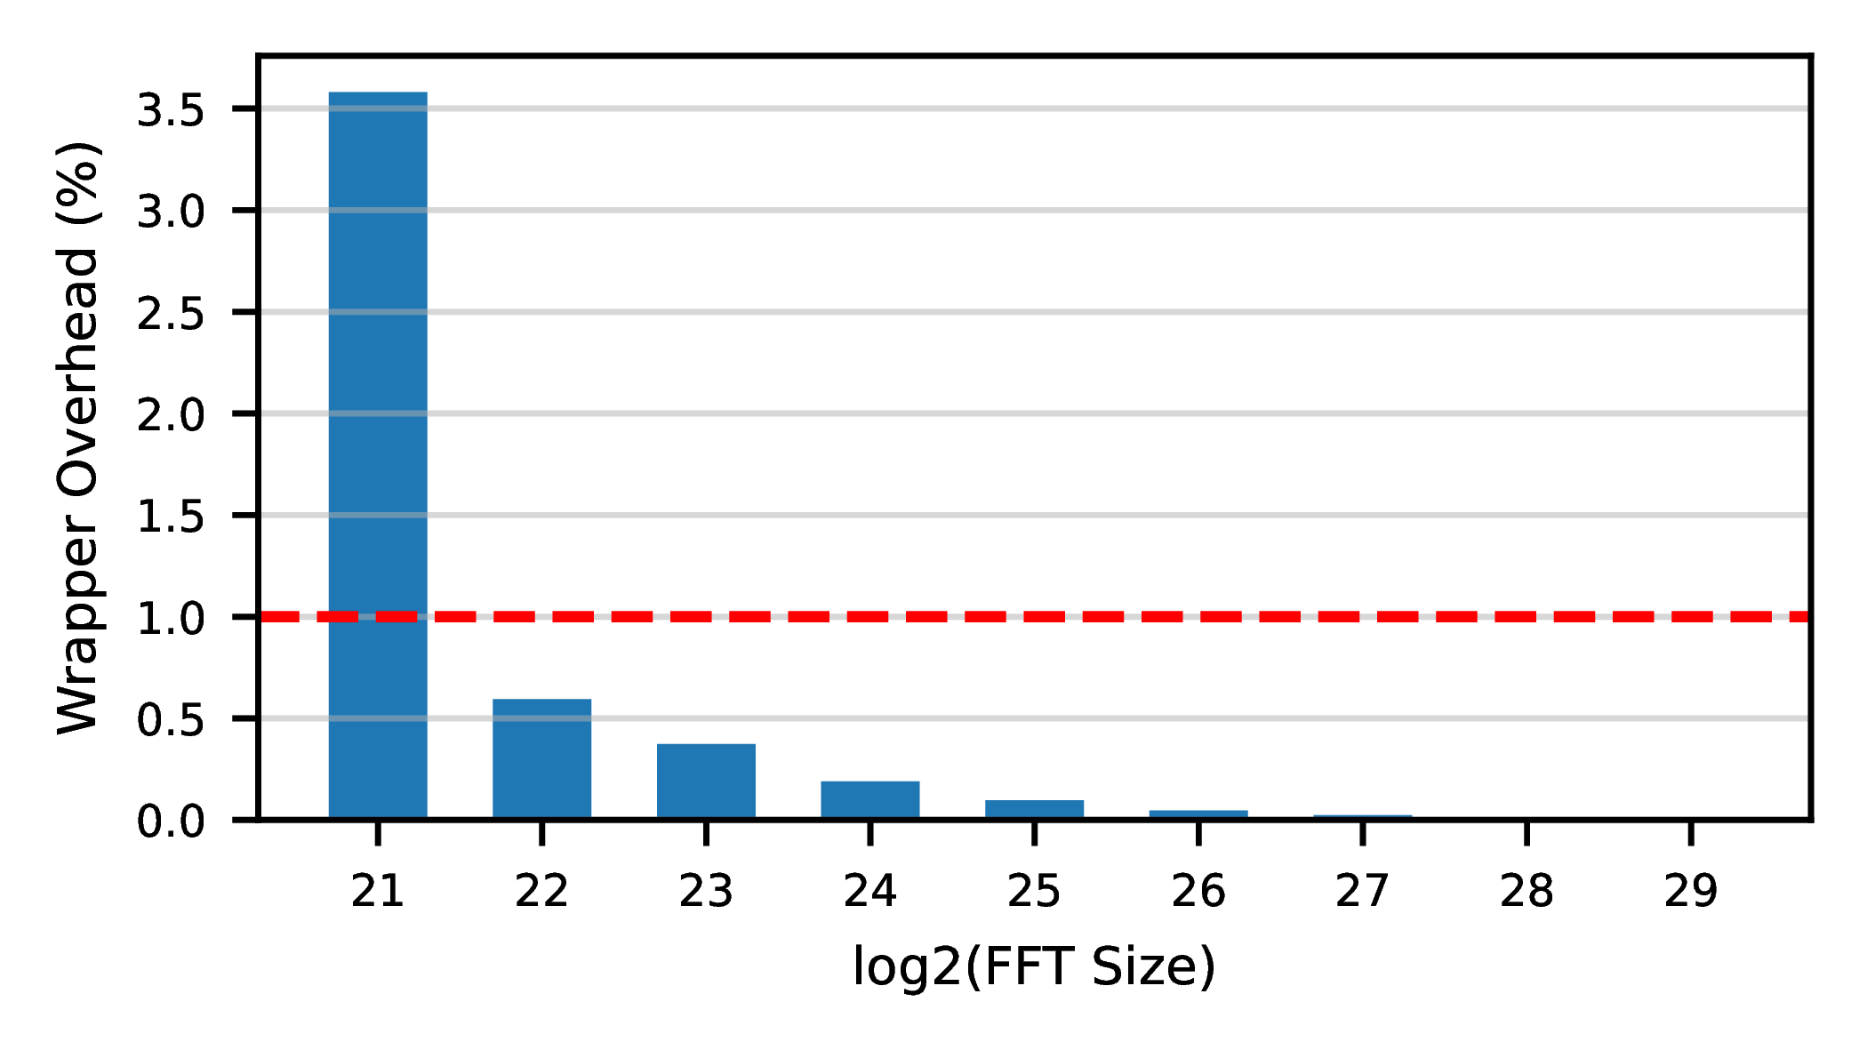
Results: Overhead
Feature Extraction: 0.024 ms
Model Inference: + 0.118 ms
Wrapper Overhead: 0.142 ms
Overhead is O(1)
Wrapper Overhead <1% of Runtime of large FFTs
Result 4: Wrapper‘s Overhead is negligible for large FFTs

Slide 22



Conclusion & Future Work
Contact:
Julius Lehner
julius.lehner@tum.de
Contributions:
A comprehensive analysis of the performance, accuracy, and trade-offs of multiple GPU FFT libraries and precisions
The design of a wrapper library that automates the selection of the optimal (Library + Precision) kernel
An exploration of lightweight ML models to accurately predict kernel error from runtime input features
Quantified the approach, achieving >40% mean speedup and >98% accuracy
Future Work
Extend hardware & library support (e.g., AMD rocFFT, tcFFT)
Apply to other precision-sensitive Kernels (e.g. GEMM, Convolutions)
Integrate and evaluate wrapper within real scientific applications
Acknowledgment: This work was supported by the BMFTR project DaREXA-F under grant number 16ME0644, as well as by the EuroHPC project 101093261, Plasma-PEPSC (which is co-funded by BMFTR under grant number 16HPC075)

