Slide 1

Performance Analysis of a High-level Abstractions-based Hydrocode on Future Computing Systems
G.R. Mudalige , I. Z. Reguly, M.B. Giles, A.C. Mallinson, W.P. Gaudin , J.A. Herdman
Oxford e-Research Centre, University of Oxford
Department of Computer Science, University of Warwick, UK
High Performance Computing, UK AWE plc. Aldermaston, UK.
gihan.mudalige@oerc.ox.ac.uk
istvan.reguly@oerc.ox.ac.uk
PMBS 2014 Workshop held as part of SC 2014, New Orleans LA.
16th November 2012

Slide 2
Outline
Motivation
Future proofing parallel HPC applications
Previous work
OPS : A High-level abstraction for Structured mesh applications
The OPS API
Re-Engineering AWE’s CloverLeaf to use OPS
Code generation
Single threaded developer version
CloverLeaf code generation with optimizations
Lessons learnt
CloverLeaf Performance
AVX, OpenMP,
CUDA,
OpenCL,
OpenACC
All the above with MPI
Future work and Conclusions

Slide 3
Future proofing parallel HPC applications
High performance computing (HPC) is currently in a period of enormous change
Emerging Many-core architectures roadmap
Mainstream CPUs with larger vector units vector units key to gaining higher performance
NVIDIA GPUs and AMD GPUs
Intel MIC - Integrated x86 multi-processor with SIMD units (Xeon Phi)
Low power designs from ARM
E.g. Mont-Blanc Project - ARM processors integrated on to a GPU
Other Heterogeneous processors – FPGAs, DSP type accelerators

Slide 4
Future proofing parallel HPC applications
Hardware is rapidly changing with ambitions to overcome exascale challenges
Massive parallelism due to single thread performance limitations – Billion-way threads ?
Limited memory bandwidth – Memory wall
Power efficiency – communications-centric architectures to reduce energy consumption ?
Resilience / Fault-tolerance
There is considerable uncertainty about which platform to target
Not clear which architectural approach is likely to “win” in the long-term,
Not even clear in the short-term which platform is best for each application.

Slide 5
Future proofing parallel HPC applications
Increasingly complex programming skills set needed to extract best performance for your workload on the newest architectures.
Need a lot of platform specific knowledge
Cannot be re-coding applications for each “new” type of architecture or
parallel system.
Currently the common approach for utilizing novel hardware is to
Manually port legacy applications
Usually converting key kernels of the application
Complete re-write of existing code to gain performance
e.g. to reduce communications
Maintain several “efficient” versions of the source code
The development of HPC applications designed to “future proof” their continued performance and portability on a diverse range of hardware and future emerging systems is of critical importance.

Slide 6
Domain Specific High-level Abstractions
One such approach, is the use of domain specific high-level abstractions (HLAs)
Provide the application developer with a domain specific abstraction
To declare the problem to be computed
Without specifying its implementation
Use domain specific constructs in the declaration
Provide a lower implementation level
To apply automated techniques for translating the
specification to different implementations
Target different hardware and software platforms
Exploit domain knowledge for better
optimisations on each hardware system
Domain specific Declaration
Automated Techniques
Optimized Implementation

Slide 7
Previous work
The use of HLAs have previously shown to have significant benefits
For developer productivity
Gaining near-optimal performance
Several Flavours
Domain Specific Language (DSL)
Embedded in general purpose host language (usually as a domain specific API)
Compiler Extension
Example HLAs
Structured mesh – Pochoir (MIT), SBLOCK (Cambridge), STELLA (MetroSwiss)
Unstructured mesh – OP2 (Oxford ), Liszt (Stanford)

Slide 8
Motivations
HLAs still remain as experimental research projects and have not yet been adopted by a wider HPC community.
A lack of HLAs that are actively used at creating production level applications.
Existing frameworks are only applied to a few application domains
We need to further explore the utility of high-level abstraction frameworks
From a range of application domains
For industry representative and production-grade applications
In this work we focus on hydrodynamics applications
Important class of codes forming a key part of the HPC workload at AWE
Use of a previously developed mini-application called CloverLeaf that implements algorithms of interest
We explore the pros and cons of re-engineering this code with an HLA framework.

Slide 9
CloverLeaf
“Mini-app” – Representative, but lightweight application
Small (~6K LoC) – compared to a production application (~0.5M LoC)
Open source software - part of the Sandia NL's Mantevo project
https://mantevo.org/
Have been ported to execute on many of the current parallel hardware using a range of parallelizations
Single-instruction-multiple-data (SIMD) - SSE and AVX
Shared memory multi-threading for multi-core CPUs - OpenMP
Single-instruction-multiple-thread (SIMT) - CUDA, OpenCL and OpenACC for GPUs and the Intel's Xeon Phi
Distributed memory parallelization (MPI) for clusters of CPUs/GPUs.

Slide 10
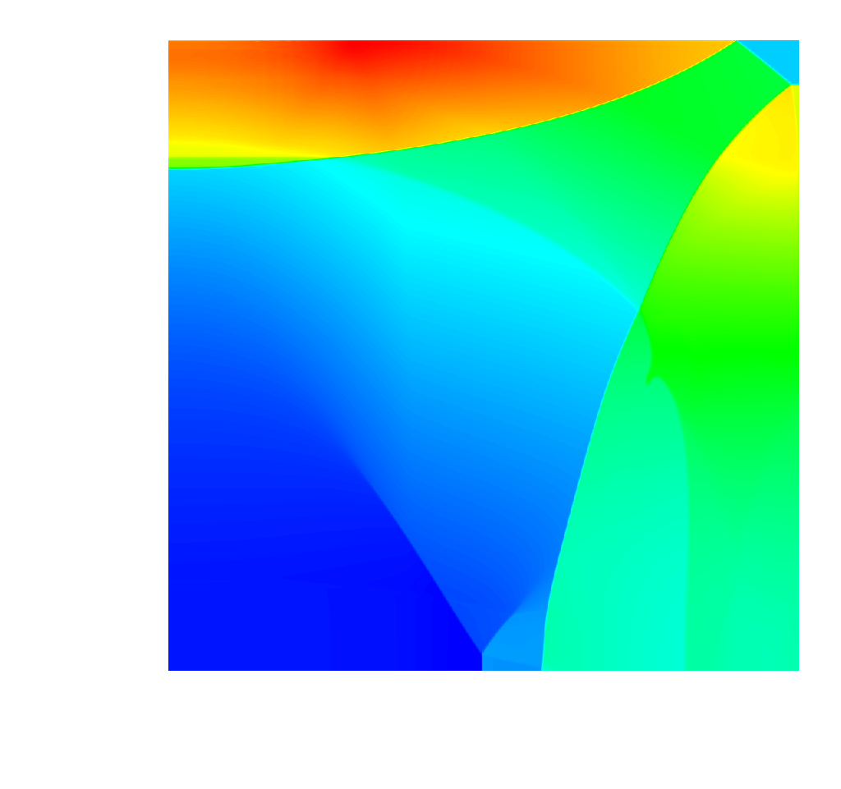
CloverLeaf – Numerical Method
2D Structured Hydrodynamics (3D application also now available)
Explicit solution to the compressible Euler equations
Finite volume predictor/corrector Lagrangian step followed by an
advective remap
Single material
A common base to all interested physics
models

Slide 11
Contributions
Re-engineer CloverLeaf to utilize a domain specific high-level abstraction framework, called OPS (Oxford Parallel Library for Structured-mesh solvers)
Results in a single high-level application source
Use automated code generation techniques of OPS to generate a range of parallel implementations.
Compare the resulting parallel applications to that of the original hand-tuned CloverLeaf applications.
Developer productivity – how difficult is it to future-proof code at design ?
Performance on an extensive range of contrasting architectures and systems
Aim is to demonstrate to a wider HPC audience how HLAs might help in solving various scientific simulation challenges on future emerging systems.

Slide 12
Structured Mesh Applications and OPS
Structured grids
Logical ( i , j ) indexing in 2D, (i, j, k) in 3D, with implicit connectivity
Easy to parallelize, including on GPUs with L1/L2 caches
Operations involve looping over
a “rectangular” multi-dimensional set of grid-points
using one or more “stencils” to access data

Slide 13
OPS API
The abstraction breaks down the specification of the problem into four parts
The structured mesh (or block ) worked on
For single structured mesh (as in CloverLeaf) there is only one block
Plans to extend to multi-block in the EPSRC project
Data defined on a block
Holds the data associated with each block
Stencil
Defines the stencil that is used in a computation
Computations
Defines the loop over a block
Indicates the data used in the loop, the stencil used to access this data and access type – read only, write only read/write, increment
The elemental operation to be performed for each iteration of the loop, declared as an out-lined kernel

Slide 14
Porting CloverLeaf to OPS – Declaring Block and Data
/* Declare a single structured block */
ops_block cgrid = ops_decl_block(2, "clover grid");
int size[2] = {x_cells+5, y_cells+5};
double* dat = NULL;
/* Declare data on block */
ops_dat density0 = ops_decl_dat(cgrid,1,size,dat,"double","density0");
ops_dat energy0 = ops_decl_dat(cgrid,1,size,dat,"double","energy0");
............
............
ops_dat pressure = ops_decl_dat(cgrid,1,size,dat,"double","pressure");
ops_dat volume = ops_decl_dat(cgrid,1,size,dat,"double","volume");

Slide 15
Porting CloverLeaf to OPS – Original Loop
DO k=y_min,y_max
DO j=x_min,x_max
v=1.0/density(j,k)
pressure(j,k)=(1.4 - 1.0)* density(j,k)*energy(j,k)
pressurebyenergy =(1.4-1.0)* density(j,k)
pressurebyvolume = - density(j,k)* pressure(j,k)
sound_speed_squared = v * v *(pressure(j,k)*
pressurebyenergy- pressurebyvolume)
soundspeed(j,k)= SQRT(sound_speed_squared)
ENDDO
ENDDO

Slide 16
Porting CloverLeaf to OPS – OPS Loop
The original CloverLeaf 2D application written in Fortran 90 was re-engineered to use OPS
Manually extracting the user kernels,
Outlining them in header files and
Converting the application to the OPS's C/C++ API.
//mesh execution range
int rangexy_inner[] = {x_min,x_max,y_min,y_max};
/*single point stencil*/
int s2D_00[] = {0,0};
ops_stencil S2D_00 = ops_decl_stencil( 2, 1, s2D_00, "00");
/*ideal_gas loop*/
ops_par_loop(ideal_gas_kernel,clover_grid, 2, rangexy_inner,
ops_arg_dat (density0, S2D_00, "double", OPS_READ),
ops_arg_dat (energy0, S2D_00, "double", OPS_READ),
ops_arg_dat (pressure, S2D_00, "double", OPS_WRITE),
ops_arg_dat (soundspeed,S2D_00, "double", OPS_WRITE));

Slide 17
Porting CloverLeaf to OPS – OPS Loop
“User kernel” – applied to every grid point
void ideal_gas_kernel( const double *density, const double *energy,
double *pressure, double *soundspeed) {
double sound_speed_squared, v, pressurebyenergy, pressurebyvolume;
v = 1.0 / density[OPS_ACC0(0,0)];
pressure[OPS_ACC2(0,0)] = (1.4 - 1.0) * density[OPS_ACC0(0,0)] *
energy[OPS_ACC1(0,0)];
pressurebyenergy = (1.4 - 1.0) * density[OPS_ACC0(0,0)];
pressurebyvolume = -1*density[OPS_ACC0(0,0)] *
pressure[OPS_ACC2(0,0)];
sound_speed_squared = v*v*(pressure[OPS_ACC2(0,0)] *
pressurebyenergy-pressurebyvolume);
soundspeed[OPS_ACC3(0,0)] = sqrt(sound_speed_squared);
}

Slide 18
Single threaded Developer version
Abstract
specification
Flatten N dimensional loop to 1D loop
Compute initial pointers based on iteration range
User kernel
Compute pointer offsets when stepping in different dimensions
Apply pointer increments

Slide 19
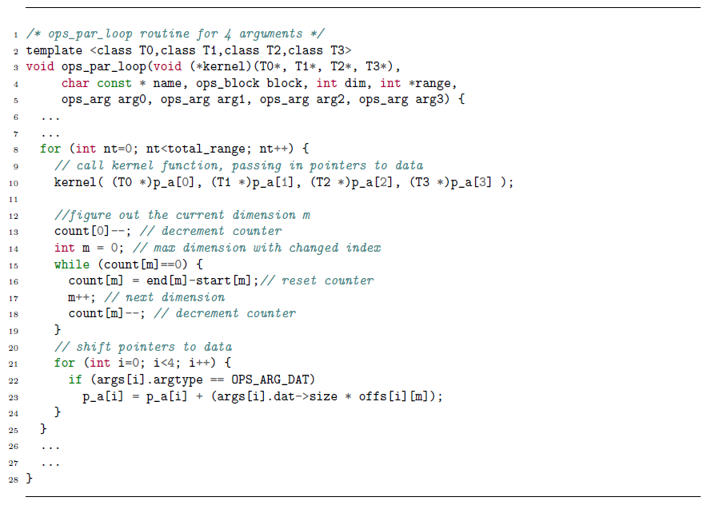
Single threaded Developer version
Template function
N dimensional loop flattened to 1D
Determine current dimension
Increment pointers

Slide 20
Single threaded Developer version
Template function
N dimensional loop flattened to 1D
Determine current dimension
Increment pointers
The “developer” version (flat 1D loop, completely general) inhibits compiler optimizations, it’s not very fast, but it’s not meant to be fast

Slide 21
Code generated versions
Abstract
specification
*Code generated*
N-dimensional loop for specific parallelizations
(e.g. OpenMP, CUDA, MPI OpenCL, OpenACC)
*Code generated* Compute initial pointers based on iteration range
*Function signature code generated*
User kernel
*Code generated*
Compute pointer offsets when stepping in different dimensions
*Code generated*
Apply pointer increments

Slide 22
Putting it all together
Structured Mesh Application
OPS Application (C/C++ API)
OPS Source-to-Source translator (Python)
OPS Platform Specific Optimized Backend libraries
Modified Platform Specific OPS Application
Platform Specific Optimized Application Files
Sequential
Link
Conventional Compiler + compiler flags
(e.g. Icc, nvcc, pgcc)
CUDA
OpenMP
MPI
OpenCL
Mesh
(hdf5)
Platform Specific Binary Executable
OpenACC
Hardware

Slide 23
Code Generation – Single threaded CPU Vectorization
Outer loop
Inner loop (divisible by
vector length)
Call user kernel
Increment pointers
Inner loop (remainder)
Call user kernel
Increment pointers
Increment pointers

Slide 24
Code Generation – Multi-threaded OpenMP
Split along the last dimension

Slide 25
Code Generation – GPU with NVIDIA CUDA
One thread per grid point
Launch CUDA kernel

Slide 26
Distributed Memory with MPI
MPI – Cartesian decomposition
Halo regions duplicated and updated
But how deep? We can tell based on the abstraction
Fully automatic, the user does not have to be aware

Slide 27
Distributed Memory with MPI
If iteration range is restricted, only one of the processes may execute
But it still needs data from its neighbors
every process carries out execution range and data dependency range computation
keep track of changes to the halos accordingly
Results in a minimal number of MPI messages and only when needed

Slide 28
Lessons Learnt
Iterative development of the OPS Framework:
Constantly trying new things,
making alterations to the API – making it more intuitive to use
at the same time make sure it does not restrict the delivery of high performance
Porting a code is still an error-prone process – typos, precedence, etc.
Implement self-checking code:
Can check if stencil access matches pre-declared stencil
Can check if the correct macro is used for different variables
Dumping data for binary comparison, visualizing data

Slide 29
Lessons Learnt
After the 2D version, we got access to the 3D version of the same code
Same structure, we just had to add new kernels
2 days writing code, 3 days debugging for typos – some in the original reference code!
Some modifications to the OPS backend libraries were required
Mostly fixing bugs that were not discovered under 2D before
Once converted, the parallelizations available with OPS could be generated without any significant development effort
AVX, OpenMP, CUDA, OpenCL and combinations with MPI could be generated almost immediately
OpenACC had some issues due to the PGI compiler – but later fixed
This is the real power of HLAs such as OPS
Introducing support for 3D in all the back-ends took very little time,
But the developers of the original will have to implement and debug each and every one of those by hand!

Slide 30
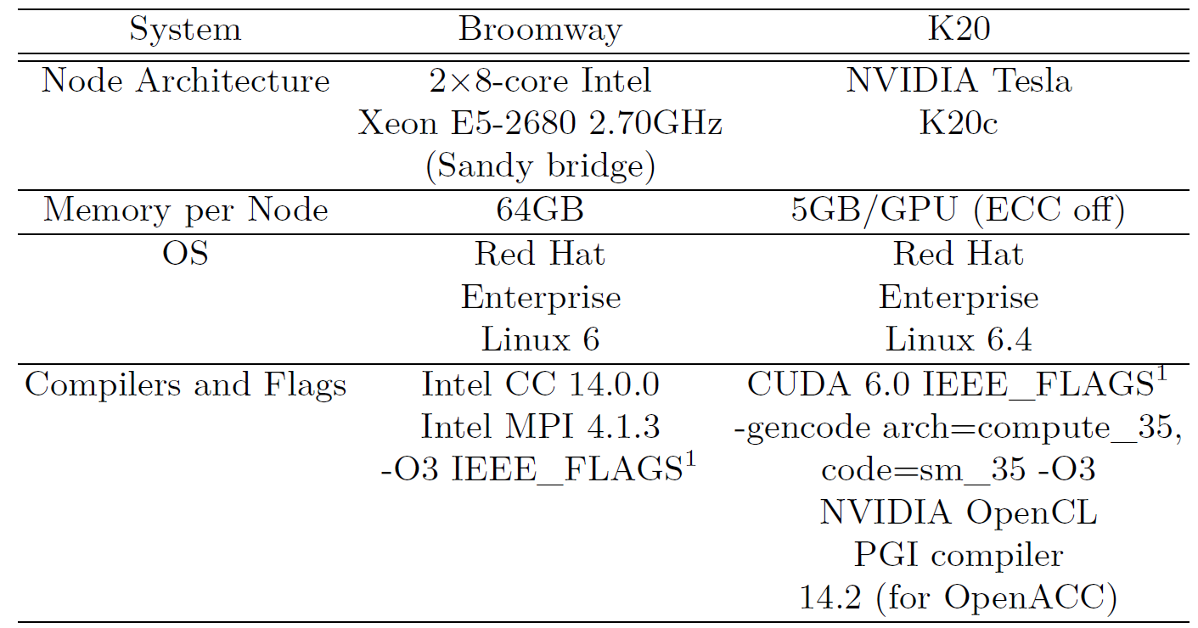
Performance – Benchmark Systems (Single Node)

Slide 31
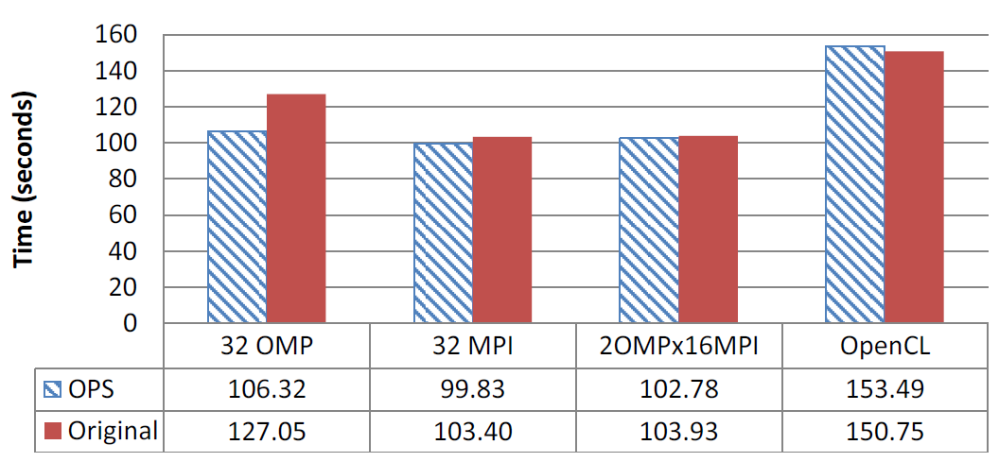
Performance – Intel CPUs (960 x 960 mesh, 2955 iterations)

Slide 32
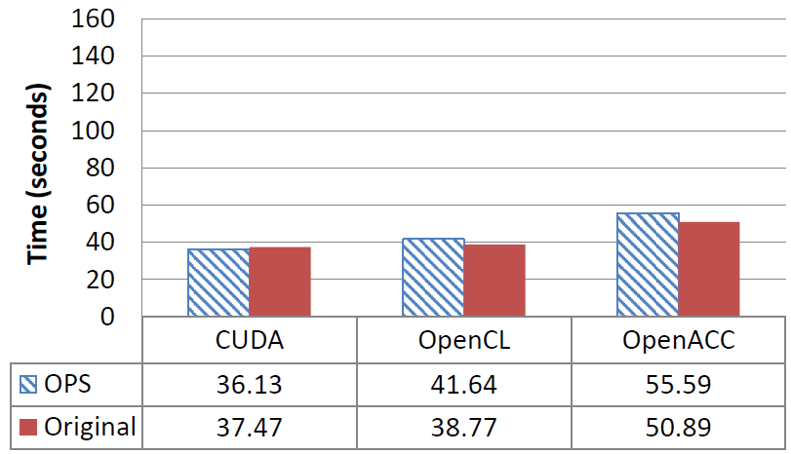
Performance – NVIDIA GPUs (960 x 960 mesh, 2955 iterations)

Slide 33
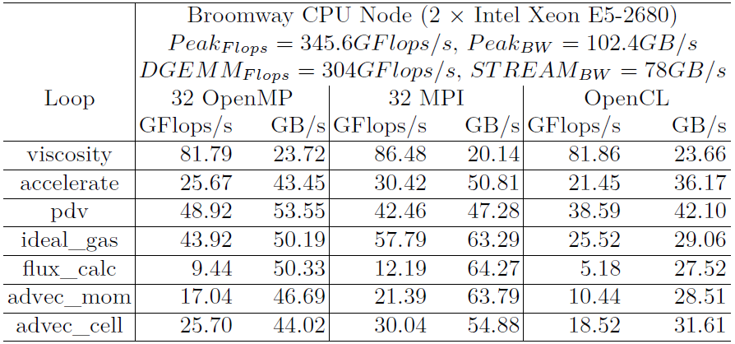
Performance – Single Node Achieved Performance Rates

Slide 34
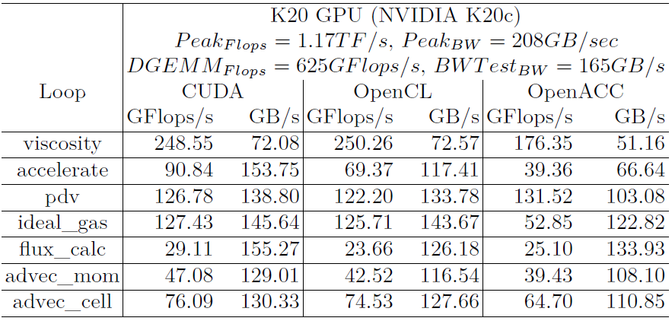
Performance – Single Node Achieved Performance Rates

Slide 35
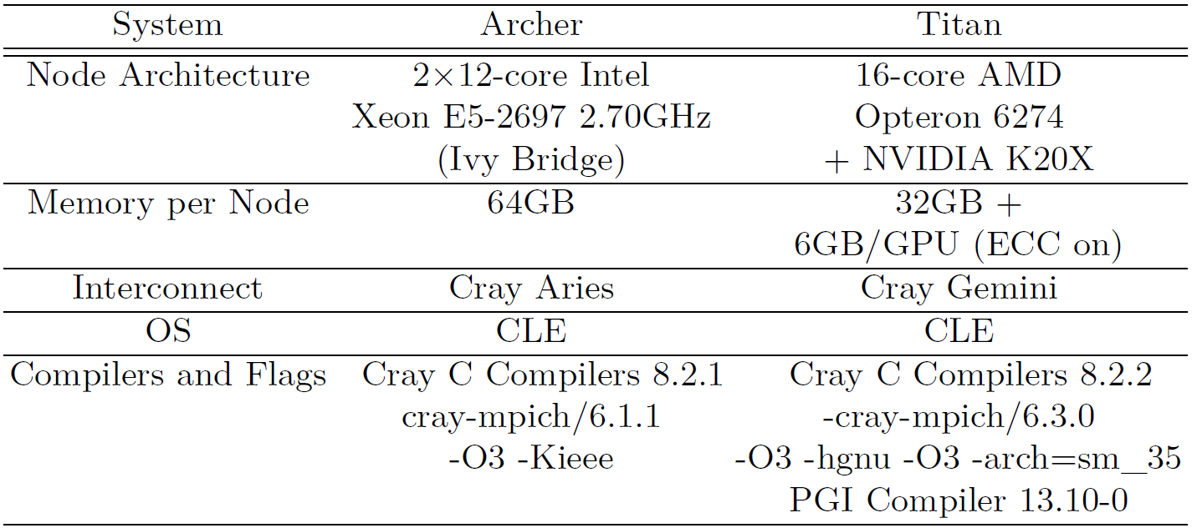
Performance – Benchmark Systems (Distributed Memory)

Slide 36
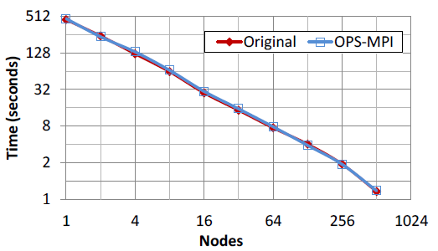
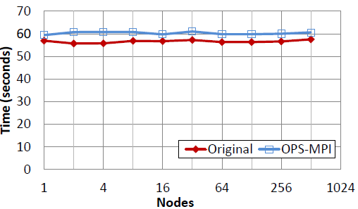
Performance – Cray XC30 (ARCHER)
Strong Scaling
15360 x 15360 mesh (87 iterations)
Weak Scaling
2x 3840 x 3840 mesh per node (87 iterations)

Slide 37
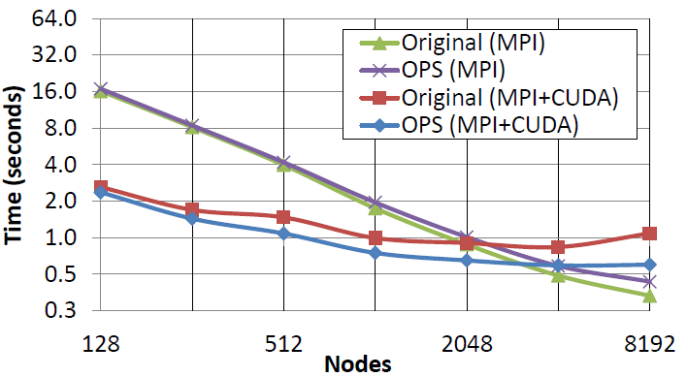
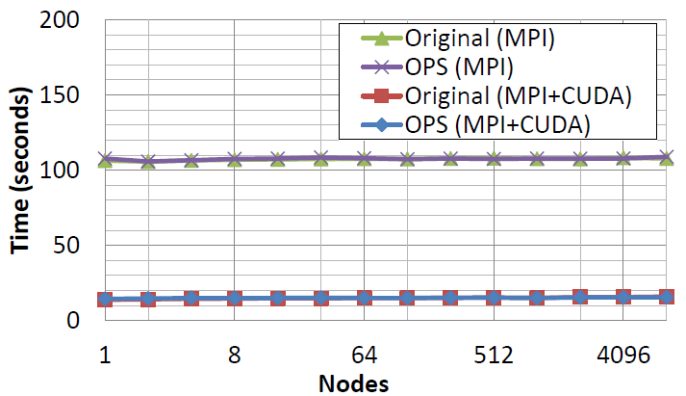
Performance – Cray XK7 (TITAN)
Strong Scaling
15360 x 15360 mesh (87 iterations)
Weak Scaling
3840 x 3840 mesh per node (87 iterations)

Slide 38
Conclusions
Aim was to demonstrate to a wider HPC audience how HLAs might help in solving various scientific simulation challenges on future emerging systems.
Re-Engineered CloverLeaf to use the OPS high-level framework
We saw that development with a high-level framework is no more time consuming nor difficult than writing a one-off parallel program targeting only a single parallel implementation.
However the HLA strategy pays off with
A highly maintainable single application source
Does not compromise performance portability
Lays the groundwork for providing support for execution on future parallel systems
CloverLeaf performance with OPS matches that of the original version
Performance matches the original – but at no cost to the developer
Pros and cons of the HLA approach
Need to select the correct abstraction and level of abstraction
Designing an HLA which is sufficiently general to handle a number of different applications, but be narrow enough be efficiently implemented by a single research group
Securing funding to maintain an HLA or a DSL so that the users can rely on it in the future

Slide 39
Acknowledgements
This research is funded by the UK AWE plc. under project “High-level Abstractions for Performance, Portability and Continuity of Scientific Software on Future Computing Systems”.
OPS is funded by the UK Engineering and Physical Sciences Research Council projects EP/K038494/1, EP/K038486/1, EP/K038451/1 and EP/K038567/1 on “Future-proof massively-parallel execution of multi-block applications” and EP/J010553/1 “Software for Emerging Architectures” (ASEArch) project.
This paper used the UK National Supercomputing Service – ARCHER and resources of the Oak Ridge Leadership Computing Facility at the Oak Ridge National Laboratory, which is supported by the Office of Science of the U.S. Department of Energy under Contract No. DE-AC05-00OR22725.
CloverLeaf development is supported by the UK AWE plc.under grants CDK0660 (The Production of Predictive Models for Future Computing Requirements) and CDK0724 (AWE Technical Outreach Programme) and also the Royal Society through their Industry Fellowship Scheme (IF090020/AM).

Slide 40
Download
OPS and CloverLeaf available as Open source software
OPS - https://github.com/gihanmudalige/OPS
Original CloverLeaf - https://github.com/Warwick-PCAV/CloverLeaf

Slide 41
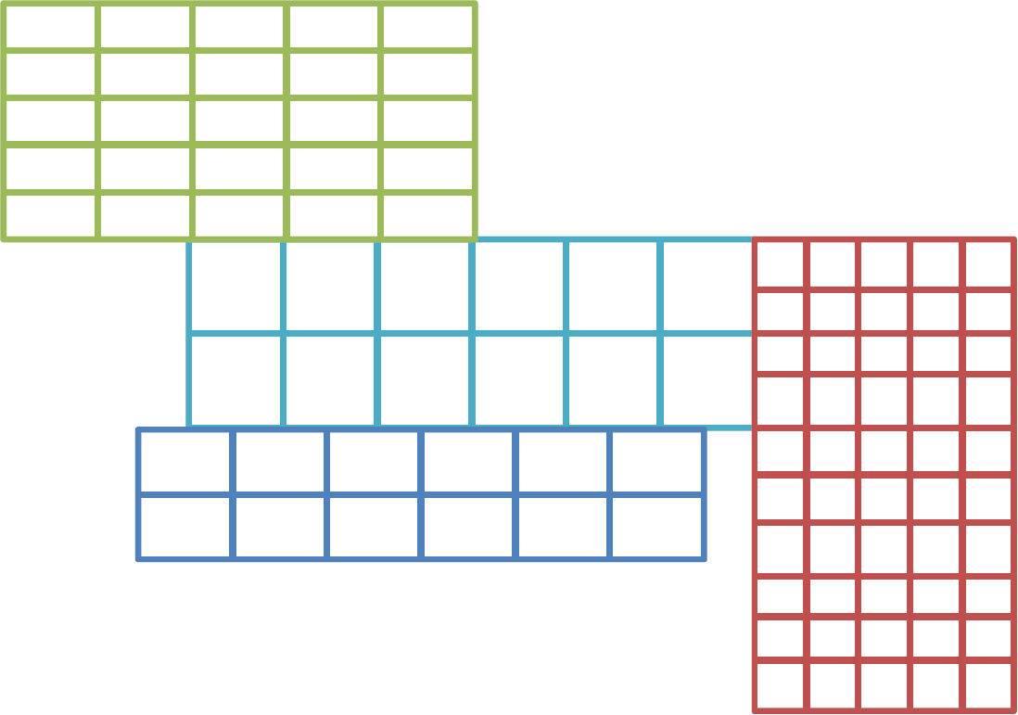
Future Work - Multi-block Structured Mesh
Multi-Block Structured grids
How do you come up with an intuitive API?
Mismatching interfaces, sliding planes
Dependencies between blocks
Semantics of parallel execution of blocks
How do you partition? Unstructured mesh of structured meshes
Some of the original codes use horrible hacks and workarounds – outperforming them may not be an issue

Slide 42
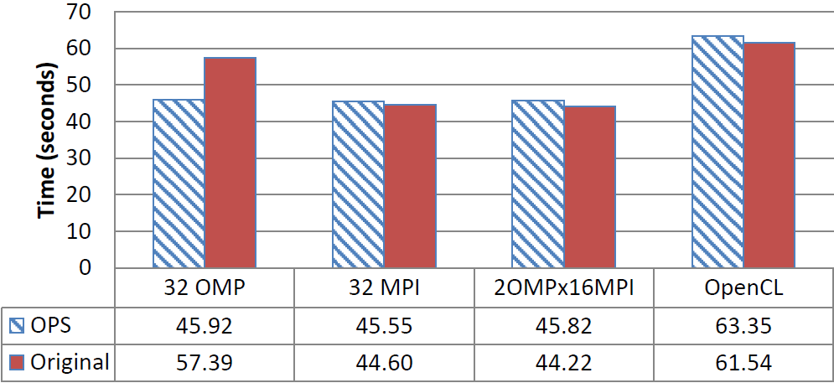
Performance – Intel CPUs (3840 x 3840 mesh, 87 iterations)

Slide 43
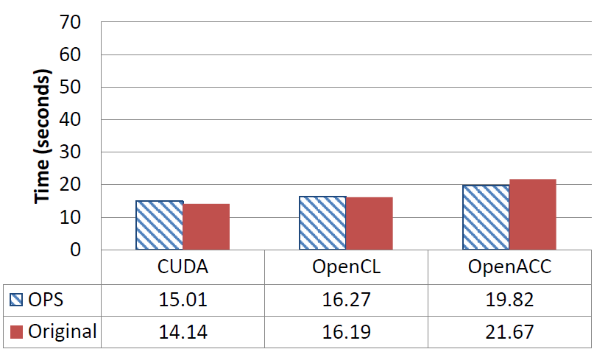
Performance – NVIDIA GPUs (3840 x 3840 mesh, 87 iterations)

