Slide 1


Insight into Application Performance Using Application-Dependent Characteristics
Waleed Alkohlani¹, Jeanine Cook², Nafiul Siddique¹
¹New Mexico Sate University
²Sandia National Laboratories

Slide 2
Introduction
Carefully crafted workload performance characterization
Insight into performance
Useful to architects, software developers and end users
Traditional performance characterization
Primarily use hardware-dependent metrics
CPI, cache miss rates…etc
Pitfall?

Slide 3
Overview
Define application-dependent performance characteristics
Capture the cause of observed performance, not the effect
Knowing the cause, one can possibly predict the effect
Fast data collection (binary instrumentation)
Apply characterization results to:
Gain insight into performance
Better explain observed performance
Understand app-machine characteristic mapping
Benchmark similarity and other studies

Slide 4
Outline
Application-Dependent Characteristics
Experimental Setup
Platform, Tools, and Benchmarks
Sample Results
Conclusions & Future Work

Slide 5
Application-Dependent Characteristics
General Characteristics
Dynamic instruction mix
Instruction dependence (ILP)
Branch predictability
Average instruction size
Average basic block size
Computational intensity
Memory Characteristics
Data working set size
Also, timeline of memory usage
Spatial & Temporal locality
Average # of bytes read/written per mem instruction
These characteristics still depend on ISA & compiler!

Slide 6
General Characteristics: Dynamic Instruction Mix
Ops vs. CISC instructions
Load, store, FP, INT, and branch ops
Measured:
Frequency distributions of the distance between same-type ops
Frequency distributions
Ld-ld, st-st, fp-fp, int-int, br-br…
Information:
Number and types of execution units

Slide 7
General Characteristics:
Instruction dependence (ILP)
Measured:
Frequency distribution of register-dependence distances
Distance in # of instrs between producer and consumer
Also, inst-to-use (fp-to-use, ld-to-use, ….)
Information:
Indicative of inherent ILP
Processor width, optimal execution units…
Branch predictability
Measured:
Branch Transition Rate
% of time a branch changes direction
Very high/low rates indicate better predictability
11 transition rate groups (0-5%, 5-10%...etc)
Information:
Complexity of branch predictor hardware required
Understand observed br misprediction rates

Slide 8
General Characteristics:
Average instruction size
Measured:
A frequency distribution of dynamic instr sizes
Information:
Relate to processor’s fetch (and dispatch) width
Average basic block size
Measured:
A frequency distribution of basic block sizes (in # instrs)
Information
Indicative of amount of exposed ILP in code
Correlated to branch frequency
Computational intensity
Measured:
Ratio of flops to memory accesses
Information:
Indirect measure of “data movement”
Moving data is slower than doing an operation on it
Should also know the # of bytes moved per memory access
Maybe re-define as # flops / # bytes moved?

Slide 9
Memory Characteristics:
Working set size
Measured:
# of unique bytes touched by an application
Information:
Memory size requirements
How much stress is on memory system
Timeline of memory usage

Slide 10
Memory Characteristics:
Temporal & Spatial Locality
Information:
Understand available locality & how cache can exploit it
How effectively an app utilizes a given cache organization
Reason about the optimal cache config for an application
Measured:
Frequency distributions of memory-reuse distances (MRDs)
MRD = # of unique n-byte blocks referenced between two references to the same block
16-byte, 32-byte, 64-byte, 128-byte blocks are used
One distribution for each block size
Also, separate distributions for data, instruction, and unified refs
Due to extreme slow-downs:
Currently, maximum distance (cache size) is 32MB
Use sampling (SimPoints)

Slide 11
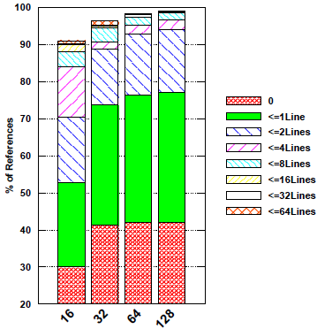
Memory Characteristics: Spatial Locality
Goal:
Understand how quickly and effectively an app consumes data available in a cache block
Optimal cache line size?
How:
Plot points from MRD distribution that correspond to short MRDs: 0 through 64
Others use only a distance of 0 and compute “stride”
Problem:
In an n-way set associative cache, the in-between references may be to the same set
Solution:
Look at % of refs spatially local with d = assoc
Capture set-reuse distance distribution!
Must know cache size & associativity
HPCCG

Slide 12
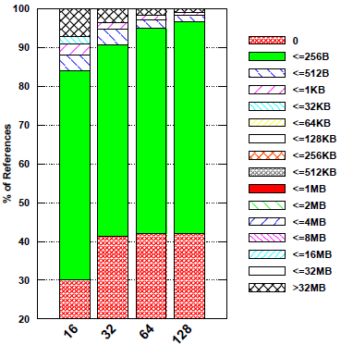
Memory Characteristics: Temporal Locality
Goal:
Understand optimal cache size to keep the max % of references temporally local
May be used to explain (or predict) cache misses
How:
Plot MRD distribution with distances grouped into bins corresponding to cache sizes
Very useful in fully (highly) assoc. caches
Problem:
In an n-way set associative cache, the in-between references may be to the same set
Solution:
Capture set-reuse distance distribution!
Must know cache size & associativity
Short MRDs, short SRD’s → good?
Long MRDs, short SRD’s → bad?
Long SRD’s?
HPCCG

Slide 13
Experimental Setup
Platform:
8-node Dell cluster
Two 6-core Xeon X5670 processors per node s(Westmere-EP)
32KB L1 and 256KB L2 caches (per core), 12MB L3 cache (shared)
Tools:
In-house DBI tools (Pin-based)
PAPIEX to capture on-chip performance counts
Benchmarks:
Five SPEC MPI2007 (serial versions only)
leslie3d, zeusmp2, lu (fluid dynamics)
GemsFDTD (electromagnetics)
milc (quantum chromodynamics)
Five Mantevo benchmarks (run serially)
miniFE (implicit FE) : problem size ➔ (230, 230, 230)
HPCCG (implicit FE) : problem size ➔(1000, 300, 100)
miniMD (molecular dynamics) : problem size ➔ lj.in (145, 130, 50)
miniXyce (circuit simulation) : input ➔ cir_rlc_ladder50000.net
CloverLeaf (hydrodynamics) : problem size ➔ (x=y=2840)

Slide 14
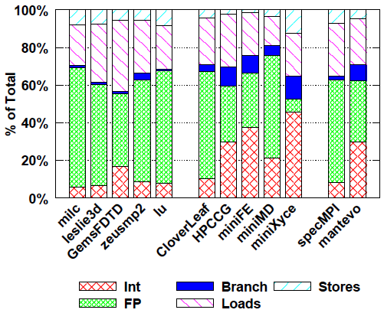
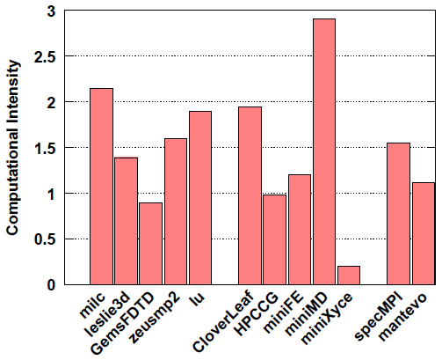
Sample Results
Instruction Mix
Computational Intensity

Slide 15
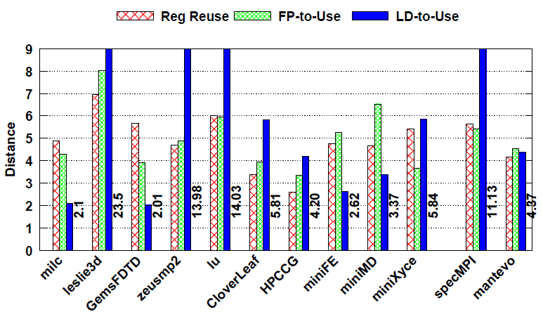
Sample Results (ILP Characteristics)
SPEC MPI shows better ILP (particularly w.r.t memory loads)

Slide 16
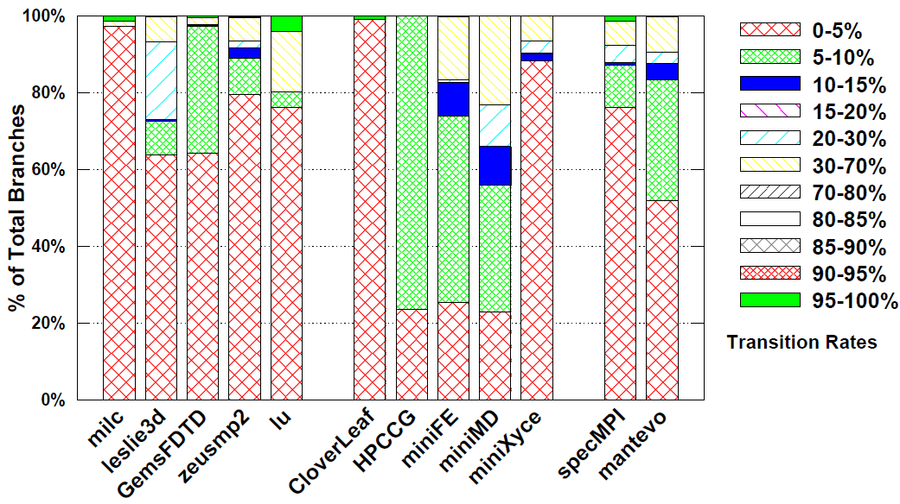
Sample Results (Branch Predictability)
miniMD seems to have a branch predictability problem

Slide 17
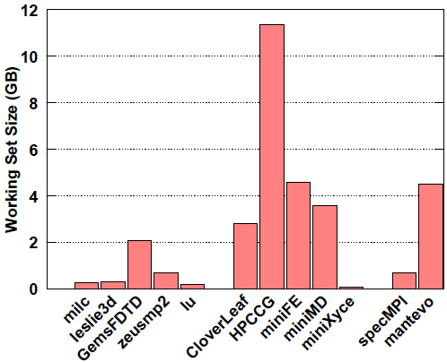
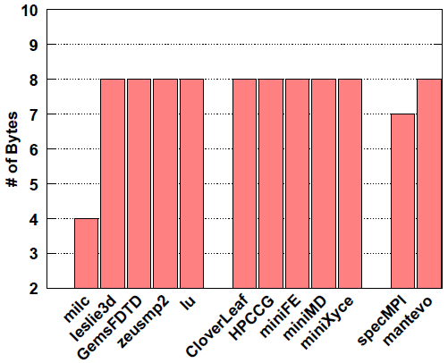
Sample Results (Memory)
Data Working Set Size
Avg # Bytes per Memory Op

Slide 18
Sample Results (Locality)
In general, Mantevo benchmarks show
Better spatial & temporal locality

Slide 19
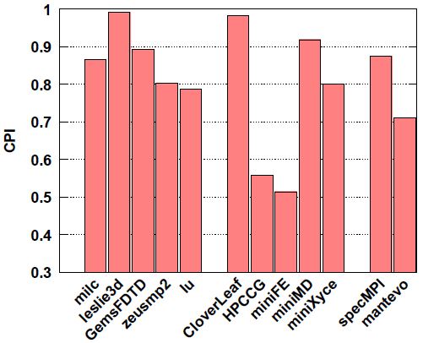
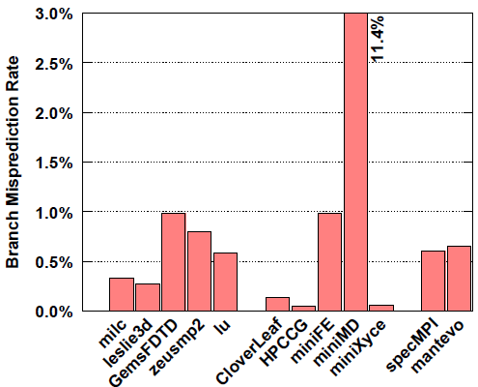
Sample Results (Hardware Measurements)
Cycles-Per-Instruction (CPI)
Branch Misprediction Rates

Slide 20
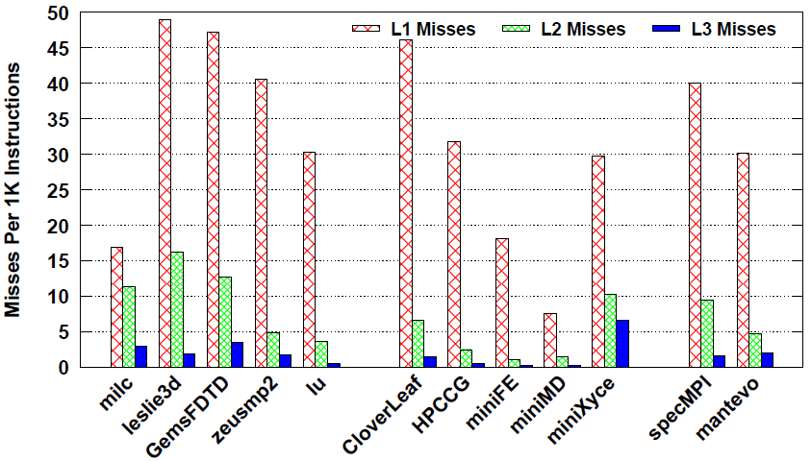
Sample Results (Hardware Measurements)
L1, L2, and L3 Cache Miss Rates

Slide 21
Conclusions & Future Work
Conclusions:
Application-dependent workload characterization
More comprehensive set of characteristics & metrics
Independent of hardware
Provides insight
Results on SPEC MPI2007 & Mantevo benchmarks
Mantevo exhibits more diverse behavior in all dimensions
Future Work:
Characterize more aspects of performance
Synchronization
Data movement

Slide 22

Questions

