Slide 1
A Scalable Analytical Memory Model for CPU Performance Prediction
Gopinath (Nath) Chennupati*^{,1},
Nandakishore Santhi¹, Robert (Bob) Bird¹, Sunil Thulasidasan¹, Abdel-Hameed A. Badaway², Satyajayanth Misra² and
Stephan Eidenbenz¹
¹ Los Alamos National Laboratory (LANL)
² New Mexico State University (NMSU)

Slide 2
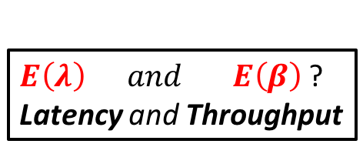
Problem & Solution
Problem ?
Program
Data
Software Code
#include <stdio.h>
#define SIZE 1000
int main () {
static int A[SIZE];
int sum = 0, i;
for (i=0; i<SIZE; i++)
{
A[i] = 2*i;
sum += A[i];
}
}
CPU
Core
Cache
Execute
Pipe Line 1
…
Pipe Line 8
RAM
L₁
L₂
ALU
ALU
L₃
Which part of Program exploits Pipelines?
$E\left(λ\right) and E\left(β\right)$ ?
Latency and Throughput
Notes:
Study the effect of pipelines on the program execution. Which part of the program efficiently exploits the pipeline capabilities

Slide 3
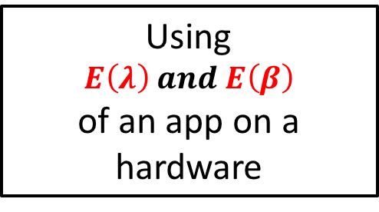
Objective
Software Code
Predict Runtime?
#include <stdio.h>
#define SIZE 1000
int main () {
static int A[SIZE];
int sum = 0, i;
for (i=0; i<SIZE; i++)
{
A[i] = 2*i;
sum += A[i];
}
}
Using
$$E\left(λ\right) and E\left(β\right)$$
of an app on a hardware

Slide 4
Analytical Memory Model (AMM)
AMM to achieve the objective
Uses the concepts of LLVM BasicBlocks
Analytical Memory Model (AMM)
Step 1: Generate Memory Trace
Step 2: Estimate Reuse Profiles, latency and throughput
Step 3: Predict Runtime
Input
Runtime
Accepts small inputs of a program, runs and records the memory traces
Estimates the reuse profiles at bigger inputs and predicts runtimes

Slide 5





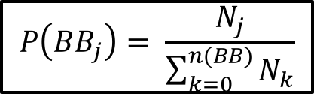
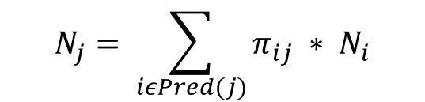
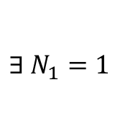
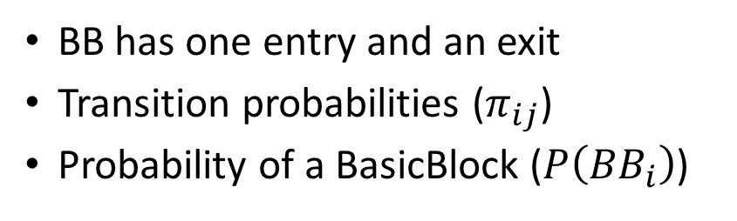
BasicBlocks (BB) and Probabilities
…
if(i%2 ==0)
A[i] = 2*i;
else
A[i] = 2*i;
…
; <label>:6 ; preds = %3
%7 = load i32, i32* %i, align 4
%8 = mul nsw i32 2, %7
%9 = load i32, i32* %i, align 4
%10 = sext i32 %9 to i64
%11 = load i32*, i32** %1, align 8
%12 = getelementptr inbounds i32, i32* %11, i64 %10
store i32 %8, i32* %12, align 4
br label %13
$${BB}_{i}$$
Pred(j)
57%
43%
$$π_{ij}$$
$$π_{1j}$$
$$π_{Lj}$$
Example BasicBlock Intermediate Representation (IR)
$$P\left({BB}_{j}\right)= \frac{N_{j}}{\sum_{k=0}^{n(BB)}{N_{k}}}$$
$${BB}_{j}$$
BB has one entry and an exit
Transition probabilities ($π_{ij}$)
Probability of a BasicBlock ($P\left({BB}_{i}\right)$)
$$N_{j}= \sum_{iεPred(j)}{π_{ij}} ∗ N_{i}$$
$$∃ N_{1}=1$$

Slide 6
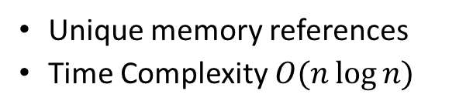
AMM -- Step 1: Memory Trace
#include <stdio.h>
#define SIZE 1000
int main () {
static int A[SIZE];
int sum = 0, i;
for (i=0; i<SIZE; i++) {
A[i] = 2*i;
sum += A[i];
} }
BasickBlock Start: (main, entry)
LOAD: 0x7ffe5d1d8db0
BasickBlock End: (main, entry)
BasickBlock Start: (main, for_cond)
LOAD: 0x7ffe5d1d8dd0
STORE: 0x60410111ff0
BasickBlock End: (main, for_cond)
BasickBlock Start: (main, for_body)
LOAD: 0x7ffe5d1d8db3
STORE: 0x7ffe5d1d8db0
BasickBlock End: (main, for_body)
(hacked !)
Byfl
Reuse
Distance (D)
BasicBlock : (main, entry)
BasicBlock : (main, body)
BasicBlock : (main, for_cond)
BasicBlock : (main, for_body)
BasicBlock : (main, for_inc)
BasicBlock : (main, for_end)
Input Program
Smaller input size of a program
Labeled Memory Trace
Basic Block Labels
Unique memory references
Time Complexity $O(n\log{n)}$
Byfl: https://github.com/lanl/Byfl

Slide 7
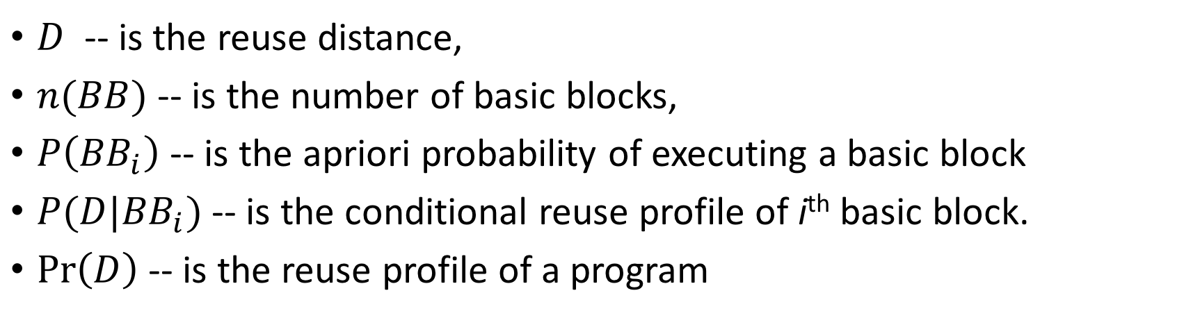
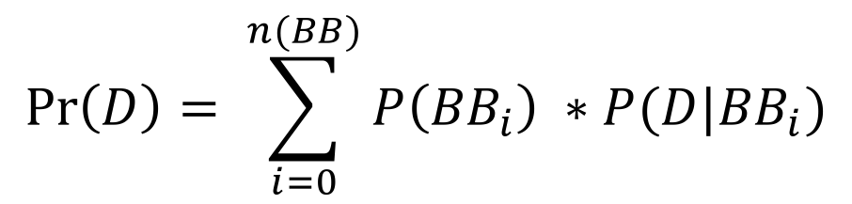
AMM -- Step 2: Reuse Profiles
$$\operatorname{Pr}\left(D\right)= \sum_{i=0}^{n(BB)}{P\left({BB}_{i}\right) ∗P(D|{BB}_{i})}$$
$D$ -- is the reuse distance,
$n(BB)$-- is the number of basic blocks,
$P\left({BB}_{i}\right)$-- is the apriori probability of executing a basic block
$P(D|{BB}_{i})$-- is the conditional reuse profile of i^{th} basic block.
$\operatorname{Pr}\left(D\right)$ -- is the reuse profile of a program

Slide 8
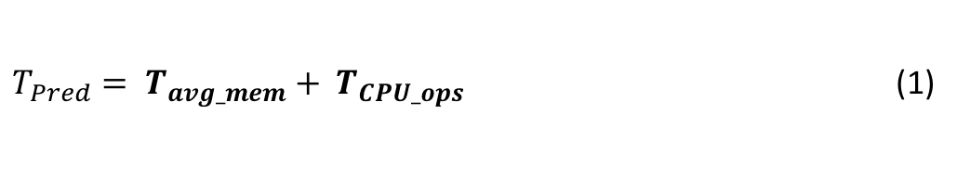
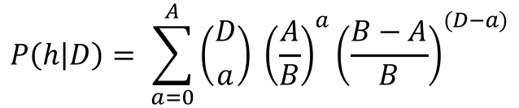
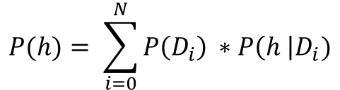
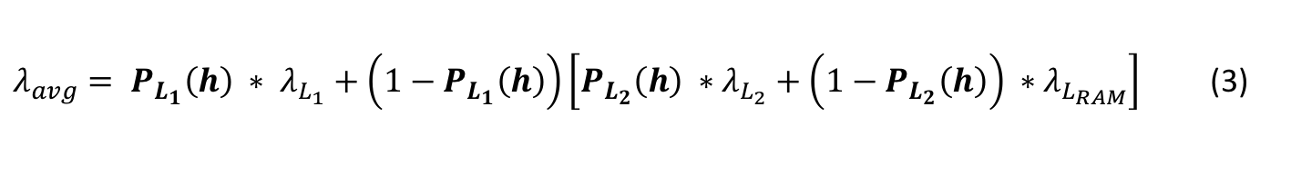
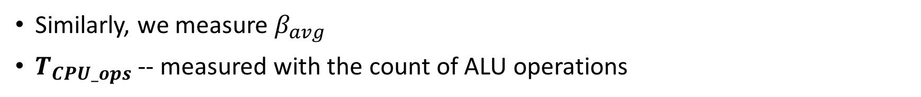
AMM -- Step 3: Predict Runtime
$T_{Pred}= T_{avg_mem}+ T_{CPU_ops}$ (1)
$T_{avg_mem}= \frac{λ_{avg}+\left(b−1\right) β_{avg}}{b} ∗total_mem$ (2)
$λ_{avg}= P_{L_{1}}\left(h\right) ∗ λ_{L_{1}}+\left(1−P_{L_{1}}\left(h\right)\right)\left[P_{L_{2}}\left(h\right) ∗λ_{L_{2}}+\left(1−P_{L_{2}}\left(h\right)\right) ∗λ_{L_{RAM}}\right]$ (3)
$$P\left(h | D\right)= \sum_{a=0}^{A}{\left({D \atop a}\right) {\left(\frac{A}{B}\right)}^{a}{\left(\frac{B−A}{B}\right)}^{(D−a)}}$$
$$P(h)= \sum_{i=0}^{N}{P\left(D_{i}\right) ∗P\left(h \right|D_{i})}$$
(4)
Similarly, we measure $β_{avg}$
$T_{CPU_ops}$ -- measured with the count of ALU operations

Slide 9
AMM in PPT
Performance Prediction Toolkit (PPT): https://github.com/lanl/PPT

Slide 10
Target Hardware & Benchmarks
# | Processor | Speed (GHz) | Cache Size (bytes) |  |  | Shared L3?
 |  |  | L1 | L2 | L3
1 | Intel Xeon E5-2695 | 2.10 | 64K | 256K | 45M | Yes
2 | Intel Core i7-4770HQ | 2.20 | 256K | 1M | 6M | No
# | Benchmark | Input Sizes
1 | STREAM | {10000, 20000, 30000, 40000}
2 | MM | {25 x 25, 50 x 50, 100 x 100, 200 x 200}
3 | BlackScholes | {16, 32, 64, 128}

Slide 11
Results -- Reuse Profiles, Sampling
1% Sampling

Slide 12
Results -- Extrapolate Reuse Profiles
Reuse distances (D) does not grow horizontally
Let’s extrapolate the growth
Fixed-Binning -- average reuse distances at each bin

Slide 13
Results – Data Availability
Measured on Intel Xeon E5
Hit-rates suddenly drop at cache sizes.
STREAM data exceeds even the L3 limits
Core i7 has smaller L3 and relatively larger L1 and L2
Hit-rates of large reuse distances are relatively low

Slide 14
Results -- Predicted Runtimes
# | BlackScholes Runtime (sec)
16 | 0.000
32 | 0.001
64 | 0.01
128 | 0.002
# | Average Error Rate
 | Xeon | Core i7
STREAM | 19.83 | 16.20
MM | 17.50 | 18.45
BlackScholes | 15.89 | 16.25
Insignificant difference in runtimes b/w hardwares for MM and BS
L3 of Xeon is bigger than Core i7, therefore the difference in times
Over prediction, due to memory only modelling
Actual Runtimes

Slide 15
Future Work -- Pipelines
; <label>:6 ; preds = %3
%7 = load i32, i32* %i, align 4
%8 = mul nsw i32 2, %7
%9 = load i32, i32* %i, align 4
%10 = sext i32 %9 to i64
%11 = load i32*, i32** %1, align 8
%12 = getelementptr inbounds i32, i32* %11, i64 %10
store i32 %8, i32* %12, align 4
br label %13
Automated Data Dependency
Analysis
Example BasicBlock IR
Tasklet Graphs

Slide 16
Conclusion
Novel Analytical Memory Model (AMM) based on LLVM BasicBlocks
Estimated the cache hit-rates, effective latency and throughput.
Used the latency and throughputs to predict runtime.
Will model pipelines, …
Integrate these node level models into MPI
Predict performance of physics codes such as PARTISN, etc.

Slide 17
References
M. Brehob and R. Enbody. An analytical model of locality and caching. Tech. Rep. MSUCSE-99-31, 1999.
S. Pakin and P. McCormick. Hardware-independent application characterization. In International Symposium on Workload Characterization (IISWC), pages 111–112, Portland, Oregon, USA, 2013. IEEE.
C. Bienia, S. Kumar, J. P. Singh, and K. Li. The parsec benchmark suite: Characterization and architectural implications. In Proceedings of the 17th International Conference on Parallel Architectures and Compilation Techniques, PACT ’08, pages 72–81, New York, NY, USA, 2008. ACM.
N. Santhi, S. Eidenbenz, and J. Liu. The simian concept: Parallel discrete event simulation with interpreted languages and just-in-time compilation. In Proceedings of the 2015 Winter Simulation Conference (WSC), pages 3013–3024. IEEE, 2015.
Y. Zhong, X. Shen, and C. Ding. Program locality analysis using reuse distance. ACM Trans. Program. Lang. Syst., 31(6), 2009.
E. Berg and E. Hagersten. StatCache: a probabilistic approach to efficient and accurate data locality analysis. In IEEE International Symposium on - ISPASS Performance Analysis of Systems and Software, 2004, pages 20–27, 2004.
N. Jain, A. Bhatele, M. P. Robson, T. Gamblin, and L. V. Kale. Predicting application performance using supervised learning on communication features. In Proceedings of the International Conference on High Performance Computing, Networking, Storage and Analysis, SC’13, pages 95:1–95:12, New York, NY, USA, 2013. ACM.

