Slide 1
Multi-fidelity Surrogate Modeling for Application/Architecture Co-design
Yiming Zhang¹, Aravind Neelakantan², Nalini Kumar², Chanyoung Park¹ Raphael T. Haftka¹, Nam H. Kim¹, Herman Lam²
¹Department of Mechanical and Aerospace Engineering
²Department of Electrical and Computer Engineering
University of Florida, Gainesville, Florida 32611

Slide 2
Introduction
Goal
Reduce computational budget of HPC codes (parent app)
Using representative apps (mini-apps, skeleton apps)
For application/architecture co-design
Low-cost model validation over larger design space
Quantitatively
Performance prediction of parent app
Parent app
How representative are we of each other?
Mini-app
Skeleton app

Slide 3
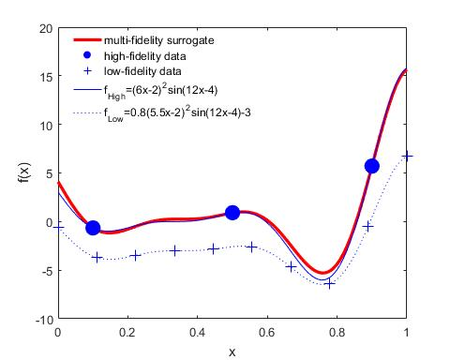
Combining Multi-fidelity Predictions
Approach
How to combine predictions with different fidelity?
Probabilistic modeling to quantify the relation
Expect improved accuracy with low cost/time
Cost/ Time
Illustration of MFS
Experiments
Simulations
Combining simulations and experiments
Analytical models
Low-fidelity
High-fidelity
Accuracy for simulating physical phenomenon

Slide 4
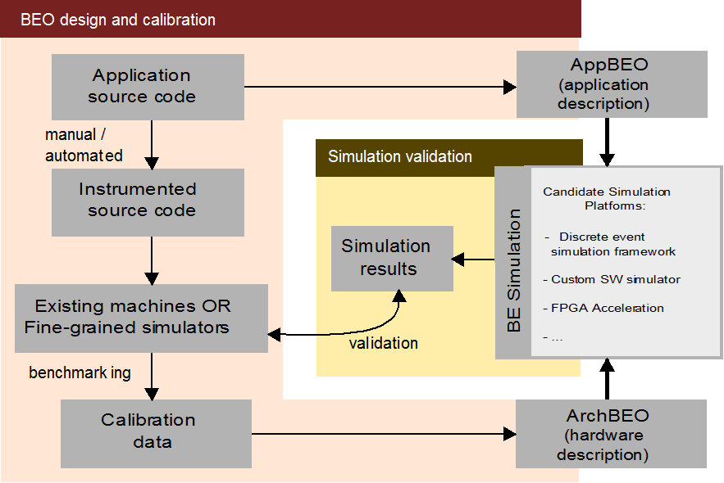
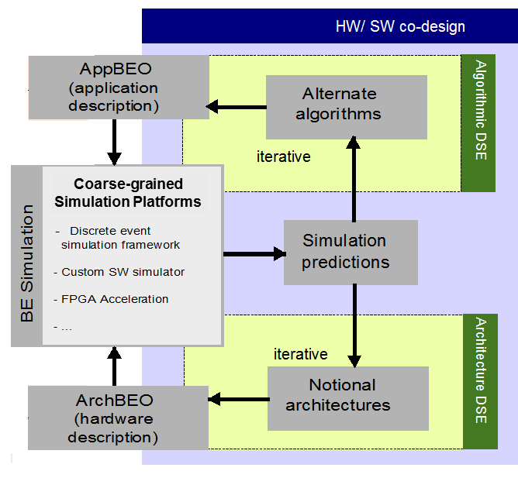
Co-Design Using Behavioral Emulation (BE)
Coarse-grained
Simulation Platforms
Simulation Platforms
BE SST
FPGA Acceleration
BE Simulation
* BEO – Behavioral Emulation Object
HW/SW co-design
Algorithmic & architectural design-space exploration (DSE)
BE is coarse-grained simulation
Balance of simulation speed & accuracy for rapid design-space evaluation

Slide 5
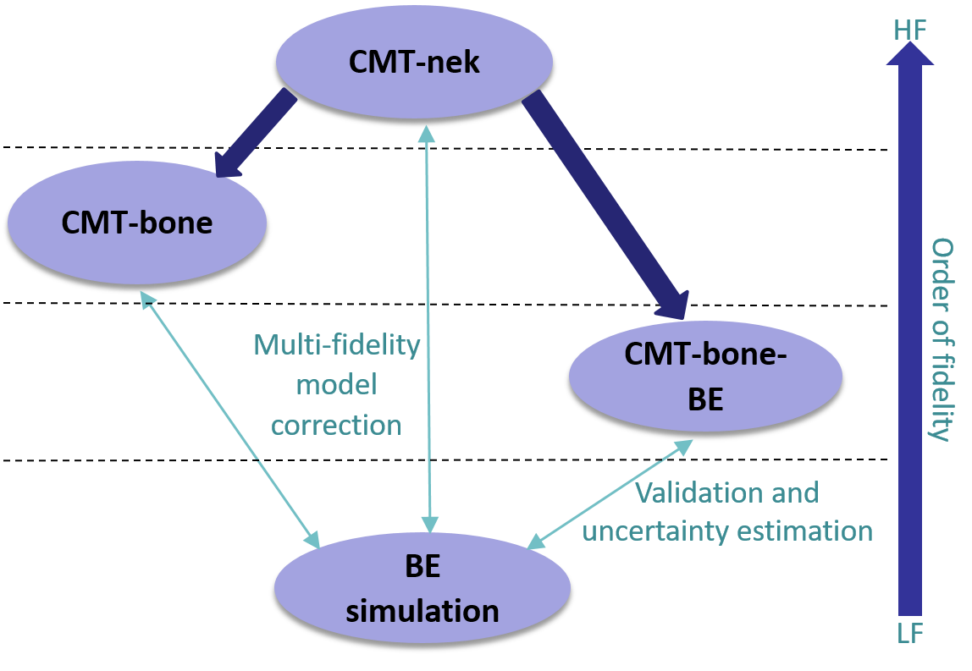
Behavioral Emulation with MFS
Objective
Reduce computational budget by fitting BE simulation to CMT-nek using Multi-Fidelity Surrogate (MFS) – current work
Extrapolation of CMT-nek towards large-scale runs using BE and MFS – extended work (email me for more details)

Slide 6
Application Case Study*
Parent app – CMT-nek
Perform simulation of instabilities, turbulence, and mixing in particulate-laden flows under conditions of extreme pressure and temperature
Developed from Nek5000 - open-source software for simulating unsteady incompressible fluid flow with thermal and passive scalar transport
Mini-app – CMT-bone
Key data structures and compute and communication kernels of CMT-nek
Simplifies number of computation and communication operations performed at each time step in simulation
Skeleton app – CMT-bone-BE
Key compute kernels & comm. patterns that affect performance
Abstract, modular, easy to modify & instrument for rapid algorithmic DSE
* All applications developed at PSAAP-II Center for Compressible Multiphase Turbulence (CCMT) at University of Florida

Slide 7
Developing MFS: Experimental setup
Design of experiment (DOE)
Element size (ES) = 5,9,13,17,21
Elements per processor (EPP) = 8,32,64,128,256
Number of processors (NP) = 16,256,2048,16384,131072
125 total data points
* BE simulation: all 125 runs
CMT-nek: 22 runs
CMT-bone: 67 runs
Multi-fidelity surrogate model
Fitting CMT-nek using corrected fitting of BE simulation
For large problems, low-fidelity BE simulation is computationally cheaper than high-fidelity CMT-nek or CMT-bone
Elements per processor
Element Size
Number of processors

Slide 8
Least Squares MFS
Translate LF data against few HF data
Linear regression with multi-fidelity data as basis for predictions
Robust with noise effect
Form of translation function
Schemes to determine surrogate parameters
Selected a popular form with a scale factor and a discrepancy surrogate
Developed a multi-fidelity surrogate for improved robustness and accuracy
Bayesian vs. Deterministic
Spatial distribution vs. Residual error
Sequential vs. Simultaneous
Heuristic vs. Analytical

Slide 9
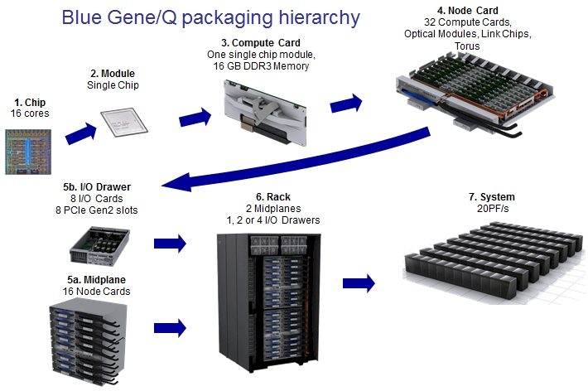
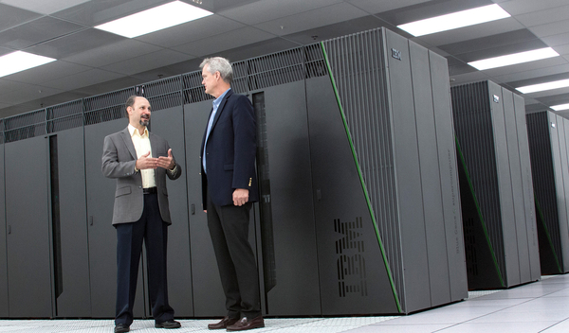
HPC system under study
Vulcan @ LLNL
IBM BG/Q architecture
16 cores/node, 24k nodes, 390k cores
16GB memory/node, 400TB compute memory

Slide 10
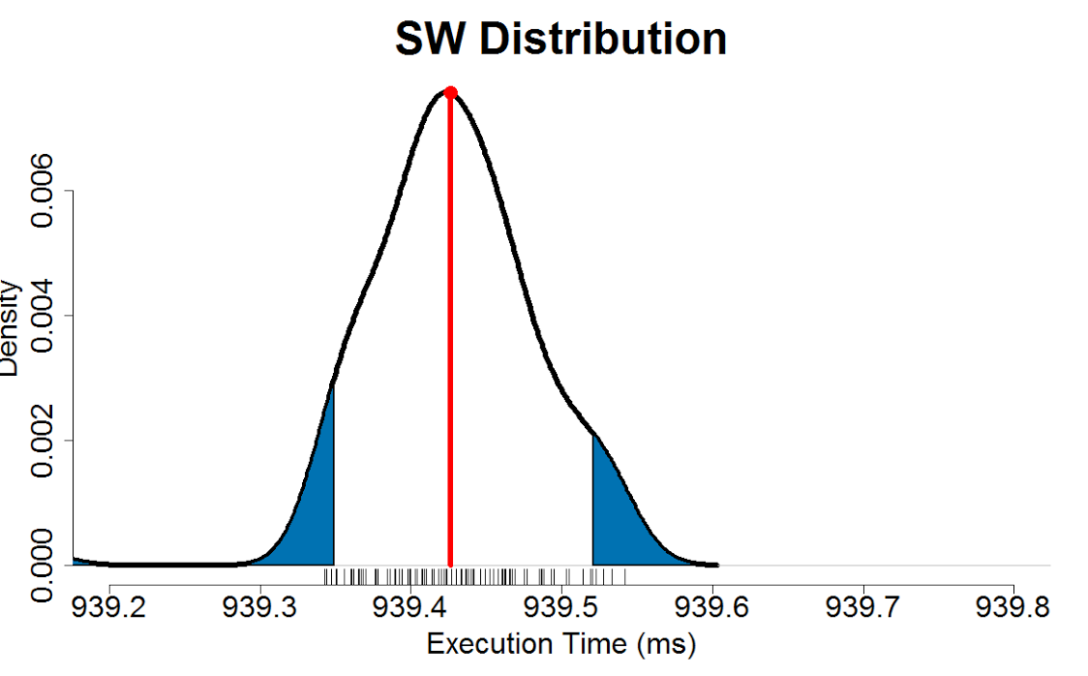
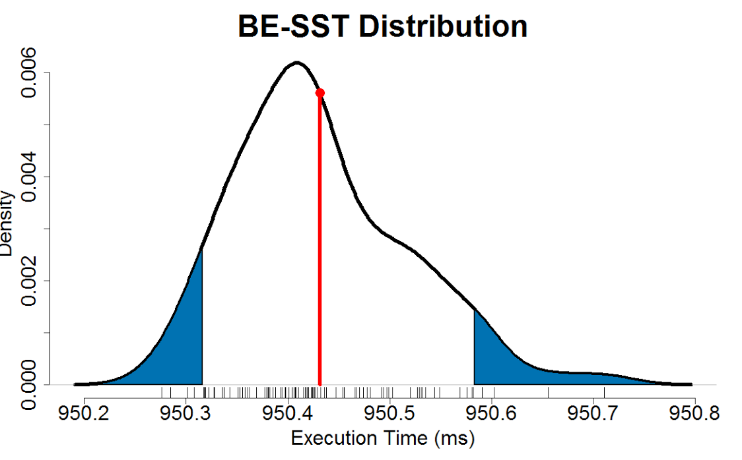
Validation: BE Simulations vs CMT-bone-BE
Measured
CMT-bone-BE (Skeleton app) Execution
100 runs & 100 simulations
BE Simulation
element size
Simulating a bigger system than Vulcan (512k cores)
Average % error between CMT-bone-BE simulation and execution time is 4%
Maximum error is 9%

Slide 11
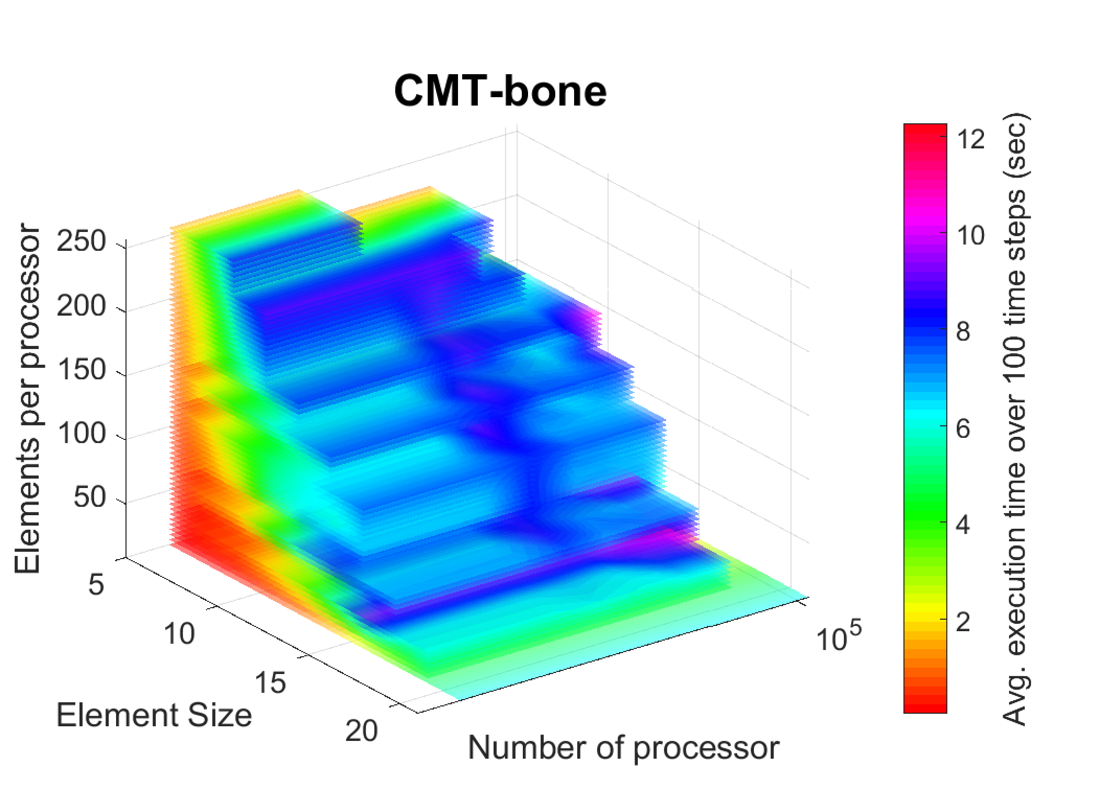
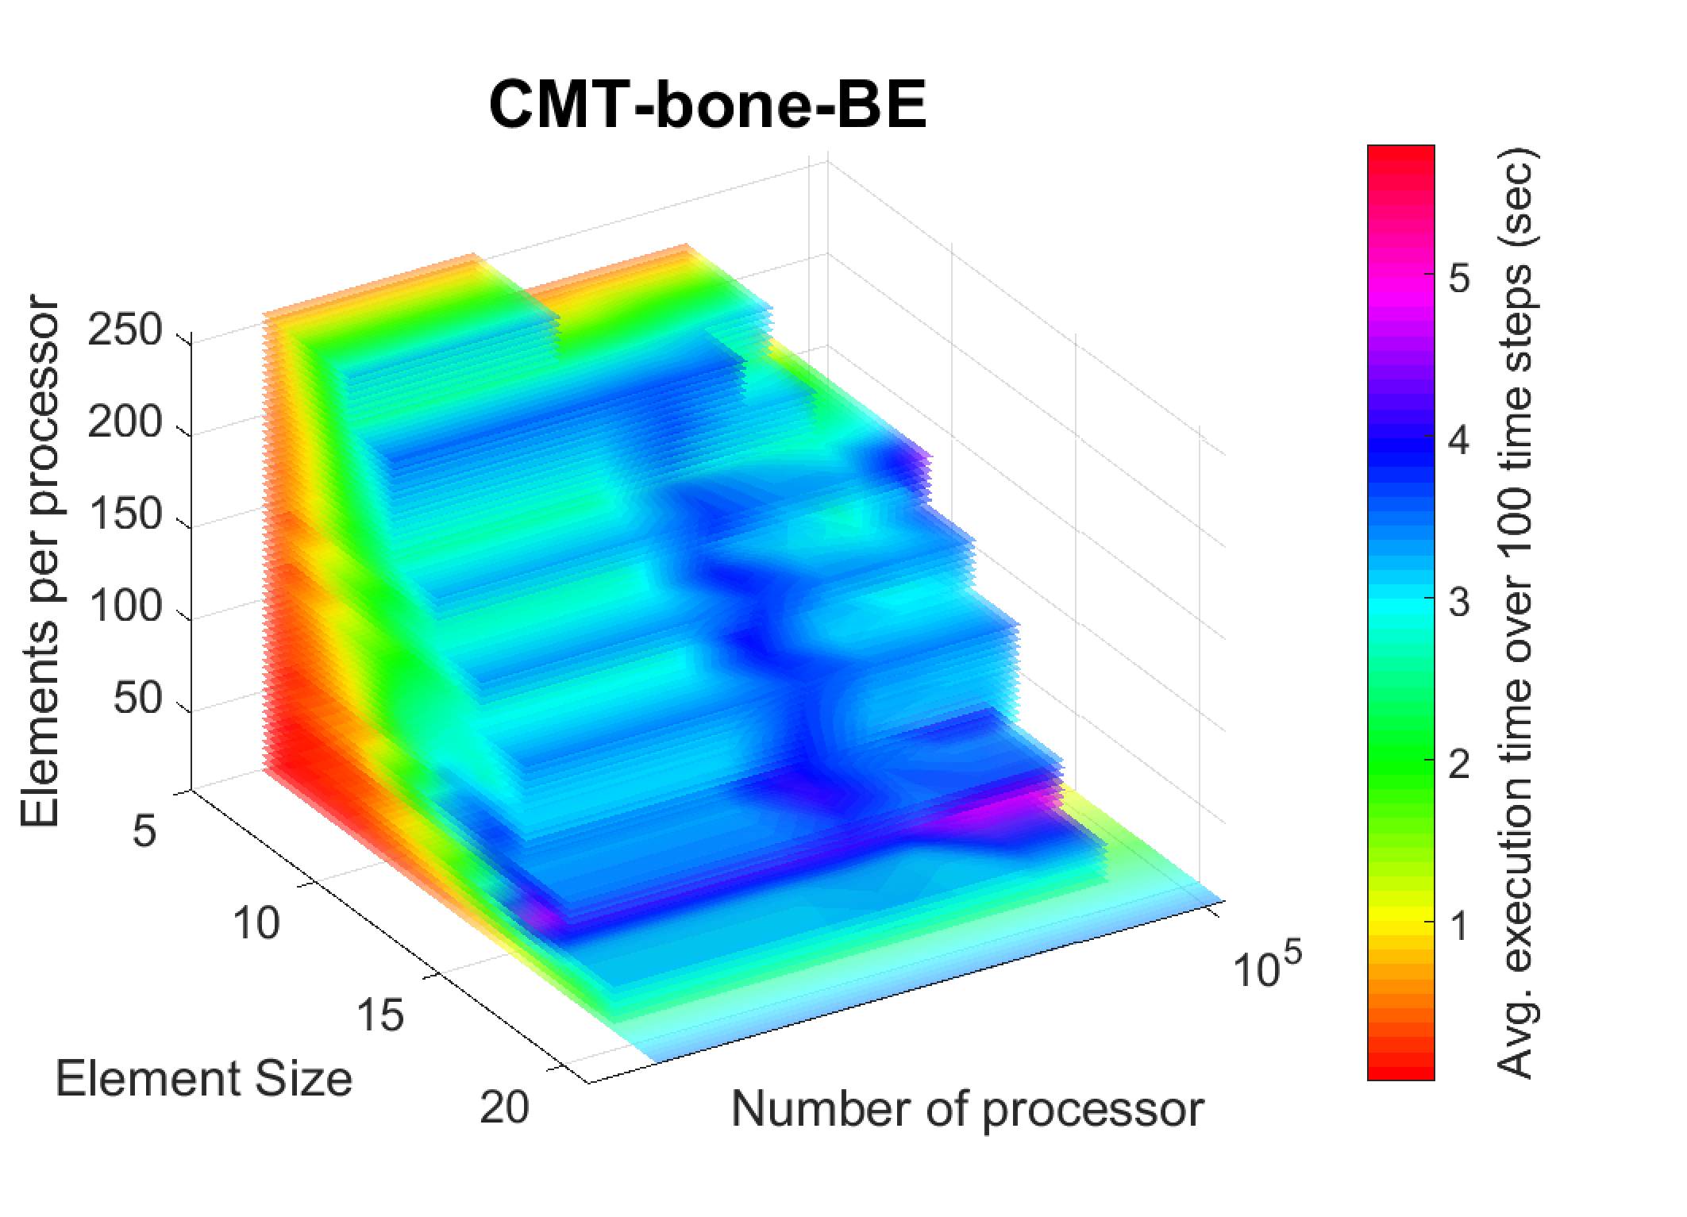
Validation: CMT-bone vs CMT-bone-BE
Comparing the trend under same experimental setup
Observation
Different ranges of execution time
CMT-bone-BE (skeleton app) is computational cheaper than CMT-bone
Similar trends between CMT-bone-BE and CMT-bone
Execution time monotonically increases for both with change in ES and EPP
Color scales on both graph verify the similarity on trend

Slide 12
Evaluating MFS Predictions
3 case studies
Multi-fidelity model based mostly on BE simulation (LF) and few CMT-nek (HF parent app) data points to predict the performance of CMT-nek (HF)
Multi-fidelity model based mostly on BE simulation (LF) and few CMT-bone (relatively HF mini-app) data points to predict performance of CMT-bone (HF)
Multi-fidelity model based mostly on CMT-bone (relatively LF mini-app) and few CMT-nek (HF) data points to predict performance of CMT-nek (HF)

Slide 13
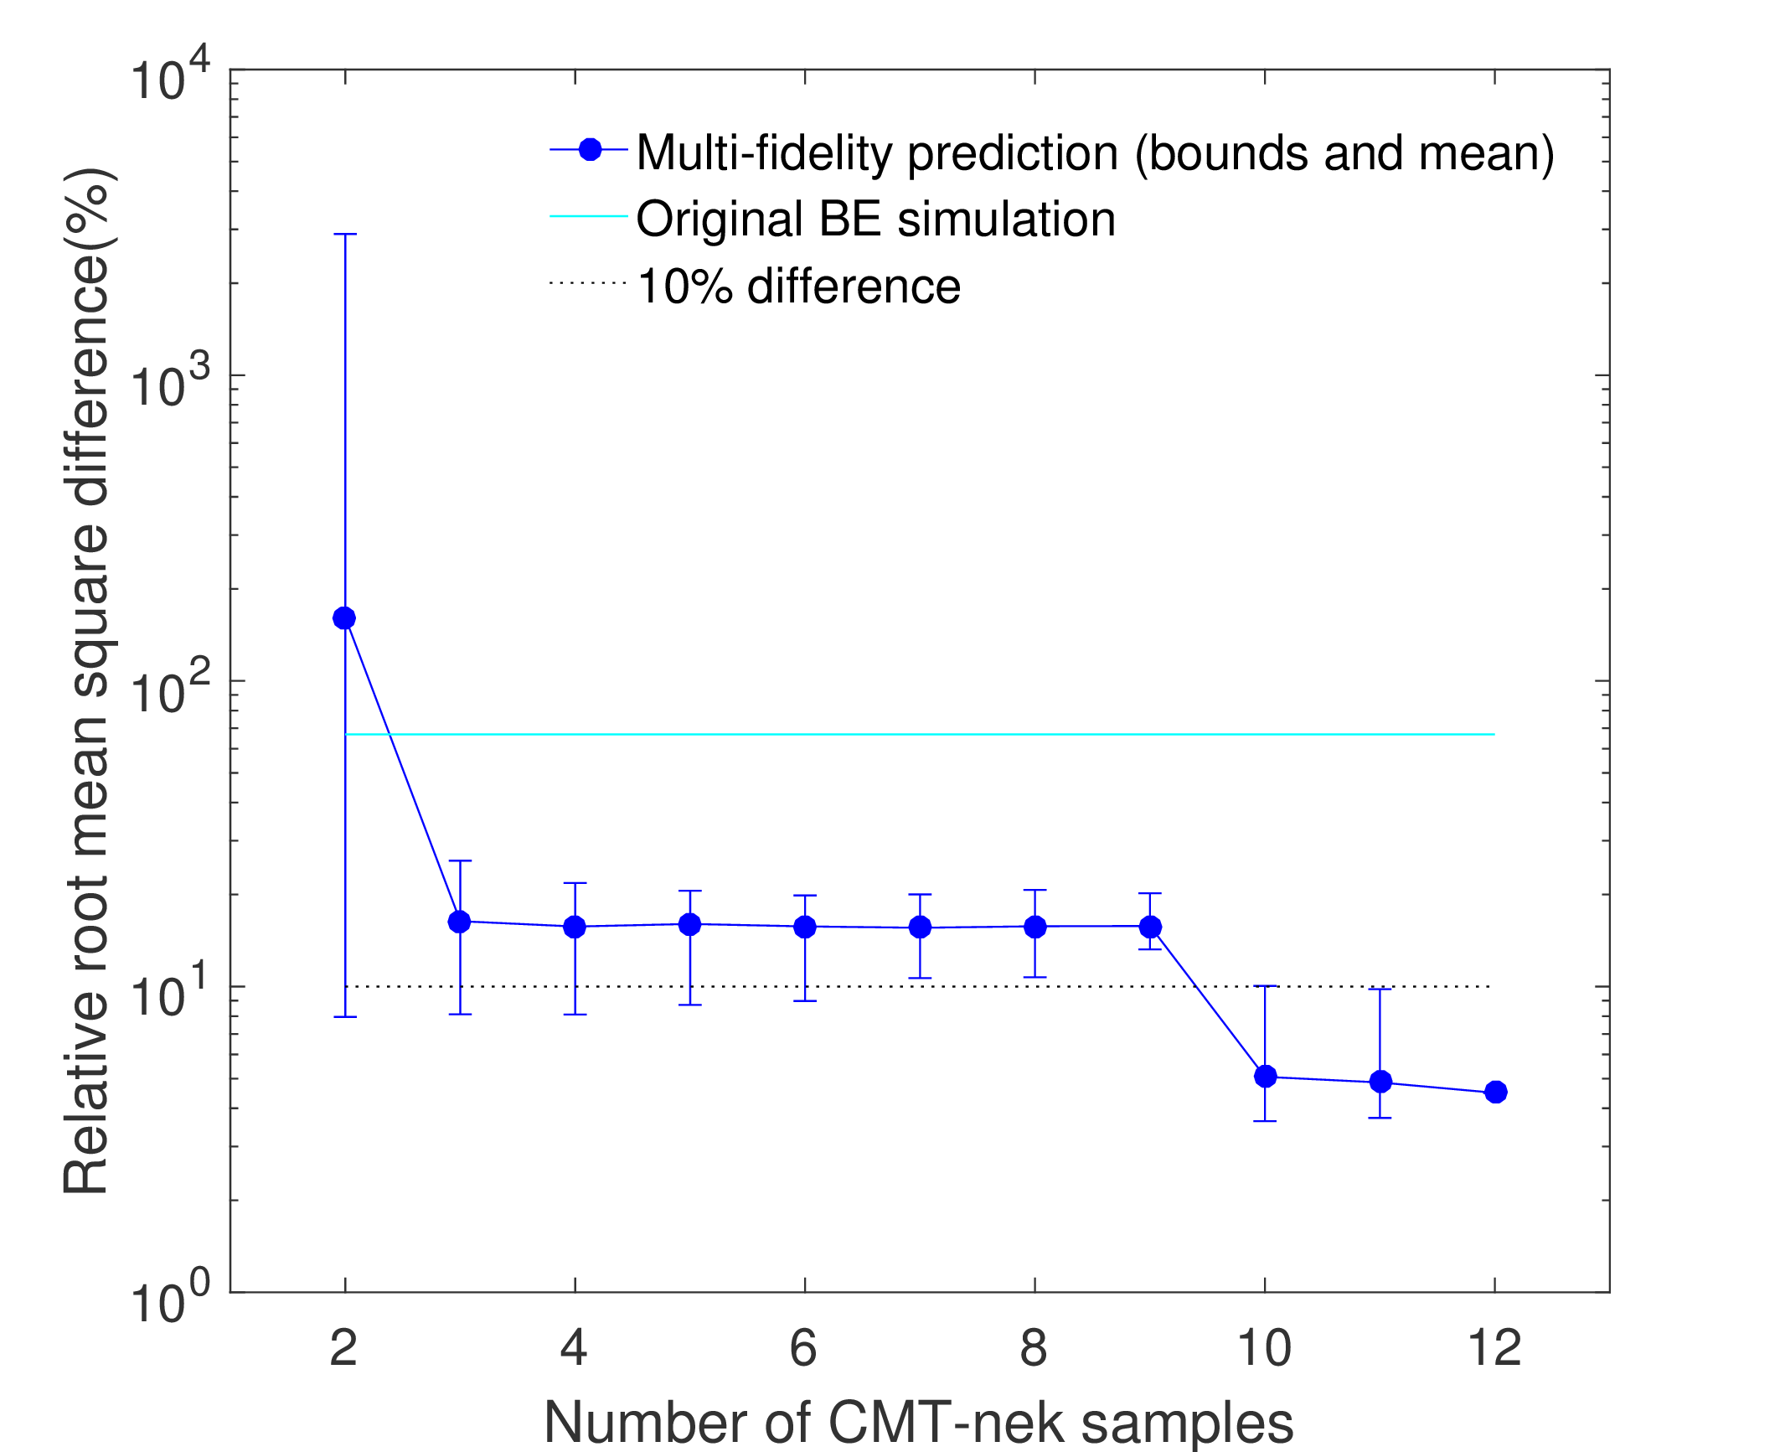
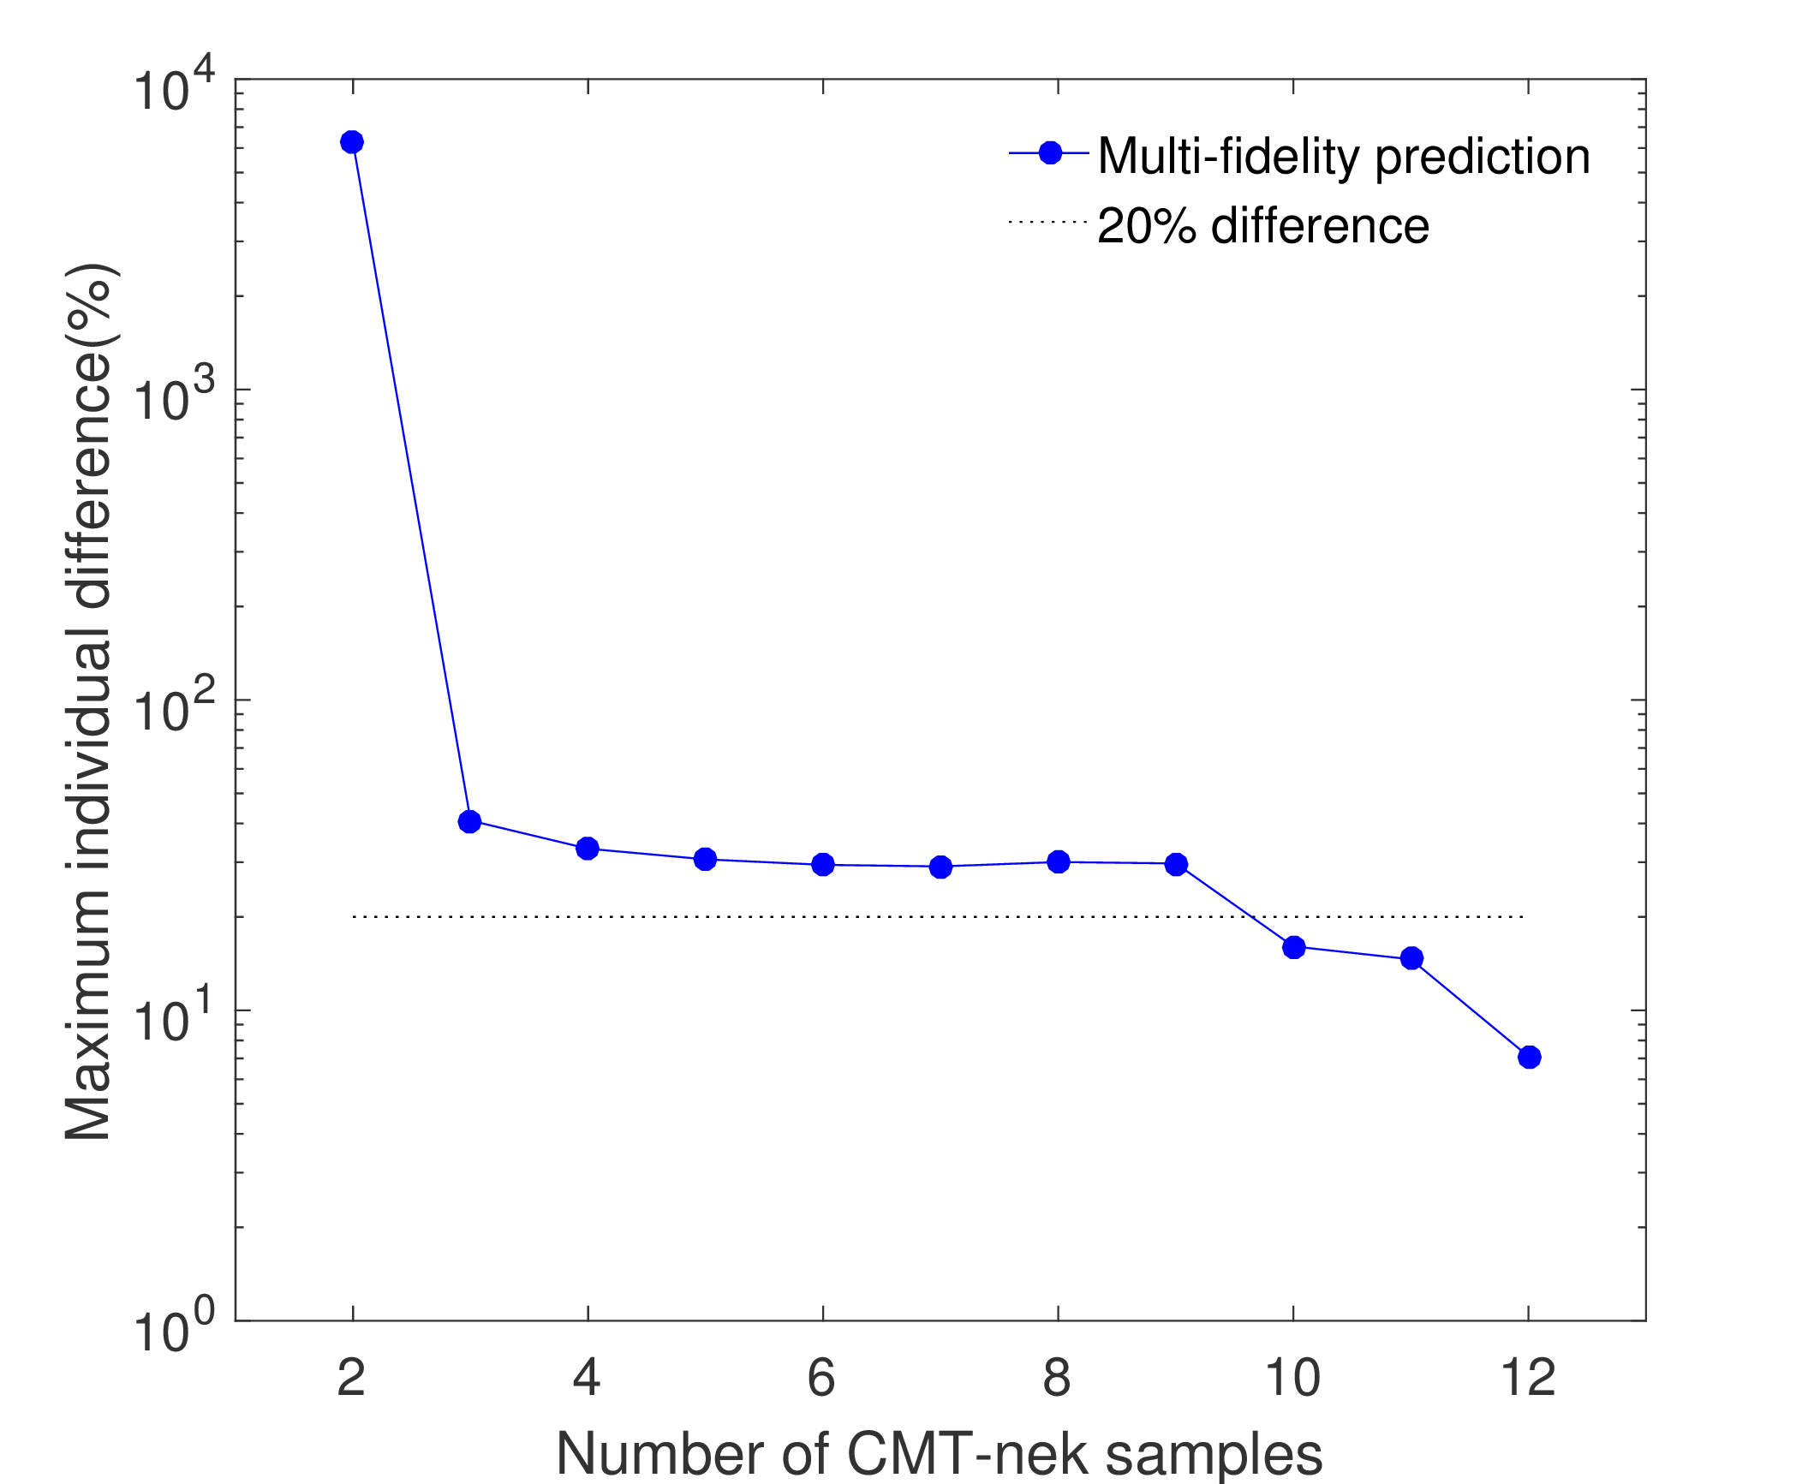
Case 1: CMT-nek (HF) vs BE simulation (LF)
Accuracy of corrected BE simulation at 10 left-out CMT-nek test points
Overall error (RMSE) is less than 8% with 10 or more nek data (left figure)
Max error is less than 15% with 10 or more CMT-nek data (right figure)

Slide 14
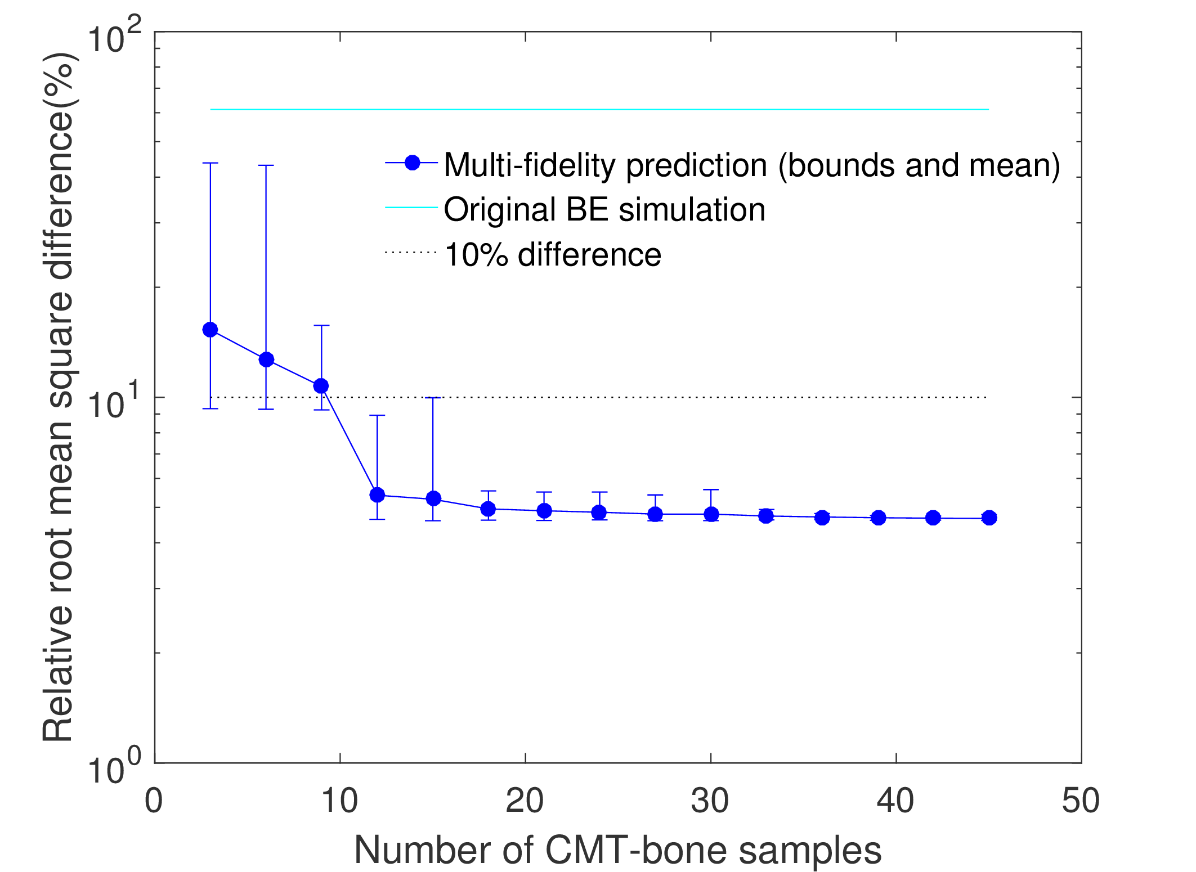
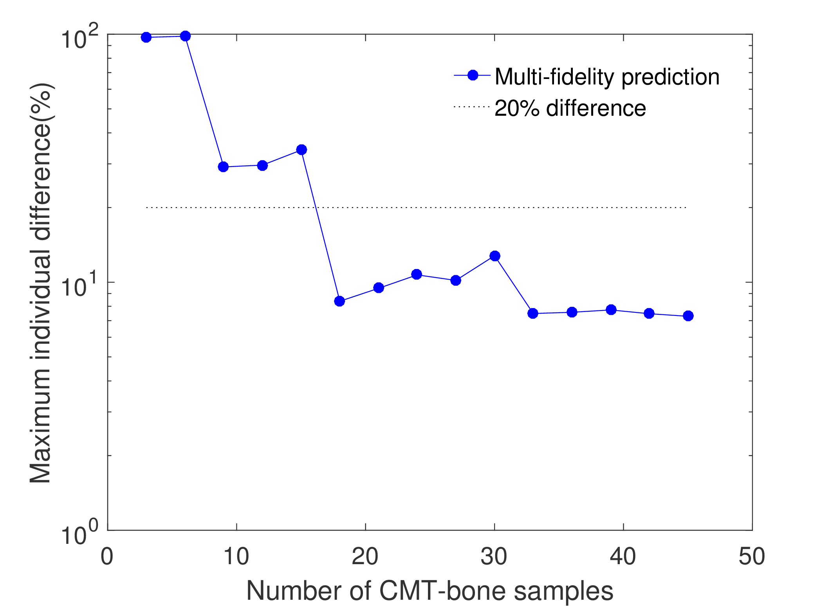
Case 2: CMT-bone (HF) vs BE simulation (LF)
Accuracy of corrected BE simulation at 20 left-out CMT-bone test points
Overall error (RMSE) is less than 10% with 10 or more CMT-bone data (left figure)
Max error is less than 20% with 9 or more CMT-bone data (right figure)

Slide 15
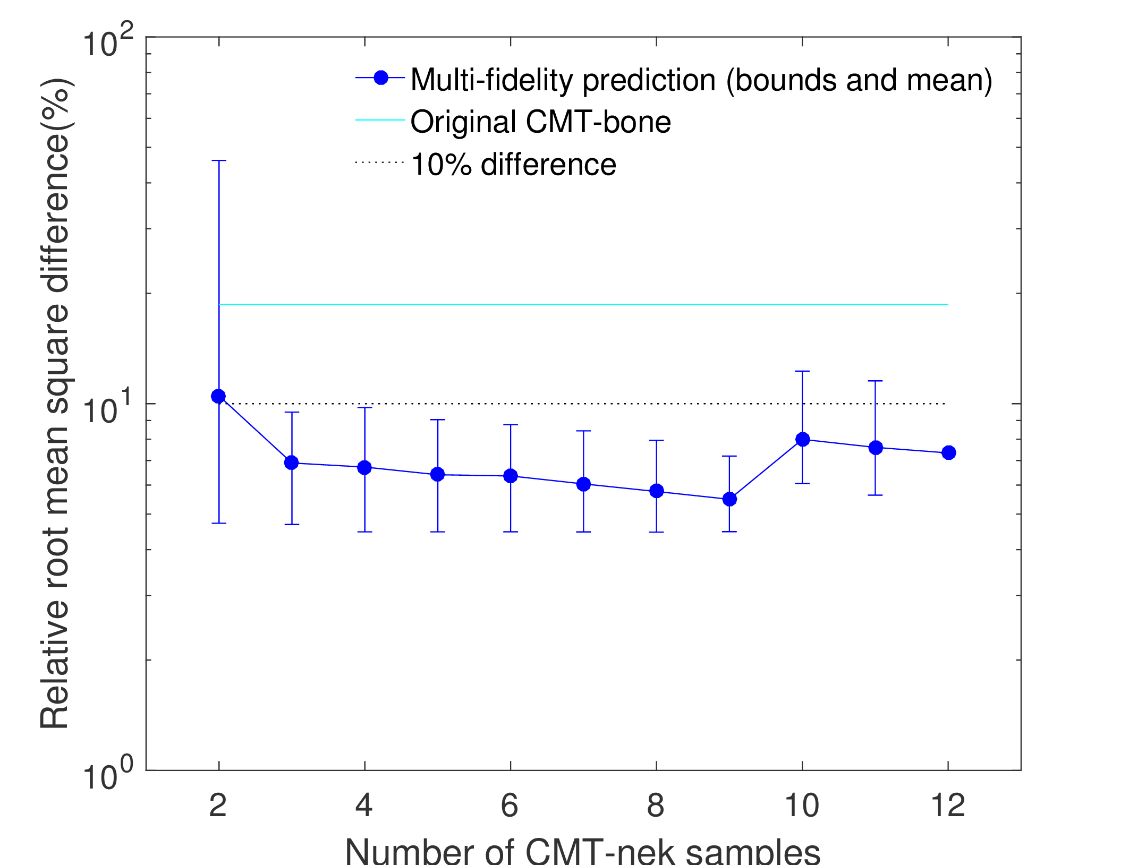
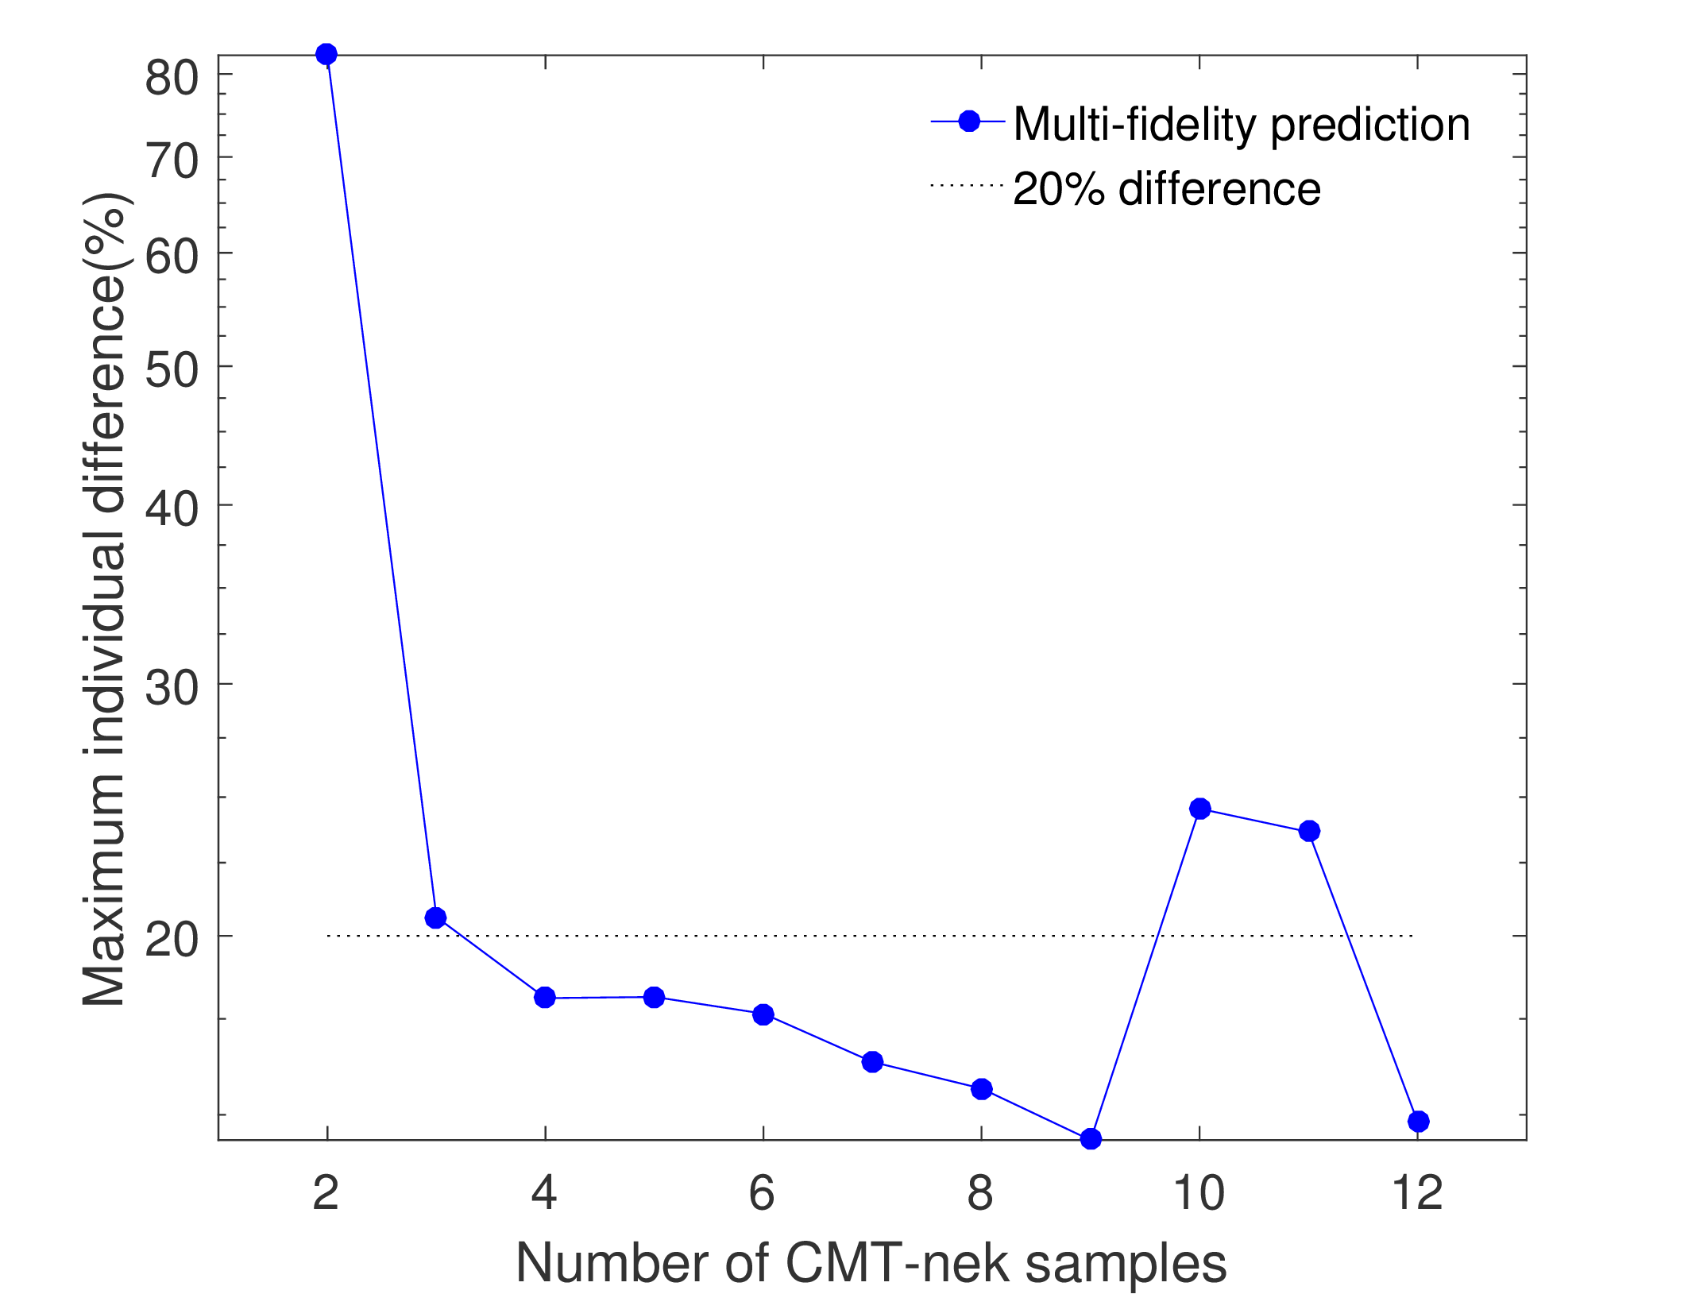
Case 3: CMT-nek (HF) vs CMT-bone (LF)
Accuracy of corrected BE simulation at 10 left-out CMT-nek test points
Overall error (RMSE) is less than 10% with 3 or more nek data (left figure)
Max error is less than 25% (at the 10 test points) with 9 or more nek data (right figure)
The jump after 9 points is due to over-fitting

Slide 16
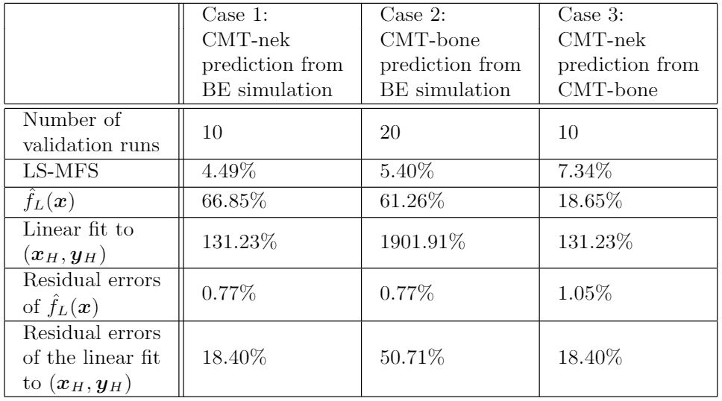
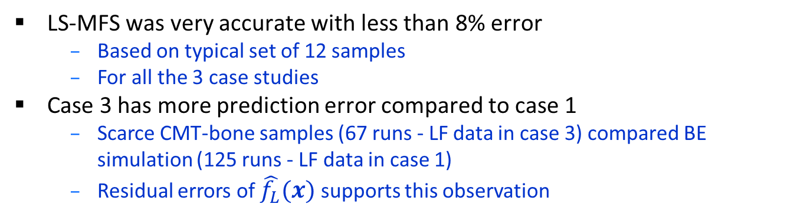
Evaluating MFS Predictions – Summary
LS-MFS was very accurate with less than 8% error
Based on typical set of 12 samples
For all the 3 case studies
Case 3 has more prediction error compared to case 1
Scarce CMT-bone samples (67 runs - LF data in case 3) compared BE simulation (125 runs - LF data in case 1)
Residual errors of $\hat{f_{L}}(x)$ supports this observation

Slide 17
Conclusion and Future Work
Performed quantitative validation at reduced computational budget using least square MFS
Less than 8% error (RMSE) in all three case studies
Demonstrated extrapolation
Email me for more details
Future work
Comparing different MFS framework – LS-MFS, co-Kriging, etc.
Extrapolation with more data points
Explore other effective design of experiments

Slide 18
Do you have any questions?
aravindneela@ufl.edu

