Slide 1
Testing the Limit of Tapered Fat Tree Networks
Sanil Rao, Philip Taffet, Edgar A. Leon, Ian Karlin
Carnegie Mellon University, Rice University, Lawrence Livermore National Laboratory
November 18, 2019

Slide 2
Background and Motivation
New system procurement is an optimization problem based on:
Target applications
Number of nodes a program executes on/Scale
Performance relative to cost tradeoffs
Dominant network topologies for modern supercomputers are Fat Tree Networks
Previous analysis highlighted benefits of a 2:1 tapered Fat tree¹
¹E. A. Leon, I. Karlin, A. Bhatele, S. H. Langer, C. Chambreau, L. H. Howell, T. D’Hooge, and M. L. Leininger, “Characterizing parallel scientific applications on commodity clusters: An empirical study of a tapered fat-tree,” in Proceedings of the International Conference for High Performance Computing, Networking, Storage and Analysis, ser. SC ’16.

Slide 3
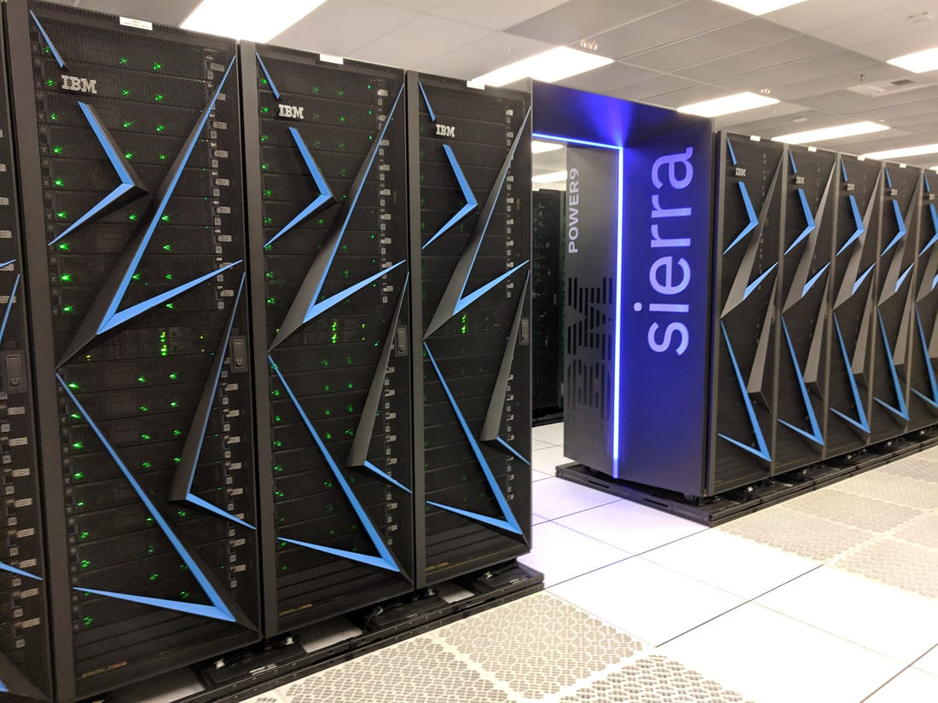

Contributions
Demonstrate the efficacy of 2:1 tapered Fat Tree networks
Cost savings of 6-8% was worth the slight performance hit
Provide real system evaluation of a variety of typical applications in the presence of severe congestion.
Provide input on future system procurement
Fat Tree
Tapered Fat Tree

Slide 4
Application Overview
Selected a variety of applications with different message sizes and communication patterns
AMG
Multigrid solver for linear systems
27-point nearest neighbor stencil
UMT
Deterministic (Sn) radiation transport miniapp
7-point stencil
pF3D
Multi-physics code for laser-plasma interactions
2D FFTs computed on 2D slabs in a 3D space
Application | % Time Spent in MPI | Average Message Size | Message Count
AMG | 26% | 4.8kB | 404M
UMT | 45% | 1.6MB | 1.2M
pF3D | 25% | 16kB | 160M

Slide 5
System Overview and Experimental Setup
Quartz, Petascale system at LLNL
2688 node with dual 18-core Broadwell CPUs
3 level 100 Gbps Omni-path 2:1 tapered fat tree network
Eight leaf switches together form a pod of 256 nodes
31 user-accessible nodes per leaf switch, 248 per pod
Small and large problem sizes
Small- 30 nodes (28 for pF3D has to be a multiple of 4)
Large – 224 nodes ~1 pod worth
1 MPI rank per core, 1000 for small problems, 8000 for large problems
Core Switch
Core Switch
2nd Level Switch
2nd Level Switch
…
2nd Level Switch
Leaf Switch
Leaf Switch
…
Leaf Switch
Tapered between switches
Compute Node
Compute Node
Compute Node
Compute Node
Compute Node
pod

Slide 6
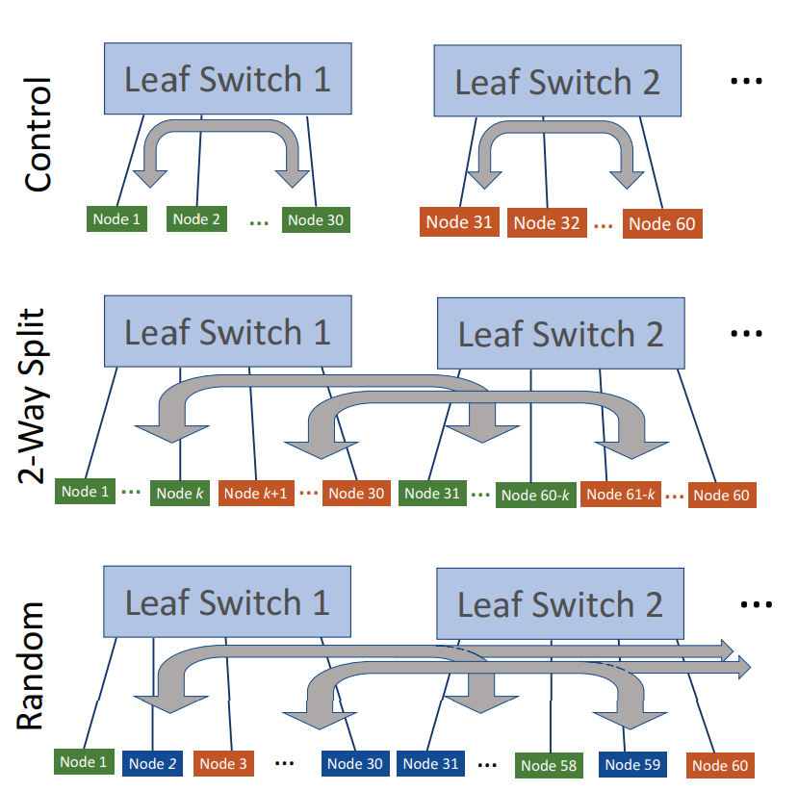
Locality Experiments
Tested small problems of applications mixed together in a single pod
Split across 2, 3, and 6 leaf switches within one pod
Compared against a control where all nodes for each application were on one leaf switch
Experiment | AMG | UMT | pF3D
S2 Small | -0.11% | 0.10% | 0.47%
S3 Small | -2.14% | -0.04% | 0.01%
S6 Small | -2.79% | -0.37% | 0.39%
Random Small | -1.48% | -0.09% | 0.18%
Random Large | -3.17% | -0.47% | -0.45%
Limited performance degradation overall with only colored values being statistically significant
Blue – p = 0.05 Red – p = 0.01

Slide 7
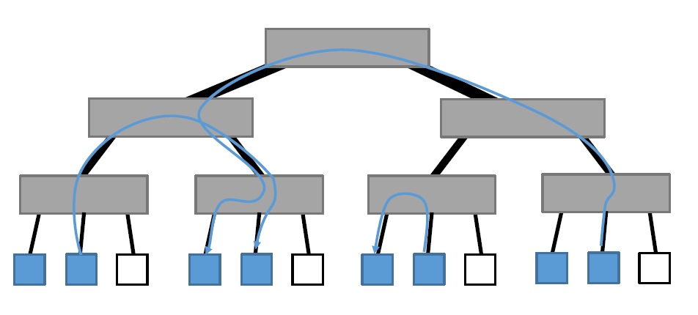
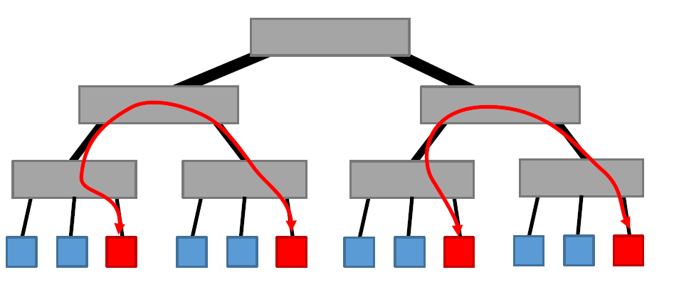
Congestion Experiments
Bully applications- applications designed to cause congestion during application execution
Variety of bully applications tested:
Light leaf bully- Large messages to adjacent leaf switch that cannot consume all bandwidth
Adjacent leaf bully- Large messages to adjacent leaf switch that can consume all bandwidth
Light/Adjacent
Control

Slide 8
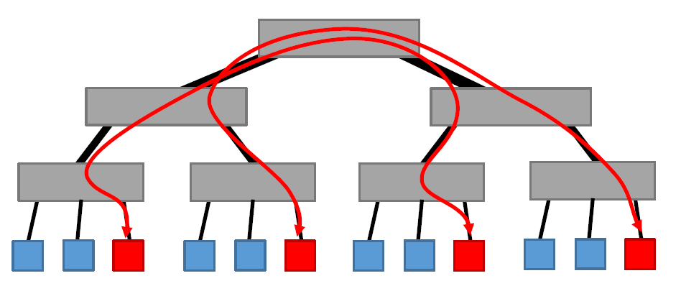
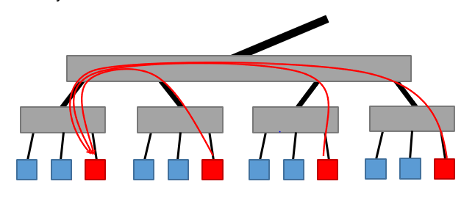
Congestion Experiments
Bisection Bully- Large messages that cross network bisection, travel between pods
Incast Bully- 7 to 1 pattern to a single leaf switch mimicking I/O traffic
Bisection
Incast

Slide 9
Results: 2:1 Tapered Fat Tree
Experiment | AMG | UMT | pF3D
Light Bully Large | -0.70% | -0.68% | 0.22%
Adjacent Bully Large | -1.74% | -0.52% | 0.19%
Adjacent Bully Small | 0.15% | -0.20% | 0.40%
Bisection Bully Large | -6.47% | -1.94% | 0.22%
Incast Bully Large | -0.74% | 0.01% | 0.08%
Limited performance degradation overall with only colored values being statistically significant
Blue – p = 0.05
Red – p = 0.01
In the worst case we saw ~6.5% degradation
An average degradation of ~1% across all experiments

Slide 10
Findings: 2:1 Tapered Fat Tree
Most experiments did not have statistically significant performance degradation matching previous studies
The performance impact of adversarial traffic was less than the cost savings of a tapered network
This validates the conclusions from the SC ’16 paper. What are the effects of more aggressive tapering?

Slide 11
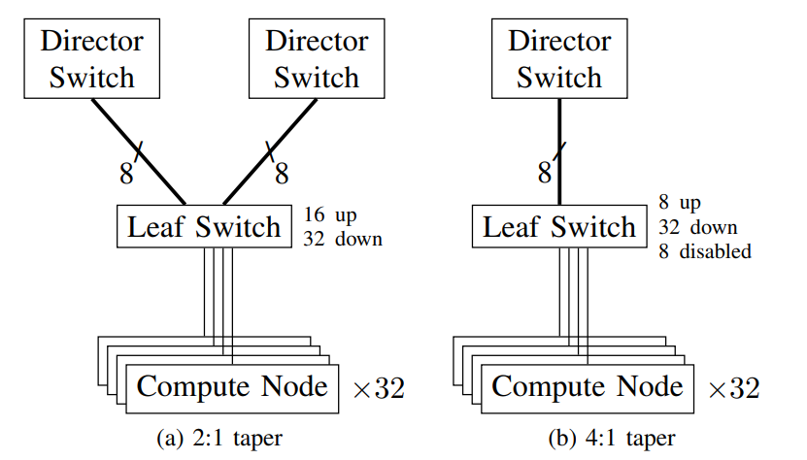
Network Illustration – moving to 4:1 Taper

Slide 12
Results: 4:1 Tapered Fat Tree versus Control
Experiment | AMG vs 4:1 Control | UMT vs 4:1 Control
Control | - | -
Random | -7.72% | -1.54%
Light Bully | -3.15% | -0.83%
Adjacent Bully | -7.72% | -1.54%
Bisection Bully | -9.29% | -3.88%
Incast Bully | -0.62% | 0.00%
Noticeable performance degradation with colored values being statistically significant
Blue – p = 0.05
Red – p = 0.01
In the worst case we saw ~9.3% degradation
Average performance degradation of ~3.5%

Slide 13
Results: 2:1 Experiments on 4:1 Taper
Experiment | AMG vs 2:1 Control | UMT vs 2:1 Control
Control | -1.41% | -0.65%
Random | -0.19% | -0.44%
Light Bully | -3.84% | -0.81%
Adjacent Bully | -7.42% | -1.67%
Bisection Bully | -4.37% | -2.61%
Incast Bully | -1.29% | -0.66%
Noticeable performance degradation comparatively with colored values being statistically significant
Blue – p = 0.05
Red – p = 0.01
In the worst case we saw ~7.4% degradation
Average performance degradation of ~2.5%

Slide 14
Findings: 4:1 Tapered Fat Tree
Performance degradation much higher in this scheme
Each bullies impact on congestion grew substantially when network bandwidth was reduced
Cost savings of reducing to 4:1 is around 3% but performance degradation increased across the board by 2.5% vs the 2:1 taper
Initial 4:1 tapering shows promise but more needs to be done to justify its implementation

Slide 15
Conclusion and Future Work
Showed the performance impact of a tapered Fat Tree network on common workloads
2:1 tapered networks have limited performance impact relative to their cost savings 6-8% cost saving even in the event of adversarial traffic
The cost benefit of further tapering is unclear given our current results
Additional workload analysis studies are needed to generalize findings
Further work needed to understand how to increase tapering without significantly reducing performance this includes application mapping

Slide 16
Disclaimer
This document was prepared as an account of work sponsored by an agency of the United States government. Neither the United States government nor Lawrence Livermore National Security, LLC, nor any of their employees makes any warranty, expressed or implied, or assumes any legal liability or responsibility for the accuracy, completeness, or usefulness of any information, apparatus, product, or process disclosed, or represents that its use would not infringe privately owned rights. Reference herein to any specific commercial product, process, or service by trade name, trademark, manufacturer, or otherwise does not necessarily constitute or imply its endorsement, recommendation, or favoring by the United States government or Lawrence Livermore National Security, LLC. The views and opinions of authors expressed herein do not necessarily state or reflect those of the United States government or Lawrence Livermore National Security, LLC, and shall not be used for advertising or product endorsement purposes.

Slide 17
Blocked vs Cyclic Mapping
Experiment | AMG | UMT | pF3D
Control Small | 3.61% | 1.64% | 10.29%
S2 Small | 3.58% | 1.53% | 9.67%
S3 Small | 5.65% | 1.44% | 8.61%
S6 Small | 6.24% | 1.59% | 8.61%
Random Small | 4.98% | 1.23% | 8.18%
Adjacent Bully Small | 3.16% | 1.79% | 10.05%
Significant performance improvement, positive values indicate cyclic performed faster than block with bolded values being statistically significant
p = 0.05

Slide 18
Shared Memory MPI Transport
Blocked vs cyclic task mapping means that some messages could be transported via shared memory
Cyclic mapping outperformed block mapping in all instances
Omni-path network faster at transferring data unless under extreme load
Cyclic not ideal- bandwidth per rank decreases, applications more sensitive to network congestion and locality
Developer dependent for best mapping, blocking results most relevant for procurements

Slide 19
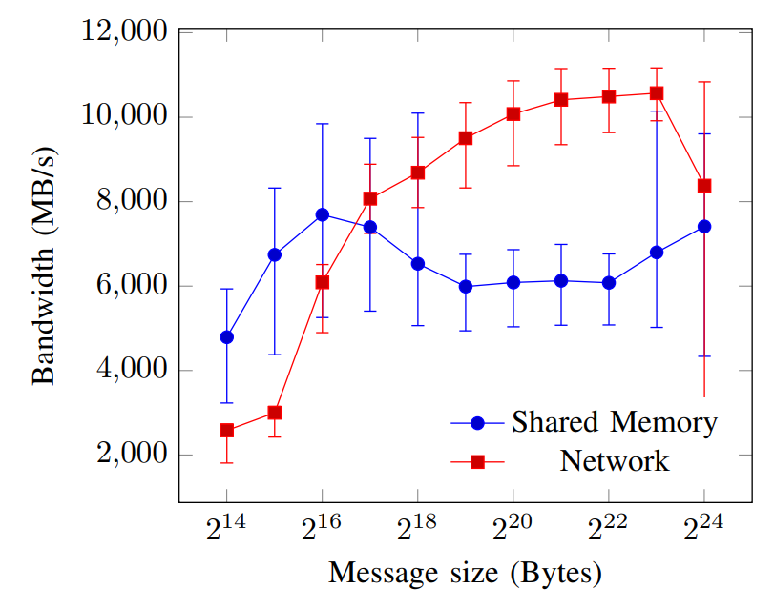
Shared Memory vs Omni-Path throughput

Slide 20
Title for Text and Tables
Select table and then click on Design tab to change table colors and attributes.
All table fonts are Arial.
Heading 1 | Heading 2 | Heading 3 | Heading 4
Body text item 1 | 100 | 200 | 300
Body text item 2 | 100 | 200 | 300
Body text item 3 | 100 | 200 | 300
Body text item 4 | 100 | 200 | 300
Body text item 5 | 100 | 200 | 300
Summary box has a full-width bleed. Delete if not needed.

Slide 21
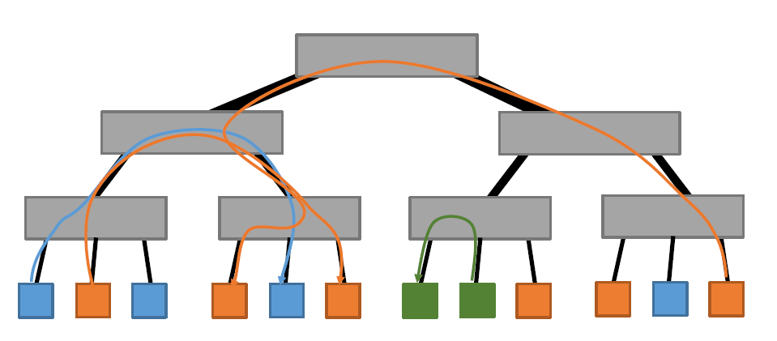
Title for bulleted text with two text boxes
Begin list of bullets here
Sub bullet
Sub bullet
Begin list of bullets here
Sub bullet
Sub bullet
Interleaved

Slide 22
Title for bulleted text with right column
Begin list of bullets here
Sub bullet
Sub bullet

Slide 23

Title for full-frame image Subtitles can be used on longer titles, 24pt “Regular” (no bold)

