Slide 1

Command and Control Subsystem for Regolith Mining Robot
Milestone 1
Pablo Canseco
Domenick Albanese
Ronald­-Dean Allado

Slide 2
Software / Comms
Process Matrix
Task | Requirements Document | Design Document | Test Plan | Research | Demo
Completion % | 100% | 100% | 100% | 60% | 100%
Pablo | 100% | 100% | 100% | 90%* | 100%
To do | Update as challenges come up | Update as software is being developed | Update with new possible test cases | Incorporation of RasPi, TCP socket, keyboard input

Slide 3
Software / Comms
Milestone 2 Planned Tasks
Develop Control Station GUI - Development has started on it with Windows Forms and C#. The plan is to continue it and get the layout finalized along with populate fields and begin working on keyboard input.
Incorporate Network Sockets- TCP communication between the control station and the raspberry pi still needs to be implemented with Python’s SocketServer module. The plan is to have either completed or made significant progress on network communications for the robot by the next milestone.
Integrate Raspberry Pi and Arduino - The two boards need to talk to each other since one is handling communications and the other sensor and motor control. They’ll be communicating over a direct serial connection and work has already started for this. The library being used is Python-Serial. The plan is to finish it by the next milestone and have bidirectional communication ready.

Slide 4
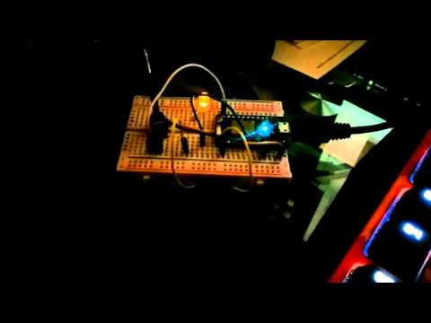
Software / Comms
Demo

Slide 5
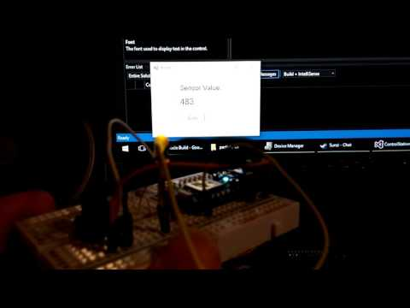
Software / Comms
Demo

Slide 6
Questions?

