Slide 1
Kouper Health ML Challenge
Mini Care Coordinator Assistant

Slide 2
The Task
Your task is to design and implement a Care Coordinator Assistant that will help a nurse take
the correct next steps when helping a patient. The assistant guides the nurse based on a
defined engagement process and context about the specific case. As an intelligent agent, it
should also be able to account for any exceptions and edge cases that may come up in real
world use cases.
Scenario
A nurse is booking appointments for patient John Doe for some referrals following a hospital
visit. The assistant should guide the nurse to book the correct appointments and answer any
questions.
In order to book an appointment, the nurse needs to know:
1. first name, last name and dob of the patient
2. the provider/doctor for the appointment
3. the type of appointment
4. the location of the appointment
Some other potential questions the assistant should be able to answer:
● If <provider> is not available at <given time>, what other providers are available?
● Does the hospital accept <insurance provider>? What

Slide 3
My Current Solution
Chatbot Features:
User interface for the Care Coordinator Assistant
A chatbot interface where the nurse can input the patient's first name, last name, and date of birth to look up the patient in the system.
The assistant will then guide the nurse through the process of booking an appointment for the patient based on the patient's referred providers and previous appointments.
The assistant will also be able to answer questions about provider availability, insurance acceptance, and patient history.
The nurse can interact with the assistant by inputting text and selecting options from dropdown lists in order to book appointments.
TODO:
Separate backend REST API for data and chat calls using FastAPI or Flask
Requires separate deployment from frontend Gradio solution or frontend UI integration with Flask
Separate Agents for Triage, Patient Data, Provider Directory, Appointment Booking, Insurance Info
Security layers for backend data calls
Explicit guardrails to protect customer and health data
Have Assistant auto-fill form fields
Data cleaning and more strict schema validation using Pydantic and determining a proper OpenAPI schema for the data

Slide 4
Guided Steps with Function Calling
1. Patient information:
- Need the first name, last name and dob of the patient to look them up in the system.
- Once you have this information, confirm the patient data by calling `get_patient_data` to display the rest of the patient's data like primary care provider, referred providers, and appointments.
- Once the patient is confirmed, remind the nurse to input the patient id (field "id" with integer value in patient data) into the form field to fill out the rest of the patient's information.
2. Determine which appointments to book based on the patient's referred providers:
- Use the patient data or call calling `get_patient_referrals` to determine the latest referrals to book an appointment for.
- Display the referred providers list to the nurse as a numbered list and ask which referral they would like to book an appointment for next.
- Repeat Steps 3 through 6 for each referral.
3. Determine provider for referral:
- Once the nurse selects a referral confirm the provider based on the patient's primary care provider or previous appointments.
- If no provider is specified, call `get_providers_by_specialty` to get a list of providers with the same specialty and ask the nurse to select one.
- If a provider is specified, confirm with the nurse before proceeding.
- Let the nurse know that they can also select the provider from a dropdown list of available providers.
4. Determine the type of appointment: "NEW" or "ESTABLISHED"
- Use the patient data to determine based on the patient's appointments history
- If the patient has had no appointments with the provider, suggest a "NEW" appointment
- If the patient has had appointments with the provider, suggest an "ESTABLISHED" appointment
- Confirm with the nurse before proceeding and let them know they can select the appointment type using the radio button.
5. Determine the time and location of the appointment:
- Start off by suggesting the first available time slot for the provider and call `check_provider_availability` first to make sure the provider is available at that time.
- If the provider is not available at that time, then show their full schedule and suggest another time.
- If the nurse suggests another provider or time then call `check_provider_availability` to confirm the availability.
- Confirm the location of the appointment based on the provider's department and address and let the nurse know they can select the location from a dropdown list of available locations.
6. Book the appointment for referral:
- Confirm the appointment details with the nurse and let them know that the appointment has been successfully booked.
- Call `book_appointment` to book the appointment and provide the nurse with the appointment confirmation details.
7. Remember to repeat Steps 3 through 6 for each referral:
- Display the remaining referrals to the nurse as a numbered list and ask which referral they would like to book an appointment for next.

Slide 5
Third Party Libraries
OpenAI Python Client: https://github.com/openai/openai-python
OpenAI Swarm: https://github.com/openai/swarm
Gradio: https://gradio.app

Slide 6
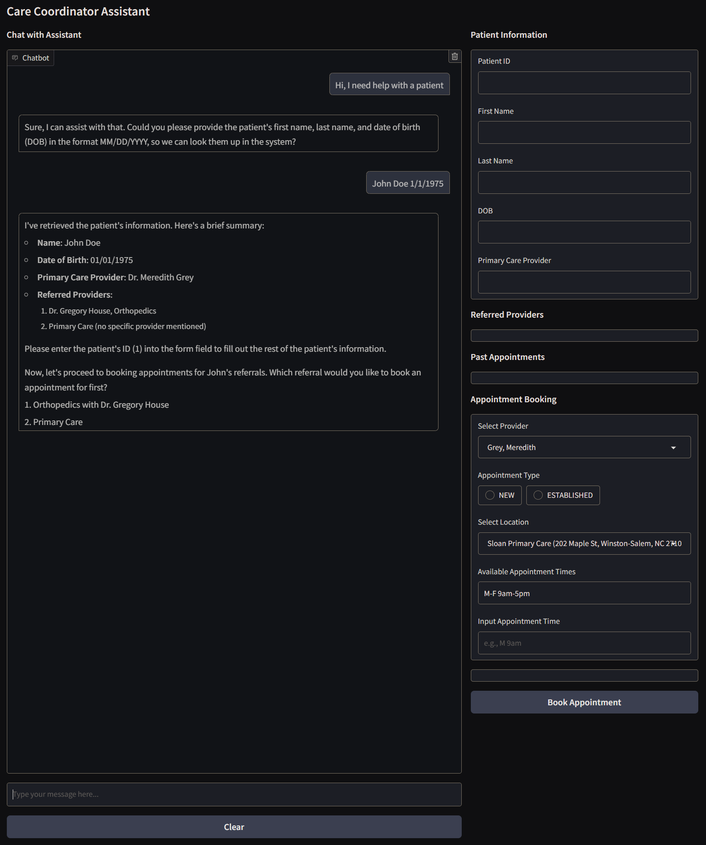
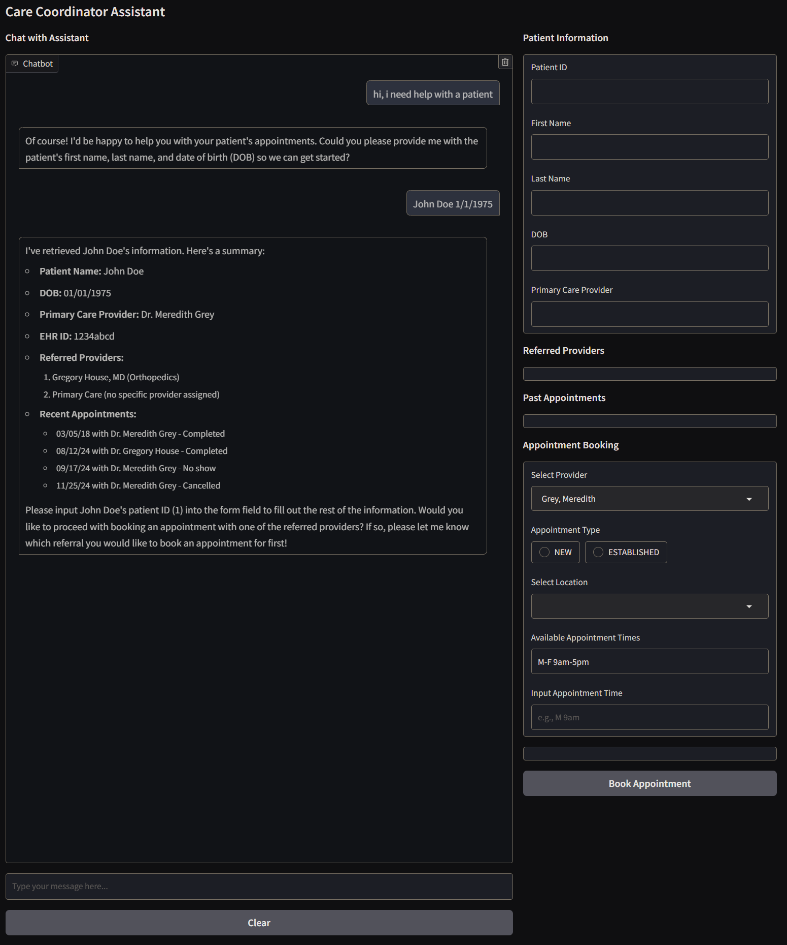
Gradio UI

Slide 7
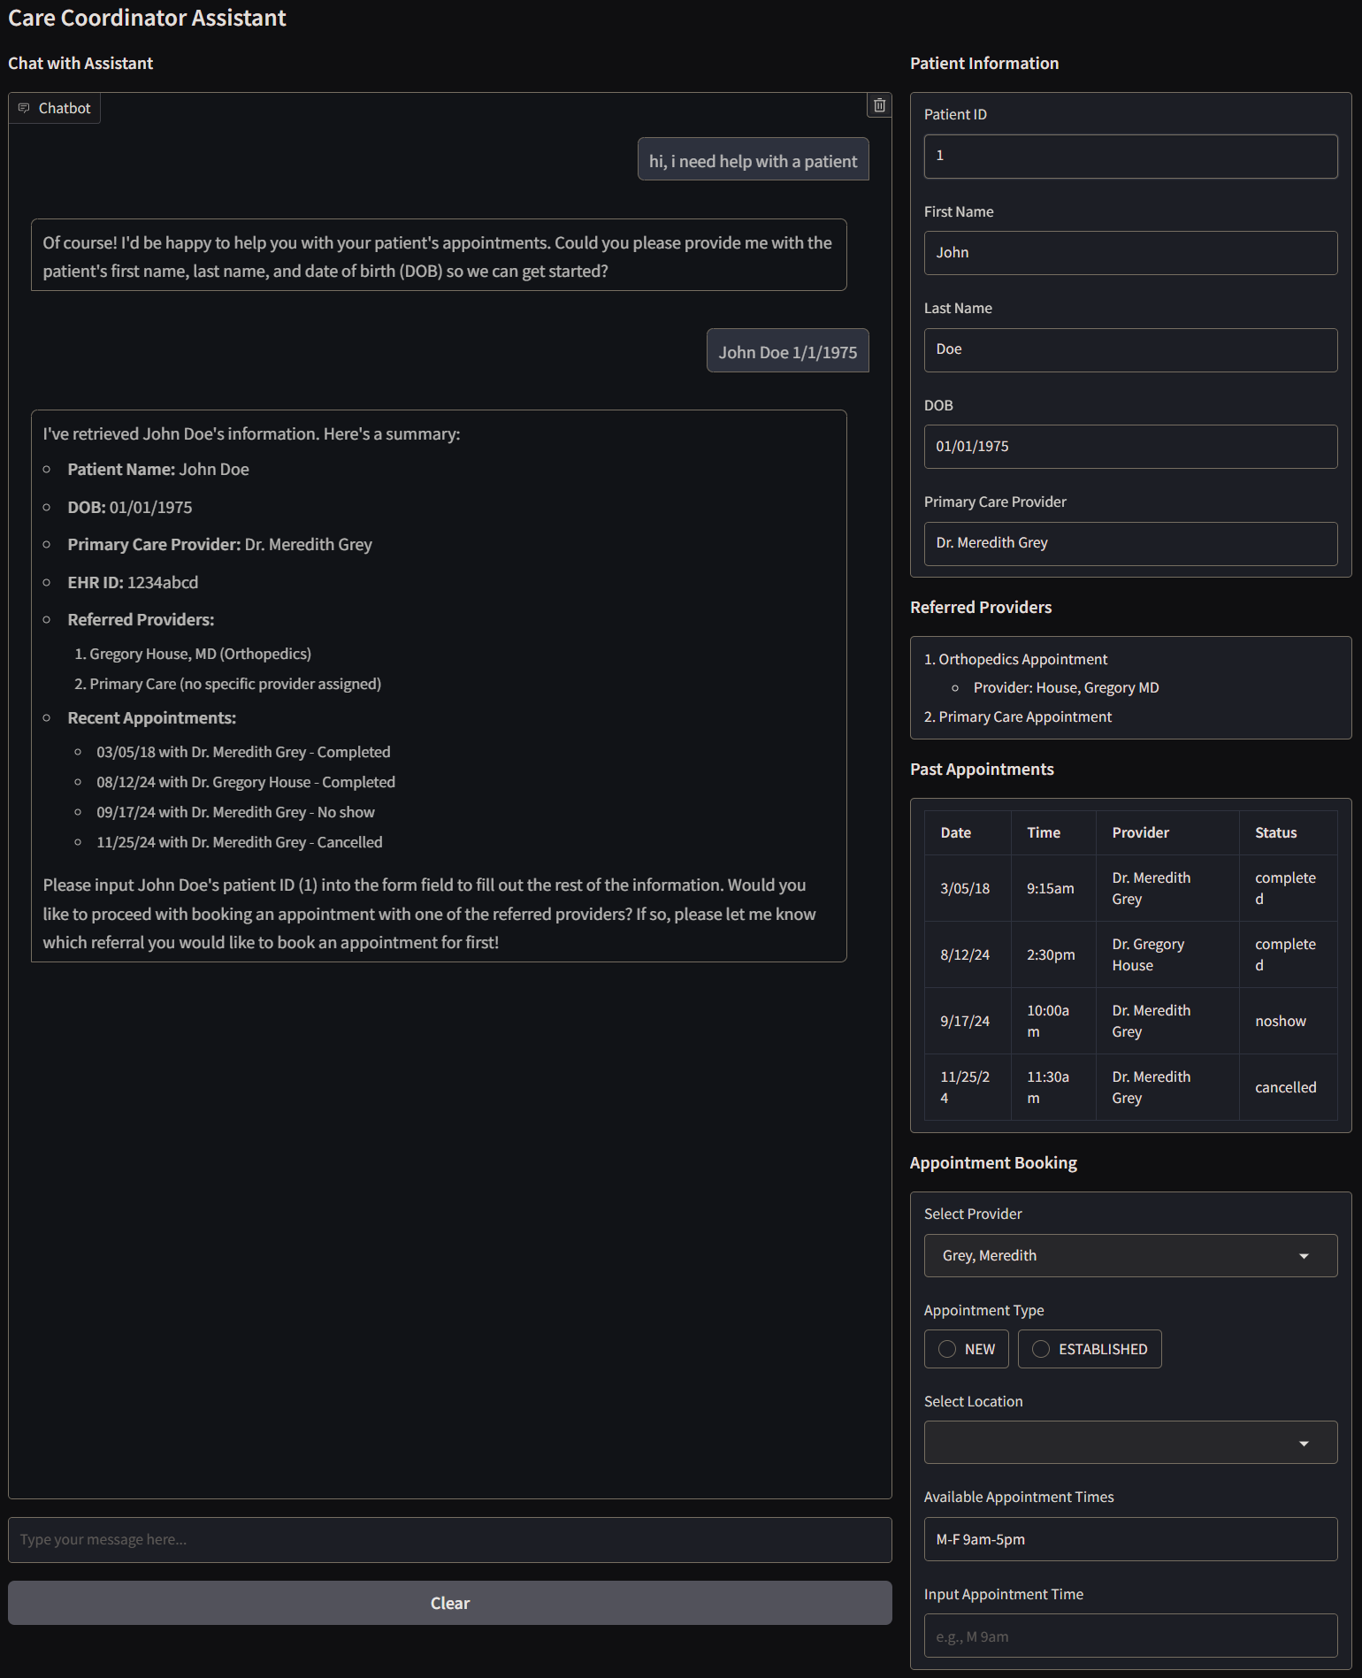
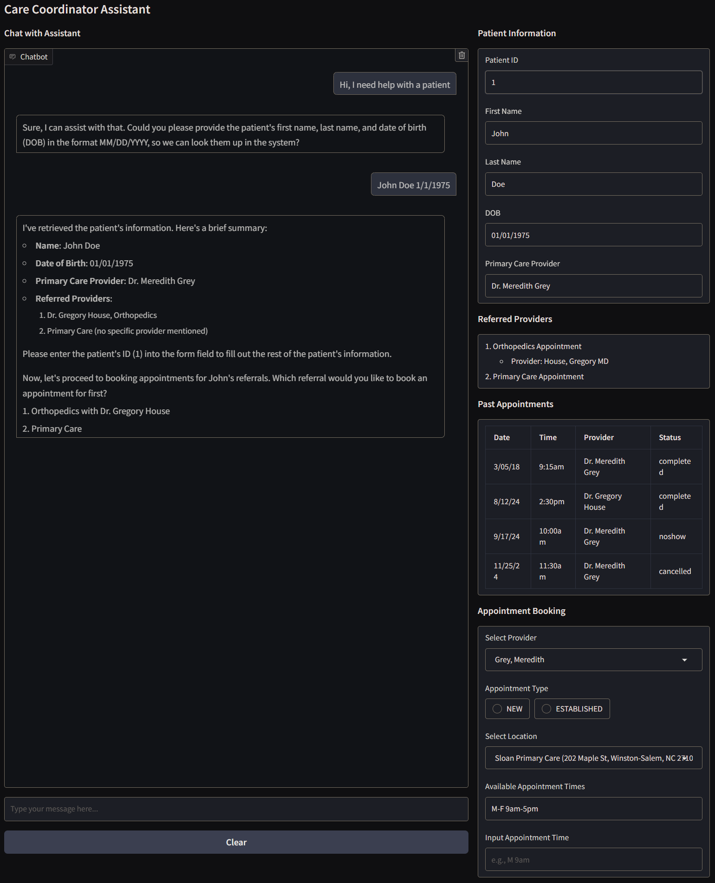
Patient Information

Slide 8
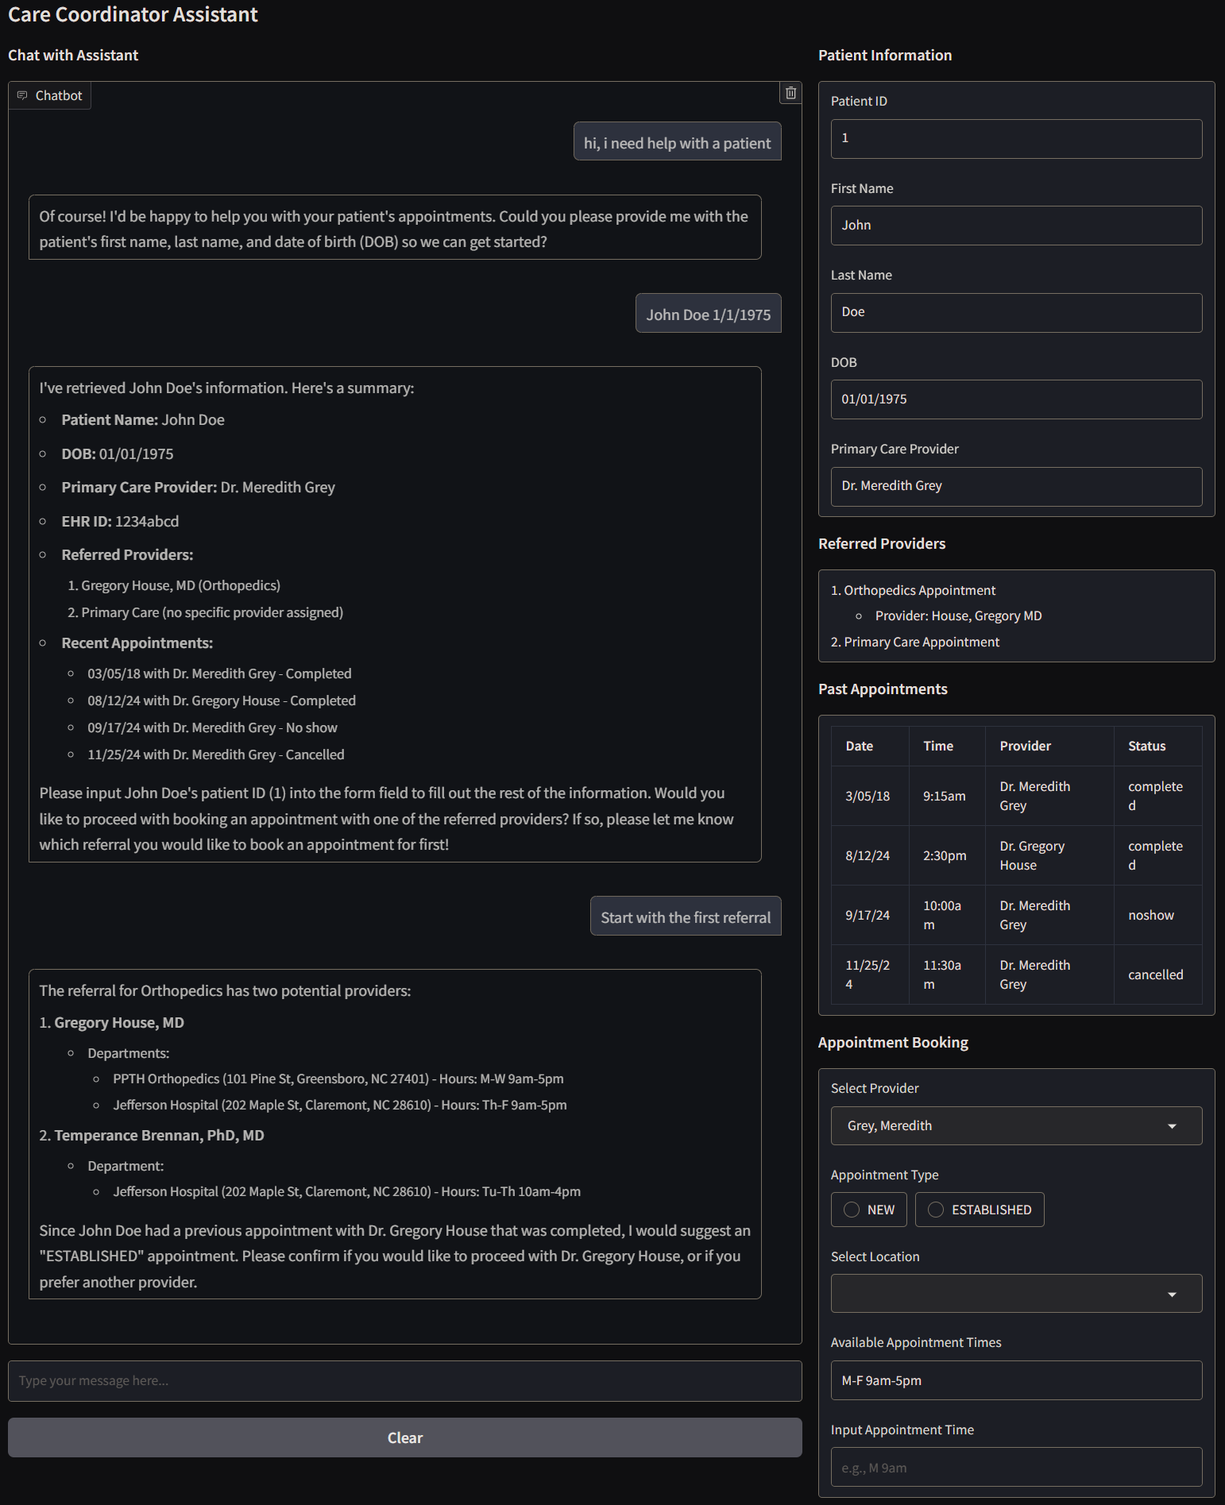
Referrals

Slide 9
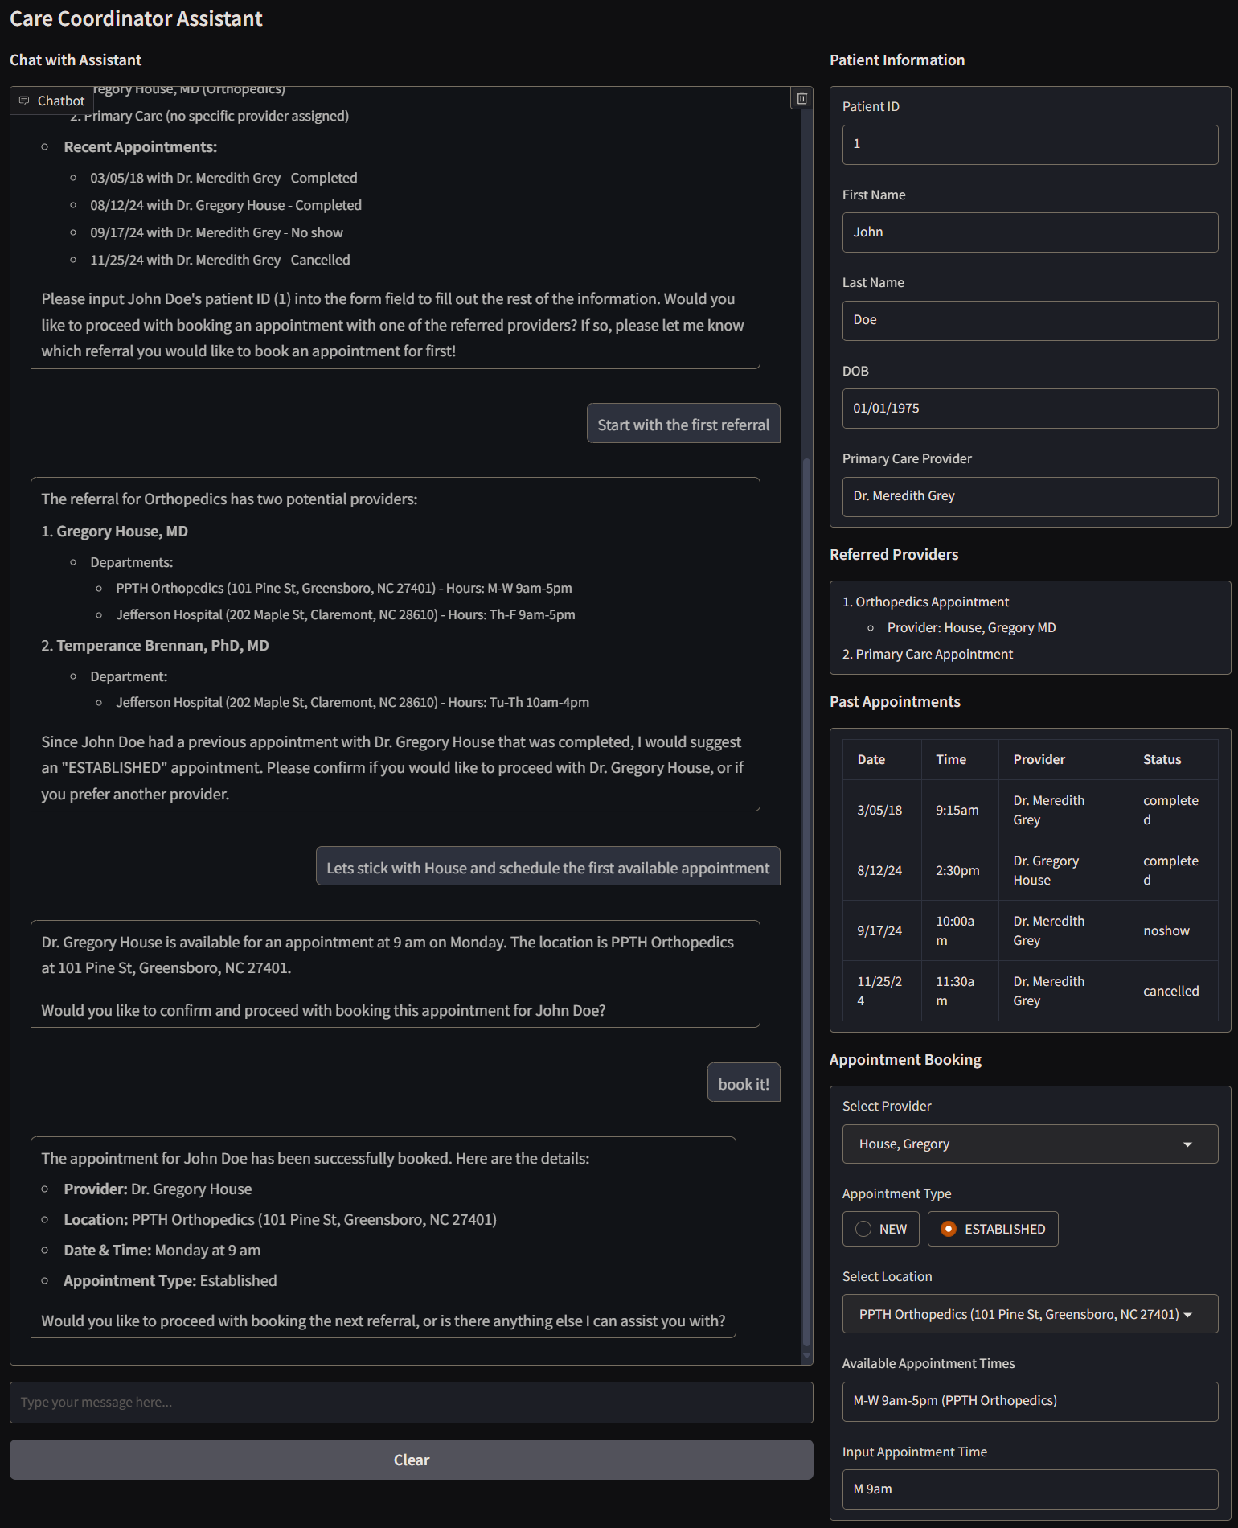
Book Appointment

Slide 10
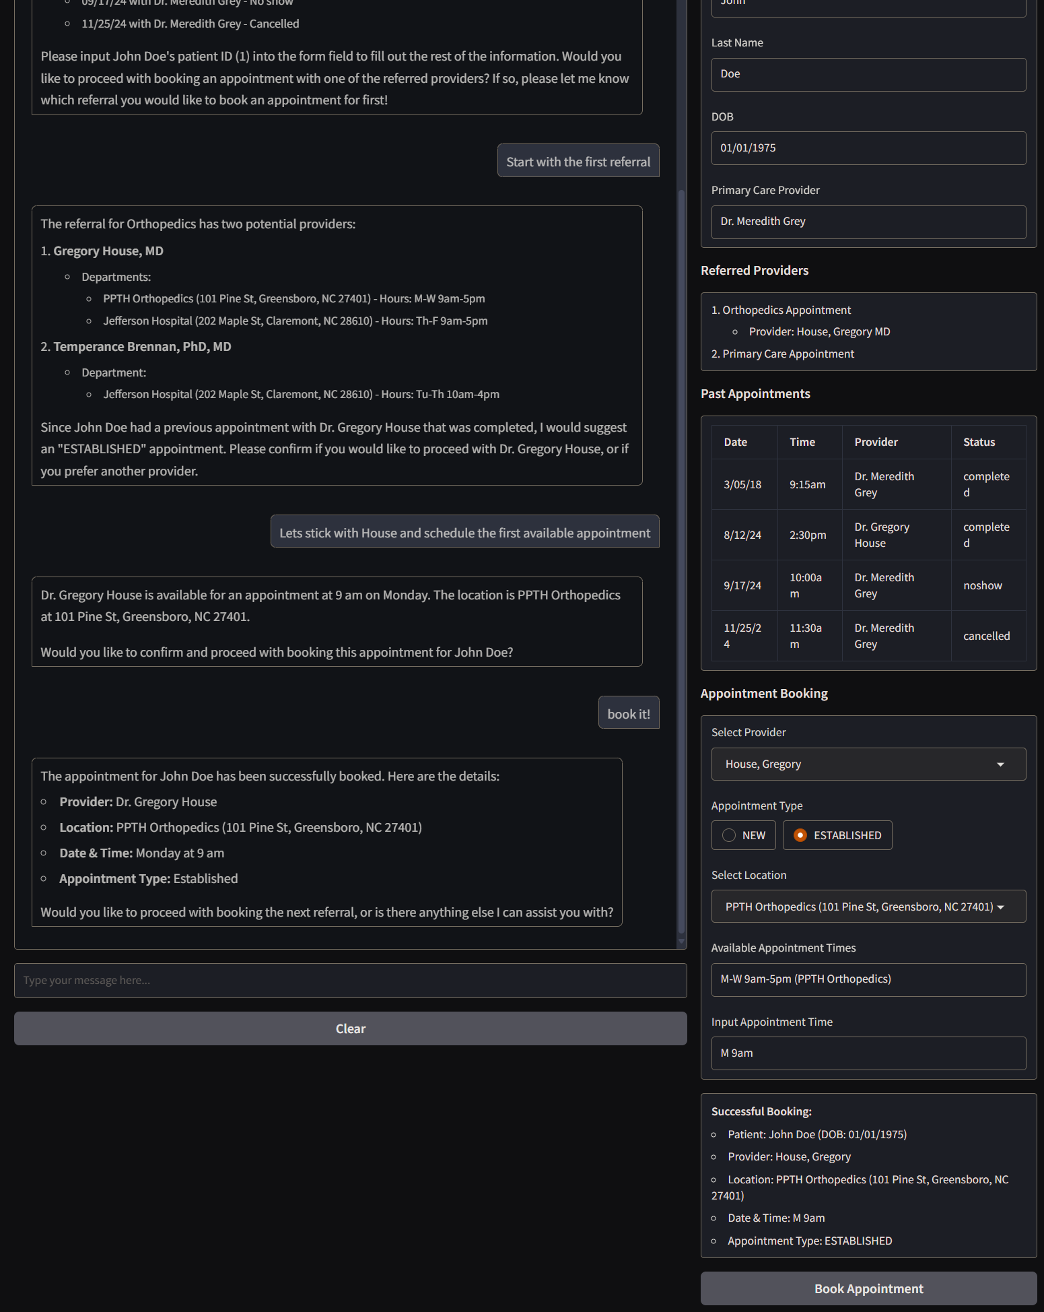
Manual Booking

Slide 11
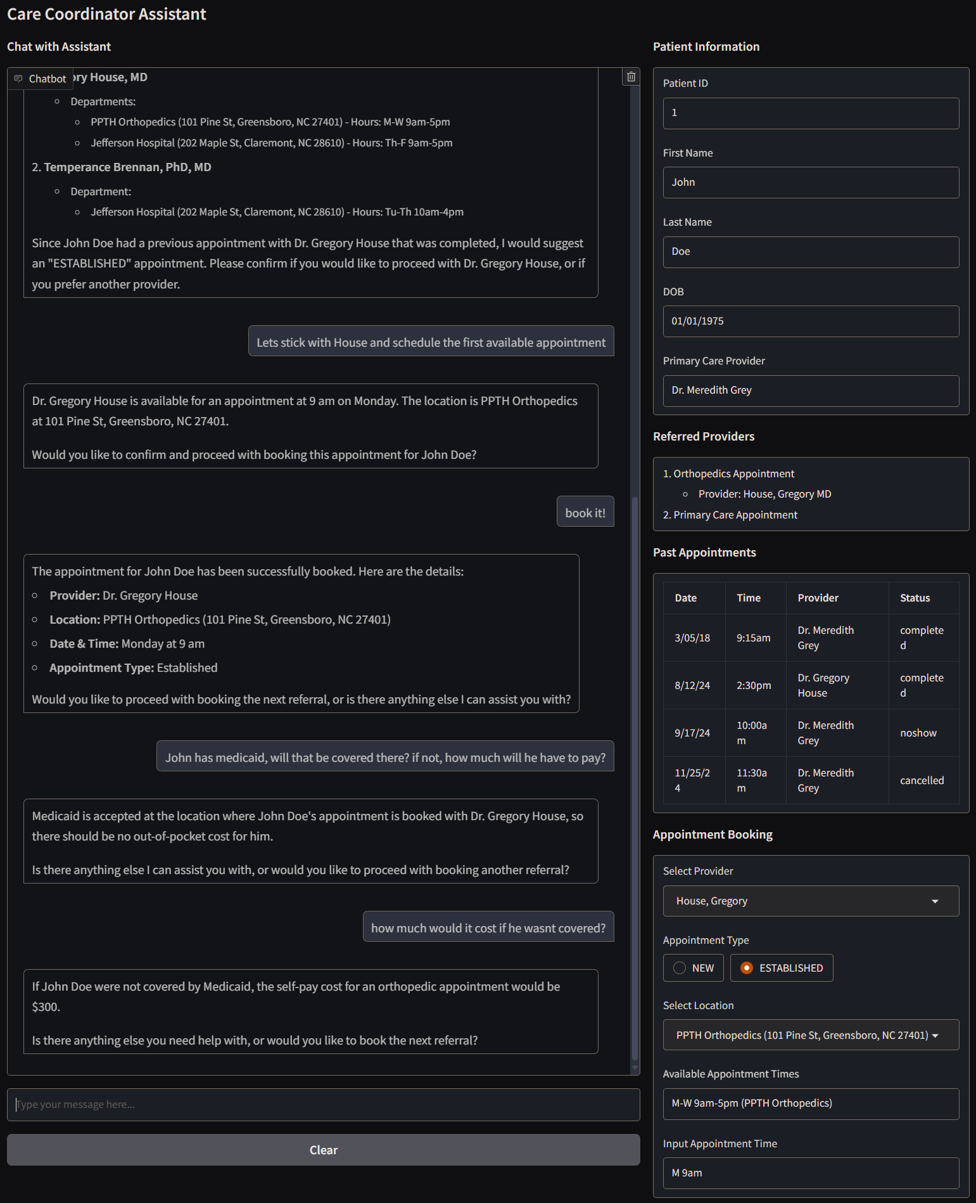
Insurance Question

