Slide 1
Lockpicking

Slide 2
Announcements
NCL Registration opens 2/10
Workshop 2: Docker is next week 2/12
Department Social Event: 2/14
Food & drink available
Come Meet representatives from all the clubs!
Speaker Series: Leo Pate 2/19
Ambassador’s Corner 3/24 - Bill Kennard (Former FCC Chairman)
Technology, Privacy, & IOT
Contact Dr. van Delden for more information if you would like to attend

Slide 3
Part One: Background

Slide 4
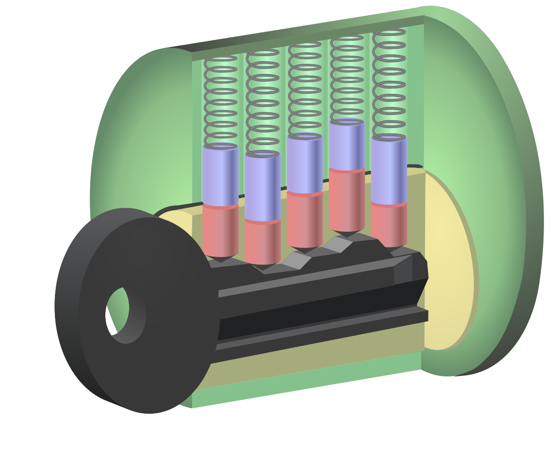
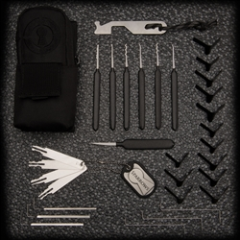
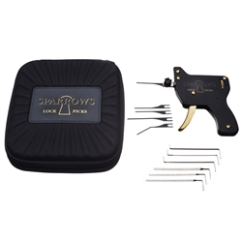
Tools of the Trade
Lock
Pins
Springs
Pick
Individual Pin Pick
Rake
Comb
Wafer
Tension Wrench
Other Picks:
Shims
Jims (Door lock)
Zip Gun

Slide 5
Part Two: How does it work??

Slide 6
Why Lockpicking Exists
Non-destructive way to open a lock
Takes advantage of exploiting imperfections

Slide 7
Part Three: How to pick locks

Slide 8
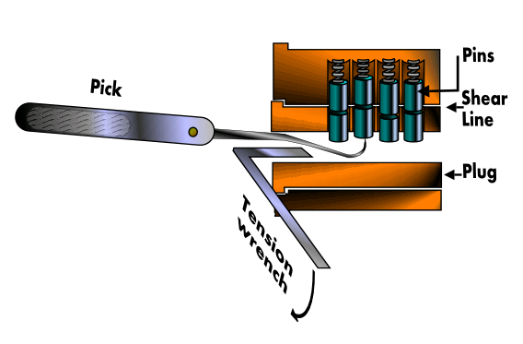
How to Pick Locks
General Formula:
tension + pick with the right pin combination = picked lock

Slide 9
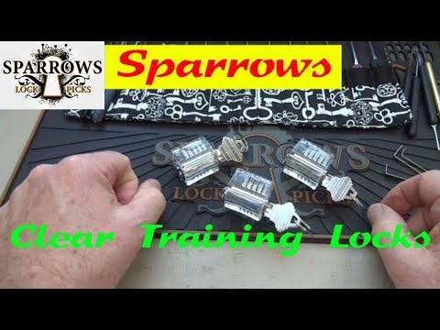
Bosnianbill Clear Locks

Slide 10
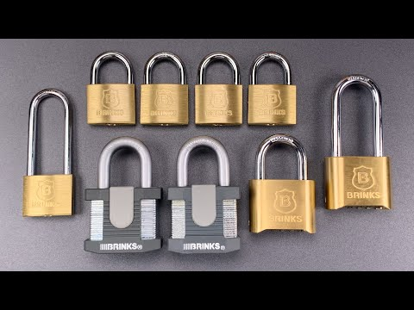
LockpickingLawyer’s Lock Exploitation

Slide 11
Why is this an important skill to know?

Slide 12
Physical Security & Access Control!!
Entry into a(n):
building
server room
file cabinet with sensitive records
office
electrical room
network closet
Concept of least privilege

Slide 13
Part Four: Hands-On

Slide 14
Part 4A: Pentest a VM on the Range

Slide 15
Range Basics
Connect to the access point
CyberRange5G: CYB3RR@ng350
Target: Metasploitable 2
Team 1 IP: 10.0.2.40
Team 2 IP: 10.0.2.41
Team 3 IP: 10.0.2.42
Team 4 IP: 10.0.2.43
What I want (DM the answers to me on the cyber security slack channel with your partner):
Open Ports
Vulnerability Scan
Any ways of entry (hint: metasploit is your friend)
With proof of entry
Banner Grab

Slide 16
Part Six: Profit!!

Slide 17
Additional Stuff

Slide 18
Lockpick Sets
Sparrows: https://www.sparrowslockpicks.com/
Entry: Kick Start ($20.00)
Mid: Tuxedo ($32.00)/EOD Light ($37.00)/EOD Full ($53.00)
Money is no object: Vorax ($95.00)
Non-Sparrows: https://amzn.to/2RTciwS

Slide 19
Sources
Reference Guide: https://www.art-of-lockpicking.com/how-to-pick-a-lock-guide/
Youtube Channels
Bosnianbill: https://bit.ly/35jWbwc
Lockpicking Lawyer: https://bit.ly/38CUzzr

