Slide 1
Content
What is docker
  VMs
  Container virtualization
What does docker add
So how do we get one of these containers running
  Run a container based on a Dockerfile
  Share a deployment image via the Docker Hub registry
  Run a mono app in a container
Volumes
Networking
Docker on bare metal
Multi host management – Orchestration, scheduling
Sample use cases
Links to start with
Q&A

Slide 2
What is docker ?
  Docker is a platform for building, shipping and running applications in a consistently isolated environment

Slide 3
VMs
Historically how did we get to VMs
  Mainframes
  Client\Server and multi-tier on physical machines
  Consolidation of physical machines with VMs

Slide 4
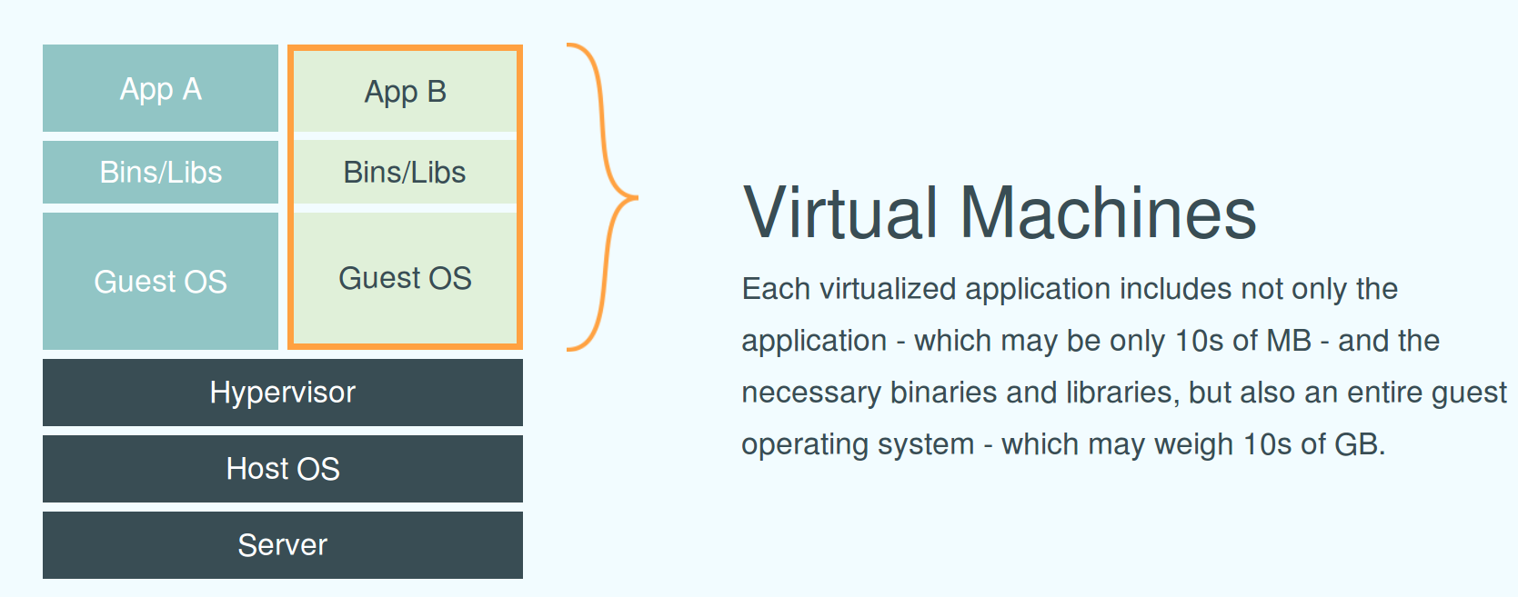
VMs

Slide 5
VMs – Pros and Cons
+ Allowed heterogeneous application stacks to run on same physical h/w, emulating h/w for each VM
+ Strong isolation between VMs
+ Live migrations, high availability and resource pooling
+ Utilization
- Each VM is a complete stack (OS, application stacks and applications)
- Each VM instance needs managing - patches to full stack
- Perf overhead when compared to bare metal

Slide 6
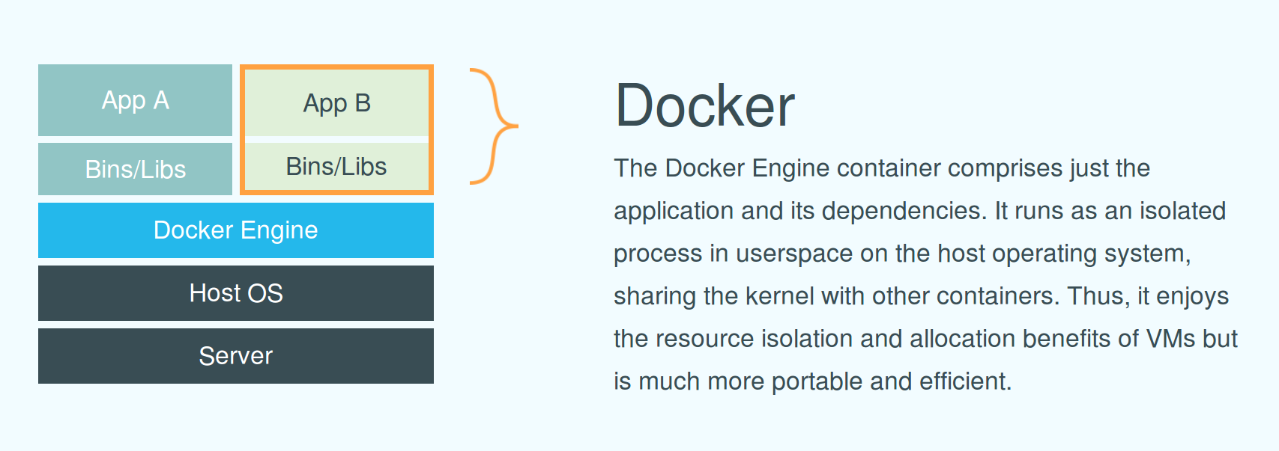
Containers

Slide 7
Containers
Prior implementations
  Solaris zone
  FreeBSD jails
  OpenVZ
Docker plans on supporting a variety of containers
  Linux containers – cgroups\namespaces
  Possibly full Vms
  Microsoft containers

Slide 8
Linux containers
In docker today we usually mean operating system level virtualization
  Linux kernel and distributions ? Do we have a high level understanding
  Process isolation
  Single kernel shared by all running containers

Slide 9
  Control groups – cgroup
  cgroups are a kernel feature that can be used to constrain and track resource usage for processes
      i.e CPU, CPUSets, Memory, IO

Slide 10
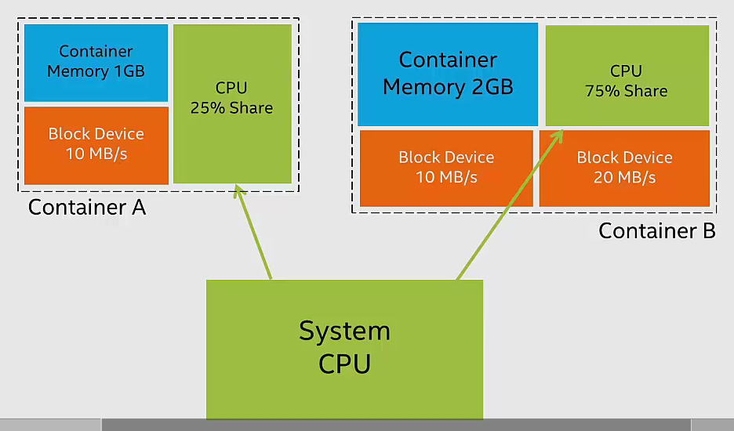
cgroups

Slide 11
Namespace isolation - namespaces
Namespaces are a kernel feature that allow isolating process environments (Views)
  i.e.Mounts, PID, MTS (hostname), Users, Networking, IPC

Slide 12
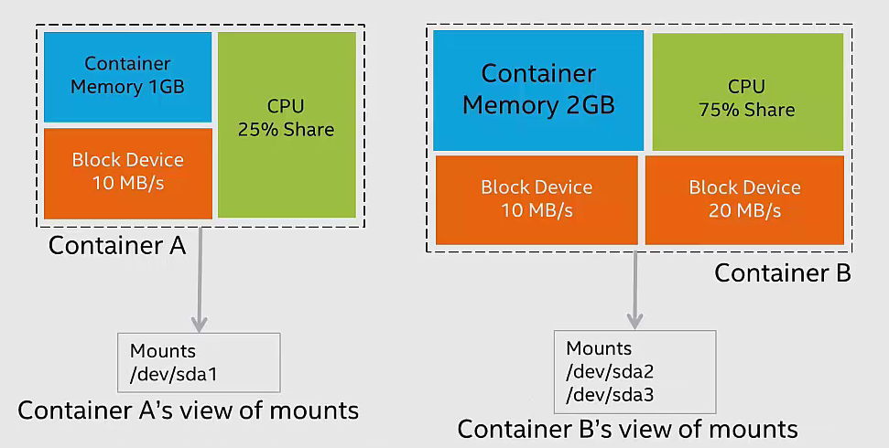
Namespaces

Slide 13
Containers - LXC
LXC is a collection of user space tools for managing cgroups and namespaces
Docker started as a wrapper around LXC
Switched to libcontainer which default on Linux is an interface over cgroups and namespaces

Slide 14
Containers – Pros and Cons
+ Improved startups when compare to VMs (Doing less)
+ Contains all s/w artifacts need to run the container within a unit
+ Lower overhead than VMs (No h/w emulation)
- Complexity - configuration, immaturity, management tools
- Weaker security isolation compare to VMs
- Linux only at this time

Slide 15
What does docker add
Docker is a much more pleasant interface for leveraging containers which mort can be happy with
Has managed to get people to start working on a common standard based effort on using container based solutions
Conversations between the big ones - Google, AWS, Rackspace, VMWare, reddhat, OpenStack, IBM, Microsoft etc
Additional features over Linux containers (These are very significant for s/w distribution)

Slide 16
Images
Template\blueprint of environment for running a process
Encourages running a single process within a container (No init pid 1)
Images can be build in two ways
  a) Manually\Interactively
  b) Dockerfile

Slide 17
Images – Manual build
Start with a base image
Run an instance of this image, this is a container
Do some work on the container preparing for running the process
Commit the container which creates a new layer on top of the last image, this is now an image itself

Slide 18
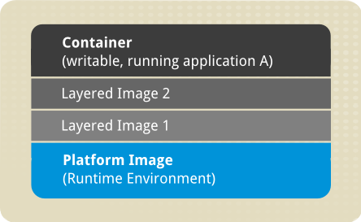
Images - layers

Slide 19
Images – Dockerfile build
DSL for building images
Describe the manual\interactive in a single file through a serious of instructions
This is the recomended way to build images, this is SCM friendly and repeatable

Slide 20
Dockerfile - Sample
FROM ubuntu:14.04
MAINTAINER ted
RUN apt-get update
RUN apt-get install -y apache2
ENV APACHE_RUN_USER www-data
ENV APACHE_RUN_GROUP www-data
ENV APACHE_LOG_DIR /var/log/apache2
EXPOSE 80
CMD ["/usr/sbin/apache2", "-D", "FOREGROUND"]

Slide 21
Images\layers
Each instruction runs an instance of the image, the instruction is then execute in the container before it is stopped and the image is saved
Copy on write file system helps with this
Like subversion SCM's diffs
Images are immutable
Local cache

Slide 22
Registries
A service that stores images
Can push an image up to a registry
Can pull the exact image down on another machine and then run
Supports the distribution of s/w
Can use public registries, default is Docker Hub
  Docker Hub
  Quay.io
Can pay for private repositories in these registries
These also support webhooks for automated builds etc
Can run your own private registry

Slide 23
Repositories
This is where images are managed
On Docker Hub can have 2 types official and normal repositories
  i.e pmcgrath/myapp:v1.0
    User
    Repository
    Tag

Slide 24
So how do we get one of these containers running
Install docker [https://docs.docker.com/]
  Select from Installation menu list for your OS
  On windows and OS X you can use boot2docker, you are interacting with a VM which is the docker host

Slide 25
Installation
Demo on aws where docker not already installed

Slide 26
Installation components
Docker engine daemon
Docker client
Empty local cache - docker info showed this

Slide 27
Run our first container – Interactively
Demo

Slide 28
Run a container based on a Dockerfile
Demo demo1 directory contents

Slide 29
Share a deployment image via the Docker Hub registry
Demo demo2 directory content

Slide 30
Run a mono app in a container
Demo mono directory content

Slide 31
Volumes
Keep data external to container
  i.e Database data
Issues with permissions
Can use data containers

Slide 32
Networking
Default is bridges but you can override
docker0 bridge
Sets its own subnet on the machine
veth pairs – one on host and one within container
External access is NAT

Slide 33
Docker on bare metal
CoreOS
redhat atomic
Mixing VMs and containers – AWS, GCE, Azure etc

Slide 34
Multi host management Orchestration, scheduling
fig
Kubernetes
fleet
flynn
etc

Slide 35
Sample use cases
Shared development environments
Deploying exact\consistent versions apps on all environments
Experimenting with new s/w without installing on your machine i.e. Redis, new version of Java
Exploring how s/w is installed - dependencies etc. can read the Dockerfile's on github
Very fast development feedback cycles
  Creation and discarding of containers
  Dockerfile failures - stop at the failed instruction so you can restart from there after fixing the problem
Run various services in containers (CI\CD with additional slave containers)
Lots of talk about potential with microservice architectures
Run cross platform tests for your s/w in multiple disposable containers
Run short jobs
  Google starts > 1 billion containers a day
  Scrape some content and store on a schedule - Once a day, many instances

Slide 36
Some links to start with
https://www.docker.com/whatisdocker/
  Watch video introduction by one of docker creators
https://www.dockerbook.com/
  Book
http://intelstudios.edgesuite.net/idf/2014/sf/aep/DATS004/DATS004.html
  Watch video for really good explanation
https://docs.docker.com/
  Docs
http://blog.docker.com/docker-weekly-archives/
  Weekly newsletter
https://github.com/docker/docker
  Source, should also look at all repos for the docker organisation

