Slide 1
Who am I
pmcgrath@gmail.com
https://github.com/pmcgrath
Last 10 years in payments industry
Developer: c#, ruby, golang
Operations: VM provisioning, setup and application deployments
Services s/w: RabbitMQ, MongoDB, Redis, ElasticSearch

Slide 2
Agenda
Brief overview of docker
VMs
Containers
What docker adds
Docker components
Installation
Demo1 – interactive bash
Demo2 - mono app running on EC2
Port mapping
Volumes
CI\CD
Possible other usages
Other considerations
Some links to start with
Q&A

Slide 3
Docker
Open source project on github
Currently linux 64 bit *
Possible inclusion of an implementation in the next Microsoft server OS

Slide 4
Docker
Software packaging mechanism
Image
Create an artifact with the entire stack and application as a single unit
i.e.
mono v3.10
specific library dependencies
mono app

Slide 5
Docker
Powerfull software distribution
Deploy images on
bare metal
VMWare
Azure
AWS EC2 & EC2 Container Service
GCE
Rackspace

Slide 6
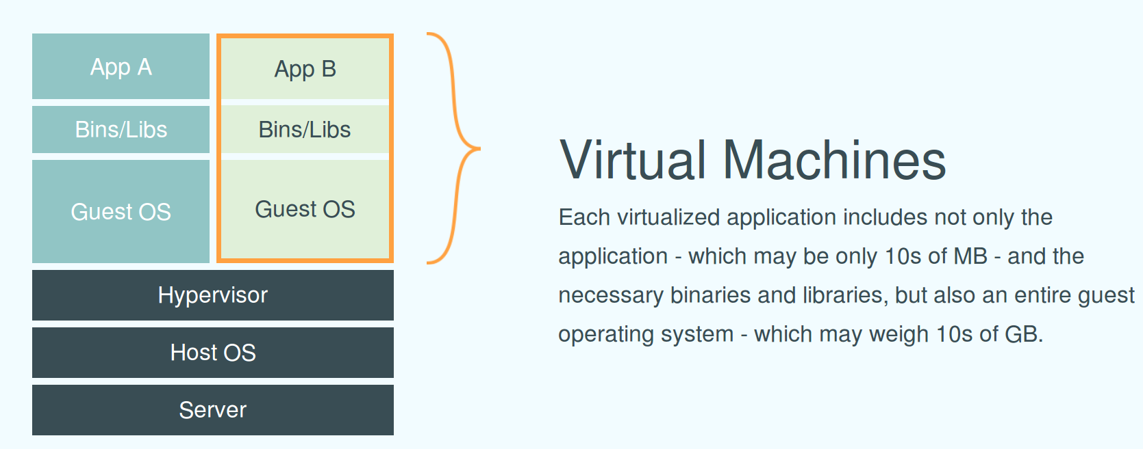
VMs

Slide 7
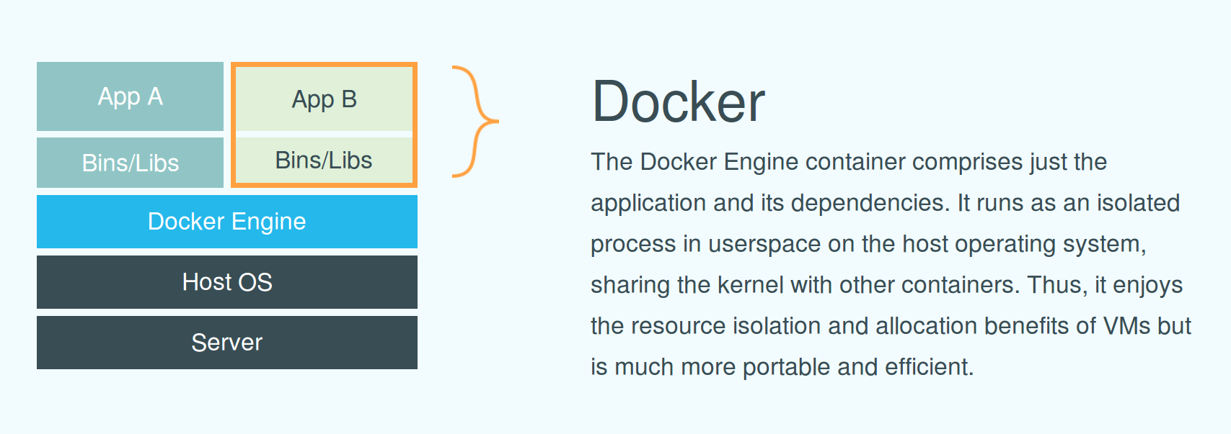
Containers

Slide 8
Containers
Solaris zones, FreeBSD Jails, OpenVZ
control goups – cgroups
namespace isolation – namespaces
LXC
Google and heroku

Slide 9
What docker adds
Simplier interface to containers
Images
Has managed to get a lot of people co-operating on these problems
Google
Rackspace
Redhat
Amazon
Microsoft
OpenStack
Cloud Foundry

Slide 10
Docker components
Docker client
Docker engine daemon
Cache
Repository
Images
Registry

Slide 11
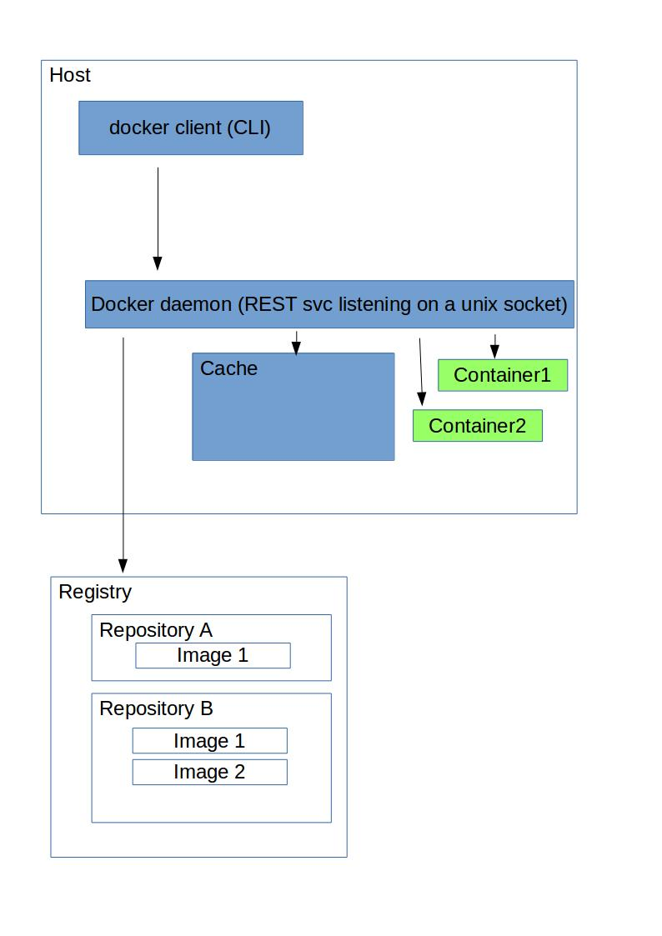
Docker components

Slide 12
Installation
Boot2docker
Windows and OS XLinux
Linux
Use docker package repository

Slide 13
Demo1 – interactive bash
docker –help
docker run –help
docker run -t -i ubuntu bash
docker ps
docker stop [cid]
docker ps
docker ps -a
docker rm
docker ps -a

Slide 14
Demo2 – mono app running on EC2
.NET application
Dockerfile
Build a local image
Run a local container instance
Push image to dockerhub registry
Run same image on EC2
v2 of same application

Slide 15
.NET application
Infinite loop
Writes environment information to stdout

Slide 16
Dockerfile
FROM mono:3.10
ADD app.cs /app/
RUN cd /app && mcs app.cs
ENTRYPOINT ["mono", "/app/app.exe"]

Slide 17
Build image
docker build -t pmcgrath/mono:v1 .
docker images
docker history pmcgrath/mono:v1

Slide 18
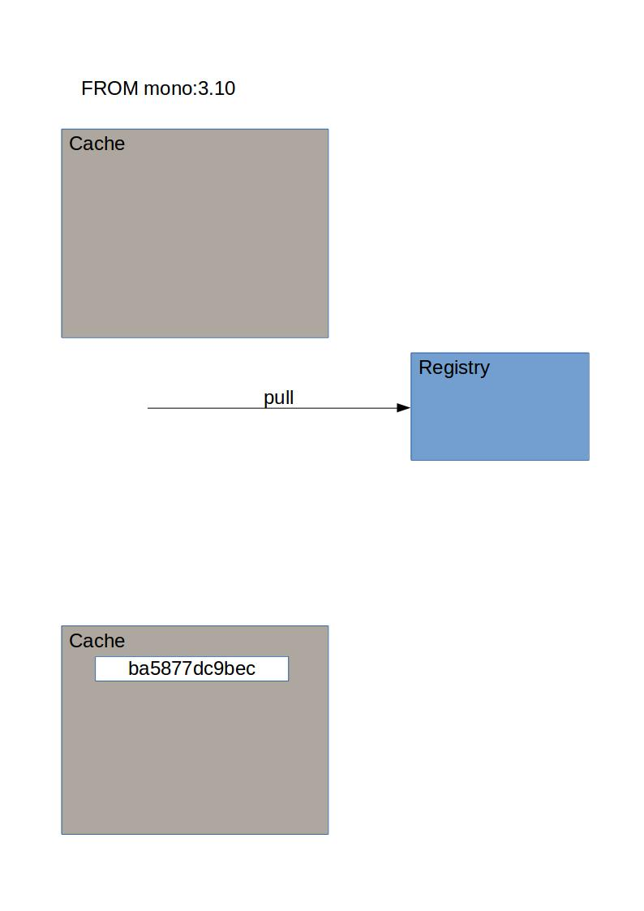
Dockerfile instruction 1 of 4

Slide 19
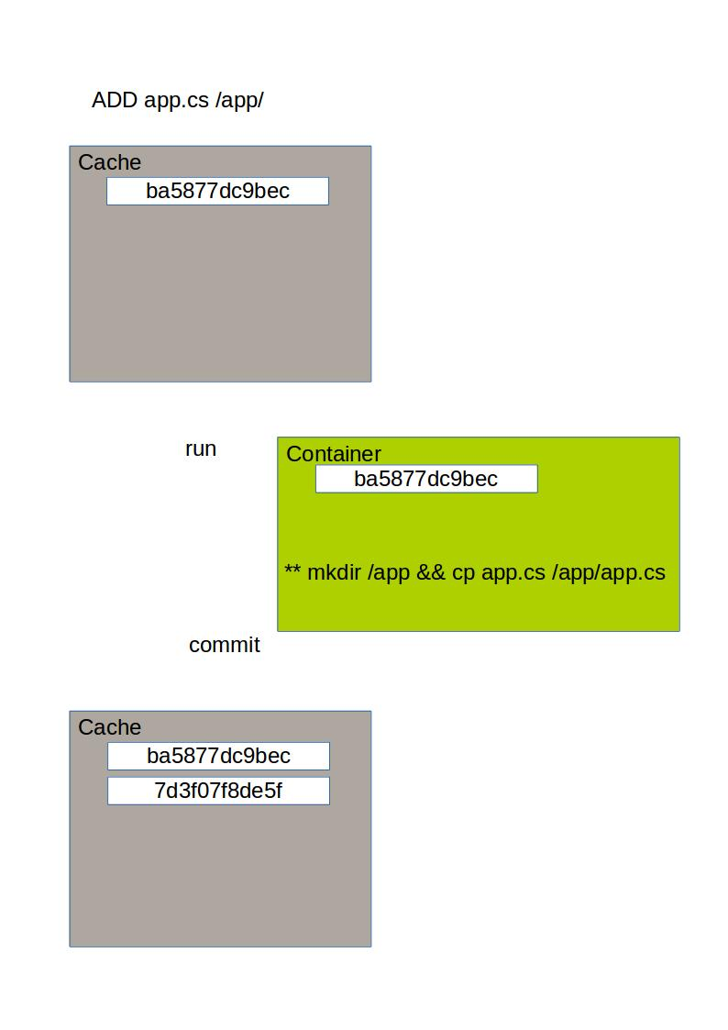
Dockerfile instruction 2 of 4

Slide 20
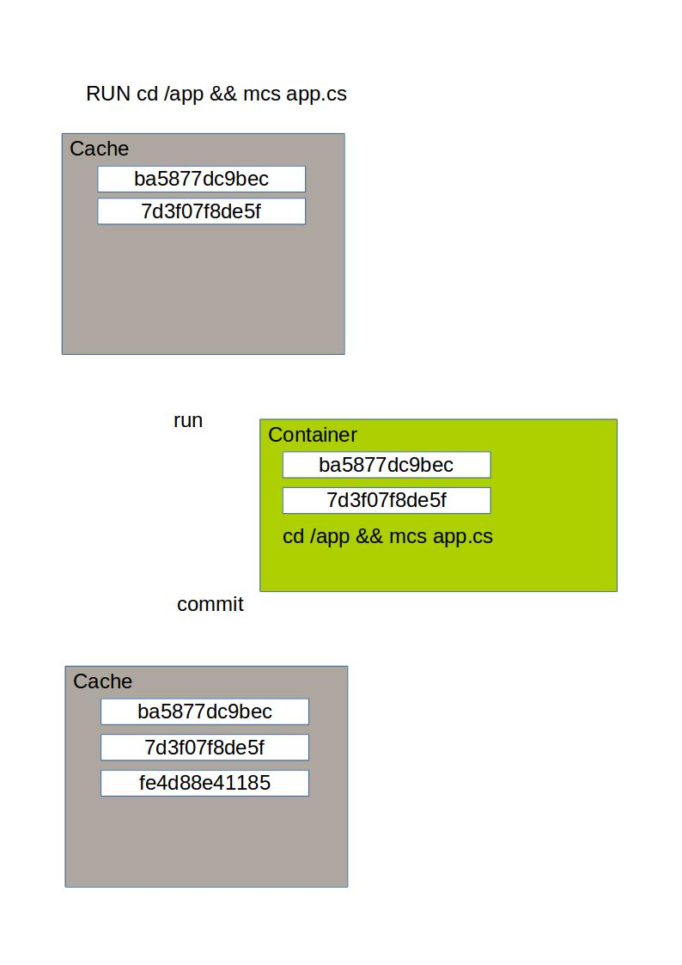
Dockerfile instruction 3 of 4

Slide 21
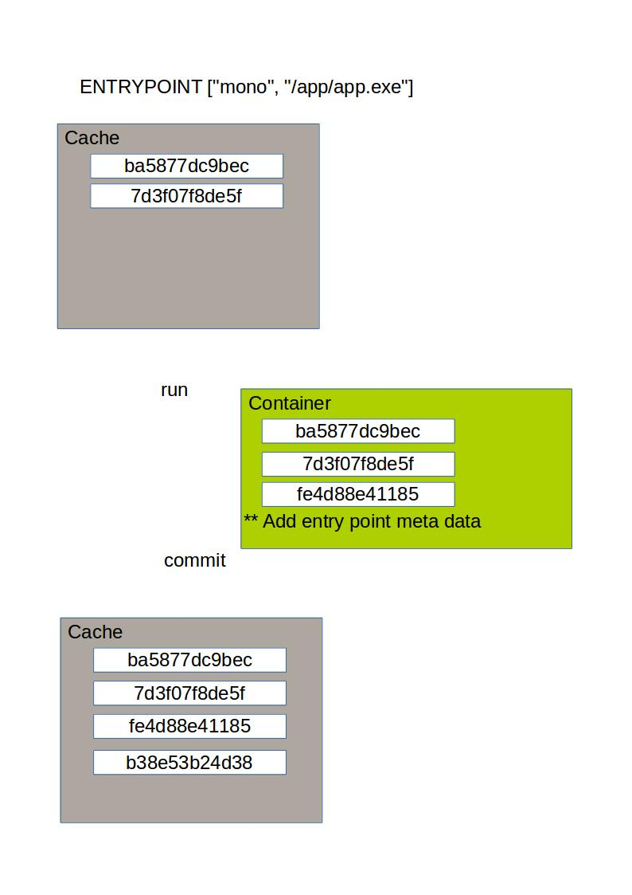
Dockerfile instruction 4 of 4

Slide 22
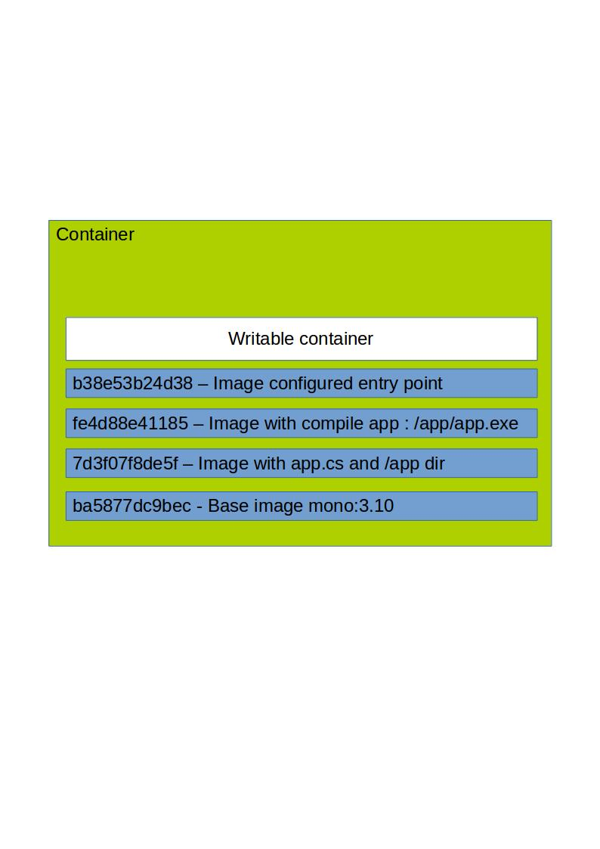
Layers

Slide 23
Run a local container instance
docker run -d --name c1 pmcgrath/mono:v1
docker logs -f c1
docker inspect c1

Slide 24
Push image to dockerhub registry
docker login
docker push pmcgrath/mono:v1

Slide 25
Run mono image on EC2
ssh onto EC2 instance
docker search pmcgrath/mono
docker pull pmcgrath/mono:v1
docker images
docker run -d --name mymonoapp pmcgrath/mono:v1
docker logs -f mymonoapp

Slide 26
Port mapping
docker run -d -p –name redis1 redis:latest
docker port redis1
docker run -d -p –name redis2 redis:latest
docker port redis2

Slide 27
Volumes
VOLUME instruction in a Dockerfile
Live outside the container
Bind mount on host on container run

Slide 28
CI\CD
Can use SCM hooks to kick of a build
Build output is a docker image
Test the same image
Deploy the same image

Slide 29
Possible other usages
Shared development environments
Hosting complicated s/w i.e. GitLab, graphite
Experimenting with new s/w without installing on your machine i.e. Redis, ElasticSearch, new version of Java
Running one of jobs
Microservice hosts

Slide 30
Other considerations
Securtity (Vms)
Use togethere
Managing multiple hosts
kubernetes
Service discovery
etcd
Orchestration\Scheduling
kubernetes, fleet, deis
Immaturity
Lots of activity, lots of people betting on kubernetes vision (Scheduling tasks on a cluster)

Slide 31
Some links to start with
https://www.docker.com/whatisdocker/
* Video introduction by one of docker's creators
http://www.dockerbook.com/
* Book
http://intelstudios.edgesuite.net/idf/2014/sf/aep/DATS004/DATS004.html
* Really good explanation
https://www.youtube.com/watch?v=68lmfNmktjY
* Good video but need to be somewhat familiar with docker
https://docs.docker.com/
* Docs
http://blog.docker.com/docker-weekly-archives/
* Weekly newsletter
https://github.com/docker/docker
* Source, should also look at all repos for the docker organisation

Slide 32
Q&A

