Slide 1
Project Four Presentation
Spatial Analytics
Paul M. Cleary
CE 597, Geospatial Data Analytics
Professor: Dr. Jie Shan
October 16, 2019
Burke Graduate Program; lyles school of civil engineering
1

Slide 2
Agenda
Data Cleaning
Functions (Perimeter, Area, Centroid)
My functions vs. R functions
Spatial Join
Number of tweets per building
Conclusion
Difficulties
Burke Graduate Program; lyles school of civil engineering
2

Slide 3
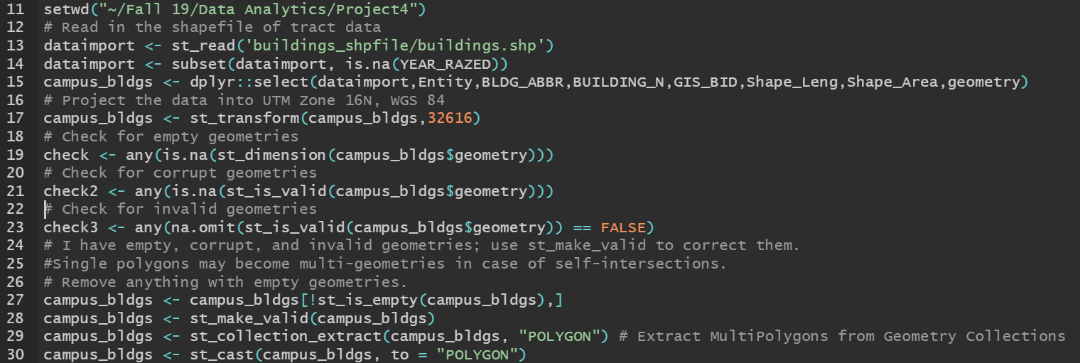
Data Cleaning
Dealing with Invalid Geometries and Demolished Buildings
Burke Graduate Program; lyles school of civil engineering
3
Notes:
Deleted rows with values (dates) in YEAR_RAZED column
Projected it to UTM ZONE 16, units = meters

Slide 4
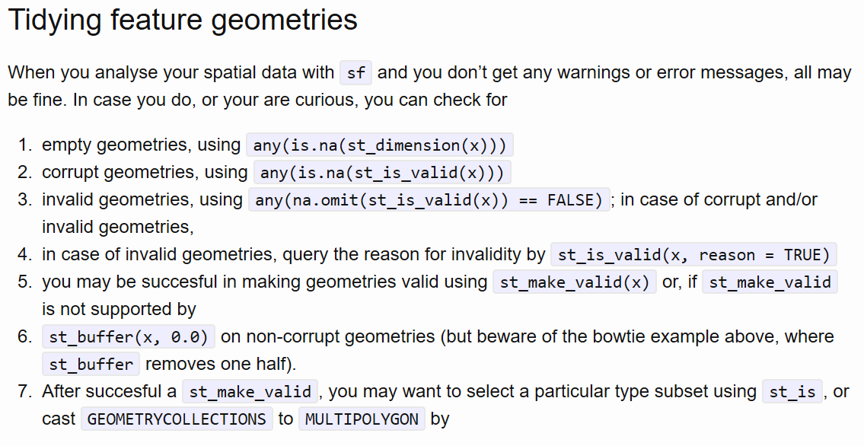
Data Cleaning
https://www.r-spatial.org/r/2017/03/19/invalid.html
Burke Graduate Program; lyles school of civil engineering

Slide 5
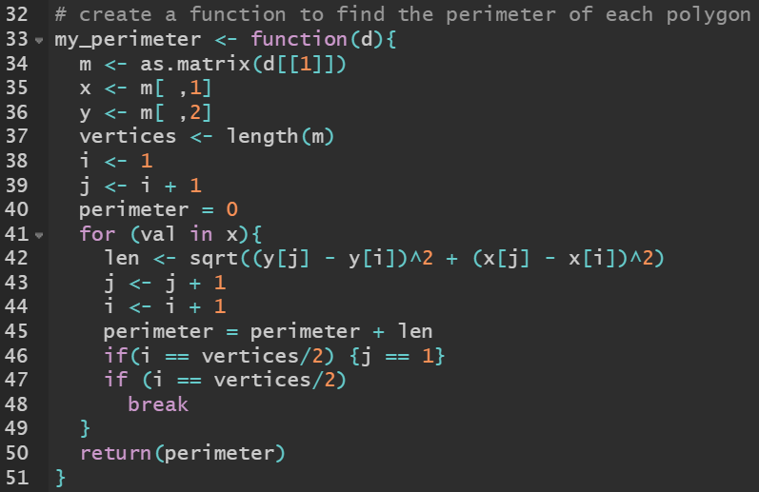
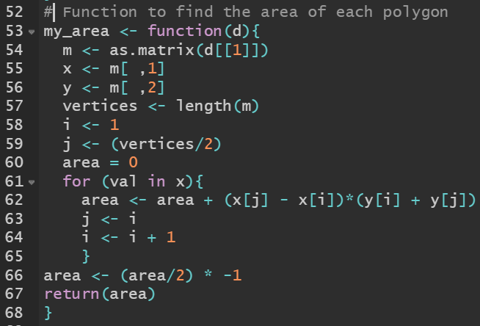
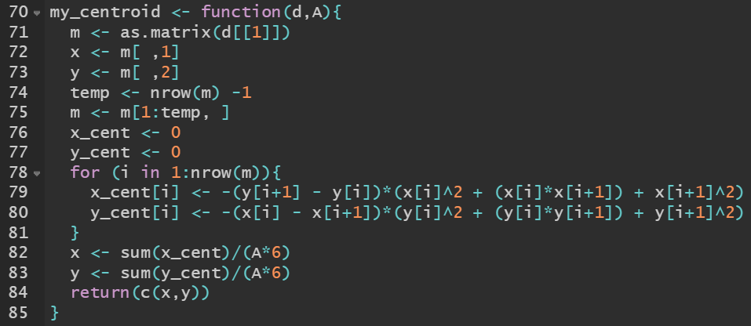
Functions
My functions for the perimeter, area, and centroid of a polygon
Burke Graduate Program; lyles school of civil engineering
4

Slide 6
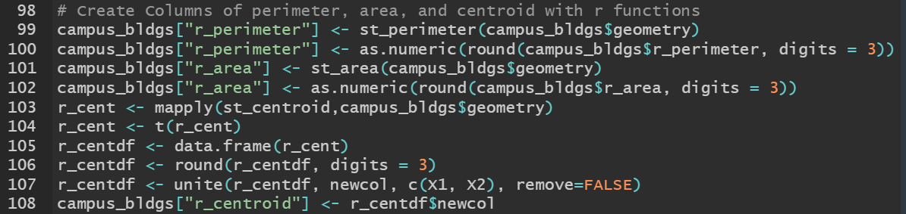
Functions
R Built in Functions
Burke Graduate Program; lyles school of civil engineering
5
Notes:
Mapply returns a matrix, used transpose to create two column vectors
Created a data frame, rounded off to 3 digits then used unite to add the two numbers to the same column

Slide 7
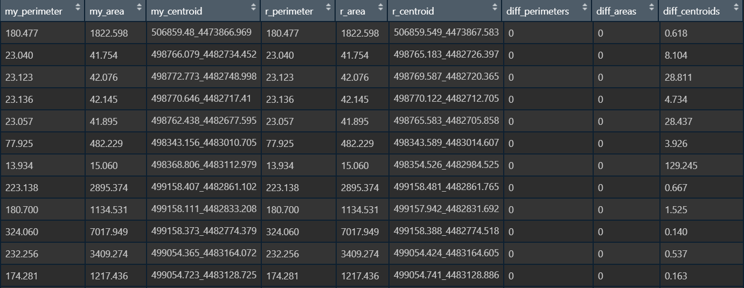
Functions
Function results
Burke Graduate Program; lyles school of civil engineering
6

Slide 8
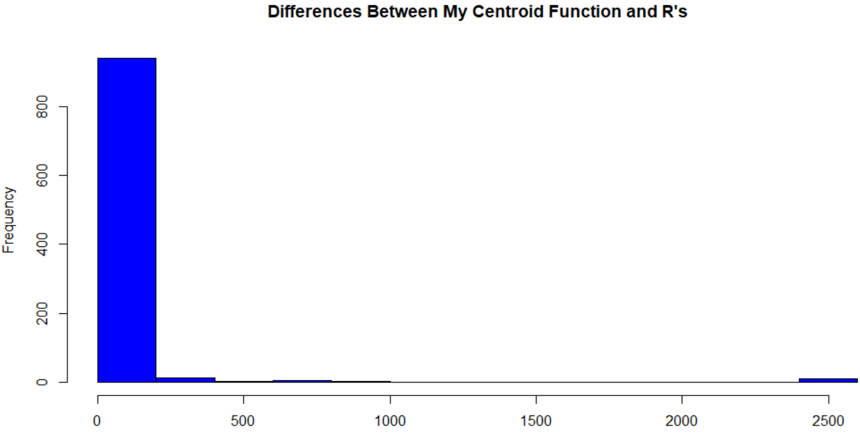
Functions
Statistics Between the Functions
Statistics | Perimeter Diff | Area Diff | Centroid Diff
Max | 0 | 0 | 2475.177 m
Mean | 0 | 0 | 41.155 m
SD | 0 | 0 | 245.385 m
Min | 0 | 0 | 0.001 m
Burke Graduate Program; lyles school of civil engineering
7
Notes:
The function is.finite will identify elements in a (numeric) vector that are not in
NA
NaN
Inf
-Inf

Slide 9
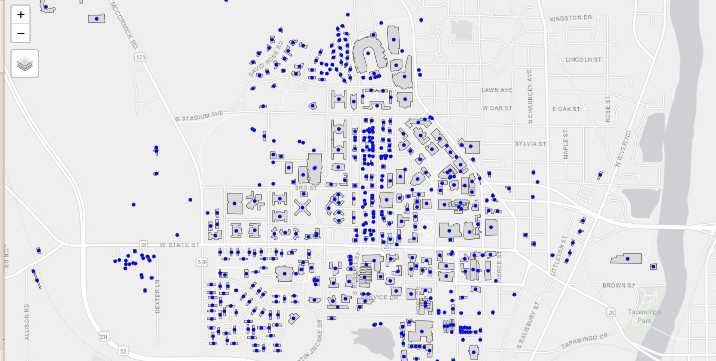
Functions
Buildings with R function Centroids
Burke Graduate Program; lyles school of civil engineering

Slide 10
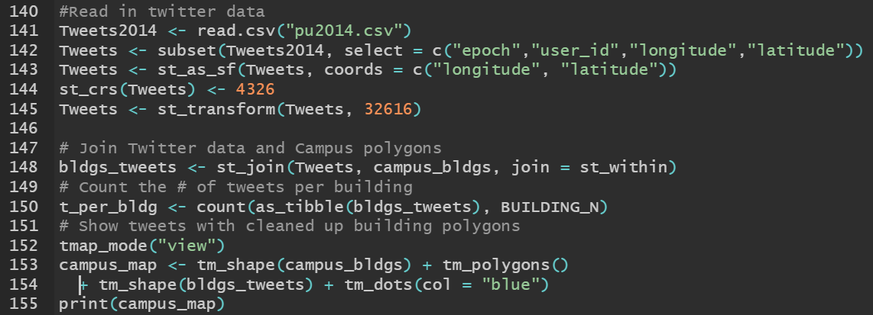
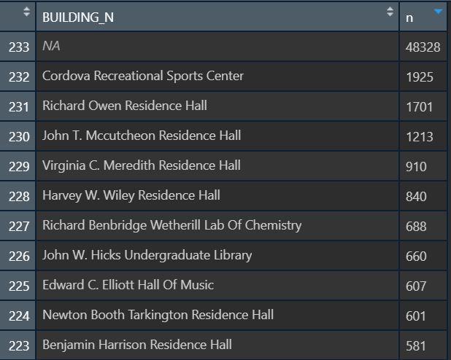
Spatial Join
Joining Building Polygons and Tweet Locations
Burke Graduate Program; lyles school of civil engineering

Slide 11
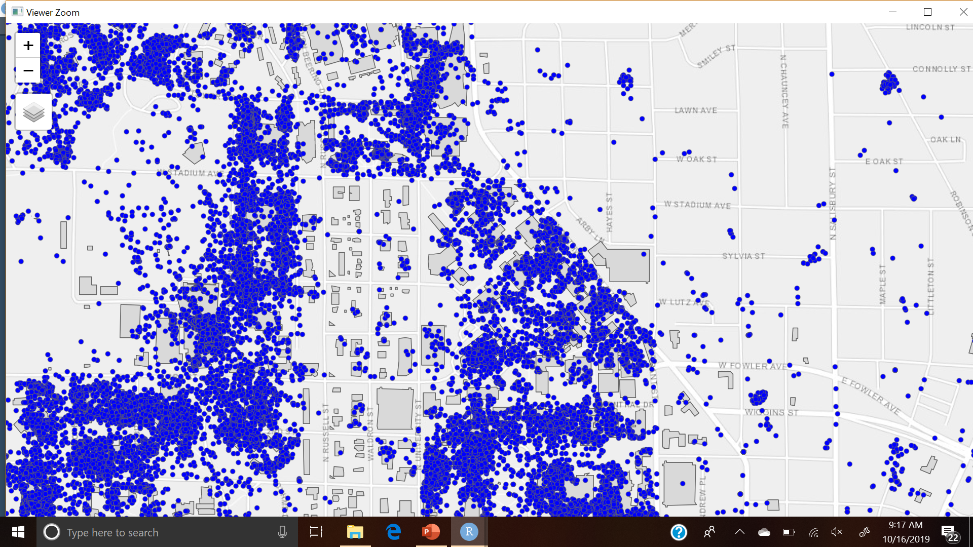
Conclusion
Challenges
Sfc objects
Breaking apart for centroid distance calculations
Creating sfc multipoint to plot centroids created with my function
Burke Graduate Program; lyles school of civil engineering

