Slide 1
Spatially Examining COVID-19
Paul Cleary, May 5, 2020

Slide 2
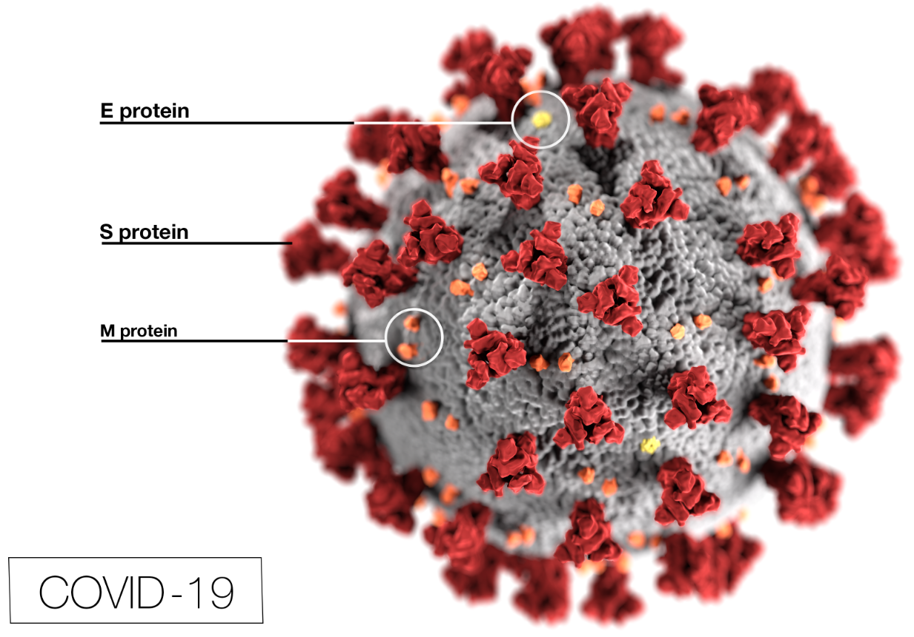
Agenda
Spatially Examining COVID-19
Timeline in Illinois and Indiana
Current distribution of the virus
Population Density
Spatially Clustered?
How is it spreading?
Forecasting the peak
Burke Graduate Program; lyles school of civil engineering
1

Slide 3
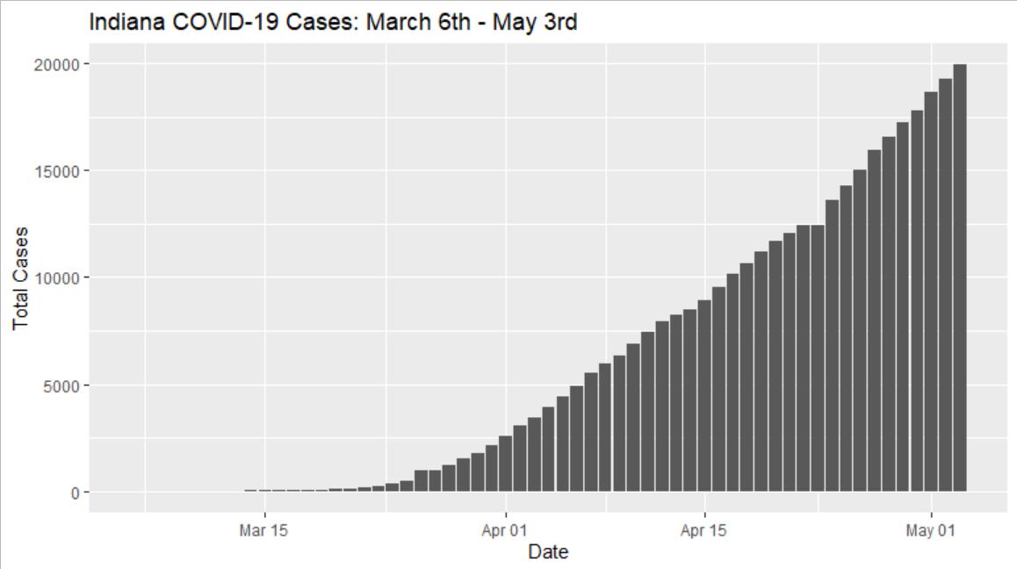
Indiana COVID-19 Timeline
March 6; First case in IN
March 24: Non-Essential Services Closed
March 25: Statewide Stay at Home Order
March 12; Mass Gatherings Restricted
March 16: Initial Business Closure
March 19: Schools Closed
Burke Graduate Program; lyles school of civil engineering
2
Notes:
Graph is date of first case to two weeks after the state lockdown went into effect

Slide 4
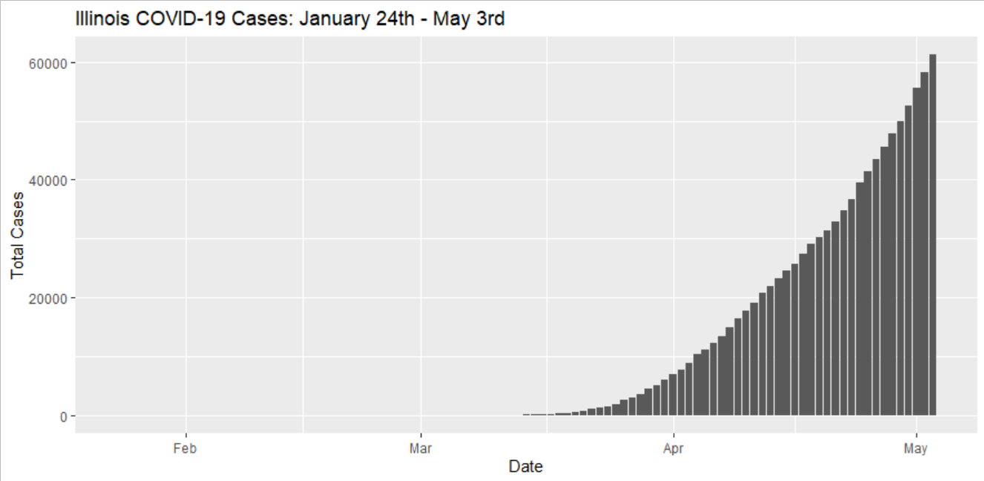
Illinois COVID-19 Timeline
January 24; First case in IL
March 21: Statewide Stay at Home Order & Non-Essential Business closed
March 13; Schools Closed
March 15: Bars and Restaurants closed
March 16: No Mass Gatherings > 50
Burke Graduate Program; lyles school of civil engineering
3

Slide 5
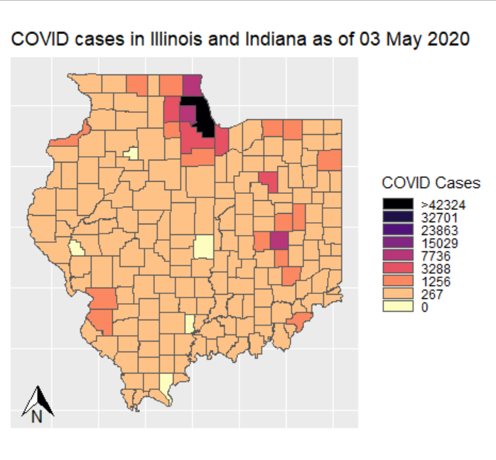
COVID-19 Cases by County
Chicago and Indianapolis regions are the most impacted
Both have major airports that may have served as the seed locations.
Is population density a factor?
How does it spread?
Burke Graduate Program; lyles school of civil engineering
4

Slide 6
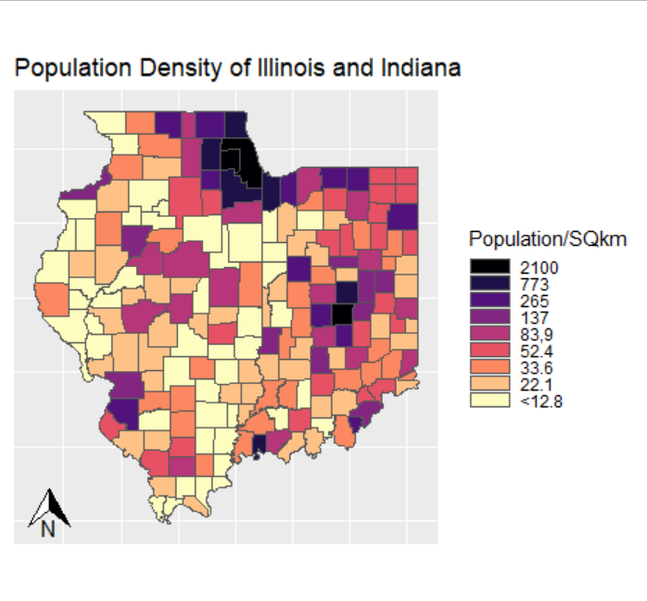
Population Density
Chicago and Indianapolis are clearly the most densely populated areas across both states.
Is there spatial clustering of both population density and COVID-19?
If so, is there an apparent connection?
Burke Graduate Program; lyles school of civil engineering
5

Slide 7
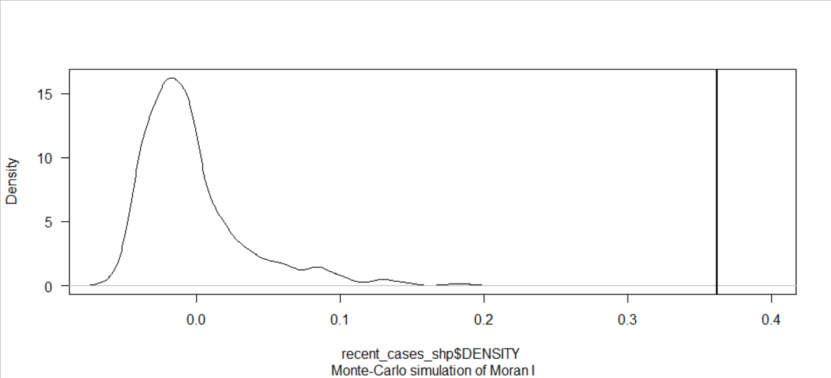
Population Density Spatial Autocorrelation
Moran’s I Results:
Moran’s I statistic = 0.3620 P-value = 0.001667
Confirms clustering of the population density when measured at the county level.
Burke Graduate Program; lyles school of civil engineering
6

Slide 8
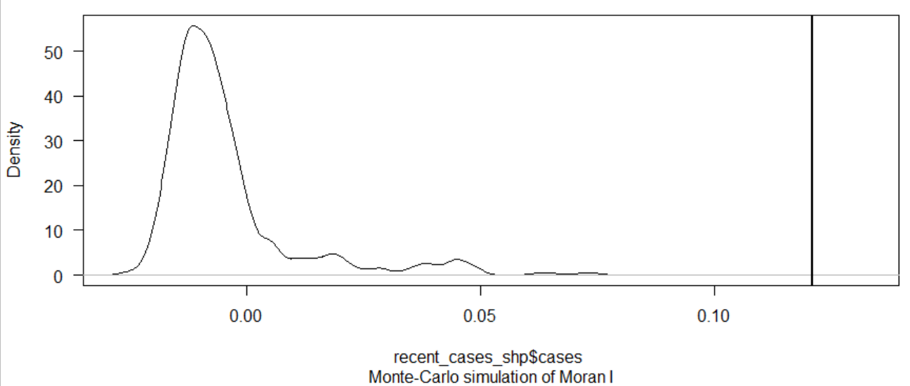
COVID-19 Cases Spatial Autocorrelation
Moran’s I Results:
Moran’s I statistic = 0.12093 P-value = 0.001667
Confirms clustering of COVID-19 cases when measured at the county level.
As of 03 May 2020
Burke Graduate Program; lyles school of civil engineering
7

Slide 9
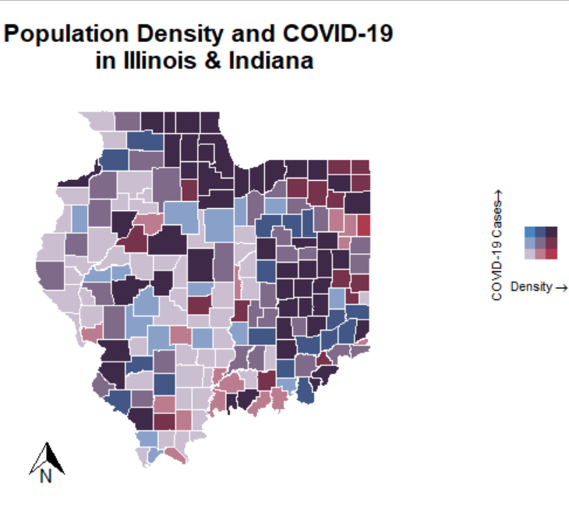
Bivariate Map
Bivariate map displaying the interaction of the population density and cases of COVID-19 in each county of Illinois and Indiana.
Uses a 3x3 grid to display nine classes of interaction.
The color in the bottom left of the grid represents a county with a low population density and few cases of COVID-19
The color in the upper right of the grid is for counties with a population density and many cases of COVID-19.
As of 03 May 2020
Burke Graduate Program; lyles school of civil engineering
8

Slide 10
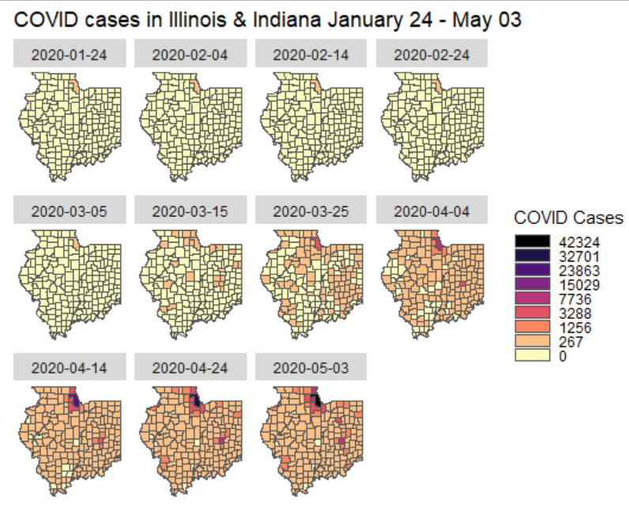
Growth of COVID-19 across Illinois & Indiana
Appears to emanate from Chicago and Indianapolis
Potentially due to the presence of airports and international travelers
Role of commuters in spreading it to the surrounding communities?
Burke Graduate Program; lyles school of civil engineering
9

Slide 11
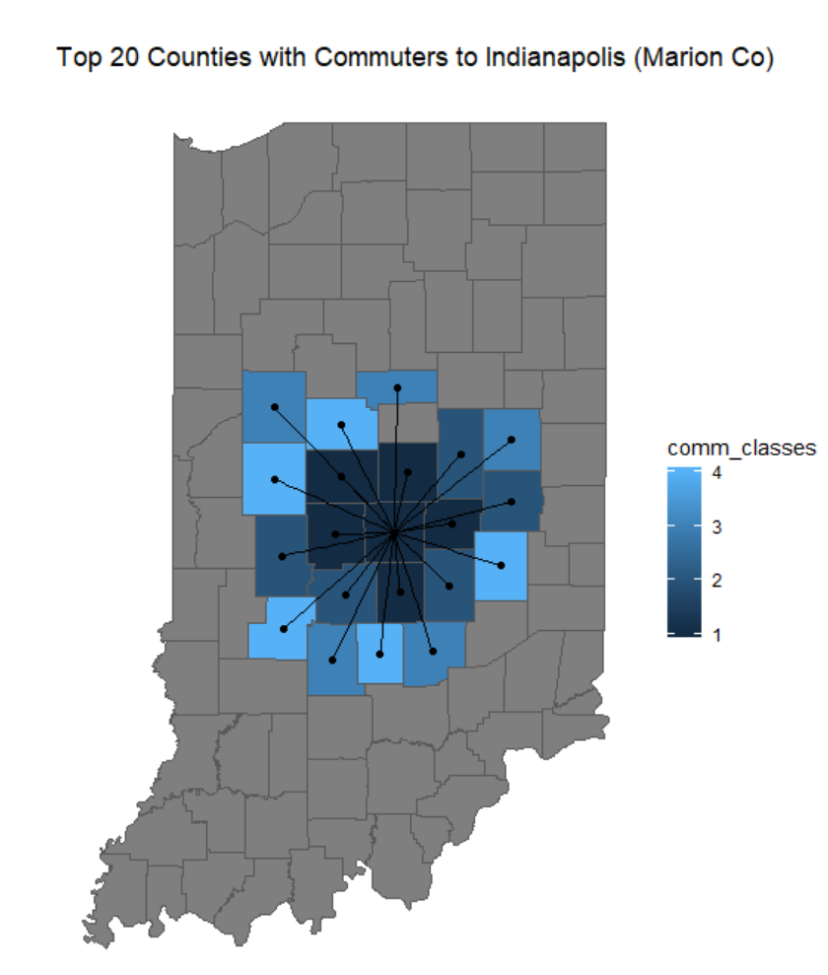
Indianapolis Commuters
The 20 counties with the most daily commuters to Indianapolis, Indiana (Marion Co)
190,715 daily commuters from these 20 counties to Indianapolis
Commuters are a likely method of transmission to the outlying counties of Indiana
Burke Graduate Program; lyles school of civil engineering
10

Slide 12
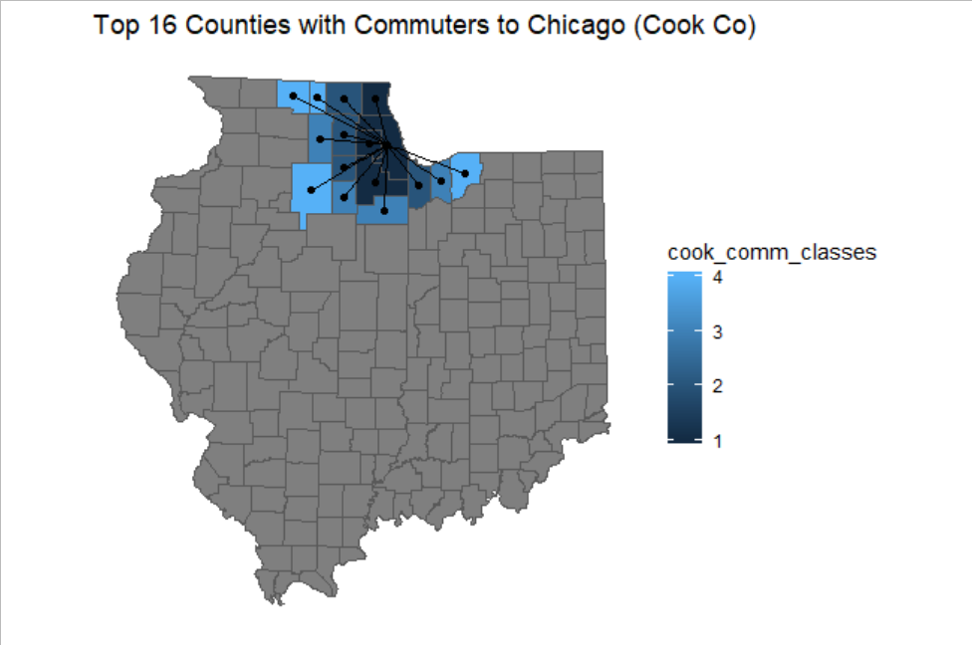
Chicago Commuters
The top 16 counties with the most
daily commuters to Chicago
449,978 daily commuters from
these counties to Chicago
Commuters from Indiana
Lake Co = 42,490
Porter Co = 5,149
Laporte Co = 1,022
Total = 48,661
Two major airports
O'Hare: busiest in the Midwest
Burke Graduate Program; lyles school of civil engineering
11

Slide 13
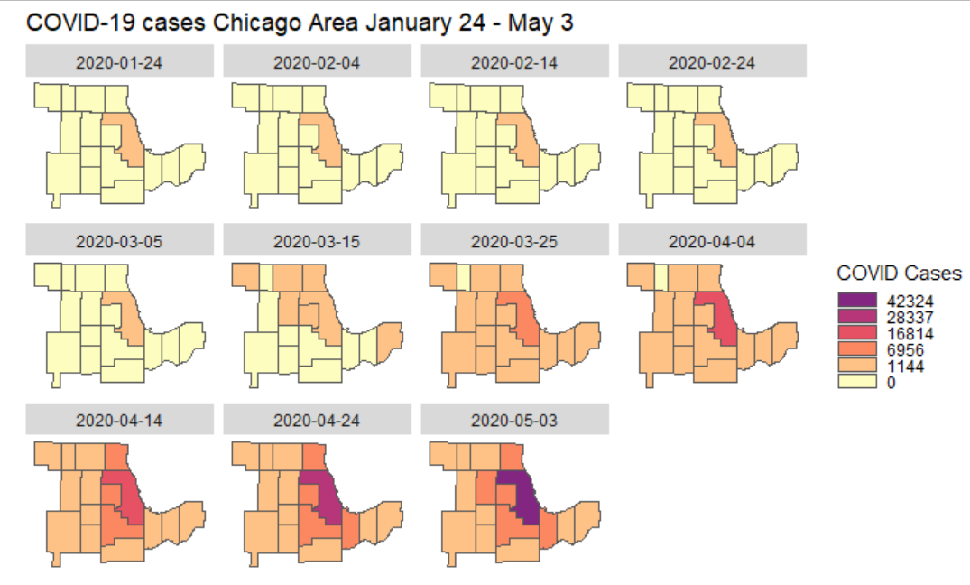
Spread of COVID-19 in Chicago Metro
Burke Graduate Program; lyles school of civil engineering
12

Slide 14
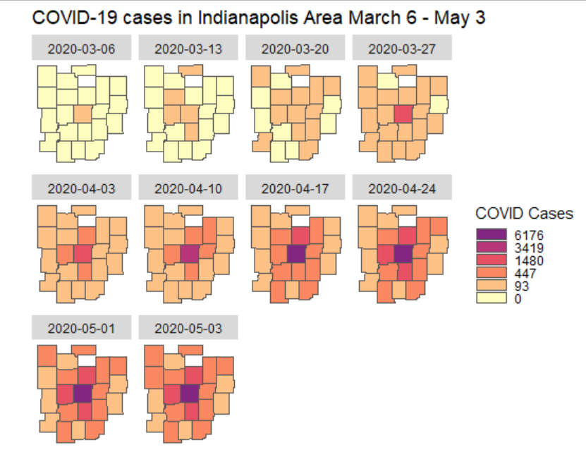
Spread of COVID-19 in Indianapolis Metro
Burke Graduate Program; lyles school of civil engineering
13

Slide 15
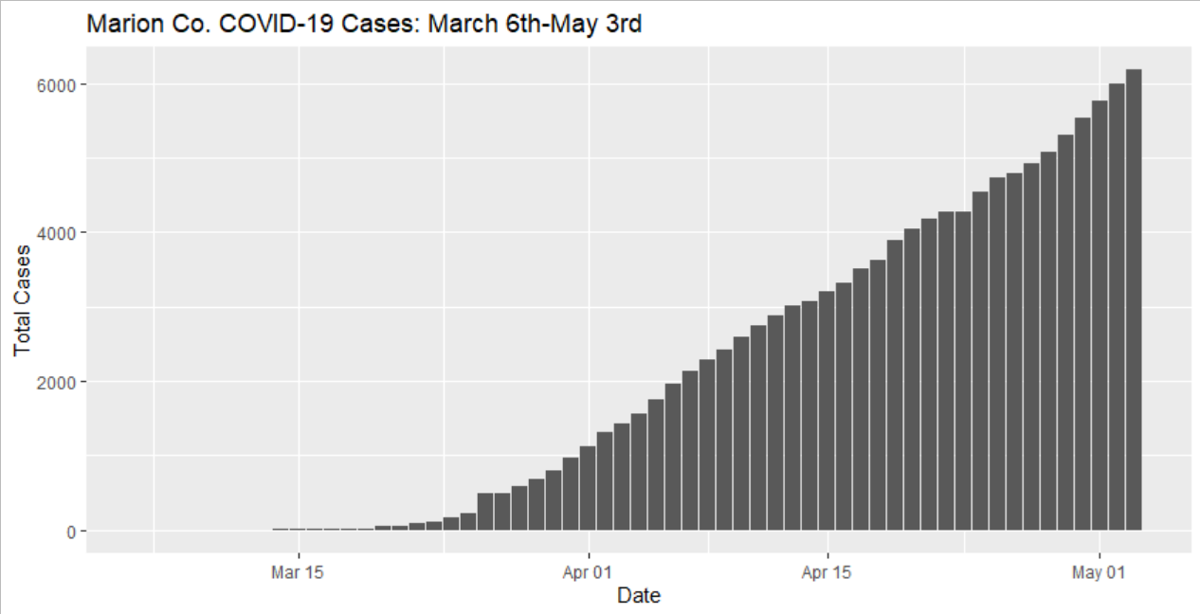
Predicting the Peak
Implemented an epidemiological predictive model in R to forecast the peak date of COVID-19 in each county.
Basic SIR model; Kermack–McKendrick theory introduced in 1927
Model source code is from GitHub
Deterministic Model that is dependent on the cumulative number of cases and population
Burke Graduate Program; lyles school of civil engineering
14

Slide 16
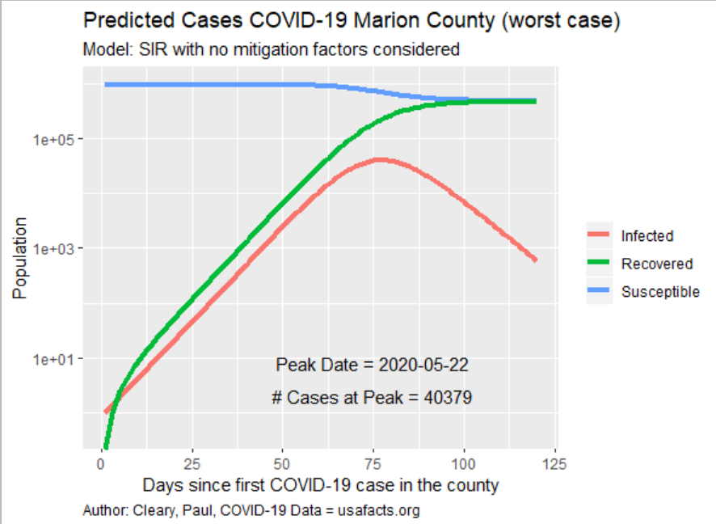
Predicting the Peak Marion Co
From April 17 to May 3 the model has shifted the peak date from May 08 to May 22
The predicted # of cases has dropped from 63,098 to 40,379
As of 03 May 2020
Burke Graduate Program; lyles school of civil engineering
15

Slide 17
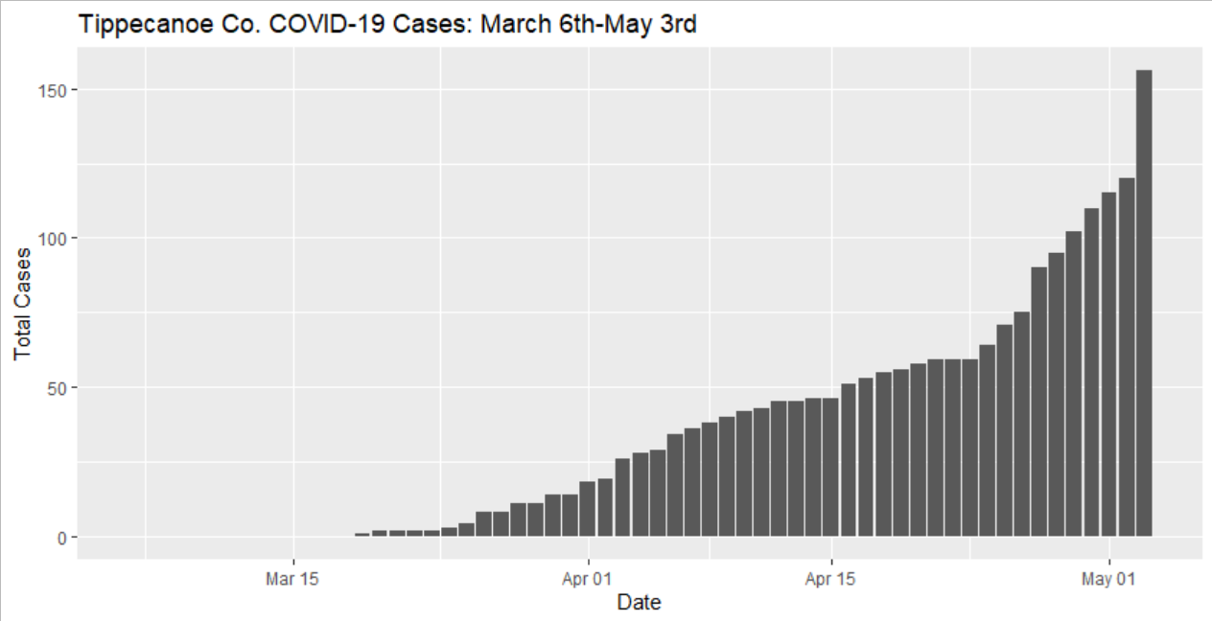
Predicting the Peak Tippecanoe Co
Burke Graduate Program; lyles school of civil engineering
16

Slide 18
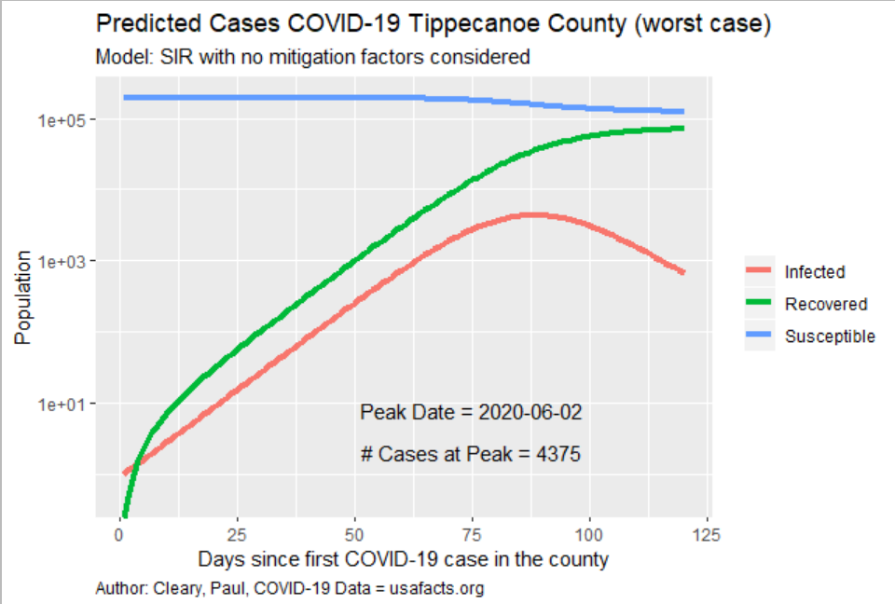
Predicting the Peak Tippecanoe Co
From April 17 to May 3 the model has shifted the peak date from May 16 to June 02
The predicted # of cases has dropped from 7,121 to 4,375
Noticed it is susceptible to sudden spikes in cases
Burke Graduate Program; lyles school of civil engineering
17

Slide 19
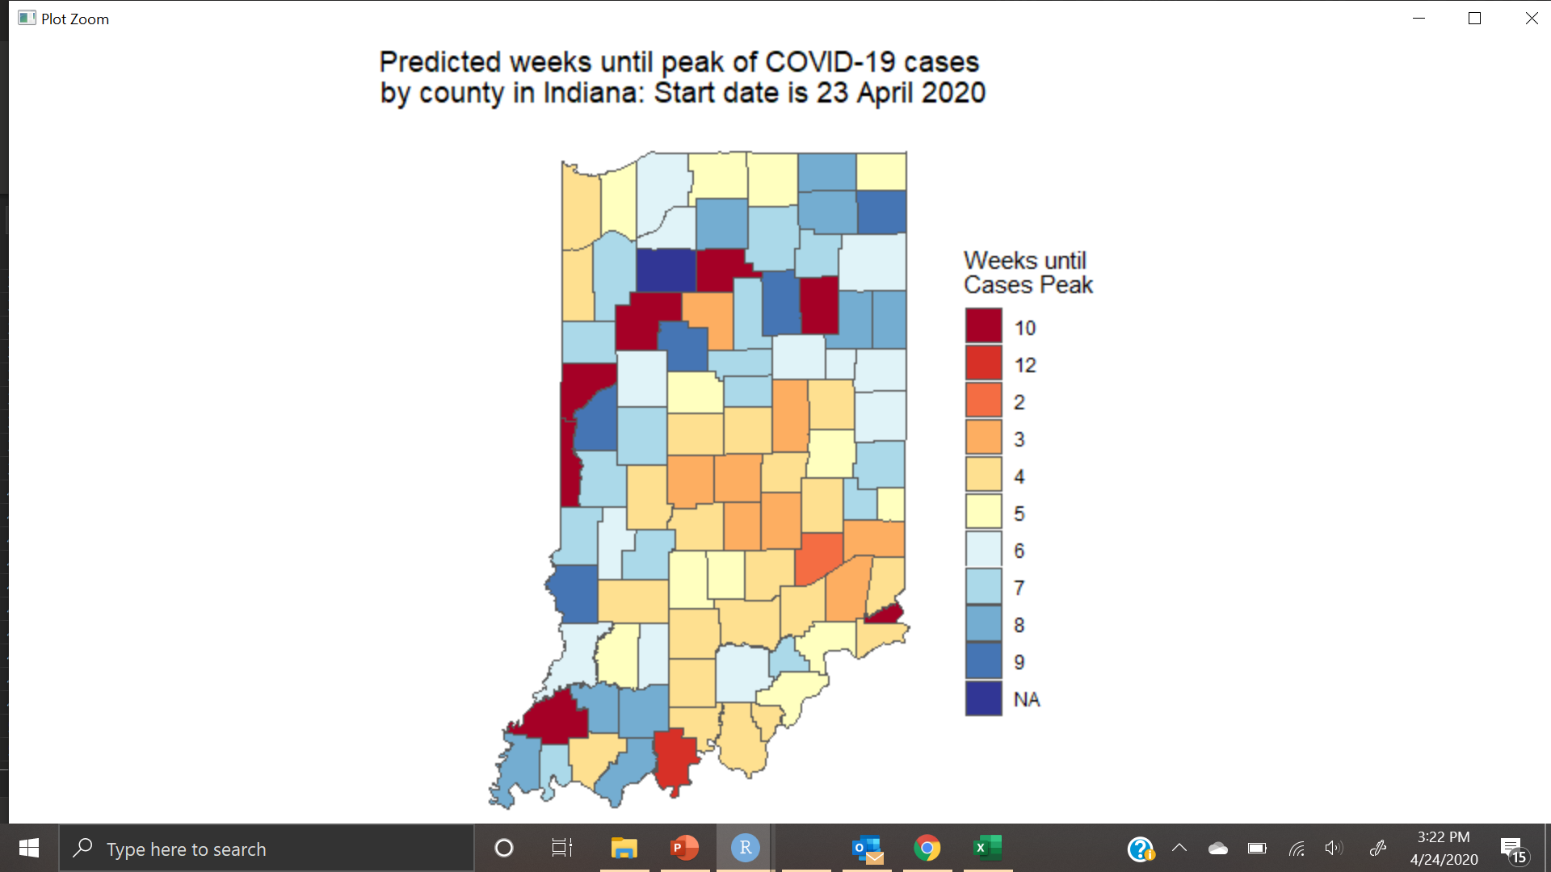
Predicting the COVID-19 Peak
Used the predicted peak date to develop a week by week forecast for the state
Intended to help in forecasting where medical assistance may be required
Burke Graduate Program; lyles school of civil engineering
18

Slide 20
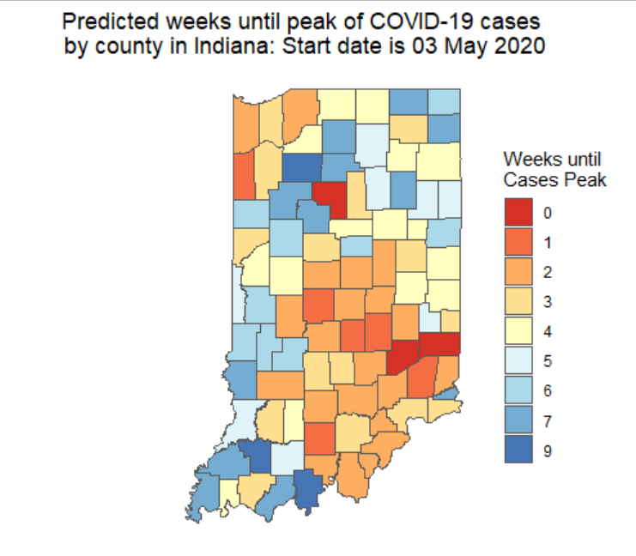
Predicting the COVID-19 Peak
The expected peak date of peak cases continues to move right on the calendar
This may be a result of social distancing and other efforts to slow the spread and ‘flatten the curve
Burke Graduate Program; lyles school of civil engineering
19

Slide 21
Conclusion
COVID-19 is clustered in higher density areas
Initial method of transmission was via air travel
Regional method of transmission is likely commuters and the workplace
Local growth of the virus continues to increase
The predicted date of peak continues to push to the right
Possibly a result of social distancing
Predicted number of cases is declining
Burke Graduate Program; lyles school of civil engineering
20

