Slide 1
Modified Bloch Equations

Slide 2
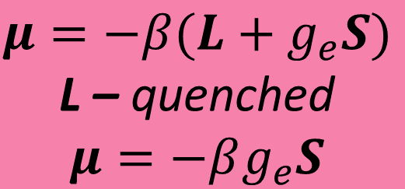
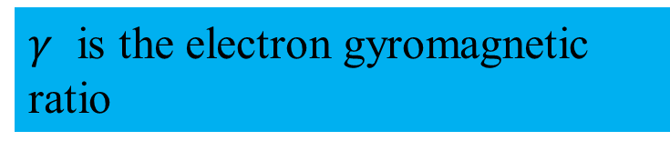
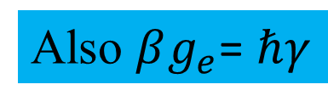
Bulk Magnetization
$$μ=−β(L+g_{e}S)$$
L – quenched
$$μ=−βg_{e}S$$
The magnetic moment (μ) is a vector parallel to the spin angular momentum (S).
$γ$ is the electron gyromagnetic ratio
Also $βg_{e}$= $ℏγ$
Unfortunately, the vast majority of the magnetic moments cancel one another. The “Boltzmann excess” in the a state add together to create bulk angular momentum (J) and magnetization (M).

Slide 3
Gyroscopes!
Classical physics tells us about the motion of a magnet in a magnetic field
This is very similar to the motion of a spinning gyroscope or top in a gravitational field
L(t) is the gyroscope’s angular momentum, r its radius from the fixed point of rotation, m its mass and g the force of gravity.

Slide 4
The macroscopic view
Equilibrium state with similarily populated α-(up, +1/2) and β(down, -1/2)-states (left), uncorrelated phases (middle) and no net phase coherence (right).
Coherent state of spins in α - or β(left) states and the projection onto the x,y plane(middle) and sum vector of the x,y component.

Slide 5
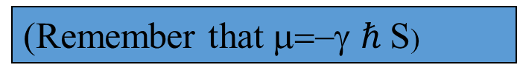
Bloch Equations
We can make the equations easier to deal with by multiplying both sides by γ
Multiply by γ
(Remember that μ=−γ $ℏ$S)

Slide 6
Bloch Equations
Therefore, Felix Bloch made the following modifications to the basic equation
Empirical modification in which a “relaxation matrix” R acts on magnetization that is different from the equilibrium state, M₀

Slide 7
Bloch Equations
This equation is easiest to understand broken into its matrix components.
Magnetization along the z-axis
Magnetization along the x-axis
Magnetization along the y-axis

Slide 8
Bloch Equations in the Rotating Frame
Substituting Ω=-γB₀-ω_{rf} (where B₀=B_{z} and is not time-dependent) into the Bloch equations yields:
The “r” superscript refers to a magnetic field in the rotating frame

Slide 9
Cramer’s Rule
Let us first show the use of Cramer's rule to solve two equations in two unknowns.
Then we will generalize it to n equations in unknowns. Consider the set of equations:

Slide 10
If we multiply the first equation by b₂, the second by b₁, and then subtract the results and solve for x, we get (if a₁ b₂ - a₂b₁≠ 0)

Slide 11
Solving for y in a similar way, we get

Slide 12
Using the definition of a second order determinant, we can write the solutions in the form

Slide 13
Energy levels of a system with S = ½ and I = 1
M_{I} = +1
M_{I} = 0
M_{I} = -1
Energy E
M_{s} = +½
ΔE = hυ = β_{e}gB + AM_{I}
M_{I} = -1
M_{I} = 0
M_{I} = +1
M_{s} = -½
B = 0
Magnetic field B
+1
0
-1
A

Slide 15
Continuous Wave (cw) EPR:

Slide 16
We have to solve the following equation
The terms containing W and V describe the loss of the spin coherence (W) and the spin coherence transfer (V)

Slide 17
Definitions and Variables

Slide 22
Dipole-Dipole Broadening

Slide 23
HSE Broadening

