Slide 1

Fermi Gas: Heat Capacity Approximation
Patrick McMillin
Dr. Taheri
PHYS 431
7 December 2017

Slide 2
Assumptions and Goal
Test two approximations for a Fermi Gas which:
Is trapped such that the energy levels are evenly spaced
Assuming spacing such that:
Where ‘U’ is the total energy, ‘q’ are the number of energy packets, and ‘η’ is the spacing of the energy levels.
Has nondegenerate energy levels (only 1 fermion per level)
The goal is to show that these approximations give the correct relationship for heat capacity for a Fermi Gas, as found analytically in class though the Sommerfeld Expansion.

Slide 3
Unrestricted Partitions
An “unrestricted partition” is the number of ways that a non-negative integer can be expressed as a sum of other non-negative integers (excluding degeneracies).
I will define p(q) as the unrestricted partition of the number ‘q’.
This relates to the nondegenerate Fermi Gas with evenly spaced energy levels because the unrestricted partition of the number of energy packets is the number of ways the available energy can be arranged among the fermions in the Fermi Gas.
This is the number of microstates which correspond to a particular energy level.

Slide 4
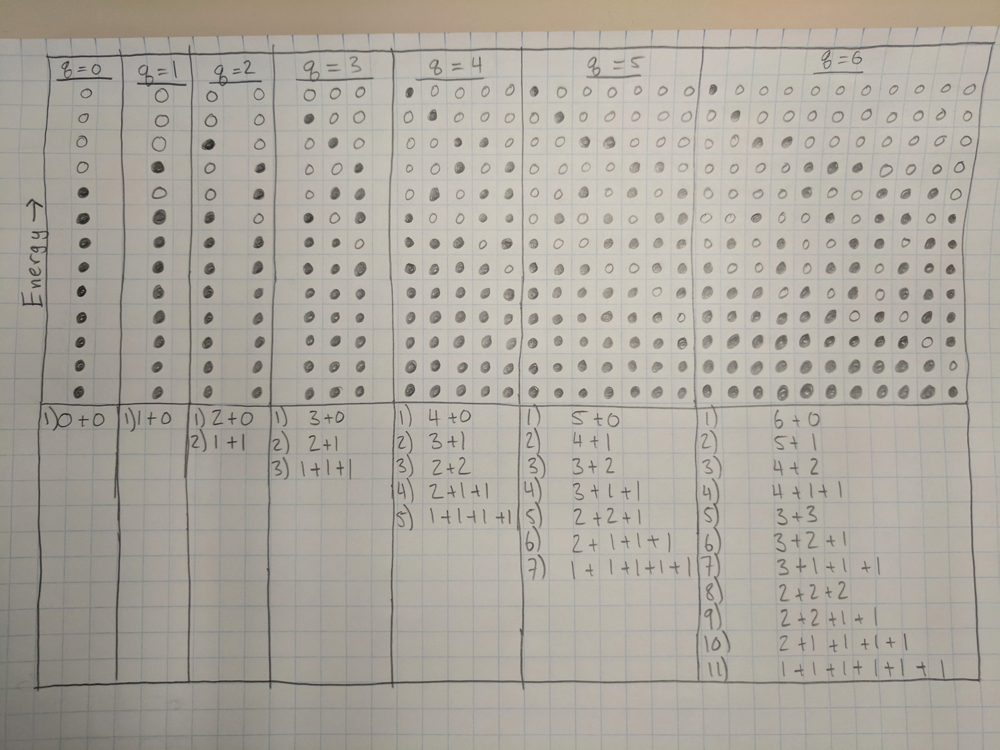
Unrestricted Partitions

Slide 5
Generating Function and the Pentagonal Numbers
There is a generating function for unrestricted partitions which comes from the Pentagonal Number Theorem:
Where the sum is taken over all non-zero values of k, and g_{k} is the k^{th} generalized pentagonal number given by:

Slide 6
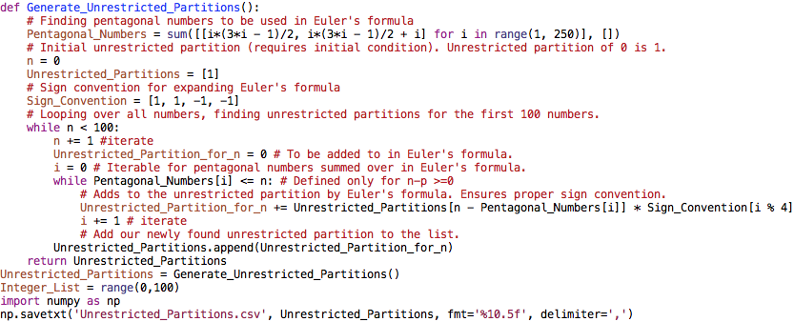
Generating Unrestricted Partitions
Python code which generates the unrestricted partitions of numbers up to 100.

Slide 7

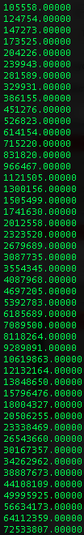

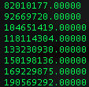
The first 100 Unrestricted Partitions
To the left are the unrestricted partitions for the numbers 0 through 100. For reference, below is a list of the first few unrestricted partitions from a Wolfram Research website.
The fact that the 100th unrestricted partition is correct is very important. Since the generating function depends on the values of the unrestricted partitions calculated before it, this tell us that all the unrestricted partitions which come before 100 are also correct.
100th Unrestricted Partition : 190569292

Slide 8
Entropy, Temperature, and Heat Capacity
Available microstates are equal to the unrestricted partitions.
Entropy is the natural logarithm of the partitions.
Temperature from the definition.
Heat Capacity from the definition.
The temperature and heat capacities are calculated from the “centered difference” method.

Slide 9
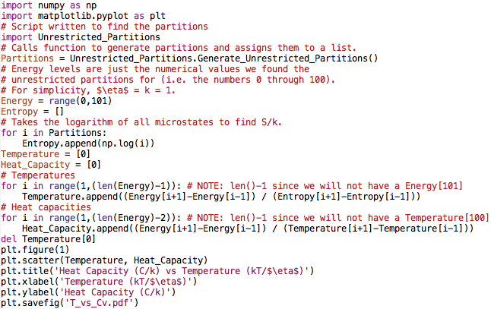
Finding Heat Capacity and Plotting

Slide 10
Heat Capacity from Partitions

Slide 11
Ramanujan’s Approximation
Ramanujan and Hardy developed an equation which estimates the unrestricted partitions of a number:
This equation works well in the limit of high q (large temperatures compared to the energy level spacing).
p(100) = 190569292 by the generating function
p(100) = 175236785 by Ramanujan’s approximation.
p(1000) is only 1.5% larger than the actual value.

Slide 12
Entropy From Ramanujan’s Approximation
From Ramanujan’s equation, we can easily find an expression for entropy to differentiate to find the temperature.
Heat capacity requires energy as a function of temperature, which is what we can obtain if we solve this quadratic equation.
This is were we make the approximation for kT >> η.
We can expand the solution to the quadratic equation, and obtain the next equation for energy as a function of temperature.
Finally, we differentiate the equation, and obtain our approximation for the heat capacity.

Slide 13
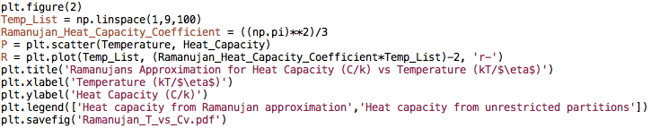
Plotting Ramanujan’s Approximation
Continued from the last script where the heat capacity of the unrestricted partitions was plotted.

Slide 14
Comparison

Slide 15
Conclusions
We find that the two approximations used for the heat capacity of a Fermi Gas follow the behavior found from the Sommerfeld expansion:
We see explicitly the correct dependence in the formula derived from Ramanujan’s approximation:

Slide 16
Differences
The main difference between this special case and the case investigated by using the Sommerfeld expansion is the lack of the ‘N’ dependence.
The approximation does not depend on N because we did not make any assumptions about the volume of the system. Our assumption of evenly spaced energy levels hides the need for a volume and distribution function for the system.

Slide 17
Sources
http://functions.wolfram.com/IntegerFunctions/PartitionsP/introductions/Partitions/ShowAll.html
J. Arnaud et al., American Journal of Physics 67, 215 (1999).
Schroeder, Daniel V. An Introduction to Thermal Physics. Pearson, 2014.

