Slide 1

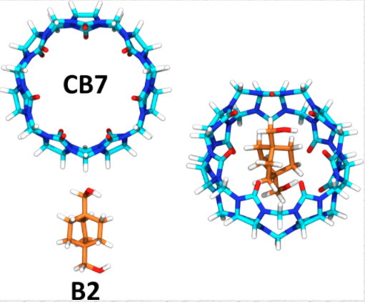
Binding Free Energies of Host-Guest Complexes Using 3D-RISM
Physics 497 Presentation 1
Live Oak Hall 1100
23 February 2018
Patrick McMillin
Advisor: Dr. Tyler Luchko

Slide 2
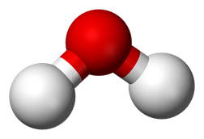
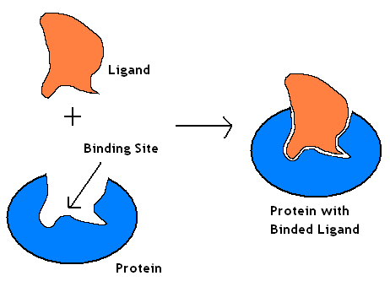
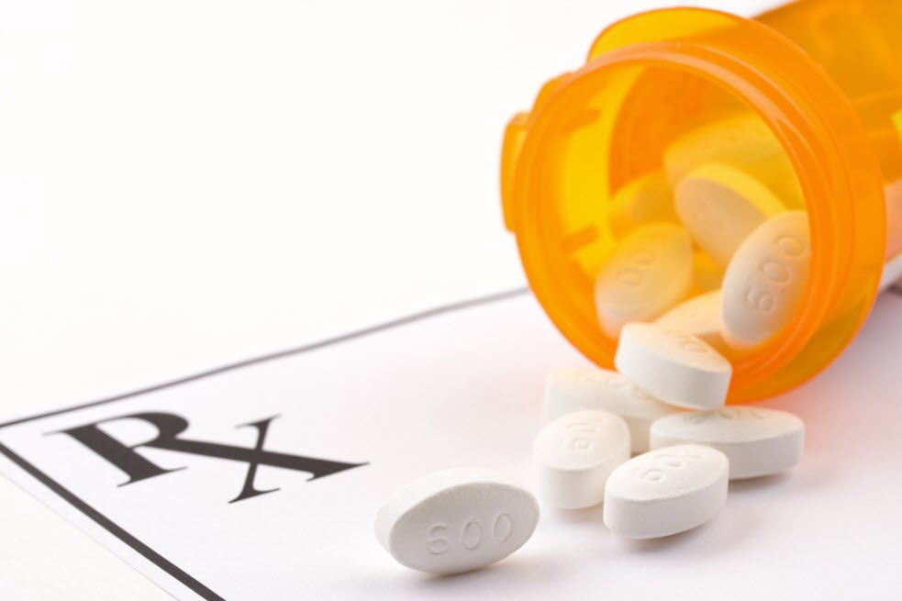
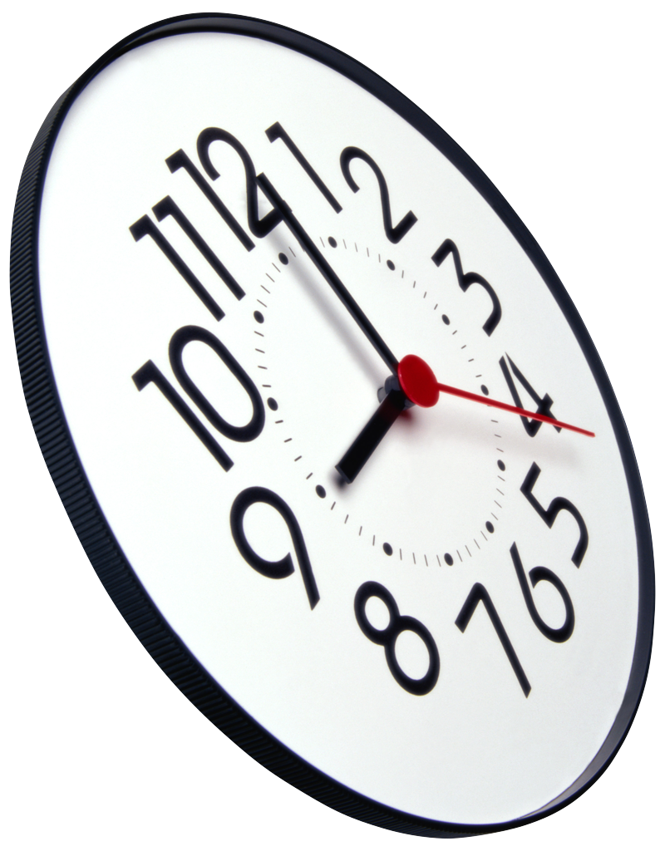
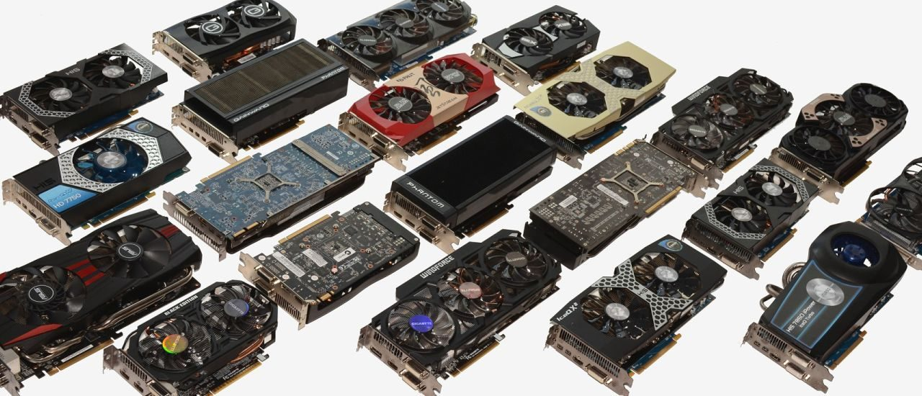
Binding, Drug Design, and Computers
Binding information is vital to drug design.
Binding sites
This is expensive information.
Computer simulations allay the costs.
There are still massive costs to this approach.

Slide 3
3D-Reference Interaction Site Model (3D-RISM)
Simulations require a solvation model.
Advantage of 3D-RISM comes in several forms
No explicit water
Solvation thermodynamics easily found
RISM is an approximate solution to the Ornstein-Zernike equation:
This solution requires a closure to connect the shorter range to the longer range .
The thermodynamic properties come from this solution.

Slide 4
Host-Guest Complexes
Host: cucurbit[7]uril
Guest: 16 molecules
Image of test molecule
(Will be ready soon!)
This small scale test serves two purposes:
Part of a blind challenge from UC Irvine
Compare 3D-RISM with other models

Slide 5
Simulations
The AMBER modeling suite
All systems were prepared with tleap
The simulations were performed through sander
Simulated 5 ns per run for 20 runs (100 ns):
the host and guests individually (17)
All host-guest pairs (16 pairs)

Slide 6
What We Want
We want .
is the sum of the molecular mechanics potential and the excess chemical potential (both found from the simulation directly).
is found from this wonderful relation (also entirely from the simulation):
But needs to be calculated form an external program called MMPBSA.py.

Slide 7
Results
So far, we have and .
I am stuck a bit on finding , and this is what I have been working on.
I have clear direction, and it should only take at most two more weeks to finish the analysis.
In other words: I’ll have numbers next time!

Slide 8
Some Numbers
The following are effective potential differences: [(Host+Guest)-Complex, Error (added in quadrature)]
'mol01_Complex_Difference': [-0.36415161371991189, 0.094155598933964552],
'mol02_Complex_Difference': [-6.7832988970055226, 0.063916003952021183],
'mol03_Complex_Difference': [4.5066129118374647, 0.096022133392155345],
'mol04_Complex_Difference': [4.793526121051741, 0.13245858614457567],
'mol05_Complex_Difference': [-14.737559225569896, 0.25237851047248355],
'mol06_Complex_Difference': [1.4457247073087842, 0.12328458283884924],
'mol07_Complex_Difference': [1.4575955644819487, 0.1167228183210033],
'mol08_Complex_Difference': [9.9385258345181455, 0.11399578255030217],
'mol09_Complex_Difference': [16.429947647571453, 0.076457703095171484],
'mol10_Complex_Difference': [-21.239486527910515, 0.14653031693112434],
'mol10b_Complex_Difference': [1.7717602591822583, 0.13408579996353098],
'mol11a_Complex_Difference': [3.5338731288551344, 0.060499864456543657],
'mol11b_Complex_Difference': [4.1073497628215705, 0.063480458795946423],
'mol12_Complex_Difference': [22.501195626613935, 0.062843937164414679],
'mol13_Complex_Difference': [16.16778047583324, 0.061281097915360599],
'mol14_Complex_Difference': [24.550321084686402, 0.063296437540702744]}

Slide 9
Conclusions
The data has been collected
Analysis is continuing
Will have some results in a few weeks

Slide 10
References
Fenley, Andrew T, and Michael K Gilson. “Host-Guest in Explicit Water Example Calculating the binding enthalpy of guest B2 with host cucurbit[7]Uril (CB7).” AMBER Advanced Tutorial 21 , ambermd.org/tutorials/advanced/tutorial21/index.html.
Nolan, Sam. “Prescription Coverage: A Roadmap and FAQ’s”. Highmark Health.https://blog.highmarkhealth.org/prescription-coverage-a-roadmap-and-faqs-on-prescription-coverage/
“The Best GPU For Mining Ethereum”. Cryptosrus. Nov. 6, 2017. https://cryptosrus.com/best-gpu-for-mining/
“How Do I Draw A Water Molecule?”. Answered by Robin Corey. Quora. Sept. 6, 2015. https://www.quora.com/How-do-I-draw-a-water-molecule
D.A. Case, R.M. Betz, D.S. Cerutti, T.E. Cheatham, III, T.A. Darden, R.E. Duke, T.J. Giese, H. Gohlke, A.W. Goetz, N. Homeyer, S. Izadi, P. Janowski, J. Kaus, A. Kovalenko, T.S. Lee, S. LeGrand, P. Li, C. Lin, T. Luchko, R. Luo, B. Madej, D. Mermelstein, K.M. Merz, G. Monard, H. Nguyen, H.T. Nguyen, I. Omelyan, A. Onufriev, D.R. Roe, A. Roitberg, C. Sagui, C.L. Simmerling, W.M. Botello-Smith, J. Swails, R.C. Walker, J. Wang, R.M. Wolf, X. Wu, L. Xiao and P.A. Kollman (2016), AMBER 2016, University of California, San Francisco.
Chong and Ham, “Dynamics of Hydration Water Plays a Key Role in Determining the Binding Thermodynamics of Protein Complexes.”
Other Images used are public domain.
Special thanks to Meng-jou wu for releasing the ligand-protein binding image.

