Slide 1
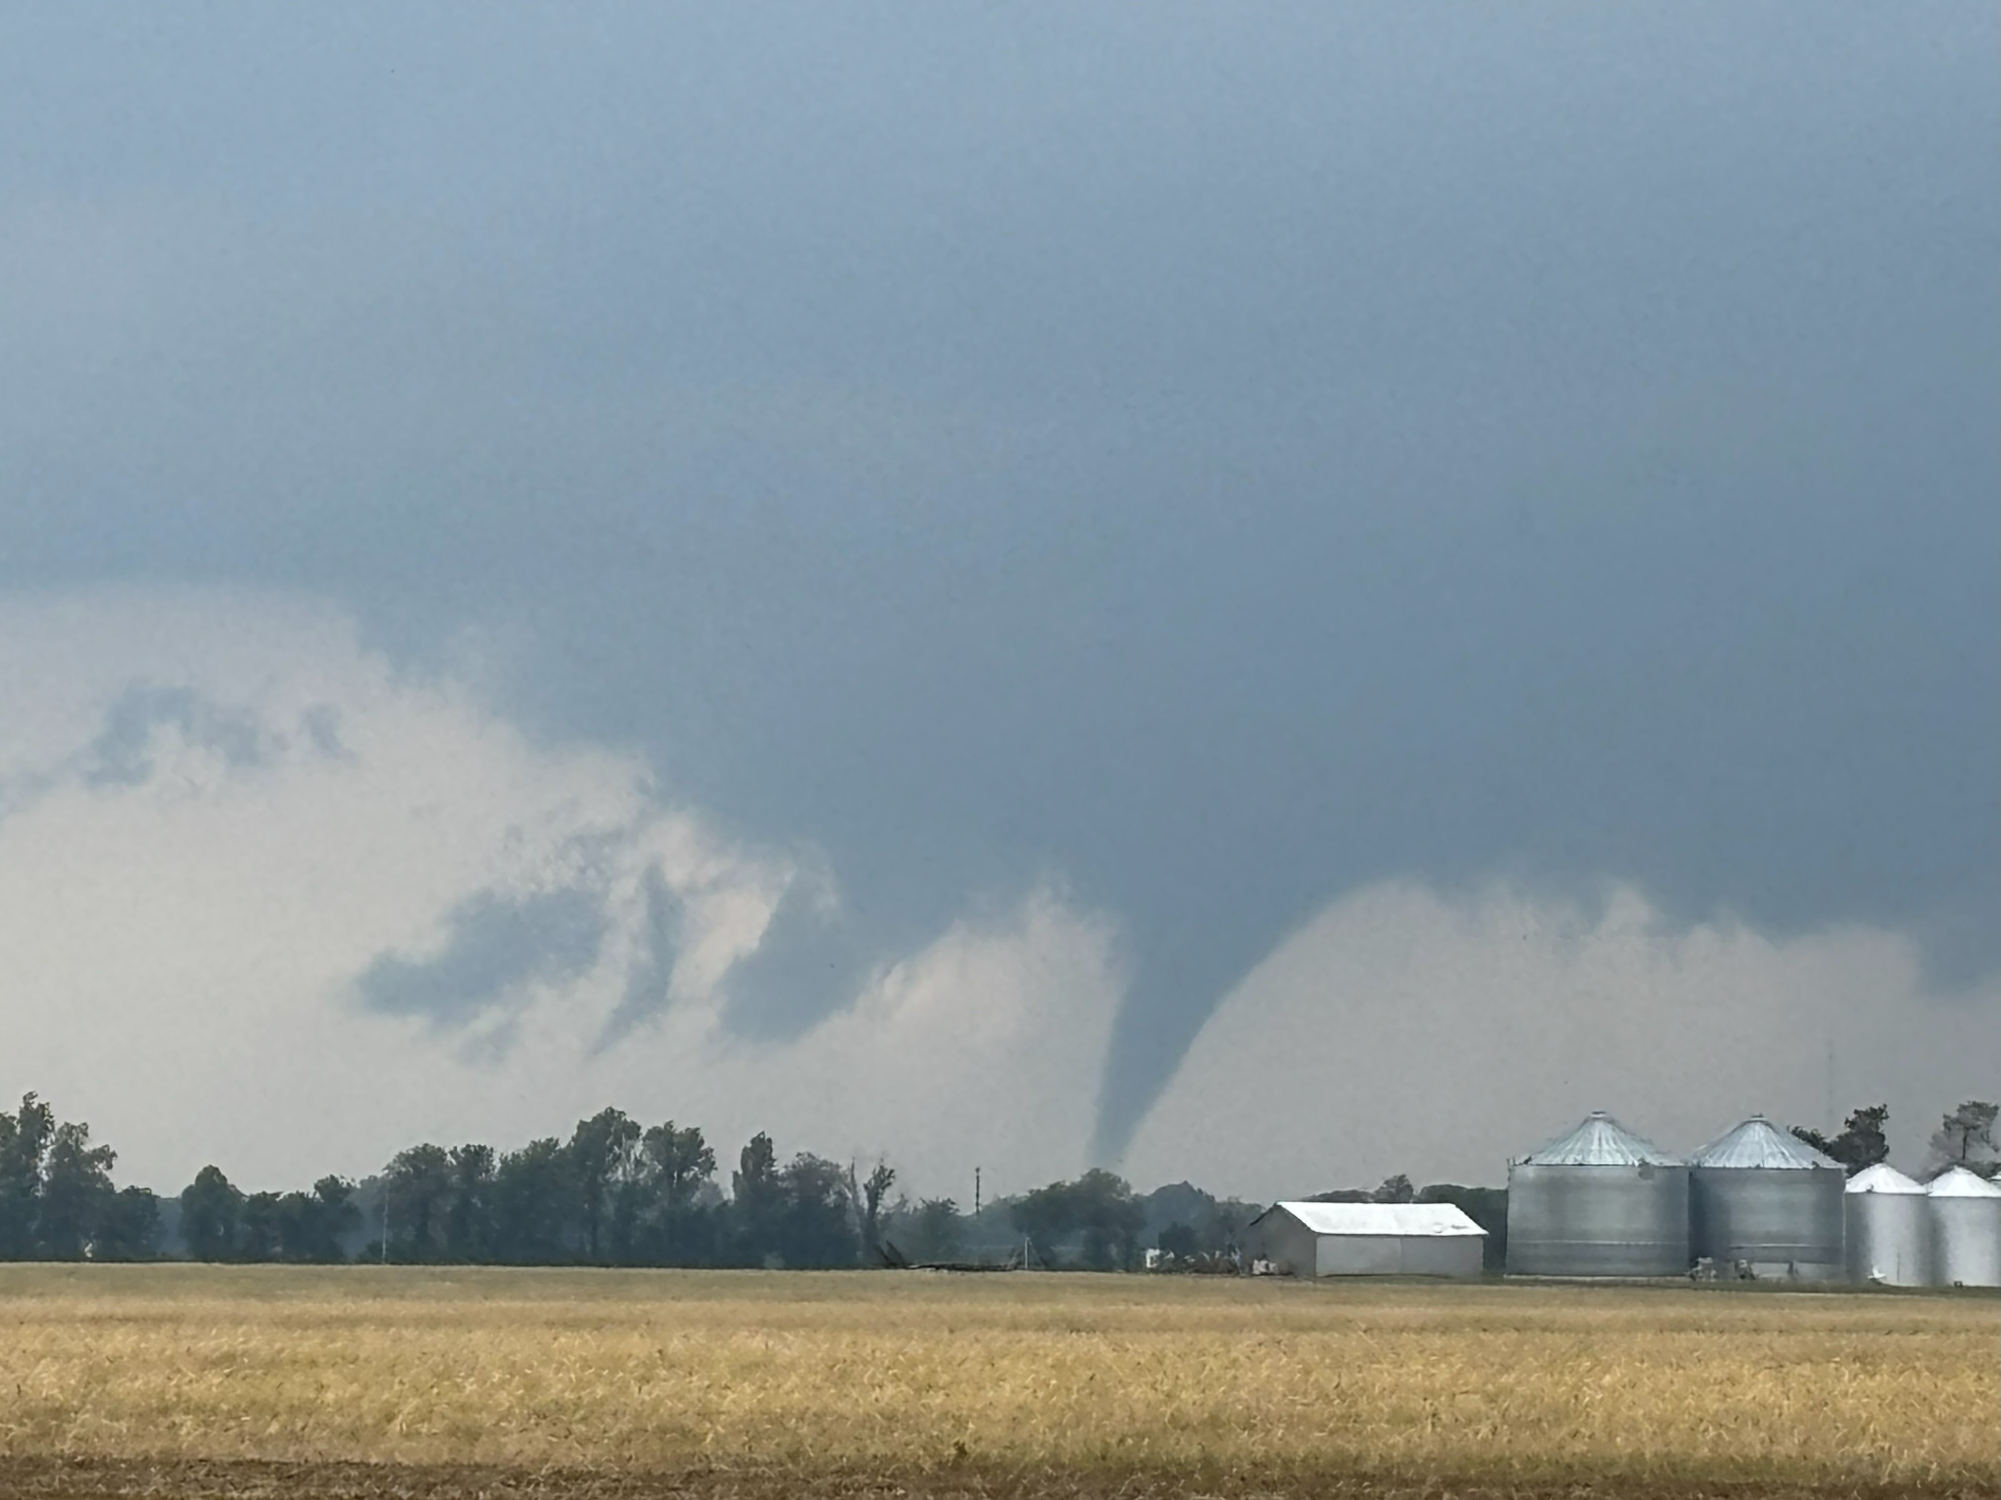




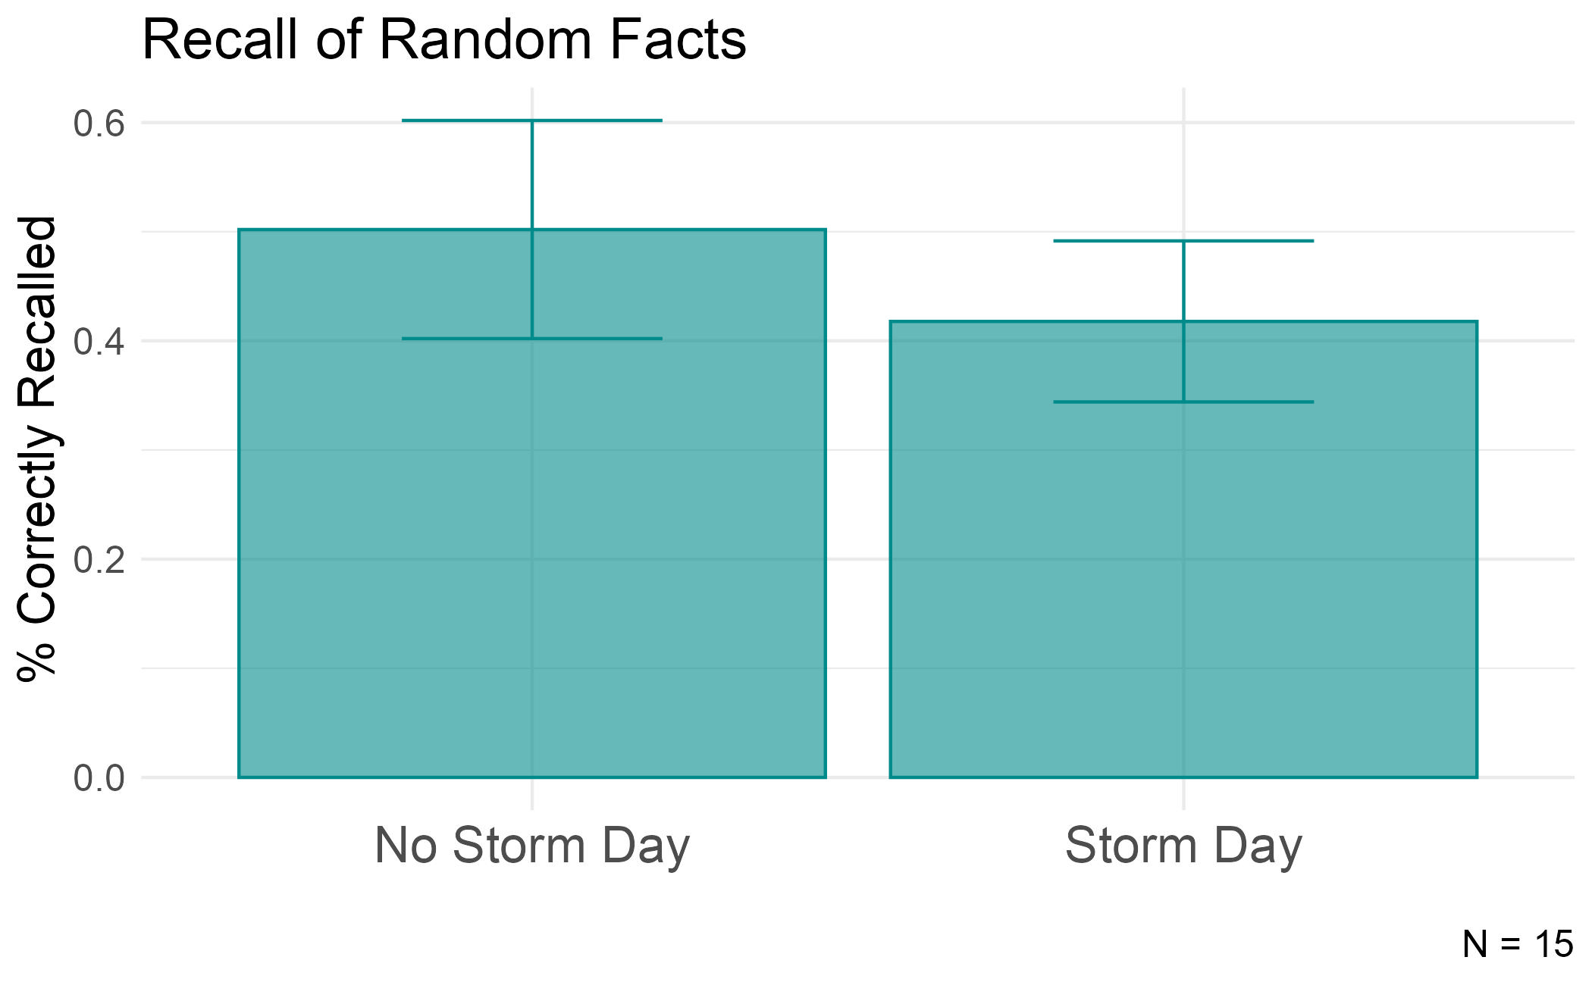
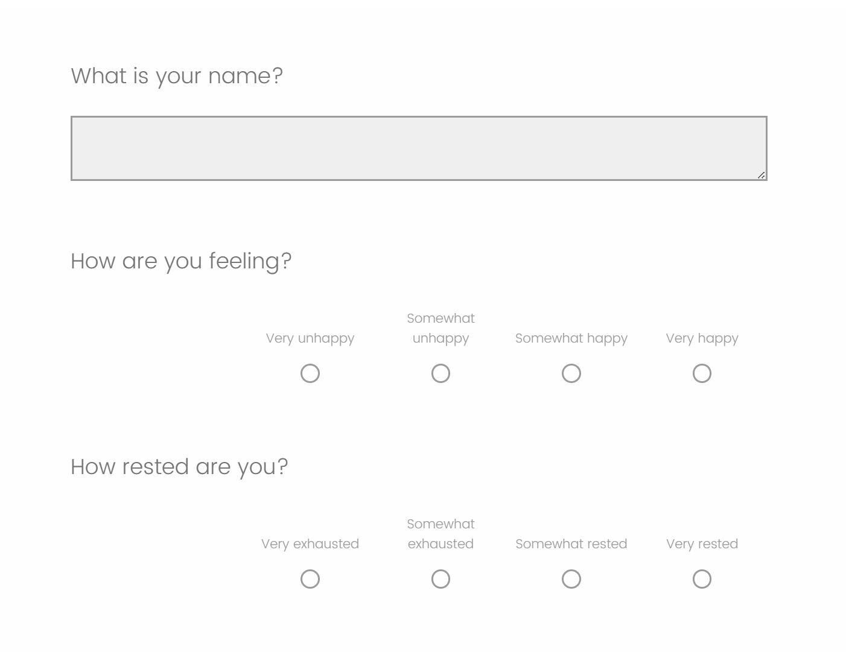
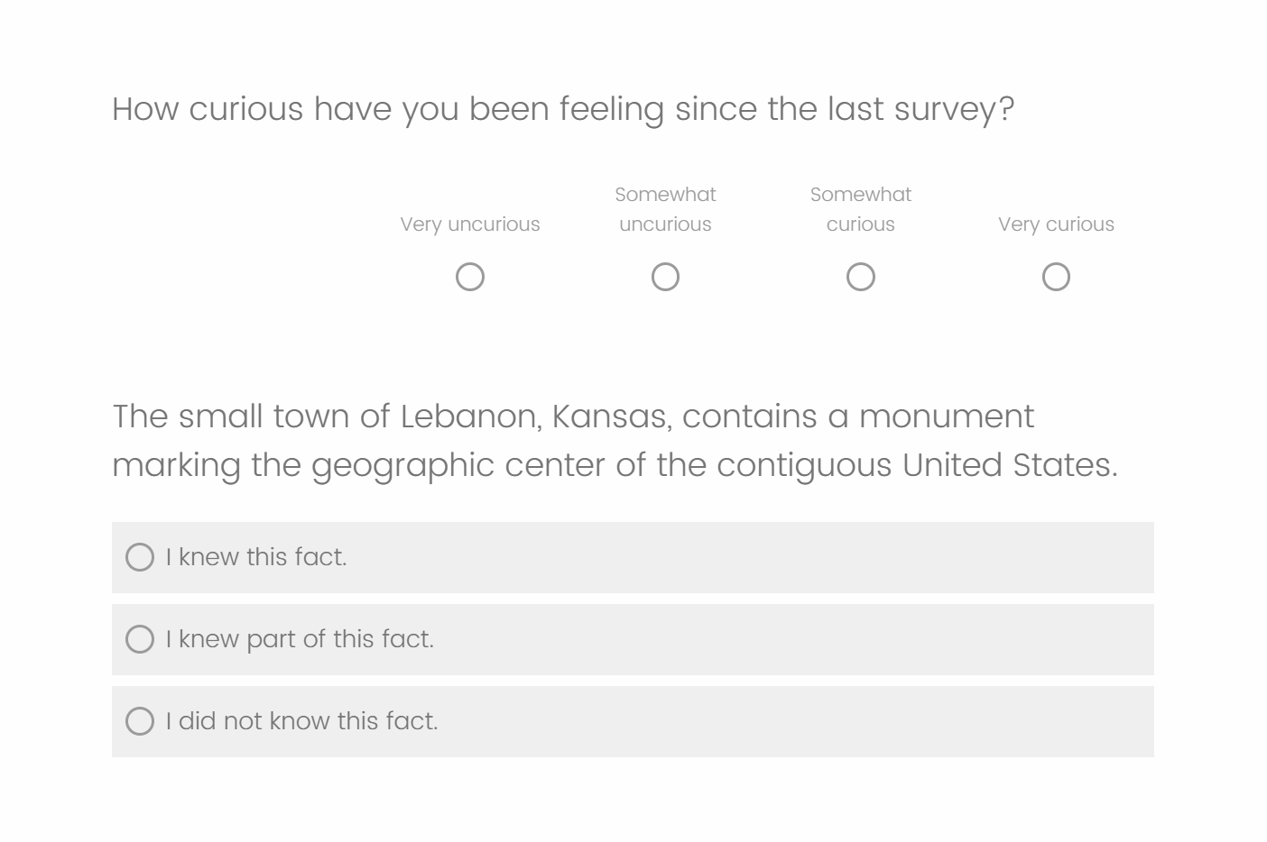
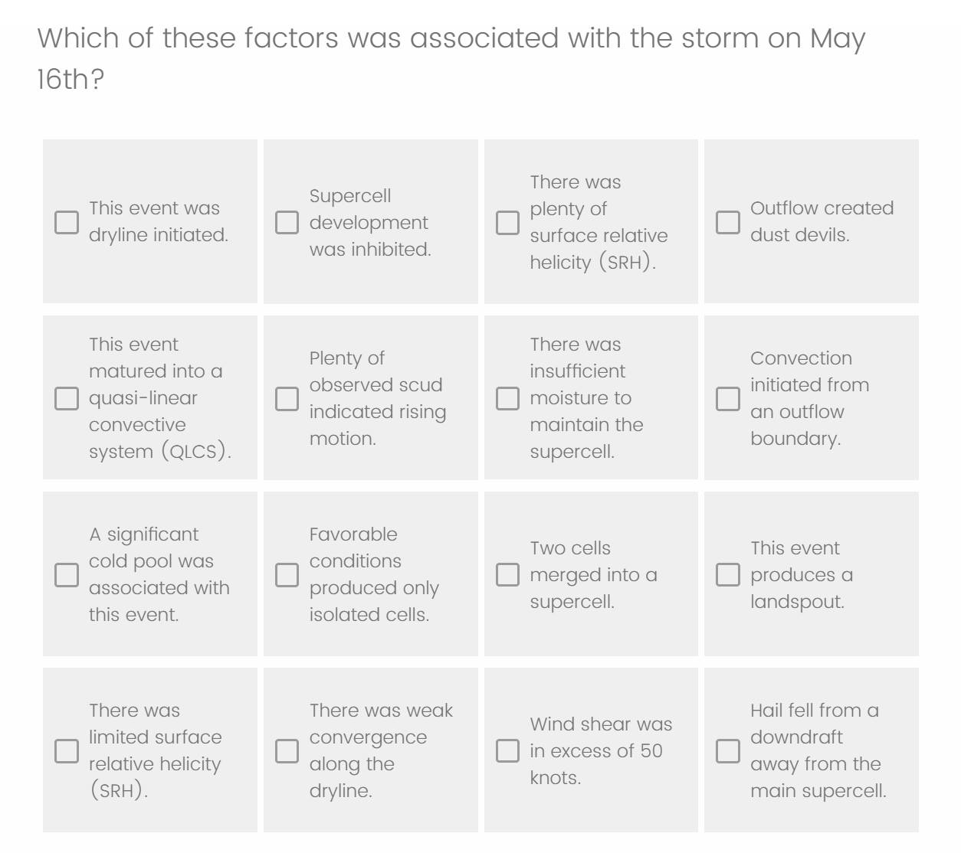
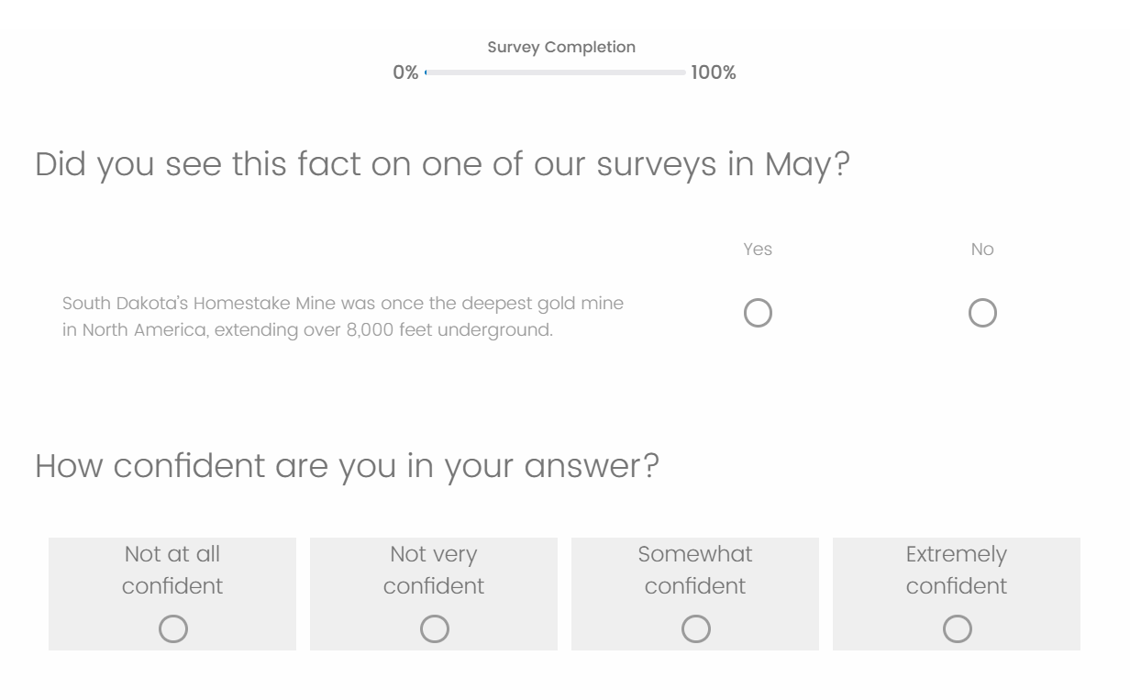
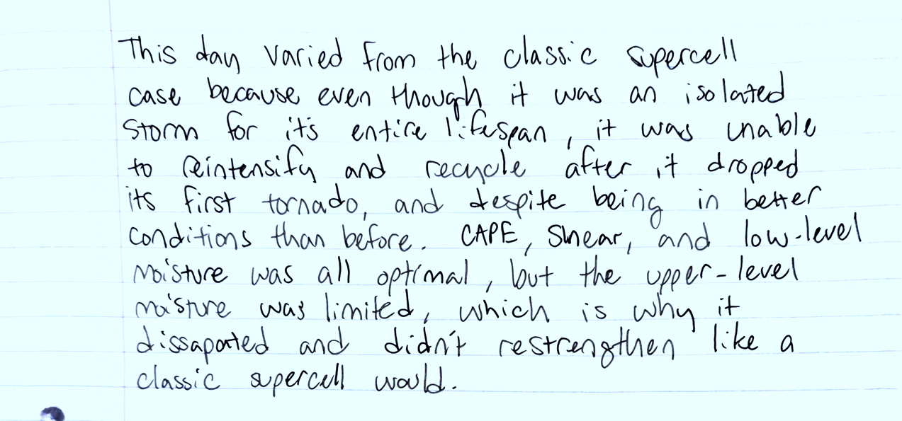
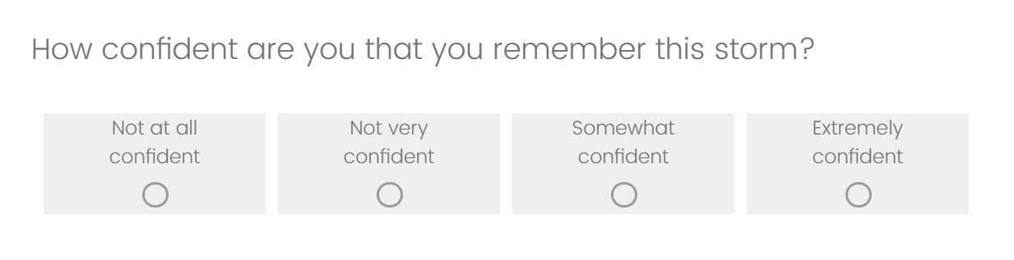
Authentic Meteorology Learning Experiences:
How do Emotions Affect Memory and
Learning During a Convective Field Study?
Patrick Schneider¹, Peggy McNeal¹, Courtney Sheckler², Tim Shipley², Teresa Bals-Elsholz³, Kevin Goebbert³
¹Towson University, ²Temple University, ³Valparaiso University
Introduction and Research Questions
Convective field courses give meteorology students the chance to learn in real time while observing storm development. These experiences can be exciting, stressful, and exhausting, all of which are emotional states known to influence how individuals remember events. This project studies how students’ emotions during an 11-day storm-chasing field course impact their memory for both meteorological concepts and geographical information. Our overall purpose is to understand how convective field experiences work as effective opportunities for learning meteorology content. Do these experiences facilitate “teachable moments”?
Our research questions are:
How does recall of random facts presented on chase days compare with those presented on non-chase days?
How does emotion regulate recall of random facts six months later?
How does emotion regulate recall of meteorological content six months later?
Note: This work is in progress, and we are continuing to analyze data to address RQ#2. Stay tuned!
Results
Results (con’t)
Validation checks: Confidence ratings significantly predicted correct recall of old facts that participants had seen in May, z = 6.11, p < .001. Additionally, prior knowledge of random facts was a significant predictor of correct recall, z = 4.11, p < .001.
Effects of Storm Chase Days: Storm chase days were associated with marginally worse recall of old facts, z = -1.91, p = .057 (Figure 5).
Subjective experience: Participants reported feeling significantly less happy, z = -2.60, p = .010, and more curious, z = 3.96, p < .001, on storm days. Feeling rested did not differ significantly between storm and non-storm days, z = -1.22, p = .225.
Subjective experience effects on memory: None of the subjective variables significantly predicted recall in the full dataset. This null pattern remained when restricting analyses to previously unknown facts and to high-confidence responses, indicating that subjective experience during encoding did not reliably predict subsequent memory performance.
Table 1. Binomial Logistic Regression Results Predicting Memory for Random Facts * p < .05. † p < .10.
Analysis | Predictor | z | p
Validation Checks
 | Confidence ratings | 6.11 | < .001*
 | Prior knowledge | 4.11 | < .001*
Storm Chase Day Effects
Memory performance | Storm day (vs. non-storm) | -1.91 | .057†
Subjective experience | Feeling (unhappy) | -2.60 | .010*
 | Curious | 3.96 | < .001*
 | Rested | -1.22 | .225
Background
Convective field studies give students the opportunity to apply forecasting, nowcasting, and storm analysis skills under rapidly changing weather conditions. Students spend long days travelling while continuously checking surface maps, examining radar, and adjusting target locations. These scenarios inspire emotional responses like excitement, anxiety, and curiosity. Prior work shows that emotional events, whether positive or negative, are memorable because they focus attention on important aspects of the experience (Kensinger, 2009).
Research shows that emotionally charged events are remembered differently than ordinary events. Arousal-biased competition theory states that when people are emotionally aroused, their attention and memory become biased towards the most meaningful or “high-priority” details of an event (Mather & Sutherland, 2011). During a storm chase, these “high-priority" details may include storm structure, hazardous features, or damages, while “low-priority” details, such as routes taken, temperature, or time of day, fade.
Highly emotional events can form long-lasting memories through emotional binding, where emotional reactions become tied to core details of events, causing these memories to persist over time (Yonelinas & Ritchey, 2015). This bind is represented in “flashbulb memories,” when individuals remember dramatic events with great detail years later (Brown & Kulik, 1977).
Figure 5. Recall of random facts.
Discussion
This study examined how emotions experienced during an 11-day convective field course influenced students’ long-term recall. Research question #1: How does recall of random facts presented on chase days compare with those presented on non-chase days? Recall of random facts encountered on storm days was lower than recall of facts encountered on non-storm days, which supports the idea that emotionally intense storm-chases focus attention on the storms themselves at the expense of peripheral details event (Mather & Sutherland, 2011.
Research question #2: How does emotion regulate recall of random facts six months later? Although participants reported higher curiosity and lower happiness on storm days, none of the measured emotional states predicted recall six months later, suggesting that being emotionally engaged by curiosity did not automatically lead to better memory. The combination of lower happiness but higher curiosity may be a unique emotional experience during storm chasing that could be explored with future research.
Future work: Statistical analysis of of data related to RQ #3 and qualitative analysis of interview data.
Methods
Data collection: During Valparaiso University’s May 2025 field course, 13 students and two instructors completed three surveys per day tracking their emotions, rest level, and curiosity using ecological momentary assessment (collecting emotional data in real time; Figure 1). Each survey included a geographical fact that participants would be tested on in the future. Participants also kept journals describing how each storm differed from the classic textbook case (Figure 2). Six months later, participants were given a 60-fact recognition test made of geographical facts from the May surveys and new geographical facts (Figure 3). They were asked to identify storm factors from a matrix based on their storm journals (Figure 4) and participated in semi-structured interviews recorded on Zoom where they were asked to recount their strongest memories from each chase day Data analysis: After cleaning and formatting the data, we ran binomial logistic regressions to validate our measures, examine whether storm chase days affected memory performance and subjective experience, and how storm chase days affected memory performance and subjective experience. All analyses predicting memory used correct recall (remembered vs. not remembered) as the outcome. We mean centered (by participant) all analyses using subjective experience measures (feeling, rested, curious); however, the pattern of results remained consistent when using raw values.
Acknowledgments
We are deeply grateful to the Valparaiso University instructors and students who participated in this study. We would like to thank Deepu Murty at the University of Oregon for assistance in the statistical analysis of our data.
This material is based upon work supported by the National Science Foundation under Grant Numbers AGS-2413370 and AGS-2413371. Any opinions, findings, and conclusions or recommendations expressed in this material are those of the author(s) and do not necessarily reflect the views of the National Science Foundation.
Figure 1. Example survey administered to participants in May 2025.
Figure 4. Matrix of storm factors used in the November 2025 follow-up survey.
References
Brown, R., Kulik, J., (1977). Flashbulb memories. Cognition, 5(1), 73-99.
Kensinger, E. A., (2009). Remembering the details: Effects of emotions. Emotion Review, 1(2): 99-113.
Mather, M., Sutherland, M. R., (2011). Arousal-biased competition in perception and memory. Social Psychological and Personality Science, 6(2): 114-133.
Yonelinas, A. P., Ritchey, M., (2015). The slow forgetting of emotional episodic memories: An emotional binding account. Trends in Cognitive Sciences, 19(5): 259-267.
Figure 2. Example journal entry, May 2025.
Figure 3. Example task from the 60-fact recognition test November 2025.

