Slide 1
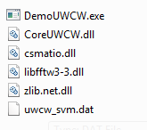
Contents
DemoUWCW.exe: the main program and UI
CoreUWCW.dll: the core functions, actual implementation of the algorithm
csmatio.dll and zlib.net.dll: a third-party library used to read .mat files
libfftw3-3.dll: FFTW library for FFT
uwcw_svm.dat: the SVM data that the program will automatically load
These files shall be kept in the same directory
Additional requirement: Microsoft .Net Framework 4.0
When you build the solution, these files will be automatically copied over to $(SolutionDir)\Release or $(SolutionDir)\Debug.
For debugging, you need to first set the working directory to that local directory so that the dependency dlls can be found and loaded.

Slide 2
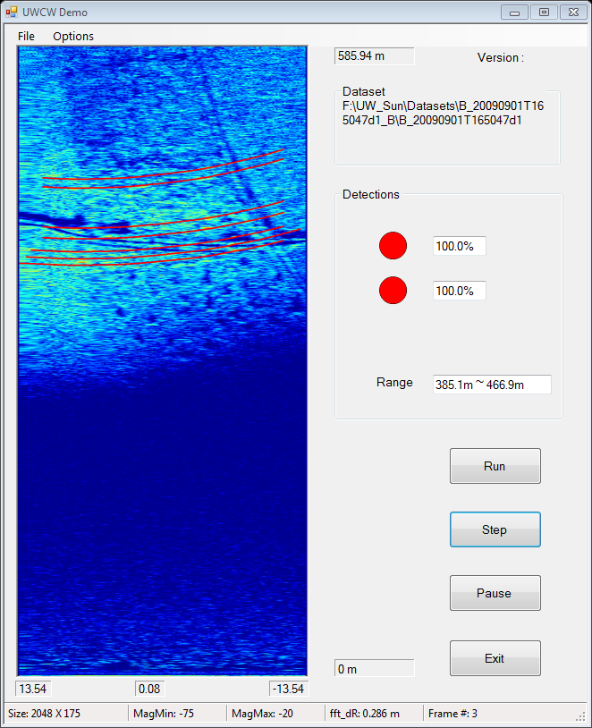
Score for current frame
Score for previous frame

Slide 3
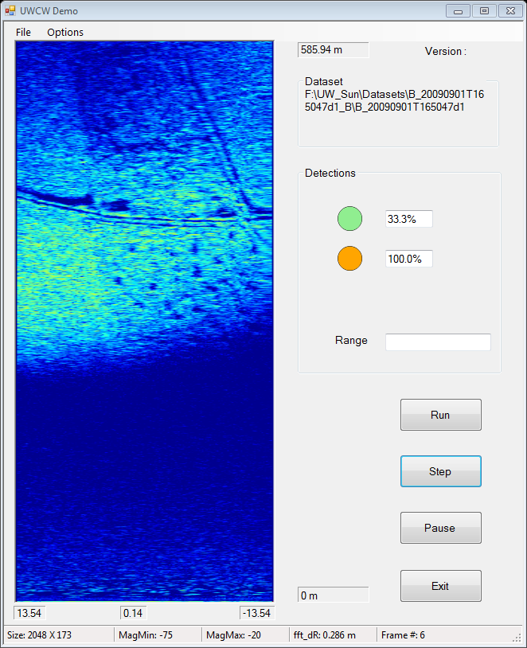
Current frame score is lower than 50%, so no warning sound is generated, the first LED is green
Previous frame score is still high, the second LED is orange

Slide 4
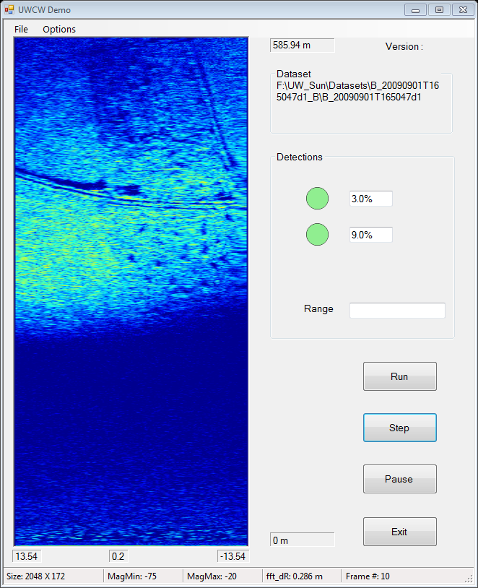
Both frame scores are low, both LEDs are green

Slide 5
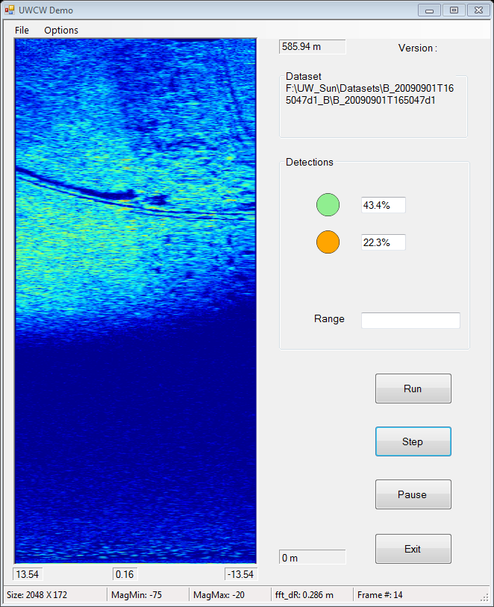
When cables start to appear again, frame score rises. Not passed 50% yet, so the first LED is green, no warning sound, while the second LED is orange.

Slide 6
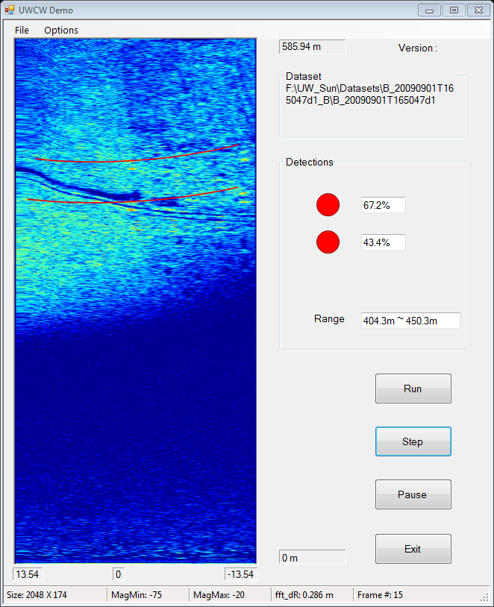
When current frame score passes threshold, warning sound is issued, and both LEDs turn red

Slide 7
Detection Output Summary
Three combinations of output signals:
Red / Red: cables detected, warning sound issued
Green / Orange: no cables detected, but based on recent history, it is likely the cables are there. No warning sound.
Green / Green: no cables detected, low confidence of having cable, no warning sound.
The first LED is directly linked to the final frame score (which already incorporated detection results from neighboring two frames) and the warning sound
The second LED gives a “short-time” prediction
The “long-time” prediction of a third LED not yet implemented, because I think without some more reasoning it’s hard to tell whether it’s because they are “hidden” in the ground return or they are not in the FoV when the cables are not there
The warning sound is just a beep when the frame score is greater than threshold 0.5. This is the easiest way to implement it.
Another possible sound warning is to have a steady warning sound rather than a single beep, but this is much more difficult to implement and is annoying when the user is using “Step” to run frame by frame

Slide 8
Datasets
Works fine for the initial 8 datasets with .mat data files (the very first two using shorter-range FFT):
B_20090831T134940d1, B_20090901T165047d1, B_20090831T135234d1, B_20090901T164646d1, B_20090902T102617d1, B_20090902T103246d1, B_20090902T101724d1, B_20090902T103810d1
For the latest 4 datasets with .bfr data files, just load and display the original video
For all these datasets, loading of the parameter files are hardwired according to the original reading script and original data formats. Possible to provide more flexible parameter file reading in the future if necessary.

