Slide 1

Cryprto Challenge

Slide 2


Logotipos
Logo Principal
Logo Secundário
Logo Alternativo

Slide 3

Landing Page

Slide 4
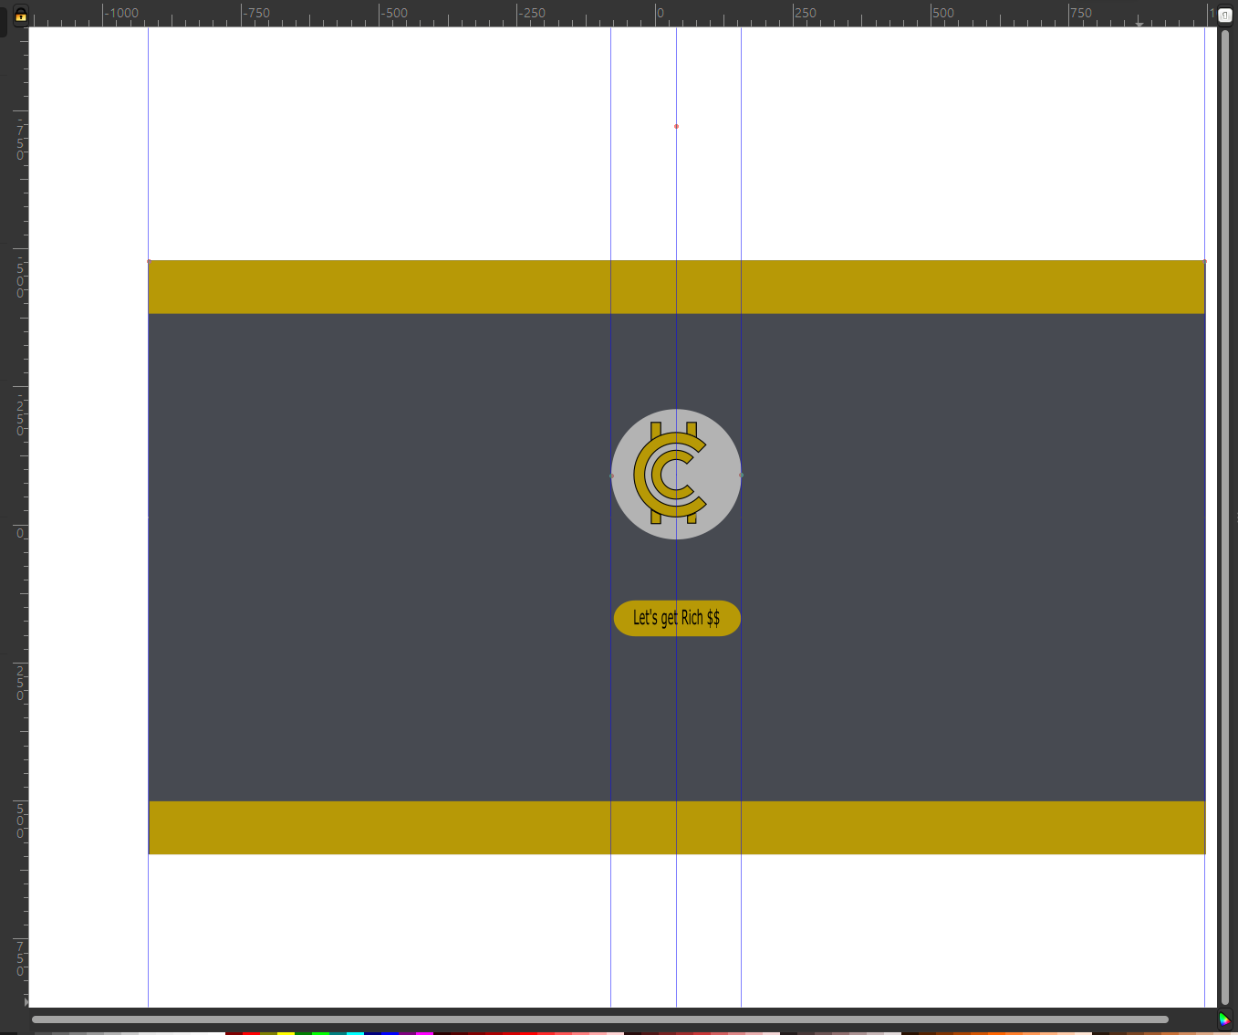
Landing Page Web (InkScape)

Slide 5
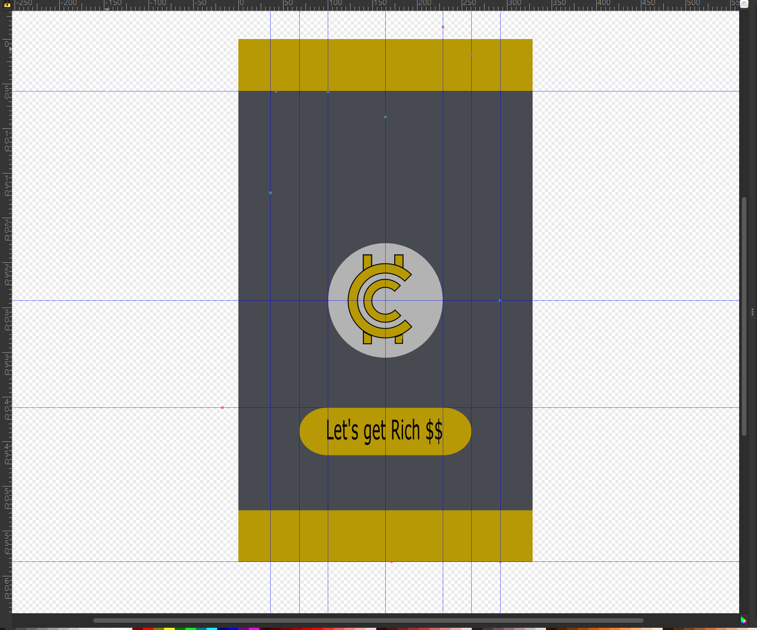
Landing Page Mobile (InkScape)

Slide 6
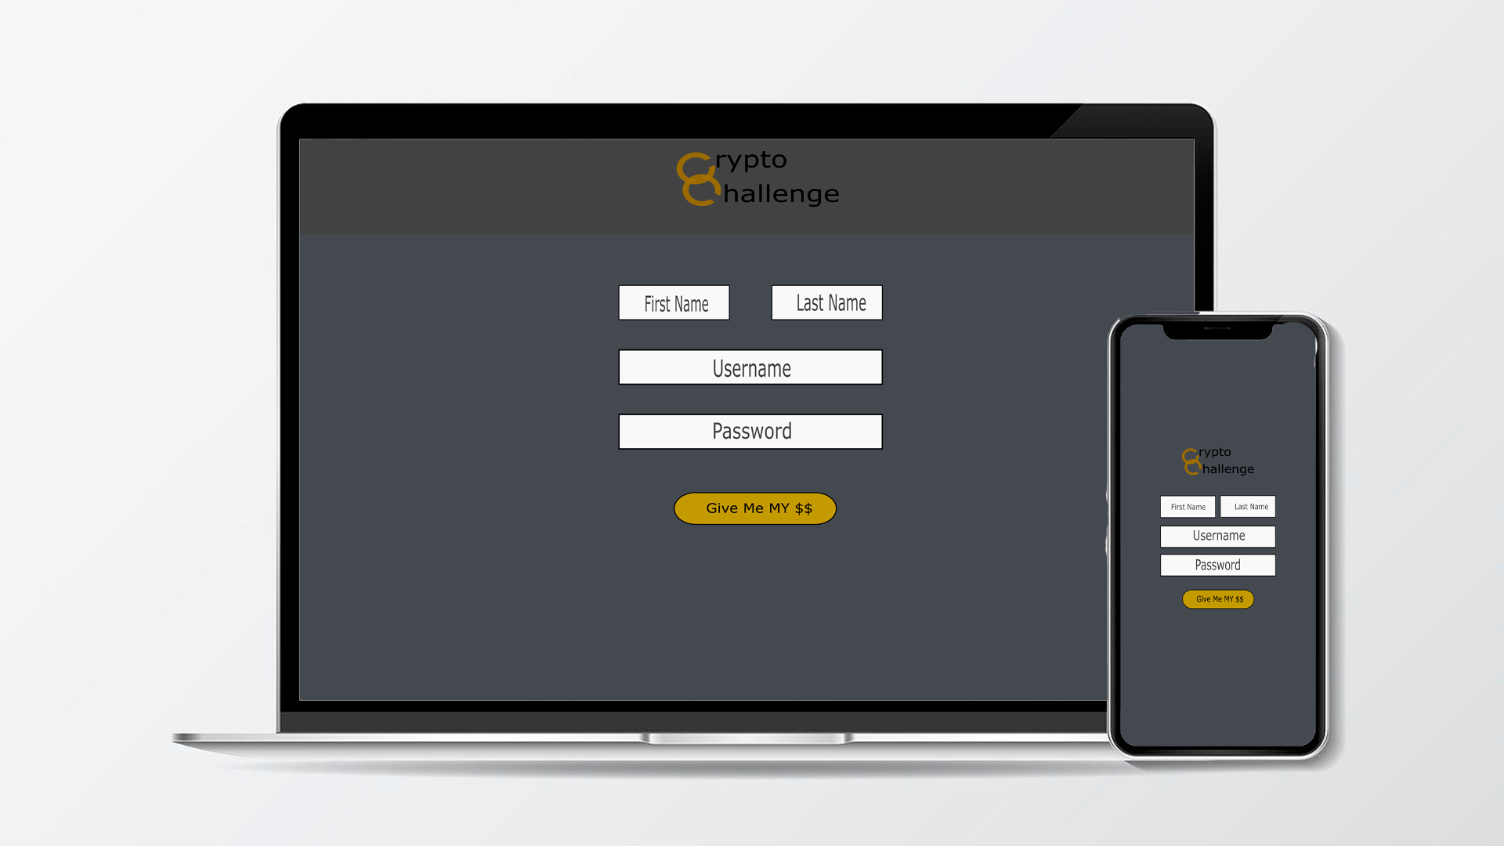
Register

Slide 7
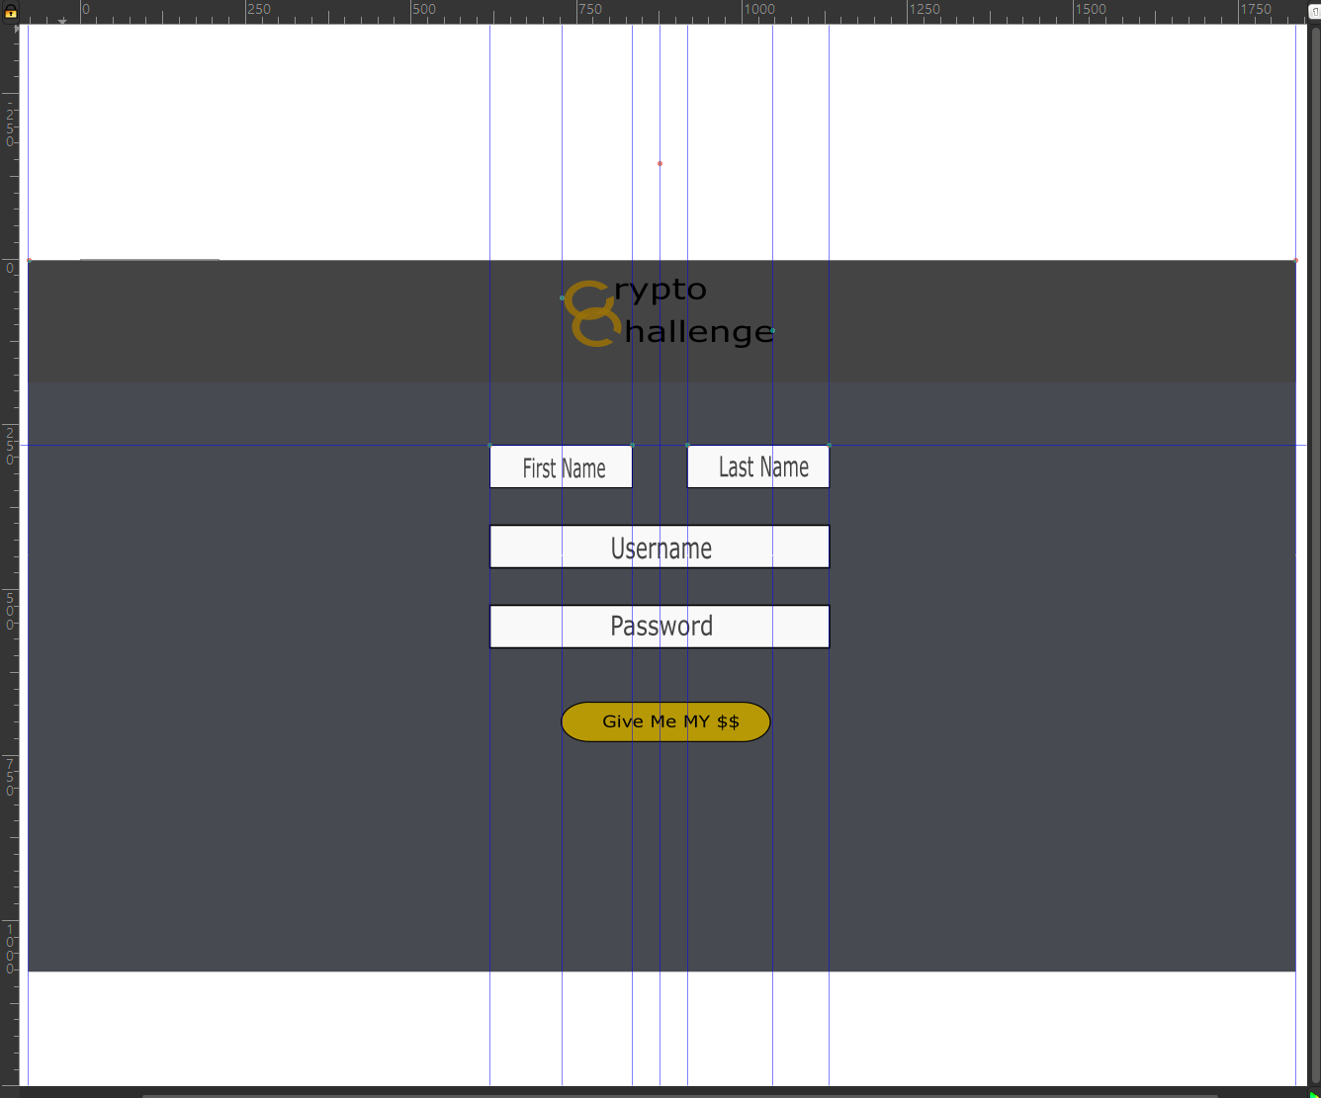
Register Mobile (InkScape)

Slide 8
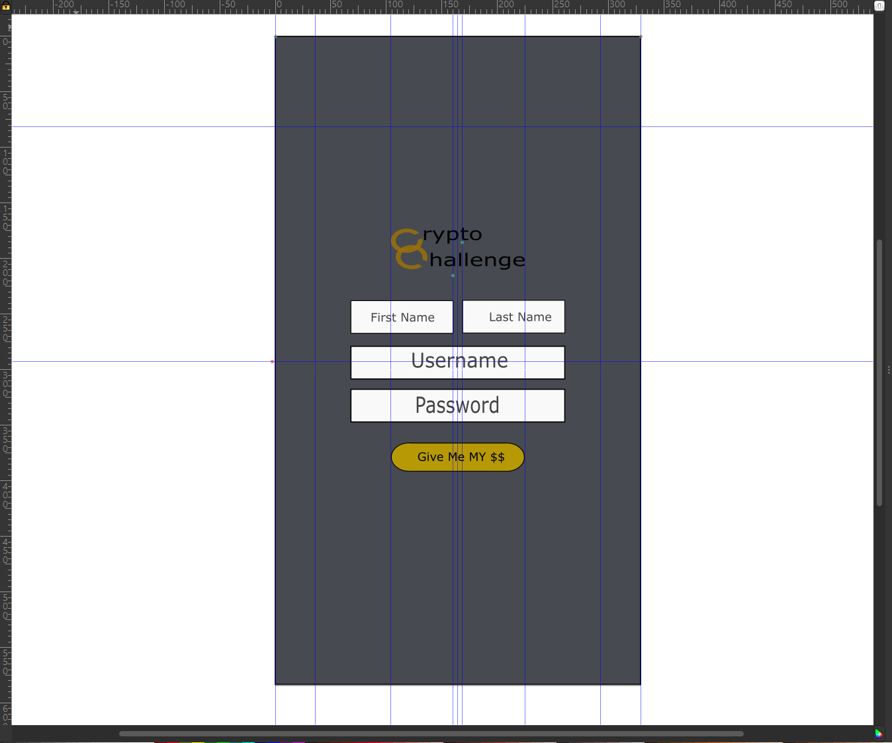
Register Web (InkScape)

Slide 9




Paleta de Cores (hexa)
#b79906
#474a51
#444
#b3b3b3

Slide 10
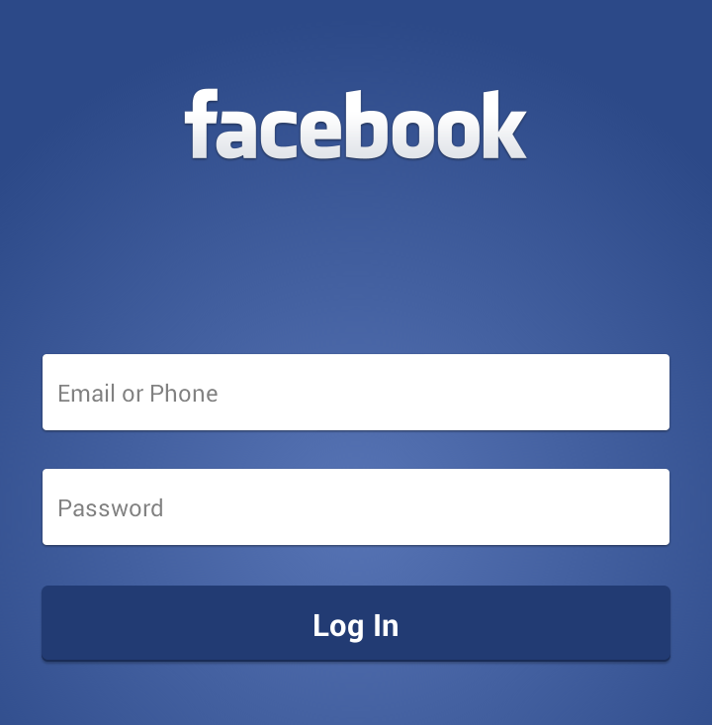
Inspiração Register

Slide 11

Fonte
Sans-Serif

