Slide 1
Basic time series
Steve Simon

Slide 2
Introduction
Keep things simple
Evenly spaced
No gaps
Single series
Topics covered
Structure
Plotting
Detrending and deseasonalizing
Basic Box-Jenkins models

Slide 3
Structure
The base R package has an object class, ts. You can specify three parameters: start, stop, and frequency.

Slide 4
Structure of co2 data
str(co2)
## Time-Series [1:468] from 1959 to 1998: 315 316 316 318 318 ...
attributes(co2)
## $tsp ## [1] 1959.000 1997.917 12.000 ## ## $class ## [1] "ts"

Slide 5
Plot of co2 data
plot(co2)

Slide 6
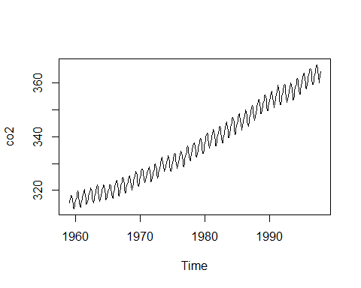

Slide 7
Structure of LakeHuron data
str(LakeHuron)
## Time-Series [1:98] from 1875 to 1972: 580 582 581 581 580 ...
attributes(LakeHuron)
## $tsp ## [1] 1875 1972 1 ## ## $class ## [1] "ts"

Slide 8
Structure of mdeaths data
str(mdeaths)
## Time-Series [1:72] from 1974 to 1980: 2134 1863 1877 1877 1492 ...
attributes(mdeaths)
## $tsp ## [1] 1974.000 1979.917 12.000 ## ## $class ## [1] "ts"

Slide 9
Structure of Nile data
str(Nile)
## Time-Series [1:100] from 1871 to 1970: 1120 1160 963 1210 1160 1160 813 1230 1370 1140 ...
attributes(Nile)
## $tsp ## [1] 1871 1970 1 ## ## $class ## [1] "ts"

Slide 10
Structure of nottem
str(nottem)
## Time-Series [1:240] from 1920 to 1940: 40.6 40.8 44.4 46.7 54.1 58.5 57.7 56.4 54.3 50.5 ...
attributes(nottem)
## $tsp ## [1] 1920.000 1939.917 12.000 ## ## $class ## [1] "ts"

Slide 11
Structure of sunspots.month
str(sunspot.month)
## Time-Series [1:3177] from 1749 to 2014: 58 62.6 70 55.7 85 83.5 94.8 66.3 75.9 75.5 ...
str(sunspot.year)
## Time-Series [1:289] from 1700 to 1988: 5 11 16 23 36 58 29 20 10 8 ...
str(sunspots)
## Time-Series [1:2820] from 1749 to 1984: 58 62.6 70 55.7 85 83.5 94.8 66.3 75.9 75.5 ...
attributes(sunspot.month)
## $tsp ## [1] 1749.000 2013.667 12.000 ## ## $class ## [1] "ts"

Slide 12
Structure of treering
str(treering)
## Time-Series [1:7980] from -6000 to 1979: 1.34 1.08 1.54 1.32 1.41 ...
attributes(treering)
## $tsp ## [1] -6000 1979 1 ## ## $class ## [1] "ts"

Slide 13
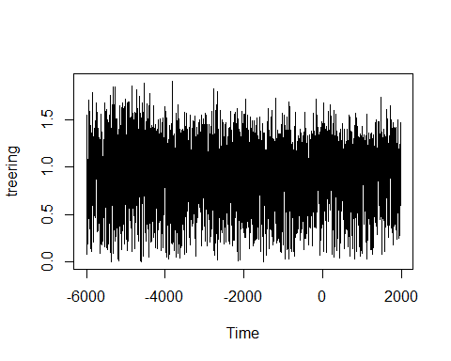
Plot of treering

Slide 14
UK time series
str(UKDriverDeaths)
## Time-Series [1:192] from 1969 to 1985: 1687 1508 1507 1385 1632 ...
str(UKgas)
## Time-Series [1:108] from 1960 to 1987: 160.1 129.7 84.8 120.1 160.1 ...

Slide 15
US time series
str(USAccDeaths)
## Time-Series [1:72] from 1973 to 1979: 9007 8106 8928 9137 10017 ...
str(USArrests)
## 'data.frame': 50 obs. of 4 variables: ## $ Murder : num 13.2 10 8.1 8.8 9 7.9 3.3 5.9 15.4 17.4 ... ## $ Assault : int 236 263 294 190 276 204 110 238 335 211 ... ## $ UrbanPop: int 58 48 80 50 91 78 77 72 80 60 ... ## $ Rape : num 21.2 44.5 31 19.5 40.6 38.7 11.1 15.8 31.9 25.8 ...
str(uspop)
## Time-Series [1:19] from 1790 to 1970: 3.93 5.31 7.24 9.64 12.9 17.1 23.2 31.4 39.8 50.2 ...

