Slide 1
Basic time series
Steve Simon

Slide 2
Introduction
Keep things simple
Evenly spaced
No gaps
Single series
Topics covered
Structure
Plotting
Detrending and deseasonalizing
Basic Box-Jenkins models

Slide 3
Decomposing a time series
Additive decomposition
Y - original data
T - time trend
S - seasonal component
Z = random component
$Y_{t}=T_{t}+S_{t}+Z_{t}$
Multiplicative decomposition
(or use a log transformation)
$Y_{t}=T_{t}×S_{t}×Z_{t}$

Slide 4
Differencing
An alternate way to remove a trend or deseasonalize a data set is through differencing.
Detrending
$D_{t}=Y_{t}−Y_{t−1}$
Deseasonalizing (s=# of seasons)
$D_{t}=Y_{t}−Y_{t−s}$

Slide 5
Models for the random component
White noise
$Z_{t}=ϵ_{t}$
Autoregressive (AR)
$Z_{t}=ϵ_{t}+ϕZ_{t−1}$
Moving average (MA)
$Z_{t}=ϵ_{t}+θϵ_{t−1}$

Slide 6
Structure
The base R package has an object class, ts. You can specify three parameters: start, stop, and frequency. You do not need to place your data in a ts object before running time series analyses.
There is a new class, tsibble, that I have not had a chance to work with. It is based on the principles of tidy data. Read the tsibble vignette for more information.

Slide 7
Structure of co2 data
str(co2)
## Time-Series [1:468] from 1959 to 1998: 315 316 316 318 318 ...
attributes(co2)
## $tsp ## [1] 1959.000 1997.917 12.000 ## ## $class ## [1] "ts"

Slide 8
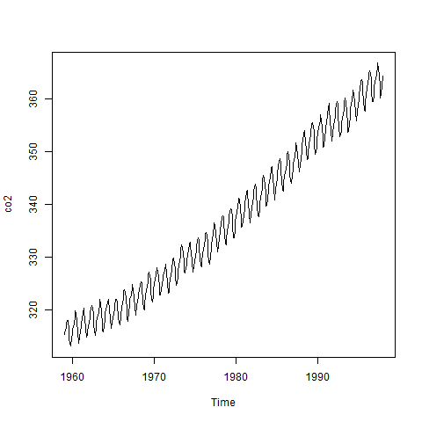
Plot of co2 data

Slide 9
Decomposition of co2
co2_d <- decompose(co2) str(co2_d)
## List of 6 ## $ x : Time-Series [1:468] from 1959 to 1998: 315 316 316 318 318 ... ## $ seasonal: Time-Series [1:468] from 1959 to 1998: -0.0536 0.6106 1.3756 2.5168 3.0003 ... ## $ trend : Time-Series [1:468] from 1959 to 1998: NA NA NA NA NA ... ## $ random : Time-Series [1:468] from 1959 to 1998: NA NA NA NA NA ... ## $ figure : num [1:12] -0.0536 0.6106 1.3756 2.5168 3.0003 ... ## $ type : chr "additive" ## - attr(*, "class")= chr "decomposed.ts"

Slide 10
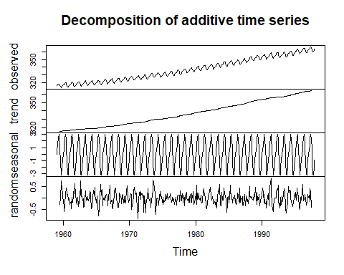
Plot of co2 decomposition

Slide 11
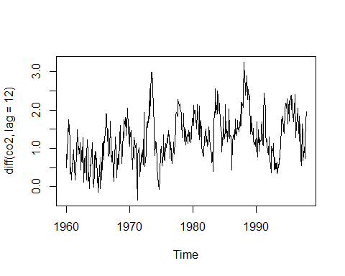
Deseasonalizing co2

Slide 12
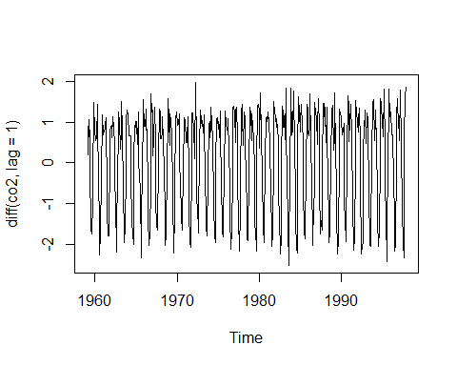
Detrending co2

Slide 13
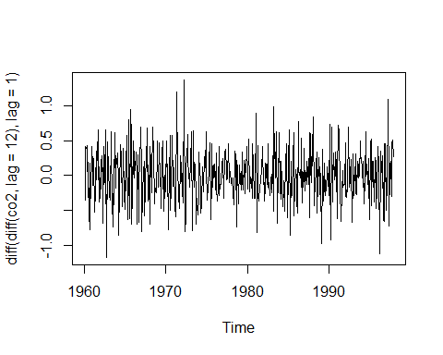
Both Detrending and deseasonalizing co2

Slide 14
UKgas
str(UKgas)
## Time-Series [1:108] from 1960 to 1987: 160.1 129.7 84.8 120.1 160.1 ...
attributes(UKgas)
## $tsp ## [1] 1960.00 1986.75 4.00 ## ## $class ## [1] "ts"

Slide 15
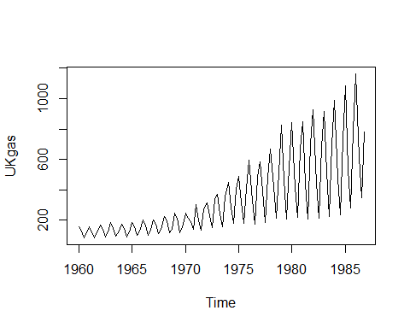
Plot UKGas

Slide 16
UKgas decomposition
UKgas_d <- decompose(UKgas, type="multiplicative") str(UKgas_d)
## List of 6 ## $ x : Time-Series [1:108] from 1960 to 1987: 160.1 129.7 84.8 120.1 160.1 ... ## $ seasonal: Time-Series [1:108] from 1960 to 1987: 1.454 0.956 0.558 1.032 1.454 ... ## $ trend : Time-Series [1:108] from 1960 to 1987: NA NA 124 123 122 ... ## $ random : Time-Series [1:108] from 1960 to 1987: NA NA 1.228 0.946 0.899 ... ## $ figure : num [1:4] 1.454 0.956 0.558 1.032 ## $ type : chr "multiplicative" ## - attr(*, "class")= chr "decomposed.ts"

Slide 17
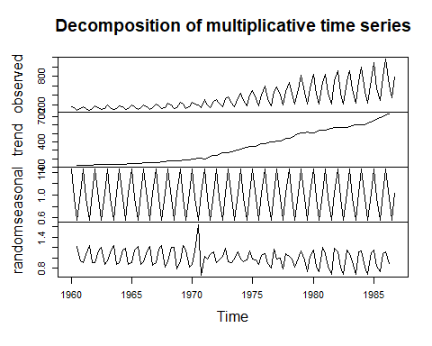
Plot of UKgas decomposition

Slide 18
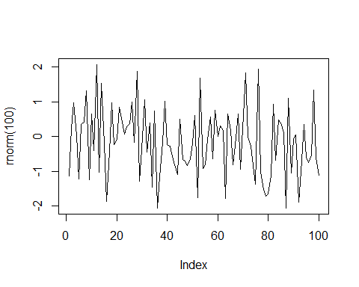
White noise

Slide 19
Correlation matrix
$Z_{t}=ϵ_{t}$
$$\begin{matrix}1 & 0 & 0 & 0 & ⋯ & 0 & 0 \\ 0 & 1 & 0 & 0 & ⋯ & 0 & 0 \\ 0 & 0 & 1 & 0 & ⋯ & 0 & 0 \\ 0 & 0 & 0 & 1 & ⋯ & 0 & 0 \\ ⋮ & ⋮ & ⋮ & ⋮ & ⋱ & ⋮ & ⋮ \\ 0 & 0 & 0 & 0 & ⋯ & 1 & 0 \\ 0 & 0 & 0 & 0 & ⋯ & 0 & 1\end{matrix}$$

Slide 20
Autoregressive
$Z_{t}=ϕZ_{t−1}+ϵ_{t}$
$Z_{t}=ϕ^{2}Z_{t−2}+ϕϵ_{t−1}+ϵ_{t}$
$Z_{t}=ϕ^{3}Z_{t−3}+ϕ^{2}ϵ_{t−2}+ϕϵ_{t−1}+ϵ_{t}$

Slide 21
Correlation matrix
$$\begin{matrix}1 & ϕ & ϕ^{2} & ϕ^{3} & ⋯ & ϕ^{n−2} & ϕ^{n−1} \\ ϕ & 1 & ϕ & ϕ^{2} & ⋯ & ϕ^{n−3} & ϕ^{n−2} \\ ϕ^{2} & ϕ & 1 & ϕ & ⋯ & ϕ^{n−4} & ϕ^{n−3} \\ ϕ^{3} & ϕ^{2} & ϕ & 1 & ⋯ & ϕ^{n−5} & ϕ^{n−4} \\ ⋮ & ⋮ & ⋮ & ⋮ & ⋱ & ⋮ & ⋮ \\ ϕ^{n−2} & ϕ^{n−3} & ϕ^{n−4} & ϕ^{n−5} & ⋯ & 1 & ϕ \\ ϕ^{n−1} & ϕ^{n−2} & ϕ^{n−3} & ϕ^{n−4} & ⋯ & ϕ & 1\end{matrix}$$

Slide 22
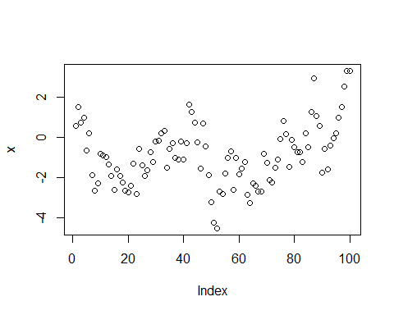
Positive autocorrelation

Slide 23
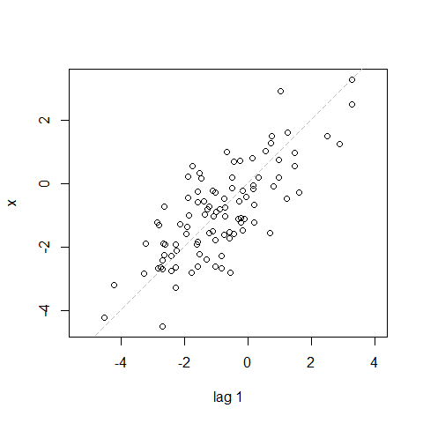
Lag plot

Slide 24
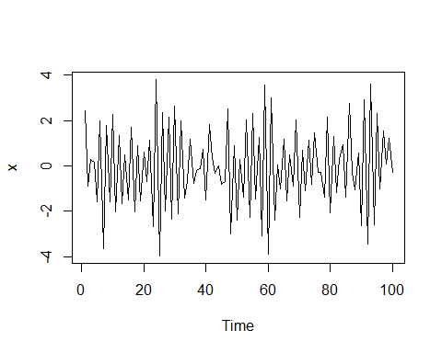
Negative autocorrelation

Slide 25
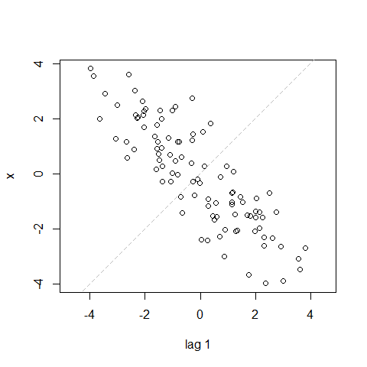
Lag plot

Slide 26
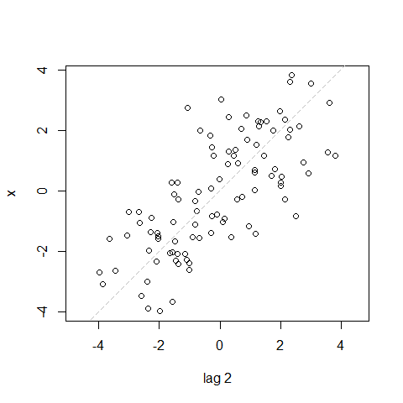
Lag plot

Slide 27
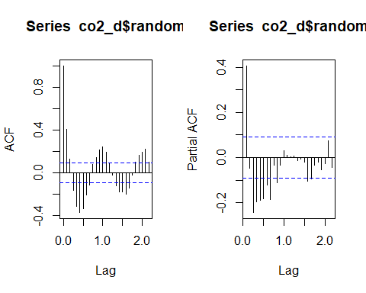
acf and pacf for co2 data

Slide 28
Structure of LakeHuron data
str(LakeHuron)
## Time-Series [1:98] from 1875 to 1972: 580 582 581 581 580 ...
attributes(LakeHuron)
## $tsp ## [1] 1875 1972 1 ## ## $class ## [1] "ts"

Slide 29
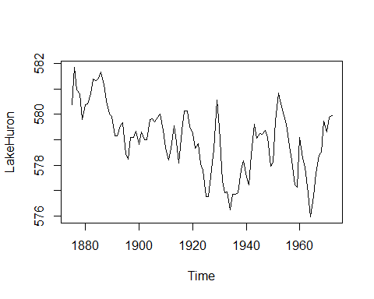
Plot of LakeHuron data

Slide 30
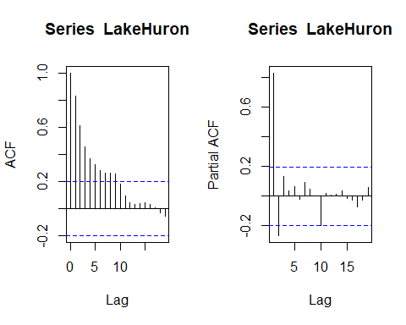
acf and pacf for data

Slide 31
Structure of mdeaths data
str(mdeaths)
## Time-Series [1:72] from 1974 to 1980: 2134 1863 1877 1877 1492 ...
attributes(mdeaths)
## $tsp ## [1] 1974.000 1979.917 12.000 ## ## $class ## [1] "ts"

Slide 32
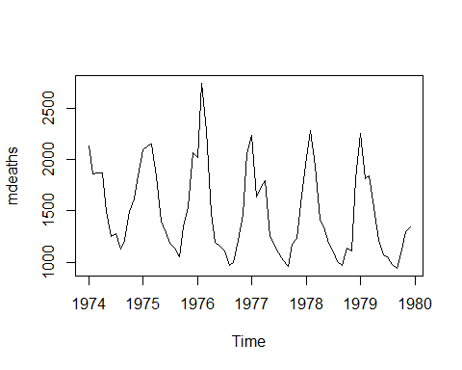
Plot of mdeaths

Slide 33
Structure of Nile data
str(Nile)
## Time-Series [1:100] from 1871 to 1970: 1120 1160 963 1210 1160 1160 813 1230 1370 1140 ...
attributes(Nile)
## $tsp ## [1] 1871 1970 1 ## ## $class ## [1] "ts"

Slide 34
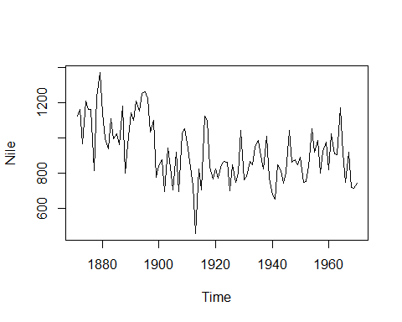
Plot of Nile data

Slide 35
Structure of nottem
str(nottem)
## Time-Series [1:240] from 1920 to 1940: 40.6 40.8 44.4 46.7 54.1 58.5 57.7 56.4 54.3 50.5 ...
attributes(nottem)
## $tsp ## [1] 1920.000 1939.917 12.000 ## ## $class ## [1] "ts"

Slide 36
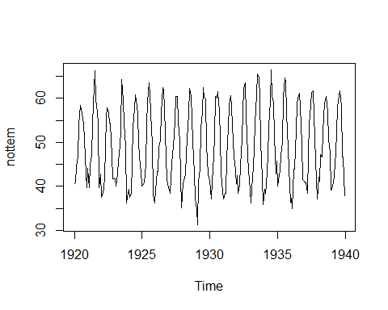
Plot of nottem

Slide 37
Structure of sunspot.year
str(sunspot.year)
## Time-Series [1:289] from 1700 to 1988: 5 11 16 23 36 58 29 20 10 8 ...
attributes(sunspot.year)
## $tsp ## [1] 1700 1988 1 ## ## $class ## [1] "ts"

Slide 38
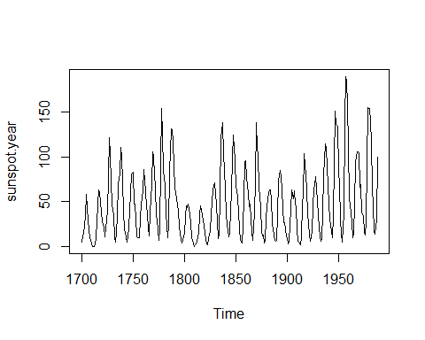
Plot of sunspot.year

Slide 39
Structure of treering
str(treering)
## Time-Series [1:7980] from -6000 to 1979: 1.34 1.08 1.54 1.32 1.41 ...
attributes(treering)
## $tsp ## [1] -6000 1979 1 ## ## $class ## [1] "ts"

Slide 40
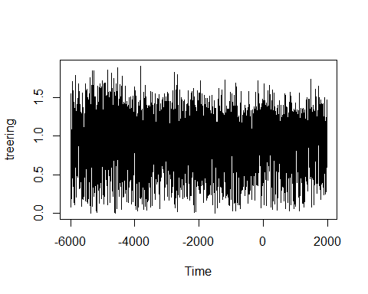
Plot of treering

Slide 41
UKDriverDeaths
str(UKDriverDeaths)
## Time-Series [1:192] from 1969 to 1985: 1687 1508 1507 1385 1632 ...
attributes(UKDriverDeaths)
## $tsp ## [1] 1969.000 1984.917 12.000 ## ## $class ## [1] "ts"

Slide 42
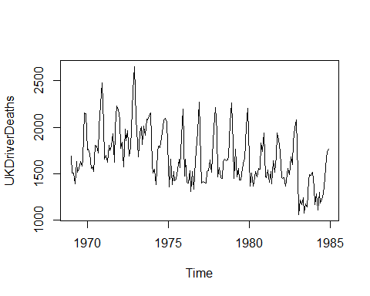
Plot UKDriver Deaths

Slide 43
USAccDeaths
str(USAccDeaths)
## Time-Series [1:72] from 1973 to 1979: 9007 8106 8928 9137 10017 ...
attributes(USAccDeaths)
## $tsp ## [1] 1973.000 1978.917 12.000 ## ## $class ## [1] "ts"

Slide 44
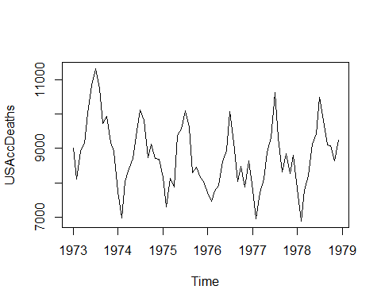
USAccDeaths plot

Slide 45
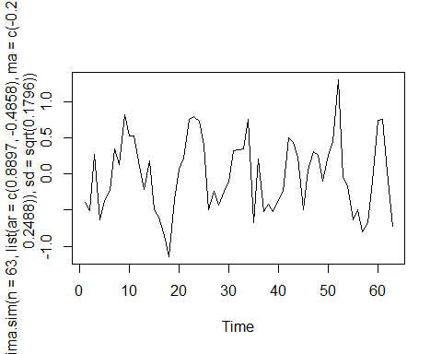
arima.sim

