Slide 1
Basic time series
Steve Simon

Slide 2
Introduction
Keep things simple
Evenly spaced
No gaps
Single series
Topics covered
Structure
Plotting
Detrending and deseasonalizing
Basic Box-Jenkins models

Slide 3
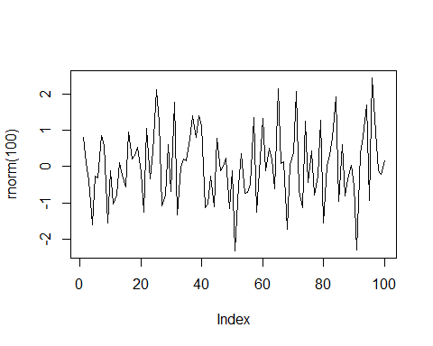
White noise

Slide 4
Structure
The base R package has an object class, ts. You can specify three parameters: start, stop, and frequency.

Slide 5
UKgas
str(UKgas)
## Time-Series [1:108] from 1960 to 1987: 160.1 129.7 84.8 120.1 160.1 ...
attributes(UKgas)
## $tsp ## [1] 1960.00 1986.75 4.00 ## ## $class ## [1] "ts"

Slide 6
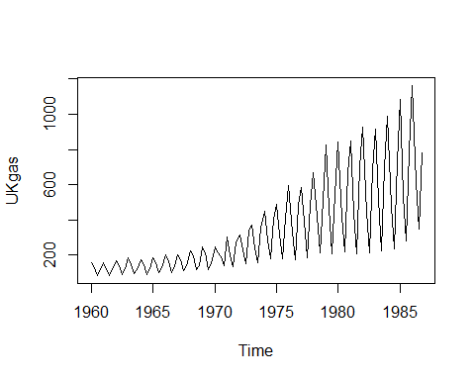
Plot UKGas

Slide 7
Structure of co2 data
str(co2)
## Time-Series [1:468] from 1959 to 1998: 315 316 316 318 318 ...
attributes(co2)
## $tsp ## [1] 1959.000 1997.917 12.000 ## ## $class ## [1] "ts"

Slide 8
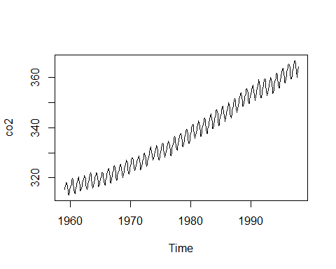
Plot of co2 data

Slide 9
Decomposition of co2
co2_d <- decompose(co2) str(co2_d)
## List of 6 ## $ x : Time-Series [1:468] from 1959 to 1998: 315 316 316 318 318 ... ## $ seasonal: Time-Series [1:468] from 1959 to 1998: -0.0536 0.6106 1.3756 2.5168 3.0003 ... ## $ trend : Time-Series [1:468] from 1959 to 1998: NA NA NA NA NA ... ## $ random : Time-Series [1:468] from 1959 to 1998: NA NA NA NA NA ... ## $ figure : num [1:12] -0.0536 0.6106 1.3756 2.5168 3.0003 ... ## $ type : chr "additive" ## - attr(*, "class")= chr "decomposed.ts"

Slide 10
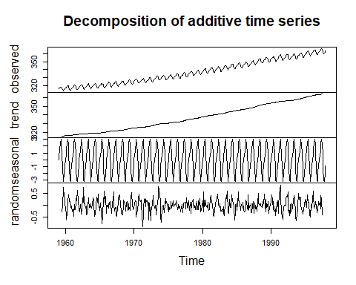
Plot of co2 decomposition

Slide 11
UKgas decomposition
UKgas_d <- decompose(UKgas, type="multiplicative") str(UKgas_d)
## List of 6 ## $ x : Time-Series [1:108] from 1960 to 1987: 160.1 129.7 84.8 120.1 160.1 ... ## $ seasonal: Time-Series [1:108] from 1960 to 1987: 1.454 0.956 0.558 1.032 1.454 ... ## $ trend : Time-Series [1:108] from 1960 to 1987: NA NA 124 123 122 ... ## $ random : Time-Series [1:108] from 1960 to 1987: NA NA 1.228 0.946 0.899 ... ## $ figure : num [1:4] 1.454 0.956 0.558 1.032 ## $ type : chr "multiplicative" ## - attr(*, "class")= chr "decomposed.ts"

Slide 12
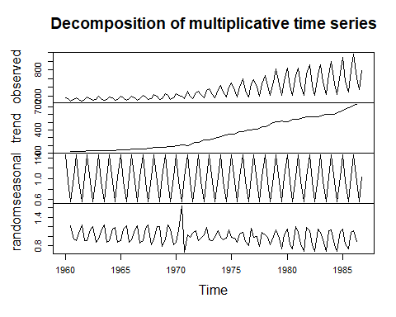
Plot of UKgas decomposition

Slide 13
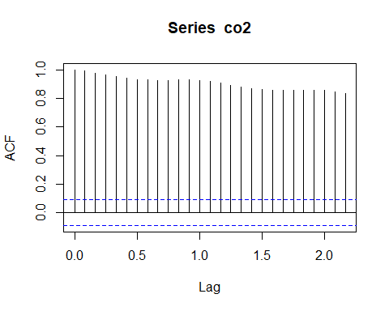
Autocorrelations of co2 data

Slide 14
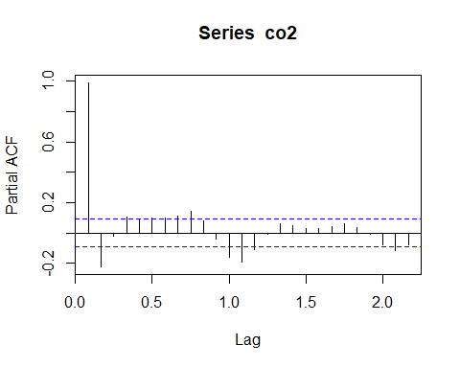
Partial autocorrelations of co2 data

Slide 15
Structure of LakeHuron data
str(LakeHuron)
## Time-Series [1:98] from 1875 to 1972: 580 582 581 581 580 ...
attributes(LakeHuron)
## $tsp ## [1] 1875 1972 1 ## ## $class ## [1] "ts"

Slide 16
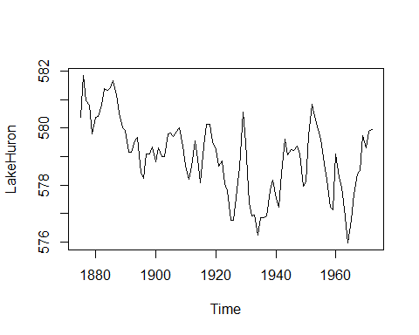
Plot of LakeHuron data

Slide 17
Structure of mdeaths data
str(mdeaths)
## Time-Series [1:72] from 1974 to 1980: 2134 1863 1877 1877 1492 ...
attributes(mdeaths)
## $tsp ## [1] 1974.000 1979.917 12.000 ## ## $class ## [1] "ts"

Slide 18
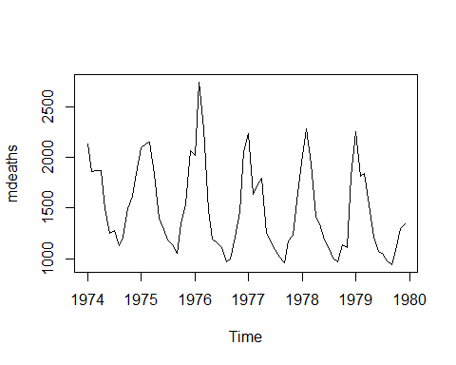
Plot of mdeaths

Slide 19
Structure of Nile data
str(Nile)
## Time-Series [1:100] from 1871 to 1970: 1120 1160 963 1210 1160 1160 813 1230 1370 1140 ...
attributes(Nile)
## $tsp ## [1] 1871 1970 1 ## ## $class ## [1] "ts"

Slide 20
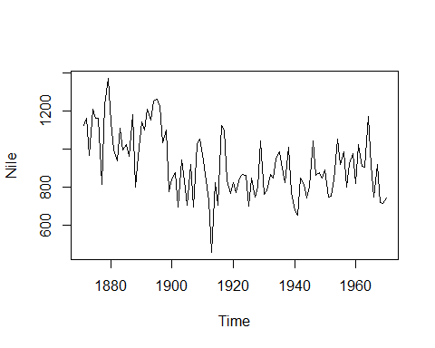
Plot of Nile data

Slide 21
Structure of nottem
str(nottem)
## Time-Series [1:240] from 1920 to 1940: 40.6 40.8 44.4 46.7 54.1 58.5 57.7 56.4 54.3 50.5 ...
attributes(nottem)
## $tsp ## [1] 1920.000 1939.917 12.000 ## ## $class ## [1] "ts"

Slide 22
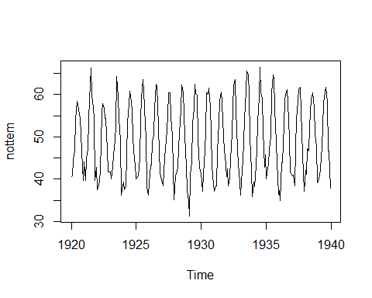
Plot of nottem

Slide 23
Structure of sunspot.year
str(sunspot.year)
## Time-Series [1:289] from 1700 to 1988: 5 11 16 23 36 58 29 20 10 8 ...
attributes(sunspot.year)
## $tsp ## [1] 1700 1988 1 ## ## $class ## [1] "ts"

Slide 24
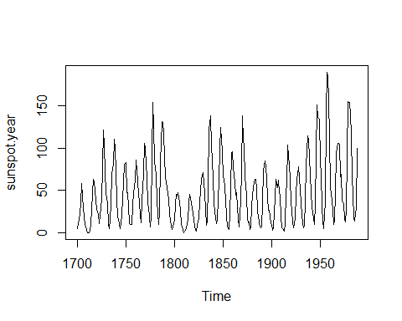
Plot of sunspot.year

Slide 25
Structure of treering
str(treering)
## Time-Series [1:7980] from -6000 to 1979: 1.34 1.08 1.54 1.32 1.41 ...
attributes(treering)
## $tsp ## [1] -6000 1979 1 ## ## $class ## [1] "ts"

Slide 26
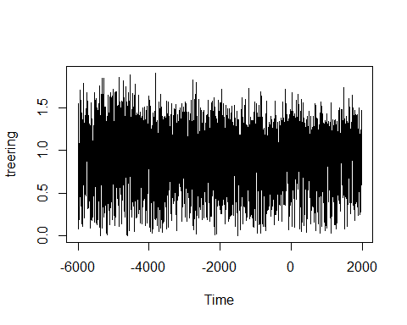
Plot of treering

Slide 27
UKDriverDeaths
str(UKDriverDeaths)
## Time-Series [1:192] from 1969 to 1985: 1687 1508 1507 1385 1632 ...
attributes(UKDriverDeaths)
## $tsp ## [1] 1969.000 1984.917 12.000 ## ## $class ## [1] "ts"

Slide 28
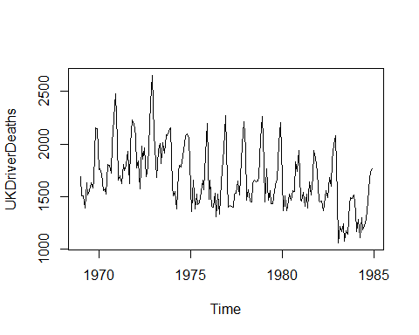
Plot UKDriver Deaths

Slide 29
USAccDeaths
str(USAccDeaths)
## Time-Series [1:72] from 1973 to 1979: 9007 8106 8928 9137 10017 ...
attributes(USAccDeaths)
## $tsp ## [1] 1973.000 1978.917 12.000 ## ## $class ## [1] "ts"

Slide 30
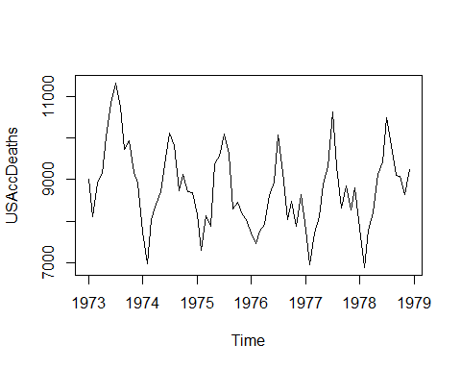
USAccDeaths plot

