Slide 1
Basic time series
Steve Simon

Slide 2
Introduction
Keep things simple
Evenly spaced
No gaps
Single long series
Topics covered
Structure
Plotting
Detrending and deseasonalizing
Basic Box-Jenkins models
Lots more examples than I have time for

Slide 3
Regression based decomposition
Additive decomposition
Y - original data
T - time trend
S - seasonal component
Z = random component
$Y_{t}=T_{t}+S_{t}+Z_{t}$
Multiplicative decomposition
(or use a log transformation)
$Y_{t}=T_{t}×S_{t}×Z_{t}$

Slide 4
Differencing
An alternate way to remove a trend or deseasonalize a data set is through differencing.
Detrending
$D_{t}=Y_{t}−Y_{t−1}$
Deseasonalizing (s=# of seasons)
$D_{t}=Y_{t}−Y_{t−s}$

Slide 5
Models for the random component
White noise
$Z_{t}=ϵ_{t}$
Autoregressive (AR)
$Z_{t}=ϵ_{t}+ϕZ_{t−1}$
Moving average (MA)
$Z_{t}=ϵ_{t}+θϵ_{t−1}$

Slide 6
Autocorrelation and partial autocorrelation
acf function
Plots corr($Z_{t},Z_{t−k}$) for k=1, 2, …
pacf function
Plots corr($Z_{t},Z_{t−k}|Z_{t−1},...,Z_{t−k+1}$) for k=2, 3, …

Slide 7
Structure
The base R package has an object class, ts.
Three parameters: start, stop, and frequency.
Not an absolute requirement for time series analyses.
New class, tsibble (not for today)
Based on the principles of tidy data.
Read the tsibble vignette.

Slide 8
Structure of co2 data
str(co2)
## Time-Series [1:468] from 1959 to 1998: 315 316 316 318 318 ...
attributes(co2)
## $tsp ## [1] 1959.000 1997.917 12.000 ## ## $class ## [1] "ts"

Slide 9
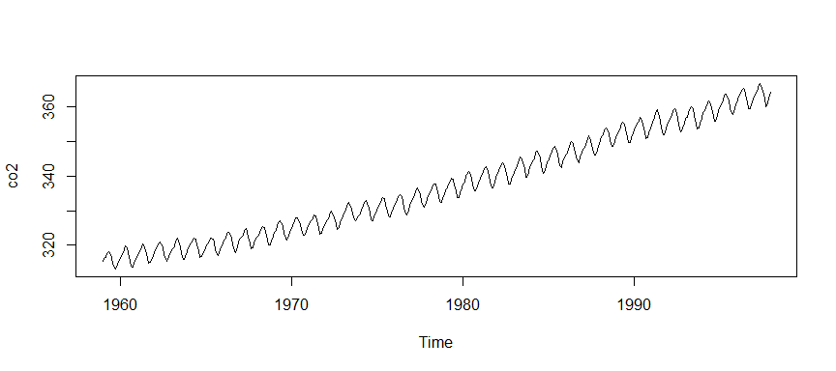
Plot of co2 data

Slide 10
Decomposition of co2
co2_d <- decompose(co2) str(co2_d)
## List of 6 ## $ x : Time-Series [1:468] from 1959 to 1998: 315 316 316 318 318 ... ## $ seasonal: Time-Series [1:468] from 1959 to 1998: -0.0536 0.6106 1.3756 2.5168 3.0003 ... ## $ trend : Time-Series [1:468] from 1959 to 1998: NA NA NA NA NA ... ## $ random : Time-Series [1:468] from 1959 to 1998: NA NA NA NA NA ... ## $ figure : num [1:12] -0.0536 0.6106 1.3756 2.5168 3.0003 ... ## $ type : chr "additive" ## - attr(*, "class")= chr "decomposed.ts"

Slide 11
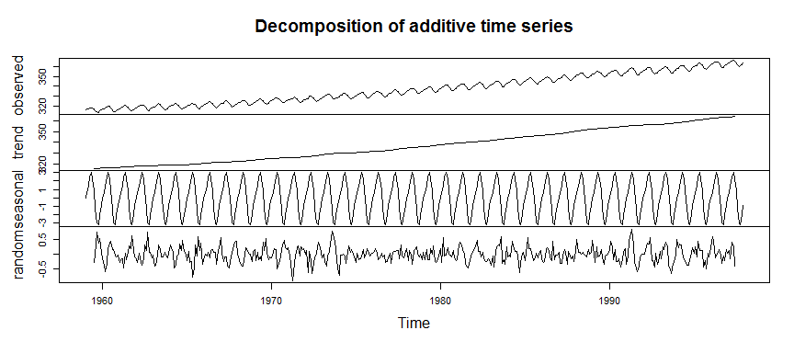
Plot of co2 decomposition

Slide 12
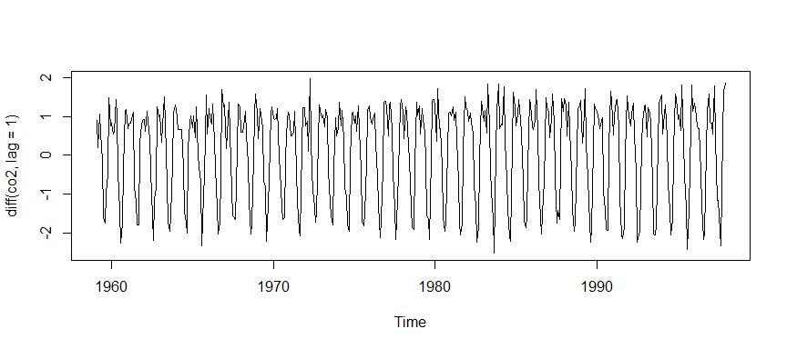
Detrending co2

Slide 13
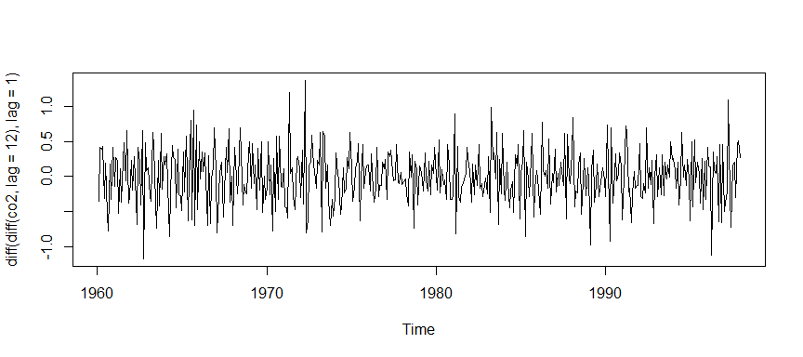
Detrending followed by deseasonalizing co2

Slide 14
UKgas
str(UKgas)
## Time-Series [1:108] from 1960 to 1987: 160.1 129.7 84.8 120.1 160.1 ...
attributes(UKgas)
## $tsp ## [1] 1960.00 1986.75 4.00 ## ## $class ## [1] "ts"

Slide 15
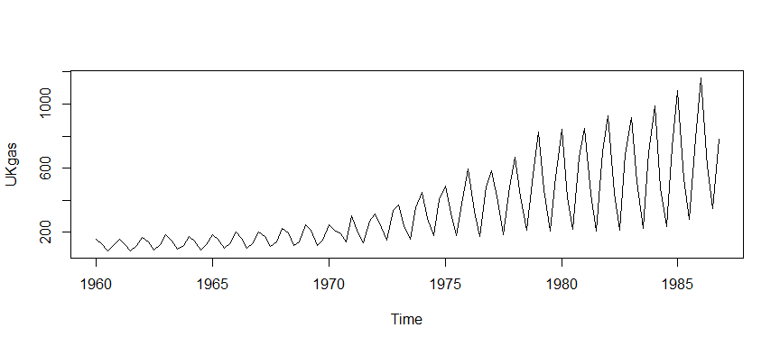
Plot UKgas

Slide 16
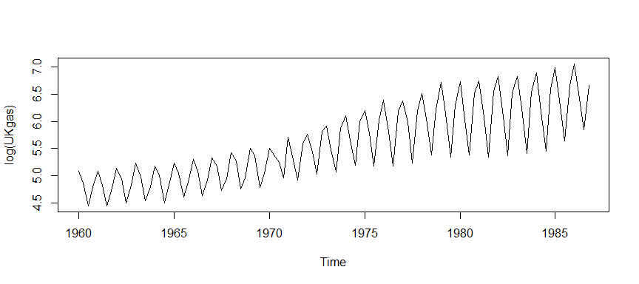
Plot UKgas on a log scale

Slide 17
UKgas decomposition
UKgas_d <- decompose(log(UKgas)) str(UKgas_d)
## List of 6 ## $ x : Time-Series [1:108] from 1960 to 1987: 5.08 4.87 4.44 4.79 5.08 ... ## $ seasonal: Time-Series [1:108] from 1960 to 1987: 0.4394 0.0137 -0.5454 0.0924 0.4394 ... ## $ trend : Time-Series [1:108] from 1960 to 1987: NA NA 4.79 4.79 4.78 ... ## $ random : Time-Series [1:108] from 1960 to 1987: NA NA 0.1933 -0.0918 -0.1465 ... ## $ figure : num [1:4] 0.4394 0.0137 -0.5454 0.0924 ## $ type : chr "additive" ## - attr(*, "class")= chr "decomposed.ts"

Slide 18
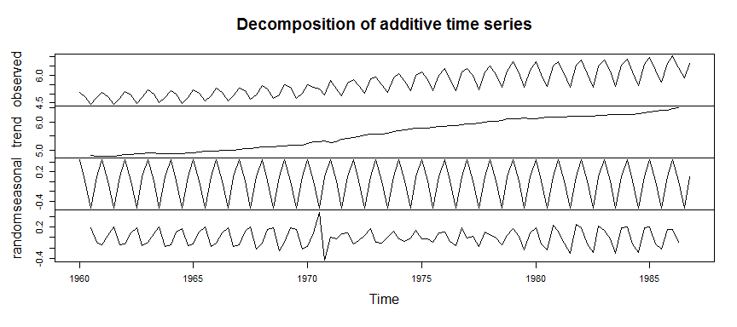
Plot of UKgas decomposition

Slide 19
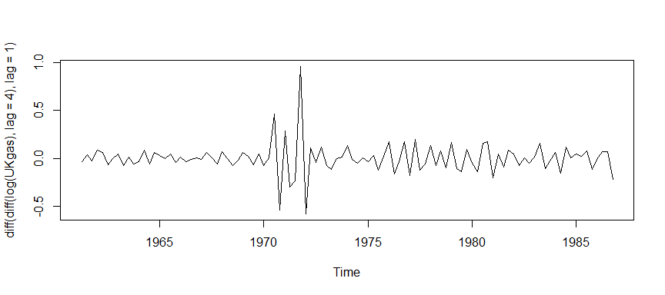
Plot ofUKgas difference model

Slide 20
White noise
$Z_{t}=ϵ_{t}$
Ideal pattern
Nothing left to predict
Any deviation from white noise is an opportunity

Slide 21
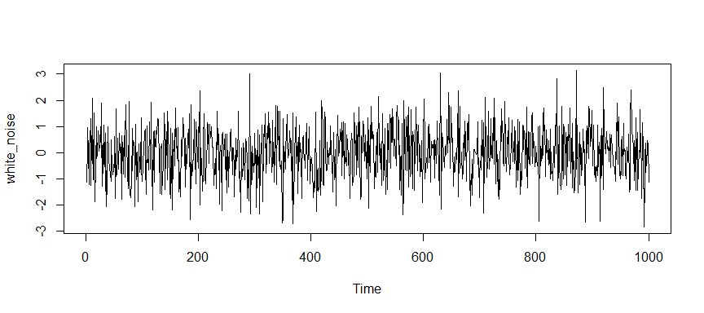
A simulation of white noise

Slide 22
Theoretical correlation matrix for white noise
## [,1] [,2] [,3] [,4] [,5] [,6] ## [1,] 1 0 0 0 0 0 ## [2,] 0 1 0 0 0 0 ## [3,] 0 0 1 0 0 0 ## [4,] 0 0 0 1 0 0 ## [5,] 0 0 0 0 1 0 ## [6,] 0 0 0 0 0 1

Slide 23
Autoregressive model
ARIMA(1, 0, 0)
$Z_{t}=ϕZ_{t−1}+ϵ_{t}$
The autoregressive model produces a “ripple effect” because this model implies a relationship going back in time.
$Z_{t}=ϕ^{2}Z_{t−2}+ϕϵ_{t−1}+ϵ_{t}$
and $Z_{t−3}$
$Z_{t}=ϕ^{3}Z_{t−3}+ϕ^{2}ϵ_{t−2}+ϕϵ_{t−1.000}+ϵ_{t}$
and so on.

Slide 24
Theoretical correlation matrix for positive autoregessive model
## [,1] [,2] [,3] [,4] [,5] [,6] ## [1,] 1.000 0.500 0.250 0.125 0.062 0.031 ## [2,] 0.500 1.000 0.500 0.250 0.125 0.062 ## [3,] 0.250 0.500 1.000 0.500 0.250 0.125 ## [4,] 0.125 0.250 0.500 1.000 0.500 0.250 ## [5,] 0.062 0.125 0.250 0.500 1.000 0.500 ## [6,] 0.031 0.062 0.125 0.250 0.500 1.000

Slide 25
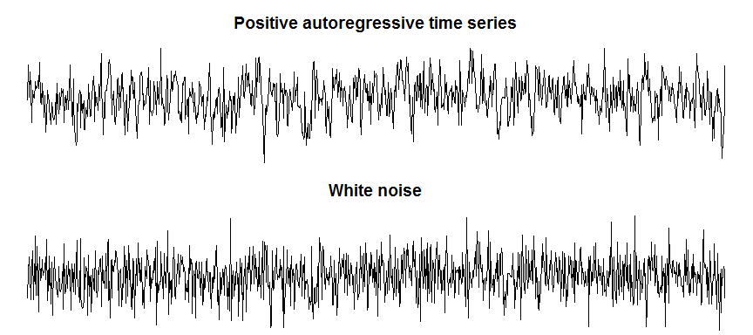
A simulation of a positive autoregressive model

Slide 26
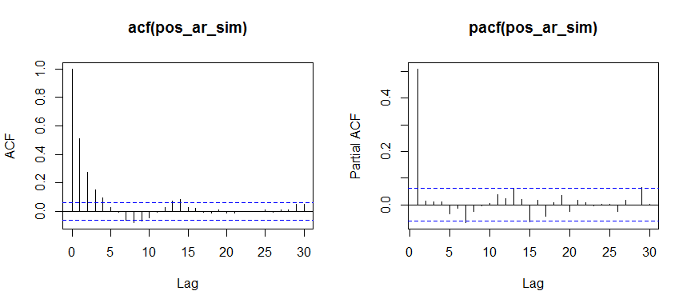
Auotcorrelation patterns for positive autoregressive model

Slide 27
Theoretical correlation matrix for negative autoregessive model
## [,1] [,2] [,3] [,4] [,5] [,6] ## [1,] 1.000 -0.500 0.250 -0.125 0.062 -0.031 ## [2,] -0.500 1.000 -0.500 0.250 -0.125 0.062 ## [3,] 0.250 -0.500 1.000 -0.500 0.250 -0.125 ## [4,] -0.125 0.250 -0.500 1.000 -0.500 0.250 ## [5,] 0.062 -0.125 0.250 -0.500 1.000 -0.500 ## [6,] -0.031 0.062 -0.125 0.250 -0.500 1.000

Slide 28
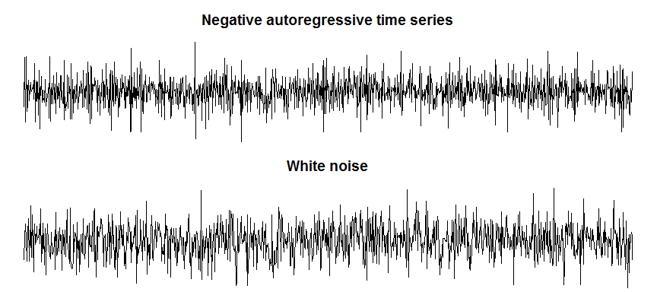
A simulation of a negative autoregressive model

Slide 29
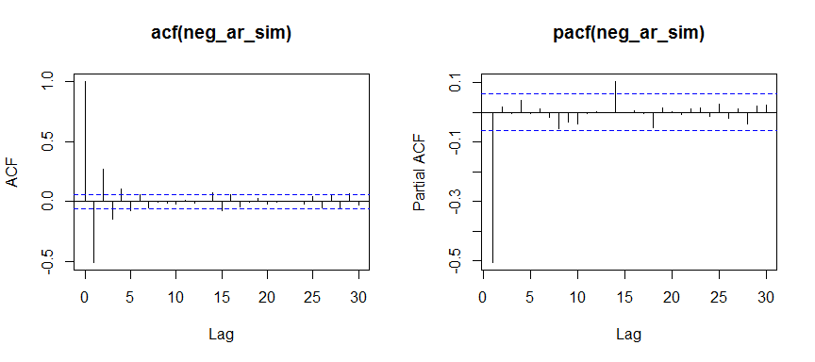
Auotcorrelation patterns for negative autoregressive model

Slide 30
Moving average model
ARIMA(0, 0, 1)
$Z_{t}=θϵ_{t−1}+ϵ_{t}$
There is no “ripple effect” with a moving average model.

Slide 31
Theoretical correlation matrix for positive moving average model
## [,1] [,2] [,3] [,4] [,5] [,6] ## [1,] 1.0 0.5 0.0 0.0 0.0 0.0 ## [2,] 0.5 1.0 0.5 0.0 0.0 0.0 ## [3,] 0.0 0.5 1.0 0.5 0.0 0.0 ## [4,] 0.0 0.0 0.5 1.0 0.5 0.0 ## [5,] 0.0 0.0 0.0 0.5 1.0 0.5 ## [6,] 0.0 0.0 0.0 0.0 0.5 1.0

Slide 32
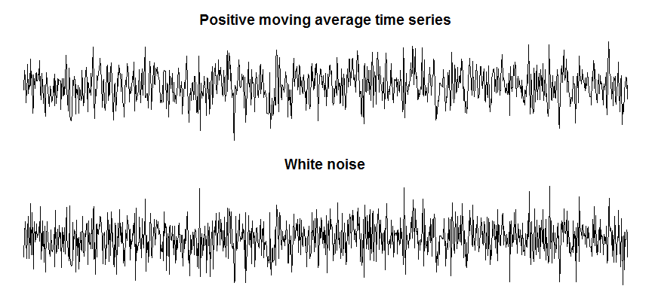
A simulation of a positive moving average model

Slide 33
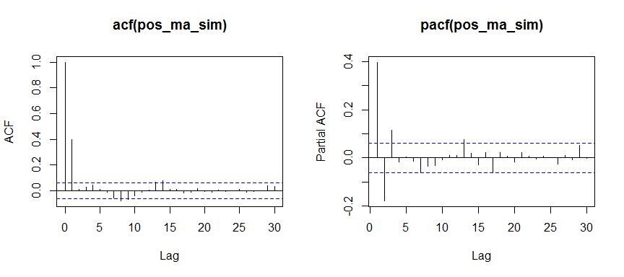
Auotcorrelation patterns for positive moving average model

Slide 34
Theoretical correlation matrix for negative moving average model
## [,1] [,2] [,3] [,4] [,5] [,6] ## [1,] 1.0 -0.5 0.0 0.0 0.0 0.0 ## [2,] -0.5 1.0 -0.5 0.0 0.0 0.0 ## [3,] 0.0 -0.5 1.0 -0.5 0.0 0.0 ## [4,] 0.0 0.0 -0.5 1.0 -0.5 0.0 ## [5,] 0.0 0.0 0.0 -0.5 1.0 -0.5 ## [6,] 0.0 0.0 0.0 0.0 -0.5 1.0

Slide 35
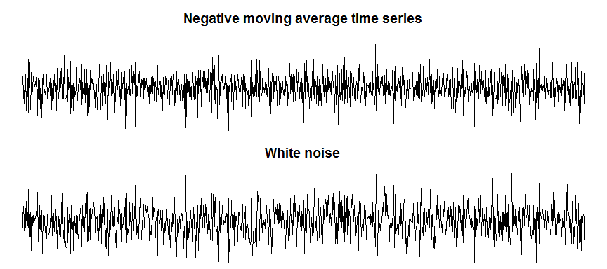
A simulation of a negative moving average model

Slide 36
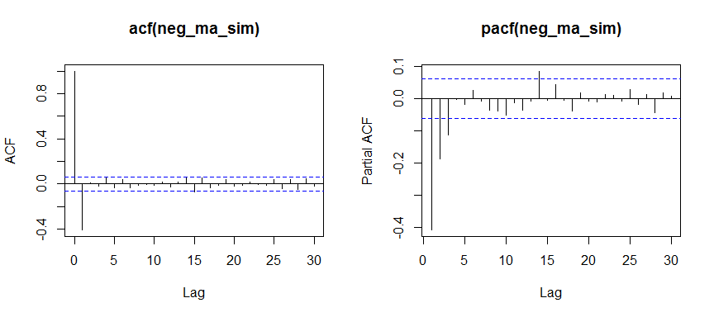
Auotcorrelation patterns for positive moving average model

Slide 37
More complex autoregressive patterns
ARIMA(2, 0, 0)
$Z_{t}=ϕ_{1}Z_{t−1}+ϕ_{2}Z_{t−2}+ϵ_{t}$
ARIMA(0, 0, 2)
$Z_{t}=θ_{2}ϵ_{t−2}+θ_{1}ϵ_{t−1}+ϵ_{t}$
ARMA(1, 0, 1)
$Z_{t}=ϕ_{1}Z_{t−1}+θ_{1}ϵ_{t−1}+ϵ_{t}$
ARIMA(1, 1, 1)
$D_{t}=ϕ_{1}D_{t−1}+θ_{1}ϵ_{t−1}+ϵ_{t}$

Slide 38
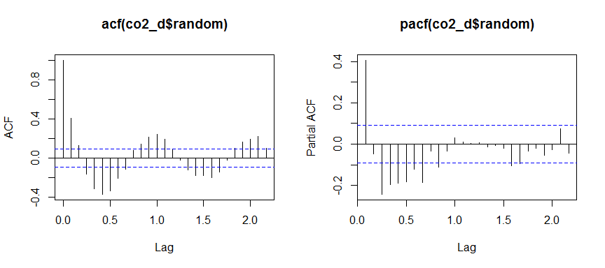
acf and pacf for co2 data

Slide 39
Structure of Nile data
str(Nile)
## Time-Series [1:100] from 1871 to 1970: 1120 1160 963 1210 1160 1160 813 1230 1370 1140 ...
attributes(Nile)
## $tsp ## [1] 1871 1970 1 ## ## $class ## [1] "ts"

Slide 40
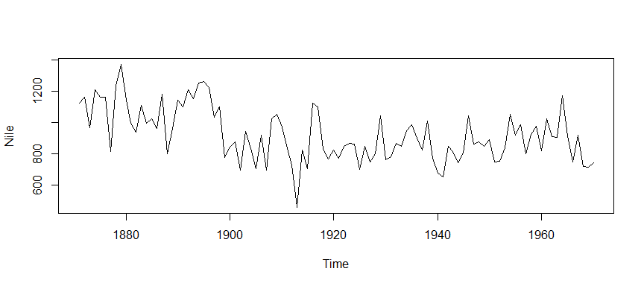
Plot of Nile data

Slide 41
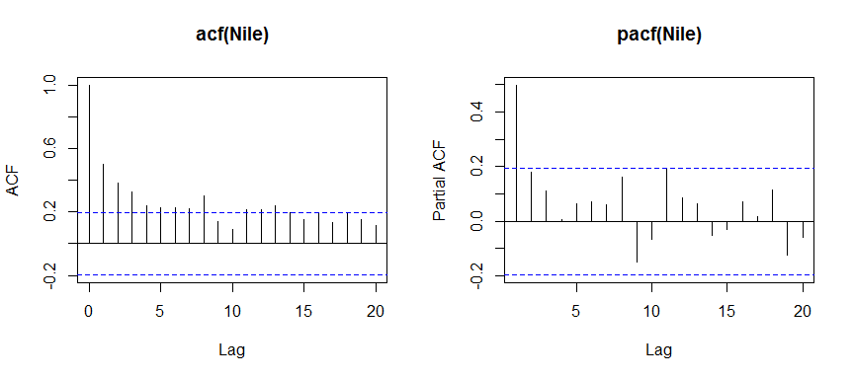
acf and pacf for Nile data

Slide 42
USAccDeaths
str(USAccDeaths)
## Time-Series [1:72] from 1973 to 1979: 9007 8106 8928 9137 10017 ...
attributes(USAccDeaths)
## $tsp ## [1] 1973.000 1978.917 12.000 ## ## $class ## [1] "ts"

Slide 43
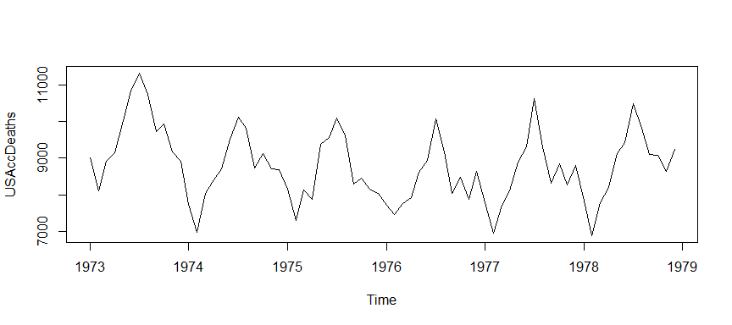
USAccDeaths plot

Slide 44
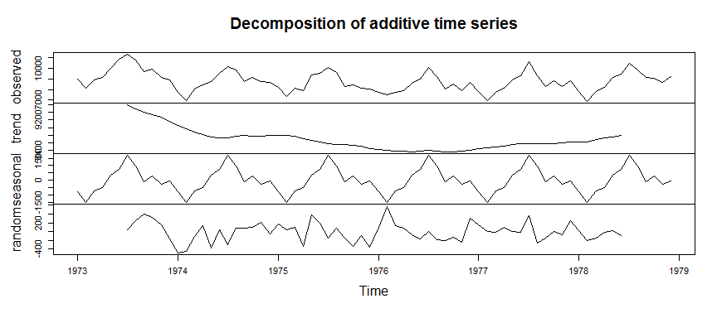
Detrend and deseasonalize USAccDeaths

Slide 45
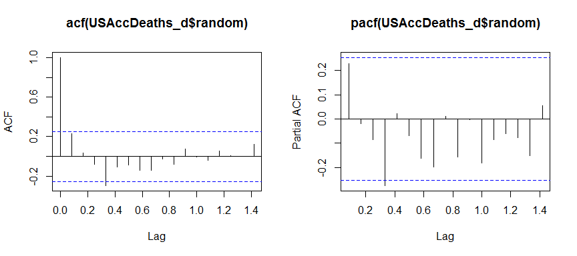
acf and pacf for USAccDeaths data

Slide 46
Structure of treering
str(treering)
## Time-Series [1:7980] from -6000 to 1979: 1.34 1.08 1.54 1.32 1.41 ...
attributes(treering)
## $tsp ## [1] -6000 1979 1 ## ## $class ## [1] "ts"

Slide 47
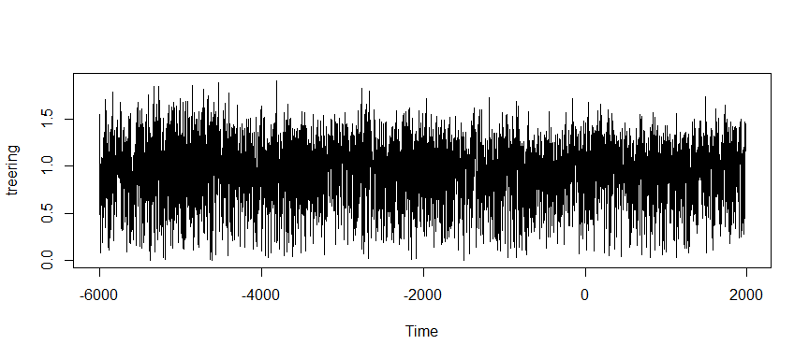
Plot of treering

Slide 48
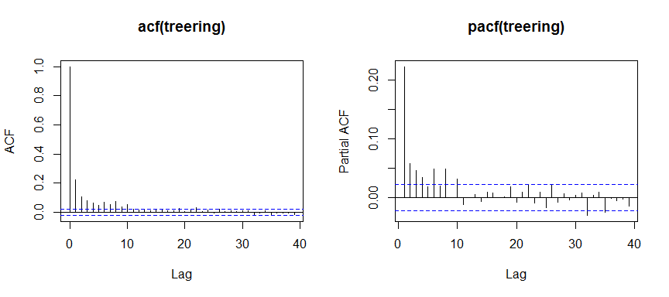
acf and pacf for treering data

Slide 49
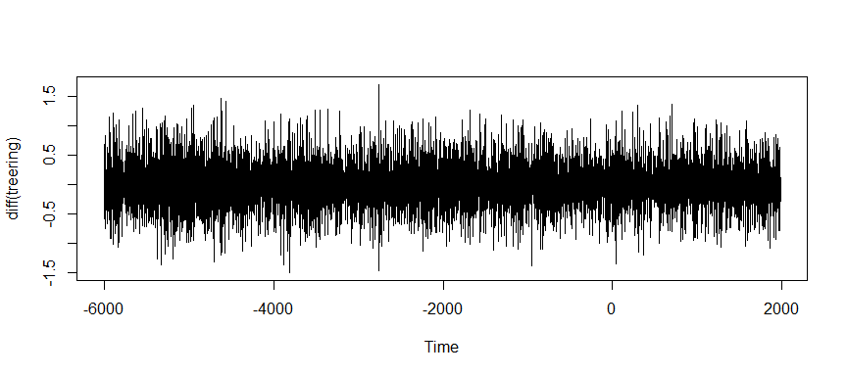
Difference plot of treering

Slide 50
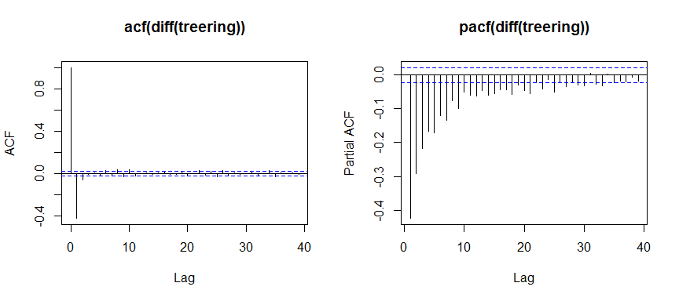
Difference acf and pacf for treering data

Slide 51
UKDriverDeaths
str(UKDriverDeaths)
## Time-Series [1:192] from 1969 to 1985: 1687 1508 1507 1385 1632 ...
attributes(UKDriverDeaths)
## $tsp ## [1] 1969.000 1984.917 12.000 ## ## $class ## [1] "ts"

Slide 52
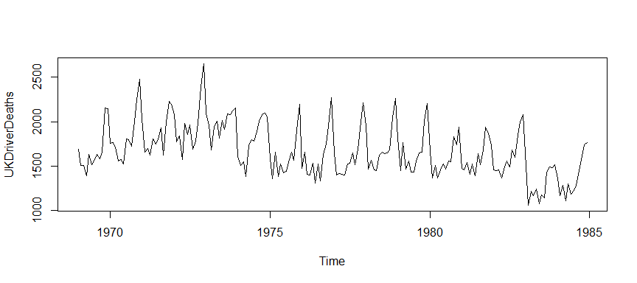
Plot UKDriverDeaths

Slide 53
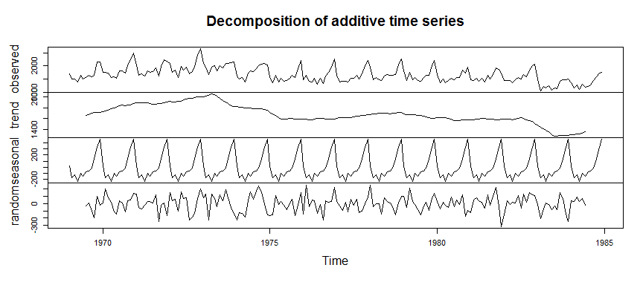
Detrend and deseasonalize UKDriverDeaths

Slide 54
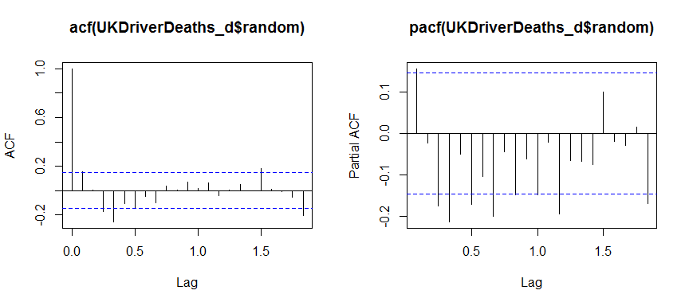
acf and pacf for UKDriverDeaths data

Slide 55
Structure of LakeHuron data
str(LakeHuron)
## Time-Series [1:98] from 1875 to 1972: 580 582 581 581 580 ...
attributes(LakeHuron)
## $tsp ## [1] 1875 1972 1 ## ## $class ## [1] "ts"
Note: Annual data has no seasonality.

Slide 56
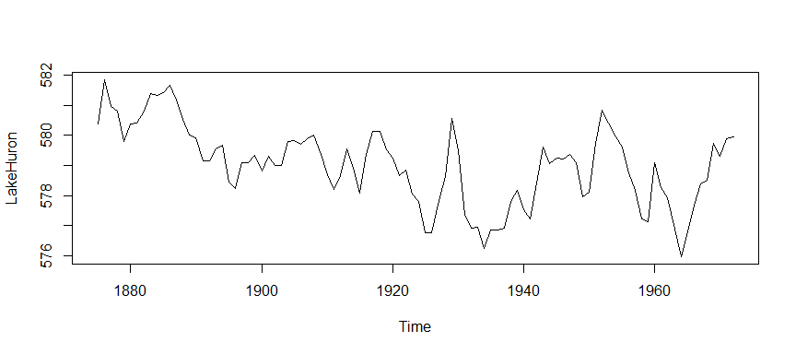
Plot of LakeHuron data

Slide 57
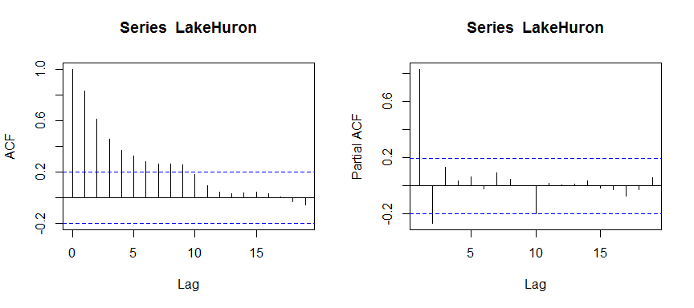
acf and pacf for LakeHuron data

Slide 58
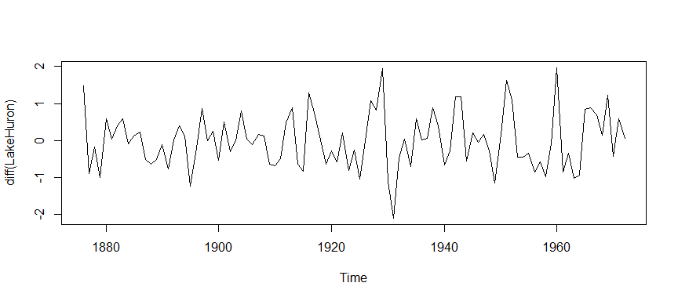
Difference plot of LakeHuron data

Slide 59
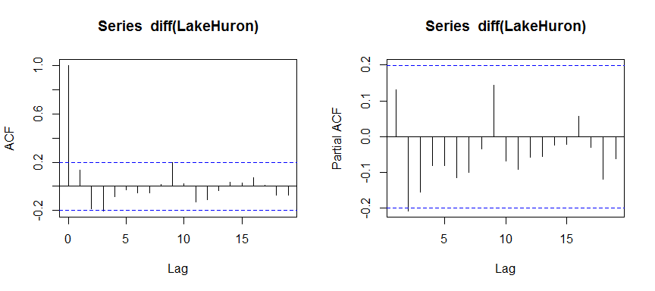
Difference acf and pacf for LakeHuron data

Slide 60
Structure of mdeaths data
str(mdeaths)
## Time-Series [1:72] from 1974 to 1980: 2134 1863 1877 1877 1492 ...
attributes(mdeaths)
## $tsp ## [1] 1974.000 1979.917 12.000 ## ## $class ## [1] "ts"

Slide 61
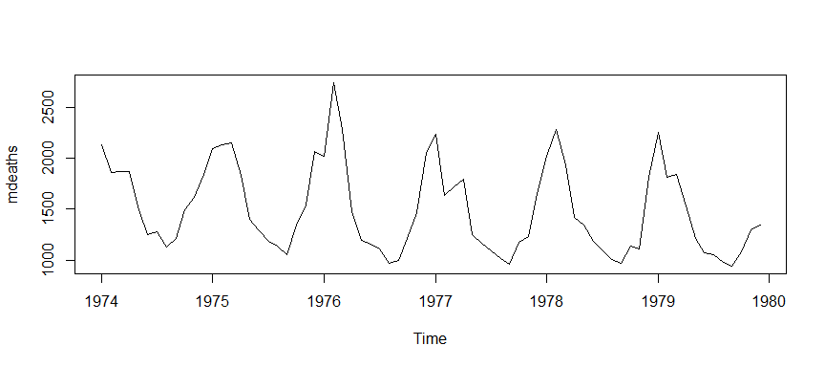
Plot of mdeaths

Slide 62
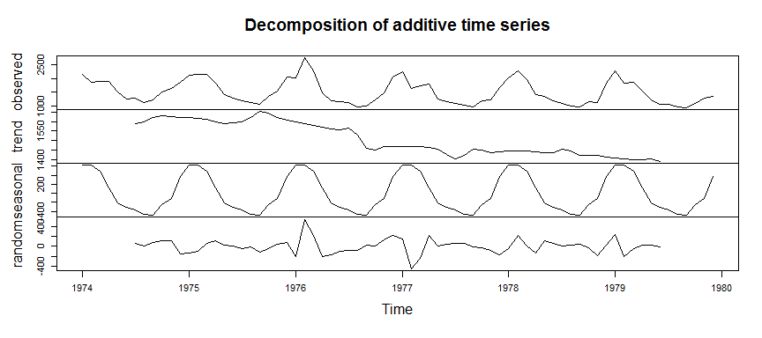
Detrend and deseasonalize mdeaths

Slide 63
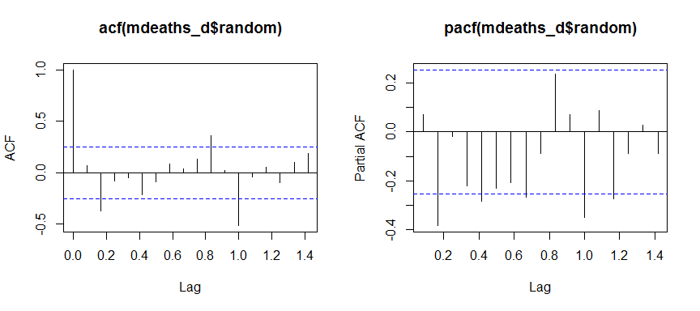
acf and pacf for mdeaths data

Slide 64
Structure of nottem
str(nottem)
## Time-Series [1:240] from 1920 to 1940: 40.6 40.8 44.4 46.7 54.1 58.5 57.7 56.4 54.3 50.5 ...
attributes(nottem)
## $tsp ## [1] 1920.000 1939.917 12.000 ## ## $class ## [1] "ts"

Slide 65
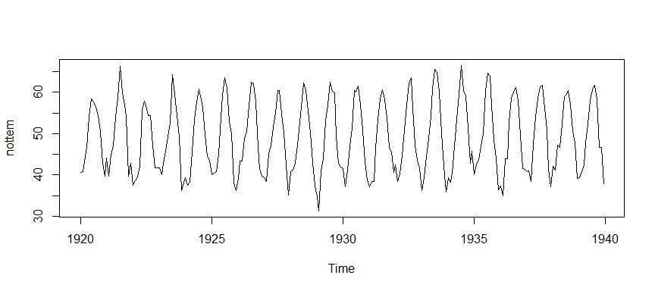
Plot of nottem

Slide 66
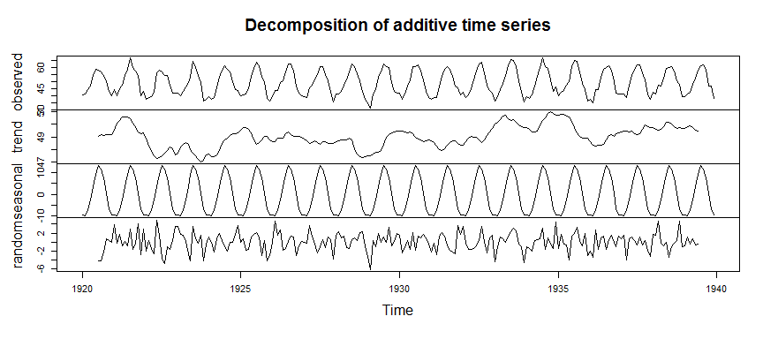
Detrend and deseasonalize nottem

Slide 67
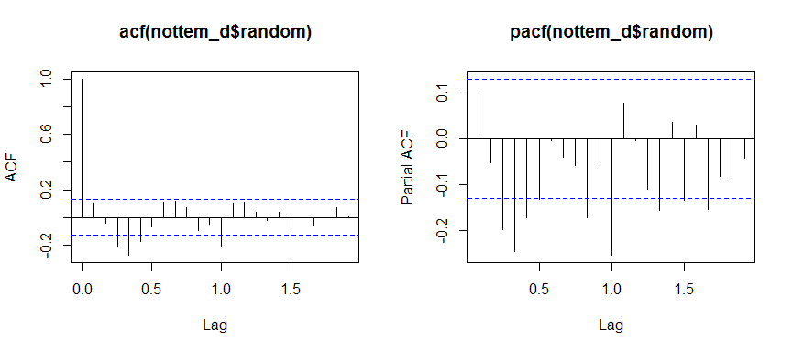
acf and pacf for nottem data

Slide 68
Structure of sunspot.year
str(sunspot.year)
## Time-Series [1:289] from 1700 to 1988: 5 11 16 23 36 58 29 20 10 8 ...
attributes(sunspot.year)
## $tsp ## [1] 1700 1988 1 ## ## $class ## [1] "ts"

Slide 69
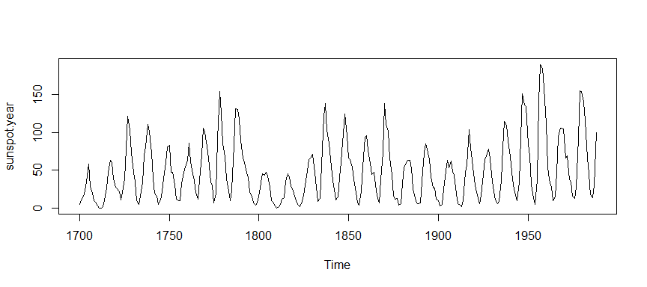
Plot of sunspot.year

