Slide 1
Basic time series
Steve Simon

Slide 2
Introduction
Keep things simple
Evenly spaced
No gaps
Single series
Topics covered
Structure
Plotting
Detrending and deseasonalizing
Basic Box-Jenkins models

Slide 3
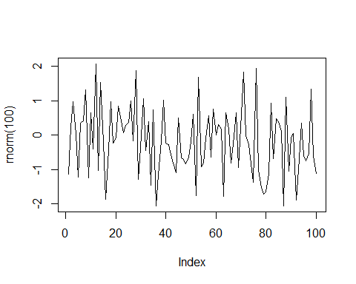
White noise

Slide 4
Structure
The base R package has an object class, ts. You can specify three parameters: start, stop, and frequency. You do not need to place your data in a ts object before running time series analyses.
There is a new class, tsibble, that I have not had a chance to work with. It is based on the principles of tidy data. Read the tsibble vignette for more information.

Slide 5
Structure of co2 data
str(co2)
## Time-Series [1:468] from 1959 to 1998: 315 316 316 318 318 ...
attributes(co2)
## $tsp ## [1] 1959.000 1997.917 12.000 ## ## $class ## [1] "ts"

Slide 6
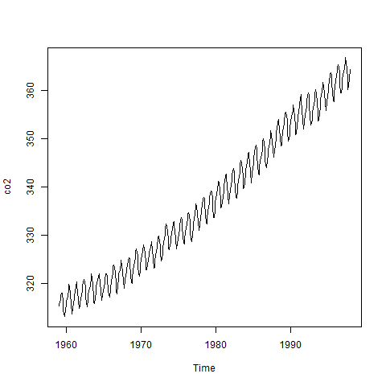
Plot of co2 data

Slide 7
Decomposition of co2
co2_d <- decompose(co2) str(co2_d)
## List of 6 ## $ x : Time-Series [1:468] from 1959 to 1998: 315 316 316 318 318 ... ## $ seasonal: Time-Series [1:468] from 1959 to 1998: -0.0536 0.6106 1.3756 2.5168 3.0003 ... ## $ trend : Time-Series [1:468] from 1959 to 1998: NA NA NA NA NA ... ## $ random : Time-Series [1:468] from 1959 to 1998: NA NA NA NA NA ... ## $ figure : num [1:12] -0.0536 0.6106 1.3756 2.5168 3.0003 ... ## $ type : chr "additive" ## - attr(*, "class")= chr "decomposed.ts"

Slide 8
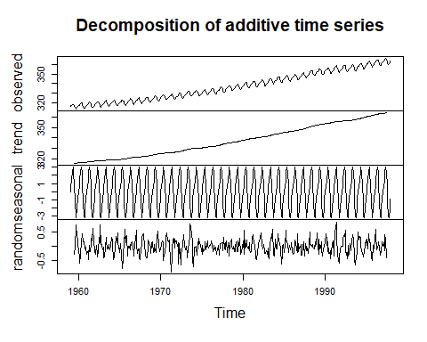
Plot of co2 decomposition

Slide 9
UKgas
str(UKgas)
## Time-Series [1:108] from 1960 to 1987: 160.1 129.7 84.8 120.1 160.1 ...
attributes(UKgas)
## $tsp ## [1] 1960.00 1986.75 4.00 ## ## $class ## [1] "ts"

Slide 10
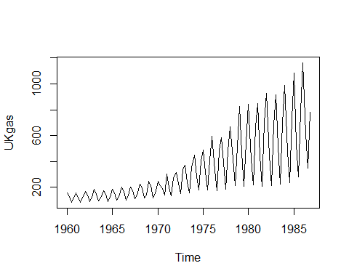
Plot UKGas

Slide 11
UKgas decomposition
UKgas_d <- decompose(UKgas, type="multiplicative") str(UKgas_d)
## List of 6 ## $ x : Time-Series [1:108] from 1960 to 1987: 160.1 129.7 84.8 120.1 160.1 ... ## $ seasonal: Time-Series [1:108] from 1960 to 1987: 1.454 0.956 0.558 1.032 1.454 ... ## $ trend : Time-Series [1:108] from 1960 to 1987: NA NA 124 123 122 ... ## $ random : Time-Series [1:108] from 1960 to 1987: NA NA 1.228 0.946 0.899 ... ## $ figure : num [1:4] 1.454 0.956 0.558 1.032 ## $ type : chr "multiplicative" ## - attr(*, "class")= chr "decomposed.ts"

Slide 12
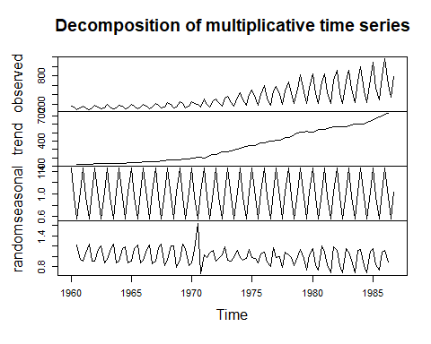
Plot of UKgas decomposition

Slide 13
Autoregressive
$Z_{t}=ϕZ_{t−1}+ϵ_{t}$
$Z_{t}=ϕ^{2}Z_{t−2}+ϕϵ_{t−1}+ϵ_{t}$
$Z_{t}=ϕ^{3}Z_{t−3}+ϕ^{2}ϵ_{t−2}+ϕϵ_{t−1}+ϵ_{t}$
$Corr(Z_{t},Z_{t−1})=ϕ$
$Corr(Z_{t},Z_{t−2})=ϕ^{2}$
$Corr(Z_{t},Z_{t−3})=ϕ^{3}$

Slide 14
Correlation matrix
$$\begin{matrix}1 & ϕ & ϕ^{2} & ϕ^{3} & ⋯ & ϕ^{n−2} & ϕ^{n−1} \\ ϕ & 1 & ϕ & ϕ^{2} & ⋯ & ϕ^{n−3} & ϕ^{n−2} \\ ϕ^{2} & ϕ & 1 & ϕ & ⋯ & ϕ^{n−4} & ϕ^{n−3} \\ ϕ^{3} & ϕ^{2} & ϕ & 1 & ⋯ & ϕ^{n−5} & ϕ^{n−4} \\ ⋮ & ⋮ & ⋮ & ⋮ & ⋱ & ⋮ & ⋮ \\ ϕ^{n−2} & ϕ^{n−3} & ϕ^{n−4} & ϕ^{n−5} & ⋯ & 1 & ϕ \\ ϕ^{n−1} & ϕ^{n−2} & ϕ^{n−3} & ϕ^{n−4} & ⋯ & ϕ & 1\end{matrix}$$

Slide 15
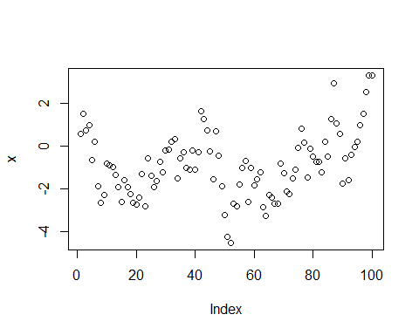
Positive autocorrelation

Slide 16
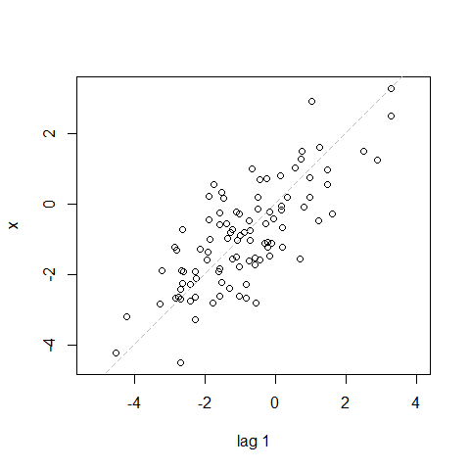
Lag plot

Slide 17
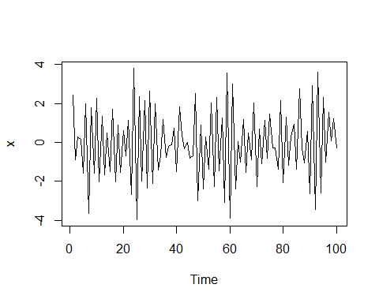
Negative autocorrelation

Slide 18
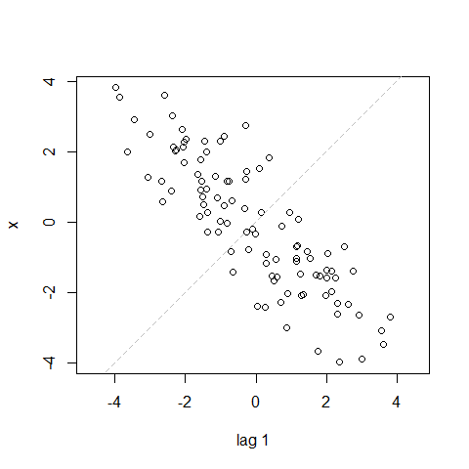
Lag plot

Slide 19
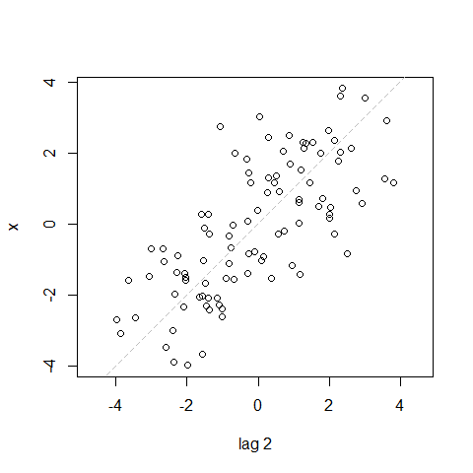
Lag plot

Slide 20
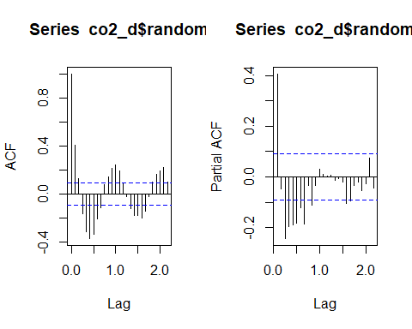
acf and pacf for co2 data

Slide 21
Structure of LakeHuron data
str(LakeHuron)
## Time-Series [1:98] from 1875 to 1972: 580 582 581 581 580 ...
attributes(LakeHuron)
## $tsp ## [1] 1875 1972 1 ## ## $class ## [1] "ts"

Slide 22
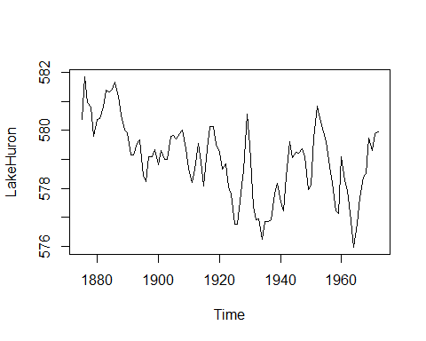
Plot of LakeHuron data

Slide 23
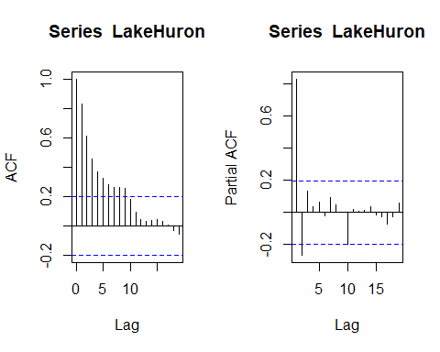
acf and pacf for data

Slide 24
Structure of mdeaths data
str(mdeaths)
## Time-Series [1:72] from 1974 to 1980: 2134 1863 1877 1877 1492 ...
attributes(mdeaths)
## $tsp ## [1] 1974.000 1979.917 12.000 ## ## $class ## [1] "ts"

Slide 25
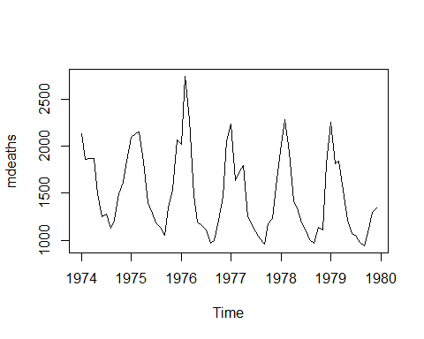
Plot of mdeaths

Slide 26
Structure of Nile data
str(Nile)
## Time-Series [1:100] from 1871 to 1970: 1120 1160 963 1210 1160 1160 813 1230 1370 1140 ...
attributes(Nile)
## $tsp ## [1] 1871 1970 1 ## ## $class ## [1] "ts"

Slide 27
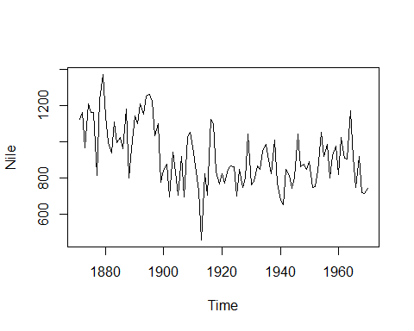
Plot of Nile data

Slide 28
Structure of nottem
str(nottem)
## Time-Series [1:240] from 1920 to 1940: 40.6 40.8 44.4 46.7 54.1 58.5 57.7 56.4 54.3 50.5 ...
attributes(nottem)
## $tsp ## [1] 1920.000 1939.917 12.000 ## ## $class ## [1] "ts"

Slide 29
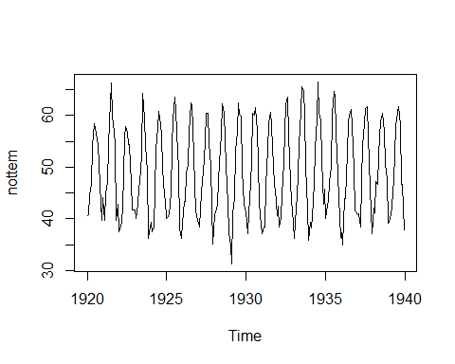
Plot of nottem

Slide 30
Structure of sunspot.year
str(sunspot.year)
## Time-Series [1:289] from 1700 to 1988: 5 11 16 23 36 58 29 20 10 8 ...
attributes(sunspot.year)
## $tsp ## [1] 1700 1988 1 ## ## $class ## [1] "ts"

Slide 31
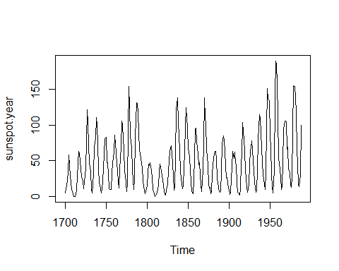
Plot of sunspot.year

Slide 32
Structure of treering
str(treering)
## Time-Series [1:7980] from -6000 to 1979: 1.34 1.08 1.54 1.32 1.41 ...
attributes(treering)
## $tsp ## [1] -6000 1979 1 ## ## $class ## [1] "ts"

Slide 33
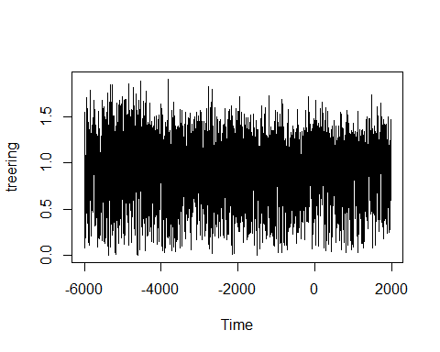
Plot of treering

Slide 34
UKDriverDeaths
str(UKDriverDeaths)
## Time-Series [1:192] from 1969 to 1985: 1687 1508 1507 1385 1632 ...
attributes(UKDriverDeaths)
## $tsp ## [1] 1969.000 1984.917 12.000 ## ## $class ## [1] "ts"

Slide 35
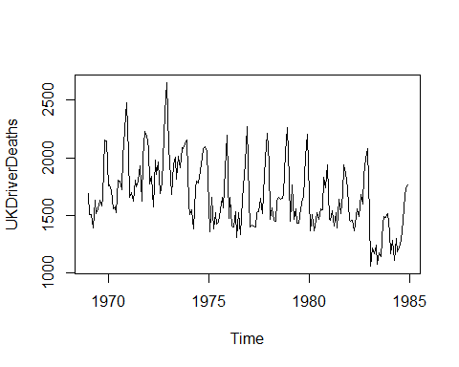
Plot UKDriver Deaths

Slide 36
USAccDeaths
str(USAccDeaths)
## Time-Series [1:72] from 1973 to 1979: 9007 8106 8928 9137 10017 ...
attributes(USAccDeaths)
## $tsp ## [1] 1973.000 1978.917 12.000 ## ## $class ## [1] "ts"

Slide 37
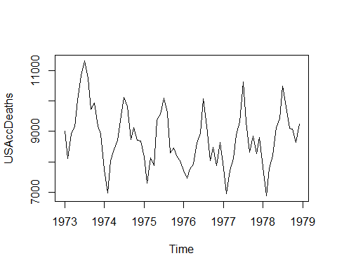
USAccDeaths plot

Slide 38
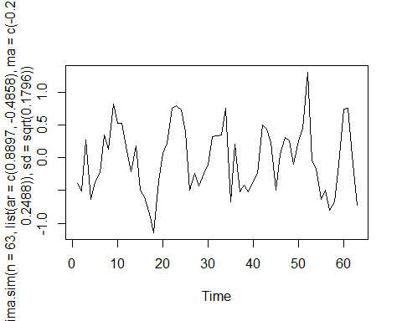
arima.sim

