Slide 1
‘Health equity tourists’: How white scholars are colonizing research on health disparities

Slide 2
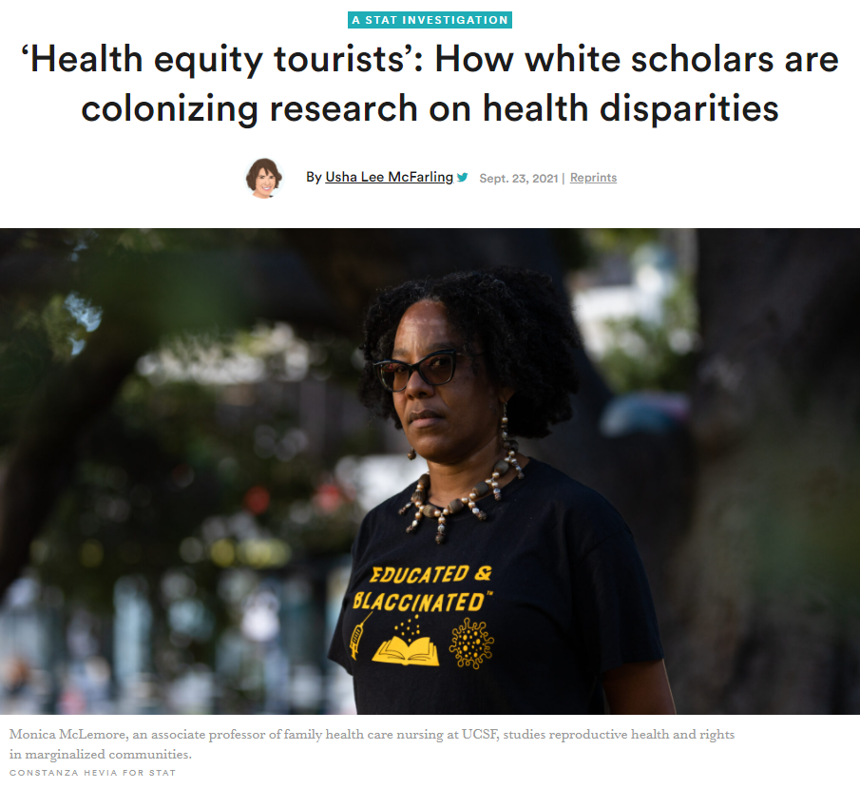
Notes:
This article raises a difficult topic. While it is good that more white researchers are interested in health disparities research recently, some newcomers have marginalized out minority researchers who have been working in the field for decades. Even worse, their research is sometimes so poorly done as to do more harm than good.
Usha Lee McFarling. ‘Health equity tourists’: How white scholars are colonizing research on health disparities. STAT, 2021-09-23. Available in html format

