Slide 1
Overfitting example using hurricane frequencies
Steve Simon

Slide 2
# Note: this code can produce a reasonable PowerPoint # presentation. The system has an annoying tendency # to put the graphs and the speaker notes on separate # slides.

Slide 3
Overfitting
Overfitting occurs when a statistical model is too complex for the amount of data that it is based on. The summary statistics on the data itself appear to be quite good, but the model will almost always produce poor predictions for new data. Here is an example of overfitting using data on hurricane frequencies from the Data and Story Library site.

Slide 4
The data used in this example (1/2)
## Decade Count ## 1 1851-1860 6 ## 2 1861-1870 1 ## 3 1871-1880 7 ## 4 1881-1890 5 ## 5 1891-1900 8 ## 6 1901-1910 4 ## 7 1911-1920 7 ## 8 1921-1930 5
Notes:
This dataset on hurricane frequency is found at the Data and Story Library website.
Here are the first eight rows of data.

Slide 5
The data used in this example (2/2)
## Decade Count ## 9 1931-1940 8 ## 10 1941-1950 10 ## 11 1951-1960 9 ## 12 1961-1970 6 ## 13 1971-1980 4 ## 14 1981-1990 4 ## 15 1991-2000 5 ## 16 2001-2006 7
Notes:
Here is the rest of the data.

Slide 6
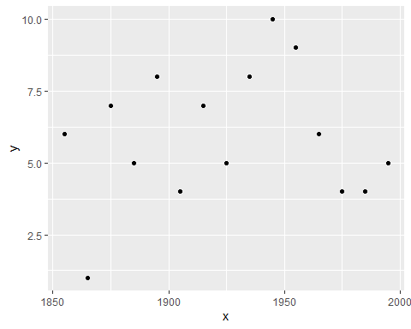
Plot the data

Slide 7
Notes:
Here’s what the data looks like in a graph. Nothing too unusual about the data. Now let’s try to forecast the number of hurricanes for the next decade.

Slide 8
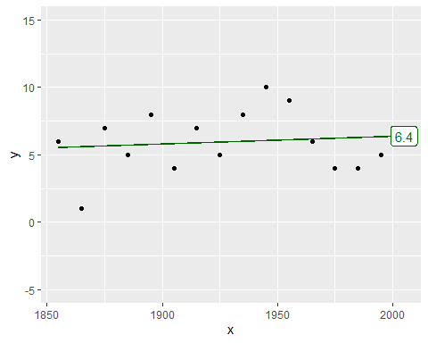
Plot the data with a linear prediction

Slide 9
Notes:
Here’s a linear trend. The prediction is 6.3904762 for the next decade.

Slide 10
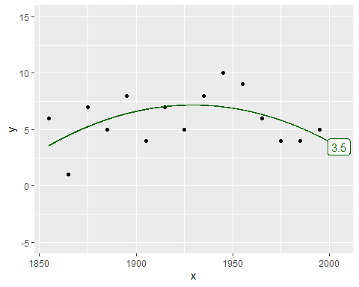
Plot the data with a quadratic prediction

Slide 11
Notes:
Here’s a quadratic trend. The prediction is 3.4527473. It’s quite a bit different.

Slide 12
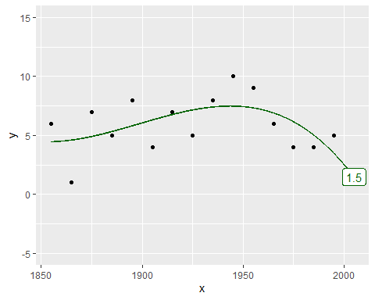
Plot the data with a cubic prediction

Slide 13
Notes:
Here’s a cubic (third order polynomial trend. The prediction is now 1.4681319.

Slide 14
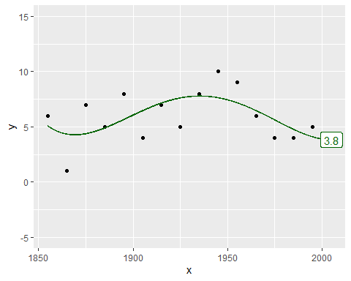
Plot the data with a 4th order polynomial

Slide 15
Notes:
Here’s a quartic (fourth order polynomial) trend. The prediction is 3.8291708.

Slide 16
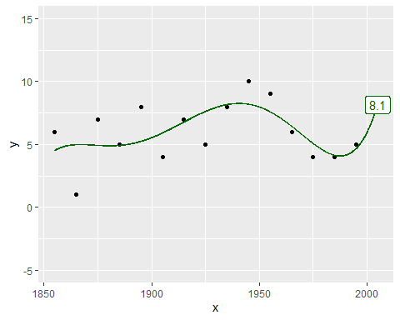
Plot the data with a 5th order polynomial

Slide 17
Notes:
Here’s a fifth order polynomial trend. The prediction is 8.1412587.

Slide 18
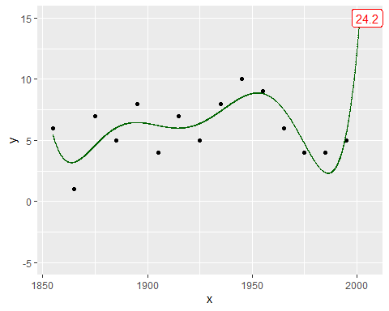
Plot the data with a 6th order polynomial

Slide 19
Notes:
Here’s where things get very weird. The sixth order polynomial produces a prediction of 24.1897436, which is more than twice as large as any previous value.

Slide 20
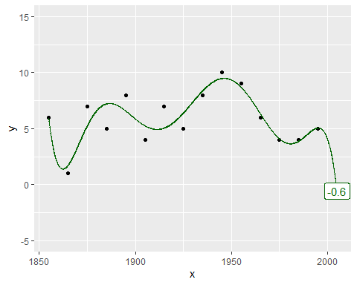
Plot the data with a 7th order polynomial

Slide 21
Notes:
The weirdness continues with the seventh order polynomial trend, which produces a negative prediction (-0.5794872.

Slide 22

Plot the data with a 8th order polynomial

Slide 23
Notes:
The eigth order polynomial trend also produces a negative prediction (-1.8747253).

Slide 24
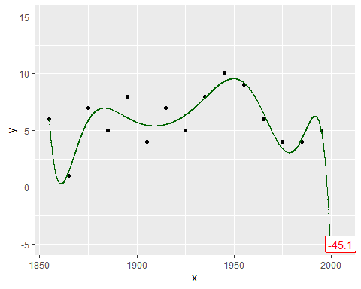
Plot the data with a 9th order polynomial

Slide 25
Notes:
Here’s a ninth order polynomial trend. The prediction is so extreme (-45.0805861) as to be ridiculous.

Slide 26
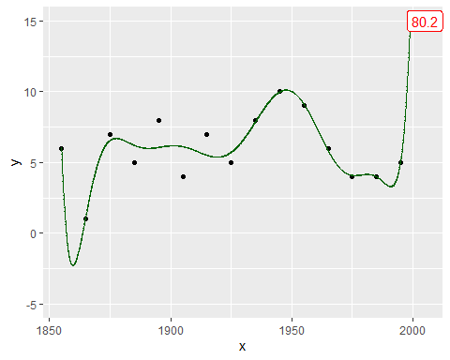
Plot the data with a 10th order polynomial

Slide 27
Notes:
For the record, here are the tenth…

Slide 28
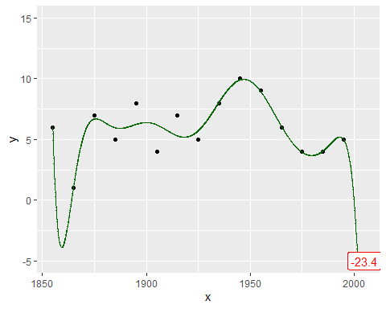
Plot the data with a 11th order polynomial

Slide 29
Notes:
… eleventh …

Slide 30
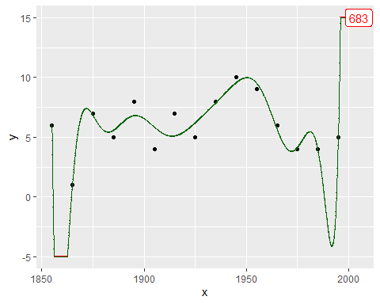
Plot the data with a 12th order polynomial

Slide 31
Notes:
… twelfth …

Slide 32
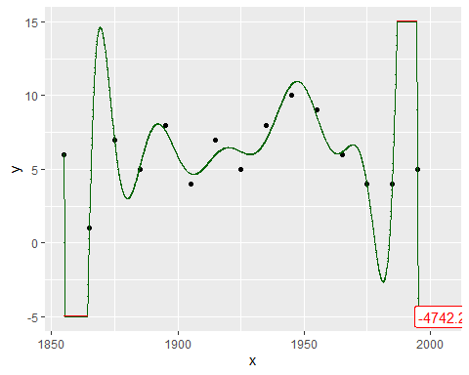
Plot the data with a 13th order polynomial

Slide 33
Notes:
… thirteenth …

Slide 34
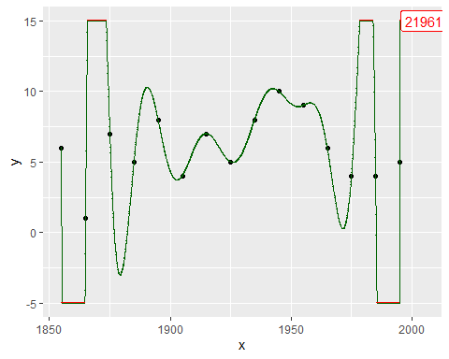
Plot the data with a 14th order polynomial

Slide 35
Notes:
… and fourteenth order polynomials.

Slide 36
Code that I used
suppressMessages(suppressWarnings(library(broom))) suppressMessages(suppressWarnings(library(dplyr))) suppressMessages(suppressWarnings(library(ggplot2))) suppressMessages(suppressWarnings(library(knitr))) suppressMessages(suppressWarnings(library(magrittr))) knitr::opts_chunk$set(echo=FALSE)
Notes:
Here are the libraries that I needed for this work.

Slide 37
Code that I used
fn <- "https://dasl.datadescription.com/download/data/3279" raw_data <- read.delim(file=fn, header=TRUE, sep="\t") raw_data[1:8, ]
Notes:
This code reads data directly from the website and prints out the first eight rows.

Slide 38
Code that I used
raw_data[9:16, ]
Notes:
This code is for printing the rest of the data.

Slide 39
Code that I used
df <- data.frame(x=seq(1855, 1995, by=10), y=raw_data$Count[1:15]) ggplot(df, aes(x, y)) + geom_point() -> point_plot plot(point_plot)
Notes:
Here’s the code for plotting the data points. I save the graph in an object so I can add trend lines later on.

Slide 40
Code that I used
add_trend <- function(point_plot, df, degree) { x_grid <- data.frame(x=seq(1855, 2005, by=0.1)) lm(y~poly(x, degree), data=df) %>% augment(newdata=x_grid) -> yhat yhat %>% mutate(.trend=ifelse(.fitted > 15, 15, .fitted)) %>% mutate(.trend=ifelse(.fitted < -5, -5, .trend)) %>% mutate(truncated=ifelse(.trend %in% c(-5, 15), "Y", "N")) -> yhat yhat_2005 <- filter(yhat, x==2005) prediction <<- yhat_2005$.fitted point_plot + geom_line(data=yhat, aes(x, .trend), color="darkgreen") + geom_point(data=yhat, aes(x, .trend, color=truncated), pch=".") + scale_color_manual(values=c("darkgreen", "red")) + geom_label( data=yhat_2005, aes(x, .trend, label=round(.fitted, 1), color=truncated)) + theme(legend.position="none") + expand_limits(y=c(-5, 15)) } add_trend(point_plot, df, 1)
Notes:
Here’s the code for adding a trend line to the graph. I am setting up a flexible function that can print the trend from any polynomial.

Slide 41
Code that I used
add_trend(point_plot, df, 2)
Notes:
It took a bit of work to put everything in a function, but now you can produce a quadratic rather than a linear trend with just a single line of code.

Slide 42
Code that I used
add_trend(point_plot, df, 3)
add_trend(point_plot, df, 4)
add_trend(point_plot, df, 5)
add_trend(point_plot, df, 6)
add_trend(point_plot, df, 7)
add_trend(point_plot, df, 8)
add_trend(point_plot, df, 9)
add_trend(point_plot, df, 10)
add_trend(point_plot, df, 11)
add_trend(point_plot, df, 12)
add_trend(point_plot, df, 13)
add_trend(point_plot, df, 14)
Notes:
Here’s code for fitting the remaining trend lines.

