Slide 1
Progress in evidence-based medicine

Slide 2
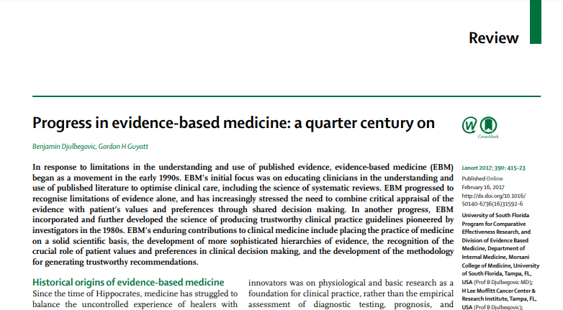
Notes:
A nice summary of the changes (mostly improvements) in Evidence Based Medicine (EBM) over the past 25 years. It was written by two of the pioneers in EBM.
Benjamin Djulbegovic, Gordon H Guyatt. Progress in evidence-based medicine: a quarter century on. The Lancet 2017-07-22, 390(10092), 415-423. Available in html format or pdf format.

